Slide 1
Data Integration and Machine Learning: A Natural Synergy
Xin Luna Dong @ Amazon.com
Theo Rekatsinas @ UW-Madison
http://dataintegration.ml

Slide 2



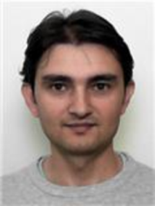


























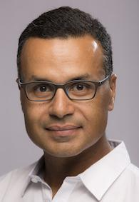






Acknowledgement
Notes:
Theo: “Would like to thank students and collaborators from UW, waterloo, stanford, technion and cornell”

Slide 3
What is Data Integration?
Data integration: to provide unified access to data residing in multiple, autonomous data sources
  Data warehouse: create a single store (materialized view) of data from different sources offline. Multi-billion dollar business.
  Virtual integration: support query over a mediated schema by applying online query reformulation. E.g., Kayak.com.
In the RDF world: different names for similar concepts
  Knowledge graph is equivalent to a data warehouse. Has been widely used in Search and Voice
  Linked data is equivalent to virtual integration

Slide 4
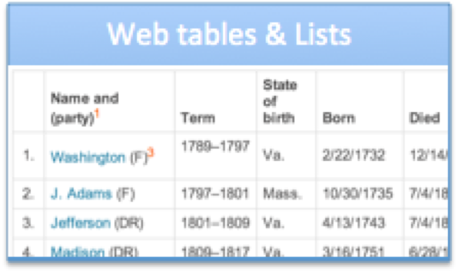
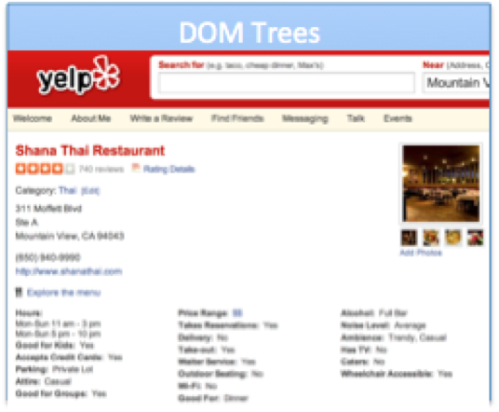
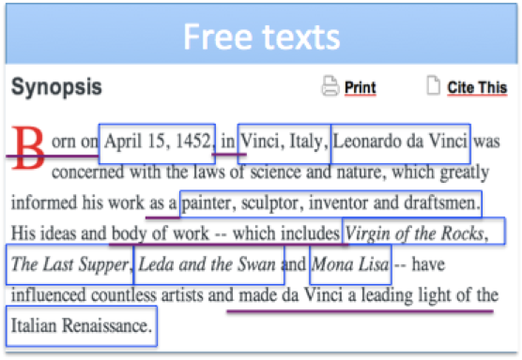
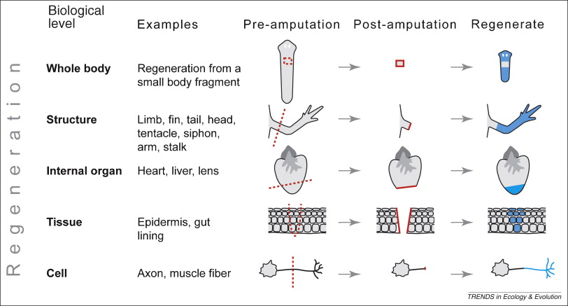
Why is Data Integration Hard?
Heterogeneity everywhere
  Different data formats
Data Extraction
Schema Alignment
Diagram
Entity Linkage
Data Fusion

Slide 5
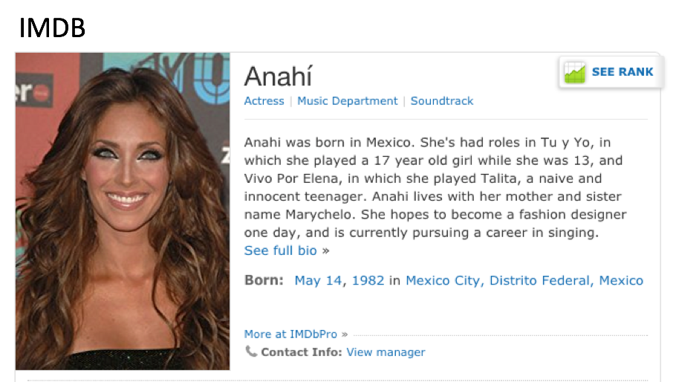
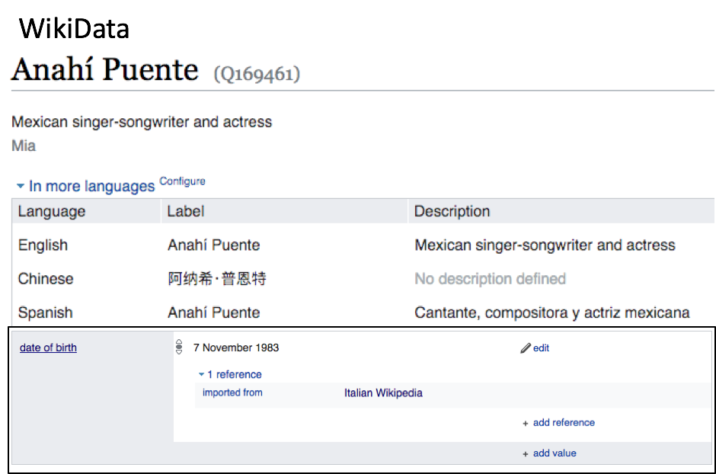
Why is Data Integration Hard?
Heterogeneity everywhere
  Different ways to express the same classes and attributes
Data Extraction
Schema Alignment
Entity Linkage
Data Fusion

Slide 6
Why is Data Integration Hard?
Heterogeneity everywhere
  Different references to the same entity
Data Extraction
Schema Alignment
Entity Linkage
Data Fusion

Slide 7
Why is Data Integration Hard?
Heterogeneity everywhere
  Conflicting values
Data Extraction
Schema Alignment
Entity Linkage
Data Fusion

Slide 8
Importance from a Practitioner’s Point of View
Entity linkage is indispensable whenever integrating data from different sources
Data extraction is important for integrating non-relational data
Data fusion is necessary in presence of erroneous data
Schema alignment is helpful when integrating relational data, but not affordable for manual work if we integrate many sources
Data Extraction
Schema Alignment
Entity Linkage
Data Fusion

Slide 9
What is Machine Learning?
Machine learning: teach computers to learn with data, not by programming
More Formal definition
A computer program is said to learn from experience E with respect to some class of tasks T and performance measure P if its performance at tasks in T, as measured by P, improves with experience E.
-- Tom Mitchell

Slide 10
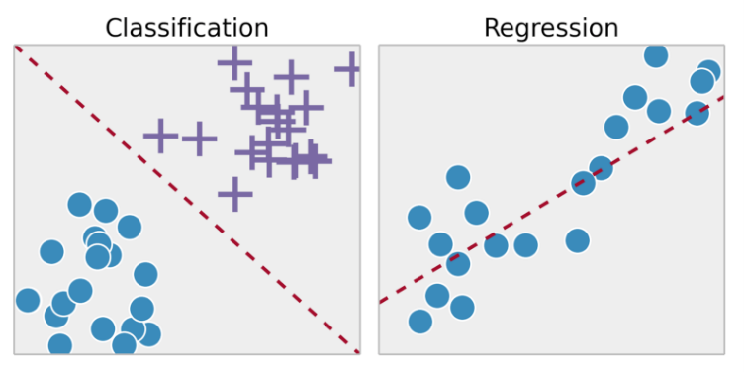
Two Main Types of Machine Learning
Supervised learning: learn by examples

Slide 11
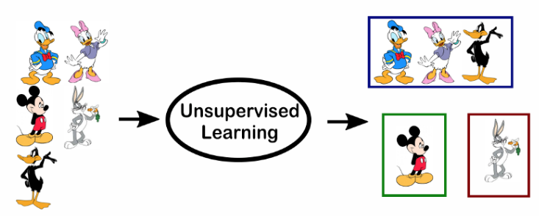
Two Main Types of Machine Learning
Unsupervised learning: find structure w/o examples

Slide 12
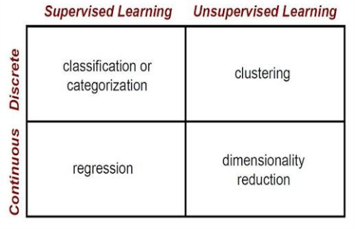
Two Main Types of Machine Learning
Supervised learning: learn by examples
Unsupervised learning: find structure w/o examples

Slide 13
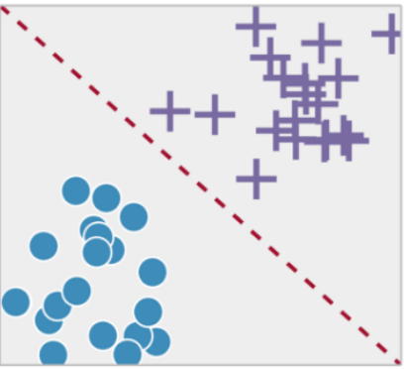
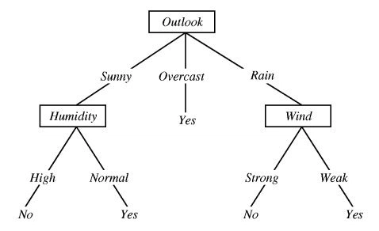

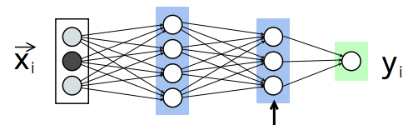
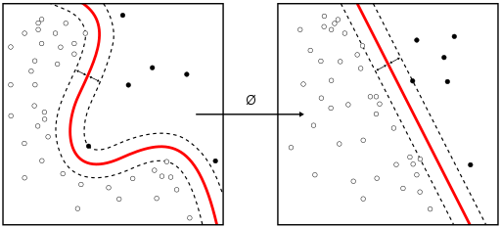
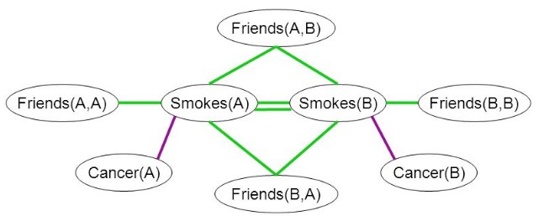
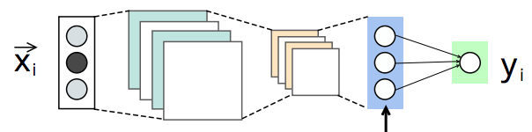

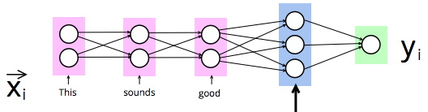
Techniques for Supervised ML
Hyperplanes | Kernel | Tree-based | Graphical Mdl | Logic Prog | Neural Netw
Linear/Logistic regression | SVM | Decision tree, Random forest | Bayes net, CRF | Pr soft logic, Markov logic net | ANN, CNN, RNN
Notes:
In VLDB we should talk about a few ML methods in more detail, such as RNN

Slide 14
Colin’s 7 minute intro to bidirectional LSTMs

Slide 15
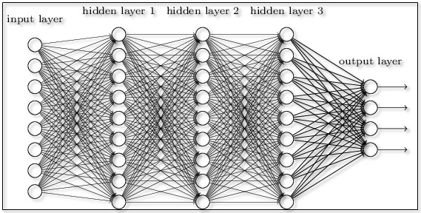
Everyone loves neural networks
They have the word “neural” in them
They have the word “network” in them
You can draw fancy diagrams

Slide 16

Everyone loves neural networks
They have the word “neural” in them
They have the word “network” in them
You can draw fancy diagrams
This thing:

Slide 17
Everyone loves neural networks
They have the word “neural” in them
They have the word “network” in them
You can draw fancy diagrams
This thing:
They are good at modeling high-dimensional non-linear functions and building sophisticated representations of complex sensory data

Slide 18
What’s a neural network?
x
Input vector

Slide 19
What’s a neural network?
Wx
Weight matrix

Slide 20
What’s a neural network?
σ(Wx)
Non-linear function
e.g. sigmoid

Slide 21
What’s a neural network?
h = σ(Wx)
Hidden layer

Slide 22
What’s a neural network?
h = σ(Wx)
y = f(h)
Differentiable function
e.g. softmax

Slide 23
Let’s use neural networks for language!
Classify sentences!
Tag parts of speech!
Find entity names!
Extract relations!

Slide 24
Let’s use neural networks for language!
PROBLEM:
Fixed # of weights
Fixed # of features
Fixed size of input

Slide 25


Slide 26

The puppy is cute.
The
puppy
is
cute
The puppy is really cute.
The puppy is really cute
Seriously, did you see this puppy, look how cute it is!

Slide 27


Slide 28
☹
Sentence classification
  Sentences have variable length!
Word tagging
  Fixed-width window around word misses full context

Slide 29
What’s a neural network?
h = σ(Wx)

Slide 30
What’s a recurrent neural network?
h = σ(Wx)

Slide 31
What’s a recurrent neural network?
h = σ(Wx)
h_{t} = σ(Wx_{t} + Uh_{t-1})

Slide 32
h₁
h₂
h₃
h₄
x₀
x₁
x₂
x₃
000010000
100000000
010000000
000000010
The
puppy
is
cute

Slide 33
h₁
h₂
h₃
h₄
f(h₄) = ‘en’
x₀
x₁
x₂
x₃
000010000
100000000
010000000
000000010
The
puppy
is
cute

Slide 34
f(h₁) -> def. art.
f(h₂) -> noun
f(h₃) -> verb
f(h₄) -> adjective
h₁
h₂
h₃
h₄
h₁
h₂
h₃
h₄
x₀
x₁
x₂
x₃
000010000
100000000
010000000
000000010
The
puppy
is
cute

Slide 35
BIDIRECTIONAL

Slide 36
h₁
h₂
h₃
h₄
x₀
x₁
x₂
x₃
000010000
100000000
010000000
000000010
The
puppy
is
cute
h’₃
h’₂
h'₁
h’₄
x₃
x₂
x₁
x₀
000010000
100000000
010000000
000000010
The
puppy
is
cute

Slide 37
Bidirectional RNN
Concatenate the two hidden representations to produce the bidirectional representation
f([h₄, h’₄])
Full sentence:
Individual word:
f([h_{i}, h’_{n-i}])

Slide 38
Okay, so RNNs are great!
Except they don’t work
  (at least for long-term dependencies)
Vanishing / exploding gradient

Slide 39
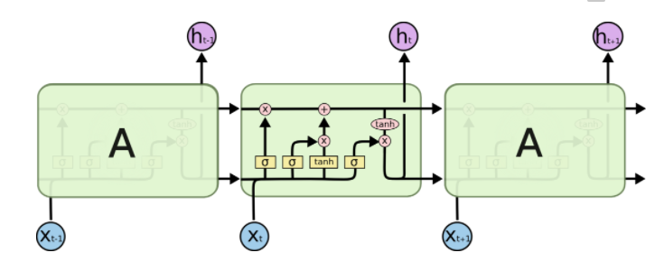
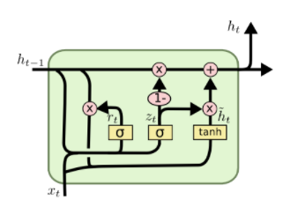
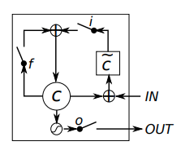
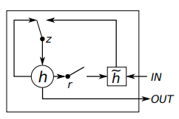
LSTM (Long Short Term Memory)
GRU (Gated Recurrent Unit)
75 other variations

Slide 40
LSTM (Long Short Term Memory)
Same basic idea
GRU (Gated Recurrent Unit)
75 other variations

Slide 41
Add more neural networks!
Add “gates” that decide how to balance impact of new input vs hidden state
  “Remember” gates
  “Forget” gates
  “Reset” gates
Take input and previous state
Hit ‘em with some weights
Run it through a sigmoid
Multiply against h_{i} or x_{i}
  Sigmoid values from 0 – 1 to signify how much to keep/forget

Slide 42

For the details, see:

Slide 43
Key Lessons for ML [Domingos, 2012]
Learning = Representation + Evaluation + Optimization
It’s generalization that counts: generalize beyond training examples
Data alone is not enough: “no free lunch” theorem--No learner can beat random guessing over all possible functions to be learned
Intuition fails in high dimensions: “curse of dimensionality”
More data beats a cleverer algorithm: Google showed that after providing 300M images for DL image recognition, no flattening of the learning curve was observed.

Slide 44
DI & ML as Synergy
ML for effective DI: AUTOMATION, AUTOMATION, AUTOMATION
  Automating DI tasks with training data
  Better understanding of semantics by neural network
DI for effective ML: DATA, DATA, DATA
  Create large-scale training datasets from different sources
  Cleaning of data used for training

Slide 45
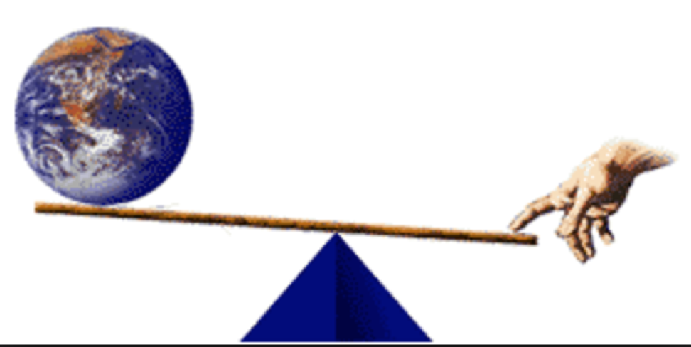
Give me a Fulscrum, I will Move the Earth
-- Archimedes

Slide 46
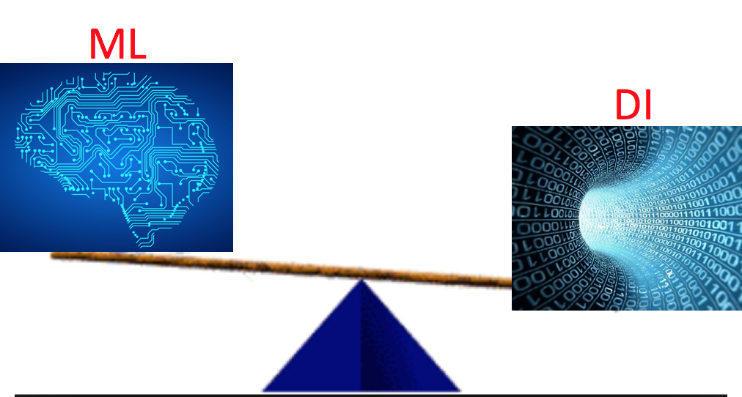
Give me a DI funnel, I will Move ML

Slide 47

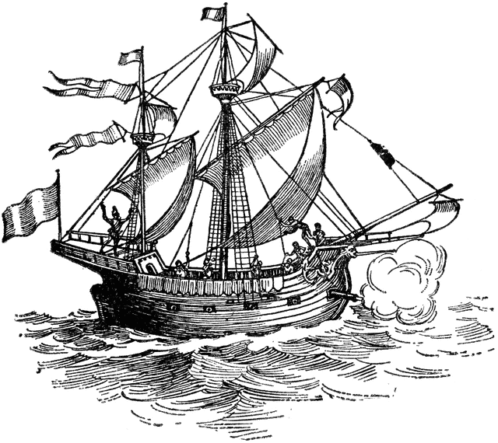










Many Systems Where DI & ML Leverage Each Other
Magellan
NELL
Increasing number of systems both in industry and academia.

Slide 48
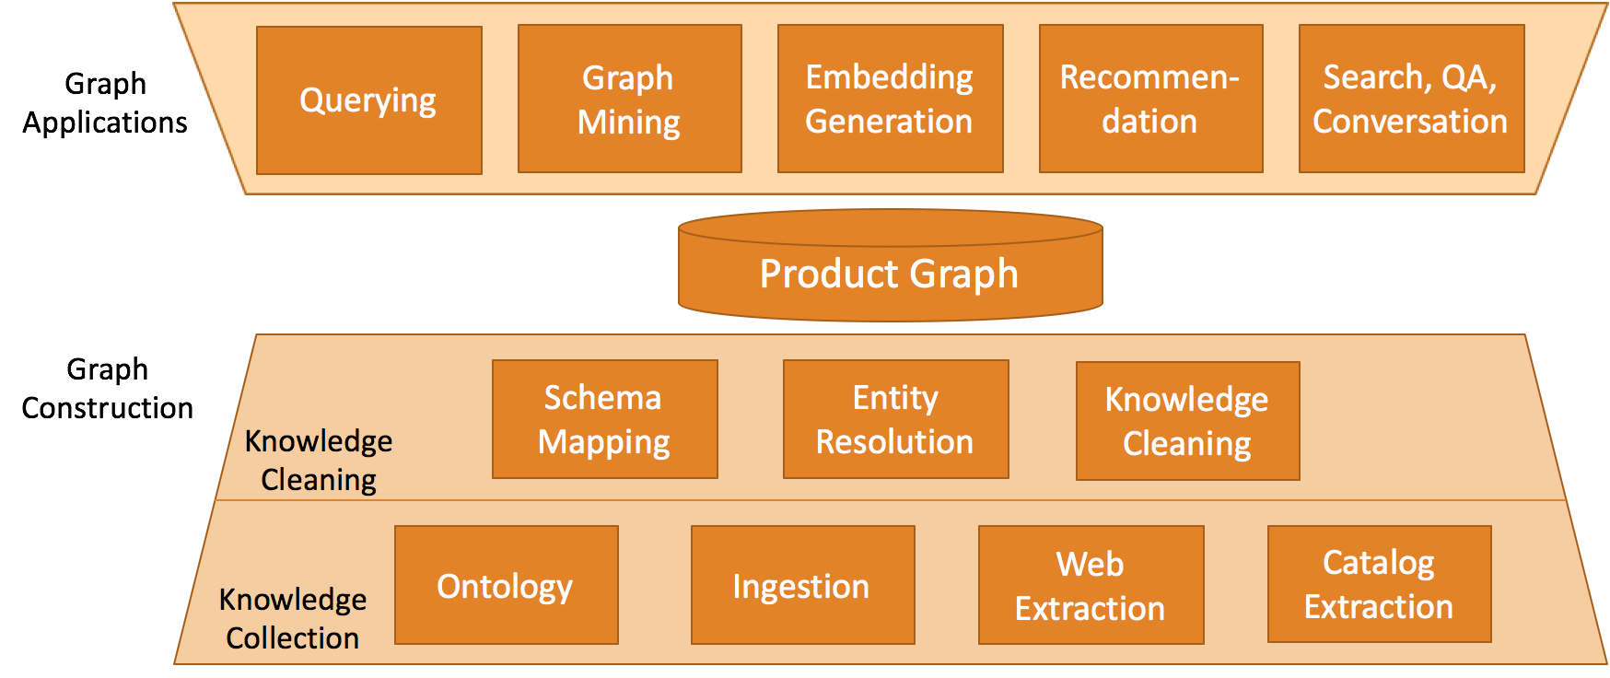
Example System: Product Graph [Dong, KDD’18]

Slide 49
Goal of This Tutorial
NO-GOALS
  Present a comprehensive literature review for all topics we are covering
GOALS
  Present state-of-the-art for DI & ML synergy
  Show how ML has been transforming DI and vice versa
  Give some taste on which tool is working best for which tasks
  Discuss what remains challenging

Slide 50
Outline
Part I. Introduction
Part II. ML for DI
Part III. DI for ML
Part IV. Conclusions and research directions

Slide 51
Data Integration Overview
Entity linkage: linking records to entities; indispensable when different sources exist
Data extraction: extracting structured data; important when non-relational data exist
Data fusion: resolving conflicts; necessary in presence of erroneous data
Schema alignment: aligning types and attributes; helpful when different relational schemas exist
Data Extraction
Schema Alignment
Entity Linkage
Data Fusion

Slide 52
Recipe
Problem definition
Brief history
State-of-the-art ML solutions
Summary w. a short answer
Data Extraction
Schema Alignment
Entity Linkage
Data Fusion

Slide 53
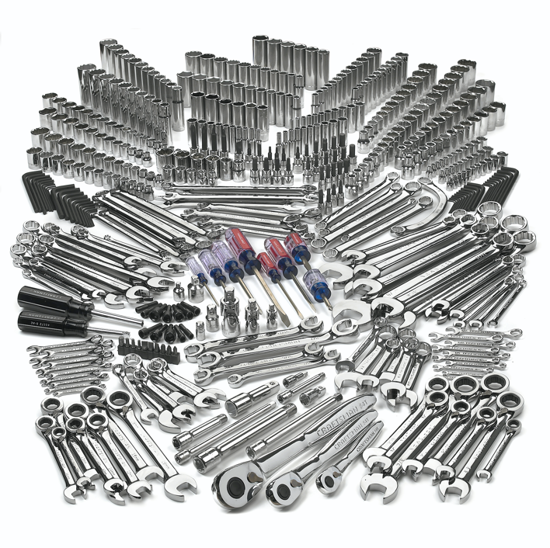
Theme I. Which ML Model Works Best?

Slide 54
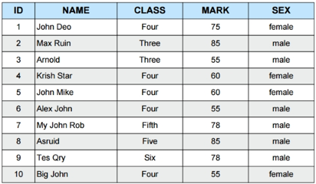
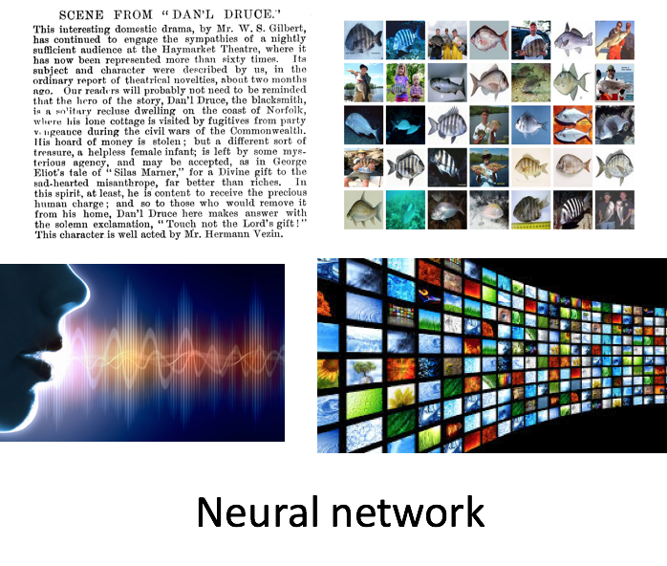

Which ML Model Works Best?
Tree-based models

Slide 55
Theme II. Does Supervised Learning Apply to DI?
Supervised learning has made a big splash recently in many fields
However, it is hard to bluntly apply supervised learning to DI tasks
  Our goal is to integrate data from many different data sources in different domains
  The different sources present different data features and distributions
  Collecting training labels for each source is a huge cost

Slide 56
Outline
Part I. Introduction
Part II. ML for DI
  ML for entity linkage
  ML for data extraction
  ML for data fusion
  ML for schema alignment
Part III. DI for ML
Part IV. Conclusions and research direction
Data Extraction
Schema Alignment
Entity Linkage
Data Fusion

Slide 57
What is Entity Linkage?
Definition: Partition a given set R of records, such that each partition corresponds to a distinct real-world entity.
Are they the same entity?

Slide 58
Quick Tour for Entity Linkage
Blocking: efficiently create small blocks of similar records
Blocking
A2
A1
C2
C1
Pairwise Matching
B1
D
Clustering
B2
B3

Slide 59
Quick Tour for Entity Linkage
Pairwise matching: compare all record pairs in a block
Blocking
A2
A1
C2
C1
Pairwise Matching
B1
D
Clustering
B2
B3

Slide 60
Quick Tour for Entity Linkage
Clustering: group records into entities
Blocking
A2
A1
C2
C1
Pairwise Matching
B1
D
Clustering
B2
B3

Slide 61
50 Years of Entity Linkage
Rule-based and stats-based
Blocking: e.g., same name
Matching: e.g., avg similarity of attribute values
Clustering: e.g., transitive closure, etc.
Supervised learning
Random forest for matching
F-msr: >95% w. ~1M labels
Active learning for blocking & matching
F-msr: 80%-98% w. ~1000 labels
~2000 (Early ML)
2018 (Deep ML)
1969 (Pre-ML)
~2015 (ML)
Sup / Unsup learning
Matching: Decision tree, SVM
F-msr: 70%-90% w. 500 labels
Clustering: Correlation clustering,
Markov clustering
Deep learning
Deep learning
Entity embedding

Slide 62
Rule-Based Solution
Rule-based and stats-based
Blocking: e.g., same name
Matching: e.g., avg similarity of attribute values
Clustering: e.g., transitive closure, etc.
[Fellegi and Sunter, 1969]
  Match: sim(r, r’) > 𝜭_{h}
  Unmatch: sim(r, r’) < 𝜭_{l}
  Possible match:
  𝜭_{l} < sim(r, r’) < 𝜭_{h}
1969 (Pre-ML)

Slide 63
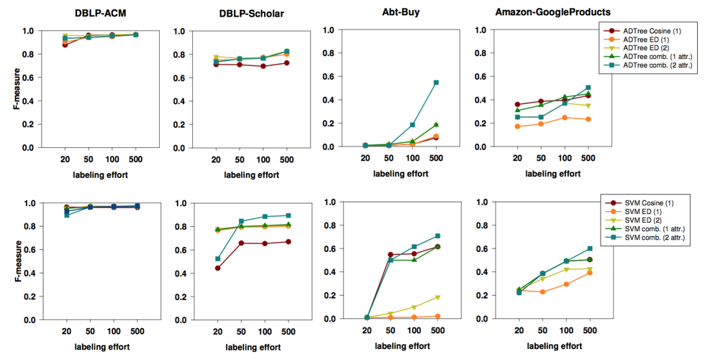
Early ML Models
[Köpcke et al, VLDB’10]
~2000 (Early ML)
Sup / Unsup learning
Matching: Decision tree, SVM
F-msr: 70%-90% w. 500 labels
Clustering: Correlation clustering,
Markov clustering

Slide 64
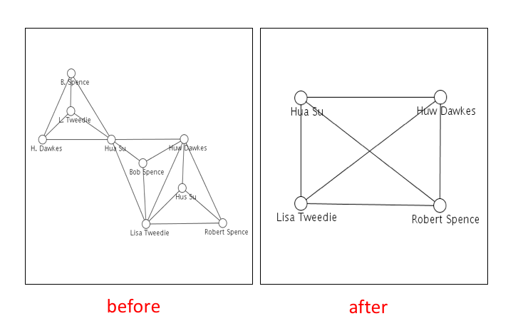
Collective Entity Resolution: Beyond Pairs
Collective reasoning across entities.
Constraints across entities:
  Aggregate constraints
  Transitivity, Exclusivity
  Functional dependencies
Use of probabilistic graphical models, PSL, MLN, to capture such domain knowledge
Out of the scope of this tutorial. For details: See tutorial by Getoor and Machanavajjhala, KDD, 2013.
[Example by Getoor and Machanavajjhala]

Slide 65
State-of-the-Art ML Models [Dong, KDD’18]
Features: attribute similarity measured in various ways. E.g.,
  string sim: Jaccard, Levenshtein
  number sim: absolute diff, relative diff
ML models on Freebase vs. IMDb
  Logistic regression: Prec=0.99, Rec=0.6
  Random forest: Prec=0.99, Rec=0.99
Supervised learning
Random forest for matching
F-msr: >95% w. ~1M labels
AL for blocking & matching
F-msr: 80%-98% w. ~1000 labels
~2015 (ML)

Slide 66
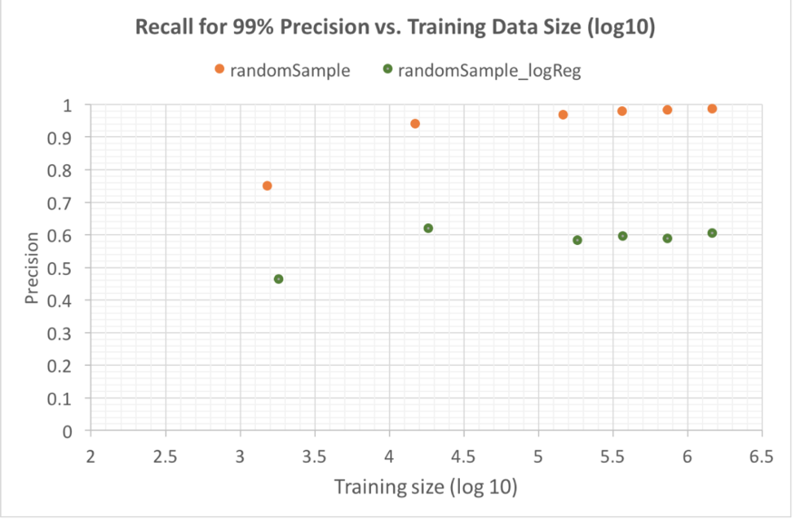
State-of-the-Art ML Models [Dong, KDD’18]
Expt 1. IMDb vs. Freebase
  Logistic regression: Prec=0.99, Rec=0.6
  Random forest: Prec=0.99, Rec=0.99
Supervised learning
Random forest for matching
F-msr: >95% w. ~1M labels
AL for blocking & matching
F-msr: 80%-98% w. ~1000 labels
~2015 (ML)

Slide 67
State-of-the-Art ML Models [Dong, KDD’18]
Features: attribute similarity measured in various ways. E.g.,
  name sim: Jaccard, Levenshtein
  age sim: absolute diff, relative diff
ML models on Freebase vs. IMDb
  Logistic regression: Prec=0.99, Rec=0.6
  Random forest: Prec=0.99, Rec=0.99
  XGBoost: marginally better, but sensitive to hyper-parameters
Supervised learning
Random forest for matching
F-msr: >95% w. ~1M labels
AL for blocking & matching
F-msr: 80%-98% w. ~1000 labels
~2015 (ML)

Slide 68
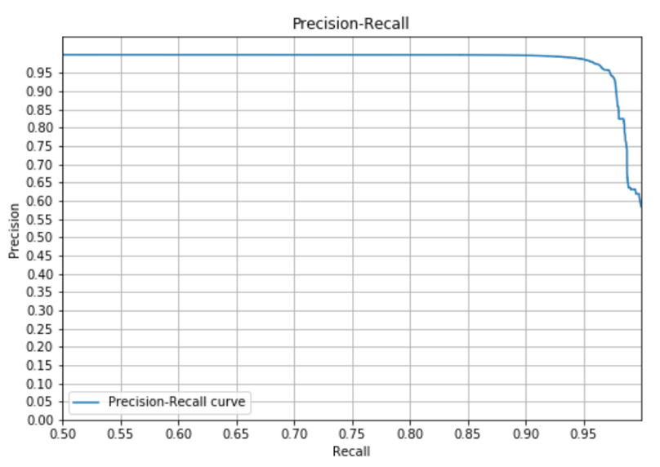
State-of-the-Art ML Models [Dong, KDD’18]
Expt 2. IMDb vs. Amazon movies
  200K labels, ~150 features
  Random forest: Prec=0.98, Rec=0.95
Supervised learning
Random forest for matching
F-msr: >95% w. ~1M labels
AL for blocking & matching
F-msr: 80%-98% w. ~1000 labels
~2015 (ML)
Ready for production, except requiring a lot of labels

Slide 69
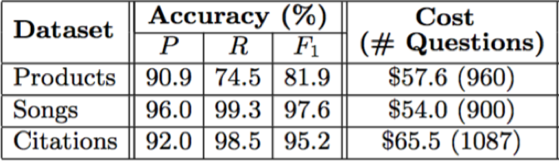
State-of-the-Art ML Models [Das et al., SIGMOD’17]
Magellan
Falcon: apply active learning both for blocking and for matching; ~1000 labels
Supervised learning
Random forest for matching
F-msr: >95% w. ~1M labels
AL for blocking & matching
F-msr: 80%-98% w. ~1000 labels
~2015 (ML)

Slide 70
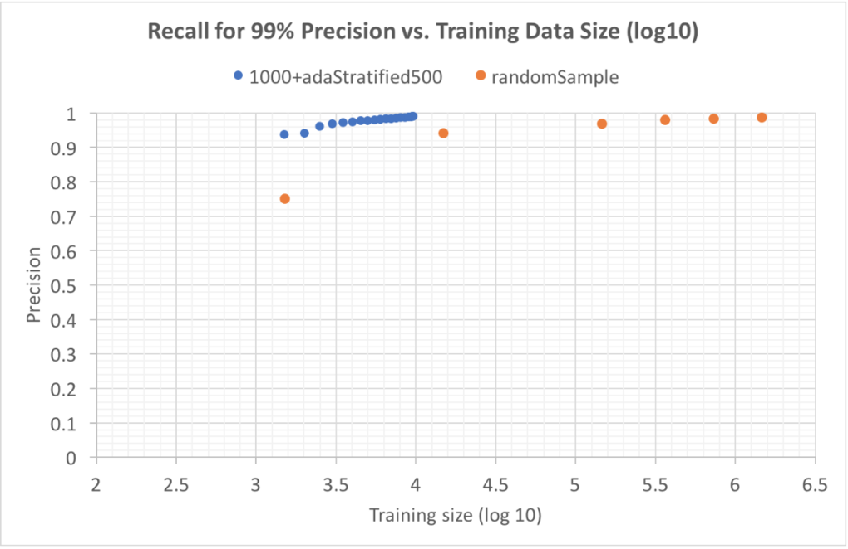
State-of-the-Art ML Models [Dong, KDD’18]
Apply active learning to minimize #labels
Supervised learning
Random forest for matching
F-msr: >95% w. ~1M labels
AL for blocking & matching
F-msr: 80%-98% w. ~1000 labels
~2015 (ML)
For 99% precision and recall, active learning reduces #labels by 2 orders of magnitude
Reaching prec=99% and rec=~99% requires 1.5M labels

Slide 71
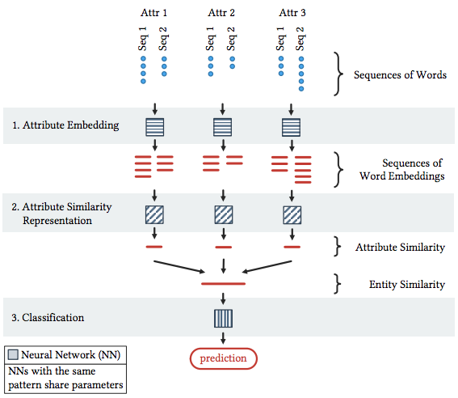
Deep Learning Models [Mudgal et al., SIGMOD’18]
Magellan
Embedding on similarities
Similar performance for structured data;
Significant improvement on texts and dirty data
2018 (Deep ML)
Deep learning
Deep learning
Entity embedding
Code at: deepmatcher.ml

Slide 72
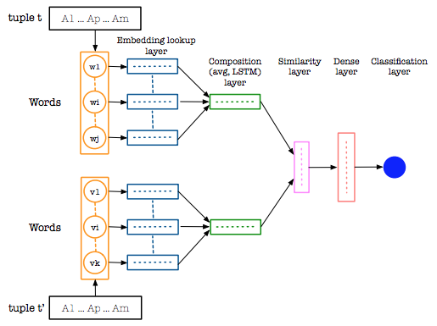
Deep Learning Models [Ebraheem et al., VLDB’18]
Embedding on entities
Outperforming existing solution
2018 (Deep ML)
Deep learning
Deep learning
Entity embedding

Slide 73
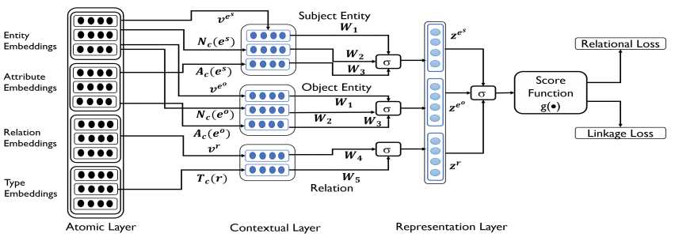
Deep Learning Models [Trivedi et al., ACL’18]
LinkNBed: Embeddings for entities as in knowledge embedding
2018 (Deep ML)
Deep learning
Deep learning
Entity embedding

Slide 74
Deep Learning Models [Trivedi et al., ACL’18]
LinkNBed: Embeddings for entities as in knowledge embedding
Performance better than previous knowledge embedding methods, but not comparable to random forest
Enable linking different types of entities
2018 (Deep ML)
Deep learning
Deep learning
Entity embedding

Slide 75
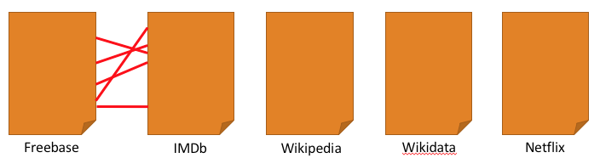
Challenges in Applying ML on EL
How can we obtain abundant training data for many types, many sources, and dynamically evolving data??
From two sources to multiple sources

Slide 76
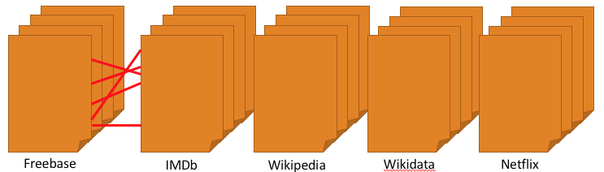
Challenges in Applying ML on EL
How can we obtain abundant training data for many types, many sources, and dynamically evolving data??
From one entity type to multiple types

Slide 77
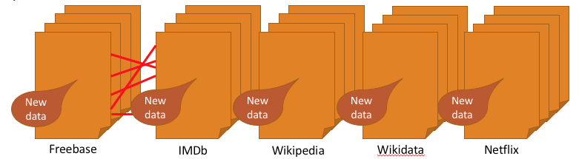
Challenges in Applying ML on EL
How can we obtain abundant training data for many types, many sources, and dynamically evolving data??
From static data to dynamic data

Slide 78

Recipe for Entity Linkage
Problem definition: Link references to the same entity
Short answers
  RF w. attribute-
  similarity features
  DL to handle texts and noises
  End-to-end solution is future work
Data Extraction
Schema Alignment
Production
Ready
Entity Linkage
Data Fusion

Slide 79
Outline
Part I. Introduction
Part II. ML for DI
  ML for entity linkage
  ML for data extraction
  ML for data fusion
  ML for schema alignment
Part III. DI for ML
Part IV. Conclusions and research direction
Data Extraction
Schema Alignment
Entity Linkage
Data Fusion

Slide 80
What is Data Extraction?
Definition: Extract structured information, e.g., (entity, attribute, value) triples, from semi-structured data or unstructured data.
Diagram
Notes:
In VLDB we shall also talk about text extraction and OpenIE

Slide 81
Three Types of Data Extraction
Closed-world extraction: align to existing entities and attributes; e.g., (ID_Obama, place_of_birth, ID_USA)
ClosedIE: align to existing attributes, but extract new entities; e.g.,
(“Xin Luna Dong”, place_of_birth, “China”)
OpenIE: not limited by existing entities or attributes; e.g.,
(“Xin Luna Dong”, “was born in”, “China”),
(“Luna”, “is originally from”, “China”)

Slide 82
35 Years of Data Extraction
Early Extraction
Rule-based: Hearst pattern, IBM System T
Tasks: IS-A, events
Extraction from semi-structured data
WebTables: search, extraction
DOM tree: wrapper induction
~2005 (Rel. Ex.)
2013 (Deep ML)
1992 (Rule-based)
2008 (Semi-stru)
Relation extraction from texts
NER→EL→RE
  Feature based: LR, SVM
  Kernel based: SVM
Distant supervision
OpenIE
Deep learning
Use RNN, CNN, attention for RE
Data programming / Heterogeneous learning
Revisit DOM extraction

Slide 83
Extraction from Texts: Quick Tour
Bill Gates founded Microsoft in 1975.
Named Entity Recognition
Entity Linking
Relation Extraction

Slide 84
Extraction from Texts: Quick Tour
Bill Gates founded Microsoft in 1975.
Named Entity Recognition
Person
Company
Entity Linking
Relation Extraction

Slide 85


Extraction from Texts: Quick Tour
Bill Gates founded Microsoft in 1975.
Named Entity Recognition
Entity Linking
Entity linkage: linking two structured records
Entity linking: linking a phrase in texts to an entity in a reference list (e.g., knowledge graph)
Relation Extraction

Slide 86
Extraction from Texts: Quick Tour
Bill Gates founded Microsoft in 1975.
Named Entity Recognition
isFounder
Entity Linking
We focus on Relation Extraction in the rest of the tutorial.
Relation Extraction

Slide 87
Extraction from Texts: Feature Based [Zhou et al., ACL’05]
Models
  Logistic regression
  SVM (Support Vector Machine)
Features
  Lexical: entity, part-of-speech, neighbor
  Syntactic: chunking, parse tree
  Semantic: concept hierarchy, entity class
Results
  Prec=~60%, Rec=~50%
~2005 (Rel. Ex.)
Relation extraction from texts
NER→EL→RE
  Feature based: LR, SVM
  Kernel based: SVM
Distant supervision
OpenIE

Slide 88
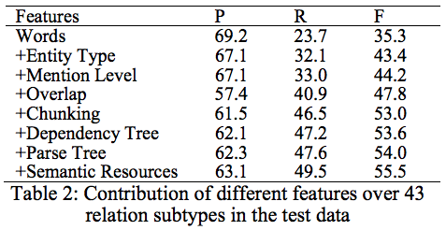
Extraction from Texts: Feature Based [Zhou et al., ACL’05]
~2005 (Rel. Ex.)
Relation extraction from texts
NER→EL→RE
  Feature based: LR, SVM
  Kernel based: SVM
Distant supervision
OpenIE
Major
Lift

Slide 89
Extraction from Texts: Kernel Based [Mengqiu Wang, IJCNLP’08]
Models
  SVM (Support Vector Machine)
Kernels
  Subsequence
  Dependency tree
  Shortest dependency path
  Convolution dependency
~2005 (Rel. Ex.)
Relation extraction from texts
NER→EL→RE
  Feature based: LR, SVM
  Kernel based: SVM
Distant supervision
OpenIE

Slide 90

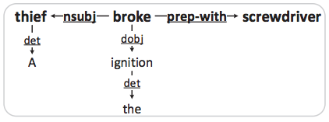
Extraction from Texts: Kernel Based [Mengqiu Wang, IJCNLP’08]
~2005 (Rel. Ex.)
Dependency tree
Relation extraction from texts
NER→EL→RE
  Feature based: LR, SVM
  Kernel based: SVM
Distant supervision
OpenIE
Shortest dependency path

Slide 91
Extraction from Texts: Kernel Based [Mengqiu Wang, IJCNLP’08]
Models
  SVM (Support Vector Machine)
Kernels
  Subsequence
  Dependency tree
  Shortest dependency path
  Convolution dependency
Results
  Prec=~70%, Rec=~40%
~2005 (Rel. Ex.)
Relation extraction from texts
NER→EL→RE
  Feature based: LR, SVM
  Kernel based: SVM
Distant supervision
OpenIE

Slide 92
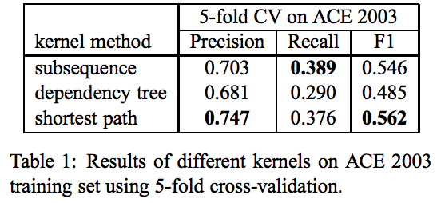
Extraction from Texts: Kernel Based [Mengqiu Wang, IJCNLP’08]
~2005 (Rel. Ex.)
Relation extraction from texts
NER→EL→RE
  Feature based: LR, SVM
  Kernel based: SVM
Distant supervision
OpenIE

Slide 93
Extraction from Texts: Deep Learning
Same intuitions, different models
  (2012-13) Recursive NN: dependency tree
  [Socher et al., EMNLP’12] [Hashimoto et al., EMNLP’13]
  (2014-15) CNN: shortest dependency path
  [Zeng et al., COLING’14][Liu et al., ACL’15]
  (2015+) LSTM: shortest dependency path,
  lexical/syntactic/semantic features
  [Xu et al., EMNLP’15][Shwartz et al., ACL’16]
  [Nguyen, NAACL’16]
2013 (Deep ML)
Deep learning
Use RNN, CNN, attention for RE
Data programming / Heterogeneous learning
Revisit DOM extraction

Slide 94
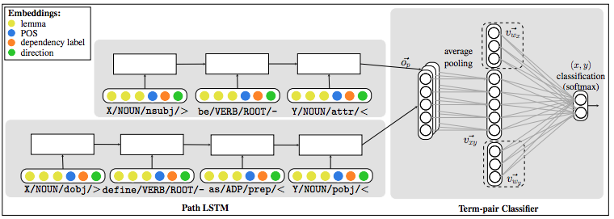
Example System: HyperNET [Shwartz et al., ACL’16]
1. Diff features
3. Combine all paths
4. Term embedding
2. LSTM on shortest paths
Quality in identifying hypernyms: Prec = 0.9, Rec = 0.9

Slide 95
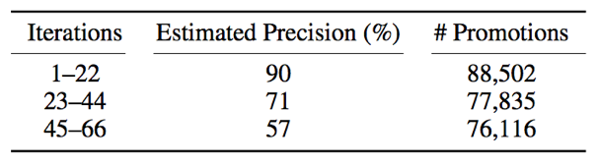
Label Generation for Extraction Training
Where are training labels from?
Semi-supervised learning
  Iterative extraction [Carlson et al., AAAI’10]
  Use new extractions to retrain models
  E.g., NELL
~2005 (Rel. Ex.)
Relation extraction from texts
NER→EL→RE
  Feature based: LR, SVM
  Kernel based: SVM
Distant supervision
OpenIE

Slide 96
Label Generation for Extraction Training
Where are training labels from?
Semi-supervised learning
  Iterative extraction [Carlson et al., AAAI’10]
  Use new extractions to retrain models
  E.g., NELL
Weak learning
  Distant supervision [Mintz et al., ACL’09]
  Rule-based annotation with seed data
  E.g., DeepDive, Knowledge Vault
~2005 (Rel. Ex.)
Relation extraction from texts
NER→EL→RE
  Feature based: LR, SVM
  Kernel based: SVM
Distant supervision
OpenIE
Will cover in “DI for ML”

Slide 97
Distant Supervision [Mintz et al., ACL’09]
Corpus Text
Training Data
Bill Gates founded Microsoft in 1975.
Bill Gates, founder of Microsoft, …
Bill Gates attended Harvard from …
Google was founded by Larry Page ...
Freebase
(Bill Gates, Founder, Microsoft)
(Larry Page, Founder, Google)
(Bill Gates, CollegeAttended, Harvard)
[Adapted example from Luke Zettlemoyer]

Slide 98
Distant Supervision [Mintz et al., ACL’09]
Corpus Text
Training Data
Bill Gates founded Microsoft in 1975.
Bill Gates, founder of Microsoft, …
Bill Gates attended Harvard from …
Google was founded by Larry Page ...
(Bill Gates, Microsoft)
Label: Founder
Feature: X founded Y
Freebase
(Bill Gates, Founder, Microsoft)
(Larry Page, Founder, Google)
(Bill Gates, CollegeAttended, Harvard)
[Adapted example from Luke Zettlemoyer]

Slide 99
Distant Supervision [Mintz et al., ACL’09]
Corpus Text
Training Data
Bill Gates founded Microsoft in 1975.
Bill Gates, founder of Microsoft, …
Bill Gates attended Harvard from …
Google was founded by Larry Page ...
(Bill Gates, Microsoft)
Label: Founder
Feature: X founded Y
Feature: X, founder of Y
Freebase
(Bill Gates, Founder, Microsoft)
(Larry Page, Founder, Google)
(Bill Gates, CollegeAttended, Harvard)
[Adapted example from Luke Zettlemoyer]

Slide 100
Distant Supervision [Mintz et al., ACL’09]
Corpus Text
Training Data
Bill Gates founded Microsoft in 1975.
Bill Gates, founder of Microsoft, …
Bill Gates attended Harvard from …
Google was founded by Larry Page ...
(Bill Gates, Microsoft)
Label: Founder
Feature: X founded Y
Feature: X, founder of Y
Freebase
(Bill Gates, Harvard)
Label: CollegeAttended
Feature: X attended Y
(Bill Gates, Founder, Microsoft)
(Larry Page, Founder, Google)
(Bill Gates, CollegeAttended, Harvard)
For negative examples, sample unrelated pairs of entities.
[Adapted example from Luke Zettlemoyer]

Slide 101
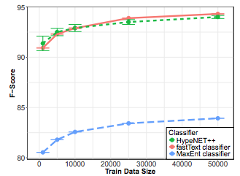
Label Generation for Extraction Training
Where are training labels from?
Distant supervision: HyperNet++ [Christodoulopoulos & Mittal, 18]
~2005 (Rel. Ex.)
Relation extraction from texts
NER→EL→RE
  Feature based: LR, SVM
  Kernel based: SVM
Distant supervision
OpenIE
F-msr > 0.9 w. 1000 labels

Slide 102
Label Generation for Extraction Training
Where are training labels from?
Semi-supervised learning
  Iterative extraction [Carlson et al., AAAI’10]
  Use new extractions to retrain models
  E.g., NELL
Weak learning
  Distant supervision [Mintz et al., ACL’09]
  Rule-based annotation with seed data
  E.g., DeepDive, Knowledge Vault
  Data programming [Ratner et al., NIPS’16]
  Manually write labelling functions
  E.g., Snorkle, Fouduer
2013 (Deep ML)
Deep learning
Use RNN, CNN, attention for RE
Data programming / Heterogeneous learning
Revisit DOM extraction
Will cover in “DI for ML”

Slide 103
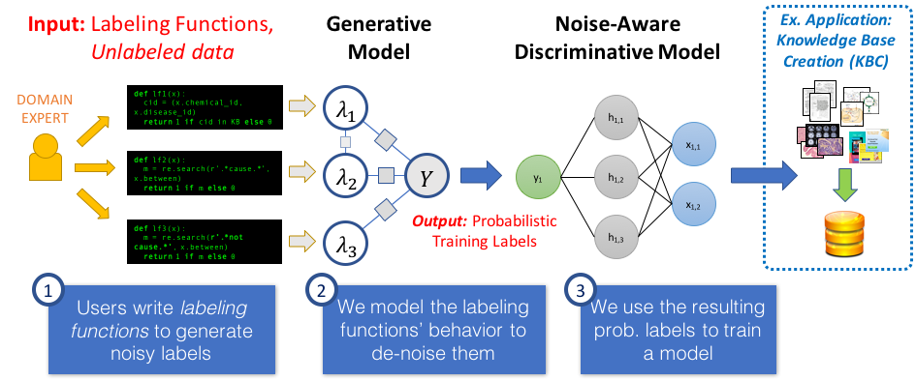
Snorkel: Code as Supervision [Ratner et al., NIPS’16, VLDB’18]
[Slide by Alex Ratner]

Slide 104
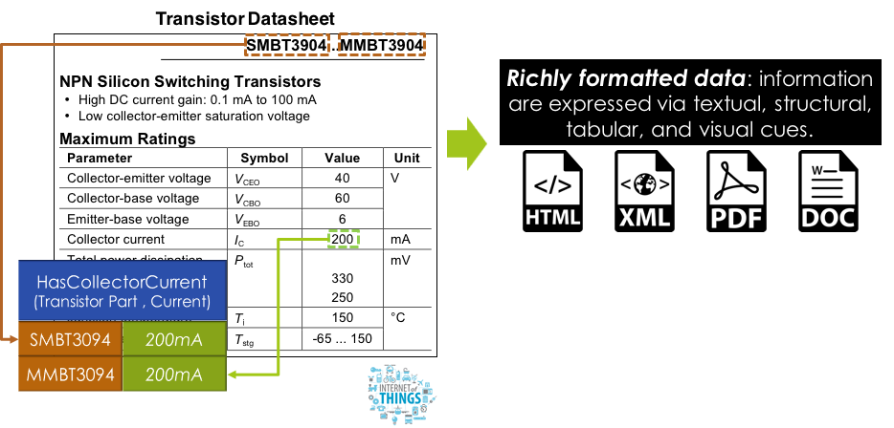


Example System: Fonduer [Wu et al., SIGMOD’18]
Fonduer combines a new biLSTM with multimodal features and data programming.
New version of code coming soon: https://github.com/HazyResearch/fonduer

Slide 105
OpenIE from Texts
Where are predicates from?
ClosedIE
  Only extracting facts corresponding to ontology
  Normalize predicates by ontology
  E.g., (Bill Gates, /person/isFounder, Microsoft)
OpenIE [Banko et al., IJCAI’07]
  Extract all relations expressed in texts
  Predicates are unnormalized strings
  E.g., (“Bill Gates”, “founded”, “Microsoft”)
~2005 (Rel. Ex.)
Relation extraction from texts
NER→EL→RE
  Feature based: LR, SVM
  Kernel based: SVM
Distant supervision
OpenIE
Bill Gates founded Microsoft in 1975.

Slide 106
OpenIE from Texts [Etzioni et al., IJCAI’11]
ClosedIE
OpenIE
Bill Gates founded Microsoft in 1975.
Named Entity Recognition
Predicate Identification
Entity Linking
Subject/Object Identification
Relation Extraction
Scoring

Slide 107
OpenIE from Texts [Etzioni et al., IJCAI’11]
ClosedIE
OpenIE
Bill Gates founded Microsoft in 1975.
Named Entity Recognition
Predicate Identification
Predicate: longest sequence of words as light verb construction
Entity Linking
Subject/Object Identification
Relation Extraction
Scoring

Slide 108
OpenIE from Texts [Etzioni et al., IJCAI’11]
ClosedIE
OpenIE
Bill Gates founded Microsoft in 1975.
Named Entity Recognition
Predicate Identification
Predicate: longest sequence of words as light verb construction
Subject: learn left and right boundary
Object: learn right boundary
Entity Linking
Subject/Object Identification
Relation Extraction
Scoring

Slide 109
OpenIE from Texts [Etzioni et al., IJCAI’11]
ClosedIE
OpenIE
Bill Gates founded Microsoft in 1975.
Named Entity Recognition
Predicate Identification
Predicate: longest sequence of words as light verb construction
Subject: learn left and right boundary
Object: learn right boundary
LR for triple confidence
Entity Linking
Subject/Object Identification
Relation Extraction
Scoring

Slide 110

OpenIE from Texts [Mausam et al., EMNLP’12]
Where are predicates from?
~2005 (Rel. Ex.)
Relation extraction from texts
NER→EL→RE
  Feature based: LR, SVM
  Kernel based: SVM
Distant supervision
OpenIE

Slide 111
Extraction from Semi-Structured Data
Extraction from semi-structured data
WebTables: search, extraction
DOM tree: wrapper induction
2008 (Semi-stru)

Slide 112

Why Semi-Structured Data?
Knowledge Vault @ Google showed big potential from DOM-tree extraction [Dong et al., KDD’14][Dong et al., VLDB’14]

Slide 113


Wrapper Induction--Vertex [Gulhane et al., ICDE’11]

Slide 114

Wrapper Induction--Vertex [Gulhane et al., ICDE’11]
Solution: find XPaths from DOM Trees

Slide 115

Wrapper Induction--Vertex [Gulhane et al., ICDE’11]
Challenge: slight variations from page to page

Slide 116

Wrapper Induction--Vertex [Gulhane et al., ICDE’11]
Challenge: slight variations from page to page

Slide 117

Wrapper Induction--Vertex [Gulhane et al., ICDE’11]
Identify representative webpages for annotation
One website may use multiple templates
(Unsupervised-clustering)
Combine attr features and textual features to find a general XPath
(LR)

Slide 118
Wrapper Induction--Vertex [Gulhane et al., ICDE’11]
Sample learned XPaths on IMDb
  //*[@itemprop="name"]
  //*[@class="bp_item bp_text_only"]/*/*/*[@class="bp_heading"]
  //*[following-sibling::*[position()=3][@class="subheading"]]/*[following-sibling::*[position()=1][@class="attribute"]]
  //*[preceding-sibling::node()[normalize-space(.)!=""][text()="Language:"]
Ensure high recall
Ensure high precision

Slide 119
Distantly Supervised Extraction
Annotation-based extraction
  Pros: high precision and recall
  Cons: does not scale--annotation per cluster per website
Distantly-supervised extraction
  Step 1. Use seed data to automatically annotate
  Step 2. Use the (noisy) annotations for training
  E.g., DeepDive, Knowledge Vault
2013 (Deep ML)
Deep learning
Use RNN, CNN, attention for RE
Data programming / Heterogeneous learning
Revisit DOM extraction

Slide 120




Distantly Supervised Extraction--Ceres [Lockard et al., VLDB’18]
Talk on Tue Research 11am, Poster on Tue Posters I 17:30pm

Slide 121



Distantly Supervised Extraction--Ceres [Lockard et al., VLDB’18]
Extraction experiments on SWDE benchmark
Very high precision
Competent w. Wrapper induction w. manual annotation

Slide 122

Distantly Supervised Extraction--Ceres [Lockard et al., VLDB’18]
Extraction on long-tail movie websites

Slide 123
Distantly Supervised Extraction--Ceres [Lockard et al., VLDB’18]
Which model is the best?
  Logistic regression: best results (20K features on one website)
  Random forest: lower precision and recall
  Deep learning??
2013 (Deep ML)
Deep learning
Use RNN, CNN, attention for RE
Data programming / Heterogeneous learning
Revisit DOM extraction

Slide 124

Challenges in Applying Deep Learning on Extracting Semi-structured Data
Web layout is neither 1D sequence nor regular 2D grid, so CNN or RNN does not directly apply

Slide 125

WebTable Extraction [Limaye et al., VLDB’10]
Model table annotation using interrelated random variables, represented by a probabilistic graphical model
  Cell text (in Web table) and entity label (in catalog)
  Column header (in Web table) and type label (in catalog)
  Column type and cell entity (in Web table)
Extraction from semi-structured data
WebTables: search, extraction
DOM tree: wrapper induction
2008 (Semi-stru)
Check-out 10-Year Best Paper Award for WebTable Search on Thursday!

Slide 126
WebTable Extraction [Limaye et al., VLDB’10]
Model table annotation using interrelated random variables, represented by a probabilistic graphical model
  Pair of column types (in Web table) and relation (in catalog)
  Entity pairs (in Web table) and relation (in catalog)
Extraction from semi-structured data
WebTables: search, extraction
DOM tree: wrapper induction
2008 (Semi-stru)
Check-out 10-Year Best Paper Award for WebTable Search on Thursday!

Slide 127
Challenges in Applying ML on DX
Automatic data extraction cannot reach production quality requirement. How to improve precision?
Every web designer has her own whim, but there are underlying patterns across websites. How to learn extraction patterns on different websites, especially for semi-structured sources?
ClosedIE throws away too much data. How to apply OpenIE on all kinds of data?

Slide 128
Recipe for Data Extraction
Problem definition: Extract structure from semi- or un-structured data
Short answers
  Wrapper induction
  has high prec/rec
  Distant supervision is critical for collecting training data
  DL effective for texts and LR is often effective for semi-stru data
Data Extraction
Schema Alignment
Production
Ready
Entity Linkage
Data Fusion

Slide 129
Outline
Part I. Introduction
Part II. ML for DI
  ML for entity linkage
  ML for data extraction
  ML for data fusion
  ML for schema alignment
Part III. DI for ML
Part IV. Conclusions and research direction
Data Extraction
Schema Alignment
Entity Linkage
Data Fusion

Slide 130

What is Data Fusion?
Definition: Resolving conflicting data and verifying facts.
Example: “OK Google,How long is the Mississippi River?”

Slide 131
The Basic Setup of Data Fusion
Source Observations
True Facts
Source | River | Attribute | Value
KG | Mississippi River | Length | 2,320 mi
KG | Missouri River | Length | 2,341 mi
Wikipedia | Mississippi River | Length | 2,202 mi
Wikipedia | Missouri River | Length | 2,341 mi
USGS | Mississippi River | Length | 2,340 mi
USGS | Missouri River | Length | 2,540 mi
River | Attribute | Value
Mississippi River | Length | ?
Missouri River | Length | ?
Fact’s true value
Goal: Find the latent true value of facts.
Source reports
a value for a fact
Fact
Conflicting value

Slide 132
The Basic Setup of Data Fusion
Source Observations
True Facts
Source | River | Attribute | Value
KG | Mississippi River | Length | 2,320 mi
KG | Missouri River | Length | 2,341 mi
Wikipedia | Mississippi River | Length | 2,202 mi
Wikipedia | Missouri River | Length | 2,341 mi
USGS | Mississippi River | Length | 2,340 mi
USGS | Missouri River | Length | 2,540 mi
River | Attribute | Value
Mississippi River | Length | ?
Missouri River | Length | ?
Fact’s true value
Idea: Use redundancy to infer the true value of each fact.
Source reports
a value for a fact
Fact
Conflicting value

Slide 133

Majority Voting for Data Fusion
Source Observations
True Facts
Source | River | Attribute | Value
KG | Mississippi River | Length | 2,320 mi
KG | Missouri River | Length | 2,341 mi
Wikipedia | Mississippi River | Length | 2,202 mi
Wikipedia | Missouri River | Length | 2,341 mi
USGS | Mississippi River | Length | 2,340 mi
USGS | Missouri River | Length | 2,540 mi
River | Attribute | Value
Mississippi River | Length | ?
Missouri River | Length | 2,341
Majority voting can be limited. What if sources are correlated (e.g., copying)?
Idea: Model source quality for accurate results.
MV’s assumptions
Sources report values independently
Sources are better than chance.

Slide 134
40 Years of Data Fusion (beyond Majority Voting)
Dawid-Skene model
Model the error-rate of sources
Expectation-maximization
Probabilistic Graphical Models
Use of generative models
Focus on unsupervised learning
~1996 (Rule-based)
2016 (Deep ML)
1979 (Statistical learning)
2007 (Probabilistic)
Domain-specific Strategies
Keep all values
Pick a random value
Take the average value
Take the most recent value
...
Deep learning
Use Restricted Boltzmann Machine; one layer version is equivalent with Dawid-Skene model
Knowledge graph embeddings
Notes:
Fix it

Slide 135

A Probabilistic Model for Data Fusion
Random variables: Introduce a latent random variable to represent the true value of each fact.
Features: Source observations become features associated with different random variables.
Model parameters: Weights related to the error-rates of each data source.
error-rate scores (model parameters)
Normalizing constant
Error-rate = probability that a source provides value v' instead of value v

Slide 136
The Challenge of Training Data
How much data do we need to train the data fusion model?
Theorem: We need a number of labeled examples proportional to the number of sources [Ng and Jordan, NIPS’01]
Model parameters: Weights related to the error-rates of each data source.
But the number of sources can be in the thousands or millions and training data is limited!
Idea 1: Leverage redundancy and use unsupervised learning.

Slide 137

The Dawid-Skene Algorithm [Dawid and Skene, 1979]
Iterative process to estimate data source error rates
Initialize “inferred” true value for each fact (e.g., use majority vote)
Estimate error rates for workers (using “inferred” true values)
Estimate “inferred” true values (using error rates, weight source votes according to quality)
Go to Step 2 and iterate until convergence
Assumptions: (1) average source error rate < 0.5, (2) dense source observations, (3) conditional independence of sources, (4) errors are uniformly distributed across all instances.

Slide 138
An Intro in Probabilistic Graphical Models
Bayesian Networks (BNs)
Local Markov Assumption: A variable X is independent of its non-descendants given its parents (and only its parents).

Slide 139
An Intro in Probabilistic Graphical Models
Bayesian Networks (BNs)
Local Markov Assumption: A variable X is independent of its non-descendants given its parents (and only its parents).
Recipe for BNs
Set of random variables X
Directed acyclic graph (each X[i] is a vertex)
Conditional probability tables P(X | Parents(X))
Joint distribution: Factorizes over conditional probability tables

Slide 140

An Intro in Probabilistic Graphical Models
Where do independence assumptions come from?
Causal structure captures domain knowledge
[Example by Andrew McCallum]

Slide 141

An Intro in Probabilistic Graphical Models
Factored joint distribution
[Example by Andrew McCallum]

Slide 142


Probabilistic Graphical Models for Data Fusion
Source Quality
Example:
Setup: Identify true source claims
Prior truth probability
[Zhao et al., VLDB 2012]
Extensive work on modeling source observations and source interactions to address limitations of basic Dawid-Skene.

Slide 143

Probabilistic Graphical Models for Data Fusion
Modeling both source quality and extractor accuracy
[Zhao et al., VLDB 2012]
[Dong et al., VLDB 2015]
Extensive work on modeling source observations and source interactions to address limitations of basic Dawid-Skene.

Slide 144


Probabilistic Graphical Models for Data Fusion
Modeling source dependencies
[Platanios et al., ICML 2016]
Extensive work on modeling source observations and source interactions to address limitations of basic Dawid-Skene.

Slide 145

PGMs in Data Fusion [Li et al., VLDB’14]
Bayesian models capture source observations and source interactions.

Slide 146

PGMs in Data Fusion [Li et al., VLDB’14]
Modeling the quality of data sources leads to improved accuracy.

Slide 147


Dawid-Skene and Deep Learning [Shaham et al., ICML’16]
Theorem: The Dawid and Skene model is equivalent to a Restricted Boltzmann Machine (RBM) with a single hidden node.
When the conditional independence assumption of Dawid-Skene does not hold, a better approximation may be obtained from a deeper network.
Dawid and Skene model.
A RBM with d visible and m hidden units.
Sketch of a two-hidden-layer RBM-based DNN.
Notes:
Make a point that these are generative models.

Slide 148


Knowledge Graph Embeddings [Survey: Nicket et al., 2015]
A knowledge graph can be encoded as a tensor.

Slide 149

Knowledge Graph Embeddings [Survey: Nicket et al., 2015]
Neural networks can be used to obtain richer representations.

Slide 150


Knowledge Graph Embeddings
Head entity
Relationship
Example: Learn embeddings from IMDb data and identify various types of errors in WikiData [Dong et al., KDD’18]
Tail entity
TransE: score(h,r,t)=-||h+r-t||_{1/2}
Hot field with increasing interest [Survey by Wang et al., TKDE 2017]

Slide 151
The Challenge of Training Data
How much data do we need to train the data fusion model?
Theorem: We need a number of labeled examples proportional to the number of sources [Ng and Jordan, NIPS’01]
Model parameters: Weights related to the error-rates of each data source.
But the number of sources can be in the thousands or millions and training data is limited!
Idea 1: Leverage redundancy and used unsupervised learning.
Idea 2: Limit model parameters and use a small number of training data.

Slide 152


SLiMFast: Discriminative Data Fusion [Rekatsinas et al., SIGMOD’17]
Limit the informative parameters of the model by using domain knowledge
Key Idea: Sources have (domain specific) features that are indicative of error rates
Example:
newly registered similar to existing domain
traffic statistics
text quality (e.g., misspelled words, grammatical errors)
sentiment analysis
avg. time per task
number of tasks
market used

Slide 153


SLiMFast: Discriminative Data Fusion [Rekatsinas et al., SIGMOD’17]
Fact value reported by a Source
Features describing a data source

Slide 154
Challenges in Data Fusion
There are few solutions for unstructured data. Mostly work on fact verification [Tutorial by Dong et al., KDD`2018]. Most data Fusion solutions assume data extraction. Can state-of-the art DL help?
Using training data is key and semi-supervised learning can significantly improve the quality of Data Fusion results. How can one collect training data effectively without manual annotation?
We have only scratched the surface of what representation learning and deep learning methods can offer. Can deep learning streamline data fusion? What are its limitations?

Slide 155
Recipe for Data Fusion
Problem definition: Resolve conflicts and obtain correct values
Short answers
  Reasoning about source
  quality is key and works for easy cases
  Semi-supervised learning has shown BIG potential
  Representation learning provides positive evidence for streamlining data fusion.
Data Extraction
Production
Ready
Schema Alignment
Entity Linkage
Data Fusion

Slide 156
Outline
Part I. Introduction
Part II. ML for DI
  ML for entity linkage
  ML for data extraction
  ML for data fusion
  ML for schema alignment
Part III. DI for ML
Part IV. Conclusions and research direction
Data Extraction
Schema Alignment
Entity Linkage
Data Fusion

Slide 157
What is Schema Alignment?
Definition: Align schemas and understand which attributes have the same semantics.
Notes:
In VLDB we shall also talk about text extraction and OpenIE

Slide 158

Quick Tour for Schema Alignment
Mediated Schema
Attribute Matching
Schema Mapping

Slide 159

Quick Tour for Schema Alignment
Mediated schema: a unified and virtual view of the salient aspects of the domain
Mediated Schema
Attribute Matching
Schema Mapping

Slide 160

Quick Tour for Schema Alignment
Attribute matching: correspondences between schema attributes
Mediated Schema
Attribute Matching
Schema Mapping

Slide 161

Quick Tour for Schema Alignment
Schema mapping: transformation between records in different schemas
Mediated Schema
Attribute Matching
Schema Mapping

Slide 162
30 Years of Schema Alignment
Description Logics
Gav vs. Lav. vs. Glav
Answering queries using views
Warehouse vs. EII
Pay-as-you-go dataspaces
Probabilistic schema alignment
1994 (Early ML)
2013 (Deep ML)
~1990 (Desc Logics)
2005 (Dataspaces)
Semi-Auto mapping
Learning to match
Schema mapping: Clio
Data exchange
Logic & Deep learning
Collective disc. by PSL
Universal schema

Slide 163

Early ML Models
[Rahm and Bernstein, VLDBJ’2001]
~2000 (Early ML)
Semi-Auto mapping
Learning to match
Schema mapping: Clio
Data exchange
Signals: name, description, type, key, graph structure, values

Slide 164

Early ML Models
[Doan et al., Sigmod’01]
~2000 (Early ML)
Semi-Auto mapping
Learning to match
Schema mapping: Clio
Data exchange
Base learners: kNN, naive Bayes, etc.
Meta learner--Stacking
Notes:
Different from bagging or boosting

Slide 165

Early ML Models
[Doan et al., Sigmod’01]
Meta learning and constraints help
Avg Accuracy: 71-92%
~2000 (Early ML)
Semi-Auto mapping
Learning to match
Schema mapping: Clio
Data exchange
More data instances help
Notes:
Different from bagging or boosting

Slide 166


Collective Mapping Discovery by PSL
[Kimmig et al, ICDE’17]
Step 1. Generate candidate mappings
E.g.,
Step 2. Solve PSL
2013 (Deep ML)
1.Prefer fewer mappings: penalty=#atoms
Logic & Deep learning
Collective disc. by PSL
Universal schema
3. Tuples inferred from the mapping should exist
2. An existing tuple can be inferred from the mappings
Notes:
Different from bagging or boosting

Slide 167


Universal Schema
[Riedel et al., NAACL’13][Yao et al., AKBC’13]
Attribute matching → Instance inference
Matrix factorization
2013 (Deep ML)
Logic & Deep learning
Collective disc. by PSL
Universal schema
Type prediction
Relation prediction
Notes:
Different from bagging or boosting

Slide 168

Universal Schema
[Riedel et al., NAACL’13]
Attribute matching → Instance inference
f(e_{s}, r, e_{o}) is computed
using embeddings;
the higher, the more
likely to be true
DistMult is a relation
embedding model
Feature Model (F):
2013 (Deep ML)
Entity Model (E):
Logic & Deep learning
Collective disc. by PSL
Universal schema
Limitation: Cannot apply to new entities
or relations
[Toutanova et al., EMNLP’15]
Notes:
Different from bagging or boosting

Slide 169

Columnless Univ. Schema w. CNN
[Toutanova et al., EMNLP’15]
Relation: organizationFoundedBy
Similarity of phrases
→ CNN
2013 (Deep ML)
Logic & Deep learning
Collective disc. by PSL
Universal schema
Notes:
Different from bagging or boosting

Slide 170

Columnless Univ. Schema w. CNN
[Toutanova et al., EMNLP’15]
2013 (Deep ML)
Logic & Deep learning
Collective disc. by PSL
Universal schema
Notes:
Different from bagging or boosting

Slide 171

Columnless Univ. Schema w. RNN
[Verga et al., ACL’16]
Similar sequences of context tokens should be embedded similarly
2013 (Deep ML)
Logic & Deep learning
Collective disc. by PSL
Universal schema
Notes:
Different from bagging or boosting

Slide 172

Rowless Univ. Schema
[Verga et al., ACL’16]
Infer relation from a set of observed relations
Similar to schema mapping w. signals from values
2013 (Deep ML)
Logic & Deep learning
Collective disc. by PSL
Universal schema
Notes:
Different from bagging or boosting

Slide 173

Rowless Univ. Schema
[Verga et al., ACL’16]
Rowless & Columnless
Recall still low
2013 (Deep ML)
Logic & Deep learning
Collective disc. by PSL
Universal schema
Similar for new entity pairs
Notes:
Different from bagging or boosting

Slide 174
Schema Mapping vs. Universal Schema
 | Schema matching | Universal schema
Granularity | Column-level decision | Cell-level decision
Expressiveness | Mainly 1:1 mapping | Allow overlap, subset/superset, etc.
Signals | Name, description, type, key, graph structure, values | Values
Results | Accu: 70-90% | MRR=~0.3, Hits@10=~0.5
Community | Database | NLP

Slide 175
Challenges in Applying Deep Learning on SM
How can we combine techs from schema matching and universal schema??
Known
Known
Leverage knowledge by inference
Known
Unknown
Leverage knowledge on types
Unknown
Unknown
Rowless

Slide 176
Recipe for Schema Alignment
Problem definition: Align attributes with the same semantics
Short answers
  Interactive semi-
  automatic mapping
  DL-based universal schema revived the field
  Combine schema matching and universal schema for future
Data Extraction
Schema Alignment
Production
Ready
Entity Linkage
Data Fusion

Slide 177


Revisit Theme I. Which ML Model Works Best?
For structured data, RF works well, and LR is often effective
For texts and semantics, deep learning shows big promise

Slide 178
Revisit Theme II. Does Supervised Learning Apply to DI?
Active learning, semi-supervised learning, and weak supervision lead to dramatically more efficient solutions.
Notes:
Summarize solutions for different parts of DI. active-learning, semi, domain-knowledge

Slide 179
Outline
Part I. Introduction
Part II. ML for DI
Part III. DI for ML
  Training data creation
  Data cleaning
Part IV. Conclusions and research directions

Slide 180

ML is data-hungry

Slide 181




Successful ML requires Data Integration
Large collections of manually curated training data are necessary for progress in ML.

Slide 182
Successful ML requires Data Integration
Large collections of manually curated training data are necessary for progress in ML.

Slide 183
Outline
Part I. Introduction
Part II. ML for DI
Part III. DI for ML
  Training data creation
  Data cleaning
Part IV. Conclusions and research directions

Slide 184
50 Years of Artificial Intelligence
Expert systems
Manually curated knowledge bases of facts and rules
Use of inference engines
No support for high-dimensional data
Graphical models and logic
Relational statistical learning
Markov logic network
2010s (Representation Learning)
1990s (Features)
1970s (Rules)
2009 (PGMs)
Classical ML
Low complexity models
Strong priors that capture domain knowledge (feature engineering)
Small amounts of training data
Deep learning
Automatically learn representations
Impressive with high-dimensional data
Data hungry!
Notes:
Mention that here AI just to include expert systems.

Slide 185




The ML Pipeline in the Deep Learning Era
Data Collection
Data Labeling
Representation Learning
and Training

Slide 186
The ML Pipeline in the Deep Learning Era
Data Collection
Data Labeling
Representation Learning
and Training
Main pain point today, most time spent in labeling data.

Slide 187
Training Data: Challenges and Opportunities
Collecting training data is expensive and slow.
We are overfitting to our training data. [Recht et al., 2018]
  Hand-labeled training data does not change
Training data is the point to inject domain knowledge
  Modern ML is too complex to hand-tune features and priors

Slide 188
Training Data: Challenges and Opportunities
Collecting training data is expensive and slow.
We are overfitting to our training data. [Recht et al., 2018]
  Hand-labeled training data does not change
Training data is the point to inject domain knowledge
  Modern ML is too complex to hand-tune features and priors
How do we get training data more effectively?

Slide 189

The Rise of Weak Supervision
Definition: Supervision with noisy (much easier to collect) labels; prediction on a larger set, and then training of a model.
Semi-supervised learning and ensemble learning
Examples:
use of non-expert labelers (crowdsourcing),
use of curated catalogs (distant supervision)
use of heuristic rules (labeling functions)
NELL

Slide 190

The Rise of Weak Supervision

Slide 191
The Rise of Weak Supervision
Definition: Supervision with noisy (much easier to collect) labels; prediction on a larger set, and then training of a model.
Related to semi-supervised learning and ensemble learning
Examples: use of non-expert labelers (crowdsourcing), use of curated catalogs (distant supervision), use of heuristic rules (labeling functions)
Methods developed to tackle data integration problems are closely related to weak supervision.

Slide 192
Learning from Crowds [Raykar et al., JMLR’10]
Setup: Supervised learning but instead of gold groundtruth one has access to multiple annotators providing (possibly noisy) labels (no absolute gold standard).
Task: Learn a classifier from multiple noisy labels.
Closely related to Dawid-Skene!
Difference: Estimating the ground truth and the annotator performance is a byproduct here. Goal is to learn a classifier.

Slide 193

Learning from Crowds [Raykar et al., JMLR’10]
Example Task: Binary classification

Slide 194


Learning from Crowds [Raykar et al., JMLR’10]
Example Task: Binary classification
Annotator performance:
Sensitivity (true positive rate) Specificity ( 1 - false positive rate)

Slide 195


Learning from Crowds [Raykar et al., JMLR’10]
Example Task: Binary classification
Annotator performance:
Sensitivity (true positive rate) Specificity ( 1 - false positive rate)
Learning:
Model parameters
{w, α, β}
EM algorithm to obtain maximum-likelihood estimates. Difference with Dawid-Skene is the estimation of w.

Slide 196
Distant Supervision [Mintz et al., ACL’09]
Goal: Extracting structured knowledge from text.
Hypothesis: If two entities belong to a certain relation, any sentence containing those two entities is likely to express that relation.
Idea: Use a database of relations to gets lots of noisy training examples
  Instead of hand-creating seed tuples (bootstrapping)
  Instead of using hand-labeled corpus (supervised)
Benefits: has the advantages of supervised learning (leverage reliable hand-created knowledge), has the advantages of unsupervised learning (leverage unlimited amounts of text data).

Slide 197
Distant Supervision [Mintz et al., ACL’09]
Corpus Text
Training Data
Bill Gates founded Microsoft in 1975.
Bill Gates, founder of Microsoft, …
Bill Gates attended Harvard from …
Google was founded by Larry Page ...
Freebase
(Bill Gates, Founder, Microsoft)
(Larry Page, Founder, Google)
(Bill Gates, CollegeAttended, Harvard)
[Adapted example from Luke Zettlemoyer]

Slide 198
Distant Supervision [Mintz et al., ACL’09]
Corpus Text
Training Data
Bill Gates founded Microsoft in 1975.
Bill Gates, founder of Microsoft, …
Bill Gates attended Harvard from …
Google was founded by Larry Page ...
(Bill Gates, Microsoft)
Label: Founder
Feature: X founded Y
Freebase
(Bill Gates, Founder, Microsoft)
(Larry Page, Founder, Google)
(Bill Gates, CollegeAttended, Harvard)
[Adapted example from Luke Zettlemoyer]

Slide 199
Distant Supervision [Mintz et al., ACL’09]
Corpus Text
Training Data
Bill Gates founded Microsoft in 1975.
Bill Gates, founder of Microsoft, …
Bill Gates attended Harvard from …
Google was founded by Larry Page ...
(Bill Gates, Microsoft)
Label: Founder
Feature: X founded Y
Feature: X, founder of Y
Freebase
(Bill Gates, Founder, Microsoft)
(Larry Page, Founder, Google)
(Bill Gates, CollegeAttended, Harvard)
[Adapted example from Luke Zettlemoyer]

Slide 200
Distant Supervision [Mintz et al., ACL’09]
Corpus Text
Training Data
Bill Gates founded Microsoft in 1975.
Bill Gates, founder of Microsoft, …
Bill Gates attended Harvard from …
Google was founded by Larry Page ...
(Bill Gates, Microsoft)
Label: Founder
Feature: X founded Y
Feature: X, founder of Y
Freebase
(Bill Gates, Harvard)
Label: CollegeAttended
Feature: X attended Y
(Bill Gates, Founder, Microsoft)
(Larry Page, Founder, Google)
(Bill Gates, CollegeAttended, Harvard)
For negative examples, sample unrelated pairs of entities.
[Adapted example from Luke Zettlemoyer]

Slide 201

Distant Supervision [Mintz et al., ACL’09]
Entity Linking is an inherent problem in Distant Supervision.
The quality of matches can vary significantly and has a direct effect on extraction quality.

Slide 202
Snorkel: Code as Supervision [Ratner et al., NIPS’16, VLDB’18]
[Slide by Alex Ratner]

Slide 203

Snorkel: Code as Supervision [Ratner et al., NIPS’16, VLDB’18]
[Slide by Alex Ratner]

Slide 204

Alex (the creator of Snorkel) is on the market!
Alex Ratner
You can find Alex at the poster session tonight!
https://ajratner.github.io

Slide 205
Challenges in Creating Training Data
Richly-formatted data is still a challenge. How can attack weak supervision when data includes images, text, tables, video, etc.?
Combining weak supervision with other data enrichment techniques such as data augmentation is an exciting direction. How can reinforcement learning help here (http://goo.gl/K2qopQ)?
How can we combine weak supervision with techniques from semi-supervised?
Most work on weak supervision focuses on text or images. What about relational data? How can weak supervision be applied there?

Slide 206

Recipe for Creating Training Data
Problem definition: Go beyond gold labels to noisy training data.
Short answers
  Transition from “gold” labels to “high-confidence” labels.
  Modeling error rates is key. The notion of data source is different.
  Need for debugging tools, bias detection, and recommendations of weak supervision signals.

Slide 207
Outline
Part I. Introduction
Part II. ML for DI
Part III. DI for ML
  Training data creation
  Data cleaning
Part IV. Conclusions and research directions

Slide 208
Successful ML requires Data Integration
Large collections of manually curated training data are necessary for progress in ML.

Slide 209

Noisy data is a bottleneck
Source: Crowdflower
Cleaning and organizing data comprises 60% of the time spent on an analytics of AI project.

Slide 210
50 Years of Data Cleaning
Data transforms
Part of ETL
Errors within a source and across sources
Transformation workflows and mapping rules; domain-knowledge is crucial
E. F. Codd
Understanding relations (installment #7). FDT - Bulletin of ACM SIGMOD, 7(3):23–28, 1975.
Null-related features of DBs
1980s (Normalization)
2000s (Data Repairs)
1970s (Nulls)
1990s
(Warehouses)
Integrity Constraints
Normal forms to reduce redundancy and integrity
FDs, MVDs etc.
Constraints and Probabilities
Dichotomies for consistent query answering
Minimality-based repairs to obtain consistent instances
Statistical repairs
Anomaly detection

Slide 211



Where are we today?
Machine learning and statistical analysis are becoming more prevalent.
Error detection (Diagnosis)
Anomaly detection [Chandola et al., ACM CSUR, 2009]
Bayesian analysis (Data X-Ray) [Wang et al., SIGMOD’15]
Outlier detection over streams (Macrobase) [Bailis et al., SIMGOD’17]
Notes:
Fix it

Slide 212



Where are we today?
Machine learning and statistical analysis are becoming more prevalent.
Data Repairing (Treatment)
Classical ML (SCARE, ERACER) [Yakout et al., VLDB’11, SIGMOD’13, Mayfield et al., SIGMOD’10]
Boosting [Krishan et al., 2017]
Weakly-supervised ML (HoloClean) [Rekatsinas et al., VLDB’17]

Slide 213


Error Detection: MacroBase [Bailis et al., SIGMOD’17]
Streaming Feature Selection
Setup: Online learning of a classifier (e.g., LR)
Goal: Return top-k discriminative features
Weight-Median Sketch Sketch of a classifier for fast updates and queries for estimates of each weight and comes with approximation guarantees
[Figure by Kai Sheng Tai]
A data analytics tool that prioritizes attention in large datasets.
Code at: macrobase.stanford.edu

Slide 214

Data Repairing: BoostClean [Krishnan et al., 2017]
Ensemble learning for error detection and data repairing.
Relies on domain-specific detection and repairing.
Builds upon boosting to identify repairs that will maximize the performance improvement of a downstream classifier.
On-demand cleaning!

Slide 215


Scalable machine learning for data enrichment
Code available at:
http://www.holoclean.io

Slide 216

Data Repairing: HoloClean [Rekatsinas et al., VLDB’17]
Holistic data cleaning framework: combines a variety of heterogeneous signals (e.g., integrity constraints, external knowledge, quantitative statistics)

Slide 217

Data Repairing: HoloClean [Rekatsinas et al., VLDB’17]
Scalable learning and inference: Hard constraints lead to complex and non-scalable models. Novel relaxation to features over individual cells.

Slide 218

Data Repairing: HoloClean [Rekatsinas et al., VLDB’17]
HoloClean is 2x more accurate. Competing methods either do not scale or perform no correct repairs.

Slide 219

Probabilistic Unclean Databases [De Sa et al., 2018]
A two-actor noisy channel model for managing erroneous data.
Preprint: A Formal Framework For Probabilistic Unclean Databases
https://arxiv.org/abs/1801.06750

Slide 220
Challenges in Data Cleaning
Error detection is still a challenge. To what extent is ML useful for error detection? Tuple-scoped approaches seem to be dominating. Is deep learning useful?
We need a formal framework to describe when automated solutions are possible.
A major bottleneck is the collection of training data. Can we leverage weak supervision and data augmentation more effectively?
Limited end-to-end solutions. Data cleaning workloads (mixed relational and statistical workloads) pose unique scalability challenges.

Slide 221

Recipe for Data Cleaning
Problem definition: Detect and repair erroneous data.
Short answers
  ML can help partly-automate cleaning. Domain-expertise is still required.
  Scalability of ML-based data cleaning methods is a pressing challenge. Exciting systems research!
  We need more end-to-end systems!

Slide 222
Outline
Part I. Introduction
Part II. ML for DI
Part III. DI for ML
  Creating training data
  Data cleaning
Part IV. Conclusions and research direction

Slide 223
DI and ML: A Natural Synergy
Data integration is one of the oldest problems in data management
Transition from logic to probabilities revolutionized data integration
  Probabilities allow us to reason about inherently noisy data
  Similar to the AI-revolution in the 80s [https://vimeo.com/48195434]
Modern machine learning and deep learning have the power to streamline DI

Slide 224
Revisit: Recipe for Data Extraction
Problem definition: Extract structure from semi- or un-structured data
Short answers
  Wrapper induction
  has high prec/rec
  Distant supervision is critical for collecting training data
  DL effective for texts and LR is often effective for semi-stru data
Data Extraction
Schema Alignment
Production
Ready
Entity Linkage
Data Fusion

Slide 225
Revisit: Recipe for Schema Alignment
Problem definition: Align attributes with the same semantics
Short answers
  Interactive semi-
  automatic mapping
  DL-based universal schema revived the field
  Combine schema matching and universal schema for future
Data Extraction
Schema Alignment
Production
Ready
Entity Linkage
Data Fusion

Slide 226
Revisit: Recipe for Entity Linkage
Problem definition: Link references to the same entity
Short answers
  RF w. attribute-
  similarity features
  DL to handle texts and noises
  End-to-end solution is future work
Data Extraction
Schema Alignment
Production
Ready
Entity Linkage
Data Fusion

Slide 227
Recipe for Data Fusion
Problem definition: Resolve conflicts and obtain correct values
Short answers
  Reasoning about source
  quality is key and works for easy cases
  Semi-supervised learning has shown BIG potential
  Representation learning provides positive evidence for streamlining data fusion.
Data Extraction
Production
Ready
Schema Alignment
Entity Linkage
Data Fusion

Slide 228
DI and ML: A Natural Synergy
Data is bottleneck of modern ML and AI applications
DI-related methods and algorithms have revolutionized the way supervision is performed.
  Weak supervision signals are integrated into training datasets
Data integration solutions (e.g., data cataloging solutions) can lead to cheaper collection of training data and more effective data enrichment

Slide 229
Revisit: Recipe for Creating Training Data
Problem definition: Go beyond gold labels to noisy training data.
Short answers
  Transition from “gold” labels to “high-confidence” labels.
  Modeling error rates is key. The notion of data source is different.
  Need for debugging tools, bias detection, and recommendations of weak supervision signals.

Slide 230
Recipe for Data Cleaning
Problem definition: Detect and repair erroneous data.
Short answers
  ML can help partly-automate cleaning. Domain-expertise is still required.
  Scalability of ML-based data cleaning methods is a pressing challenge. Exciting systems research!
  We need more end-to-end systems!

Slide 231
Opportunities for DI
One System vs. An Ecosystem: Every RBMS is a monolithic system. This paradigm has failed for DI. Tools for different DI tasks are prevalent. We need abstractions and execution frameworks for such ecosystems.
Humans-in-the-loop: DI tasks can be very complex. Is weak supervision the right approach to inject domain knowledge? What about quality evaluation?
Multi-modal DI: ML-based DI has focused on structured data with the exception of DI over images using crowdsourcing and some recent efforts that target textual data. DL is the de facto solution to reasoning about high dimensional data. Can is help develop unified DI solutions for visual, textual, and structured data?
Efficient Model Serving: This means efficient model serving. Many compute-intensive operations such as normalization and blocking are required. Featurization may also rely on compute-heavy tasks (e.g., computing string similarity). What is the role of pipelining and RDBMS-style optimizations?

Slide 232

Opportunities for ML
Data Catalogs: Data augmentation relies on data transformations performed on data records in a single dataset. How can we leverage data catalogs and data hubs to enable data augmentation go beyond a single dataset?
Valuable Data for ML applications: Our community has focused on assessing the value of data [Dong et al., VLDB’12, Koutris et al., JACM 2015]. These ideas are not pervasive to ML but if ML is to become a commodity [Jordan, 2018] we need methods to reason about the value of data.
DI for Benchmarks: Increasing efforts on creating manually curated benchmarks for ML. Current efforts rely on manual collection and curation. How can we leverage meta-data and existing DI solutions to automate such efforts?
“How reliable are our current measures of progress in machine learning?”
Do CIFAR-10 Classifiers Generalize to CIFAR-10?, Ben Recht et al., 2018

Slide 233
DI & ML as Synergy
ML for effective DI: AUTOMATION, AUTOMATION, AUTOMATION
  Automating DI tasks with training data
  Ensemble learning and deep learning provide promising solutions
  Better understanding of semantics by neural network
DI for effective ML: DATA, DATA, DATA
  The software 2.0 stack is data hungry
  Create large-scale training datasets from different sources
  Cleaning of data used for training

Slide 234

Hiring Postdocs and PhD students
Talk to me during the conference or contact me at thodrek@cs.wisc.edu

Slide 235
DI & ML as Synergy
ML for effective DI: AUTOMATION, AUTOMATION, AUTOMATION
  Automating DI tasks with training data
  Ensemble learning and deep learning provide promising solutions
  Better understanding of semantics by neural network
DI for effective ML: DATA, DATA, DATA
  The software 2.0 stack is data hungry
  Create large-scale training datasets from different sources
  Cleaning of data used for training
Thank you!

Slide 236
References Part I: Introduction
Bengio, Y., Goodfellow, I.J. & Courville, A., 2015. Deep learning. Nature, 521(7553), pp.436–444.
Bishop, C.M., 2016. Pattern Recognition and Machine Learning, Springer New York.
Doan, A., Halevy, A.Y. & Ives, Z.G., 2012. Principles of Data Integration, Morgan Kaufmann.
Domingos, P., 2012. A Few Useful Things to Know About Machine Learning. Communications of the ACM, 55(10), pp.78–87.
Dong, X. et al., 2014. Knowledge Vault: A Web-scale Approach to Probabilistic Knowledge Fusion. In Proceedings of the 20th ACM
SIGKDD International Conference on Knowledge Discovery and Data Mining. KDD ’14. New York, NY, USA: ACM, pp. 601–610.
Dong, X.L. & Srivastava, D., 2015. Big data integration. Synthesis Lectures on Data Management, 7(1), pp.1–198.
Dong, X.L. & Srivastava, D., 2013. Big Data Integration. Proceedings of the VLDB Endowment International Conference on Very Large
Data Bases, 6(11), pp.1188–1189.
Getoor, L. & Machanavajjhala, A., 2012. Entity resolution: theory, practice & open challenges. PVLDB, 5(12), pp.2018–2019.
Goodfellow, I. et al., 2016. Deep learning, MIT press Cambridge.
Halevy, A., Norvig, P. & Pereira, F., 2009. The Unreasonable Effectiveness of Data. IEEE intelligent systems, 24(2), pp.8–12.
Konda, P. et al., 2016. Magellan: Toward Building Entity Matching Management Systems. PVLDB, 9(12), pp.1197–1208.

Slide 237
References Part I: Introduction
Kumar, A., Boehm, M. & Yang, J., 2017. Data Management in Machine Learning: Challenges, Techniques, and Systems. In Proceedings
of the 2017 ACM International Conference on Management of Data. SIGMOD ’17. New York, NY, USA: ACM, pp. 1717–1722.
Lockard, C. et al., 2018. CERES: Distantly Supervised Relation Extraction from the Semi-Structured Web. arXiv [cs.AI]. Available at:
http://arxiv.org/abs/1804.04635.
Mohri, M., Rostamizadeh, A. & Talwalkar, A., 2012. Foundations of Machine Learning, MIT Press.
Polyzotis, N. et al., 2017. Data Management Challenges in Production Machine Learning. In Proceedings of the 2017 ACM International
Conference on Management of Data. SIGMOD ’17. New York, NY, USA: ACM, pp. 1723–1726.
Ratner, A. et al., 2017. Snorkel: Rapid Training Data Creation with Weak Supervision. PVLDB, 11(3), pp.269–282.
Rekatsinas, T. et al., 2017. HoloClean: Holistic Data Repairs with Probabilistic Inference. PVLDB, 10(11), pp.1190–1201.
Wu, S. et al., 2018. Fonduer: Knowledge Base Construction from Richly Formatted Data. In Proceedings of the 2018 International
Conference on Management of Data. ACM, pp. 1301–1316.
Zheng, G. et al., 2018. OpenTag: Open Attribute Value Extraction from Product Profiles. In KDD. Available at:
https://people.mpi-inf.mpg.de/~smukherjee/research/OpenTag-KDD18.pdf.

Slide 238
References Part II: Entity Linkage
Bhattacharya, I. & Getoor, L., 2006. A latent dirichlet model for unsupervised entity resolution. In SDM. SIAM, pp. 47–58.
Das, S. et al., 2017. Falcon: Scaling Up Hands-Off Crowdsourced Entity Matching to Build Cloud Services. In Sigmod. pp. 1431–1446.
Doan, A. et al., 2017. Human-in-the-Loop Challenges for Entity Matching: A Midterm Report. In Proceedings of the 2nd Workshop on
Human-In-the-Loop Data Analytics, HILDA@SIGMOD 2017, Chicago, IL, USA, May 14, 2017. pp. 12:1–12:6.
Fellegi, I.P. & Sunter, A.B., 1969. A Theory for Record Linkage. Journal of the Americal Statistical Association, 64(328), pp.1183–1210.
Getoor, L. & Machanavajjhala, A., 2012. Entity resolution: theory, practice & open challenges. PVLDB, 5(12), pp.2018–2019.
Gokhale, C. et al., 2014. Corleone: Hands-off Crowdsourcing for Entity Matching. In Proceedings of the 2014 ACM SIGMOD
International Conference on Management of Data. SIGMOD ’14. New York, NY, USA: ACM, pp. 601–612.
Hassanzadeh, O. et al., 2009. Framework for Evaluating Clustering Algorithms in Duplicate Detection. PVLDB, 2(1), pp.1282–1293.
Ji, H., 2014. Entity Linking and Wikification Reading List. Available at: http://nlp.cs.rpi.edu/kbp/2014/elreading.html.
Konda, P. et al., 2016. Magellan: Toward Building Entity Matching Management Systems. PVLDB, 9(12), pp.1197–1208.
Kopcke, H., Thor, A. & Rahm, E., 2010. Evaluation of entity resolution approaches on real-world match problems. PVLDB, 3(1),
pp.484–493.

Slide 239
References Part II: Entity Linkage
Mudgal, S. et al., 2018. Deep Learning for Entity Matching: A Design Space Exploration. In Proceedings of the 2018 International
Conference on Management of Data. ACM, pp. 19–34.
Pujara, J. & Getoor, L., 2016. Generic Statistical Relational Entity Resolution in Knowledge Graphs. In AAAI.
Rakshit Trivedi, Bunyamin Sisman, Xin Luna Dong, Christos Faloutsos, Jun Ma and Hongyuan Zha., LinkNBed: Multi-Graph
Representation Learning with Entity Linkage. In 56th Annual Meeting of the Association for Computational Linguistics. ACL.
Sarawagi, S. & Bhamidipaty, A., 2002. Interactive deduplication using active learning. In SIGKDD.
Singla, P. & Domingos, P., 2006. Entity Resolution with Markov Logic. In ICDM. Washington, DC, USA: IEEE Computer Society, pp.
572–582.
Stonebraker, M. et al., 2013. Data Curation at Scale: The Data Tamer System. In CIDR.
Verroios, V., Garcia-Molina, H. & Papakonstantinou, Y., 2017. Waldo: An Adaptive Human Interface for Crowd Entity Resolution. In
Proceedings of the 2017 ACM International Conference on Management of Data, SIGMOD Conference 2017, Chicago, IL, USA, May 14-19, 2017. pp. 1133–1148.

Slide 240
References Part II: Data Extraction
Das, R. et al., 2017. Chains of reasoning over entities, relations, and text using recurrent neural networks. In EACL.
Dong, X. et al., 2014. Knowledge Vault: A Web-scale Approach to Probabilistic Knowledge Fusion. In Proceedings of the 20th ACM
SIGKDD International Conference on Knowledge Discovery and Data Mining. KDD ’14. New York, NY, USA: ACM, pp. 601–610.
Dong, X.L., 2017. Challenges and Innovations in Building a Product Knowledge Graph. In AKBC.
Gulhane, P. et al., 2011. Web-scale information extraction with vertex. In 2011 IEEE 27th International Conference on Data Engineering.
pp. 1209–1220.
He, R. et al., 2017. An Unsupervised Neural Attention Model for Aspect Extraction. In ACL.
Hoffmann, R. et al., 2011. Knowledge-based Weak Supervision for Information Extraction of Overlapping Relations. In Proceedings of
the 49th Annual Meeting of the Association for Computational Linguistics: Human Language Technologies - Volume 1. HLT ’11.
Stroudsburg, PA, USA: Association for Computational Linguistics, pp. 541–550.
Limaye, G., Sarawagi, S. & Chakrabarti, S., 2010. Annotating and Searching Web Tables Using Entities, Types and Relationships.
Proceedings of the VLDB Endowment International Conference on Very Large Data Bases, 3(1-2), pp.1338–1347.
Lockard, C. et al., 2018. CERES: Distantly Supervised Relation Extraction from the Semi-Structured Web. arXiv [cs.AI]. Available at:
http://arxiv.org/abs/1804.04635.

Slide 241
References Part II: Data Extraction
Mintz, M. et al., 2009. Distant supervision for relation extraction without labeled data. In ACL.
Mitchell, T. et al., 2018. Never-ending Learning. Communications of the ACM, 61(5), pp.103–115.
Neelakantan, A., Roth, B. & McCallum, A., 2015. Compositional vector space models for knowledge base completion. In ACL.
Riedel, S. et al., 2013. Relation Extraction with Matrix Factorization and Universal Schemas. In HLT-NAACL.
Shin, J. et al., 2015. Incremental Knowledge Base Construction Using DeepDive. Proceedings of the VLDB Endowment International
Conference on Very Large Data Bases, 8(11), pp.1310–1321.
Wu, S. et al., 2018. Fonduer: Knowledge Base Construction from Richly Formatted Data. In Proceedings of the 2018 International
Conference on Management of Data. ACM, pp. 1301–1316.
Zhang, C. et al., 2017. DeepDive: Declarative Knowledge Base Construction. CACM, 60(5), pp.93–102.

Slide 242
References Part II: Data Fusion
Dawid, A.P. & Skene, A.M., 1979. Maximum Likelihood Estimation of Observer Error-Rates Using the EM Algorithm. Journal of the Royal
Statistical Society. Series C, Applied statistics, 28(1), pp.20–28.
Dong, X.L. et al., 2014. From Data Fusion to Knowledge Fusion. PVLDB.
Dong, X.L. et al., 2015. Knowledge-based Trust: Estimating the Trustworthiness of Web Sources. Proceedings of the VLDB Endowment
International Conference on Very Large Data Bases, 8(9), pp.938–949.
Dong, X.L. & Naumann, F., 2009. Data Fusion: Resolving Data Conflicts for Integration. Proceedings of the VLDB Endowment
International Conference on Very Large Data Bases, 2(2), pp.1654–1655.
Gao, J. et al., 2016. Mining Reliable Information from Passively and Actively Crowdsourced Data. In KDD. pp. 2121–2122.
Jaffe, A., Nadler, B. & Kluger, Y., 2015. Estimating the accuracies of multiple classifiers without labeled data. In Artificial Intelligence and
Statistics. Artificial Intelligence and Statistics. pp. 407–415.
Li, H., Yu, B. & Zhou, D., 2013. Error rate analysis of labeling by crowdsourcing. In ICML Workshop: Machine Learning Meets
Crowdsourcing. Atlanta, Georgia, USA.
Li, Q. et al., 2014. A Confidence-aware Approach for Truth Discovery on Long-tail Data. Proceedings of the VLDB Endowment International Conference on Very Large Data Bases, 8(4), pp.425–436.

Slide 243
References Part II: Data Fusion
Li, X. et al., 2013. Truth Finding on the Deep Web: Is the Problem Solved? PVLDB, 6(2).
Li, Y. et al., 2016. A Survey on Truth Discovery. SIGKDD Explor. Newsl., 17(2), pp.1–16.
Nickel, M. et al., 2016. A Review of Relational Machine Learning for Knowledge Graphs. Proceedings of the IEEE, 104(1), pp.11–33.
Pasternack, J. & Roth, D., 2010. Knowing what to believe (when you already know something). In COLING. pp. 877–885.
Platanios, E. A., Dubey, A., & Mitchell, T. (2016, June). Estimating accuracy from unlabeled data: A bayesian approach. In International Conference on Machine Learning(pp. 1416-1425).
Rekatsinas, T. et al., 2017. SLiMFast: Guaranteed Results for Data Fusion and Source Reliability. In Proceedings of the 2017 ACM
International Conference on Management of Data. SIGMOD ’17. New York, NY, USA: ACM, pp. 1399–1414.
Shaham, U. et al., 2016. A Deep Learning Approach to Unsupervised Ensemble Learning. In International Conference on Machine
Learning. International Conference on Machine Learning. pp. 30–39.
Wang, Q. et al., 2017. Knowledge Graph Embedding: A Survey of Approaches and Applications. IEEE transactions on knowledge and
data engineering, 29(12), pp.2724–2743.
Yin, X., Han, J. & Yu, P.S., 2007. Truth discovery with multiple conflicting information providers on the web. In Proceedings of the 13th
ACM SIGKDD international conference on Knowledge discovery and data mining. ACM, pp. 1048–1052.

Slide 244
References Part II: Data Fusion
Zhang, Y. et al., 2014. Spectral Methods meet EM: A Provably Optimal Algorithm for Crowdsourcing. In Z. Ghahramani et al., eds.
Advances in Neural Information Processing Systems 27. Curran Associates, Inc., pp. 1260–1268.
Zhao, B. et al., 2012. A Bayesian Approach to Discovering Truth from Conflicting Sources for Data Integration. Proceedings of the VLDB
Endowment International Conference on Very Large Data Bases, 5(6), pp.550–561.

Slide 245
References Part III: Training Data Creation
Chapelle, O., Scholkopf, B. & Eds., A.Z., 2009. Semi-Supervised Learning (Chapelle, O. et al., Eds.; 2006) [Book reviews]. IEEE
transactions on neural networks / a publication of the IEEE Neural Networks Council, 20(3), pp.542–542.
Dawid, A.P. & Skene, A.M., 1979. Maximum Likelihood Estimation of Observer Error-Rates Using the EM Algorithm. Journal of the Royal
Statistical Society. Series C, Applied statistics, 28(1), pp.20–28.
Mintz, M. et al., 2009. Distant supervision for relation extraction without labeled data. In ACL.
Mitchell, T., 2017. Learning from Limited Labeled Data (But a Lot of Unlabeled Data). Available at:
https://lld-workshop.github.io/slides/tom_mitchell_lld.pdf.
Platanios, E.A., Dubey, A. & Mitchell, T., 2016. Estimating Accuracy from Unlabeled Data: A Bayesian Approach. In International
Conference on Machine Learning. International Conference on Machine Learning. pp. 1416–1425.
Ratner, A. et al., 2017. Snorkel: Rapid Training Data Creation with Weak Supervision. PVLDB, 11(3), pp.269–282.
Ratner, A.J. et al., 2016. Data programming: Creating large training sets, quickly. In Advances in Neural Information Processing
Systems. pp. 3567–3575.
Raykar, V.C. et al., 2010. Learning From Crowds. Journal of machine learning research: JMLR, 11, pp.1297–1322.
Recht, B. et al., 2018. Do CIFAR-10 Classifiers Generalize to CIFAR-10? arXiv [cs.LG]. Available at: http://arxiv.org/abs/1806.00451.

Slide 246
References Part III: Training Data Creation
Roth, B. & Klakow, D., 2013. Combining generative and discriminative model scores for distant supervision. In Proceedings of the 2013
Conference on Empirical Methods in Natural Language Processing. pp. 24–29.
Russell, S. & Stefano, E., 2017. Label-free supervision of neural networks with physics and domain knowledge. Proceedings of AAAI.
Salimans, T. et al., 2016. Improved techniques for training gans. In Advances in Neural Information Processing Systems. pp.
2234–2242.
Schapire, R.E. & Freund, Y., 2012. Boosting: Foundations and Algorithms. Adaptive computation and machine learning.

Slide 247
References Part III: Data Cleaning
Bailis, P. et al., 2017. MacroBase: Prioritizing Attention in Fast Data. In Proceedings of the 2017 ACM International Conference on
Management of Data. SIGMOD ’17. New York, NY, USA: ACM, pp. 541–556.
Chu, X. et al., 2016. Data Cleaning: Overview and Emerging Challenges. In Proceedings of the 2016 International Conference on
Management of Data. SIGMOD ’16. New York, NY, USA: ACM, pp. 2201–2206.
Chandola, V., Banerjee, A. & Kumar, V., 2009. Anomaly Detection: A Survey. ACM Comput. Surv., 41(3), pp.15:1–15:58.
Galhardas, H. et al., 2001. Declarative data cleaning: Language, model, and algorithms. In VLDB. pp. 371–380.
Hellerstein, J.M., 2008. Quantitative data cleaning for large databases. Statistical journal of the United Nations Economic Commission
for Europe. Available at: http://db.cs.berkeley.edu/jmh/papers/cleaning-unece.pdf.
Ilyas, I.F., 2016. Effective Data Cleaning with Continuous Evaluation. IEEE Data Eng. Bull., 39, pp.38–46.
Krishnan, S. et al., 2016. ActiveClean: Interactive Data Cleaning for Statistical Modeling. Proceedings of the VLDB Endowment
International Conference on Very Large Data Bases, 9(12), pp.948–959.
Krishnan, S. et al., 2017. BoostClean: Automated Error Detection and Repair for Machine Learning. arXiv [cs.DB]. Available at:
http://arxiv.org/abs/1711.01299.

Slide 248
References Part III: Data Cleaning
Mayfield, C., Neville, J. & Prabhakar, S., 2010. ERACER: A Database Approach for Statistical Inference and Data Cleaning. In
Proceedings of the 2010 ACM SIGMOD International Conference on Management of Data. SIGMOD ’10. New York, NY, USA: ACM,
pp. 75–86.
Rekatsinas, T. et al., 2017. HoloClean: Holistic Data Repairs with Probabilistic Inference. PVLDB, 10(11), pp.1190–1201.
Wang, X., Dong, X.L. & Meliou, A., 2015. Data X-Ray: A Diagnostic Tool for Data Errors. In Proceedings of the 2015 ACM SIGMOD
International Conference on Management of Data. SIGMOD ’15. New York, NY, USA: ACM, pp. 1231–1245.
Yakout, M., Berti-Équille, L. & Elmagarmid, A.K., 2013. Don’T Be SCAREd: Use SCalable Automatic REpairing with Maximal Likelihood
and Bounded Changes. In Proceedings of the 2013 ACM SIGMOD International Conference on Management of Data. SIGMOD ’13.
New York, NY, USA: ACM, pp. 553–564.

