Slide 1


Exploiting data distribution in distributed learning of deep classification models under the parameter server architecture
VLDB 2021
PhD Workshop
Nikodimos Provatas
supervised by Prof. nectarios koziris

Slide 2
Introduction
Deep Learning
widely used in a variety of applications
higher classification accuracy → more data
leads to more complex model architectures
numerous hours to train in CPU machines
Distributed Learning Architectures
need to accelerate training (GPUs, distributed setups)
Parameter Server Architecture
All – reduce
Synchronization overheads → harm training speed
No overheads, stale gradients→ harm accuracy
In this PhD Research
training data distribution
could training benefit from it?
Systematic data assignment to workers
Training access patterns
singlenode, parameter server

Slide 3
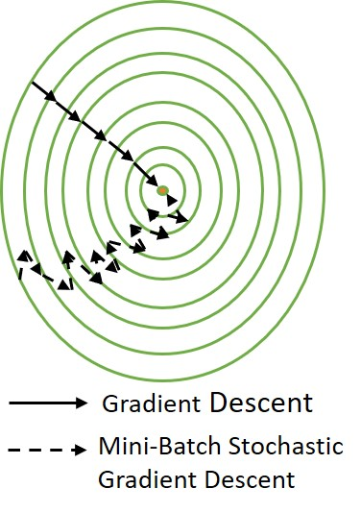
Background (I) – Optimization in ML
Neural Networks
weights : solution of optimization problem
loss function
gradient descent (GD)
Gradient Descent Variants
GD → slow iterations
Mini-Batch Stochastic Gradient Descent
subset of data / iteration
more iterations to converge
view on whole distribution / iteration
may stuck on local minima
Adam, AdaGrad, etc.

Slide 4
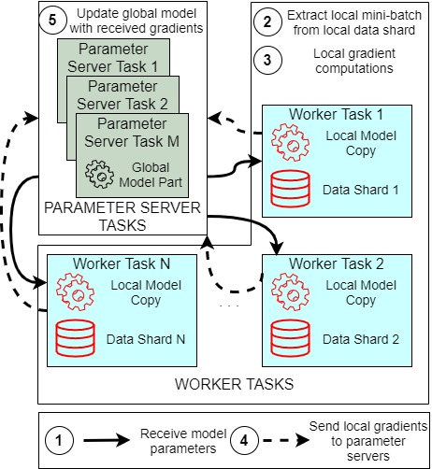
Background (II) – Parameter Server Architecture
Parameter Servers
  store neural networks in distributed fashion
Workers
  local model copy
  assigned data shard
  compute gradients with SGD variants
Usually asynchronous aggregation
  on global model
Training Model under Parameter server architecture

Slide 5
Exploiting data distribution
Mini – Batch SGD
restricted view on data / iteration
not moving directly towards opt. point
shuffling → less correlated data
Algorithmic batch extraction
faster learning / higher accuracy ?
mini-batch representative of data
data preprocess
better convergence based on data traits
PhD Research Related Goals
Study algorithmic mini – batch selection
Example on CIFAR-10
representative to data distribution
cluster each classes to 2 subclasses
mini-batch from all subclasses
Bengio – Curriculum Learning
5% / 2% improvement in validation loss / error
Single Node Training

Slide 6
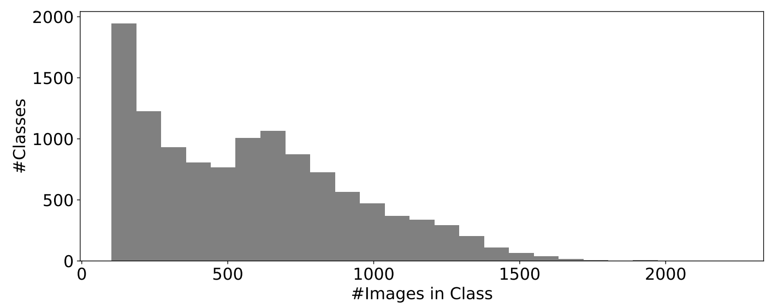
Exploiting data distribution
Stale Gradients Effect
gradients using old model parameters
possible solutions
variable learning rate (Dutta - 2013)
learning rate techniques – heterogeneous environment (Jiang - 2017)
FlexPS: staleness parameter – aging (Huang - 2018)
Better Data Assignment
up to now algorithmic solutions
parameter server / learning rate level
systematic data sharding
up to now random (TensorFlow using mod)
data skew in class level may occur
unbalanced classes (Imagenet example)
Idea! exploit stratification and hidden stratification
Stratification – Related Work
approximate query processing
use in data sharding / per worker mini-batch selection
smooth staleness effect
learning from heterogeneous databases
medical image classification
locality / data sensitive hashing
Parameter Server Training
Imagenet Data Distribution

Slide 7
Research Plan
Measure the effects of mini-batch design in single node training
01
Evaluate techniques to extract distribution traits from big data sets
02
Apply distribution related information in data sharding.
03
Streaming system for serving mini-batches to workers
04
representative mini-batches
exploit real time metrics
clustering algorithms
data sensitive hashing
stratification
distribution traits
collect data information
efficiently prepare mini-batches

Slide 8



Technologies
Apache Arrow
Apache Spark
Clustering Algorithms – SparkML
Google TensorFlow
Metrics Computation
Model Training
Parameter Server Architecture
streaming data batches
optimize data in columnar format
CPU / GPU computations
TensorFlow Compatibility
Benchmarking Setup
Measurements on
  training speed
  training / validation metrics
Baseline
  training state of the art models under the parameter server setup
Compare with
  models exploiting distribution traits

Slide 9

Questions?
Thank you
Contact Information:
Nikodimos Provatas
Email: nprov@cslab.ece.ntua.gr

