Slide 1



Context ○○○○ | State of the art ○○ | Our contributions ○○ | Future Work ○○○
Cooperative Techniques for Dealing with Unsatisfactory Answers in RDF Knowledge Bases
Louise PARKIN
Supervised by Brice CHARDIN, Stéphane JEAN, Allel HADJALI
LIAS – ISAE/ENSMA, Chasseneuil-du-Poitou, France
louise.parkin@ensma.fr, brice.chardin@ensma.fr,
jean@ensma.fr, allel.hadjali@ensma.fr
August 16, 2021
Cooperative Treatment of Unsatisfactory Answers in RDF VLDB 2021 PhD workshop louise.parkin@ensma.fr

Slide 2


Context ○○○○ | State of the art ○○ | Our contributions ○○ | Future Work ○○○
Outline
Context
  RDF Knowledge bases
  Unexpected answers
Dealing with unexpected answers
  Query modification
  Answer explanation
A generalized approach based on failure causes
Future work
August 16, 2021
Cooperative Treatment of Unsatisfactory Answers in RDF VLDB 2021 PhD workshop louise.parkin@ensma.fr

Slide 3
Context ●○○○ | State of the art ○○ | Our contributions ○○ | Future Work ○○○
Context - RDF
RDF Knowledge Base
SPARQL Query
subject | predicate | object
n1 | treats | p1
p1 | age | 45
p1 | suffersFrom | flu
p1 | suffersFrom | brokenArm
…
SELECT * WHERE {
?p ward ICU . t1
?p status Dead . t2
?n treats ?p . t3
?n ward ICU . t4
?p suffersFrom ?i } t5
Results
?p | ?n | ?i
p1 | n1 | flu
p1 | n1 | brokenArm
p1 | n2 | flu
p1 | n2 | brokenArm
p2 | n1 | stroke
…
Cooperative Treatment of Unsatisfactory Answers in RDF VLDB 2021 PhD workshop louise.parkin@ensma.fr
16/28/2021
Cooperative Treatment of Unsatisfactory Answers in RDF VLDB 2021 PhD workshop louise.parkin@ensma.fr
August 16, 2021

Slide 4
Context ○●○○ | State of the art ○○ | Our contributions ○○ | Future Work ○○○
Hypotheses
The user is unfamiliar with the KB
The expressed query does not match the user’s requirement
The answers do not satisfy the user
We need to help the user reformulate their query
We do not deal with issues related to the content of the KB
August 16, 2021
Cooperative Treatment of Unsatisfactory Answers in RDF VLDB 2021 PhD workshop louise.parkin@ensma.fr

Slide 5
Context ○○●○ | State of the art ○○ | Our contributions ○○ | Future Work ○○○
Example
We want to know the patients that died in the ICU, the nurses they were treated by and why they died (about 100 deaths)
Suppose we fix this problem by removing ?n ward ICU
SELECT * WHERE {
?p ward ICU .
?p status Dead .
?n treats ?p .
?n ward ICU .
?p suffersFrom ?i }
Wrong name: IntensiveCareUnit
Incompatible properties
No answers!
Wrong property: worksIn
August 16, 2021
Cooperative Treatment of Unsatisfactory Answers in RDF VLDB 2021 PhD workshop louise.parkin@ensma.fr

Slide 6
Context ○○○● | State of the art ○○ | Our contributions ○○ | Future Work ○○○
Example
We want to know the patients that died in the ICU, the nurses they were treated by and why they died (about 100 deaths)
There are over 10 000 answers
Patient123 died in the ICU and is not included in the answer
SELECT * WHERE {
?p ward ICU .
?p status Dead .
?n treats ?p .
?p suffersFrom ?i }
Insufficiently constrained
Missing property
Number of answers multiplied
August 16, 2021
Cooperative Treatment of Unsatisfactory Answers in RDF VLDB 2021 PhD workshop louise.parkin@ensma.fr

Slide 7

Context ○○○○ | State of the art ●○ | Our contributions ○○ | Future Work ○○○
Dealing with unexpected answers
Relaxation
[Godfrey 1997]
[Vasilyeva et al. 2016]
Query modification
Refinement
[Bosc et al. 2008]
Modification
[Moises, Pereira 2014]
[Song et al. 2019]
Unexpected answers
[Bosc et al. 2009] [Jannach 2006] [McSherry 2004] [Fokou et al. 2016]
False presuppositions
[Kaplan 1982]
[Motro 1986]
Answer explanation
Failure causes
[Godfrey 1997]
[Wang et al. 2019]
August 16, 2021
Cooperative Treatment of Unsatisfactory Answers in RDF VLDB 2021 PhD workshop louise.parkin@ensma.fr

Slide 8
Context ○○○○ | State of the art ○● | Our contributions ○○ | Future Work ○○○
Dealing with unexpected answers
Problem | Query modification | Answer explanation
Empty answers
Too few answers
Too many answers
Missing answer
Unwanted answer
Combined problems
[Godfrey 1997]
[Fokou et al. 2016]
[Godfrey 1997]
[Fokou et al. 2016]
[Bosc et al. 2006]
[Moises, Pereira 2014]
[Vasilyeva et al. 2016]
[Tran, Chan 2010]
[Song et al. 2019]
[Bidoit et al. 2014]
[Wang et al. 2019]
[Song et al. 2019]
August 16, 2021
Cooperative Treatment of Unsatisfactory Answers in RDF VLDB 2021 PhD workshop louise.parkin@ensma.fr

Slide 9
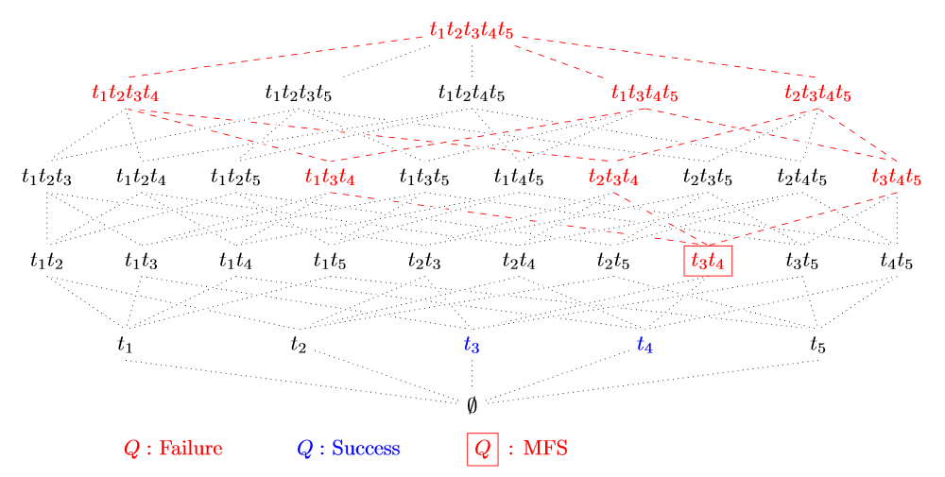
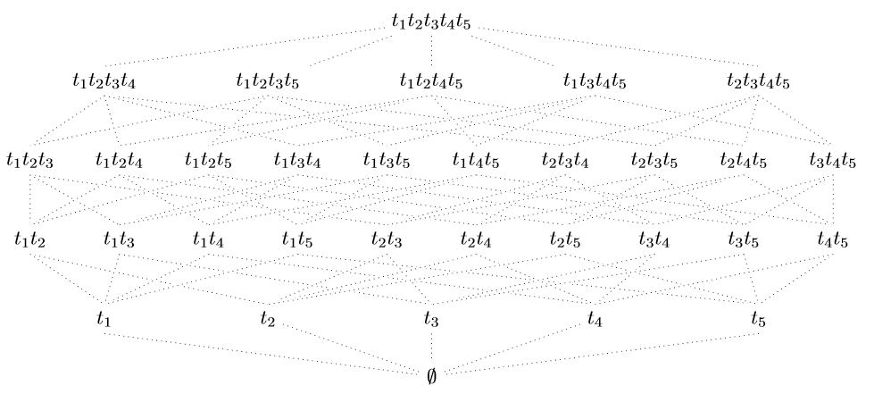
Context ○○○○ | State of the art ○○ | Our contributions ●○ | Future Work ○○○
A generalized approach
Failure cause definition
Existing definition: MFS (Minimal Failing Subqueries)
SELECT * WHERE {
?p ward ICU . t1
?p status Dead . t2
?n treats ?p . t3
?n ward ICU . t4
?p suffersFrom ?i } t5
August 16, 2021
Cooperative Treatment of Unsatisfactory Answers in RDF VLDB 2021 PhD workshop louise.parkin@ensma.fr

Slide 10
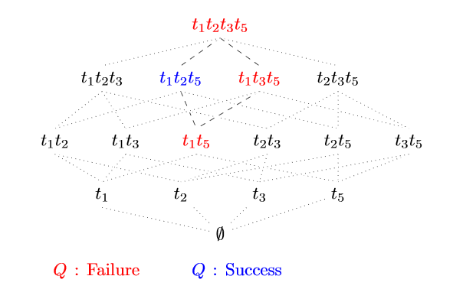
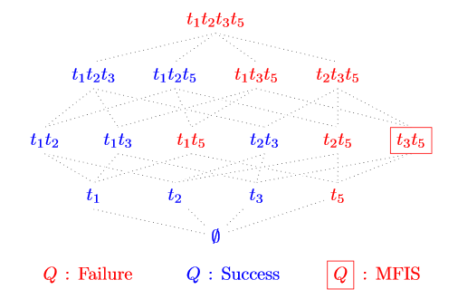
Context ○○○○ | State of the art ○○ | Our contributions ○● | Future Work ○○○
A generalized approach
SELECT * WHERE {
?p ward ICU . t1
?p status Dead . t2
?n treats ?p . t3
?p suffersFrom ?i } t5
Failure cause definition
Extension: lack of monotony
MFIS: Minimal Failure-Inducing Subquery
Use of deduction rules to compute MFIS
Experiments on synthetic and real data show that MFIS can be computed in a reasonable time
August 16, 2021
Cooperative Treatment of Unsatisfactory Answers in RDF VLDB 2021 PhD workshop louise.parkin@ensma.fr

Slide 11
Context ○○○○ | State of the art ○○ | Our contributions ○○ | Future Work ●○○
Future Work
Framework for generic failure conditions
Specify the initial query
Specify the failure condition (combination of existing problems)
Determine an algorithm to find MFIS and an execution method
August 16, 2021
Cooperative Treatment of Unsatisfactory Answers in RDF VLDB 2021 PhD workshop louise.parkin@ensma.fr

Slide 12
Context ○○○○ | State of the art ○○ | Our contributions ○○ | Future Work ○●○
Future Work
Building a framework
User based
Interactive
Automatic
Query modification
August 16, 2021
Cooperative Treatment of Unsatisfactory Answers in RDF VLDB 2021 PhD workshop louise.parkin@ensma.fr

Slide 13
Context ○○○○ | State of the art ○○ | Our contributions ○○ | Future Work ○○●
Future Work
Building a framework
Comparing our generic framework performance to dedicated solutions
Testing the helpfulness of our feedback on a student population
Query modification
Experimentation
August 16, 2021
Cooperative Treatment of Unsatisfactory Answers in RDF VLDB 2021 PhD workshop louise.parkin@ensma.fr

Slide 14
Context ○○○○ | State of the art ○○ | Our contributions ○○ | Future Work ○○○
Any questions?
Cooperative Treatment of Unsatisfactory Answers in RDF VLDB 2021 PhD workshop louise.parkin@ensma.fr
Cooperative Treatment of Unsatisfactory Answers in RDF VLDB 2021 PhD workshop louise.parkin@ensma.fr
August 16, 2021
Cooperative Treatment of Unsatisfactory Answers in RDF VLDB 2021 PhD workshop louise.parkin@ensma.fr

