Slide 1
Fast Set Intersection in Memory
Bolin Ding Arnd Christian König
UIUC Microsoft Research

Slide 2
Outline
Introduction
Intersection via fixed-width partitions
Intersection via randomized partitions
Experiments

Slide 3
Outline
Introduction
Intersection via fixed-width partitions
Intersection via randomized partitions
Experiments

Slide 4
Introduction
Motivation: general operation in many contexts
Information retrieval (boolean keyword queries)
Evaluation of conjunctive predicates
Data mining
Web search
Preprocessing index in linear (to set size) space
Fast online processing algorithms
Focusing on in-memory index

Slide 5
Related Work
|L₁|=n, |L₂|=m, |L₁∩ L₂|=r
Sorted lists merge
B-trees, skip lists, or treaps
Adaptive algorithms
Hash-table lookup
Word-level parallelism
Intersection size r is small
w: word size
Map L₁ and L₂ to a small range
[Hwang and Lin 72], [Knuth 73], [Brown and Tarjan 79], [Pugh 90], [Blelloch and Reid-Miller 98], …
(bound # comparisons w.r.t. opt)
[Demaine, Lopez-Ortiz, and Munro 00], …
[Bille, Pagh, Pagh 07]

Slide 6
Basic Idea
Preprocessing:
L₁
Small
groups
1. Partitioning into small groups
Hash
images
2. Hash mapping to a small range {1, …, w}
Hash
images
w: word size
Small
groups
L₂

Slide 7
Basic Idea
Two observations:
L₁
Small
groups
1. At most r = |L₁∩L₂| (usually small) pairs of small groups intersect
Hash
images
2. If a pair of small groups does NOT intersect, then, w.h.p., their hash images do not intersect either (we can rule it out)
Hash
images
Small
groups
L₂

Slide 8
Basic Idea
Online processing:
L₁
Small
groups
1. For each possible pair, compute h(I₁)∩h(I₂)
I₁
Hash
images
h(I₁)
2.1. If empty, skip (if r = |L₁∩L₂| is small we can skip many);
2.2. otherwise, compute the intersection of two small groups I₁∩I₂
Hash
images
h(I₂)
Small
groups
I₂
L₂

Slide 9
Basic Idea
Two questions:
L₁
Small
groups
1. How to partition?
I₁
Hash
images
h(I₁)
2. How to compute the intersection of two small groups?
Hash
images
h(I₂)
Small
groups
I₂
L₂

Slide 10
Our Results
|L₁|=n, |L₂|=m, |L₁∩ L₂|=r
Sets of comparable sizes
Sets of skewed sizes (reuse the index)
Generalized to k sets and set union
Improved performance (wall-clock time) in practice (compared to existing solutions)
(i) Hidden constant; (ii) random/scan access
Best in most cases; otherwise, close to the best
,
(efficient in practice)
(better when n<<m)

Slide 11
Outline
Introduction
Intersection via fixed-width partitions
Intersection via randomized partitions
Experiments

Slide 12
Fixed-Width Partitions
Outline
Sort two sets L₁ and L₂
Partition into equal-depth intervals (small groups)
Compute the intersection of two small groups using QuickIntersect(I₁, I₂)
|L₁|=n, |L₂|=m, |L₁∩ L₂|=r
w: word size
elements in each interval
pairs of small groups

Slide 13
Subroutine QuickIntersect
(Preprocessing)
Map I₁ and I₂ to {1, 2, …, w} using a hash function h
123401 | 132405 | 156710 | 189840
h
0100001000100001
Hash images are encoded as words of size w
{1, 2, …, w}
0100000000000001
(Online processing)
Compute h(I₁)∩h(I₂)
(bitwise-AND)
0100010001000001
h
122402 | 132406 | 156710 | 192340
(Online processing)
Lookup 1’s in h(I₁)∩h(I₂) and “1-entries” in the hash tables
Go back to I₁ and I₂ for each “1-entry”
Bad case: two different elements in I₁ and I₂ are mapped to the same one in {1, 2, …, w}

Slide 14
Analysis
(Preprocessing)
Map I₁ and I₂ to {1, 2, …, w} using a hash function h
123401 | 132405 | 156710 | 189840
h
0100001000100001
Hash images are encoded as words of size w
{1, 2, …, w}
0100000000000001
(Online processing)
Compute h(I₁)∩h(I₂)
(bitwise-AND)
0100010001000001
h
one operation
122402 | 132406 | 156710 | 192340
|L₁|=n, |L₂|=m, |L₁∩ L₂|=r
(Online processing)
Lookup 1’s in h(I₁)∩h(I₂) and “1-entries” in the hash tables
Go back to I₁ and I₂ for each “1-entry”
|h(I₁)∩h(I₂)| = (|I₁∩I₂| + # bad cases) operations
Total complexity:
Bad case: two different elements in I₁ and I₂ are mapped to the same one in {1, 2, …, w}
one bad case for each pair in expectation

Slide 15
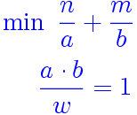
Analysis
|L₁|=n, |L₂|=m, |L₁∩ L₂|=r
w: word size
Optimize the parameter a bit
--- total # of small groups (|I₁| = a, |I₂| = b)
s.t.
--- ensure one bad case for each pair of I₁ and I₂
Total complexity:

Slide 16
Outline
Introduction
Intersection via fixed-width partitions
Intersection via randomized partitions
Experiments

Slide 17
Randomized Partition
Outline
Two sets L₁ and L₂
Grouping hash function g (different from h):
group elements in L₁ and L₂ according to g(.)
Compute the intersection of two small groups:
I₁^{i}={x∈L₁ | g(x)=i} and I₂^{i}={y∈L₂ | g(y)=i}
using QuickIntersect
|L₁|=n, |L₂|=m, |L₁∩ L₂|=r
w: word size
The same grouping function for all sets
g(x) = 1
g(x) = 2
… …

Slide 18
Randomized Partition
Outline
Two sets L₁ and L₂
Grouping hash function g (different from h):
group elements in L₁ and L₂ according to g(.)
|L₁|=n, |L₂|=m, |L₁∩ L₂|=r
w: word size
The same grouping function for all sets
g(x) = 1
g(x) = 2
… …
g(y) = 1
g(y) = 2
… …

Slide 19
Analysis
Number of bad cases for each pair
Then follow the previous analysis:
Generalized to k sets
Rigorous analysis is trickier

Slide 20
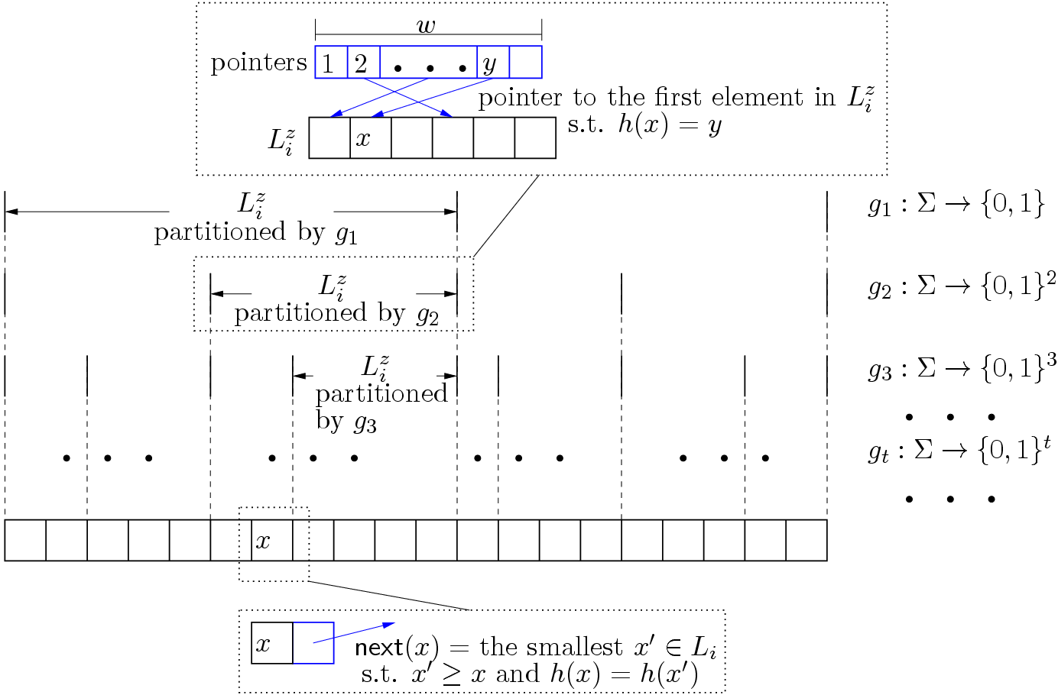
Data Structures
Multi-resolution structure for online processing
Linear (to the size of each set) space

Slide 21
A Practical Version
Outline
Motivation: linear scan is cheap in memory
Instead of using QuickIntersect to compute I₁^{i}∩I₂^{i}, just linear scan them, in time O(|I₁^{i}|+|I₂^{i}|)
(Preprocessing)
Map I₁^{i} and I₂^{i} into {1, …, w} using a hash function h
(Online processing)
Linear scan I₁^{i} and I₂^{i} only if h(I₁^{i})∩h(I₂^{i}) ≠
w: word size

Slide 22
A Practical Version
Outline
Motivation: linear scan is cheap in memory
Instead of using QuickIntersect to compute I₁^{i}∩I₂^{i}, just linear scan them, in time O(|I₁^{i}|+|I₂^{i}|)
I₁^{i}
h(I₁^{i})
Linear scan
h(I₂^{i})
I₂^{i}

Slide 23
A Practical Version
Outline
Motivation: linear scan is cheap in memory
Instead of using QuickIntersect to compute I₁^{i}∩I₂^{i}, just linear scan them, in time O(|I₁^{i}|+|I₂^{i}|)
I₁^{i}
h(I₁^{i})
Linear scan
h(I₂^{i})
I₂^{i}

Slide 24
Analysis
The probability of false positive is bounded:
Using p hash functions, false positive happens with lower probability: at most
Complexity
When I₁^{i}∩I₂^{i} = , (false positive) scan it with prob
When I₁^{i}∩I₂^{i} ≠ , must scan it (only r such pairs)
Rigorous analysis is trickier

Slide 25
Intersection of Short-Long Lists
Outline (when |I₁^{i}|>>|I₂^{i}|)
Linear scan in I₂^{i}
Binary search in I₁^{i}
Based on the same data structure, we get
L₁:
L₂:

Slide 26
Outline
Introduction
Intersection via fixed-width partitions
Intersection via randomized partitions
Experiments

Slide 27
Experiments
Synthetic data
Uniformly generating elements in {1, 2, …, R}
Real data
8 million Wikipedia documents
(inverted index – sets)
The 10 thousand most frequent queries from Bing (online intersection queries)
Implemented in C, 4GB 64-bit 2.4GHz PC
Time (in milliseconds)

Slide 28
Experiments
|L₁|=n, |L₂|=m, |L₁∩ L₂|=r
Sorted lists merge
B-trees, skip lists, or treaps
Adaptive algorithms
Hash-table lookup
Word-level parallelism
Intersection size r is small
w: word size
Map L₁ and L₂ to a small range
[Hwang and Lin 72], [Knuth 73], [Brown and Tarjan 79], [Pugh 90], [Blelloch and Reid-Miller 98], …
(bound # comparisons w.r.t. opt)
[Demaine, Lopez-Ortiz, and Munro 00], …
[Bille, Pagh, Pagh 07]

Slide 29
Experiments
Sorted lists merge
B-trees, skip lists, or treaps
Adaptive algorithms
Hash-table lookup
Word-level parallelism
Merge
SkipList
Adaptive
SvS
Hash
Lookup
BPP

Slide 30
Experiments
Our approaches
Fixed-width partition
Randomized partition
The practical version
Short-long list intersection

Slide 31
Experiments
Our approaches
Fixed-width partition
Randomized partition
The practical version
Short-long list intersection
IntGroup
RanGroup
RanGroupScan
HashBin

Slide 32
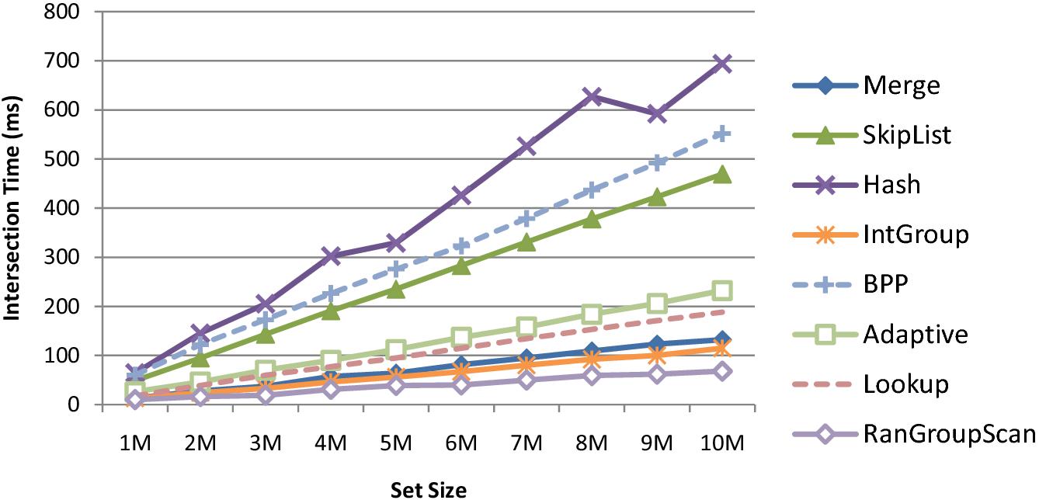
Varying the Size of Sets
|L₁|=n, |L₂|=m, |L₁∩ L₂|=r
n = m = 1M~10M
r = n*1%

Slide 33
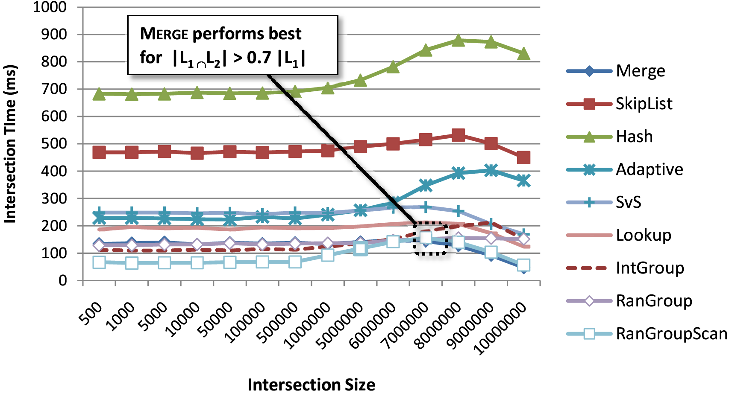
Varying the Size of Intersection
|L₁|=n, |L₂|=m, |L₁∩ L₂|=r
n = m = 10M
r = n*(0.005%~100%) = 500~10M

Slide 34
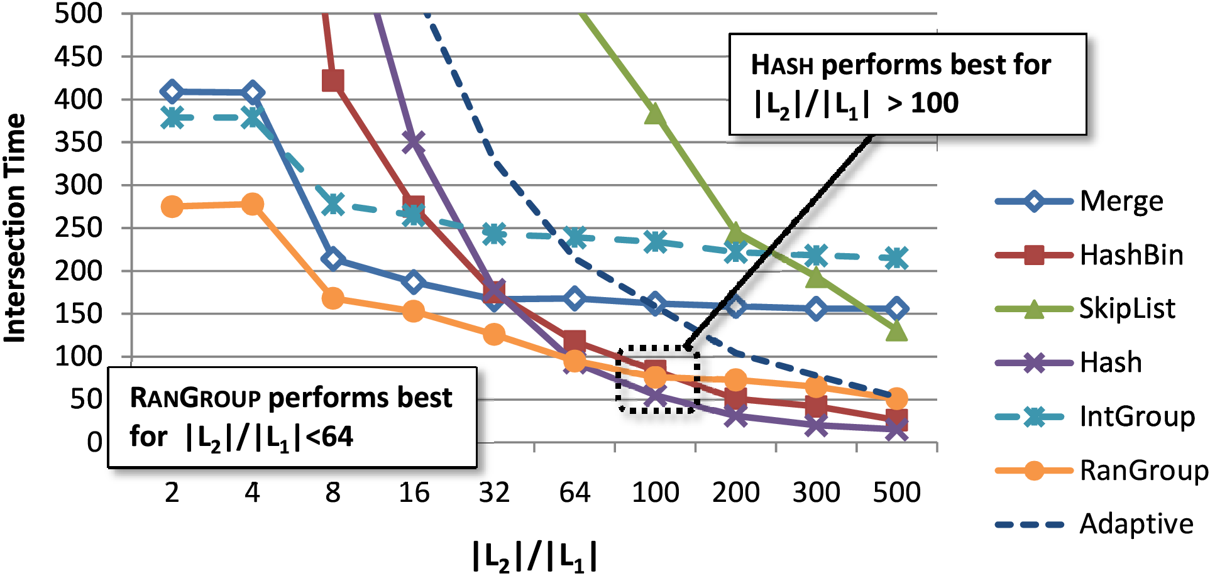
Varying the Ratio of Set Sizes
|L₁|=n, |L₂|=m, |L₁∩ L₂|=r
m = 10M, m/n = 2~500
r = n*1%

Slide 35
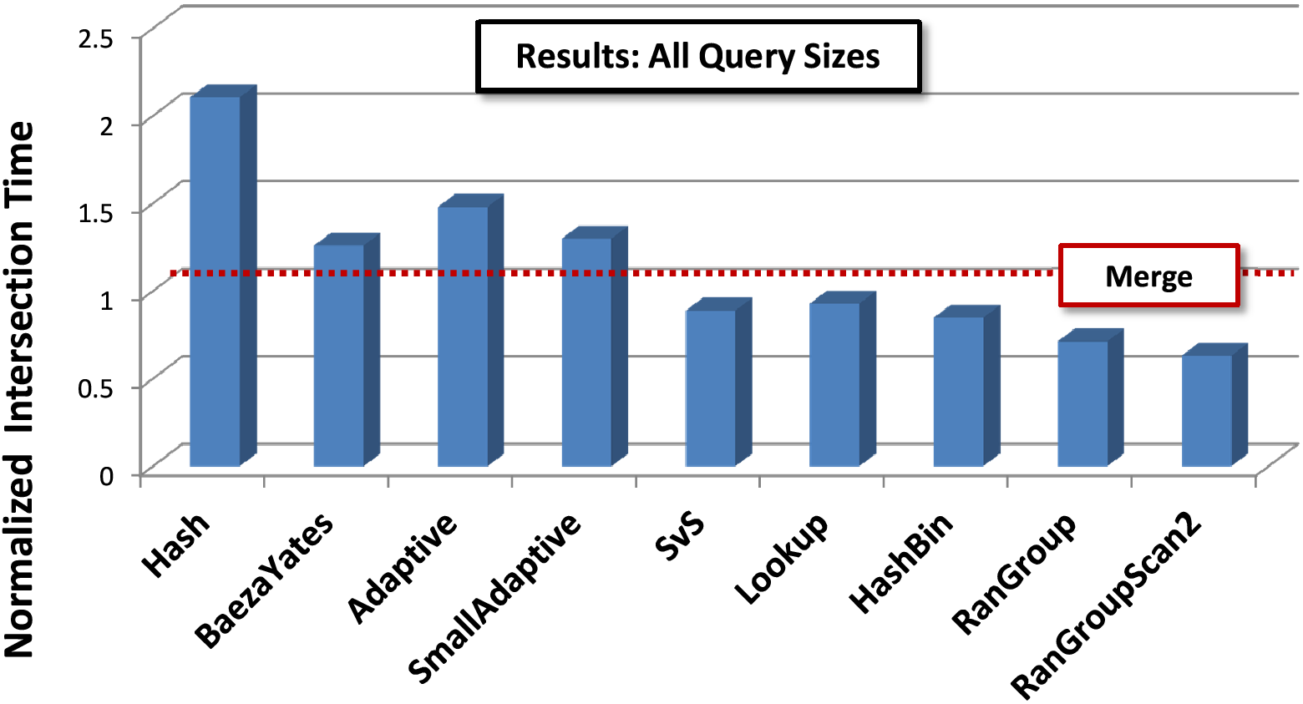
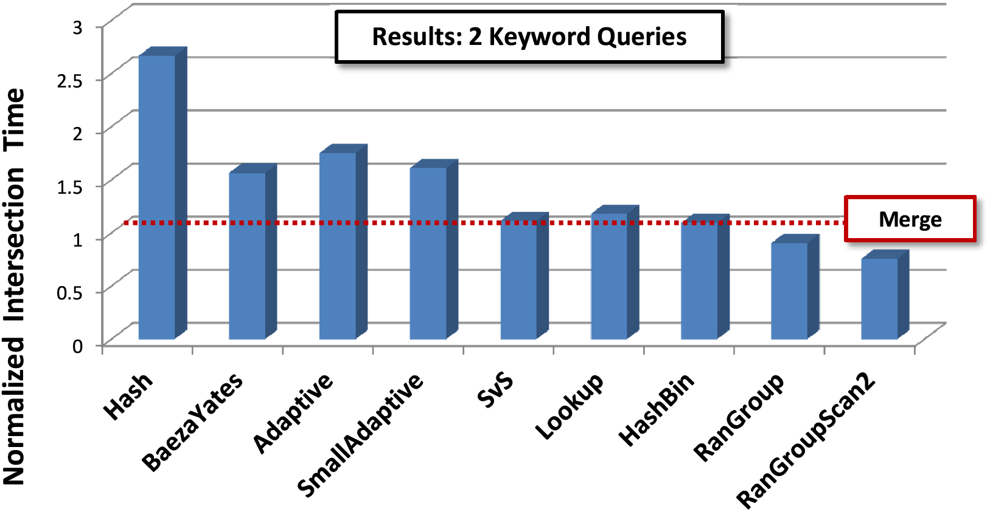
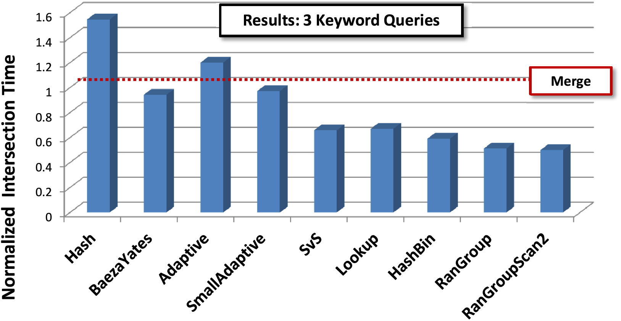
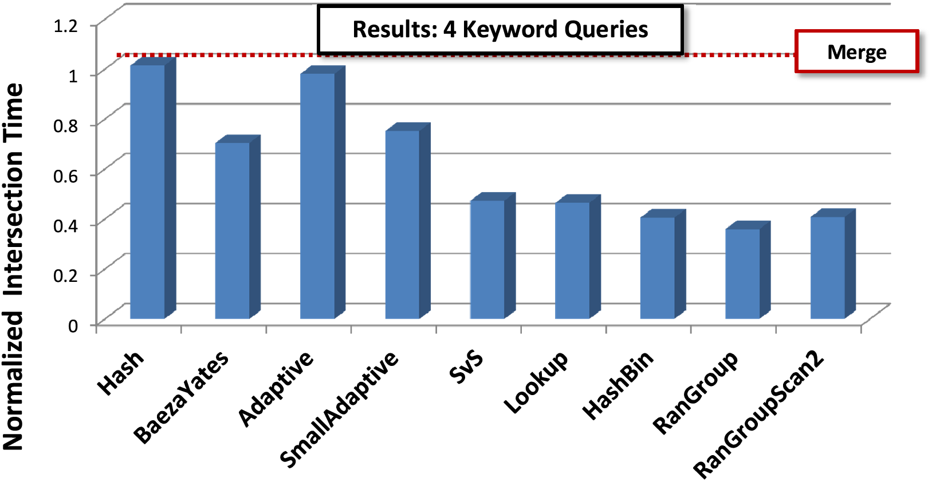
Real Data

Slide 36
Conclusion and Future Work
Simple and fast set intersection algorithms
Novel performance guarantee in theory
Better wall-clock performance: best in most cases; otherwise, close to the best
Future work
Storage compression in our approaches
Select the best algorithm/parameter by estimating the size of intersection
(RanGroup v.s. HashBin) (RanGroup v.s. Merge)
(parameter p) (sizes of groups)

Slide 37
Thank you!

Slide 38
Compression (preliminary results)
Storage compression in RanGroup
Grouping hash function g:
random permutation/prefix of permuted ID
Storage of short lists
suffix of permuted ID
Compared with Merge algo on δ-compression of inverted index
Compressed Merge:
70% compression, 7 times slower (800ms)
Compressed RanGroup:
40% compression, 1.5 times slower (140ms)

Slide 39
Remarks (cut or not?)
Linear additional space for preprocessing and indexing
Generalized to k lists
Generalized to disk I/O model
Difference between Pagh’s and ours
Pagh: Mapping + Word-level parallelism
Ours: Grouping + Mapping

Slide 40
Data Structures (remove)
Linear scan

Slide 41
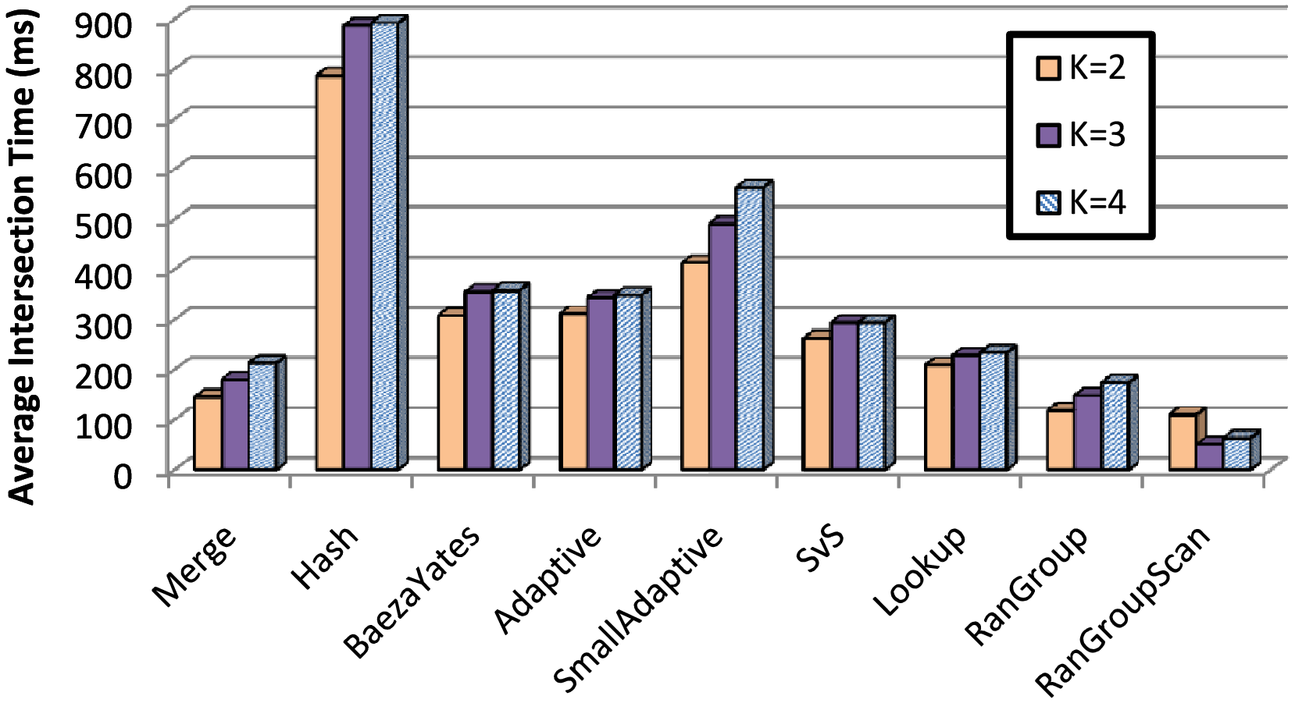
Number of Lists (skip)
size = 10M

Slide 42
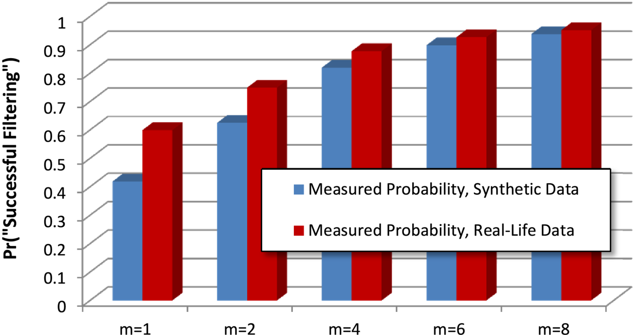
Number of Hash Functions (remove)
p = 1 p = 2 p = 4 p = 6 p = 8

Slide 43
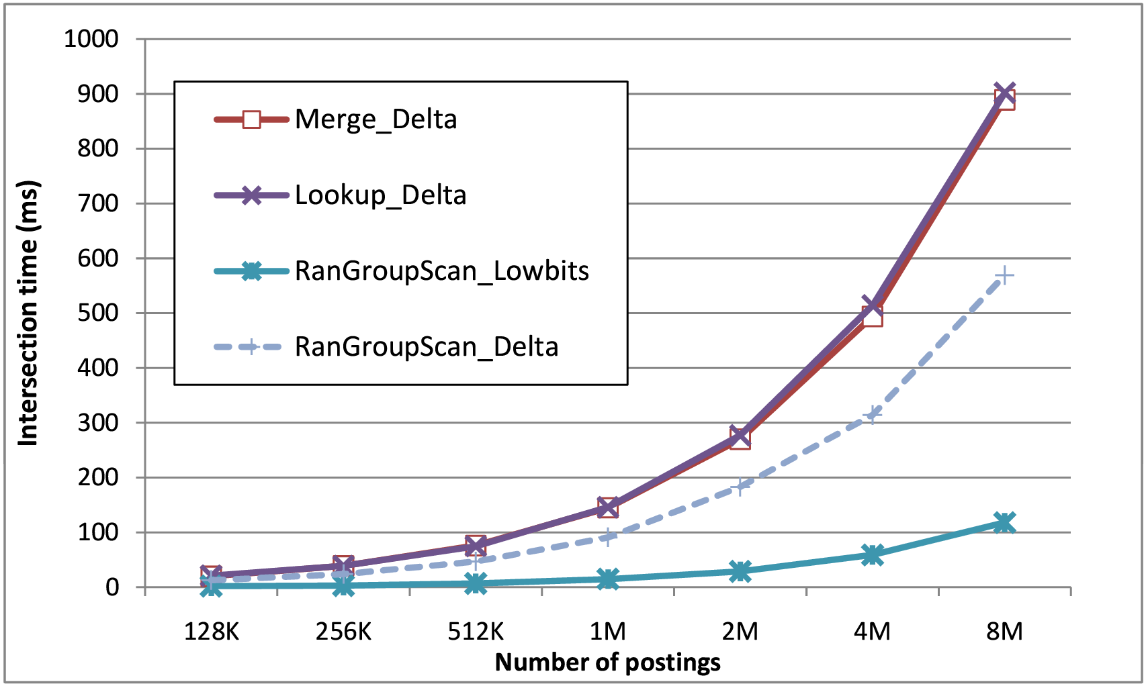
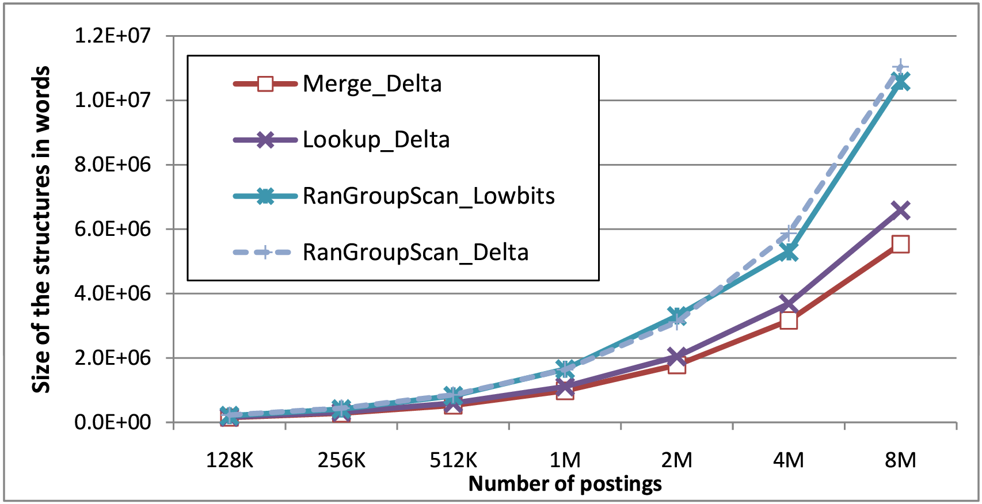
Compression (remove)
n = m = 1M~10M
r = n*1%

Slide 44
Intersection of Short-Long Lists
Outline
Two sorted lists L₁ and L₂
Hash function g:
Group elements in L₁ and L₂ according to g(.)
For each element in I₂^{i}={y∈L₂ | g(y)=i},
binary search it in I₁^{i}={x∈L₁ | g(x)=i}
(Preprocessing)
(Online processing)
L₁:
L₂:

Slide 45
Analysis
Online processing time
Random variable S_{i}: size of I₂^{i}
E(S_{i}) = 1;
∑_{i} |I₁^{i}| = n;
concavity of log(.)
Comments:
1. The same performance guarantee as B-trees, skip-lists, and treaps
2. Simple and efficient in practice
3. Can be generalized for k lists

Slide 46
Data Structures
Random access
Linear scan

