Slide 1




Mining Top-K Large Structural Patterns in a Massive Network
Feida Zhu¹, Qiang Qu², David Lo¹, Xifeng Yan³,
Jiawei Han⁴, and Philip S. Yu⁵
¹Singapore Management University, ²Peking University,
³University of California – Santa Barbara,
^{4,5}University of Illinois – Urbana-Champaign & Chicago
Notes:
Large patterns in a single large graph

Slide 2
Motivation - Why large graph patterns?
Graph data is getting ever bigger, and so are the patterns.
E.g., social networks like Facebook, Twitter, etc.
Often, large patterns are more informative in characterizing large graph data.
E.g., in DBLP, small patterns are ubiquitous, larger patterns better characterize different research communities.
E.g., in software engineering, large patterns can correspond to software backbones
Notes:
Graph data is getting larger in size and so are the patterns contained in them. For examples, as more and more people join Facebook, the size of various communities in Facebook would grow. Daily thousands to millions of new links are added to Facebook friendship network and twitter messaging network.
Also, large patterns are often more informative than small patterns in characterizing large graph data. For example, in DBLP small patterns involving a few authors collaborating together is common. Large patterns could capture surprising patterns that characterize a group of authors/differentiate different research communities. When applied on software engineering data, large patterns can correspond to software backbones that reveal the main logic of a program and can help developers in understanding a legacy system.

Slide 3
Motivation – Why is it challenging?
Larger frequent patterns from larger input graphs.
Pattern explosion is notorious in frequent graph mining even for small patterns and data
Frequent pattern mining in single graph setting is tricky!
Support computation and embedding maintenance in single graph setting is tricky.
Most of large graph data are no longer graph transaction database, they are single graphs.
Notes:
Why our problem is challenging?
First, mining large patterns from large input graphs is technically difficult due to pattern explosion problem. Even mining small-medium sized patterns could result in an exponential number of patterns. The problem is aggravated when the frequent patterns are large.
Next, we consider a single graph setting. Support computation and embedding maintenance is tricky in this setting as we need to consider the issue of multiple overlapping embeddings.
However, this setting is important as many large graph data are not a graph database but single large graphs. For example, the friendship network in Facebook is a single large graph.

Slide 4
Talk Outline
Motivation
Related Work
Problem Definition
Our Solution: SpiderMine
Experiments
Conclusion and Future Work

Slide 5
Related Work
Single-graph setting
SUBDUE and SEuS
Use different heuristics and work well for mining smaller patterns on certain classes of input graphs.
MoSS
State-of-the-art for mining complete pattern set.
Suffers from scalability issue for large patterns and input graphs due to exponential result size.

Slide 6
Related Work
Graph-transaction setting
AGM, FSG, gSpan, FFSM, etc.
Mine complete pattern set.
Suffers from scalability issue for large patterns and input graphs due to exponential result size.
CloseGraph, SPIN and MARGIN
Mine closed or maximal patterns.
Still suffers from scalability issue as the number of closed or maximal patterns could be formidable.
ORIGAMI
Mine a representative pattern set.
Returns a pattern set of mixed sizes.

Slide 7
Problem
Given a graph, mine the top-K largest patterns.
But, to capture them exactly, no more and no less, we might have to generate all the smaller ones, which we cannot afford.
Let’s find them probabilistically, with user-defined error bound.
Problem definition:
“Mine top-K largest frequent patterns whose diameters are bounded by Dmax with a probability of at least 1-ε“

Slide 8
Our Solution: SpiderMine

Slide 9
Main Idea
How to capture large graph patterns?
Observation:
Large patterns are composed of a large number of small components, called “spiders”, which will eventually connect together after some rounds of pattern growth.

Slide 10
r-Spider
An r-spider is a frequent graph pattern P such that there exists a vertex u of P, and all other vertices of P are within distance r to u.
u is called the head vertex.
r
u

Slide 11
SpiderMine Overview
Mine the set S of all the r-spiders.
Randomly draw M r-spiders from S as the initial set of patterns.
Grow these patterns for t iterations.
Extend pattern boundary with spiders.
At each iteration, we increase the radius of a pattern by r.
Merge two patterns whenever possible.
Discard unmerged patterns.
Continue to grow the remaining ones to maximum size.
Return the top-K largest ones in the result.
t = Dmax/2r

Slide 12
Large patterns vs small patterns
Why can SpiderMine save large patterns and prune small ones with good chance?
Small patterns are less likely to be hit in the random draw.
First pruning at the initial random draw
Even if a small pattern is hit, it’s even much less likely to be hit multiple times.
Second pruning after t pattern growth iteration
The larger the pattern, the greater the chance it is hit and saved.
Notes:
Small patterns are less likely to contain one of the randomly drawn spider. Thus the first pruning of small patterns happen when we randomly draw m spiders.
Also, even if a small pattern contain one spider it is less likely to contain multiple spiders. If a pattern only contain one spider; that spider would result in an unmerged pattern at the end of t iteration and unmerged patterns would be discarded. This is the second pruning strategy.
On the other hand, for large patterns, the larger it is the more likely it would contain two or more spiders. By growing and merging these spiders we would be able to recover these large patterns.

Slide 13
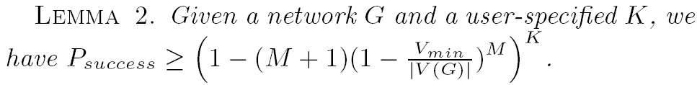
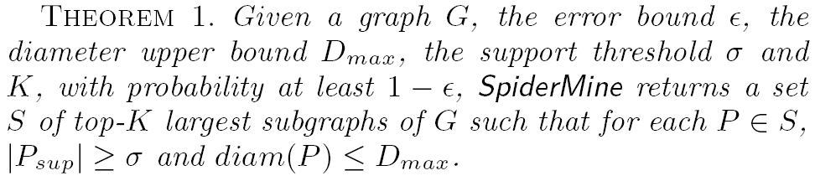
How many r-spiders to draw?
With user-defined error threshold ε, we solve for M by setting:

Slide 14
Why Spiders?
Reduce combinatorial complexity of pattern growth
Observation:
Spiders are shared by many larger patterns.
Once obtained, they can be efficiently assembled to generate large patterns.
Mining Top-K Large Structural Patterns in a Massive Network

Slide 15
Why Spiders?
Improve graph isomorphism checking
We propose a novel graph pattern representation
Spider-set representation.
A pattern is represented by the set of its constituent r-spiders.
Two isomorphic patterns must have the same spider-set representation.
Two patterns having the same spider-set representations are highly likely to be isomorphic.

Slide 16
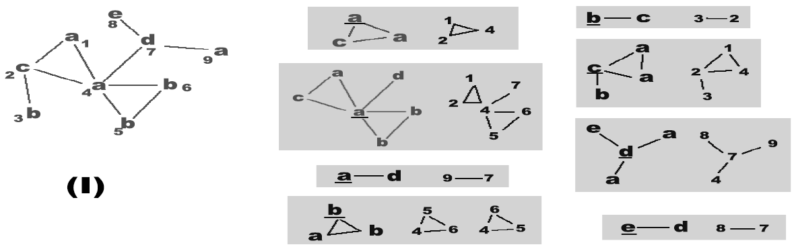
Why Spiders?
Example
The larger the r, the more effective is our spider-based isomorphism detection.
More topological constraints
.
Notes:
Limit the flexibility to construct two non-isomorphic graphs using the same set of spiders

Slide 17
Experimental Results

Slide 18
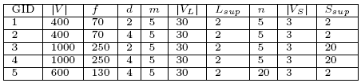
Synthetic Datasets
Random Network (Erdos-Renyi)
Generate background graph & inject freq. patterns
|V|, f – number of vertices and labels, respectively
d – average degree
m,n – number of small or large patterns injected
|V_{L}|, |V_{S}| (L_{sup}, S_{sup}) - number of vertices of injected large/small patterns (with their supports)
Scale-Free Network (Barabasi-Albert)

Slide 19
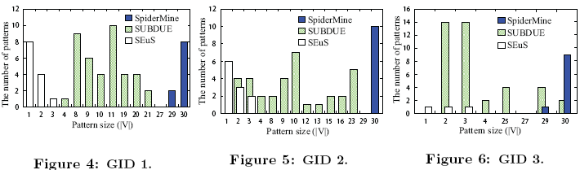
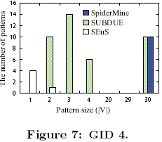
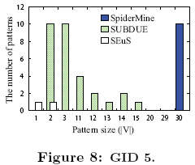
Experiments(I) --- Random Network

Slide 20
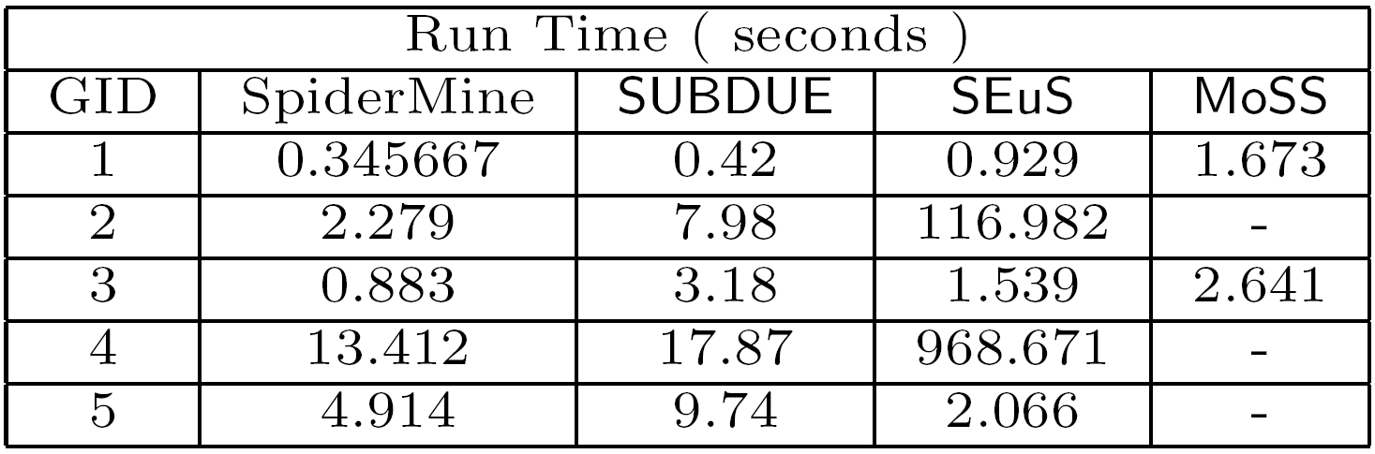
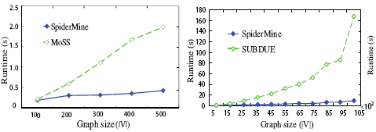
Experiments(I) --- Random Network
Runtime comparison with SUBDUE, SEuS, and MoSS

Slide 21
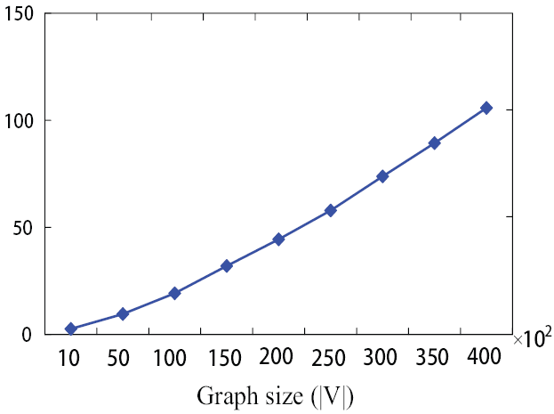
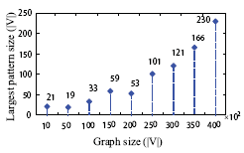
Experiments(I) --- Random Network
Further increasing input graph size to 40000

Slide 22
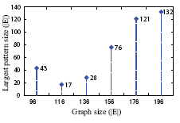
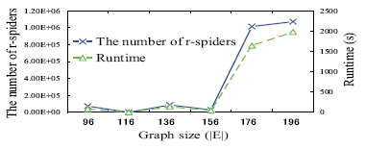
Experiments(II) --- Scale-free Network
Barabasi-Albert Model
Generate graphs with power law degree distribution

Slide 23
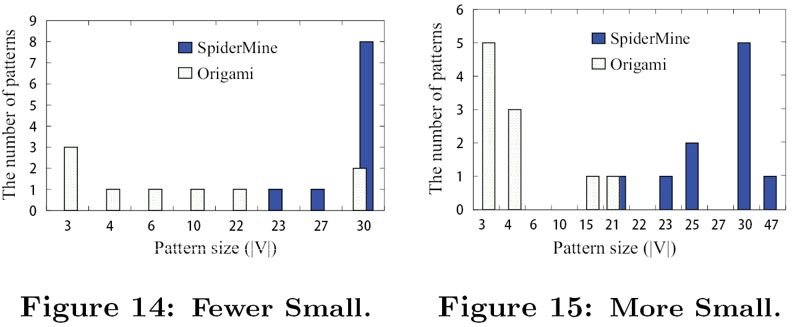
Experiments(III) --- Graph-transactions
Comparison with ORIGAMI with varied distribution of large and small patterns.

Slide 24
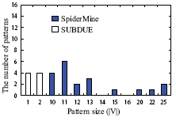
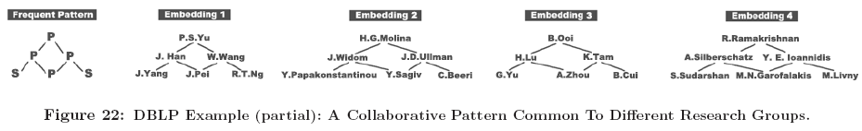
Experiments(IV) --- DBLP data
15071 authors in DB/DM
Label authors by # of papers
Prolific (P): >= 50 papers
Senior (S): 20~49 papers
Junior (J): 10 ~ 19 papers
Beginner(B): 5~9 papers
6508 authors, 24402 edges

Slide 25
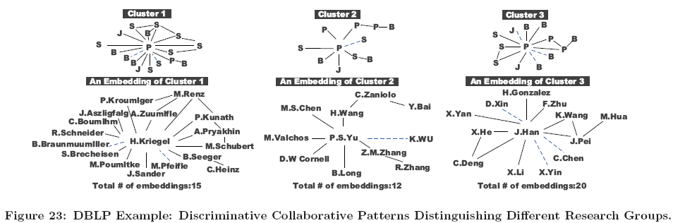
Experiments(IV) --- DBLP data

Slide 26
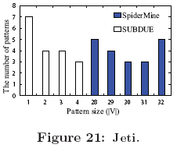
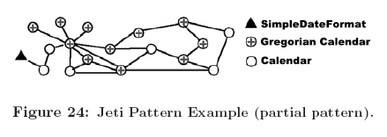
Experiments(V) --- Jeti data
Jeti, a popular full featured open source instant messaging application.
49,000 lines of code and comments.
835 nodes, 1754 edges and 267 labels.

Slide 27
Conclusion
We propose a novel probabilistic algorithm, SpiderMine, for top-K large pattern mining from a single graph with user-defined error bound.
We propose a new concept of r-spider, which reduces both the complexity in pattern growth and the cost of graph isomorphism checking.
Extensive experiments on both synthetic and real data demonstrate the effectiveness and efficiency of SpiderMine.

Slide 28
Future Work
Improve the mining algorithm further
Remove the constraint on D_{max}
Design algorithms tailored for patterns with long diameter
Applications of mined large patterns in various domains
Social network mining
Software engineering
Bioinformatics
Etc.

Slide 29
Thank You
Questions, Comments, Advice ?
Mining Top-K Large Structural Patterns in a Massive Network
Notes:
8/30/2011

