Slide 1
On Querying Historical Evolving Graph Sequences
Chenghui Ren$, Eric Lo*, Ben Kao$, Xinjie Zhu$, Reynold Cheng$
$The University of Hong Kong
${chren, kao, xjzhu, ckcheng}@cs.hku.hk
* Hong Kong Polytechnic University
*ericlo@comp.polyu.edu.hk

Slide 2
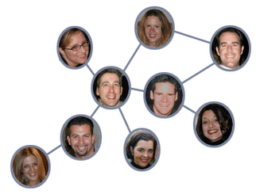
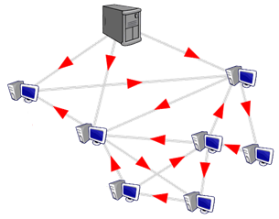
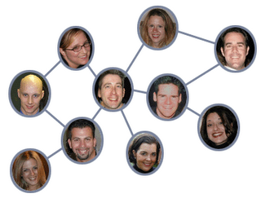
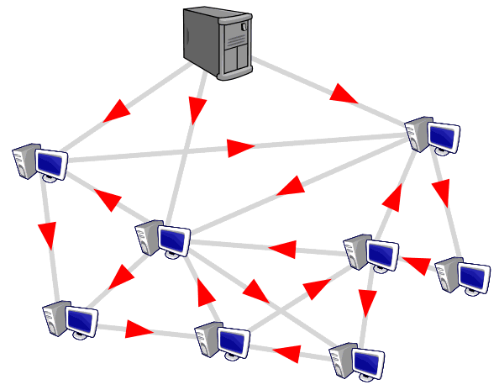
Motivation
Graphs are widely used to model the world
…
The world is ever changing/Graphs evolve with time
…

Slide 3
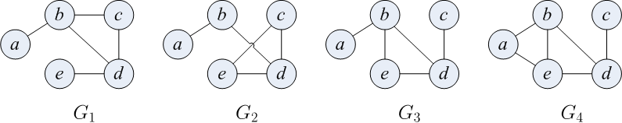
Motivation
…
Evolving Graph Sequence (EGS)
How does the importance of a vertex change?
  E.g. closeness centrality

Slide 4
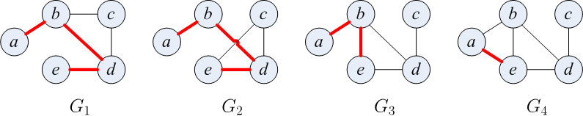
Motivation
…
Evolving Graph Sequence (EGS)
How does the shortest path between a and e change?
…

Slide 5
Example Study on Facebook EGS
Shortest Path Query
The shortest path distances between two particular Facebook users over one year period (365 snapshots)
Key moments:
Their distance changed
How did they get closer?

Slide 6
Problem Definition
…
Evolving Graph Sequence (EGS)
Problem: Given a query (e.g., shortest path between a and e), find the solution for each snapshot in the EGS:
…

Slide 7
Issues of Querying EGS
We are interested in the EGSs such that the snapshot graphs are:
Large
Numerous
Gradually evolving
Example: Facebook EGS
a) 60,000 vertices, 900,000 edges
b) 365 snapshots
c) 99%+ edges in common
We need:
Efficient algorithm to process queries on EGSs
Effective storage models to store EGSs

Slide 8
Outline
Introduction
Solution framework
Storage models
Experimental evaluation
Conclusions

Slide 9
Baseline Algorithm
Baseline algorithm: run a traditional algorithm directly on each snapshot in an EGS
  E.g., breadth-first-search for shortest path query
  Not efficient
    Graphs in an EGS are usually large and numerous
Our goal: Exploit graph redundancies in an EGS to make query processing faster

Slide 10
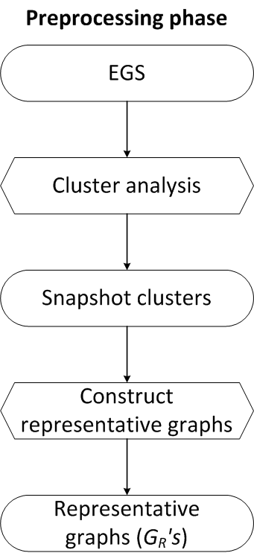
Find-Verify-Fix (FVF) Framework
An EGS
Notes:
Brief description of FVF framework

Slide 11
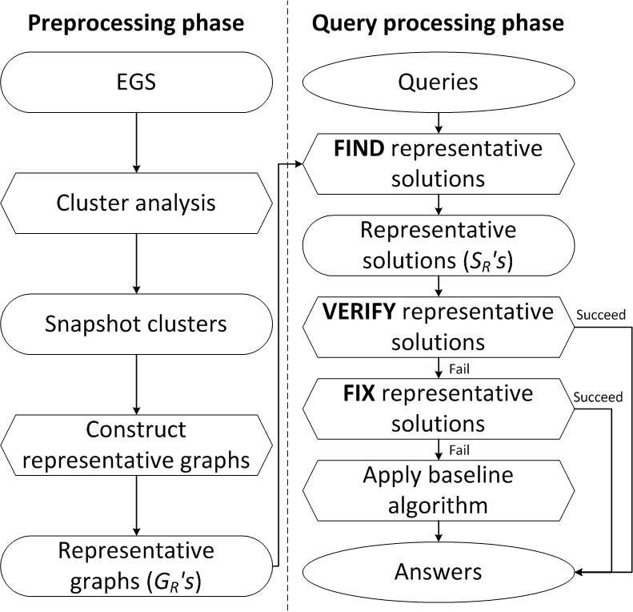
Find-Verify-Fix (FVF) Framework
√
√
√
√
Notes:
We call it V step. Baseline algorithm: give an example, like BFS, Dijkstra

Slide 12
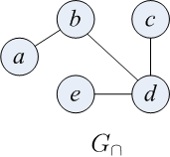
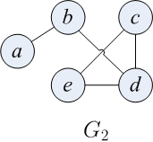
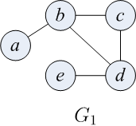
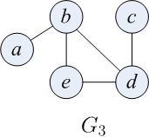
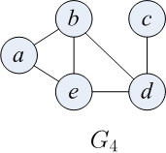
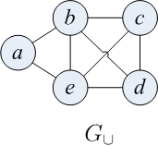
Preprocessing:
Construct Representative Graphs

Slide 13
Preprocessing: Cluster Analysis
EGS
Segmentation clustering algorithm:
A cluster consists of successive snapshots
A cluster satisfies:

Slide 14
Query Processing Phase
Type of queries we use FVF to solve:
  Shortest path
  Closeness centrality
  Graph diameter

Slide 15
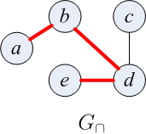
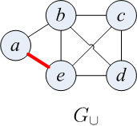
Shortest Path Query Processing
FIND Representative Solutions

Slide 16
Shortest Path Query Processing
VERIFY Representative Solutions
Bounding property:
Notes:
Objective first: Pruning baseline executions

Slide 17
Shortest Path Query Processing
VERIFY Representative Solutions
×
×
√
×

Slide 18
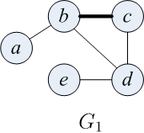
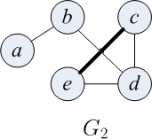
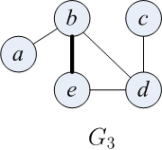
Shortest Path Query Processing
VERIFY Representative Solutions
√
√
×
Notes:
Explanation of Delta set

Slide 19
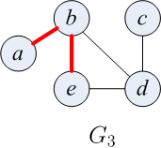
Shortest Path Query Processing
FIX Representative Solutions

Slide 20
Outline
Introduction
Solution framework
Storage models
Experimental evaluation
Conclusions

Slide 21
EGS Storage Models
Wikipedia dataset (365 snapshots, >1M articles, >20M hyperlinks)
Space cost: more than 365X20M = 7.3billion hyperlinks!!!
Aims of storage models:
1) Compress data to fit in memory
2) Support the application of the FVF algorithm framework
Effectiveness of our storage models:
50M hyperlinks for the baseline algorithm,
100M hyperlinks for the FVF algorithm,
compared to 7.3 billion hyperlinks without compression!!!
Notes:
engineered

Slide 22
Experimental Evaluation
Datasets
  Real datasets
    Facebook-friendship
    YouTube
    Wikipedia
  Synthetic datasets
FVF VS Baseline
  Baseline: Execute a graph algorithm on each snapshot independently
Settings
  C++, Linux, CPU: 2.83GHz Dual Core, Memory: 4G

Slide 23
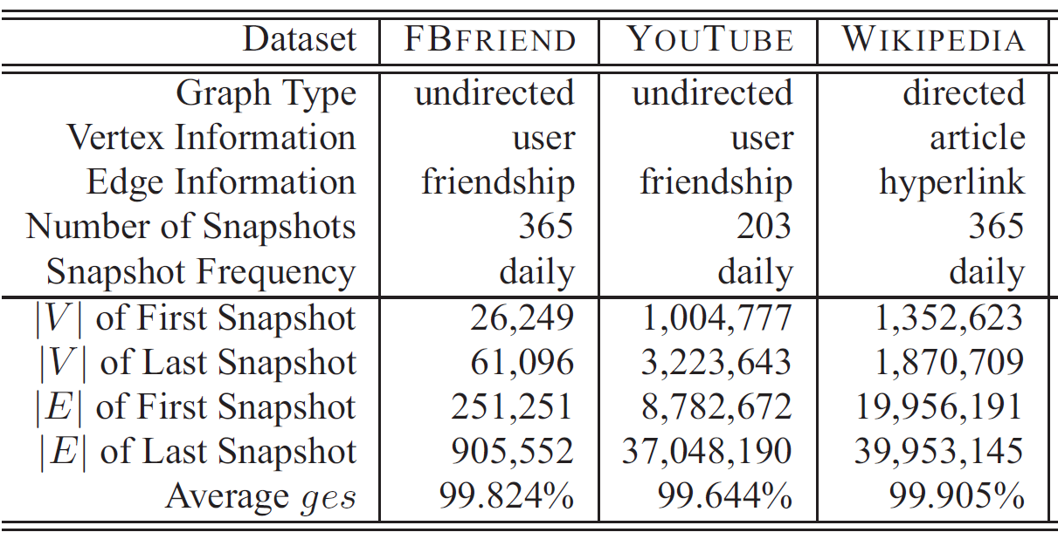
Experimental Evaluation
Dataset statistics
Average graph edit similarity (ges) between successive snapshots

Slide 24
Experimental Evaluation-
Shortest Path Queries
500 queries

Slide 25
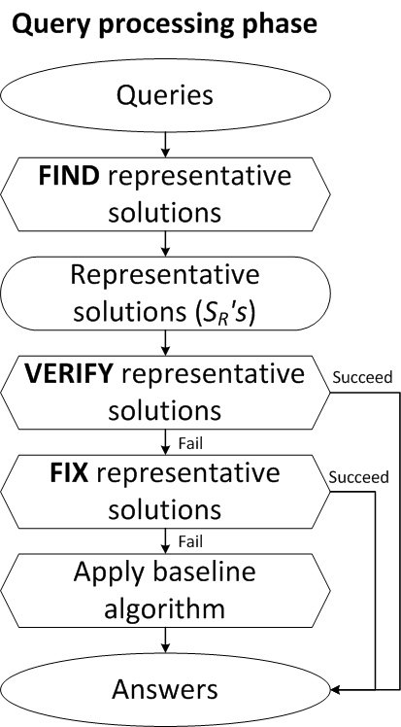
Experimental Evaluation-
Shortest Path Queries
A cluster satisfies:
Fewer graphs in a cluster
More clusters
Find Time
VF-Time
Residual-SPA Time
FBFriend dataset
Notes:
Given G_cap, G_cup of a cluster

Slide 26
Experimental Evaluation-
Shortest Path Queries
Fewer graphs in a cluster
More clusters
FBFriend dataset
Notes:
Line marked with triangle…

Slide 27
Experimental Evaluation-
Shortest Path Queries
Fewer graphs in a cluster
More clusters
FBFriend dataset
Notes:
Stringint

Slide 28
Experimental Evaluation-
Shortest Path Queries
FBFriend dataset
Notes:
Optimal alpha

Slide 29
Experimental Evaluation-
Closeness Centrality Queries
FBFriend dataset

Slide 30
Conclusions
We proposed the evolving graph sequences to model world evolution
We demonstrated that interesting information can be obtained by posing queries on the various EGSs
We introduced the find-verify-fix (FVF) framework to query EGSs
We discussed how to store EGSs
Experiments showed that our FVF framework is efficient and interesting information can be unveiled

Slide 31
Thank you!
Chenghui Ren$, Eric Lo*, Ben Kao$, Xinjie Zhu$, Reynold Cheng$
$The University of Hong Kong
${chren, kao, xjzhu, ckcheng}@cs.hku.hk
* The Hong Kong Polytechnic University
*ericlo@comp.polyu.edu.hk

Slide 32
Related Work
Distance-based queries on a single large graph [F. Wei 2010, Y.Xiao 2009]
  Our work focuses on processing queries on an evolving graph sequence
Graph database [D. Shasha 2002, X.Yan 2005]
  Different: Their work usually only support graph queries (e.g. sub/super-graph query)
  Similar: Both target to minimize the number of expensive graph operations
Time-dependent graph [B. Ding 2008]
  Our work is different in two ways:
    Node set is not fixed
    Find answers on all snapshots

