Slide 1

CRIUS: User-Friendly Database Design
Li (Eric) Qian, Kristen LeFevre, H. V. Jagadish
University of Michigan, Ann Arbor

Slide 2
Outline
Motivation
Interface
Algebra
Guidance Feature
Storage
Evaluation

Slide 3



Motivation
Non-technical people directly exposed to data.
Hard to design a schema in advance.
Start with a simple structure and grow it as needed.
We call this process organic schema evolution
Notes:
Non-technical people are increasingly discovering the necessity of storing, managing, accessing and manipulating electronic data.
They find it difficult to design a schema in advance, taking into account all the considerations of good database design.
Rather, they start with a simple structure that captures the data initially at hand, and then modify this as new data elements are added that do not fit the existing structure.
We call this process organic schema evolution
To support this, our system must render schema evolution easy and cheap.

Slide 4
Motivation Cont’d
While users have the freedom of organically growing their schema, the data is now subject to denormalization.
Consequently, users have to explicitly deal with duplicated data entries, which may produce errors that violate integrity constraints.
Therefore, an organic database system must:
Make it easy for the end user to make schema changes
Guarantee efficient and safe data entry
Implement these features with low cost
Notes:
Denormalization occurs with freely designed schema.
Users may make errors violating integrity constraints.

Slide 5
Challenges
Schema Update Specification
Data Migration
Data Entry
Schema Evolution Performance
Notes:
To specify a hierarchical schema is challenging for end-users.
We design a direct manipulation interface to support schema creation and modification in CRIUS.
Fitting data to a new schema requires complex manipulation.
We design a set of direct manipulation operators which automatically translate semantic changes to underlying manipulation.
Data entry becomes error-prone in our freestyle environment.
We design data entry guidance that auto-completes duplicated values and reacts to possible input errors based on functional dependencies.
Schema Evolution is usually slow.
CRIUS enables efficient evolution by vertical partitioning.

Slide 6
Outline
Motivation
Interface
Algebra
Guidance Feature
Storage
Evaluation

Slide 7
Spreadsheet?
Flat spreadsheets
v.s. Hierarchical semantics
Name | City | Address
Mary | Chicago | 2364 Bishop
Keith | Ann Arbor | 101 Plymouth
Name | City | Address
Keith | Ann Arbor | 202 Main
ID | Address
1 | 2364 Bishop
2 | 101 Plymouth
2 | 202 Main
ID | Name | City
1 | Mary | Chicago
2 | Keith | Ann Arbor
Person
Address
Notes:
hard to deal with hierarchical data in flat spreadsheets because of denormalization.
Nomalizing spreadsheets causes two problems:
Manual ID linking
Cross-table schema evolution specification

Slide 8
How to support hierarchical semantics?
We permit nesting!
Name | City | [Address]
 |  | Address
Mary | Chicago | 2364 Bishop
Keith | Ann Arbor | 101 Plymouth
 |  | 202 Main

Slide 9
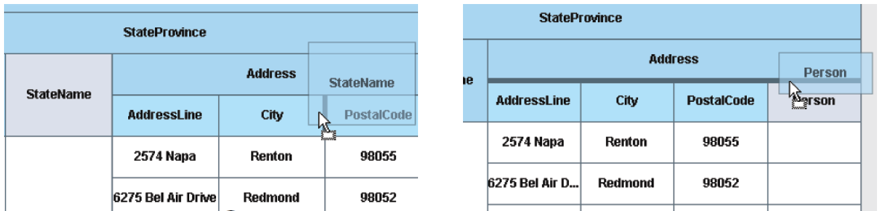
Span Table
Span Table: a next-generation spreadsheet that nests data in a single representation:
schema
data
Specify an evolution by dragging StateName inside Address
Specify an evolution by dragging Person upward.
Notes:
Table header represents the hierarchical schema.
Table body constructs multiple related flat relations into a nested relation according to the schema header.
Users specify schema evolution by directly dragging part of the schema header and drop it on appropriate positions.

Slide 10
Outline
Motivation
Interface
Algebra
Guidance Feature
Storage
Evaluation

Slide 11
Data Migration in Schema Evolution
Data needs to be migrated from the old schema to the new one.
May involve data copy/merge.
Users need to edit in a cell-by-cell manner.
Name | City | Address
Mary | Chicago | 2364 Bishop
Keith | Ann Arbor | 101 Plymouth
Keith | Ann Arbor | 202 Main
Name | City | [Address]
 |  | Address
Mary | Chicago | 2364 Bishop
Keith | Ann Arbor | 101 Plymouth
 |  | 202 Main

Slide 12
Introducing Operators!
Schema restructuring operators:
IMPORT, EXPORT, FLOAT, SINK
Extended spreadsheet operators:
Schema modification: Adding/Dropping Columns
Data manipulation: Inserting/Deleting/Updating Tuples
Collectively, we call this set of operators Span Table Algebra.

Slide 13
Span Table Algebra: Schema Restructuring Operators
Operator | Description
Import(A) | Move A inward into a descendant relation.
Export(A) | Move A outward into an ancestor relation.
Sink(A) | Push A to create a new leaf relation.
Float(A) | Lift A to create a new intermediate level.
Sink(Address)
Import(City)
Export(City)
Name | City | Address
Mary | Chicago | 2364 Bishop
Keith | Ann Arbor | 101 Plymouth
Keith | Ann Arbor | 202 Main
Name | [Address]
 | City | Address
Mary | Chicago | 2364 Bishop
Keith | Ann Arbor | 101 Plymouth
 | Ann Arbor | 202 Main
Name | City | [Address]
 |  | Address
Mary | Chicago | 2364 Bishop
Keith | Ann Arbor | 101 Plymouth
 |  | 202 Main
Name | City | [Address]
 |  | Address
Mary | Chicago | 2364 Bishop
Keith | Ann Arbor | 101 Plymouth
 |  | 202 Main

Slide 14
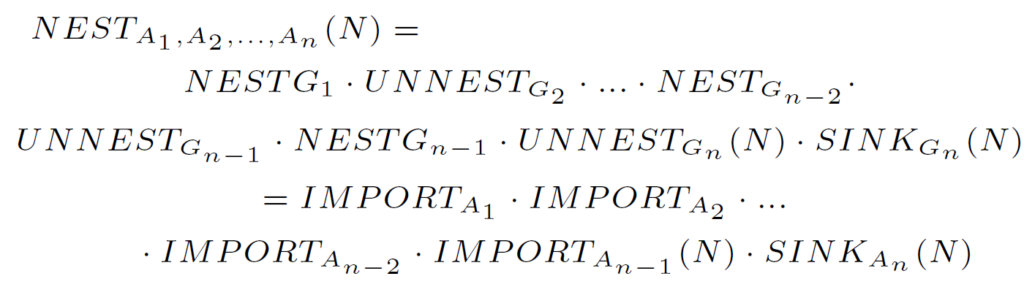
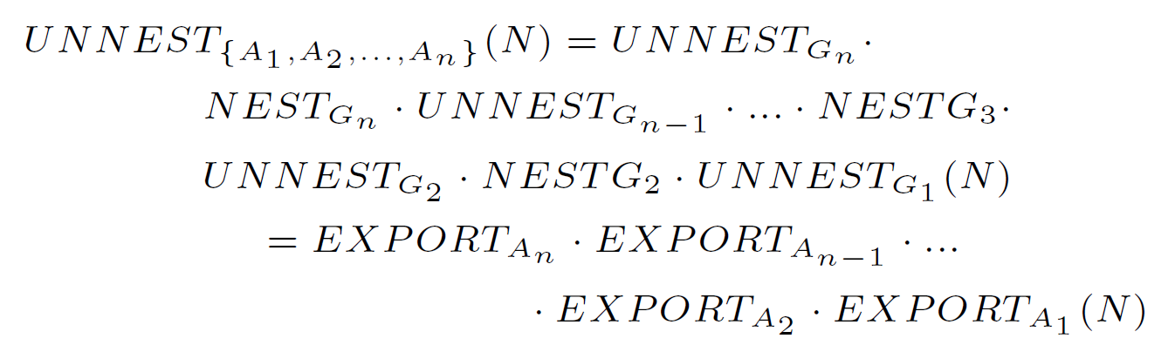
Span Table Algebra: Expressive Power Analysis
Import and Export etc. can be expressed in terms of Nest and Unnest:
Nest and Unnest can be expressed as a sequence of Span Table Operators:
Detailed proofs in paper appendix.

Slide 15
Outline
Motivation
Interface
Algebra
Guidance Feature
Storage
Evaluation

Slide 16
Inevitable Denormalization
Traditional design uses data integrity constraints
We can not do this since we have no pre-defined constraints
Denormalization
A | B | C
a0 | b0 | c0
a0 | b1 | c1
A | B | C
a0 | b0 | c0
a0 | b0 | c1
FD: A → B
Notes:
User don’t know data constraints, not to say how to specify them.
Consequently, denormalization is inevitable.
This is bad because user may easily brake real-life constraints by forgetting update on duplicated entries.

Slide 17
Guide User Data Entry
We maintain a set of “soft” functional dependencies (FDs) to guide user data entry:
Inductive completion
Error prevention
(1) rollback
(2) also update relevant entries to preserve data integrity
(3) force the entry and update the soft FDs.
ID | Name | Course | Grade
1 | Peter | Math | A
2 | Peter | Physics | A
3 | Leo | Math | B
ID | Name | Course | Grade
1 | Peter | Math | A
2 | Peter | Physics | A
3 | Leo | Math | B
 | Leo
ID | Name | Course | Grade
1 | Peter | Math | A
2 | Peter | Physics | A
3 | Leo | Math | B
 | Leo |  | B
ID | Name | Course | Grade
1 | Peter | Math | A
2 | Peter | Physics | A
3 | Leo | Math | B
 | Leo |  | C
ID | Name | Course | Grade
1 | Peter | Math | A
2 | Peter | Physics | A
3 | Leo | Math | C
 | Leo |  | C
ID | Name | Course | Grade
1 | Peter | Math | A
2 | Peter | Physics | A
3 | Leo | Math | B
 | Leo |  | C
FD: Name → Grade
FD: Name, Course → Grade
Notes:
Inductive completion: auto-complete the determined attribute (rhs) of an FD according to newly entered data.
Error prevention: prompt the user for possible data entry errors and react to user decision:

Slide 18
How to Manage FDs?
Frequent data entry
Frequent FD re-induction
Past solution too expensive to be applied
Incremental FD Induction (IFDI):
Induce Initial FDs and maintain important data structures.
Maintain these structures and incrementally re-induce FDs.
We optimize the way to update these structures so that the algorithm is able to respond in real time.
Notes:
Since user update may continuously invalidate induced FDs, we need to frequently update them. Past FD induction solutions are too expensive for frequent update. CRIUS incrementally maintains the soft FDs.

Slide 19
Outline
Motivation
Interface
Algebra
Guidance Feature
Storage
Evaluation

Slide 20
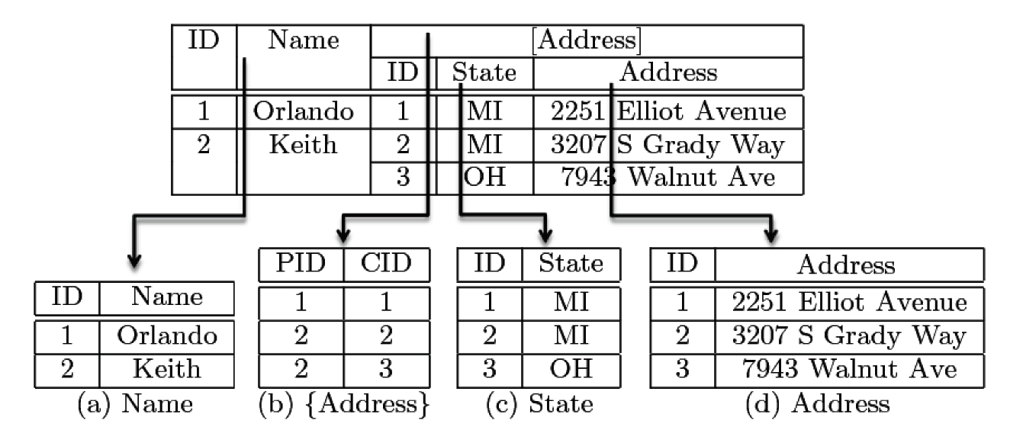
Vertical Partitioning
Span tables are vertically partitioned and stored in relational databases.
Connecting span table to underlying storage:
Upward mapping
Downward mapping
Notes:
Upward mapping constructs span table from underlying relations.
Downward mapping translates span table algebra to relational executions.

Slide 21
Outline
Motivation
Interface
Algebra
Guidance Feature
Storage
Evaluation

Slide 22
Evaluation:
Our experiments are designed to answer four questions:
Span Table usability
Guidance feature usability
IFDI efficiency
Storage performance

Slide 23
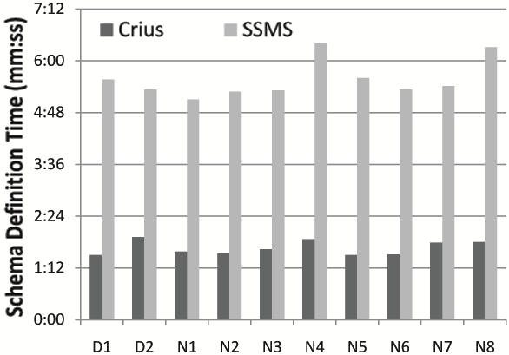
Evaluation: User Study on Schema Operations
Tasks:
Schema Design: Create the schema for an address book.
Schema Update: Move an attribute from one relation to another in a gene database.
Measure:
Time to complete each task.
Compared against SSMS (MS SQL Server Management Studio 2008).
All users failed in this task using SSMS since they were unable to migrate the data manually. In contrast, all of them were able to complete the task within seconds with CRIUS.
Schema Design
Schema Update
Notes:
Schema update task: measure time to move an attribute in an in-use gene database with CRIUS and SSMS.
All users failed in this task using SSMS since they were unable to migrate the data manually. In contrast, all of them were able to complete the task within seconds with CRIUS.

Slide 24
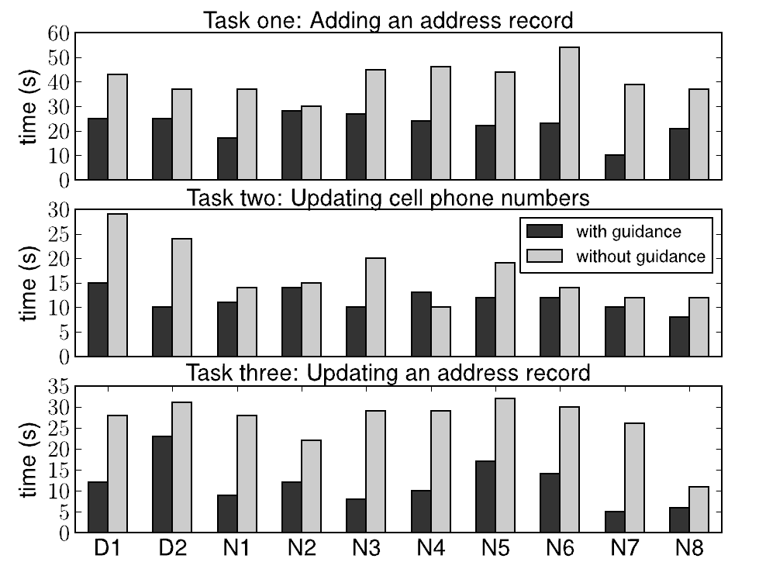
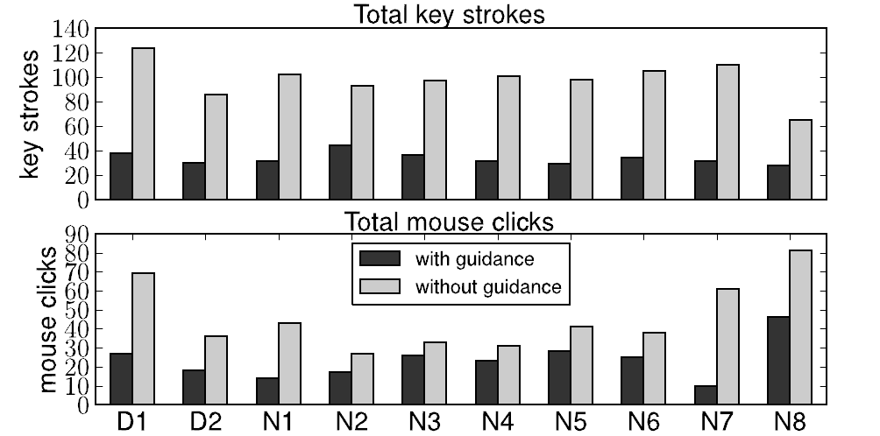
Evaluation: User study on Integrity-Based Guidance
The three tasks:
Insert a new contact and his address into the address book.
Update the cell phone number of one contact.
Update the address of one contact to the address of another contact.
Measure:
time to complete each task, and
overall count of key strokes/mouse clicks.
Compare with and without the guidance feature on.

Slide 25
Conclusion
The design and implementation of CRIUS
Span table algebra
Integrity-based guidance based on IFDI
Storage
Evaluation
Notes:
We described the design and implementation of CRIUS, a system that allows non-technical users to develop and evolve schemas for their data, within the familiar context of a spreadsheet-style interface and data model.
We proposed a novel span table algebra that offers abundant usability and has the same expressive power as nested relational algebra.
We introduced the first algorithm for incrementally updating FDs and investigated its usage in guiding user data entry in CRIUS’s freestyle environment.
We introduced a storage strategy which vertically partitions span table into underlying flat relational tables, which enables efficient schema update operator execution and data display.
We evaluated the various aspects of the CRIUS implementation via both user studies and performance experiments, showing that CRIUS does provides user-friendly database design.

Slide 26
?
?
Questions

Slide 27
IFDI: Inducing Initial FDs
ID | Name | Course | Grade
1 | Peter | Math | A
2 | Peter | Physics | A
3 | Leo | Math | B
4 | Leo | Physics | B
5 | Jack | Math | A
Attribute Lattice:
{(1,2), (3,4)}
{(1,3,5), (2,4)}
{(1,2,5), (3,4)}
N
C
G
Attribute Partitions:
P_{N} = {(1,2), (3,4), (5)}
P_{C} = {(1,3,5), (2,4)}
P_{G} = {(1,2,5), (3,4)}
P_{NC} = {(1), (2), (3), (4), (5)}
P_{NG} = {(1,2), (3,4), (5)}
P_{CG} = {(1,5), (2), (3), (4)}
P_{NCG} = {(1), (2), (3), (4), (5)}
{}
{(1,2), (3,4)}
{(1,5)}
NC
NG
CG
{}
P_{XUY} = P_{X} · P_{Y}
NCG
X → Y iff P_{X} = P_{XUY}
N → G since P_{N} = P_{NG}
NC → G since P_{NC} = P_{NCG} (dominated by the above)

Slide 28
IFDI: Maintaining FDs on Value Update
Attribute Lattice:
ID | Name | Course | Grade
1 | Peter | Math | A
2 | Peter | Physics | A→B
3 | Leo | Math | B
4 | Leo | Physics | B
5 | Jack | Math | A
{(1,2), (3,4)}
{(1,3,5), (2,4)}
{(1,2,5), (3,4)}
N
C
G
↑
{(1,5), (2,3,4)}
{}
{(1,5)}
Attribute Partitions:
P_{N} = {(1,2), (3,4), (5)}
P_{C} = {(1,3,5), (2,4)}
P_{G} = {(1,2,5), (3,4)} → P_{G} = {(1,5), (2,3,4)}
P_{NC} = {(1), (2), (3), (4), (5)}
P_{NG} = {(1,2), (3,4), (5)} → P_{NG} = {(1), (2), (3,4), (5)}
P_{CG} = {(1,5), (2), (3), (4)} → P_{CG} = {(1,5), (2, 4), (3)}
P_{NCG} = {(1), (2), (3), (4), (5)} → P_{NCG} = {(1), (2), (3), (4), (5)}
Attribute Partitions:
P_{G} = {(1,2,5), (3,4)}
P_{NG} = {(1,2), (3,4), (5)}
P_{CG} = {(1,5), (2), (3), (4)}
P_{NCG} = {(1), (2), (3), (4), (5)}
P_{G} = {(1,5), (2,3,4)}
P_{NG} = {(1), (2), (3,4), (5)}
P_{CG} = {(1,5), (2, 4), (3)}
P_{NCG} = {(1), (2), (3), (4), (5)}
NC
NG
CG
↑
{(1,2), (3,4)}
{(1,5), (2,4)}
↑
{(3,4)}
{}
↑
NCG
{}
Only visit half of the lattice nodes!
X → Y iff P_{X} = P_{XUY}
N → G no longer holds since P_{N} ≠ P_{NG}
NC → G since P_{NC} = P_{NCG}

Slide 29
IFDI: Maintaining FDs on Value Update Cont’d
How do we efficiently update attribute partitions?
P_{CG} = {(1,5), (2), (3), (4)} → P_{CG} = {(1,5), (2, 4), (3)} when tuple 2 is updated.
Naively re-computing product:
Incrementally update product:
P_{CG} = P_{C} · P_{G}
P’_{CG} = Update (P_{CG} , P_{C} , P’_{G} , tid)
P_{C} = {(1,3,5), (2,4)}
P_{CG} = {(1,5), (2), (3), (4)}
tid = 2
P_{G} = {(1,2,5), (3,4)}
P_{G} = {(1,2,5), (3,4)}
P_{G} = {(1,2,5), (3,4)}
P_{C} = {(1,3,5), (2,4)}
P_{C} = {(1,3,5), (2,4)}
S₁ = {1,5}
S₂ = {2}
S₁ = {3}
S₂ = {4}
S₁ = {}
S₂ = {}
P’_{G} = {(1,5), (2,3,4)}
P’_{G} = {(1,5), (2,3,4)}
1) Remove tuple from the old group:
P_{CG} = {(1,5), (2)}
P_{CG} = {(1,5), (2), (3), (4)}
P_{CG} = {}
2) Add tuple to the new group:
P’_{CG} = {(1,5), (2, 4), (3)}
P’_{CG} = {(1,5), (3), (4)}
P’_{CG} = {(1,5), (2), (3), (4)}
P’_{CG} = P_{C} · P’_{G}
P’_{CG} = {(1,5), (3), (4)}
P_{C} = {(1,3,5), (2,4)}
P’_{G} = {(1,5), (2,3,4)}
P’_{CG} = {(1,5), (2, 4), (3)}

Slide 30
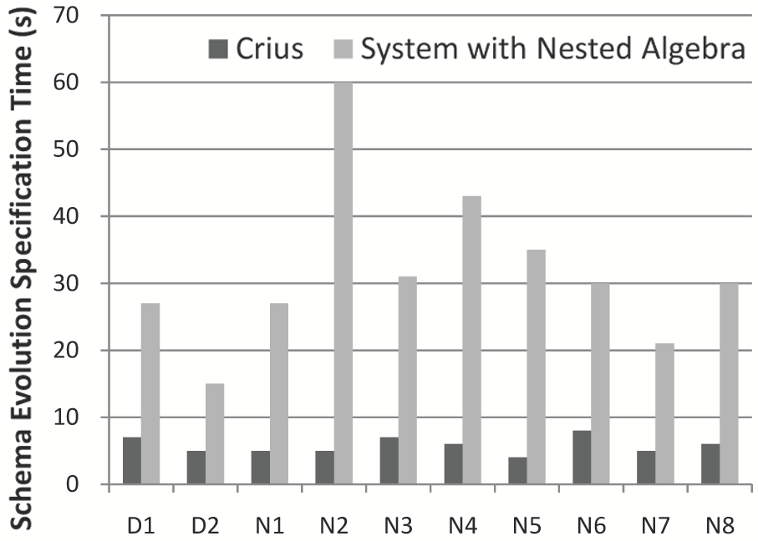
Evaluation: User Study on Schema Operations Cont’d
Task:
move an attribute across relations in a gene database (the same as before).
Measure:
time to complete the task.
Compare CRIUS with a strawman system with only nested relational operators.
Notes:
To gain further insight into the usability of the Span Table Algebra, we measure the time for the same users to perform the same schema update task using CRIUS and a strawman system with only operators in nested relational algebra:

Slide 31
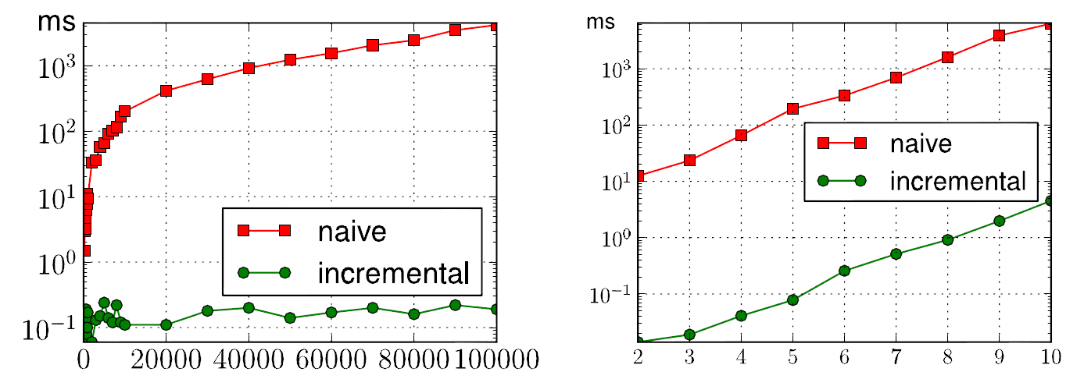
Evaluation: Performance of IFDI
Task:
Re-generate the minimal FDs on value update.
Measure:
The time to complete the task.
Compare IFDI with the naive algorithm.
a five-column table with varying row size
a ten-thousand-row table with varying column size.
Notes:
simulated incremental update environment to compare a naive approach, which recalculates the FDs for each update, and the IFDI algorithm
Average time generating new FDs using the naive approach and IFDI, for (a) a five-column table with varying row size, and (b) a ten-thousand-row table with varying column size.

Slide 32
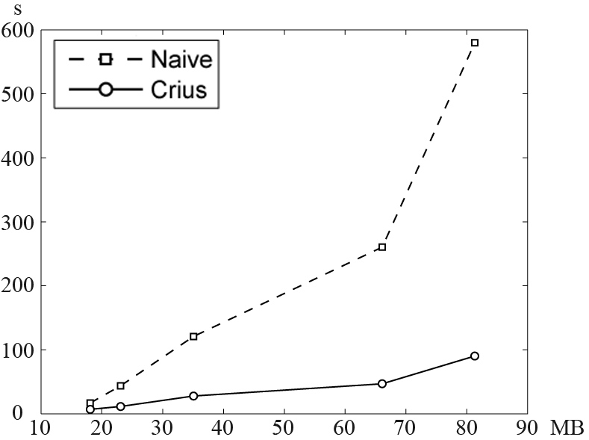
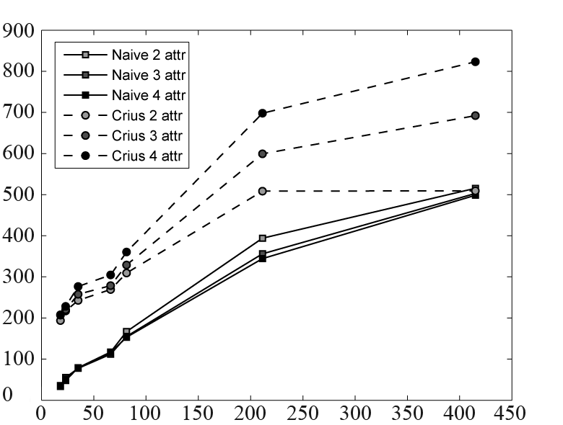
Evaluation: Performance of Vertical Storage
Tasks:
Execute an schema update.
Load data from the relational back-end and construct a span table.
Measure:
Time to complete each task.
Compare CRIUS with the naive storage
ms
MB
Time to move an attribute with varying DB size.
Time to display data with varying DB size.
Notes:
Finally, we compared the performance of the vertically-partitioned storage in CRIUS with a naive approach, which stores tables contiguously using a row-major layout.
Schema Update performance: how efficient is the downward mapping.
Data Display performance: how efficient is the upward mapping.

