Slide 1
Optimizing Probabilistic Query Processing on Continuous Uncertain Data
Liping Peng
Yanlei Diao
Anna Liu
VLDB 2011
Seattle WA, US
Notes:
Hi everyone. I’m Liping. Today i’m going to present our paper Optimizing Probabilistic Query Processing on Continuous Uncertain Data
it’s a joint work with my advisor Yanlei Diao and Anna Liu

Slide 2
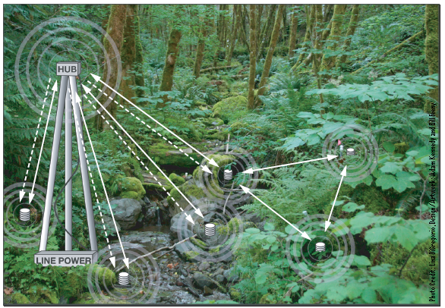
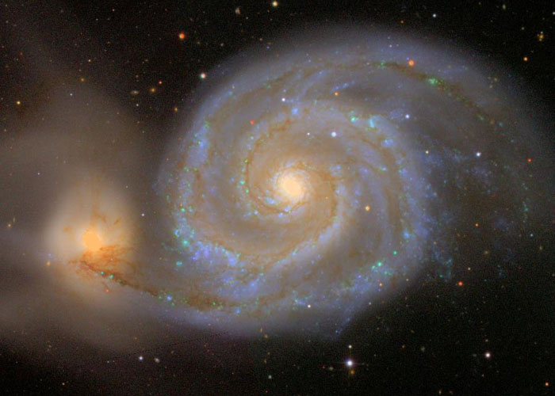
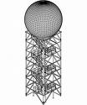
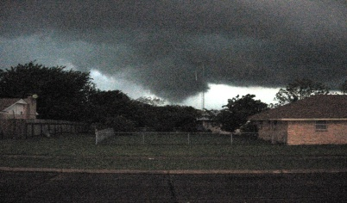
Applications of Uncertain Data Management
TV
Notes:
Uncertain data management is important to a wide range of applications, including traditional applications like information extraction, sensor networks. They are also important to new large-scale scientific applications such as severe weather monitoring, computational astrophysics.
It’s known that almost all scientific data that results from real-world measurements is uncertain. Therefore managing uncertain data is a key component of scientific data management systems.

Slide 3
Motivating Application – Sloan Digital Sky Survey
Q1:
SELECT *
FROM Galaxy AS G
WHERE G.r < 22
AND G.q_r²+G.u_r² > 0.25
name | type | description
OBJ_ID | bigint | SDSS identifier
… | …
(rowc, rowc_err) | real | (row center position, error term)
(colc, colc_err) | real | (column center position, error term)
(q_u, qErr_u) | real | (stokes Q parameter, error term)
(u_u, uErr_u) | real | (stokes U parameter, error term)
(ra, dec, ra_err, dec_err, ra_dec_corr) | real | (right ascension, declination, error in ra, error in dec, ra/dec correlation)
… | …
Q2:
SELECT *
FROM Galaxy AS G1, Galaxy AS G2
WHERE G1.OBJ_ID < G2.OBJ_ID
AND |(G1.u-G1.g)-(G2.u-G2.g)| < 0.05
AND |(G1.g-G1.r)-(G2.g-G2.r)| < 0.05
AND (G1.rowc-G2.rowc)²+
(G1.colc-G2.colc)² < 1E4
Continuous uncertain data
Complex selection and join predicates
Return answers of high confidence efficiently
Notes:
-specifically motivated by the Sloan Digital Sky Survey.
-partial schema of Galaxy, 297, 151, modeled by continuous random variables.
-In SDSS, each query can have an arbitrary mix of complex selection and join predicates. Let’s look at two sample queries from the SDSS benchmark. They have predicates on multiple uncertain attributes, written in a linear form [two in Q2] or in a quadratic form [one from Q1 and one in Q2].
-Given uncertainty of input data, many answers are possible, but the user would want to retrieve query answers of high confidence. So the system should be able to compute the answers of high confidence efficiently.

Slide 4
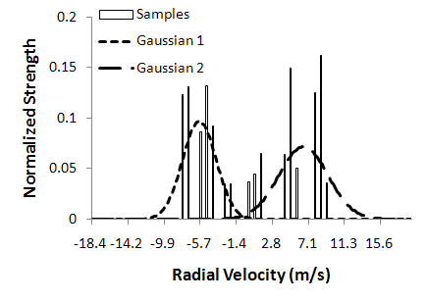
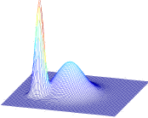
Previously Proposed Data Model
Gaussian Mixture Models (GMMs) for continuous uncertain attributes
Flexible
Succinct
Computation efficiency
Object_ID | Speed | X | Y
MA123456
TEP
Tuple model
0.7
[Tran et al. PODS: A New Model and Processing Algorithms for Uncertain Data Streams. SIGMOD 2010
Tran et al. Conditioning and Aggregating Uncertain Data Streams: Going Beyond Expectations. PVLDB 2010]
Notes:
First let me introduce the data model proposed in our previous work quickly. For continuous uncertain attributes, we use GMMs. A GMM is a convex combination of Gaussian distributions.
This example shows a distribution of velocity at the boundary between a positive velocity area and a negative velocity area in a tornado. The distribution has two Gaussian components, with mean -6 and 6, variances 4 and 8, respectively. and the velocity follows the each component with probability 0.5
We adopt GMMs for several reasons. First, it’s flexible. A Theoretical result shows that a GMM can approximate any continuous distribution arbitrarily well.
Second, it offers a parametric representation. Tuple only need to carry parameters, not samples
And most importantly, it allows efficient computation of relational operators, as we have shown in previous work
Now let me introduce the model for the entire tuple. A tuple can have multiple attributes, each can be either deterministic or uncertain.
Example: ID-deterministic, speed is independent of other attributes, so use a 1-dim GMM to represent its distribution. X and Y are correlated, so use a 2-dim GMM to represent the joint distribution.
Optionally it can have TEP as an attribute, ranging from 0 to 1. For the details of this model, see our paper in SIGMOD 2010 and PVLDB 2010

Slide 5
Scope of Problem
Probabilistic threshold query processing and optimization
Avoid expensive operations for non-viable tuples
Find efficient plans based on predicates and distributions
id
r
TEP
Results with tuple existence probability (TEP) >λ
1
0.8
2
0.5
Select-Project-Join (SPJ) queries with threshold λ
SELECT *
FROM Galaxy AS G
WHERE G.r > 22
(λ=0.7)
id
r
TEP
Continuous uncertain data
Gaussian Mixture Models (GMMs)
1
1
2
1
Notes:
Now let me give the problem definition. In this work, we specifically focus on the probabilistic threshold queries processing and optimization as explained in the following.
We take continuous uncertain data modeled by GMMs, run SPJ queries on them. in addition we take a threshold \lambda as the input, and we only retain results with TEP>\lambda
Here is an example: there are two tuples, each initially has existence probability 1. We run a simple query with probability threshold \lambda=0.7. After running the query, the existence probability of the 1st tuple is 0.75, so we keep it in the final result; the existence probability for the 2nd tuple is 0.5, so we drop it.
Our goal is to avoid expensive operations for non-viable tuples and also to find efficient query plans based on both predicates and distributions.

Slide 6
Outline
Motivation
Optimize Probabilistic Threshold Selections
Optimize Probabilistic Threshold Joins
Per-tuple Based Planning and Execution
Evaluation
Notes:
first let’s take a look at the optimization of probabilistic threshold joins

Slide 7
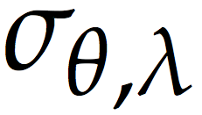
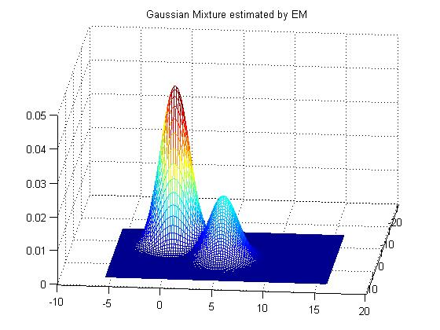
Probabilistic Threshold Selections
SELECT *
FROM Galaxy AS G
WHERE G.q_r²+G.u_r² < 0.25
Selection condition θ
u_r
Continuous uncertain attributes:
Selection region R_{θ}
S={q_r, u_r}
q_r
f
Given a tuple with distribution f, the probability to satisfy θ:
q_r
u_r
>
Return tuples with TEP>0.8 (λ)
Notes:
Now let me define a probabilistic threshold selection.
1: The example query has one selection predicate. We call it the selection condition \theta
2: in the 2-dim space (q_r, u_r) the condition defines a selection region, we call it R_\theta. In this example, it is a circle.
3: Given a tuple with a distribution, the probability for the tuple to satisfy selection condition \theta is the integration of the distribution f over the selection region R_\theta.
4: Finally we need to compare the probability with the threshold \lambda to only keep results with TEP at least \lambda

Slide 8
Probabilistic Threshold Selections
Q2:
SELECT * FROM Galaxy AS G1, Galaxy AS G2
WHERE G1.OBJ_ID < G2.OBJ_ID
AND |(G1.u-G1.g)-(G2.u-G2.g)| < 0.05
AND |(G1.g-G1.r)-(G2.g-G2.r)| < 0.05
AND (G1.rowc-G2.rowc)²+(G1.colc-G2.colc)² < 1E4
Selection condition θ
Continuous uncertain attributes:
S={G1.u, G1.g, G1.r, G1.rowc, G1.colc,
G2.u, G2.g, G2.r, G2.rowc, G2.colc}
Selection region R_{θ}
Given a tuple with distribution f, the probability to satisfy θ:
>
Return tuples with TEP>0.8 (λ)
A high-dimensional integral for each tuple!
Notes:
Now let’s see a more complex query. Q2 is a self join of the Galaxy table. Assume the cross-product has been performed already.
There are three predicates on uncertain attributes. They collectively form the selection condition \theta and define a selection region R_\theta in a 10-dim space. So now the integral needs to take place in a 10-dim domain.
For each tuple, we need to compute a high-dimensional integral. This is highly expensive.

Slide 9
Applying Fast Filters to Avoid Integrals
Derive an upper bound (Ũ) for the integral at a low cost
If Ũ<λ, filter tuples without computing integrals
Otherwise, still integrate to compute the true probability
A general approach to derive an upper bound
Given a tuple X, define a (multi-dim) Chebyshev region
Test the overlap of R_{λ}(X) with predicate region R_{θ}
If R_{λ}(X) and R_{θ} are disjoint, filter the tuple
R_{λ}(X)
u
0.2
R_{θ}
g
-0.2
0.2
A geometric intersection problem
Constrained optimization generally. Can use techniques like Lagrange multiplier
-0.2
|u|<0.2 and |g|<0.2
Fast filters for common predicates
Notes:
0: Even with linear transformation, we still need to compute one integral for each tuple. In order to avoid integrals, we propose a filter operator. It finds an upper bound of the true probability that a tuple satisfies the selection condition. If the upper bound is less than the threshold, we could filter the tuple without computing integrals. Otherwise, we still have to use integrals to compute the true probability.
1: We first propose a general approach to find an upper bound
2: Given a tuple X, we define a multi-dim Chebyshev region that covers probability mass at least 1-λ by using multi-dimensional Chebyshev’s inequality. In other words, the probability mass outside the Chebyshev region is less than \lambda. The Chebyshev region is an ellipse centered at \mu. And in this example the predicate region R\theta is the grey square.
3: Next we only need to test the overlap of the Chebyshev region with the predicate region. If they are disjoint, the probability mass in the predicate region is guaranteed be be less than \lambda, so we can filter the tuple.
4: The test of overlap amounts to a geometric intersection problem. It is generally a constrained optimization problem, which we can solve efficiently using techniques like Lagrange multiplier for many common cases in our target applications.
5 We also devise fast filters for simpler predicates. More details are in our paper.

Slide 10
Reducing Dimensionality of Integration
Linear transformation (LT):
Let X_{n}~N(μ,Σ) and Y=B_{m×n}X+b_{m×1} then Y_{m}~N(Bμ+b,BΣB^{T})
σ_{θ} : n-dim space
region: R_{θ}
distribution: f_{X}(x)
integral:
Y=BX+b
σ_{θ’} : m-dim space
region: R’_{θ} = {y|y=Bx+b, x R_{θ}}
distribution: f_{Y}(y)
integral:
An algorithm to find a transformation matrix B_{m×n}
m≤n
if m<n, LT helps to reduce dimensionality
if m=n, LT does not help
Notes:
When a tuple passes the fast filters, we still needs to compute the true probability using integrals to remove the false positives. In order to expedite the integration, our idea is to reduce its dimensionality using linear transformation.
Linear transformation basically says that given a vector X that follows a multivariate Gaussian and Y is a linear transformation of X, then Y also follows a multivariate Gaussian. We can simply extend this result to a GMM
1: To apply the above result, given a selection region R_\theta and a distribution f_X defined in an n-dim space, after applying linear transformation, we get a new selection region and a new distribution in the m-dim space. So the integral is transformed from an n-dim one to an m-dim one.
2: In our paper, we have a full algorithm to find a transformation matrix and let me summarize the results: the probabilities before and after the transformation are equal, which means we can still get a correct value for the integral, and
m<n, we can reduce the dimensionality of integration
We next show how to find such a transformation matrix

Slide 11
Outline
Motivation
Optimize Probabilistic Threshold Selections
Optimize Probabilistic Threshold Joins
Per-tuple Based Planning and Execution
Evaluation
Notes:
Next let’s move on to the optimization of probabilistic threshold joins

Slide 12
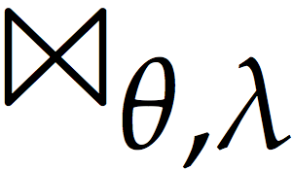
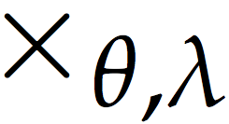
Probabilistic Threshold Joins
A probabilistic threshold join of relations R and S is:
True match: tuple pair (r,s) such that
>
Large numbers of intermediate tuples!
Key idea: filtered cross-product using indexes
For each tuple r, the index returns a subset of S to pair with r
(r,s) pairs returned by include all true matches
A necessary condition for
“Tight” enough, a sufficient and necessary condition if possible
>
Notes:
a probabilistic threshold join of relations R and S is defined to be a cross-product followed by a probabilistic threshold selection. The true matches are the tuple pairs (r,s) that satisfy the join condition \theta with probability greater than \lambda.
1: The problem is that the cross-product will generate large numbers of intermediate tuples that maybe filtered later.
2: We introduce a new operator called the filtered cross-product. It uses indexes to filter non-viable tuple pairs early. Assume we build an index on S. For each probing tuple r, the index returns a subset of S to pair with r. And the (r,s) pairs returned by the filtered cross-product include all true matches. After this, we still need to evaluate the selection to filter the false positives.
3: Since the filtered cross-product returns a superset of true matches, we say the tuples it returned satisfy the necessary condition for the true matches. Of course we want it to be “tight” enough to minimize the number of false positives, and a sufficient and necessary condition if possible

Slide 13
Designing an Index
Build an index on S for a<R.A-S.A<b
search key
query region
Deterministic
Instantiate with a deterministic value of R.A
E.g. when R.A=5, 5-b<S.A<5-a
S.A
Probabilistic
A distribution instead of a deterministic value!
A necessary condition for
Instantiate with
quantities concerning R
Quantities concerning S
Notes:
1: let’s consider the join predicate R.A−S.A<δ and assume we build an index on S. The design of the join index needs to answer two questions: (1) what is the search key of the index? (2) given a probing tuple, how do we form a query region over the index?
2: in a traditional database where both R.A and S.A have deterministic values
3: S.A naturally forms the search key of an index such as a B-tree
4: Given an R tuple, the join predicate can be instantiated with a deterministic value of R.A and naturally forms a query region. For example, given R.A=5, the query region is S.A > 5 − δ.
5: Now consider the join in the probabilistic case, where R.A and S.A each follows a distribution.
6: From our previous discussion, in order to build an index for continuous uncertain data, the key is to find a necessary condition
7: When it comes to the index design, the necessary condition has to meet two requirements: (1) the quantities concerning S can be used to form the search key of a common index structure such as an R-tree
8: (2) Given an R tuple, after the necessary condition is instantiated with all the quantities concerning R, it should form a query region that can be easily tested for overlap with the index entries.
I’ll show how to design an index for continuous uncertain data in more details next.

Slide 14
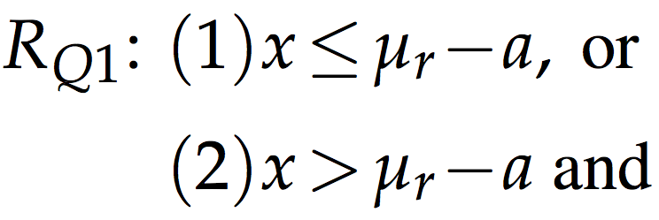
Band Join of GMMs （a<R.A-S.A<b)
r.A: X_{r}, μ_{r}, σ_{r}²
s.A: X_{s}, μ_{s}, σ_{s}²
Necessary condition:
？
➔
R1
R2
x
y
Search key:
Query region:
R3
R4
R5
R6
R7
Theorem 1:
…
Z=X_{r}-X_{s} follows a GMM with
μ_{z}=μ_{r}-μ_{s} and σ_{z}²=σ_{r}²+σ_{s}²
➔
y
Overlap test of R_{Q1} and R_{I} [x₁,x₂;y₁,y₂]: R_{I} overlaps with R_{Q1} if its upper left vertex (x₁,y₂) is in R_{Q1}
x
μ_{r}-a
Notes:
Let’s consider the band join when R.A and S.A follow GMMs. Then r.v.s and their means and variances are shown in the upper right corner.
1: The first question is what is the necessary condition for the true matches of this predicate?
2: In our paper, we provided a theorem which gives the necessary condition for a single variable Z in between a and b with a probability greater than \lambda. The necessary condition is the conjunction of two inequalities.
3: Given Xr and Xs follow GMMs, their difference still follows a GMM and we can get its mean and variance.
4: We plug the expression of the new mean and variance back to the inequalities and then obtain the necessary condition we want.
Next i’ll show you how to use a necessary condition to build an index.
5: In the two inequalities in the necessary condition, μs and σs2 are the quantities from relation S. We use them to form the search key. For each tuple s, we insert the pair (μs, σs2) into an R-tree. The R-tree indexes points in a two-dimensional space in leaf nodes and groups them into minimum bounding rectangles in non-leaf nodes.
6: For each probing tuple r, the query region is naturally formed by instantiating μr and σr2 in the two inequalities. Let’s take the 2nd inequality for example. We can rewrite it by setting x = μs and y = σs2. Then we get a query region.
7: as shown by the shaded area in the right figure.
8: Now given an index entry which is a rectangle, It is not hard to see that an index entry overlaps with the query region if its upper left vertex falls in the query region.
9: if a node in the r-tree doesn’t overlap with the query region, we do not search the subtree rooted at it.
10+11: Otherwise, we need to go down and search its children recursively.
We can rewrite the 1st inequality and develop the test condition in a similar way.

Slide 15
Band Join of Gaussians (a<R.A-S.A<b)
Gaussian properties offer a sufficient and necessary condition
Theorem 2:
Given Z~N(μ,σ²), Pr[a<Z<b] > λ iff there exists an such that
inverse of the standard normal cdf
Z=X_{r}-X_{s}
Search key:
Query region:
y’
x’
Overlap test: Requires math derivation; can be implemented efficiently
Notes:
The previous discussion works for any GMM. Gaussian distributions are a common special case of GMMs. The known Gaussian properties allow us to find a sufficient and necessary condition, so we can design an index with better filtering power.
1: We have another theorem in the paper which gives the sufficient and necessary condition for a normally distributed variable Z in the range of a and b with probability greater than \lambda. The details are in the paper. Let me show you how to use this sufficient and necessary condition to build an index.
2: We derive the search key and query region still by using linear transformation Z=Xr-Xs. We obtain the search key just the same as before. But the query region has a highly complex expression.
3: Then, in order to simplify the overlap test, we apply a one-to-one mapping to both the query region and the index entry and test the overlap in the transformed domain.
4: Here we show the shape of the query region in the transformed domain when \lambda=0.7. In general, \lambda controls the shape and the a and b values determine the stretch along both dimensions.
5: In the transformed domain, the overlap test is efficient but obtained through a complex mathematical analysis. Due to time constraints, interested people are referred to our paper for the details.

Slide 16
Outline
Motivation
Optimize Probabilistic Threshold Selections
Optimize Probabilistic Threshold Joins
Per-tuple Based Planning and Execution
Evaluation
Notes:
Next let’s move on to query planning and execution

Slide 17
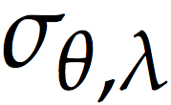
Query Planning
Logical
Operators
Physical
Operators
Faster filters based on inequalities
Filtered cross-product using indexes
Exact selection using integrals (with LT）
How to arrange operators to get an efficient plan ?
Notes:
now we consider the whole select-project-join query with a probability threshold \lambda.
1: We defined two probabilistic threshold operators – selections and joins. Since projections do not change TEP, we will not discuss projections here.
2: Our previous discussion covered three implemented operators: fast filters based on statistical inequalities, the filtered cross product using indexes, the exact selection using integrals possibly with reduced dimensionality.
3: Since both the fast filters and indexes are based on relaxed conditions, they may generate false positives. In order to get the true results, we need to validate the tuples returned by them with exact evaluation of selections.
4: Besides our techniques for joins and selections, there remains a query optimization issue: What is the most efficient way to arrange operators to get an efficient plan?

Slide 18
Per-tuple Based Planning
Consider both selectivity and cost like the traditional planner
Differences
Exact selections are expensive due to the use of integrals
Selectivity should be defined on a per-tuple basis
=> The optimal order varies on a per-tuple basis
Q1: SELECT *
FROM Galaxy
WHERE r < 24
AND q_r²+u_r² > 0.25
Tuple Attributes
id | r | q_r | u_r
1 | N(27, 2.2) | N(1, 2.2) | N(0.1, 1.1)
2 | N(21, 0.1) | N(0, 0.1) | N(-0.1, 0.1)
Predicate Selectivities
θ1
θ1
θ2
θ2
0.08
0.95
1
0.0002
Optimal plan for t1:
θ1
→
θ2
Optimal plan for t2:
θ2
→
θ1
20
24
25
30
Notes:
1: Like in the traditional query optimizer, we consider both the cost and selectivity of operators but with two key differences
2: (1) Exact selections are expensive due to the use of integrals
(2) Selectivity should be defined on a per-tuple basis, and depends on both the predicates and the distribution.
3: Consider Q1 and two tuples t1, t2 from SDSS. Let’s denote the first predicate as \theta_1. it’s defined on the r attribute
4: We show the values on attribute r for both tuples. The red curve is for the 1st tuple, a Gaussian with mean 27 and standard deviation 2.2. The blue curve is for the 2nd tuple, a Gaussian with mean 21 and standard deviation 0.1.
5+6: For each tuple, Integrate its distribution for the r attribute over “r<24”. the 1st tuple satisfies \theta_1 with probability 0.08, while the 2nd tuple satisfies it with a probability very close to 1. So t1 has a much lower probability to pass θ1 than t2.
7: To the contrary, for predicate θ2, given the know distributions, t2 has a much lower probability to pass than t1.
8: Thus, the optimal evaluation order is θ1 followed by θ2 for t1, and the reverse for t2
9: As we can see, the optimal order of evaluating operators varies on a per-tuple basis.

Slide 19
Tuple-based Query Planning and Execution
Tuple t1 from R needs to go through three selection predicates and five join predicates
Step 1: Estimate selectivities and rank selection predicates
Step 2: Execute filters first, then exact selections
Step 3: Choose a relation to join with
Step 4: Execute the (filtered) cross-product
To-process tuple pool
Predicates on R | σ_{θ1} | σ_{θ2} | σ_{θ3}
Est. cost | 100 | 300 | 10⁴
Selectivity
Rank
t₁
0.8
0.2
0.1
2
1
3
σ_{θ1}
σ_{θ2}
σ_{θ3}
Join R with | S |  |  | T
Predicate
Est. cost | 500 | 300 | 100 | 10⁴ | 50
Has index | Y | Y | N | Y | N
#candidates
Choose
_{θ4}
_{θ5}
_{θ6}
_{θ7}
_{θ8}
_{θ4}
_{θ5}
_{θ6}
_{θ7}
_{θ8}
t₄
t₃
t₂
10
4
10⁵
1
10²
selection: θ4 θ5 θ6
join: θ7 θ8
✓
Notes:
We next show our tuple-based query planning and execution with a concrete example.
Consider tuple t1 from relation R in the to-process tuple pool. It has to pass three selection predicates (\theta1-\theta3), three join predicates with relation S (\theta4-\theta6), and two join predicates with relation T (\theta7, \theta8). The selection cost is the time for an integral over the selection region. It is estimated offline based on the shape and dimensionality of the selection region. The join cost is the cost of evaluating the selection on the join predicate for the paired tuples. For each join predicate, we also know whether an index exists or not at runtime.
[Recall selectivity is for each tuple]The 1st step is to estimate the selectivities of the selection predicates and rank them. We can obtain the lower and upper bounds of the selectivity by using known statistical inequalities. We then estimate the selectivity by taking the average. Next we rank the selection predicates in ascending order of selectivity over cost.
The 2nd step is to execute filters first and then execute exact selections in order. A tuple is dropped whenever its TEP is less than \lambda. in this example, we don’t show the filters. Since the selections are ranked with θ2 first, then θ1, and finally θ3, the tuple goes in this order.
The 3rd step is to choose a relation to join with. we probe all available indexes without retrieving tuples and count the number of candidates from each index. We then multiply the number of candidates with the cost, and finally choose the join index that has the smallest value of the product. In this example, we choose the join with S using \theta5.
The 4th step is, we execute the filtered cross product. For each new tuple generated, we mark all join predicates that involve the relation we just picked as selection predicates, and keep other join predicates as they are. In this example, after the filtered cross-product, tuple t1 is paired with three candidates from S. Associate each with θ4 θ5 θ6 as selection predicates and θ7 θ8 as join predicates, and send them back to the to-process pool for further processing
repeat the above four steps for each new tuple sent to the to-process tuple pool.

Slide 20
Outline
Motivation
Optimize Probabilistic Threshold Selections
Optimize Probabilistic Threshold Joins
Per-tuple Based Planning and Execution
Evaluation using Data and Queries from SDSS
Notes:
----- Meeting Notes (8/25/11 14:02) -----
Finally we show our evaluation results using real data and queries in SDSS

Slide 21
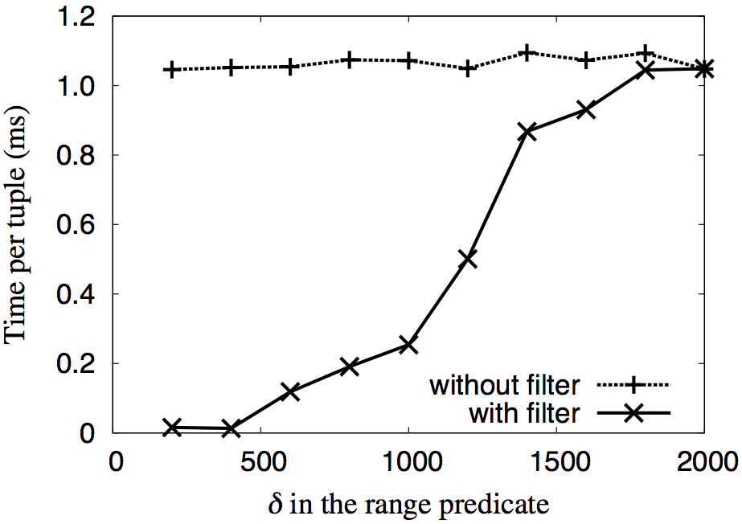
Fast Filters for Selections
SELECT * FROM Galaxy WHERE 100<rowc<100+δ AND 100<colc<100+δ (λ=0.7)
General filter v.s. Exact integration
Data Characteristics
Gaussians (from SDSS)
Parameters
δ: predicate range
λ: probability threshold
Metrics
Time per tuple
Without filters, constant high cost for all ranges tested
With filters, per tuple cost is very low for small predicate ranges
More improvement for larger λ values tested
Notes:
We first evaluate our general filtering technique. We consider a selection where attribute rowc and colc is in the range from 100 to 100+\delta. The data is from SDSS and rowc and colc are modeled by bivariate Gaussians.
Parameters include \delta which controls the predicate range and \lambda which is the probability threshold. We first set the threshold λ = 0.7 and varied δ from 200 to 2000. This value range of \delta approximately covers selectivities from 0% to 100%.
Our metric is the time cost per tuple for evaluating the selection.
We made the following observations:
1: Without filters, selections incur a constant high cost for all predicate ranges tested, because it computes a 2-dimensional integral for each tuple, no matter what δ value is given.
2: In contrast, using our filter the per tuple cost is very low for small δ values because most tuples can be filtered without computing integrals. As δ grows, more tuples pass the filter and invoke integrals for exact evaluation.
3: λ mainly affects the number of tuples that pass the selection. We also tested larger \lambda values. The larger \lambda is, the more performance gains the filters provide

Slide 22
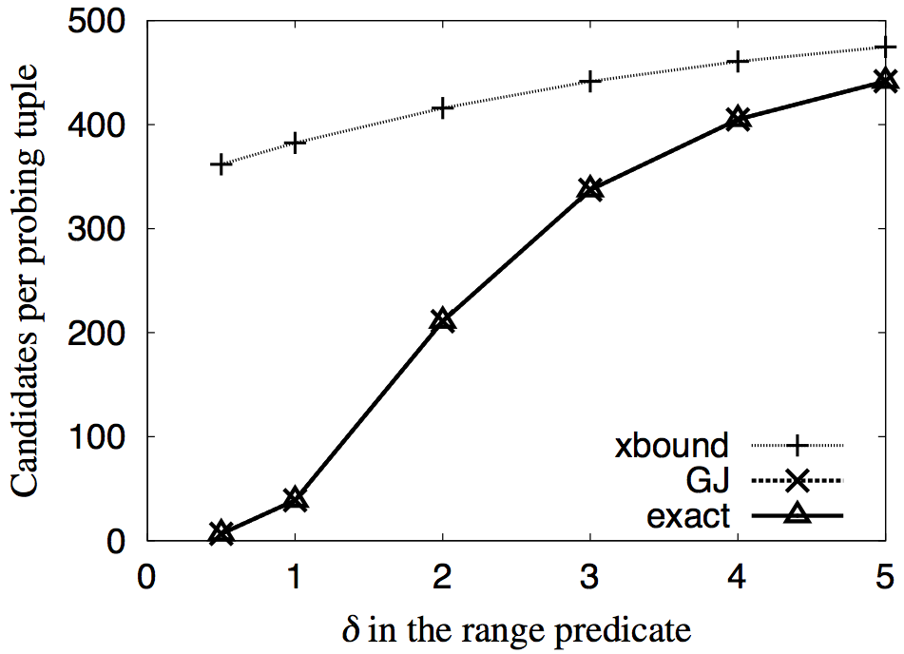
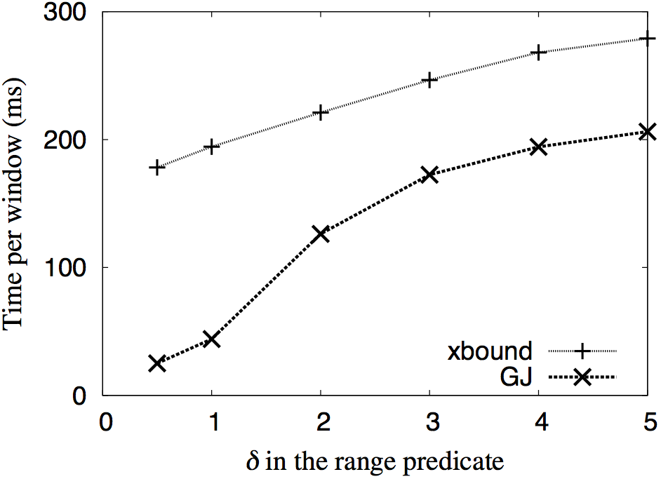
Indexes for Band Joins (stream)
SELECT * FROM Galaxy AS R, Galaxy AS S WHERE |R.u-S.u|<δ (λ=0.7, W=500)
xbound vs GaussJoin in filtering power
xbound vs GaussJoin in efficiency
Xbound join index [R. Cheng et al. VLDB 2004 & CIKM 2006]
Given a distribution f and [l,u], store x% quantiles from both ends
A loose necessary condition for true matches
Our index for Gaussians returns exactly the true match set
Xbound returns more candidates
Our index outperforms xbound in efficiency significantly
Notes:
We next evaluate our index for band joins of Gaussians in the stream setting, where the index construction, lookup and validation are all performed in-memory.
We compare our index with the state-of-the-art index, xbound.
Given a distribution f and its domain [l,u], the xbound index precomputes quantiles from both ends of its domain and stores them in an R-tree. This allows a loose necessary condition to find the superset of true matches.
We set threshold λ = 0.7 , window size equals 500 and vary δ in the range predicate.
The left plot reports the number of candidates per probing tuple and the right plot reports the time cost per window.
1: We can see that GJ returns exactly the true match set because it uses a sufficient and necessary condition for the join predicate.
2: xbound index returns much more candidates. The difference becomes smaller as δ increases, because more tuples become true matches;
In the experiment of efficiency, GJ significantly outperforms xbound because xbound returns more candidates and it needs to validate each candidate by doing an integral
We also have results in a disk setting, where indexes are pre-computed and stored on disk. The performance difference is more drastic because xbound returns a lot more candidates than our index, and validating each candidate incurs both the integration cost and the I/O cost

Slide 23
Tuple Based Planning and Execution
Q1:
SELECT *
FROM Galaxy AS G
WHERE G.r < δ₁
AND G.q_r²+G.u_r² > δ₂²
θ₁
θ₂
δ₁ | δ₂ | static order | static time (ms) | dynamic time (ms) | performance gain | optimal time (ms)
20 | 0.2 | [1 2] | 0.6 | 0.181 | 70% | 0.177
20 | 0.5 | [1 2] | 0.6 | 0.068 | 89% | 0.067
20 | 1 | [2 1] | 9.6 | 0.050 | 99% | 0.048
22 | 0.2 | [2 1] | 18.2 | 7.216 | 60% | 7.007
22 | 0.5 | [2 1] | 13.9 | 1.515 | 89% | 1.482
22 | 1 | [2 1] | 9.6 | 0.351 | 96% | 0.348
24 | 0.2 | [2 1] | 18.2 | 15.613 | 14% | 15.287
24 | 0.5 | [2 1] | 14.4 | 6.390 | 56% | 6.334
24 | 1 | [2 1] | 9.6 | 2.264 | 76% | 2.236
Dynamic query planning
Rank predicates for each tuple
Very close to the optimal in all cases
Over 50% gains in most cases
Static query planning [Y. Qi et al. SIGMOD 2010]
A fixed plan for each query based on the selectivities of predicates over entire data set
Optimal query planning
Generate the best plan for each tuple offline and load it into memory before execution
Notes:
We finally evaluate our dynamic per-tuple planning technique. The left figure shows the query templates for Q1. Basically all tuples will be routed to the quick filters whenever the filters can be applied and there is no specific order of applying filters. After that, the dynamic optimizer decides the order of evaluating exact selection predicates for each tuple, shown by a box in the figure.
We compare our dynamic per-tuple planning with the state-of-the-art static query planning, where a fixed plan is chosen for each query based on the selectivities of predicates over the entire data set, and the optimal planning, where the best plan for each tuple is generated offline and loaded into memory before execution.
We vary the parameters δ1, δ2 to tune the overall selectivity of each predicate.
2: get over 50% performance gains in most cases and is very close to the optimal planning in all cases. There are three reasons: (1) Each tuple is routed based on its distribution and resulting selectivities of predicates. A tuple may be sent to a predicate that is overall not selective but has a larger chance to filter this tuple. (2) The predicate cost is taken into consideration. It is possible for a tuple to be routed to a predicate with only a modest chance to filter the tuple but has a very low cost. (3) Our fast filters can drop tuples earlier at a lower cost than using the exact integration to evaluate predicates.

Slide 24
Conclusions
Optimize probabilistic threshold selections
Fast filters to avoid integrals
Reducing dimensionality of integration by linear transformation
Optimize probabilistic threshold joins
Filtered cross-product using new indexes
Dynamic, per-tuple based planning
Evaluation
Significant performance gains over the state-of-the-art indexing technique and query optimizer
Future work
Extend to a larger class of queries including group-by aggregates
Support user-defined functions
Query optimization with correlated tuples

Slide 25
Thank you!
Q & A
Optimizing Probabilistic Query Processing on Continuous Uncertain Data
Liping Peng Yanlei Diao Anna Liu
http://claro.cs.umass.edu/

Slide 26
Challenges & Contributions
: TEP computation involves
high-dimensional integrals
Find upper bounds for fast filtering
Reduce dimensionality of integration
: Large numbers
of intermediate tuples
Index for continuous uncertain data
Predicate+Distribution→Selectivity Best plan varies
Dynamic, per-tuple based planning
Evaluate using real-world data
Real data and queries from SDSS. Remarkable performance gains over the state-of-the-art techniques
[VLDB04,CIKM06] [SIGMOD10]
Notes:
Let me summarize our challenges and contributions.
The evaluation of selections requires to compute the TEP, which involves high-dimensional integrals, as i’ll explain in a minute. We develop fast filters for a wide range of predicates. They find an upper bound of the integral efficiently and can be used to prune tuples quickly. We also propose optimizations to reduce dimensionality of integration.
The traditional strategy for joins is a cross-product followed by a selection. It can be highly inefficient as it may generate a large number of intermediate tuples. We design new indexes for continuous uncertain data and support a range of join predicates.
Query optimization for continuous uncertain data fundamentally differs from traditional query optimization because selectivity now depends on both the predicates and the distribution. Thus the best plan for one tuple may be bad for another. We design a dynamic, per-tuple based query optimizer.
Lastly, we evaluate our techniques using real data and queries from SDSS. Our results further demonstrate remarkable performance gains over the state-of-the-art techniques

Slide 27
Finding B and b
SELECT * FROM Galaxy AS G1, Galaxy AS G2
WHERE G1.OBJ_ID < G2.OBJ_ID
AND |(G1.u-G1.g)-(G2.u-G2.g)| < 0.05
AND |(G1.g-G1.r)-(G2.g-G2.r)| < 0.05
AND (G1.rowc-G2.rowc)²+(G1.colc-G2.colc)² < 1E4
Step 1: Partition attributes based on schema and predicates
Guarantee
Denote the returned matrix as B_{m×n} (m≤n)
If m<n, LT helps to reduce dimensionality
If m=n, LT does not help
find independent attribute groups based on schema
{G1.u},{G1.g},{G1.r},{G1.rowc, G1.colc},{G2.u},{G2.g},{G2.r},{G2.rowc, G2.colc}
merge independent groups based on predicates
X₁={G1.u, G1.g, G1.r, G2.u, G2.g, G2.r}, X₂={G1.rowc, G1.colc, G2.rowc, G2.colc}
Step 2: Rewrite linear sub-expressions to get B and b. If B does not have full row rank, remove rows until it has. Update b accordingly.
Step 3: Compute the new distribution and region, then the reduced integral
Dimensionality reduced from 6 to 2!
Notes:
Given a query with complex predicates,
1: our first step is to partition the attributes based on both the schema and the predicates.
2: In this example, let’s consider a tuple after the cross-product. They have 10 attributes in total. According to the schema, rowc and colc are correlated, so the 10 attributes form 8 independent attribute groups. Then we merge groups involved in the same predicate into one. [Pointing to the first predicate] The first two predicates will connect … together and the last predicate will connect the 4 together . Finally we have two partitions of attributes.
3: In the 2nd step, for each group of attributes, we define a random vector X (point to X1) and find maximum linear sub-expressions relevant to X from the selection condition (point to the two predicates in both the query and the matrix for Y), Then rewrite the linear expressions as the product of a matrix and X plus a vector. Denote the matrix as B. If B does not have full row rank, remove rows from B, one at a time, until it has full row rank. Remove elements from b accordingly. For the first partition of attributes X1, we can find two relevant linear expressions in the selection condition. After rewriting, B already has full row rank. So the 2nd step completes here.
5 6: After we get B and b, the last step is to apply the linear transformation to compute the new distribution and region, and finally the reduced integral in the transformed domain for Y. As is shown, we reduce the dimensionality of integration from 6 to 2.
9: We formally proved that this procedure can always compute the correct value for the integral. Since the returned matrix has full row rank, m is less than or equal to n. if…; otherwise it does not help.

Slide 28
Fast Filters for Common Predicates
Union of non-overlapping intervals
E.g. “ra²>1” ➔
Apply Markov’s, Chebyshev’s, Cantelli’s inequalities
Multidimensional quadratic forms
E.g. “q²+u²>0.25”
Step 1: Compute mean and variance of the quadratic form
Step 2: Apply Cantelli’s inequality
Predicates that can be reduced to the above two by LT
E.g. “(G1.rowc-G2.rowc)²+(G1.colc-G2.colc)² < 1E4” ➔ z₁²+z₂²<1E4

Slide 29
One-dimensional Inequalities
Markov’s inequality
Chebyshev’s inequality
Cantelli’s inequality
-a
0
a
μ-kσ
μ
μ+kσ
μ
μ+kσ
μ-kσ
μ

Slide 30
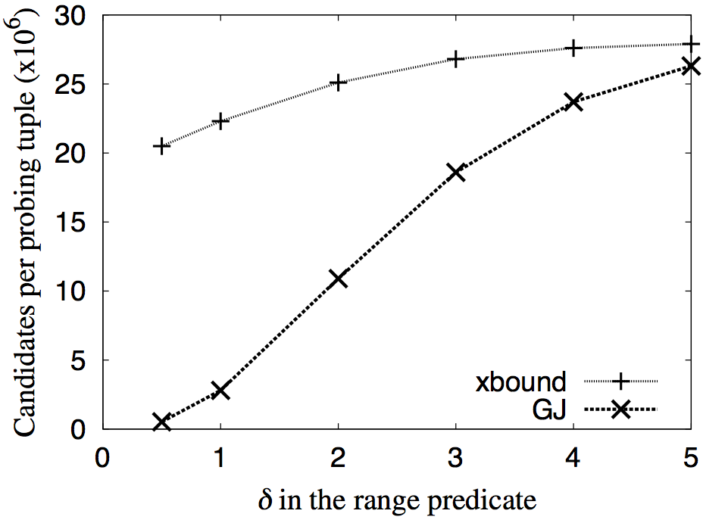
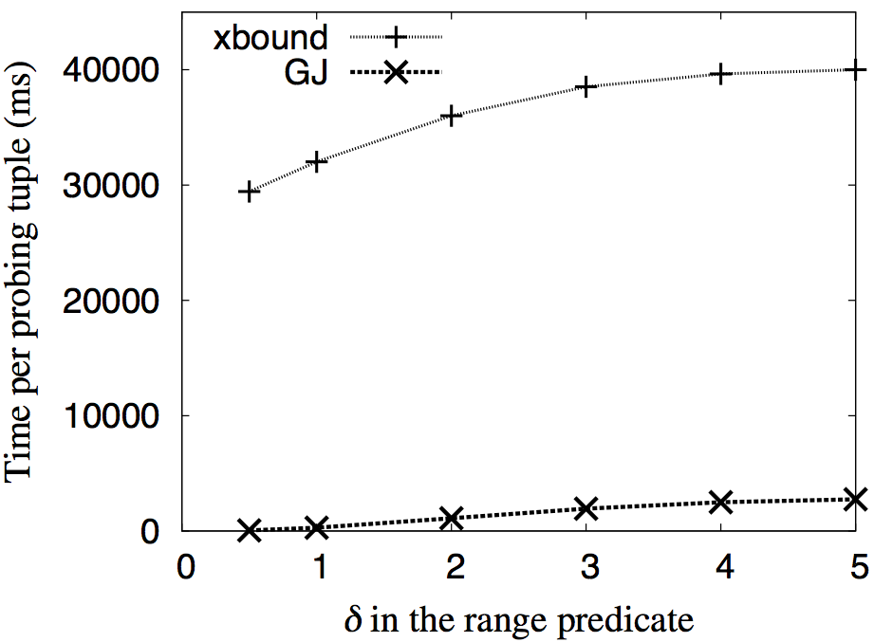
Indexes for Band Joins (disk)
SELECT * FROM Galaxy AS R, Galaxy AS S WHERE |R.u-S.u|<δ (λ=0.7)
xbound vs GJ in filtering power
xbound vs GJ in efficiency
Similar trend for #candidates returned to that in the stream setting
Drastic difference in efficiency due to both the validation cost and the I/O cost
Notes:
We then evaluate the same join in a disk setting, where indexes are pre-computed and stored on disk. Since indexes are pre-constructed, their construction costs are not considered.
1: While the trend for the number of candidates appears similar to that in the stream setting, the absolute number for the number of candidates is much larger because we do a join over two big tables
2:The performance difference is more drastic difference because xbound returns a lot more candidates than our index, and validating each candidate incurs both the integration cost and the I/O cost

