Slide 1
QSkycube: Efficient Skycube Computation
Using Point-Based Space Partitioning
VLDB 2011
Pohang University of Science and Technology (POSTECH) Republic of Korea
2011. 9. 1
Jongwuk Lee, Seung-won Hwang

Slide 2
Outline
Motivation
Skycube Computation
Experiments
Conclusion

Slide 3


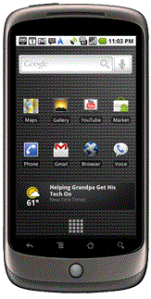

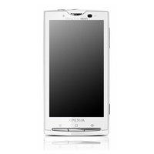




What is a Skyline?
Alice looks for the cheapest and lightest cell phone.
Skyline: a set of points that are not dominated by any other points.
A set of top-1 candidates
heavy
a dominates b. → a is no worse than b on all dimensions.
Weight
dominates
a
a is incomparable with b. → a is not dominated by b and vice versa.
light
low
Price
high
is incomparable with

Slide 4
Subspace Skyline
What if users may issue skyline queries based on arbitrary subsets of dimensions?
Subspace skylines can vary significantly, depending on user-specific preferences.
<price, weight>, <price, LCD size>, <LCD size, weight>, …
heavy
small
LCD size
Weight
light
big
low
Price
high
low
Price
high
Skyline on ⟨Price, Weight⟩
Skyline on ⟨Price, LCD size⟩

Slide 5
What is a Skycube?
A skycube is the collection of all possible subspace skylines.
A d-dimensional space contains 2^{d} - 1 subspaces.
Naïve approach: serially compute skylines for each subspace.
Is it possible to reuse subspace skyline computation?
Skycube
Price Weight Size
Dimension Skyline
D₁ D₂ D₃
U SKY_{U}(S)
D₁D₂D₃
a 3 2 5
D₁ g
b 4 7 2
D₂ f
c 9 5 6
D₃ d, e, g
D₁D₂
D₁D₃
D₂D₃
d 4 6 1
D₁D₂ a, e, f, g
e 2 3 1
D₁D₃ g
f 6 1 3
D₂D₃ e, f
D₁
D₂
D₃
g 1 4 1
D₁D₂D₃ a, e, f, g
Yidong Yuan et al. “Efficient Computation of the Skyline Cube”, VLDB 2005

Slide 6
Outline
Motivation
Skycube Computation
Experiments
Conclusion

Slide 7
Strategies for Computing the Skycube (1 / 2)
Sharing result: exploits pre-computed subspace skylines to compute another subspace skyline.
If U ⊆ V, then SKY_{U}(S) ⊆ SKY_{V}(S) under distinct value condition.
Bottom-up skycube algorithm (BUS) [VLDB2005]
compute the skycube in a level-wise and bottom-up manner.
Reduce the number of dominance tests for SKY_{V}(S).
The dominance tests of non-skyline points cannot be reused.
No two points have the same values for each dimension.
SKY_{D1D2}(S)
D₁D₂
SKY_{D1D2}(S)
SKY_{D1}(S)
SKY_{D1}(S)
D₁
D₂
U = D₁ ⊆ V = D₁D₂

Slide 8
Strategies for Computing the Skycube (2 / 2)
Sharing structure: exploits a structure to compute skylines on overlapped subspaces.
Top-down skycube algorithm (TDS) [VLDB2005]
Compute the skycube in a top-down manner.
Exploit two-dimensional space partitioning derived from DC algorithm.
Dominance and incomparability relationships cannot be optimized in high-dimensional data.
D₁D₂
SKY_{D1D2}(S)
…
…
…
D₁
D₂
…
…
…
…
…
SKY_{D1}(S)

Slide 9
One Summary Slide
Existing algorithms still has room for optimization.
How to compute the skycube more efficiently?
Main idea
Exploit finer structure to further share both dominance and incomparability.
→ Point-based space partitioning
Sharing result for single parent can be extended into multiple parents.

Slide 10












Point-Based Space Partitioning (1 / 3)
Basic idea
A pivot point is selected as a skyline point.
A pivot point is partitioned d-dimensional space into 2^{d} subregions.
For , each subregion is mapped into a 2-bit binary vector.
D2
01
c
11
10
d
a
9
g
8
7
f
11
6
b
5
e
dominates { }.
4
h
i
01
10
3
2
00
10
{ } and { } are
incomparable.
j
1
D1
o
1
2
3
4
5
6
7
8
9
10

Slide 11

Point-Based Space Partitioning (2 / 3)
Binary vectors are used to restrict possible subspaces to be a skyline point.
D2
Computing SKY_{D1D2}(S)
Computing SKY_{D1} (S)
D2
01
11
10
10
9
9
8
8
7
7
6
6
5
5
4
4
3
0
1
00
3
2
10
2
1
1
o
D1
o
D1
1
2
3
4
5
6
7
8
9
10
1
2
3
4
5
6
7
8
9
10

Slide 12
Point-Based Space Partitioning (3 / 3)
Projecting D1D2D3 into D1D2
Identify the relationships between points by projecting binary vectors.
`
000
00*
`
`
001
010
100
`
01*
10*
011
101
110
11*
111

Slide 13
Constructing a SkyTree
Skyline algorithm using point-based space partitioning
Partition subregions in a recursive way.
Construct a skytree in computing the skyline.
D2
01
c
11
Partitioned point set
10
Selected pivot point
a
d
9
g
8
(e, S)
Entire point set
7
f
6
b
01
10
5
e
(null, {a, b, c})
(null, {h, i, j})
(b, {a, b, c})
(h, {h, i, j})
4
01’
h
i
11’
3
10’
2
00
10
00’
j
10’
1
(j, {j})
D1
o
1
2
3
4
5
6
7
8
9
10

Slide 14
Sharing a SkyTree (1 / 3)
Vertical relationship I
For the skytree on V, if any link connected between p and q is associated with a binary vector B such that ∀di ∈ U : Bi = 1, p dominates q on U such that U ⊂ V.
Vertical relationship 2
For the skytree on V, if any link connected between p and q is associated with a binary vector B such that ∀di ∈ U : Bi = 0, p dominates q on U such that U ⊂ V.
t
Vertical relationship 1: t dominates {q, r} on D₁D₂.
t
001
110
00*
11*
Projecting D₁D₂
p
q
p
q
010
01*
r
Vertical relationship 2:
p dominates t on D₁D₂.
r

Slide 15
Sharing a SkyTree (2 / 3)
Horizontal relationship
Exploit the transitivity between two vertical relationships.
Propagate the relationships by combining both vertical and horizontal relationships.
If p dominates q, and q dominances r, then p dominates r.
horizontal relationship: p dominates {q, r} on D₂.
t
t
001
010
00*
01*
Projecting D₁D₂
Vertical relationship:
q dominates r on D₁.
p
q
p
q
100
10*
If p dominates q, on D₁, then p dominates r on D₁D₂.
r
r

Slide 16
Sharing a SkyTree (3 / 3)
Identify skyline candidates by traversing the skytree.
Access nodes in a topological order that preserves the dominance relationships between nodes.
D2
{D₁}
e
c
11
01
10
10
01
d
a
9
b
h
g
8
7
f
10
6
b
5
e
{D₂}
j
4
h
i
SKY_{D1D2}(S) = {b, e, h, j}
3
2
00
10
SKY_{D1}(S) = {b}
j
1
D1
SKY_{D2}(S) = {j}
o
1
2
3
4
5
6
7
8
9
10

Slide 17

Sharing Multiple Parents
Sharing single parent
If U ⊆ V, then SKY_{U}(S) ⊆ SKY_{V}(S) under distinct value condition.
→ If p $∉$ SKY_{V}(S), then p $∉$ SKY_{U}(S) under distinct value condition.
Sharing multiple parents: more restrict candidates for SKY_{U}(S).
If U ⊆ V, then SKY_{U}(S) ⊆ $⋂$_{U ⊆ V}SKY_{V}(S).
SKY_{D1D3}(S)
SKY_{D1D2}(S)
SKY_{D1}(S)

Slide 18
Proposed Algorithm: QSkycube
Compute the skycube in a top-down manner.
Compute the skyline and construct the corresponding skytree.
Sharing a skytree
Traverse the skytree in a depth-first way and reduce non-skyline points.
Sharing multiple parents
When computing SKY_{D1}(S), both SKY_{D1D2}(S) and SKY_{D1D3}(S) are used.
D₁D₂D₃
Subspace Skyline
D₁ g
D₂ f
D₁D₂
D₁D₃
D₂D₃
D₃ d, e, g
…
D₁D₂ a, e, f, g
D₁D₃ g
…
…
D₁
D₂
D₃
D₂D₃ e, f
…
D₁D₂D₃ a, e, f, g
…
…
…
…

Slide 19
Outline
Motivation
Skycube Computation
Experiments
Conclusion

Slide 20
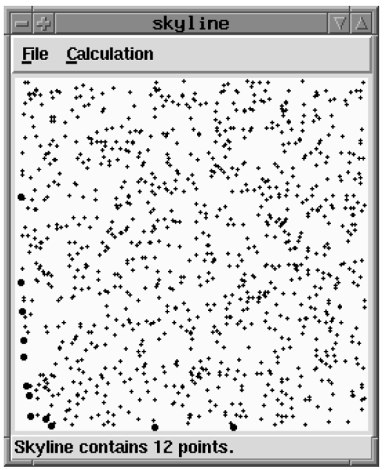
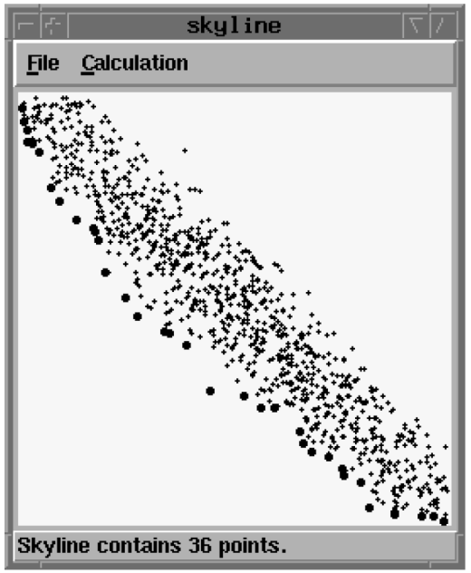
Experiments (1 / 5)
Experimental settings
Distribution: Independent, Anti-correlated
Dimensionality d: 4 ~ 22 (default d = 12)
Cardinality n: 200K ~ 1,000K (default n = 200K)
Compared algorithms
BUS: exploit sharing result based on SFS.
TDS: exploit sharing structure based on DC.
BSkytreeS: serially compute each subspace skyline using BSkyTree-P.
vs. QSkycube
Jongwuk Lee et al. “BSkyTree: Scalable Skyline Computation Using a Balanced Pivot Point Selection”, EDBT 2010

Slide 21
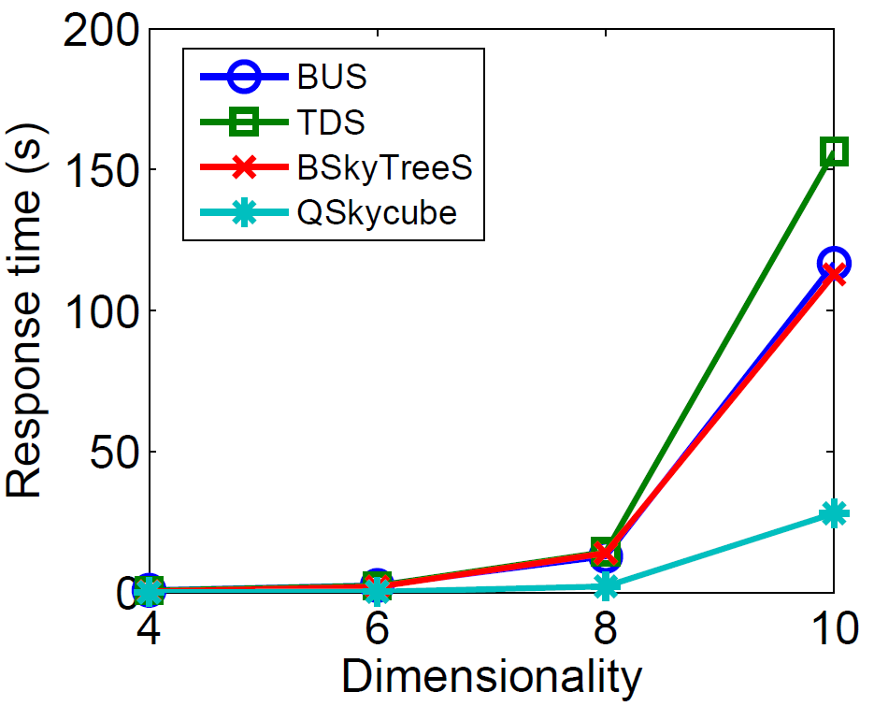
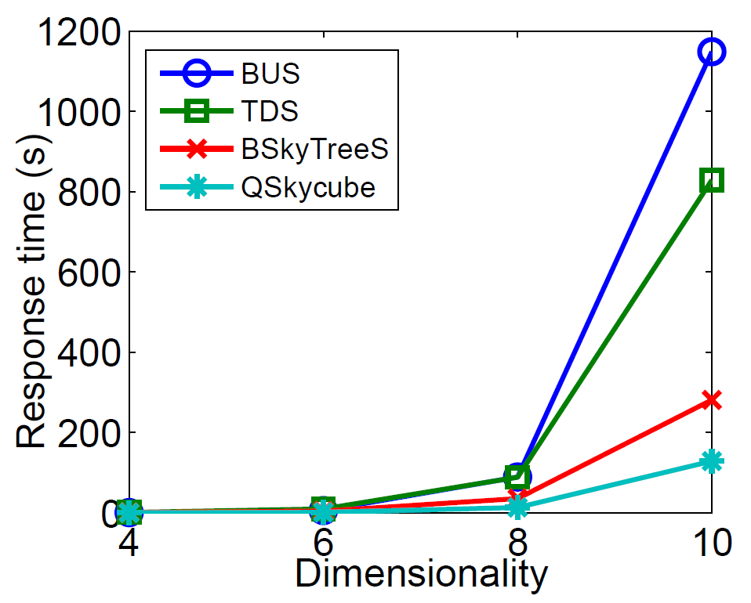
Experiments (2 / 5)
Scalability of our proposed algorithm over dimensionality
Ours
Independent
Anti-correlated

Slide 22
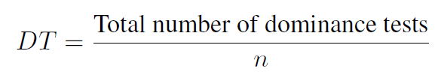
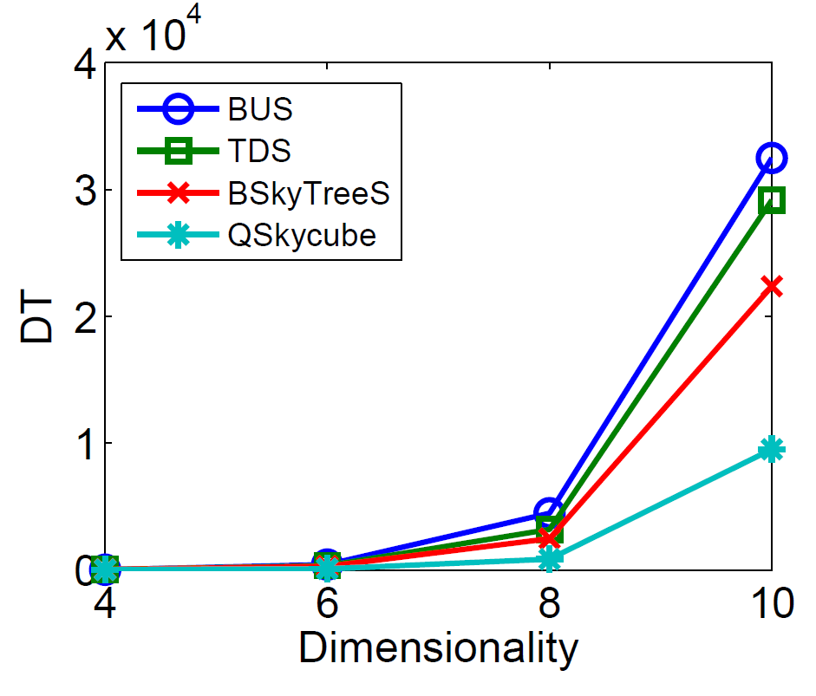
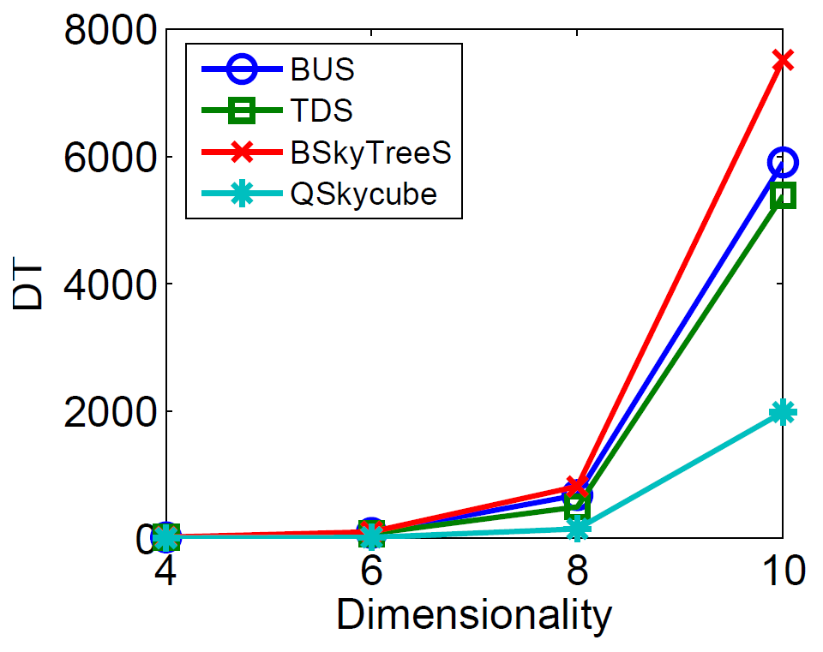
Experiments (3 / 5)
Scalability of our proposed algorithm over dimensionality
Ours
Independent
Anti-correlated

Slide 23
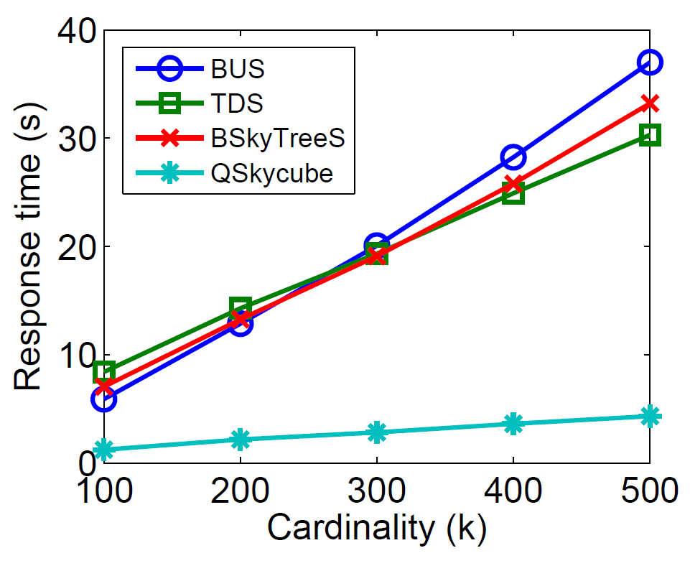
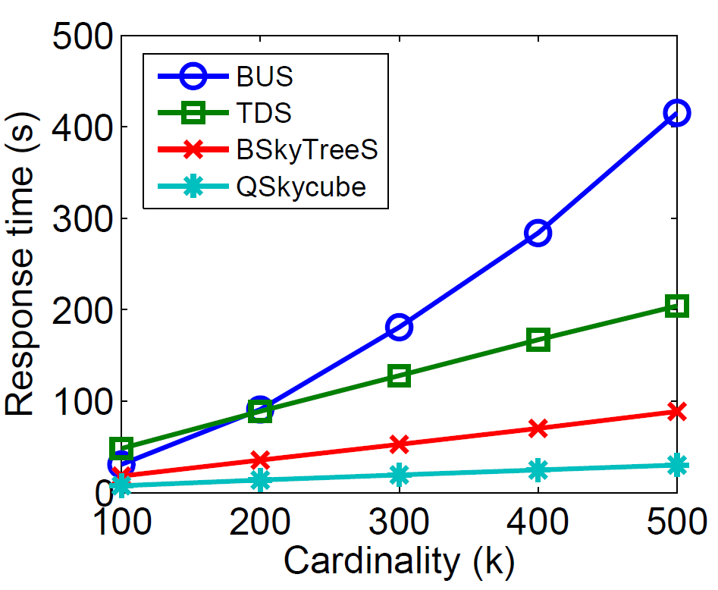
Experiments (4 / 5)
Scalability of our proposed algorithm over cardinality
Ours
Independent
Anti-correlated

Slide 24
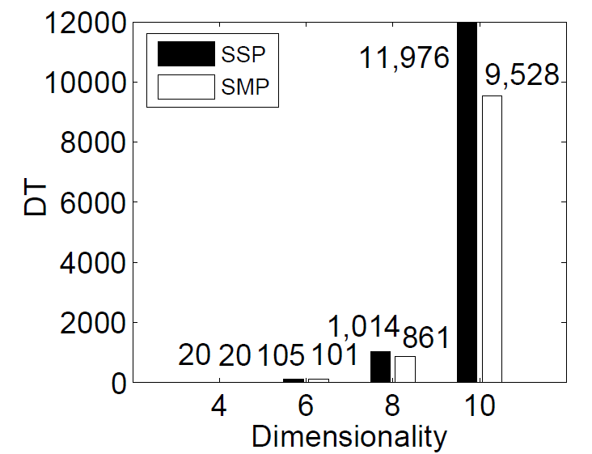
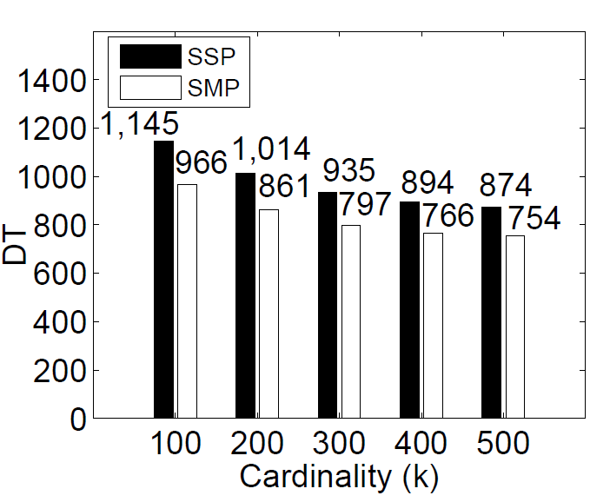
Experiments (5 / 5)
Effect of sharing multiple parents
Sharing Single Parent (SSP) vs. Sharing Multiple Parents (SMP)
Ours
Anti-correlated
Anti-correlated

Slide 25
Outline
Motivation
Skycube Computation
Experiments
Conclusion

Slide 26
Conclusion
We studied efficient skycube algorithm based on point-based space partitioning.
QSkycube exploits sharing structure with finer granularity and sharing result for multiple parents.
The proposed algorithm is significantly faster than state-of-the-art algorithms.
QSkycube is about 4 ~ 5 times faster than existing algorithms.

Slide 27
Q & A
Thank you!

Slide 28
References
Yidong Yuan et al. “Efficient Computation of the Skyline Cube”, International Conference on Very Large Data Bases (VLDB) 2005
Jongwuk Lee et al. “BSkyTree: Scalable Skyline Computation Using a Balanced Pivot Point Selection”, International Conference on Extending Database Technology (EDBT) 2010

