Slide 1
Recovering Semantics of Tables on the Web
Fei Wu
Google Inc.
Petros Venetis, Alon Halevy, Jayant Madhavan, Marius Paşca, Warren Shen, Gengxin Miao, Chung Wu

Slide 2
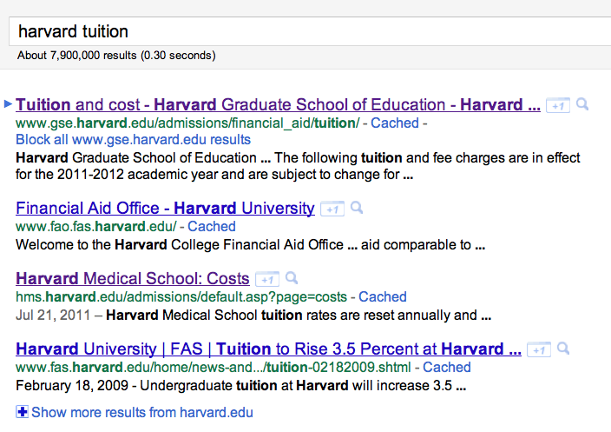
Finding Needle in Haystack
Notes:
Nowadays, search engines are very good at retrieving answers for a specific question posed by users, like harvard tuition. Most likely, users will find the fact right for the question in top resulting pages.

Slide 3
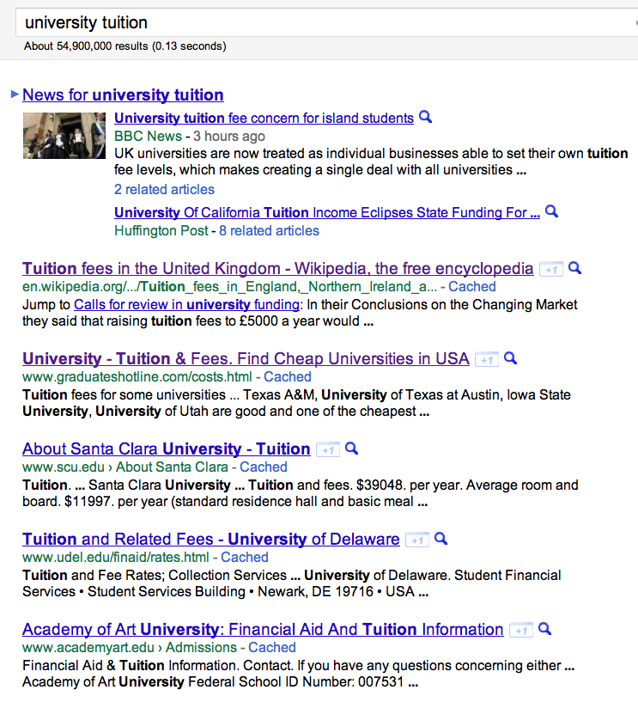
Finding Structured Data
Notes:
When it comes to “finding structured data” like tables, things are different. Suppose I’d like to know the tuitions of all universities. I sent the query “university tuition” to google, and here are the results. None of the top results contain a full list summarizing the tuitions of different universities. In stead, starting from the 4th result, it lists tuition information about each individual university. I need to click through each page and cut out the numbers by myself.

Slide 4
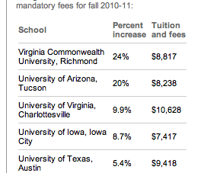
Finding Structured Data
[from usatoday.com]
Millions of such queries every day
searching for structured data!

Slide 5
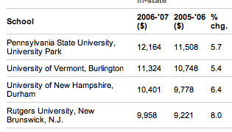
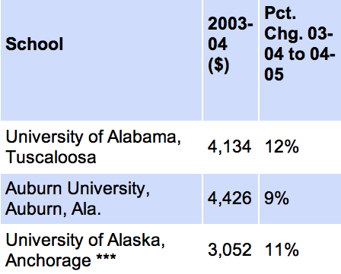
Tuition
Time

Slide 6
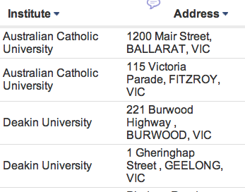
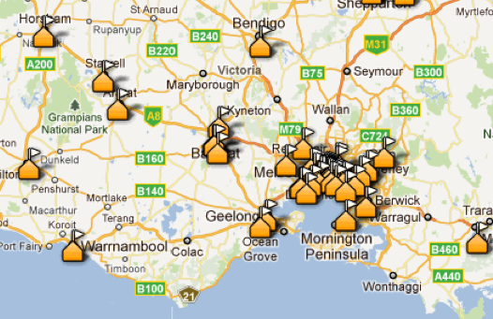
Tuition
Time

Slide 7
Tuition
Time

Slide 8
Recovering Table Semantics
Table Search
Novel applications

Slide 9
Recovering Table Semantics
Table Search
Novel applications
Located In

Slide 10

Recovering Table Semantics
Table Search
Novel applications
Located In

Slide 11
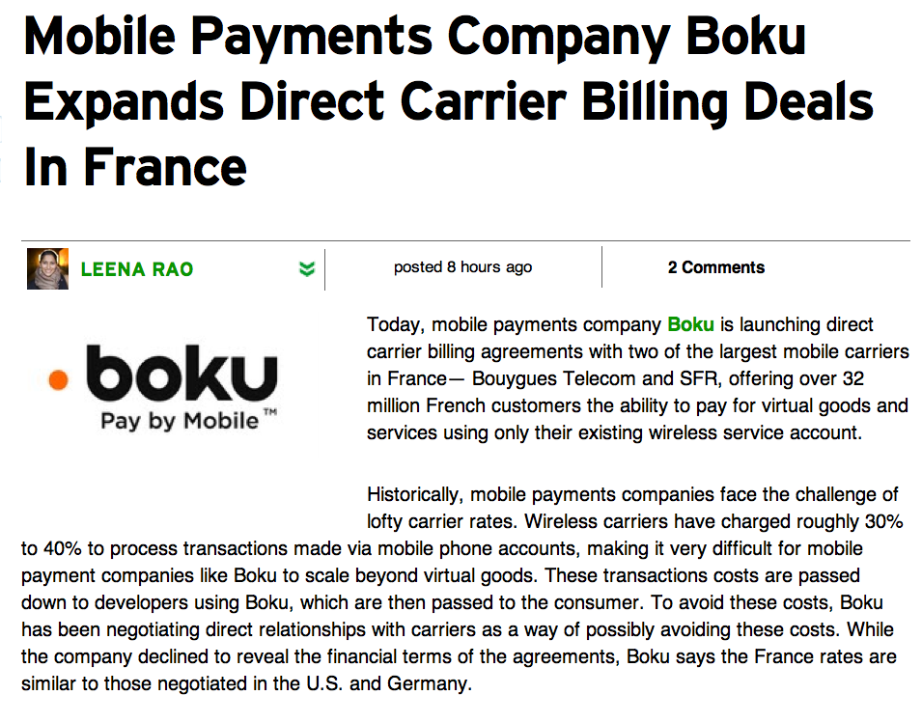
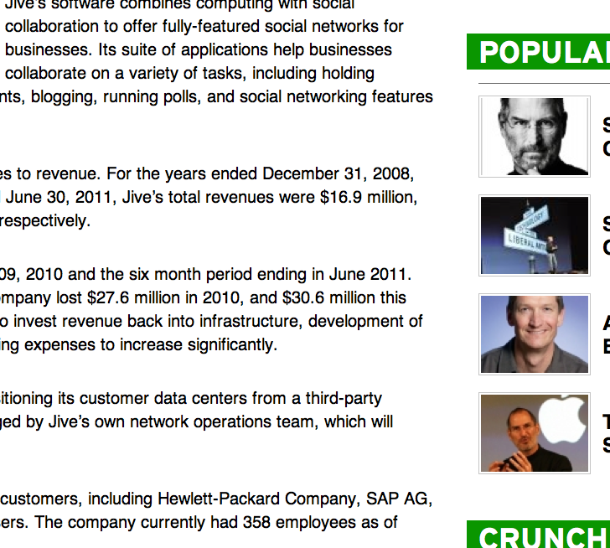
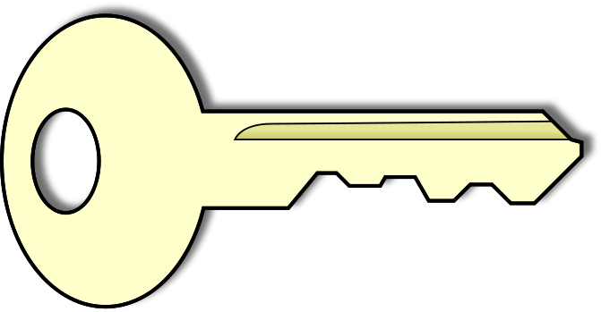
Recovering Table Semantics
Table Search
Novel applications
Located In

Slide 12
Outline
Recovering Table Semantics
Entity set annotation for columns
Binary relationship annotation between columns
Experiments
Conclusion

Slide 13
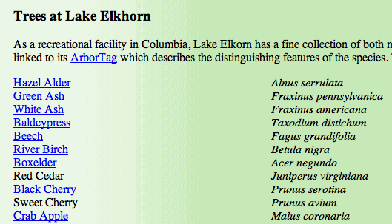
Table Meaning Seldom Explicit by Itself
Trees and their scientific names
(but that’s nowhere in the table)

Slide 14
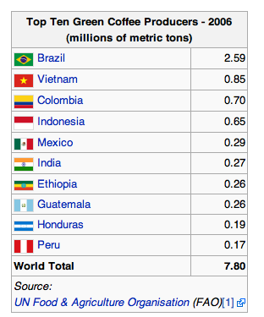
Much better, but schema extraction is needed

Slide 15
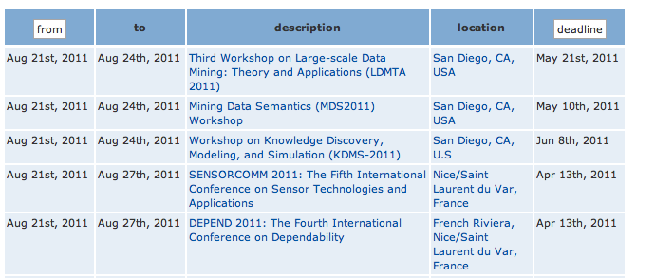
Terse attribute names hard to interpret

Slide 16
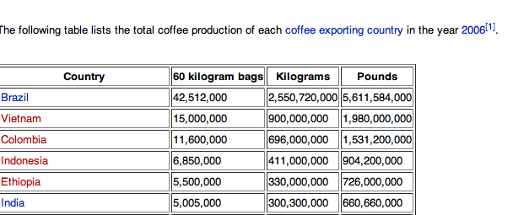
Schema Ok, but context is subtle
(year = 2006)

Slide 17
Focus on 2 Types of Semantics
Entity set types for columns
Binary relationships between columns
Conference
AI Conference
Location
City

Slide 18
Focus on 2 Types of Semantics
Entity set types for columns
Binary relationships between columns
Conference
AI Conference
Location
City
Starting Date
Located In

Slide 19
Recovering Entity Set for Columns
Conference
AI Conference
Location
City

Slide 20
Recovering Entity Set for Columns
Web tables’ scale, breadth and heterogeneity
hand-coded domain knowledge
Key: use facts extracted from Web
documents to interpret Web tables!
Conference
AI Conference
Location
City

Slide 21
Recovering Entity Set for Columns
…… will be held in Chicago from July 3rd to July 8th, 2010. The conference features 12 workshops such as the Mining Data Semantics Workshop and the Web Data Management Workshop. The early-bird registrations…….

Slide 22
Recovering Entity Set for Columns
…… will be held in Chicago from July 3rd to July 8th, 2010. The conference features 12 workshops such as the Mining Data Semantics Workshop and the Web Data Management Workshop. The early-bird registrations…….
Question 1:
How to generate the isA database?

Slide 23
Generating isA DB from the Web
Well studied task in NLP [Hearst 1992 ], [Paşca ACL08], etc
…… will be held in Chicago from July 3rd to July 8th, 2010. The conference features 12 workshops such as the Mining Data Semantics Workshop and the Web Data Management Workshop. The early-bird registrations…….
C is a plural-form noun phrase
I occurs as an entire query in query logs
Only counting unique sentences
100M documents + 50M anonymized queries
60,000 classes with 10 or more instances
Class labels >90% accuracy; class instance ~ 80% accuracy

Slide 24
The isA DB from Web is not Perfect
Popular entities tend to have more evidence
(Paris, isA, city) >> (Lilongwe, isA, city)
Extraction is not complete
Patterns may not cover everything said on the Web
E.g., not be able to extract “acronyms such as ADTG”
Extraction error
“We have visited many cities such as Paris and Annie has
been our guide all the time.”

Slide 25
The isA DB from Web is not Perfect
Popular entities tend to have more evidence
(Paris, isA, city) >> (Lilongwe, isA, city)
Extraction is not complete
Patterns may not cover everything said on the Web
E.g., not be able to extract “acronyms such as ADTG”
Extraction error
“We have visited many cities such as Paris and Annie has
been our guide all the time.”
Question 2:
How to infer entity set types?

Slide 26
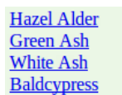

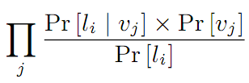



Maximum Likelihood Hypothesis
1

Slide 27
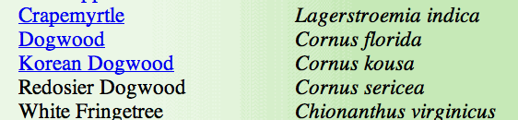
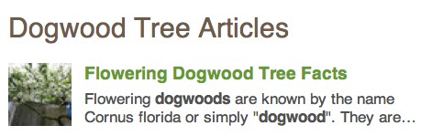
Recovering Binary Relationships
Flowering dogwood has the scientific name of Cornus florida, which was introduced by …

Slide 28
Generating Triple DB from the Web
Well studied task in NLP [Banko IJCAI07 ], [Wu CIKM07], etc
Flowering dogwood has the scientific name of Cornus florida, which was introduced by …
<dogwood, has the scientific name of, Cornus florida>

Slide 29
Generating Triple DB from the Web
Well studied task in NLP [Banko IJCAI07 ], [Wu CIKM08], etc
Flowering dogwood has the scientific name of Cornus florida, which was introduced by …
<dogwood, has the scientific name of, Cornus florida>
TextRunner [Banko IJCAI 07 ]
CRF extractor, “producing hundreds of millions of assertions extracted from 500 million high-quality Web pages”
73.9% precision; 58.4% recall

Slide 30
Maximum Likelihood Hypothesis

Slide 31
Annotating Tables with Entity, Type, and Relation Links [Limaye et al. VLDB10]
Relation label
Writes(Book,Person) bornAt(Person,Place)
leader(Person,Country)
Entity
Type hierarchy
Title
Author
Person
Type label
Uncle Petros and the Goldback conjecture
A Doxiadis
Book
Physicist
Uncle Albert and the Quantum Quest
Russell Stannard
B94
B95
B41
Entities
P22
Entity label
The Time and Space of Uncle Albert
Lemmas
Albert Einstein
Relativity: The Special and the General Theory
A Einstein
Uncle Albert and the Quantum Quest
Relativity: The Special…
Catalog
YAGO
~ 250 K types
~ 2 million entities
~ 100 relationships
Notes:
Use colors to name the links

Slide 32
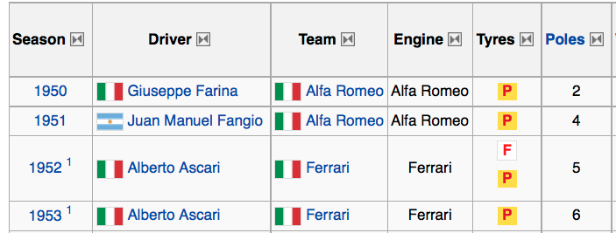
Subject Column Detection
Subject column ≠ key of the table
Subject column may well contain duplicates
Subject composed of several columns (rare)

Slide 33
Subject Column Detection
Subject column ≠ key of the table
Subject column may well contain duplicates
Subject composed of several columns (rare)
SVM Classifier: 94% accuracy
vs.
83% (selecting the left-most non-numeric column)

Slide 34
Outline
Recovering Table Semantics
Entity set annotation for columns
Binary relationship annotation between columns
Experiments
Conclusion

Slide 35
Experiment
Table Corpus [Cafarella et al. VLDB08]
12.3M tables from a subset of Web crawl
English pages with high page-rank
Filtered forms, calendars, small tables (1 column or less than 5 rows)

Slide 36
Experiment: Label Quality
AI Conference
Conference
Company
Location
City
Three methods for comparison:
Maximum Likelihood Model
Majority(t): at least t% cells have the label (t=50)
Hybrid: b) concatenated by a)

Slide 37
Experiment: Label Quality
AI Conference
Conference
Company
Location
City
DataSet:
168 Random tables with meaningful subject columns that have labels from M(10)
labels from M(10) were marked as vital, ok or incorrect
Labeler might also add extra valid labels
On average, 2.6 vital; 3.6 ok; 1.3 added

Slide 38
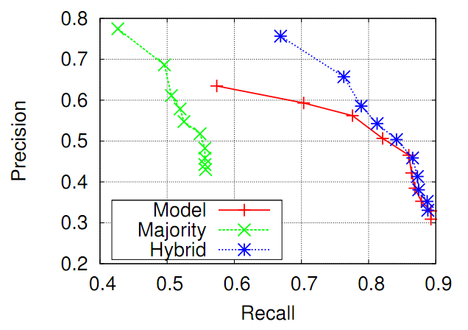
Experiment: Label Quality

Slide 39
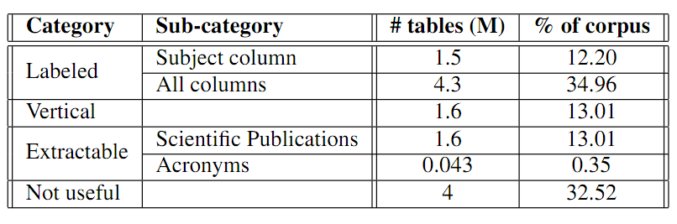
The Unlabeled Tables
Only labeled 1.5M/12.3M tables when only subject columns are considered
4.3M/12.3M tables if all columns are considered

Slide 40
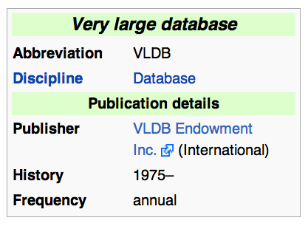
The Unlabeled Tables
Vertical tables

Slide 41
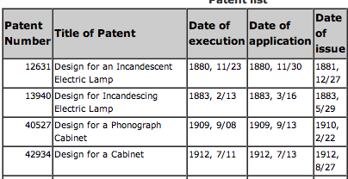
The Unlabeled Tables
Vertical tables
Extractable

Slide 42
The Unlabeled Tables
Vertical tables
Extractable
Not useful for queries (e.g. <univ, tuition>) for structured data
Course description tables
Posts on social networks
Bug reports
…

Slide 43
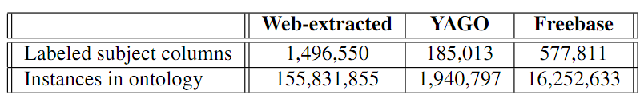
Labels from Ontologies
12.3M tables in total
Only consider subject columns

Slide 44
Experiment: Table Search
Query set:
100 <C,P> queries from Google Square query logs
<presidents, political party> <laptops, price>
Algorithms:
TABLE
GOOG
GOOGR
DOCUMENT

Slide 45
Experiment: Table Search
Query set:
100 <C,P> queries from Google Square query logs
Algorithms:
TABLE
Has C as one class label
Has P in schema or binary labels
Weight sum of signals: occurrences of P; page rank; incoming anchor text; #rows; #tokens; surrounding text

Slide 46
Experiment: Table Search
Query set:
100 <C,P> queries from Google Square query logs
Algorithms:
TABLE
GOOG: results from google.com
GOOGR: intersection of table corpus with GOOG
DOCUMENT: as in [Cafarella et al. VLDB08]
Hits on the first 2 columns
Hits on table body content
Hits on the schema

Slide 47
Experiment: Table Search
Evaluation:
For each <C,P> query like <laptops, price>
Retrieve the top 5 results from each method
Combine and randomly shuffle all results
For each result, 3 users were asked to rate:
Right on
Relevant
Irrelevant
In table (only when right on or relevant)

Slide 48
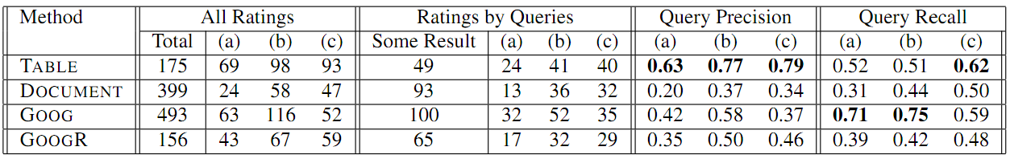
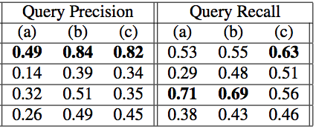

Table Search
(a): Right on (b): Right on or Relevant (c): In table
# of queries method “m” retrieved some result
# of queries method “m” rated “right on”
# of queries some method rated “right on”

Slide 49
Conclusion
Web tables usually don’t contain explicit semantics by themselves
Recovered table semantics with a ML model based on facts extracted from the Web
Explored an intriguing interplay between structured and unstructured data on the Web
Recovered table semantics can greatly help improve table search

Slide 50
Future Works
More applications, like related tables, table join/union/summarization, etc.

Slide 51
Future Works
More applications, like related tables, table join/union/summarization, etc.
Other table search queries besides <C,P>

Slide 52
Future Works
More applications, like related tables, table join/union/summarization, etc.
Other table search queries besides <C,P>
Better information extraction from the Web

Slide 53
Future Works
More applications, like related tables, table join/union/summarization, etc.
Other table search queries besides <C,P>
Better information extraction from the Web
Extracting tables structured websites.

