Slide 1


Output URL Bidding
Panagiotis Papadimitriou, Hector Garcia-Molina,
(Stanford University)
Ali Dasdan, Santanu Kolay
(Ebay Inc)

Slide 2
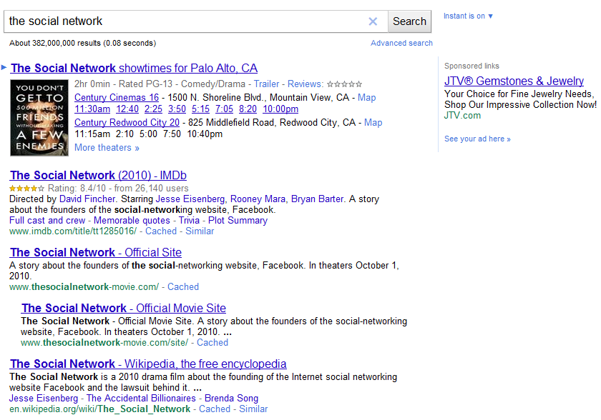

Search Engine Results Page (SERP)
Query
Sponsored Ads
Sponsored Search Ads
Organic Results

Slide 3




Keyword bidding
Advertiser
Search Engines
KEYWORDS
the social network
lord of the rings
the matrix
lotr III
...
...
# keywords = ~ 10K

Slide 4
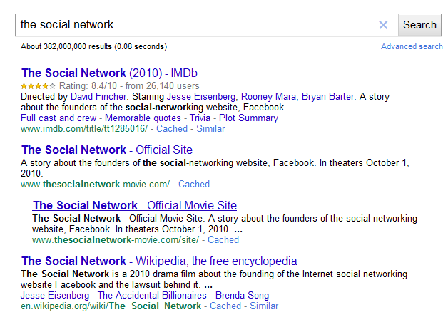
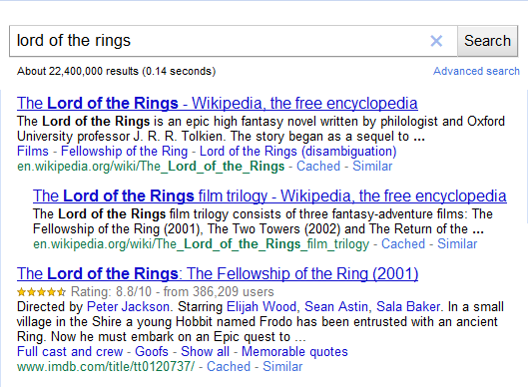
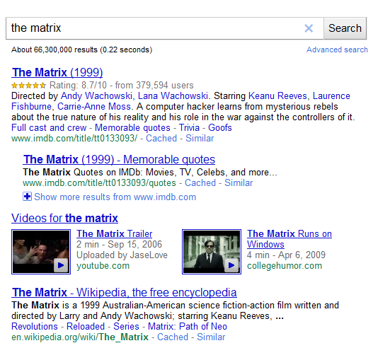
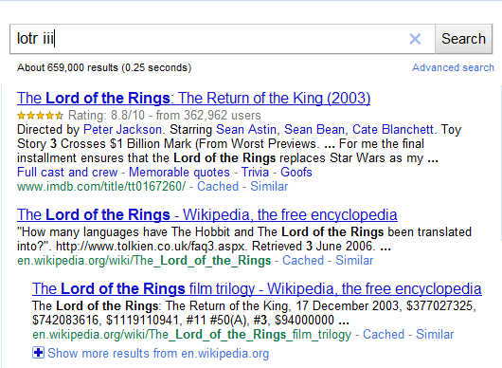
Example SERPs
the social network
the lord of the rings
en.wikipedia.org/wiki/The_Lord_of_the_rings
www.imdb.com/title/tt1285016/
www.imdb.com/title/tt120737/
en.wikipedia.org/wiki/The_Social_Network
the matrix
lotr iii
www.imdb.com/title/tt133093/
www.imdb.com/title/tt167260/
en.wikipedia.org/wiki/The_Lord_of_the_rings
en.wikipedia.org/wiki/The_Matrix

Slide 5
Output URL bidding
Advertiser
Search Engines
URLs
imdb.com AND wikipedia.org
# URLs = 2
Notes:
Say that Yahoo is interested, the general idea came from Ali who is here

Slide 6


Topics
Implementation
Evaluation

Slide 7
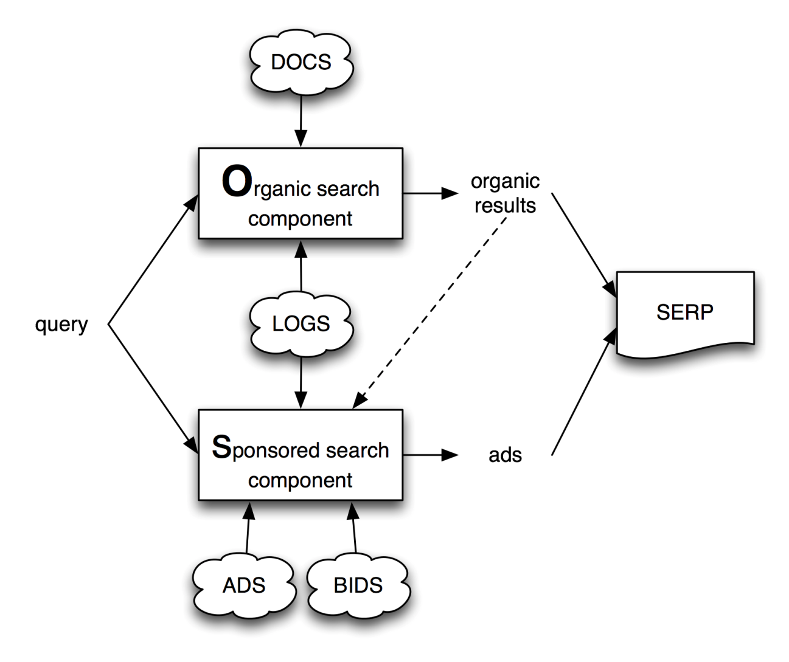
Implementation challenge
SERP

Slide 8
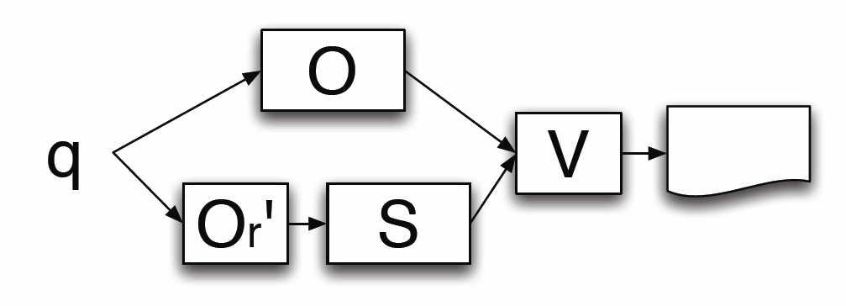
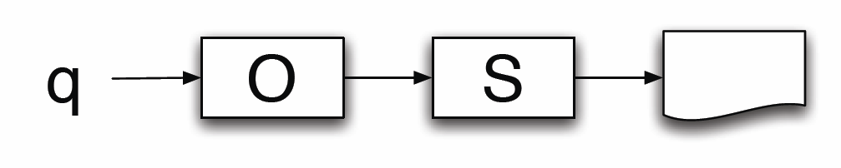
Alternative implementation solutions
1. Serialization
2. Parallelization
No latency
Simplicity
More resources
Latency
SERP
SERP
O: Organic Search Component
S: Sponsored Search Component
O: Organic Search Comp. (Or + Op)
Or’: Small replica of Or
S: Sponsored Search Component
V: Ad validation
Notes:
More architectures that employ pipelining, caching

Slide 9
Topics
Implementation
Evaluation

Slide 10
Bid language model
Output Expression
  e.g., a := (u1 ∧ u2)∨ u3 ∨ (h1 ∧ h2)
  u: URL
    e.g., en.wikipedia.org/wiki/The_Social_Network
  h: host
    e.g., en.wikipedia.org

Slide 11
How to evaluate/study output bidding?
Use existing keyword campaigns to generate realistic output expressions to study
The social network
lord of the rings
the matrix
lotr III
…
…
Output Expression Generator
imdb.com AND wikipedia.org

Slide 12
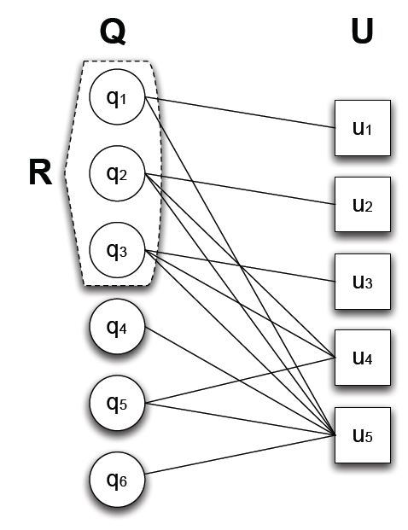
Generator input & output
INPUT: set of keywords R (from a keyword campaign)
OUTPUT: expression a that “covers” R, i.e.,
∀q∈ R, matches(a, results of q)
Candidate expressions
Output Expression
a₁ := u₁ ∨ u₂ ∨ u₃
a₂ := u₁ ∨ u₄
a₃ := u₅

Slide 13
Which expression to select?
Compactness
Contain few URLs
Spill minimization
Do not match “irrelevant” queries
Candidate expressions
Output Expression | Size |a| | spill(a,R)
a₁ := u₁ ∨ u₂ ∨ u₃ | 3 | {}
a₂ := u₁ ∨ u₄ | 2 | {q₅}
a₃ := u₅ | 1 | {q₄,q₅, q₆}

Slide 14
Output expression generation problem statement
Query Set Output Cover
min. γ|a| + (1-γ)|spill(a, R)|
subj. to matches(a, q), ∀q∈ R
γ : regularization parameter
NP-hard to solve
  Reduction from Set Cover, Red-Blue Set Cover (see paper)
Developed Greedy Algorithm (see paper)

Slide 15
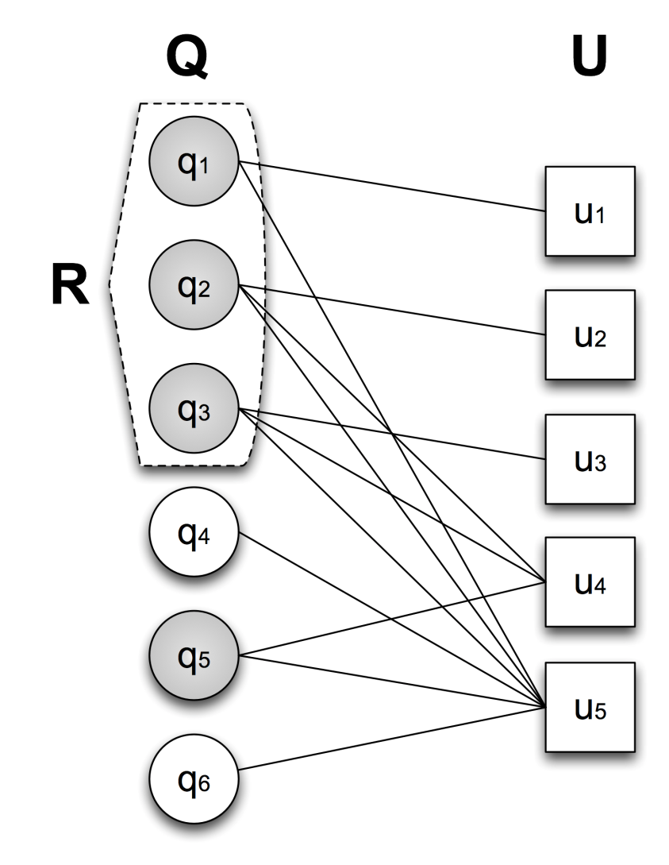
Is spill always “bad”?
Example:
  q₁: lord of the rings
  q₂: the matrix
  q₃: the social network
  q₄: …
  q₅: lotr
  q₆: …
→(lord of the rings)
Output Expression | Size |a| | spill(a,R)
a₁ := u₁ ∨ u₂ ∨ u₃ | 3 | {}
a₂ := u₁ ∨ u₄ | 2 | {q₅}
a₃ := u₅ | 1 | {q₄,q₅, q₆}
Notes:
Real log

Slide 16
Spill may be good!
Cluster queries Q using the bipartite graph (see paper)
Divide spill(a, R) into:
  positive: relevant
  negative: irrelevant
Output Expression | Size |a| | spill(a,R)
 |  | + | -
a₁ := u₁ ∨ u₂ ∨ u₃ | 3 | {} | {}
a₂ := u₁ ∨ u₄ | 2 | {q₅} | {}
a₃ := u₅ | 1 | {q₅} | {q₄, q₆}
Notes:
Real log

Slide 17
Experimental evaluation goals
Recall output expression looks like
  a := (u1 ∧ u2)∨ u3 ∨ (h1 ∧ h2)
Evaluation questions
  URLs, hosts or mixed?
  Specific or generic? (# conjuncts)
  Long or compact? (# disjuncts)
Comparison criteria
  Compactness vs spill tradeoff
  Positive vs negative spill

Slide 18
Experimental setup
Dataset (from Yahoo query logs)
  2,251 ads
  13M queries, 63M URLs (7M hosts)
The social network
lord of the rings
the matrix
lotr III
…
…
Output Expression Generator
imdb.com AND wikipedia.org
γ
- URLs
- hosts
- mixed
# conjuncts

Slide 19
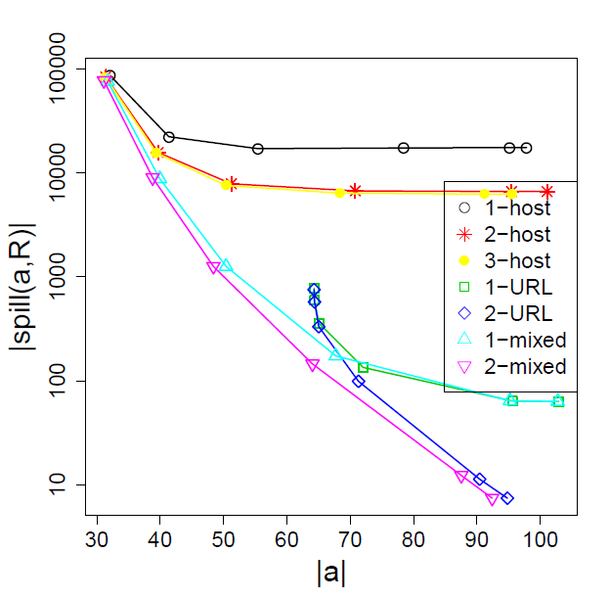
Compactness vs spill tradeoff
URLs, hosts or mixed?
Mixed expression curves dominate others
Specific vs generic?
2 conjuncts suffice
Long or compact?
Next slide…

Slide 20
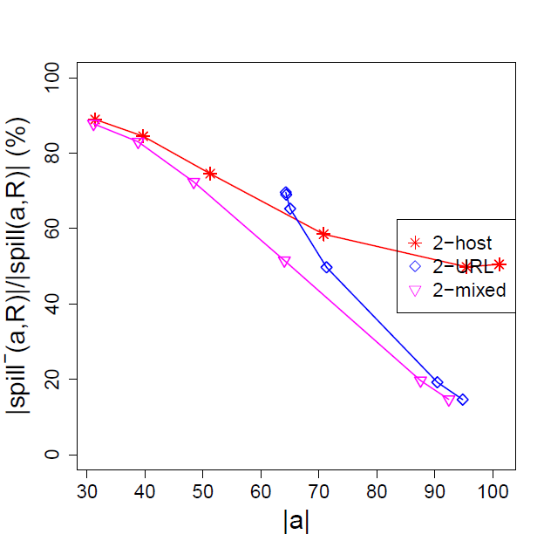
Positive vs negative spill
For |a|>60, more than 50% of spill is positive
URLs, hosts or mixed?
Mixed expression curves dominate others
Long or compact?
|a|=70-80 suffice
(1/3 the size of equivalent keyword set)

Slide 21
More experiments in paper
Combining keyword and output bidding
  E.g., a movie advertiser uses:
    1. imdb.com ∧ wikipedia.org cover 80% of queries
    2. keyword1, keyword2, … cover 20% of queries
Combined expressions
  are as compact as output expressions
  yield less (negative) spill than output expressions

Slide 22
Conclusions
Output URL bidding can be implemented efficiently
Advantages over keyword bidding
  Bid compactness
  More relevant queries (positive spill)
Combining keyword and output bidding seems to be the most promising direction

Slide 23
Thank you!
Contact: papadimitriou@stanford.edu
http://panagiotis.info

