Slide 1




Efficient Parallel Lists Intersection and Index Compression Algorithms using Graphics Processing Units
Naiyong Ao, Fan Zhang, Di Wu, Douglas Stones
Gang Wang, Xiaoguang Liu, Jing Liu, Sheng Lin
Notes:
Hello, My name is Zhang Fan from Nankai University, and my topic is Efficient Parallel …

Slide 2
Outline
Background and Preliminaries
Parallel Architecture
Lists Intersection
Index Compression
Experimental Results
Conclusion
Notes:
This is the outline of today’s talk. We first look at what we are studying, introducing the background. And then introduce the batch algorithm we use in the project. Lists intersection, index compression, experimental results, and the conclusion.

Slide 3
Outline
Background and Preliminaries
Parallel Architecture
Lists Intersection
Index Compression
Experimental Results
Conclusion
Notes:
So first let’s look at the what are we are studying.

Slide 4

Query Processing in Search Engine
When a query “Seattle VLDB 2011” submitted to the search engine
Sorted Inverted List
Seattle 3, 16, 17, 24, 111, 127, 156, 777, 11437,…, 12457
VLDB 15, 16, 17, 24, 88, 97,100, 156, 1234, 4356, …,12457
2011 16, 29, 88, 97, 112, 156,4356, 8712, …,12457, 22888
s
Query Term
Document ID
More Steps
Intersect all the 3 inverted lists
16, 156, …,12457
Notes:
So I will focus on the query processing in a web search engine.
For example, when a user input a query “Seattle VLDB 2011” in for example Bing’s search box.
This is the inverted list of a query term, a list of document id in which the query term occurs. Note that the inverted list must be sorted. tAn important operation in the search engine is lists intersection, that is the common document id of all the inverted lists.
And after more steps, such as ranking according to the relevance, we get the final results.

Slide 5
For Compressed lists…
Compression
Scheme (offline)
Decompression
Scheme (online)
First convert the
inverted list to d-gap list
Perform scan (prefix sum)
to recover the original list
Especially this part…
Encoding algorithm such as PFor or VByte
Decoding algorithm
Focus on optimizing online part…
Compressed Inverted Index
Notes:
And in the paper, we also study the case in which the inverted lists are compressed before intersection.
So for compression part which is run offline, we first convert the list to d-gap list. And then we run encoding algorithm such Pfor which is a widely used algorithm in inverted list compression or Vbyte. Last, we store index.
And for decompression scheme which is run online, usually with list intersection.
As the online part has direct impact on the user experience. We focus on accelerating the online part.
And especially this part… We use see later.

Slide 6
Problem
Lists decompression and intersection occupy a significant part of CPU time in the process of queries
The query traffic could be quite heavy
  Tens of thousands queries may arrive to one server in just one second
Response time: the less the better
We will use GPU technology to solve the problem.
Notes:
So we can conclude some problems we face~
1
2
3
In this paper, we will use GPU technology to solve the problem

Slide 7
GPU Characteristics
Massive parallel computation power
  480 cores in NVIDIA GTX480
32 threads are grouped into a warp which executes one common instruction at a time
  Full efficiency is realized when all 32 threads of a warp agree on their execution path
Notes:
I will briefly summarize some important features related to our paper.
GPU abbreviation for Graphic Processing Unit has massive parallel computation power, for instance, NVIDIA GTX 480 equips with 480 cores.
…

Slide 8
Outline
Background and Preliminaries
Parallel Architecture
Lists Intersection
Index Compression
Experimental Results
Conclusion
Notes:
Next we will

Slide 9
Parallel Architecture
We store the queries in a buffer at CPU end until sufficiently many (called a batch) are made, then process them simultaneously on the GPU in one GPU kernel invocation
We assume heavy query traffic and there are no delays due to buffering
Notes:
We propose a parallel architecture to attack the problem.
We store the queries in a buffer at CPU end until sufficiently many are made, then process them simultaneously on the GPU in one GPU kernel invocation
We assume heavy query traffic and there are no delays due to buffering.

Slide 10
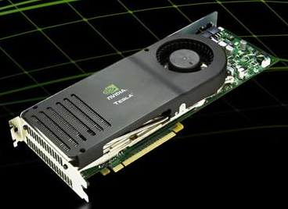

Query Collection
One batch of queries
Q0
Q1
Q2
Inverted index are stored in the GPU memory (ideal assumption)
CPU sends the queries to the GPU
GPU sends back the results to the CPU

Slide 11
Batch Size
Sum of the length of shortest inverted lists from each query exceeds a certain computational threshold
We can dynamically adjust the threshold according to:
High query traffic → Increase Threshold → Increase Throughput
Low query traffic → Decrease Threshold → Decrease Latency
Notes:
……………..

Slide 12
Outline
Background and Preliminaries
Parallel Architecture
GPU Lists Intersection
Index Compression
Experimental Results
Conclusion

Slide 13
GPU Intersection algorithm
The basic idea for intersecting two lists on GPU is parallel binary search
  Assign each docid of list₁ to a GPU thread
  Do binary search in the list₂ to check whether the docid is in list₂ (Membership Test)
  Perform scan and compact operation to generate the final result
Notes:
So how GPU intersect lists?
We take a two-term query for example.
The basic idea for intersecting two lists intersection on GPU is parallel binary search
For two list: list1 and list2:
We first assign each element of list1 to a GPU thread.

Slide 14
GPU Intersection algorithm(cont.)
Binary search is good in practice
The most time-consuming part
Can we surpass binary search?
Focus on contracting the initial search range
Each docid is assigned to one GPU thread.
list₂
8 | 20 | 30 | 44 | 45 | 50 | 54 | 55 | 60 | 65 | 70 | 80
Binary Search
list₁
10 | 20 | 30 | 40 | 45 | 48 | 55 | 57 | 65 | 80
0-1 array
0 | 1 | 1 | 0 | 1 | 0 | 1 | 0 | 1 | 1
parallel scan
_{(Prefix sum)}
0 | 0 | 1 | 2 | 2 | 3 | 3 | 4 | 4 | 5
Compact
result
20 | 30 | 45 | 55 | 65 | 80 | 0 | 0 | 0 | 0
Notes:
This page gives a explanation of how two lists intersect on GPU.
First each docid is aasigned to one GPU thread.

Slide 15
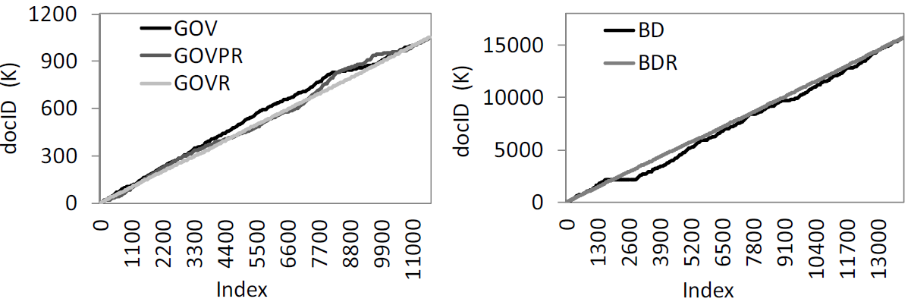
Motivation
Scatter plots for an randomly selected inverted list obtained from the dataset
Random shuffle to generate more linear shape
Reordered by PageRank to create local clusters
Motivation: Can we use interpolation search to replace binary search?

Slide 16
Interpolation Search
Interpolation search performs O(log log (n)) comparisons on average on a uniformly distributed sorted list
But it is inefficient on the GPU
  Worst case complexity O(n)
  A single slow thread will cause the entire kernel to be slow
  Interpolation search does not perform well on the local non-linearity
  More global memory accesses
Notes:
Now Let us look at interpolation search.

Slide 17
Linear Regression Approach
Left Boundary
The best fitting line using least square
Right
Boundary
Safe search range given the boundary
Original Search Range

Slide 18
Linear Regression Search
d
Binary search the docid in the range
L_{t}
R_{t}

Slide 19
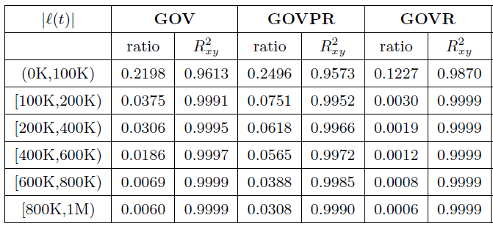
Contraction ratio and R_{xy}²
Coefficient of determination:
measure of how well the data are likely to be predicted by the linear model
We give a theoretic analysis of how the ratio changes with respect length of inverted list. Please refer to paper for detail.
Reduce 8 iterations

Slide 20
Hash Segmentation Approach
Another range restricting approach is hash segmentation (HS)
  Using , we divide an inverted list into segments
  Take the most significant m bits as hash segment ID
  The tradeoff is using more space to save the offsets
Offsets
Segmented Inverted List

Slide 21
Hash Segmentation Approach
8 | 20 | 30 | 44 | 45 | 50 | 54 | 55 | 60 | 65 | 70 | 80
The largest docID uses 7 bits : (80)₁₀ = (1010000)₂,
we set k = 7
If we use the most significant 2 bits as hash segment ID, then the inverted list will be divided as follows:
8 | 20 | 30
44 | 45 | 50 | 54 | 55 | 60
65 | 70 | 80
00 XXXXX
01 XXXXX
10 XXXXX

Slide 22
Outline
Background and Preliminaries
Parallel Architecture
Lists Intersection
Index Compression
Experimental Results
Conclusion

Slide 23
D-gap Based (De)Compression
Since an inverted list is converted to d-gap list:
To intersect two compressed list, we need to perform prefix sum to recover the list first, which has low concurrency and high thread communication overhead.
Can we decompress faster on the GPU?

Slide 24
Linear Regression (De)Compression
After decoding, if every docid can be recovered independently, we can surpass fastest scan operation
Another advantage is that: it can be easily combined with intersection. When searching a docid in a list or segment, it is not necessary to decompress all the docids, only decompress the docids that is looked up on the fly.
Each docid can be recovered independently
and no communication between GPU threads

Slide 25
Linear Regression (De)Compression (cont.)
Vertical Deviations
docid
Each docid is decompressed by a GPU thread independently
Convert the vertical deviations to non-negative integers so that they can be compressed using PFor algorithm
index

Slide 26
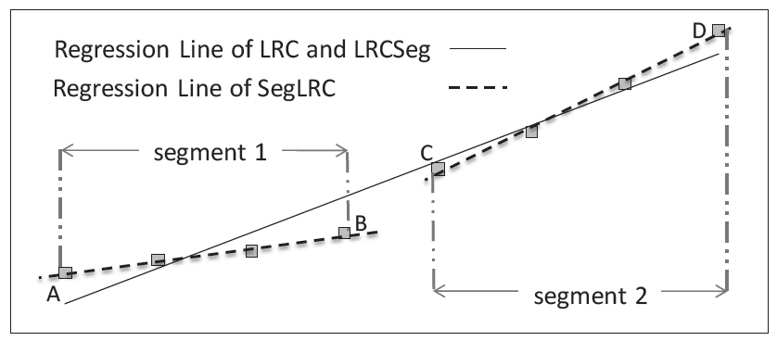
Optimization for Compression Ratio
Performing linear regression globally and then performing segmentation to obtain better local fluctuation ranges (LRCSeg).
Performing even segmentation first, then performing linear regression compression for each segment (SegLRC).
  HS_LRC (First Hash Segmentation, and LRC)

Slide 27
Outline
Background and Preliminaries
Parallel Architecture
Lists Intersection
Index Compression
Experimental Results
Conclusion

Slide 28
Environment
CPU
AMD
Memory
2GB*2
GPU Card
GTX480
PhenomIIX 4945
DDR3 1333 memory
Notes:
Next several pages, we will first see some experiment about the synchronous mode and then the asynchronous mode.

Slide 29
Dataset
TREC GOV
  1053372 html documents
  Query: Terabyte 2006, 100,000 Queries
TREC GOV2
  5038710 html documents
  Query: Terabyte 2006, 100,000 Queries
Baidu dataset (BD)
  15749656 html documents crawled in 2009
  Query: Baidu 2009 query set, 33337 queries

Slide 30
Throughput (Intersection of uncompressed lists)
Hash Segmentation performs the best!
Linear Regression is a better than binary search.
Interpolation Search is worse than binary search.

Slide 31
Compression Ratio
d-gap based methods have better compression ratio

Slide 32
Decompression Speed
Faster than d-gap based methods

Slide 33
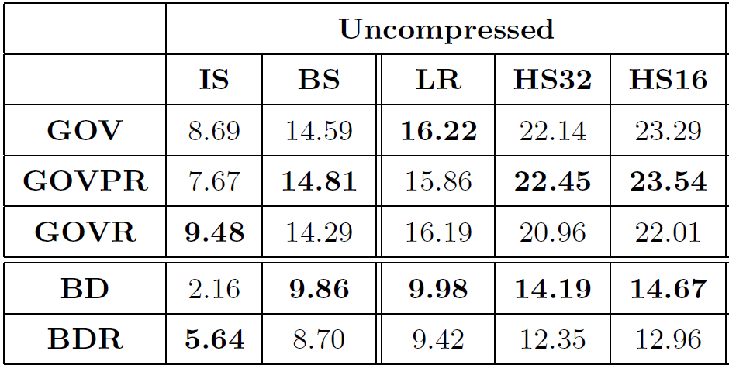
Speedup
Compared with an optimized CPU version

Slide 34
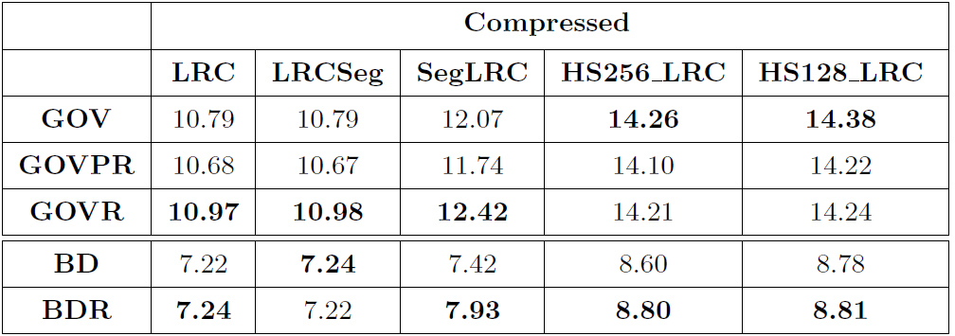
Speedup (cont.)

Slide 35
Outline
Background and Preliminaries
Parallel Architecture
Lists Intersection
Index Compression
Experimental Results
Conclusion

Slide 36
Conclusion
Lists intersection
  Linear Regression (LR)
  Hash Segmentation (HS)
Index compression
  Linear Regression Compression (LRC)

Slide 37
Thank you for your attention!
Question and Answer!

