Slide 1


High-Throughput Transaction Executions on Graphics Processors
Bingsheng He (NTU, Singapore)
Jeffrey Xu Yu (CUHK)

Slide 2
Main Results
GPUTx is the first transaction execution engine on the graphics processor (GPU).
We leverage the massive computation power and memory bandwidth of GPU for high-throughput transaction executions.
GPUTx achieves a 4-10 times higher throughput than its CPU-based counterpart on a quad-core CPU.

Slide 3
Outline
Introduction
System Overview
Key Optimizations
Experiments
Summary

Slide 4

Tx is
Tx has been the key for the success of database business.
According to IDC 2007, the database market segment has a world-wide revenue of US$15.8 billion.
Tx business is ever growing.
Traditional: banking, credit card, stock etc.
Emerging: Web 2.0, online games, behavioral simulations etc.
Notes:
Tx is the most important and advanced part of a database.

Slide 5
What is the State-of-the-art?
Database transaction systems run on expensive high-end servers with multiple CPUs.
H-Store [VLDB 2007]
DORA [VLDB 2010]
In order to achieve a high throughput, we need:
The aggregated processing power of many servers, and
Expert database administrator (DBA) to configure the various tuning knobs in the system for performance.

Slide 6
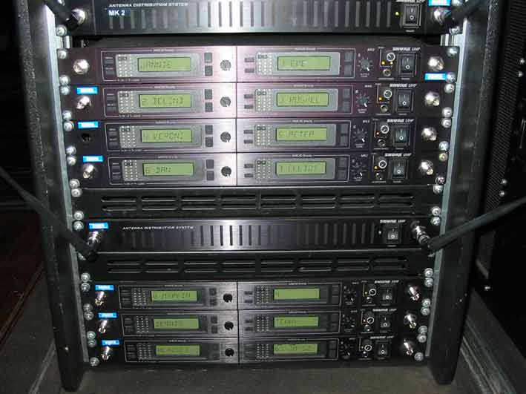



“Achilles Heel” of Current Approaches
High total ownership cost
SME (small-medium enterprises) ☹
Environmental costs

Slide 7
Our Proposal: GPUTx
Hardware acceleration with graphics processors (GPU)
GPUTx is the first transaction execution engine with GPU acceleration on a commodity server.
Reduce the total ownership cost by significant improvements on Tx throughput.

Slide 8
GPU Accelerations
GPU
Multiprocessor 1
Multiprocessor N
P1
P2
Pn
P1
P2
Pn
CPU
Local memory
Local memory
Device memory
PCI-E
Main
memory
GPU has over 10x higher memory bandwidth than CPU.
Massive thread parallelism of GPU fits well for transaction executions.

Slide 9
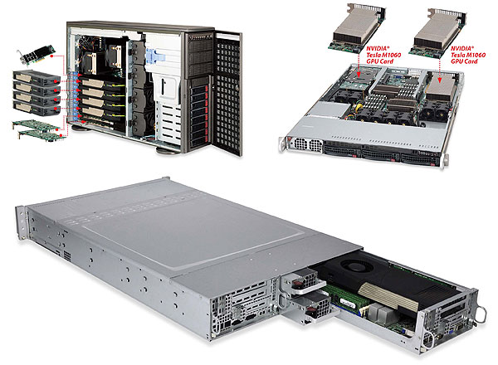
GPU-Enabled Servers
Commodity servers
PCI-E 3.0 is on the way (~8GB/sec)
A server can have multiple GPUs.
HPC Top 500 (June 2011)
3 out of top 10 are based on GPUs.

Slide 10
Outline
Introduction
System Overview
Key Optimizations
Experiments
Summary

Slide 11
Technical Challenges
GPU offers massive thread parallelism in SPMD (Single Program Multiple Data) execution model.
Hardware capability != Performance
Execution model: Ad-hoc transaction execution causes severe underutilization of the GPU.
Branch divergence: There are usually multiple transaction types in the application.
Concurrency control: GPUTx need to handle many small transactions with random reads and updates on the database.

Slide 12
Bulk Execution Model
Assumptions
No user interaction latency
Transactions are invoked in pre-registered stored procedures.
A transaction is an instance of the registered transaction type with different parameter values.
A set of transactions can be grouped into a single task (Bulk).

Slide 13
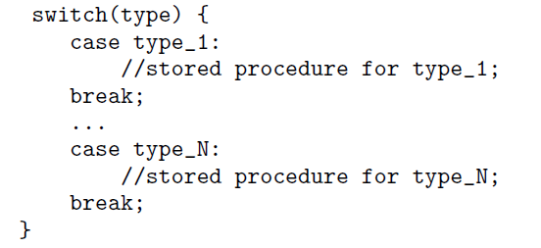
Bulk Execution Model (Cont’)
A bulk = An array of transaction type IDs
+ their parameter values.

Slide 14
Correctness of Bulk Execution
Correctness. Given any initial database, a bulk execution is correct if and only if the result database is the same as that of sequentially executing the transactions in the bulk in the increasing order of their timestamps.
The correctness definition scales with bulk sizes.

Slide 15
Advantages of Bulk Execution Model
The bulk execution model allows much more concurrent transactions than ad-hoc execution.
Data dependencies and branch divergence among transactions are explicitly exposed within a bulk.
Transaction executions become tractable within a kernel on the GPU.

Slide 16
System Architecture of GPUTx
GPUTx
Tx
Results
Tx
Results
Transaction pool
Time
Result pool
CPU &
Main memory
Bulk
Result
GPU
MP1
MP2
MPn
Device memory
In-memory processing
Optimizations for Tx executions on GPUs

Slide 17
Outline
Introduction
System Overview
Key Optimizations
Experiments
Summary

Slide 18
Key Optimizations
Issues
What is the notion for capturing the data dependency and branch divergence in bulk execution?
How to exploit the notion for parallelism on the GPU?
Optimizations
T-dependency graph.
Different strategies for bulk execution.

Slide 19
T-dependency Graph
T-dependency graph is a dependency graph augmented with the timestamp of the transaction.
K-set
0-set: the set of transactions that do not have any preceding conflicting transactions.
K-set: the transactions that have at least one preceding conflicting transactions in (K-1)-set.
T1: Ra Rb Wa Wb
T2: Ra
T2
T3: Ra Rb
T1
T4
Time
T4: Rc Wc Ra Wa
T3
0-set
2-set
1-set

Slide 20
Properties of T-Dependency Graph
Transactions in 0-set can be executed in parallel without any complicated concurrency control.
Transactions in K-set does not have any preceding conflicting transactions if all transactions in (0, 1, …, K-1)-sets finish executions.

Slide 21
Transaction Execution Strategies
GPUTx supports the following strategies for bulk execution:
TPL
Classic two phase locking execution method on the bulk.
Locks are implemented with atomic operations on the GPU.
PART
Adopt the partitioned based approach in H-Store.
A single thread is used for each partition.
K-SET
Pick the 0-set as a bulk for execution.
The transaction executions are entirely in parallel.

Slide 22
Transaction Execution Strategies (Cont’)
0
1
B₁
T_{1,1}
T_{1,2}
T_{1,1}
T_{1,2}
T_{1,1}
T_{1,2}
T_{1,1}
T_{1,2}
0
1
B₂
T_{2,1}
T_{2,2}
T_{2,1}
T_{2,2}
T_{2,1}
T_{2,2}
T_{2,1}
T_{2,2}
0
1
B_{n}
T_{n,1}
T_{n,2}
T_{n,1}
T_{n,2}
T_{n,1}
T_{n,2}
T_{n,1}
T_{n,2}
(a) T-dependency graph
(b) A bulk of TPL
(c) A bulk of PART
(d) Bulks in K-SET
A bulk
Execution order within
a partition of PART

Slide 23
Other Optimization Issues
Grouping transactions according to transaction types in order to reduce the branch divergence.
Partial grouping to balance between the gain on reducing branch divergence and the overhead of grouping.
A rule-based method to choose the suitable execution strategy.

Slide 24
Outline
Introduction
System Overview
Key Optimizations
Experiments
Summary

Slide 25
Experiments
Setup
One NVIDIA C1060 GPU (1.3GHz, 4GB GRAM, 240 cores)
One Intel Xeon CPU E5520 (2.26GHz, 8MB L3 cache, four cores)
NVIDIA CUDA v3.1
Workload
Micro benchmarks (basic read/write operations on integer arrays)
Public benchmarks (TM-1, TPC-B and TPC-C)

Slide 26
Impact of Grouping According to Transaction Types
(Micro benchmark: _L, lightweight transactions; _H, heavy-weight transactions)
A cross-point for light-weight transactions.
Grouping always wins for heavy-weight transactions.

Slide 27
Comparison on Different Execution Strategies
(Mico benchmark: 8 million integers, random transactions)
The throughput of TPL decreases due to the increased contention of locks.
K-SET is slightly faster than PART, because PART has a larger runtime overhead.

Slide 28
Overall Comparison on TM-1
The single-core performance of GPUTx is only 25-50% of the single-core CPU performance.
GPUTx is over 4 times faster than its CPU-based counterparts on the quad-core CPU.

Slide 29
Throughput Vs. Response Time
(TM-1, sf=80)
GPUTx reaches the maximum throughput when the latency requirement can tolerate 500ms.

Slide 30
Outline
Introduction
System Overview
Key Optimizations
Experiments
Summary

Slide 31
Summary
The business for database transactions is ever growing in traditional and emerging applications.
GPUTx is the first transaction execution engine with GPU acceleration on a commodity server.
Experimental results show that GPUTx achieves a 4-10 times higher throughput than its CPU-based counterpart on a quad-core CPU.

Slide 32
Limitations
Support for pre-defined stored procedures only.
Sequential transaction workload.
Database fitting into the GPU memory.

Slide 33
Ongoing and Future Work
Addressing the limitations of GPUTx.
Evaluating the design and implementation of GPUTx on other many-core architectures.

Slide 34
Acknowledgement
An AcRF Tier 1 grant from Singapore
An NVIDIA Academic Partnership (2010-2011)
A grant No. 419008 from the Hong Kong Research Grants Council.
Claim: this paper does not reﬂect opinions or policies of funding agencies

Slide 35
Thank you and Q&A

Slide 36
PART
 | Maximum | Suitable value
TM-1 | f million | f million/128
TPC-B | f | f
TPC-C | f*10 | f*10

Slide 37
The Rationale
Hardware acceleration on commodity hardware
Significant improvements on Tx throughput
→Reduce the number of servers for performance
→Reduce the requirement on expertise and #DBA
→→Reduce the total ownership cost

Slide 38
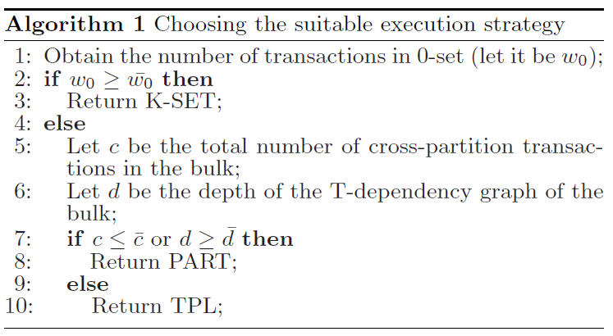
The Rule-based Execution Strategies

Slide 39
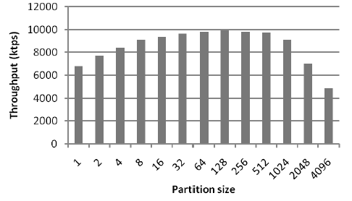
Throughput Varying the Partition Size in PART

Slide 40
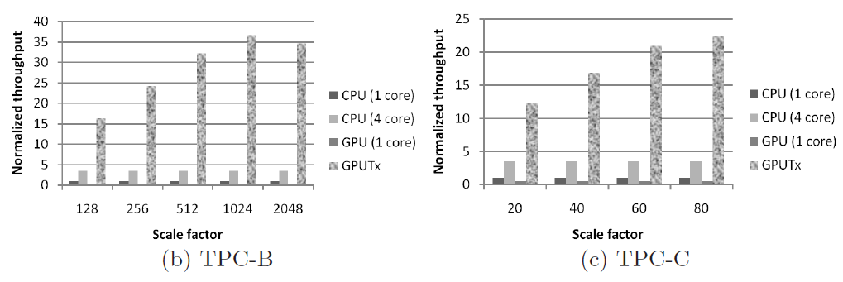
TPC-B and TPC-C

