Slide 1
Fast Sparse Matrix-Vector Multiplication on GPUs: Implications for Graph Mining
Xintian Yang, Srinivasan Parthasarathy and P. Sadayappan
Department of Computer Science and Engineering
The Ohio State University
Notes:
Good afternoon, everyone! I am Xintian Yang. I am from the data mining research lab in the ohio state university. Today I am going to present my work about fast sparse matrix and vector multiplication on GPUs and its application on graph mining. This is joint work with my advisor Professor Srinivasan Parthasarathy and Professor Sadayappan.

Slide 2
Outline
Motivation and Background
Single- and Multi- GPU SpMV Optimizations
Automatic Parameter Tuning and Performance Modeling
Conclusions
Notes:
I will first introduce the motivation of our work and some background knowledge about GPUs.

Slide 3
Introduction
Sparse Matrix-Vector Multiplication (SpMV)
y = Ax, where A is a sparse matrix and x is a dense vector.
Dominant cost when solving large-scale linear systems or eigenvalue problems in iterative methods.
Focus of much research
Scientific Applications, e.g. finite element method
Graph Mining algorithms
PageRank, Random Walk with Restart, HITS
Industrial Strength Efforts
CPUs, Clusters (e.g. Vuduc, Yelick et al 2009)
GPUs (e.g. NVIDIA 2010)
Notes:
Sparse matrix and vector multiplication computes the vector y as a product of a sparse matrix A and a dense vector x. Usually, this operation is the dominant cost when solving a large-scale linear system or eigen value problem in iterative methods. Spmv kernel is widely used, for example, scientific applications, such as finite element methods use this kernel.
In graph mining area, algorithms including PageRank, Random walk with restart and Hits, they all depend on the spmv kernel. There are much industrial strength efforts on improving the performance of this kernel. Researchers have investigated the implementation of this kernel on cpus, cluster of cpus, for example the work by Vuduc and Yelick et al. and Researchers from Nvidia recently proposed to implement this kernel on GPUs. The focus of this talk is about how to improve the performance of this kernel further on GPUs.

Slide 4
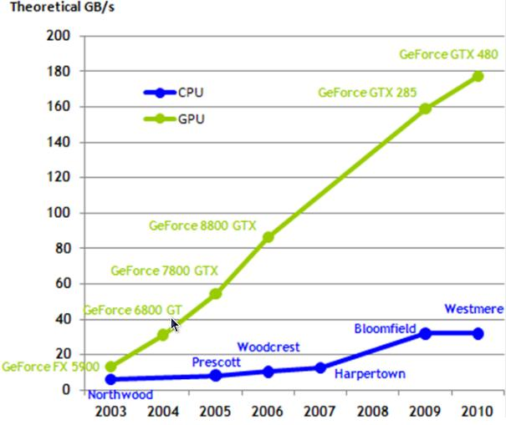
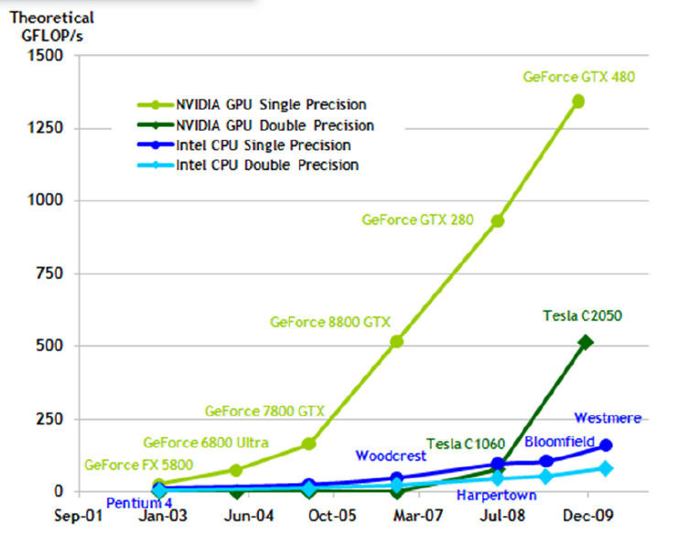
Why GPUs?
High Performance
GPU is 10x faster
High Memory Bandwidth
180 GB/s v.s. <40 GB/s
High Productivity
CUDA (now) vs. OpenGL (before)
GB/s
GFLOPS
[ Source: www-sop.inria.fr/nachos ]
Notes:
So why do we use gpus? First of all, the peak performance of GPUs is much higher than cpus. The right figure shows a comparative study of GPU and CPUs. The y axis represents performance numbers in GFLOPS. The two green lines represent peak single and double precision performance of GPUs, the two blue lines show the numbers of intel CPUs. We can see the current Fermi gpu is about 10 times faster than the current intel cpus. Second, the memory bandwidth of GPU is much higher than CPU. The right figure shows the memory bandwidth comparison of GPU and CPU. The y axis shows the bandwidth number in GB/s. As we know the SpMV kernel is a memory bound problem. The high bandwidth of GPU provides us great opportunity for improving the performance of the SpMV kernel. Third, after nvidia introduced the CUDA programming model, the productivity of gpu programming is much higher than before.

Slide 5
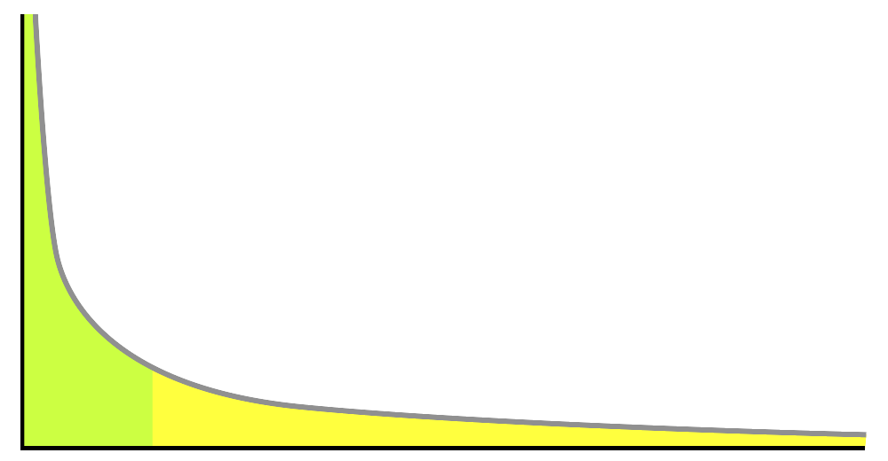
Problem Statement and Challenges
Can we improve upon industrial strength efforts for computing SpMV on matrices representing large power-law graphs on GPU?
Does it yield end-to-end improvements in graph mining application (e.g. PageRank) ?
Challenges
Need to balance load
Power-law nature of graphs
Need to coalesce memory access
Need to avoid conditional divergence
SIMD architecture prefers the threads follow
identical control flow in branching instructions.
Need to handle large matrices
Degree
Graph Nodes
[ Source: Wikipedia ]
Notes:
In this paper, we want to address the question that “Can we improve upon industrial strength efforts for computing SpMV on matrices representing large power-law graphcs?” and “Does it yield end-to-end improvements in graph mining applications?” There are several challenges to solve the above problems: Firs we need to balance the workload among the parallel threads on GPU. This is due to the power-law nature of the graph data used by graph mining algorithms. The figure on the right shows the degree distribution of an example power-law graph. We can see there are small number of nodes with very high degrees and large number of nodes with low degree. This means the computational workload at each graph node is not balanced. Second, we need to coalesce the memory accesses. Memory coalescing is a special requirement of GPU that we have to follow, otherwise the performance will be penalized. I will introduce it in the following slides. Third, we need to avoid conditional divergence among the parallel threads. This is due to the SIMD nature of GPU and it prefers that the parallel threads follow identical control flow. Finally, we want to handle large matrices that cannot fit in the memory of a single GPU.

Slide 6
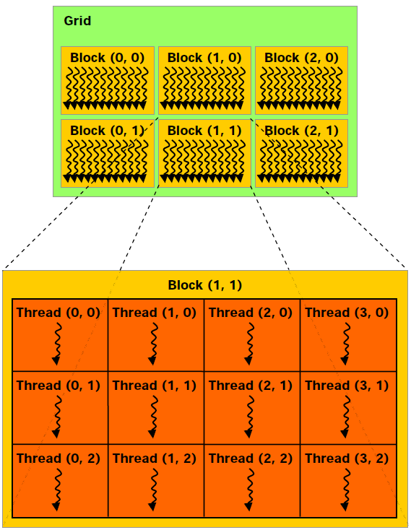
Background: CUDA Architecture
Programming Model (logical hierarchy):
Grid
Block
Thread
Kernel
[ Source: NVIDIA CUDA guide ]
Notes:
Next I will introduce some background knowledge about the CUDA GPU architecture. I will first talk about the programming model of CUDA GPU.
GPU is a highly parallel architecture with thousands of parallel threads on it.
This is the logical view of the programmer. A cuda program has a 1D or 2D thread grid, represented by the green rectangle. Within the thread grid,
There are many parallel thread blocks. And within a thread block, there are many parallel threads. The number of blocks and number of threads in a block can be defined by the programmer. All the thread will execute the same piece of code, which is called the kernel, but on different data.

Slide 7
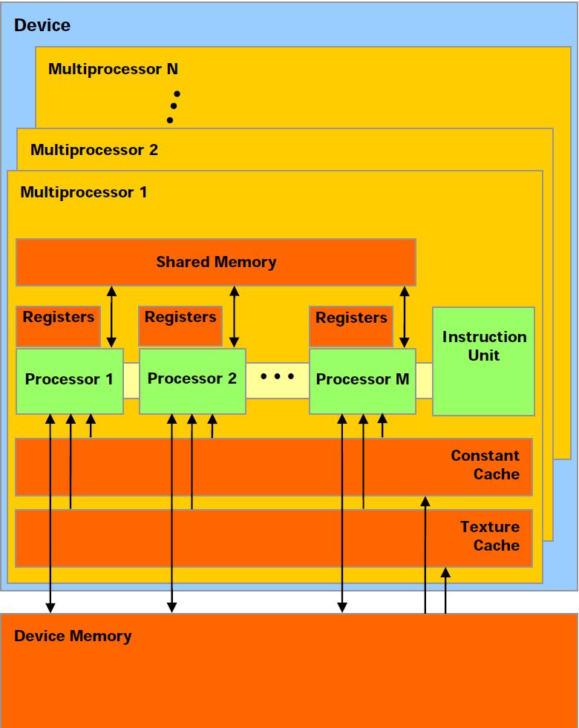
Background: CUDA Architecture
Hardware (Physical):
A set of multiprocessors
A warp = 32 threads, concurrently run the same instructions
Conditional divergence
Parallel threads should follow identical control flow to avoid performance penalty.
Memory System
Global memory: coalescing
Texture cache
6~8KB texture cache per multiprocessor
[ Source: NVIDIA CUDA guide ]
Notes:
On this slide, I will introduce some key hardware features that our paper relies on. A cuda hardware has a set of multiprocessors. The parallel threads will be scheduled onto these multiprocessors. The minimum scheduling unit is called a warp which has 32 threads. Threads within a warp concurrently run the same instructions. If there is a conditional branch in the instruction, and threads in a warp are taking different branches, then these threads will be serialized. Parallel threads should follow identical control flow to avoid performance penalty.
Next, I will introduce the memory system of CUDA GPUs. There are several memory spaces on a GPU. First is the global memory, it is accessible by all the threads. It is used to transfer data from the cpu memory to gpu. The latency is high, but if 16 threads in a half warp are accessing 16 consecutive words of global memory, then the 16 accesses are coalesced into 1 memory transaction, and is much faster. So we want to make sure that all memory accesses from global memory are coalesced. The GPU also has texture cache. I will talk about how our optimizations utilize the texture cache to improve the performance of SpMV kernel on later slides.

Slide 8
Outline
Motivation and Background
Single- and Multi- GPU SpMV Optimizations
Automatic Parameter Tuning and Performance Modeling
Conclusions
Notes:
Next I will talk about our optimizations for single and multi gpu spmv kernels.

Slide 9
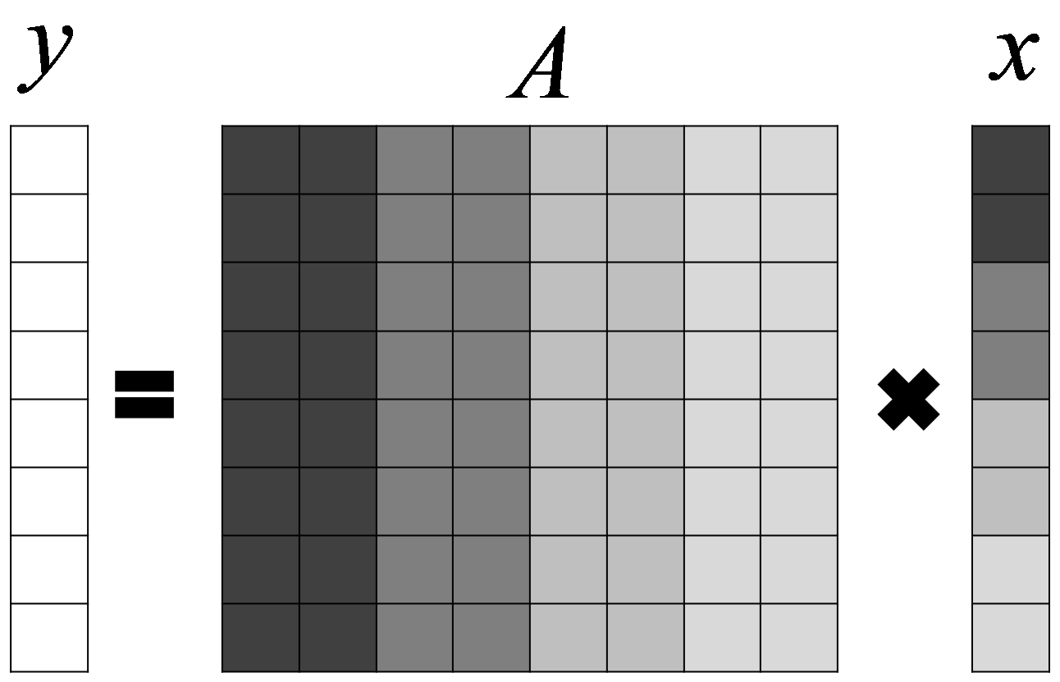
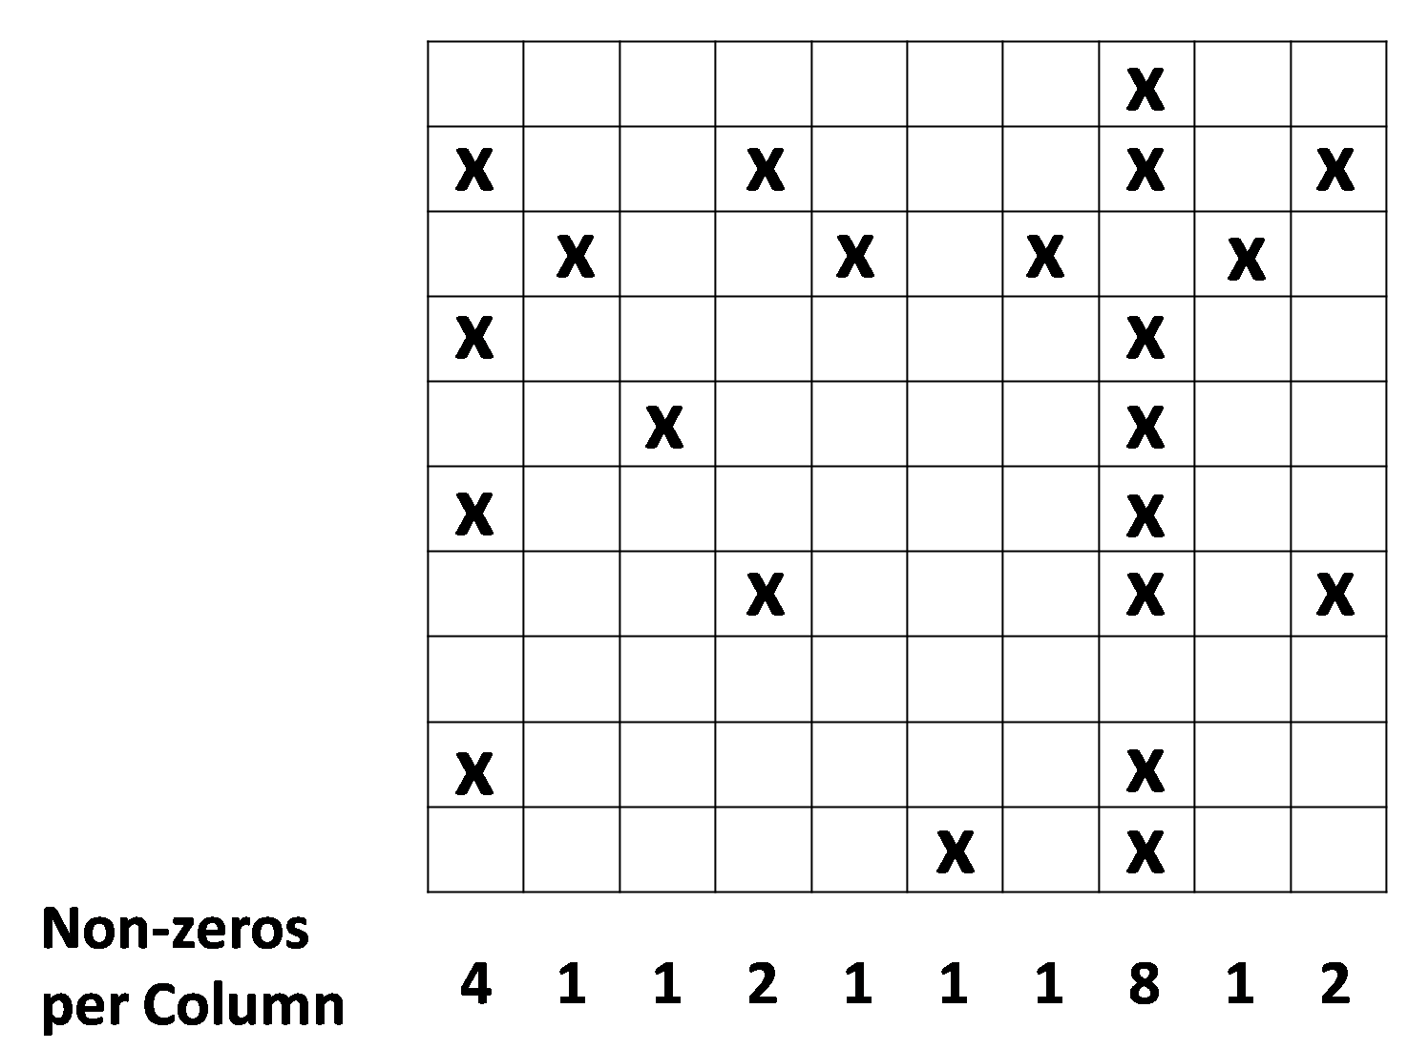
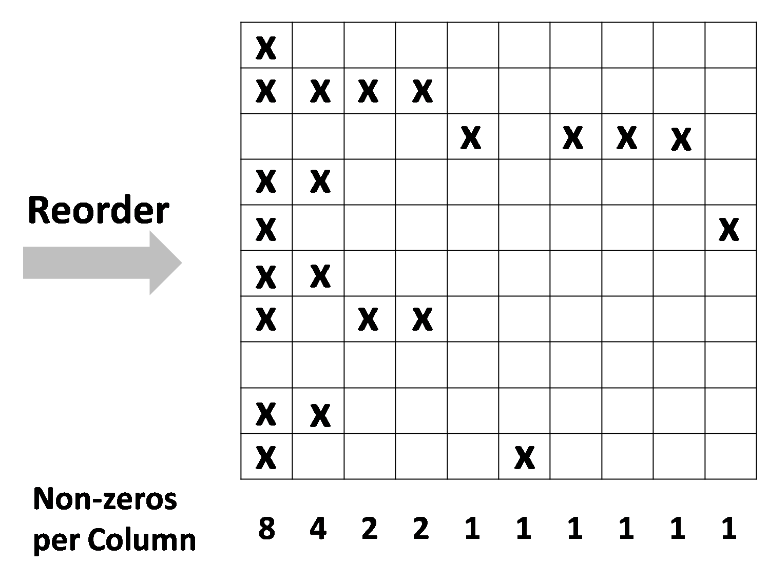
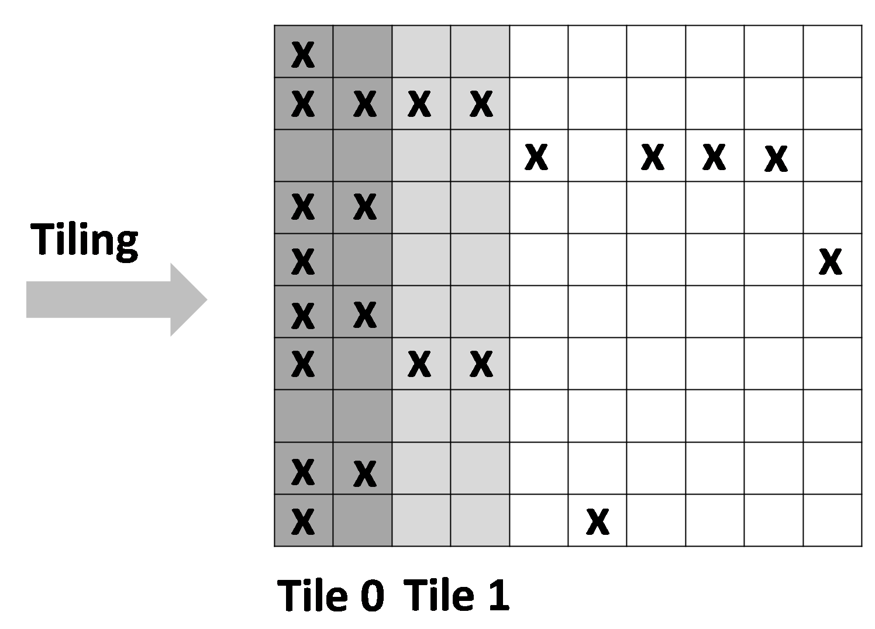
Single GPU Optimizations I
Problem I: Row accesses random values in vector x -- bad locality.
Solution: Tiling matrix A and vector x by texture cache.
Problem II: Full tiling is not always beneficial (power-law)
Solution: Partially tiling (parameterized), reorder by column length.
Texture cache size was not available
Estimated to be 250 KB (=64,000 columns)
Note entire X cannot fit on texture cache
Notes:
Our optimizations are based on several observations of the problems in previous methods. The first problem we observed is that the rows in matrix A will access random values in vector X. This results in very bad locality. We want to use the texture cache to store vector X, so the accesses will be much faster. But the challenge here is vector is usually too large to fit in the cache. Here we propose the solution of tiling matrix A and vector X by texture cache. In this example, suppose our texture cache can hold two elements in vector X. We first load its first two elements into cache, and we first do the multiplication of the first two columns of A with the 2 elements in the cache. Then we move to the second two columns and so on. With this setting, we insure that all the accesses to X are from the cache. However, we also observe that fully tiling of all columns in the matrix is not always beneficial. This is because the column length follows power-law distribution and there many columns with a single elements. On such columns we don’t have any reuse of the value in the cache. So we propose a solution of partially tiling, by first reorder the columns by length and we only tile the dense part with long columns. Here we introduce a parameter to decide when do we stop the tiling. I will talk about how do we tune this parameter automatically. In this example, we have the original matrix on the left, we reorder the columns by length in the middle matrix, and we only tile the first four long columns in the matrix.

Slide 10
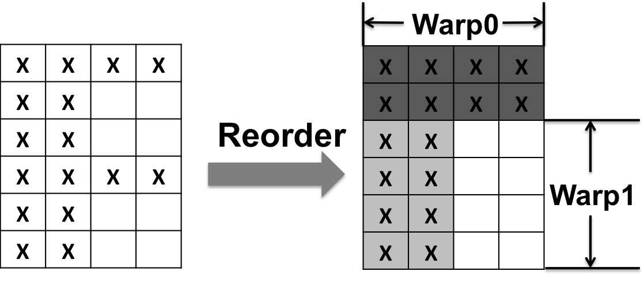
Single GPU Optimizations II
Problem III: Imbalance in Row Length
Solution: Composite Storage
Row major performs well on long rows (1 warp per row).
Column major performs well on short rows (1 thread per row).
Partition rows into workload with similar size, padded with 0.
Workload with long rows will be stored in row major.
Workload with many short rows will be stored in column major.
Workload size: parameterized
Notes:
Our second optimization is related to the elements within a tile after tiling. We observed the problem that the rows within a tile are not balanced due to the power-law nature of the graph.
The solution we propose here is a composite storage scheme. Our benchmarking shows that for long rows, it is more efficient to store them in row major and assign 1 thread warp per row.
And for short rows, if we have many of them together, like the long tail part of the power-law distribution, it is more efficient to store them in column major and compute each row with 1 thread.
In our composite storage method, we first reorder the rows in each tile from long to short. Then the rows are partitioned into workload with similar size. The workload that has long rows will be stored in row major and the workload that has many short rows will be stored in column major. Here the workload size is parameterized, I will talk about its tuning later.
In the following example, we have the original matrix tile on the left, we first reorder the rows, so the two long rows with 4 elements will be grouped together, we put them in one workload, store them in row major and assign a thread warp to work on them row by row. The next 4 short rows with 2 elements are grouped together, we store them in column major and assign a thread warp to work on them column by column.

Slide 11
Empirical Results on NVIDIA Tesla GPU
Power-law matrices
Notes:
This slide shows the experiment results on 5 power-law matrices on NVIDIA Tesla GPU.
On each dataset, the two bars on the right hand side represent our two optimizations.
We compare our methods with a CPU implementation, 4 GPU implementations from NVIDIA, and an optimized GPU kernel from IBM. The top figure shows the performance result of each implementation. Our method has 1.5-2x speedup over the best GPU implementation from NVIDIA and about 30X speedup over CPU implementation.
The bottom figure shows the memory bandwidth results, which has similar trend to the performance results.
This slide shows that our single GPU methods are very effective on power-law matrices.

Slide 12
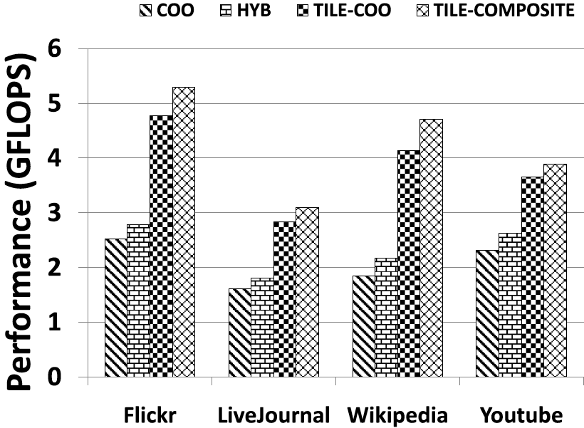
Results: PageRank
CPU: Vuduc, Yelick et al 2009
GPU: NVIDIA 2010
up to 16.5X over CPU
GPU: Tile-Composite
up to 30X over CPU
up to 2X over NVIDIA GPU
Notes:
Next, I will show the performance of the PageRank graph mining algorithms using our spmv kernel on 4 datasets from social network.
We compare our methods with the COO and HYB kernels, they are the best two kernels from NVIDIA on these dataset. The top left figure shows the performance result,
The table at the bottom shows the total running time in seconds. We compared our kernel with a CPU implementation using Vuduc and Yelick’s method, and GPU implementation from NVIDIA. NVIDIA’s method can achieve up to 16.5 times speed up over CPU. Our method achieves up to 2x speed up over NVIDIA’s GPU kernels. And up to 30 times faster than the CPU kernel.
This experiment shows that our optimizations can provide similar speedups in graph mining applications such as PageRank.

Slide 13
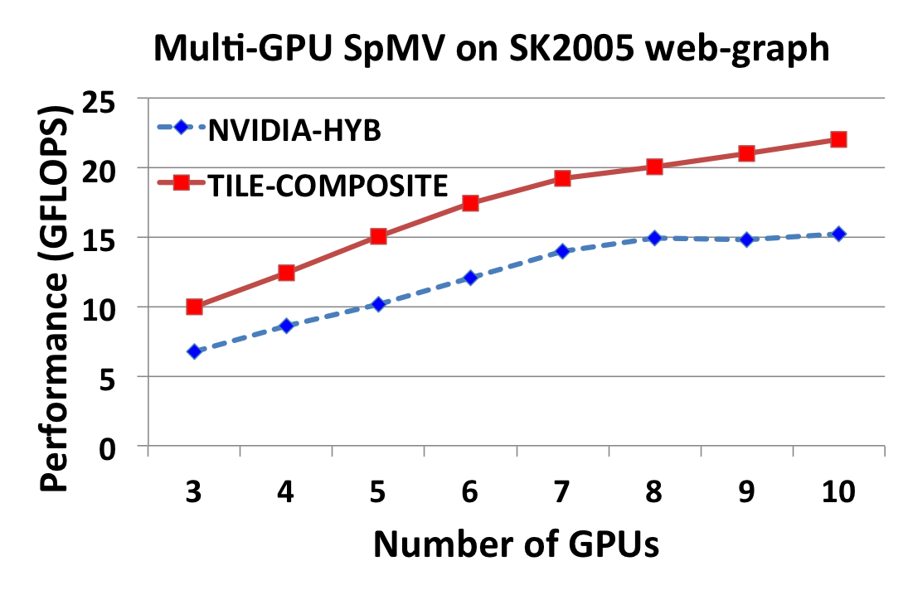
Multi-GPU SpMV
Problem IV: Handling Large Matrices
Challenge: PCI-express bandwidth limitation(max 8GB/s)
Solution: Processing on Multiple GPUs
Partition the matrix by rows
and distribute the work to
different GPUs in a cluster.
SK2005 dataset:
50 million nodes
2 billion edges
75% parallel efficiency
Improvement over NVIDIA – 1.5X
Notes:
Next, we want to extend our optimizations to handle large matrices that cannot fit on the memory of a single GPU.
The challenge here is that the bandwidth of the PCI-express bus that connects GPU to CPU is a limitation factor. The maximum bandwidth of it is 8GB/s, however the bandwidth result of our spmv kernel can achieve more than 50 GB/s. So we cannot move the data in a streaming fashion from CPU to GPU through the PCI bus.
We overcome this limitation by processing large matrices on multiple GPUs. We partition the matrix by rows and distribute the work to different GPUs.
Here we show the experimental result on the SK2005 web graph dataset. It has 50million nodes and 2 billion edges. The red line in the right figure shows the performance results
using 3 to 10 GPUs, where each GPU runs our Tile-composite kernel. Here the number of GPUs starts from 3 because the data cannot fit on a single GPU. We can see our method can achieve 75% parallel efficiency with less than 10 GPUs. The blue line shows the result of multi-GPU spmv using NVIDIA’s Hybrid kernel locally. We can see we still get about 1.5 times speed up over NVIDIA’s method.

Slide 14
Outline
Motivation and Background
Single- and Multi- GPU SpMV Optimizations
Automatic Parameter Tuning and Performance Modeling
Conclusions
Notes:
Next, I will introduce the performance modeling of our method and automatic tuning of the parameters in our methods.

Slide 15
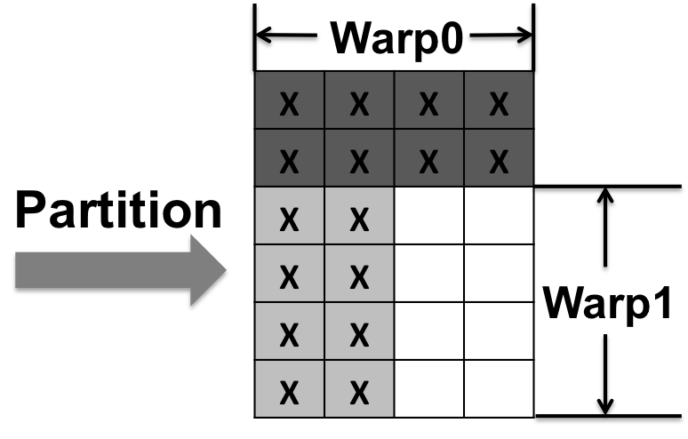
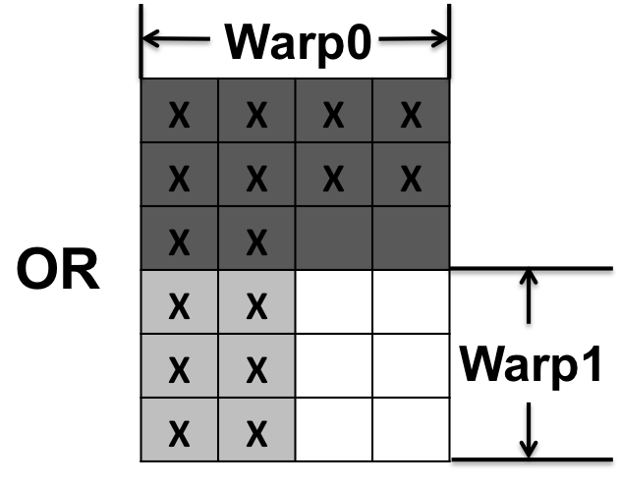
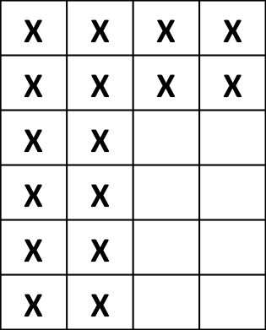
Automatic Parameter Tuning
Two parameters in our approach
Number of tiles: when to stop partially tiling?
Workload size in a tile: how to partition a tile?
Stop when no memory
reuse benefits!
Notes:
There are two parameters.
First, the number of tiles which decides when to stop the partially tiling. This parameter is straight forward to tune. The performance gain of tiling comes from the reuse of the values in the x vector. Our experiment shows that if there is any reuse, however small, tiling is beneficial. So we tile until the columns have only one non-zero. There is no reuse of vector x on such columns, then we stop tiling.
The second parameter is the workload size in a tile, which tells us how to partition a tile.
Given an example tile, there are many ways of partition. In this example, we can either put the first two rows in a partition or the first three rows.
Next I will talk about the details on how do we tune the value of this parameter.

Slide 16
Automatic Parameter Tuning
Performance Modeling
Offline component: map a workload to a performance number
Parameter search space pruning
Dataset independent and one time cost per hardware
Online component: given all the workloads of a matrix tile, take the average performance as predicted performance
Streaming Multiprocessor
Warp 0
Warp 1
Warp 2
Warp 3
1x64
2x32
32x2
64x1
6 GFLOPS
4 GFLOPS
3 GFLOPS
1 GFLOPS
Notes:
We build a performance model to model the execution of our kernel on GPUs.
During the execution, there will be multiple thread warps on each streaming multiprocessor. But different warps will work on different workloads. For example, in this figure, there are four warps on the multiprocessor, each one has a different workload. In our performance model, we have an offline component to map a workload to a performance number. For example, we can map the first workload to 6GFOPS, second to 4 GFLOPS and so on. We will have a lookup table to store this mapping. We need to run one benchmark experiment for every possible workload size. And there are many of them. To reduce this number, we have some parameter search space pruning techniques. Please refer to our paper for the details. Here I want to emphasize that this mapping is dataset independent, so it is a one time cost per hardware. Since there are not many new chips coming out frequently, this cost is acceptable. After we get this mapping from the offline component, we have an online component to predict the performance of a matrix tile. Given a partition, we will take the average performance of all workloads as the predicted performance. We will pick the partitioning that has the best predicted performance as our optimal parameter.

Slide 17
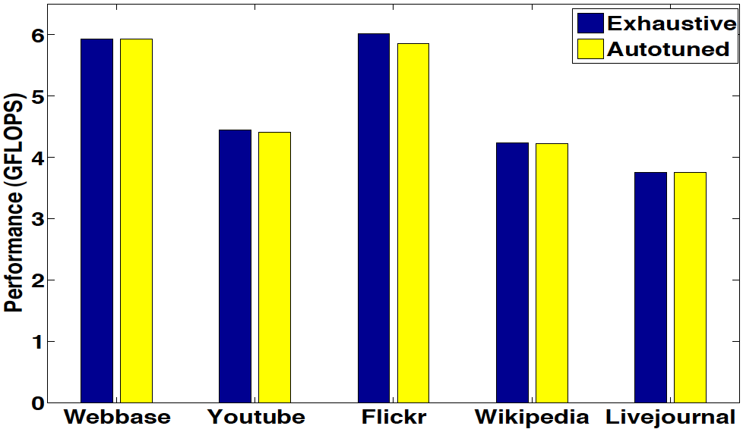
Automatic Parameter Tuning
Results
Performance model can also be used to predict performance.
Notes:
Next, we show some results about our automatic parameter tuning. In this figure, the blue bar shows the best performance on each dataset through exhaustive search. The yellow bar shows the performance of the kernel using autotuned parameters. We can see that the autotuned are very closed to the performance by exhaustive search. So our autotuning method works pretty well to find the optimal parameters.
Here I also want to mention that our performance model can also be used to predict performance without running the kernel on the hardware.

Slide 18
Outline
Motivation and Background
Single- and Multi- GPU SpMV Optimizations
Automatic Parameter Tuning and Performance Modeling
Conclusions
Notes:
Next, I will conclude my talk with some take home messages for you.

Slide 19
Take Home Messages
Architecture conscious SpMV optimizations for graph mining kernels (e.g. PageRank, RWR, HITS) on GPU
Highlight I: Orders of magnitude improvement over best CPU implementations.
Highlight II: 2X improvement over industrial strength implementations from NVIDIA and others
PCI-express bandwidth limiting factor for processing large graphs
Multiple GPUs can handle large web graph data.
Auto-tuning leads to non-parametric solution!
Also enables accurate performance modeling.
Notes:
In this work we made architecture conscious SpMV optimizations for graph mining kernels on GPU.
Our single GPU optimization is orders of magnitude faster than CPU implementations and it is about 2 times speedup over industrial strength implementations from NVIDIA.
Second, due to the PCI-express bandwidth limiting factor for processing large graphs, we propose a multi-gpu solution that can handle large web graph data.
Finally, our auto-tuning method leads to a non-parametric solution. And it also enables accurate performance modeling.

Slide 20
Acknowledgment: grants from NSF
CAREER-IIS-034-7662
RI-CNS-0403342
CCF-0702587
IIS-0917070
Thank you for your attention!
Questions?
Notes:
I would like to thank our funding agencies for providing grants for us to conduct this research. Thank you for your attention! And I would like to take any questions.

Slide 21
Backup slides

Slide 22
SpMV Kernel
Unstructured matrices: non-power-law
Notes:
However, our optimizations are not free-lunch. On this slide, we show the performance and bandwidth of different methods on non-power-law matrices. On these datasets, no method dominates the others on all the datasets. Because these matrices tend to have balanced row lengths, the hybrid kernel from nvidia and the optimized csr-vector kernels perform better. Here I want to point out the bandwidth result on the dense matrix. Our tiling with composite storage methods achieves105 GB/s bandwidth which is even higher than the number of the peak bandwidth of the hardware we used. This is because we use the cache to store vector x, and it is highly reused.

Slide 23
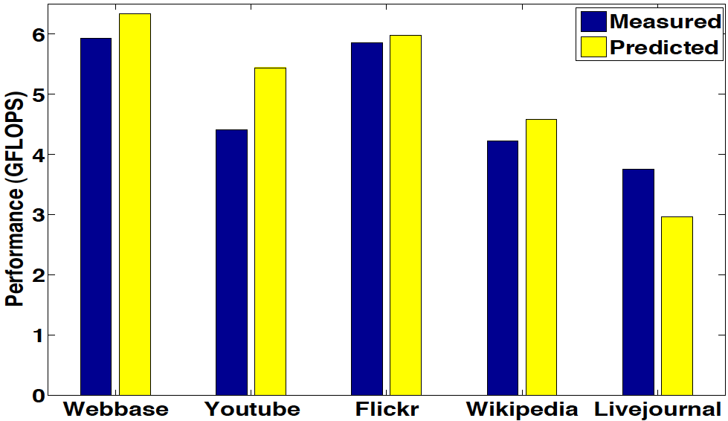
Performance Prediction

Slide 24
Dataset

Slide 25
Hardware Details
CPU: AMD Opteron X2 with 8GB RAM
GPU: NVIDIA Tesla C1060 with 30 multiprocessors, 240 cores and 4GB global memory
MPI-based cluster with 1 CPU and 2 GPUs per node.
CUDA version 3.0

Slide 26
Sorting Cost
Sorting is used to re-structure the columns and rows of the matrix.
When the row or column lengths follow power-law distribution, they can be sorted very efficiently
The numbers in the long tail of the power-law distribution can be sorted using bucket sort in linear time.
We only need to sort the remaining numbers.
Further more, these cost can be amortized by the iterative call to the SpMV kernel.

Slide 27
Parameter search space pruning for workload size
Lower bound: the longest row in a tile
It cannot be partitioned.
Upper bound: total number of non-zeros in a tile divided by the maximum number of available warps (960 on the Tesla GPU)
We want to fully utilize the available resource.
Workload size must be an integer multiple of the longest row
The first workload must be a rectangle.

Slide 28
Data Mining Applications
Given directed graph G = (V, E) , and adjacency matrix A
PageRank:
W is row normalization of A
c = 0.85, U is a n by n matrix with all elements set to 1/n.
Random Walk with Restart (RWR): given a query node i, compute the relevance score from all other nodes to node i.
W is column normalization of A
c = 0.9, the ith element in is 1, the others are all 0.
HITS: each web page is assigned an authority score and a hub score.

Slide 29
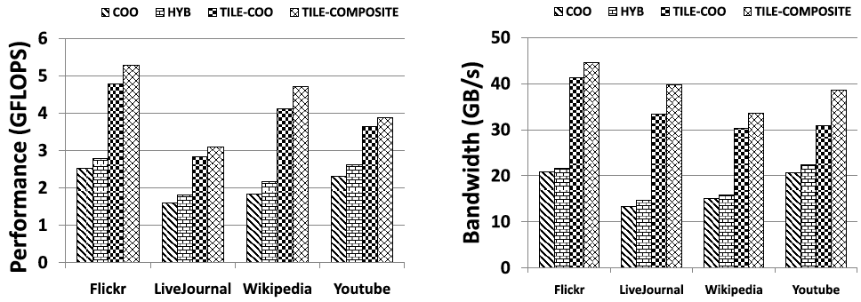
PageRank

Slide 30
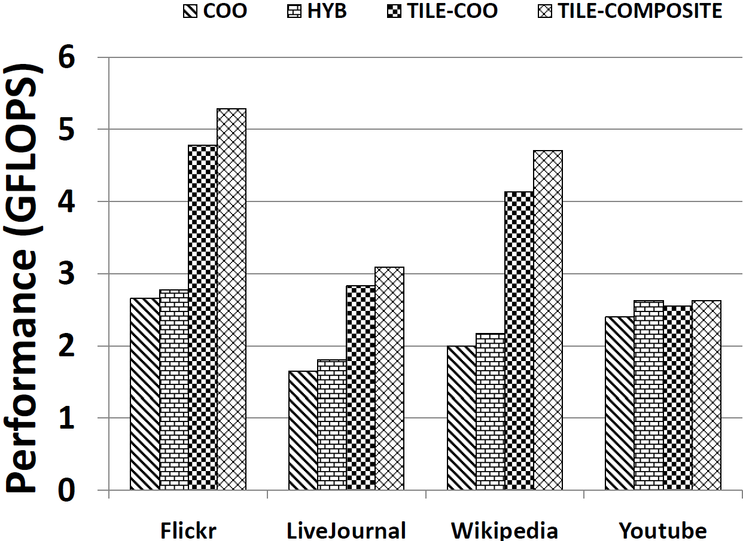
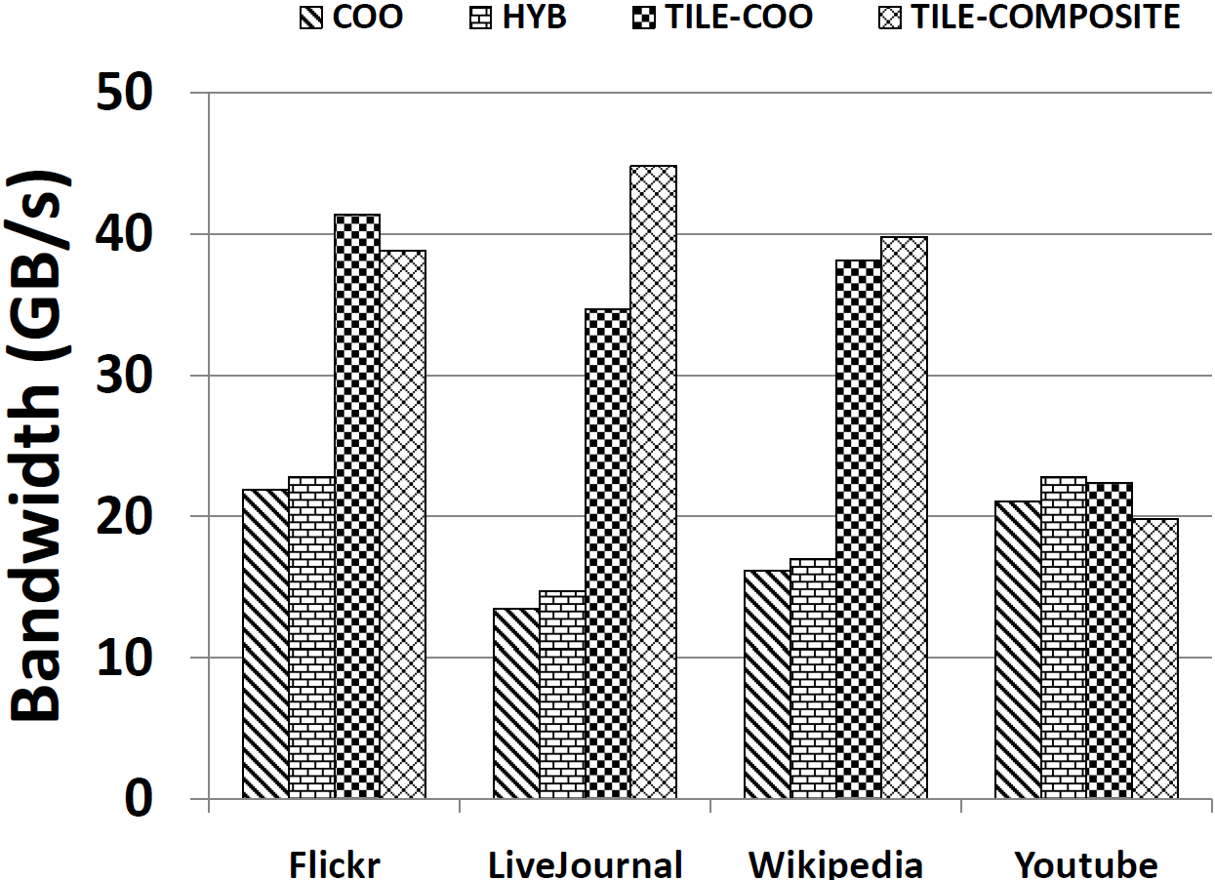
Random Walk with Restart

Slide 31
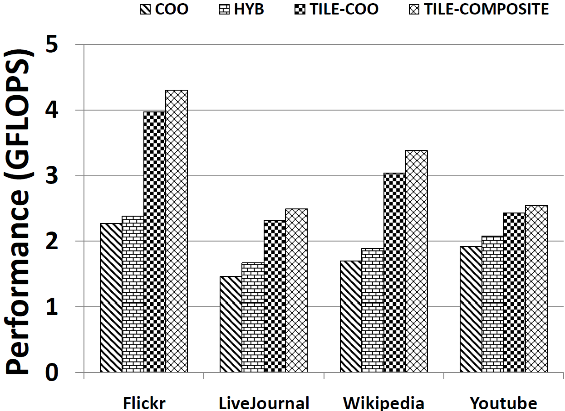
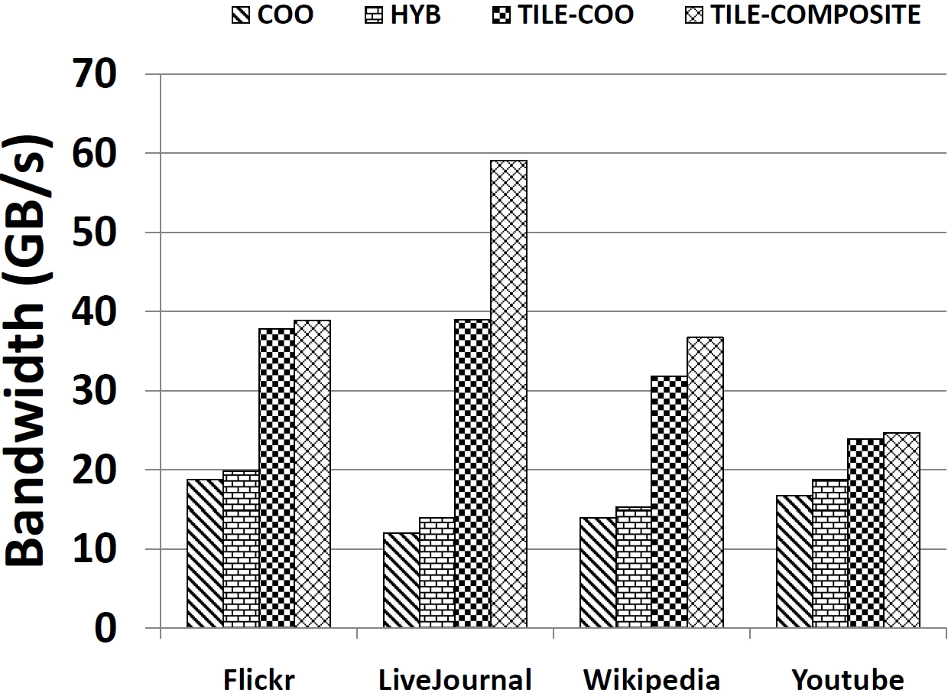
HITS

Slide 32
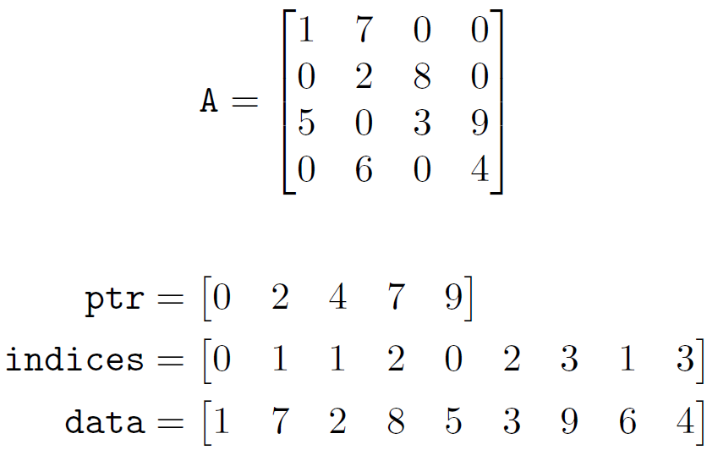
Limitations of Previous Work
NVIDIA’s SpMV Library based on different storage formats of matrix A.
CSR
CSR kernel
CSR-vector kernel
Optimized CSR-vector
Baskaran et al.
CSR: Imbalanced workload amongst threads, non-
coalesced memory accesses.
CSR-vector: many short rows, waste of threads

Slide 33
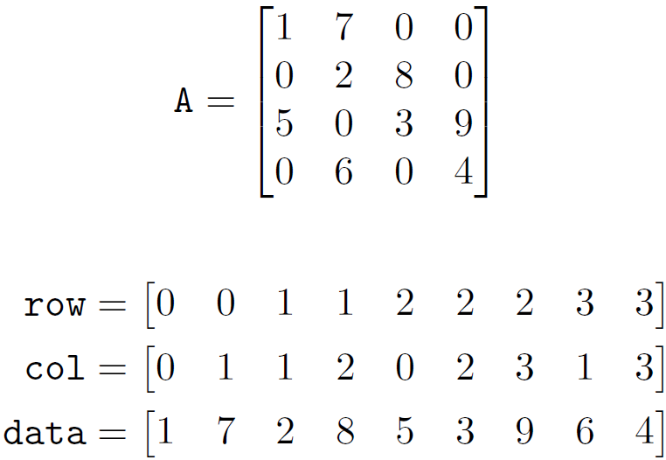
Limitation of Previous Work
COO kernel
Each warp works on one interval
Warps run in parallel
With in one warp, threads do binary reduction, need to check whether two operands are from the same row
warp0
warp1
COO: thread divergence, low thread level parallelism

Slide 34
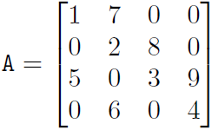
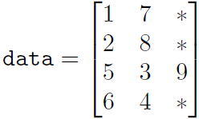
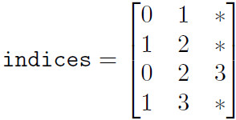
Limitation of Previous Work
ELL kernel
Requires row lengths are bounded by a small number k, 0s are padded if a row is shorter than k.
Data and index matrices are stored in column major, each thread works on one row.
HYB kernel: ELL + COO
ELL: long rows can’t be bounded
HYB: ELL part only covers small amount of computation,
COO part is slow, increasing the ratio of ELL part
introduces memory overhead.

