Slide 1


Synthesizing Products For
Online Catalogs
Hoa Nguyen
Juliana Freire
University of Utah
Ariel Fuxman
Stelios Paparizos
Rakesh Agrawal
Microsoft Research
Notes:
- This work has been done while I did my internship at Microsoft

Slide 2
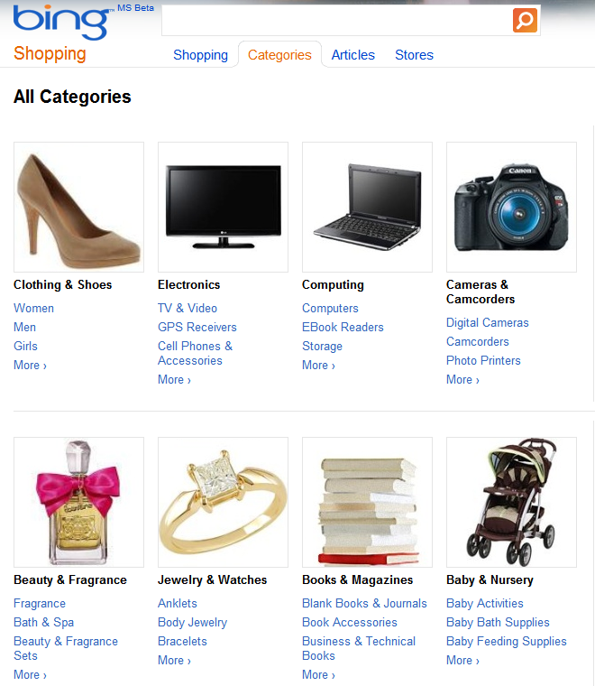
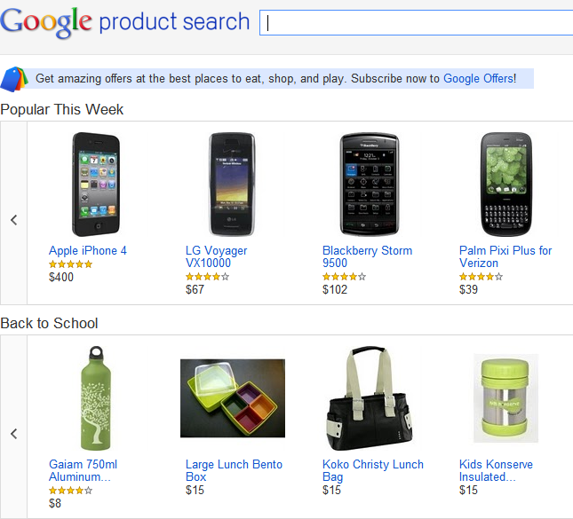
Commerce Search Engines
All major search engine companies provide an offering for Commerce Search

Slide 3
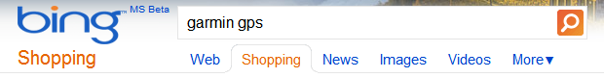
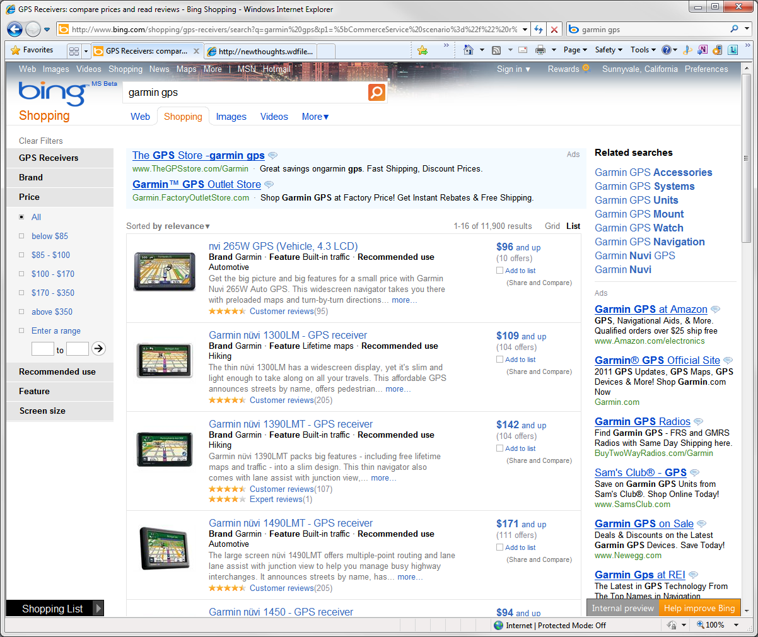
Commerce Search Engines
Product
Catalog
Relevant Products
Notes:
Biz model: relying on connecting users with merchants who sell products

Slide 4
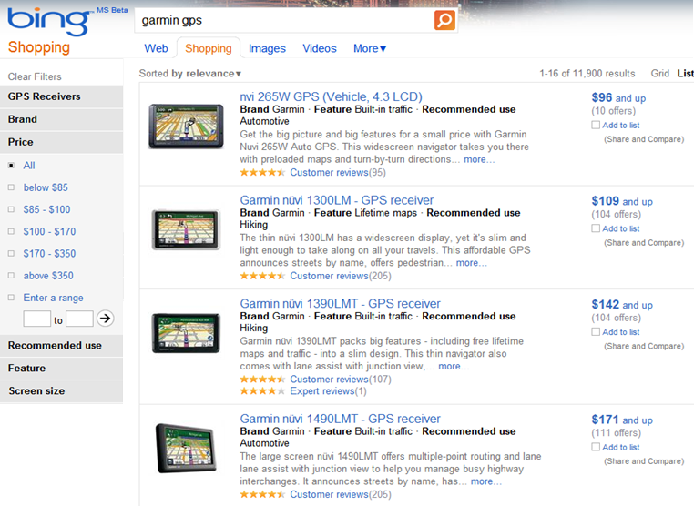
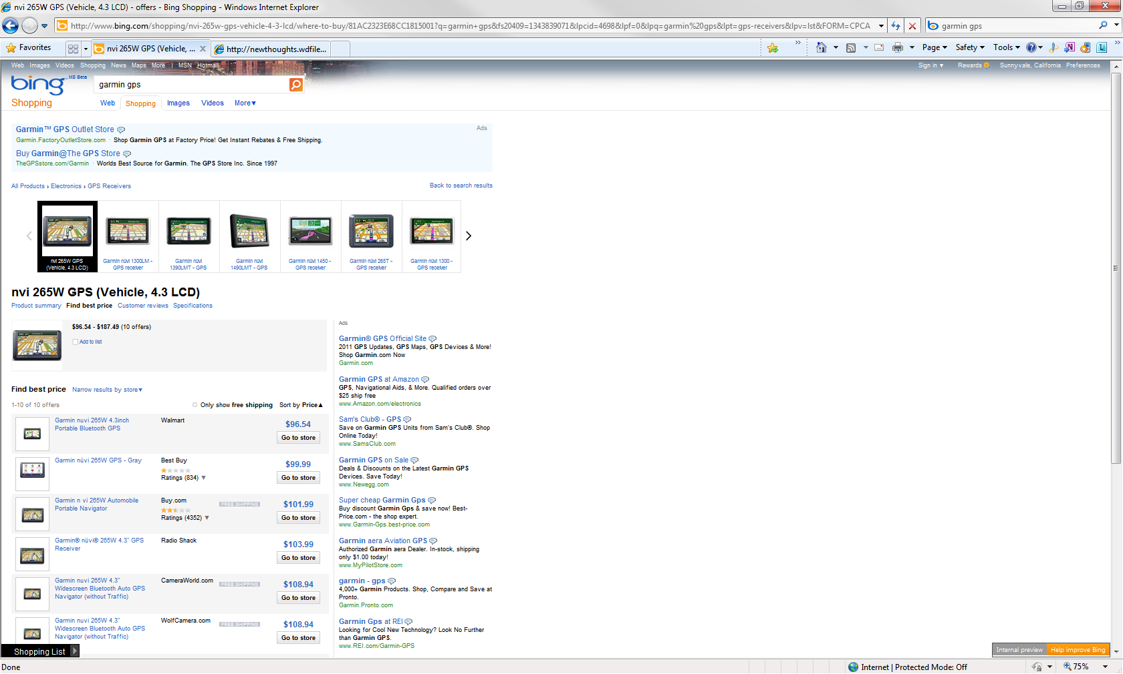
Economic Importance of Catalogs
Building catalogs in a timely fashion is at the heart of the business model of Commerce Search Engines
The search engine receives revenue
for every click to a merchant offer
Merchant offers
If an offer has no matching product,
it is dropped and will never receive any click

Slide 5
Building Catalog Today
Catalogs are currently built from data aggregator feeds who employ mostly manual techniques
Manual techniques cannot keep up with the introduction of new products to the market
No product, no clicks
Our Goal:
Automatically build product catalogs
Notes:
Product catalog to commerce search is similar to what web index is to web search

Slide 6
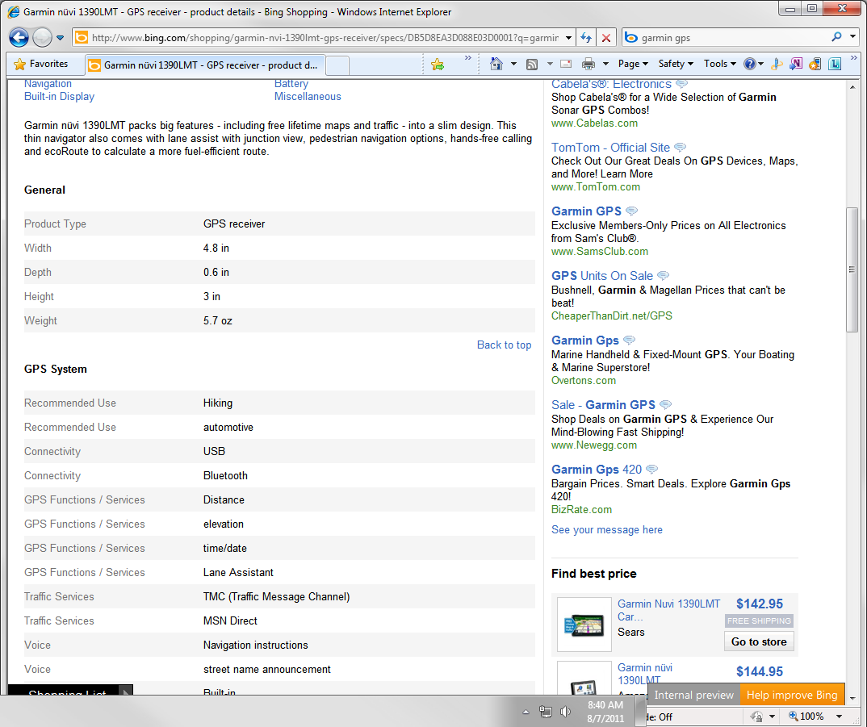
Structured Data
Catalogs contain structured data about their products

Slide 7
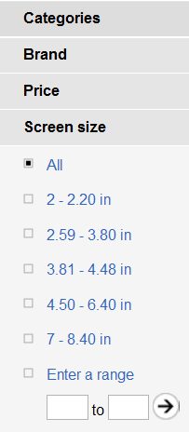
Structured Data Drives Commerce Experience
It enables faceted search
Notes:
Structured data to drive user experiences

Slide 8

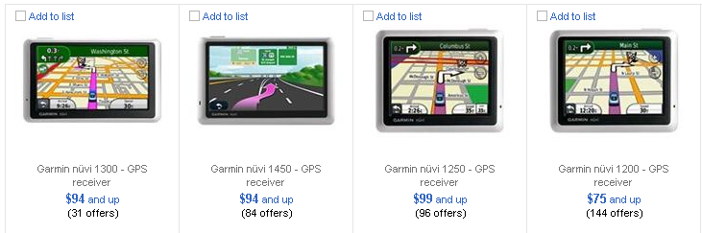
Structured Data Drives Commerce Experience
It enables the use of structure to improve search
Our Goal:
Add structured data to the Catalog
Notes:
Structured data to drive user experiences

Slide 9
Product Synthesis
Automated construction of product catalogs
  End-to-end system
  Producing structured product representations
  Scalable to millions of products and thousands of categories

Slide 10
Outline
Problems and solutions
  Identifying data sources
  Extracting structured data
  Schema matching
End-to-end system
Experimental evaluation
Conclusion

Slide 11
Identifying Data Sources
Leverage merchant offer feeds
Input:
Merchant Offers
Output:
Synthesized Products
Our System

Slide 12
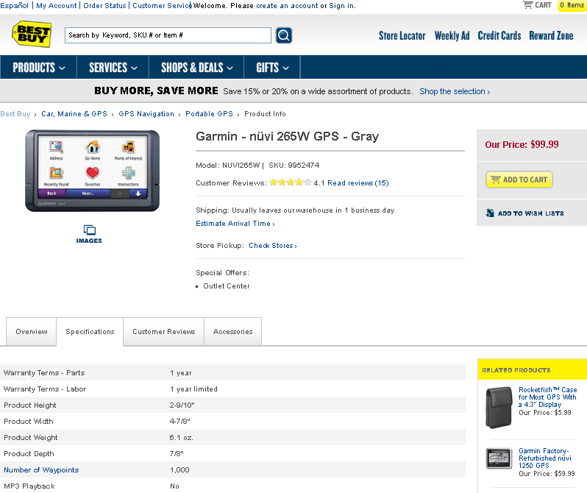
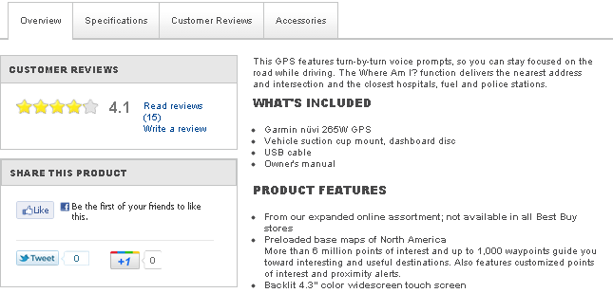
Offer Feeds Lack Structured Data
Information extraction from merchant landing pages
Table with offer specification

Slide 13
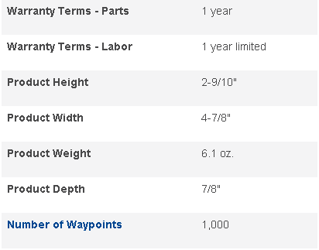
Information Extraction
Generating one wrapper per merchant does not scale
Our solution: Use generic wrappers
Warranty Terms-Parts | 1 year
Warranty Terms-Labor | 1 year limited
Product Height | 2-9/10”
Product Height | 4-7/8”
Product Weight | 6.1 oz
… | …
Notes:
Table wrappers

Slide 14
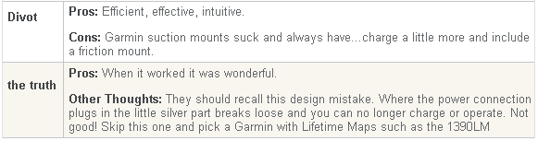
Dealing With Data Heterogeneity
Generic wrappers are noisy
Vocabulary mismatch between catalog and data extracted from merchant pages
Our solution: Schema matching
Divot | Pros: efficient, effective, …
The truth | Pros: When it worked …
Attribute Name | Merchant
part number: | AutoAnything.com
mpn: | Runtechmedia.com
mfg sku number | Number1Direct
manufacturer part: | Memory Place
msku: | AppliancesConnection.com
part # | MemorySuppliers.com

Slide 15
Schema Matching For Noise Filtering
Potential Attributes
Divot | Pros: efficient, effective, …
The truth | Pros: When it worked …
No overlap with catalog
values
Product
Catalog
Manufacturer | Tomtom, Garmin, Magellan, Garmin
Screen Size | 4.3, 3.5, 4.3, 4.3
Weight | 7.51, 3.8, 6.8, 5.7
Notes:
TODO: Use GPS Example

Slide 16
Schema Matching In The Wild
Large-scale schema matching problem
  Thousands of merchants
  Thousands of categories---each merchant-category consists of a different schema
Our Solution: Exploiting historical offer-product associations to automatically learn matches
Notes:
Thousands of schemas

Slide 17
Exploiting Historical Associations
Problem: Merchants and catalog may have widely different value distributions
Catalog
Garmin.com offers
Manufacturer | Screen Size | Weight
Garmin | 4.3 “ | 4.2
Tom Tom | 3.5 “ | 6.8
Garmin | 4.3 “ | 6.1
Magellan | 3.0 “ | 3.8
Garmin | 5 “ | 7.8
Description | Brand | Weight
Garmin Nuvi 3490LMT | Garmin | 4.2 ounces
Nuvi 265WT | Garmin | 6.1 ounces
Nuvi 1490T | Garmin | 7.8 ounces

Slide 18
Exploiting Historical Associations
Match offers to products
Keep only matching offers to products
Catalog
Garmin.com offers
Manufacturer | Screen Size | Weight
Garmin | 4.3 “ | 4.2
Tom Tom | 3.5 “ | 6.8
Garmin | 4.3 “ | 6.1
Magellan | 3.0 “ | 3.8
Garmin | 5 “ | 7.8
Description | Brand | Weight
Garmin Nuvi 3490LMT | Garmin | 4.2 ounces
Nuvi 265WT | Garmin | 6.1 ounces
Nuvi 1490T | Garmin | 7.8 ounces

Slide 19


Overcoming Sparsity
For the tail of merchants, data may be too sparse to construct reliable distributions
Our Solution: Match at multiple levels of granularity
GPS offers from all merchants
Product Catalog
Mom&PapGPS offers
Mom&PapGPS has few offers
Does
Interface
match
Connectivity
?

Slide 20
Learning Classifier To Identify Matches
Compute features for every candidate
  Exploit historical associations
  Compute features for multiple granularity levels
Build a classifier:
  Automatically create training set
  Logistic regression classifier
<Catalog attribute, Merchant Attribute, Merchant, Category>

Slide 21
Classifier Features
Computed on three types of matching
  Fine grained
O_{m,c} offers of merchant m in category c
P_{m,c} products in catalog that match offers in O_{m,c}
  Coarse grained, grouped by category
O_{c} offers in category c (regardless of merchant)
P_{c} products in catalog that match offers in O_{c}
  Coarse grained, grouped by merchant
O_{m} offers of merchant m (regardless of category)
P_{m} products in catalog that match offers in O_{m}

Slide 22
Classifier Features
matching of offers O and products P
catalog attribute a_{c}
merchant attribute a_{m}
For each
  Get bag of words from a_{c} and a_{m}
  Compute term distributions p_{c} and p_{m} from bag of words
  Compute Jensen-Shannon divergence
  Compute Jaccard coefficient

Slide 23
End-To-End System
OFFLINE LEARNING
Product database
Offer-to-product matching
Schema Matching Component
Offers matched to products
Extraction from tables
Extracted offer data
Historical
Offers
Dictionary of schema matches
RUNTIME PRODUCT SYNTHESIS PIPELINE
Extraction from tables
Schema Reconciliation
Offer Clustering
Value Fusion
Unmatched
Offers
Notes:
2 phases: Offline and Runtime phases

Slide 24
End-To-End System
OFFLINE LEARNING
Product database
Offer-to-product matching
Schema Matching Component
Offers matched to products
Extraction from tables
Extracted offer data
Historical
Offers
Dictionary of schema matches
RUNTIME PRODUCT SYNTHESIS PIPELINE
Extraction from tables
Schema Reconciliation
Offer Clustering
Value Fusion
Unmatched
Offers
Notes:
2 phases: Offline and Runtime phases

Slide 25
End-To-End System
OFFLINE LEARNING
Product database
Offer-to-product matching
Schema Matching Component
Offers matched to products
Extraction from tables
Extracted offer data
Historical
Offers
Dictionary of schema matches
RUNTIME PRODUCT SYNTHESIS PIPELINE
Extraction from tables
Schema Reconciliation
Offer Clustering
Value Fusion
Unmatched
Offers
Notes:
2 phases: Offline and Runtime phases

Slide 26
End-To-End System
OFFLINE LEARNING
Product database
Offer-to-product matching
Schema Matching Component
Offers matched to products
Extraction from tables
Extracted offer data
Historical
Offers
Dictionary of schema matches
RUNTIME PRODUCT SYNTHESIS PIPELINE
Extraction from tables
Schema Reconciliation
Offer Clustering
Value Fusion
Unmatched
Offers
Notes:
2 phases: Offline and Runtime phases

Slide 27
End-To-End System
OFFLINE LEARNING
Product database
Offer-to-product matching
Schema Matching Component
Offers matched to products
Extraction from tables
Extracted offer data
Historical
Offers
Dictionary of schema matches
RUNTIME PRODUCT SYNTHESIS PIPELINE
Extraction from tables
Schema Reconciliation
Offer Clustering
Value Fusion
Unmatched
Offers
Notes:
2 phases: Offline and Runtime phases

Slide 28
End-To-End System
OFFLINE LEARNING
Product database
Offer-to-product matching
Schema Matching Component
Offers matched to products
Extraction from tables
Extracted offer data
Historical
Offers
Dictionary of schema matches
RUNTIME PRODUCT SYNTHESIS PIPELINE
Extraction from tables
Schema Reconciliation
Offer Clustering
Value Fusion
Unmatched
Offers
Notes:
2 phases: Offline and Runtime phases

Slide 29
End-To-End System
OFFLINE LEARNING
Product database
Offer-to-product matching
Schema Matching Component
Offers matched to products
Extraction from tables
Extracted offer data
Historical
Offers
Dictionary of schema matches
RUNTIME PRODUCT SYNTHESIS PIPELINE
Extraction from tables
Schema Reconciliation
Offer Clustering
Value Fusion
Unmatched
Offers
Notes:
2 phases: Offline and Runtime phases

Slide 30
End-To-End System
OFFLINE LEARNING
Product database
Offer-to-product matching
Schema Matching Component
Offers matched to products
Extraction from tables
Extracted offer data
Historical
Offers
Dictionary of schema matches
RUNTIME PRODUCT SYNTHESIS PIPELINE
Extraction from tables
Schema Reconciliation
Offer Clustering
Value Fusion
Unmatched
Offers
Notes:
2 phases: Offline and Runtime phases

Slide 31
End-To-End System
OFFLINE LEARNING
Product database
Offer-to-product matching
Schema Matching Component
Offers matched to products
Extraction from tables
Extracted offer data
Historical
Offers
Dictionary of schema matches
RUNTIME PRODUCT SYNTHESIS PIPELINE
Extraction from tables
Schema Reconciliation
Offer Clustering
Value Fusion
Unmatched
Offers
Notes:
2 phases: Offline and Runtime phases

Slide 32
End-To-End System
OFFLINE LEARNING
Product database
Offer-to-product matching
Schema Matching Component
Offers matched to products
Extraction from tables
Extracted offer data
Historical
Offers
Dictionary of schema matches
RUNTIME PRODUCT SYNTHESIS PIPELINE
Extraction from tables
Schema Reconciliation
Offer Clustering
Value Fusion
Unmatched
Offers
Notes:
2 phases: Offline and Runtime phases

Slide 33
Experimental Setup: Data Set
Data set obtained from Bing Shopping catalog
850K offers from 1100 merchants
Merchant landing pages fetched using crawler
500 leaf-level categories
  Computing products (laptops, hard drives, etc.)
  Cameras (digital cameras, lenses, etc.)
  Home furnishings (bedspreads, home lighting, etc.)
  Kitchen and housewares (air conditioners, dishwashers, etc.)
Notes:
Select different categories because they have diff characteristics. Some is more well-structured, some less

Slide 34
Experimental Goals
Validate effectiveness of end-to-end system
  What is the quality of synthesized products?
Drill down into schema matching results
  Understand the effect of using historical associations
  Comparison with state of the art schema matchers

Slide 35
End-to-End System: Metrics
Attribute Precision
  Fraction of correct attribute-value pairs over the total number of extracted pairs
Attribute Recall
  Fraction of correct attribute-value pairs over the expected number of pairs
Product Precision
  Fraction of correct product over all products
  A product is correct if all offers and attribute-value pairs are correct

Slide 36
End-To-End System: Results
Attribute Precision 92%
  Out of 1.1 M synthesized attribute-value pairs
Product Precision 85%
  Out of 280K synthesized products
Attribute Recall
Products with >= 10 offers | 66%
Products with < 10 offers | 47%
  Higher recall when there are more offers
  associated with a product

Slide 37
Schema Matching: Metrics
Precision
  Fraction of correct matches over the number of extracted matches
Coverage
  Absolute number of extracted matches
  Higher coverage at same precision → higher recall
Notes:
Don’t tell about absolute recall

Slide 38
Benefit Of Matching Step
Offer-to-product matching step improves quality

Slide 39
Comparison To State-Of-Art
Outperforms state-of-the-art schema matchers
Notes:
Removed about AnHai (LSD)
We compare against many approaches inclduing naïve bayes instance-based approach, …

Slide 40
Conclusions
End-to-end solution for product synthesis
Schema matching at huge scale
  Thousands of merchants and categories
  Resilient to noisy data from generic extractors
Experimental evaluation on Bing Shopping data

Slide 41
Thank you!

Slide 44

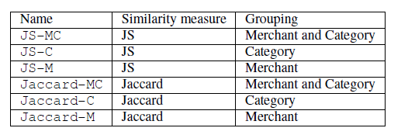
Schema Matching Component
Classification based on logistic regression
Probability that candidate
<Catalog attribute, Merchant Attribute, Merchant, Category>
is a match
Importance score of features
(computed offline using
automatically-created training
data)
Values for Features

Slide 45
Runtime Pipeline
RUNTIME PRODUCT SYNTHESIS PIPELINE
Extraction from tables
Schema Reconciliation
Offer Clustering
Value Fusion
Unmatched
Offers
Schema Reconciliation:
  Translate the merchant attribute names into the product attribute names using the extracted attribute correspondences
Merchant Attribute | Catalog Attribute
Operating System@Microwarehouse | OS Provided/Type
Platform@Amazon | OS Provided/Type

Slide 46
Runtime Pipeline
RUNTIME PRODUCT SYNTHESIS PIPELINE
Extraction from tables
Schema Reconciliation
Offer Clustering
Value Fusion
Unmatched
Offers
Offer Clustering:
  Group offers of the same product together
  The more offers, the more attributes are synthesized
  Using *Key* catalog attributes (e.g., MPN, UPC):
    Get values from merchant attributes which are corresponded to the key catalog attributes
    Group offers that have the same values for those key attributes

Slide 47
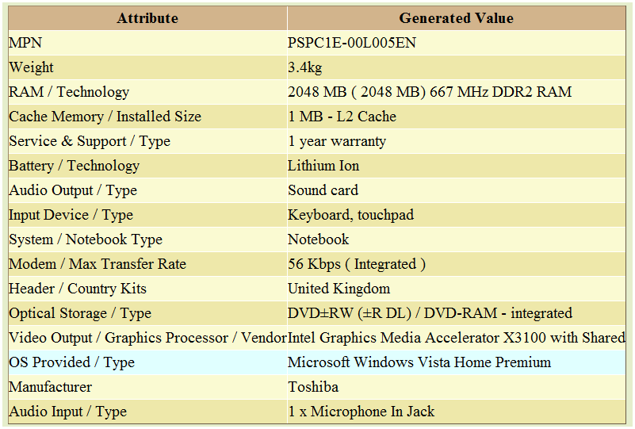
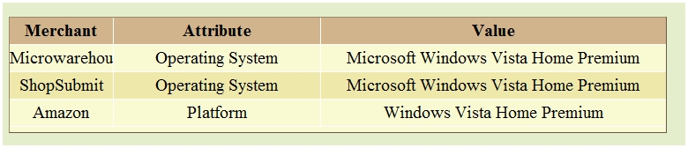
Runtime Pipeline
RUNTIME PRODUCT SYNTHESIS PIPELINE
Extraction from tables
Schema Reconciliation
Offer Clustering
Value Fusion
Unmatched
Offers
Value Fusion:
  Generate spec using learned correspondences and centroid computation

