Slide 1
Dissemination of Models Over Time-Varying Data
Zografoula Vagena
Rice University
Joint work with:
Yongluan Zhou
Jonas Haustad
University of Southern Denmark

Slide 2
Time-Varying Data
Stock-Market Prices
Daily Closing Value of the Dow Jones Index
Currency-Exchange Rates
Patient-Monitoring Data
Real-Time Traffic Information
Annual Flow Volume of the Nile River at Aswan
Many more….

Slide 3
Time-Varying Data
Stock-Market Prices
Daily Closing Value of the Dow Jones Index
Currency-Exchange Rates
Patient-Monitoring Data
Real-Time Traffic Information
Annual Flow Volume of the Nile River at Aswan
Many more….
To facilitate processing and analysis, raw data is transformed using mathematical/statistical models

Slide 4
Plethora of Data Models…
Data Cleaning
Central Tendency, Seasonality, Outliers, Heavy Hitters etc.
Data Aggregation
Data Anonymization
Value Prediction
Other…

Slide 5
…and Model Consumers
e.g. stock data consumers:
Trader: exact stock quotes with very tight accuracy and timeliness requirements
Financial Observer: model to identify long-term market movements
Regulatory Watchdog: value quotes that diverge significantly from previously reported ones
General Public: favorable trends and/or patterns

Slide 6
Current Approach
Disseminate Raw Data to End Users
Leverages vast work on data/information dissemination

Slide 7
Current Approach
Disseminate Raw Data to End Users
Leverages vast work on data/information dissemination
Impractical
Resource constraint consumers
Large bandwidth requirements

Slide 8
Current Approach
Disseminate Raw Data to End Users
Leverages vast work on data/information dissemination
Impractical
Resource constraint consumers
Large bandwidth requirements
Impossible
Privacy concerns
Regulatory restrictions

Slide 9
Our solution
Disseminate the models

Slide 10
Our solution
Disseminate the models
Formal problem formulation
Design of a model agnostic dissemination framework
Novel model construction/routing algorithms
Enable model sharing to reduce bandwidth constraints
Leverage dissemination infrastructure to
Empirical evaluation

Slide 11
Problem formulation
Given an infinite, numerical timeseries T:
… x_{i}, x_{i + 1}, x_{i + 2}, …, x_{i + N}….
K end users; each one requests a model over a specific snapshot T[p:q]
x_{p}, x_{p + 1}, x_{p + 2}, …, x_{q}
Accuracy Requirements (ar) are specified for each model

Slide 12
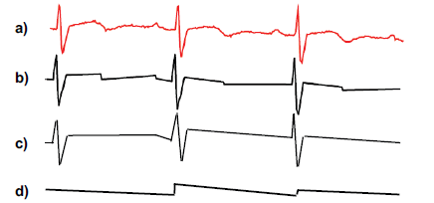
Requested Models
Focus on piecewise linear approximations (PCA)
Notes:
A timeseries is partitioned into segments and each segment is approximated by a linear function

Slide 13
Measures for Accuracy Requirements
Direct value approximation, e.g. ranges of the form [v – ε, v + ε ], etc.
Cumulative error measures, e.g. mean square error, distance metrics, etc.
Probability-based accuracy constraints, such as variance, standard deviation, etc.

Slide 14
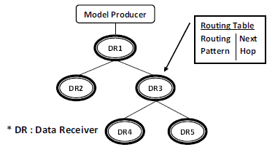
Dissemination System
Model dissemination nodes are structured into routing trees and communicate by exchanging messages

Slide 15
Model public interface
Model parameters : number and schema
Model accuracies and valid ranges ****
Model generators
Create models for T with given ar
Determine valid range of model m_{i} for accuracy ar_{j}
Captures models presented as piece-wise functions, one per timeseries segment
Notes:
As the dissemination system
is model agnostic, we need to dene a generic public interface
that the dissemination system can access. This interface,
will provide the system with the necessary information to
eectively route the models and at the same time hide any
specic internal mechanisms of the individual models.

Slide 16
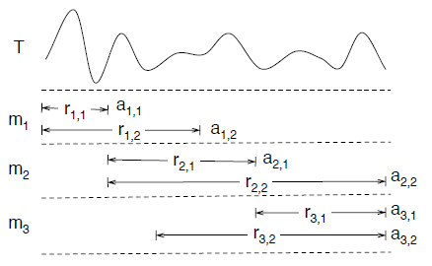
Model Accuracies and Valid Ranges

Slide 17
Dissemination System Objective
Decide which models to send to each user
Given a set of models {m₁,..m_{n}} over T, the accuracy requirement ar_{k} of each data receiver, n_{k}, and the routing structure of the overlay network, choose the set of models M_{k} that are applicable to n_{k}, such that the T is totally covered by the valid ranges of the models in M_{k} and the total number of models that are sent over the network is minimized.

Slide 18
Dissemination System Objective
Decide which models to send to each user
Given a set of models {m₁,..m_{n}} over T, the accuracy requirement ar_{k} of each data receiver, n_{k}, and the routing structure of the overlay network, choose the set of models M_{k} that are applicable to n_{k}, such that the T is totally covered by the valid ranges of the models in M_{k} and the total number of models that are sent over the network is minimized.

Slide 19
Compact Model Representation (CMR)
Minimize number of models independently for each user
Network oblivious
Fails to exploit model sharing opportunities

Slide 20
Centrally Controlled Routing (DCR)
Assumes that model producer knows network structure and all accuracy requirements
Chooses data receivers whose models, if shared, can reduce the transmitted data
The rest of the models are created by extending the valid ranges of those models
Need to prune redundant models

Slide 21
Vantage accuracies (1)
Suppose a model m_{i} is consistent with accuracy requirement ar_{k} and [s, e] is the valid range. Then m_{i} is also consistent with any ar_{j} ≥ ar_{k} in the range [s + ε ₁, e + ε₂]

Slide 22
Vantage accuracies (2)
Optimally choosing vantage accuracies requires a computationally expensive global optimization process

Slide 23
Vantage accuracies (2)
Optimally choosing vantage accuracies requires a computationally expensive global optimization process
Heuristically choose vantage accuracies by identifying data receiver with most stringent ar at each branch in the tree

Slide 24
Pruning of redundant models
The valid ranges of some models are fully covered by the ranges of other models

Slide 25
Pruning of redundant models
The valid ranges of some models are fully covered by the ranges of other models
Prune by mapping problem to set cover:
Given M over T, choose the minimum number of ranges that covers T from the subset
{r_{i,j} | a_{i,j} ≤ ar_{k}}.

Slide 26
Distributed Routing (DR)
Previous algorithm may result in model provider becoming the bottleneck
However:
computations that must take place at the model producer are those involving the raw data
once a model has reached a data receiver n_{k} with ar_{k} it can be forwarded to any descendant, n_{j} of n_{k} with ar_{k} ≤ ar_{j}

Slide 27
Distributed Routing (DR)
Start by generating the valid ranges at the model producer
Forward ranges to children
Each node performs routing for its children
Redundant model elimination is also performed at each node

Slide 28
DR with Accuracy Clustering (DRAC)
A large number of ar’s may result in generation of a large number of models
Group ar’s into a fixed number of N groups based on their proximity
Each data receiver in the group is assigned the strictest ar of that group
Minimize:

Slide 29
DR with Accuracy Clustering (DRAC)
Group identification performs in a bottom-up fashion starting from each leaf
Start with K groups, where K = number of data receivers
At each intermediate node
If number of groups <= N forward clusters to parent
Otherwise merge clusters

Slide 30
Experimental Evaluation

Slide 31
Experimental Setup
Prototype System: simulated network using Java RMI for communication among nodes
Data: sensor measurements from Intel Berkeley Research:
temperature data of sensor 45
Workload: 500 users structured in a balanced tree of fanout 3
Measures:
network bandwidth
running time at each node

Slide 32
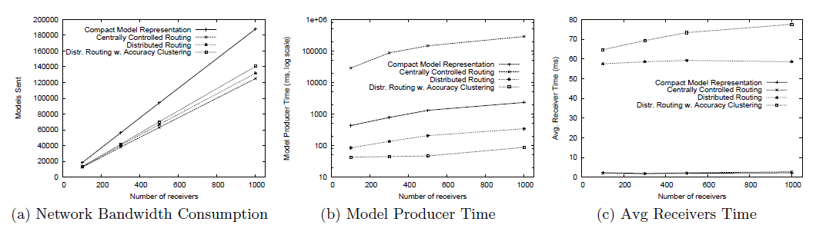
Varying Number of Receivers

Slide 33
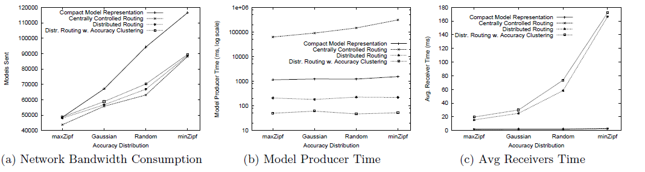
Varying Accuracy Requirements

Slide 34
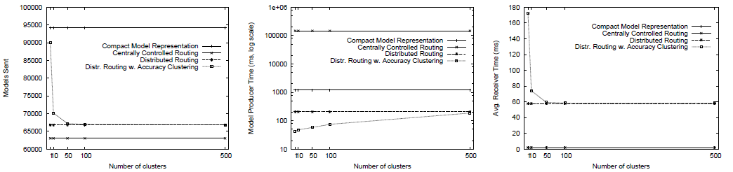
Varying Number of Accuracy Clusters

Slide 35
Summary
Dissemination of Models over Time-Varying Data
Formal problem definition
Design of a model agnostic dissemination framework
Novel model construction/routing algorithms
Enable model sharing to reduce bandwidth constraints
Leverage dissemination infrastructure to
Empirical evaluation

Slide 36
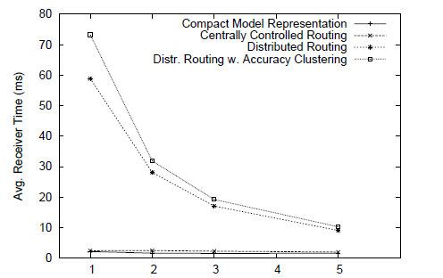
Varying Degree of Polynomials

