Slide 1
Linking Temporal Records
Pei Li1, Xin Luna Dong2, Andrea Maurino1, Divesh Srivastava2
1Università di Milano Bicocca, 2AT&T Labs-Research
VLDB 2011, Seattle
Notes:
1
Mention co-authors

Slide 2
Some Statistics from DBLP
Top 10 authors with most number of papers
Wei Wang (476 papers)
Top 5 authors with most number of co-authors
Wei Wang (656 co-authors)
Top 10 authors with most number of conference papers within the same year
Wei Wang (75 conf. papers in 2006)
http://www2.research.att.com/~marioh/dblp.html
(last updated on March 13th 2009)
Notes:
There are many data app. nowadays that contains temporal info. The one we are mostly familiar with. Is possibly DBLP.
Some researchers have collected some interesting statistics from DBLP: among a number of analysis, I found a very productive author: Wei Wang. He is among the top 10 authors with most number of papers….
You may start to wonder: Is this author really incredibly productive or there is wrong with the data?
So I searched wei wang on DBLP. And surprisingly, by the time I searched, there exist 19 wei wang entries, and the biggest entry has more than 500 papers (they are from different affiliations actually).

Slide 3
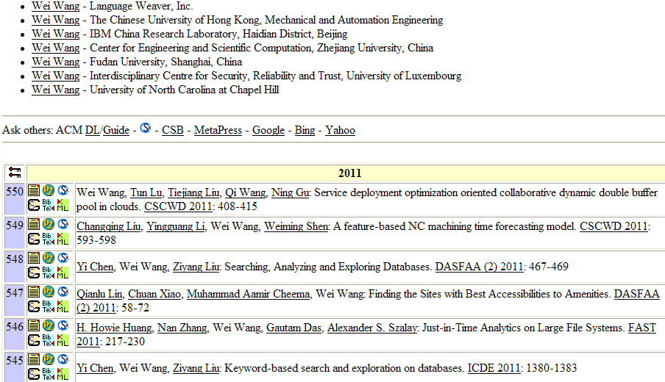
Some Statistics from DBLP
Notes:
Sth. must be wrong. Actually, there are more than 18 entries named WW in DBLP, and the biggest potpourri contains more than 500 papers.

Slide 4
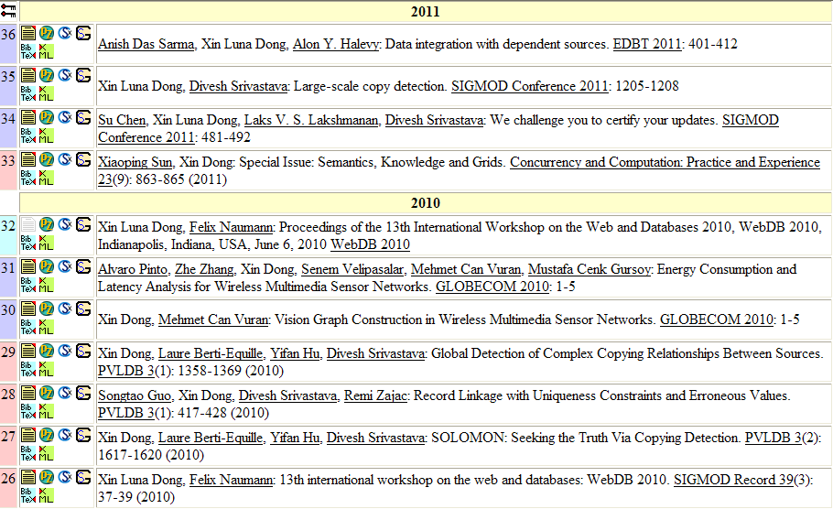
Real-life Stories from Luna (I)
Notes:
But still, there are mistakes on her records. E.g, These two papers are wrongly merged.

Slide 5
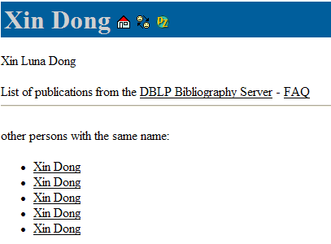
Real-life Stories from Luna (II)
Luna’s DBLP entry
Notes:
Our co-author Luna has motivated a lot on this work from her own experience. She used to two different DBLP entries with disjoint sets of papers. And she had to email to Mecheal before coming to the job-market.

Slide 6
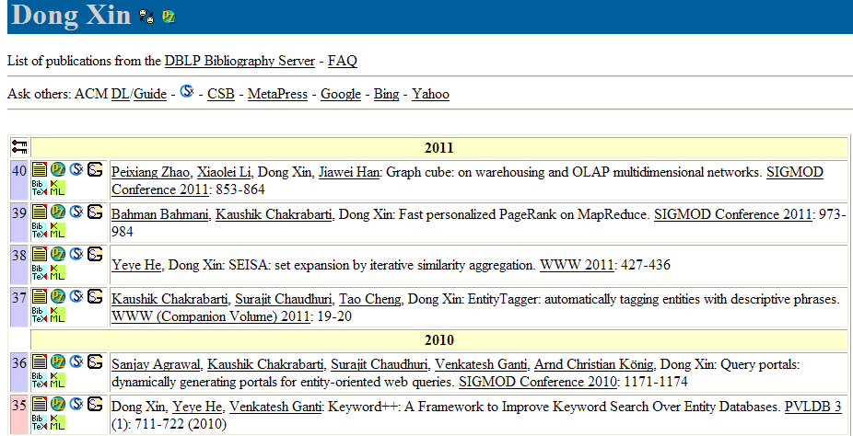
Real-life Stories from Luna (III)
Lab visiting
Sorry, no entry is found for Xin Dong
Notes:
Another story happened when Luna was visiting a research lab, where she tested an e-library system by searching her name. However, the system returned no results, ‘cause it mistakenly merged her papers with the publication of another author Dong Xin, whose first name is the same as Luna’s last name, and whose last name is Luna’s first name.

Slide 7
r1: Xin Dong
R. Polytechnic Institute
r4: Xin Luna Dong
University of Washington
r2: Xin Dong
University of Washington
r5: Xin Luna Dong
AT&T Labs-Research
r3: Xin Dong
University of Washington
r6: Xin Luna Dong
AT&T Labs-Research
How many authors?
What are their authoring histories?
1991
1991
2004
1991
2005
1991
2006
1991
2007
2008
2009
2010
2011
r11: Dong Xin
Microsoft Research
r8:Dong Xin
University of Illinois
r12: Dong Xin
Microsoft Research
r9: Dong Xin
Microsoft Research
r10: Dong Xin
University of Illinois
r7: Dong Xin
University of Illinois
Notes:
To solve these common-place mistakes, let’s take some records from DBLP, each with author name, affiliation, and a time stamp extracted from publication entries.
The questions we’d ask are: 1. how many authors are there? 2. what are their authoring histories?

Slide 8
r1: Xin Dong
R. Polytechnic Institute
r4: Xin Luna Dong
University of Washington
r2: Xin Dong
University of Washington
r5: Xin Luna Dong
AT&T Labs-Research
r3: Xin Dong
University of Washington
r6: Xin Luna Dong
AT&T Labs-Research
Ground Truth
1991
1991
2004
1991
2005
1991
2006
1991
2007
2008
2009
2010
2011
r11: Dong Xin
Microsoft Research
r8:Dong Xin
University of Illinois
3 authors
r12: Dong Xin
Microsoft Research
r9: Dong Xin
Microsoft Research
r10: Dong Xin
University of Illinois
r7: Dong Xin
University of Illinois
Notes:
In reality, these 12 records belong to 3 authors.

Slide 9
r1: Xin Dong
R. Polytechnic Institute
r4: Xin Luna Dong
University of Washington
r2: Xin Dong
University of Washington
r5: Xin Luna Dong
AT&T Labs-Research
r3: Xin Dong
University of Washington
r6: Xin Luna Dong
AT&T Labs-Research
Solution 1:
requiring high value consistency
1991
1991
2004
1991
2005
1991
2006
1991
2007
2008
2009
2010
2011
r11: Dong Xin
Microsoft Research
5 authors
false negative
r8:Dong Xin
University of Illinois
r12: Dong Xin
Microsoft Research
r9: Dong Xin
Microsoft Research
r10: Dong Xin
University of Illinois
r7: Dong Xin
University of Illinois
Notes:
A very common solution is to require high value consistency. So if two records have the same/similar author names, the same affiliation, we will merge them.
It results in 5 authors. this solution causes false negative.

Slide 10
r1: Xin Dong
R. Polytechnic Institute
r4: Xin Luna Dong
University of Washington
r2: Xin Dong
University of Washington
r5: Xin Luna Dong
AT&T Labs-Research
r3: Xin Dong
University of Washington
r6: Xin Luna Dong
AT&T Labs-Research
Solution 2:
matching records w. similar names
1991
1991
2004
1991
2005
1991
2006
1991
2007
2008
2009
2010
2011
r11: Dong Xin
Microsoft Research
2 authors
false positive
r8:Dong Xin
University of Illinois
r12: Dong Xin
Microsoft Research
r9: Dong Xin
Microsoft Research
r10: Dong Xin
University of Illinois
r7: Dong Xin
University of Illinois
Notes:
Another solution is to match records once they have similar names. Then we will have two clusters, and in the worst case, we may even merge all records together.

Slide 11
Opportunities
Continuity of history
Smooth transition
ID | Name | Affiliation | Co-authors | Year
r1 | Xin Dong | R. Polytechnic Institute | Wozny | 1991
r2 | Xin Dong | University of Washington | Halevy, Tatarinov | 2004
r7 | Dong Xin | University of Illinois | Han, Wah | 2004
r3 | Xin Dong | University of Washington | Halevy | 2005
r4 | Xin Luna Dong | University of Washington | Halevy, Yu | 2007
r8 | Dong Xin | University of Illinois | Wah | 2007
r9 | Dong Xin | Microsoft Research | Wu, Han | 2008
r10 | Dong Xin | University of Illinois | Ling, He | 2009
r11 | Dong Xin | Microsoft Research | Chaudhuri, Ganti | 2009
r5 | Xin Luna Dong | AT&T Labs-Research | Das Sarma, Halevy | 2009
r6 | Xin Luna Dong | AT&T Labs-Research | Naumann | 2010
r12 | Dong Xin | Microsoft Research | He | 2011
Seldom erratic changes
Notes:
Despite the above challenges, temporal information acutally presents additional evidence for record linkage.
First, record values typically transit smoothly. E.g., after Dong Xin moved to MSR, he still keeps some co-authors from the former affiliation.
Second, record values seldom change erratically. In reality, it is not likely that an author was in UI in 2004, and moved to UW one year later, and moved back to UI in 2007.
Third, records that refer to the same real-world entity often observe continuity. E.g., when we see a record with author name Xin Dong in 1991, and another one with the same name 13 years later, we are not so confident to say these two records belong to the same author.

Slide 12
Intuitions
ID | Name | Affiliation | Co-authors | Year
r1 | Xin Dong | R. Polytechnic Institute | Wozny | 1991
r2 | Xin Dong | University of Washington | Halevy, Tatarinov | 2004
r7 | Dong Xin | University of Illinois | Han, Wah | 2004
r3 | Xin Dong | University of Washington | Halevy | 2005
r4 | Xin Luna Dong | University of Washington | Halevy, Yu | 2007
r8 | Dong Xin | University of Illinois | Wah | 2007
r9 | Dong Xin | Microsoft Research | Wu, Han | 2008
r10 | Dong Xin | University of Illinois | Ling, He | 2009
r11 | Dong Xin | Microsoft Research | Chaudhuri, Ganti | 2009
r5 | Xin Luna Dong | AT&T Labs-Research | Das Sarma, Halevy | 2009
r6 | Xin Luna Dong | AT&T Labs-Research | Naumann | 2010
r12 | Dong Xin | Microsoft Research | He | 2011
Less reward on the same value over time
Less penalty on different values over time
Consider records in time order for linkage
Notes:
Given these motivations, our intuitions for temporal record linkage are as follows:
We’d like to give less penalty on different values over time. E.g., even r2 and r5 have different affiliations, it is not a strong indicator for us to split them;
We’d like to give less reward on same values over time. E.g., even r1 and r2 have the same author name, it is not a strong indicator for us to merge them.
We’d consider the records in time order whn we decide which records refer to the same person (call out in slidesw)

Slide 13
Outline
Motivation & intuitions
Problem statement
Solution
Decay
Temporal clustering
Experimental evaluation
Conclusions
Notes:
Given the above motivation and intuitions, we’ll first show the formal definition of our problem. Our solution contains two parts: time decay for record similarity, and temporal clustering. Then we show experimental results over three data sets. Finally we present the related work before conclusion.

Slide 14
Problem Statement
Input: a set of records R, in the form of (x1, …, xn, t)
t: time stamp
xi: value of attribute Ai at time t
Output: clustering of R such that
records in the same cluster refer to the same entity
records in different clusters refer to different entities
Notes:
The output is the clustering of R

Slide 15
Outline
Motivation
Problem statement
Solution
Decay
Temporal clustering
Experimental evaluation
Conclusions
Notes:
In the following slides, I’ll introduce an important concept – time decay – that aims at capturing the effect of time elapsing on value evolution.

Slide 16
Disagreement Decay
Intuition: different values over a long time is not a strong indicator of referring to different entities.
University of Washington (01-07)
AT&T Labs-Research (07-date)
Definition (Disagreement decay)
Disagreement decay of attribute A over time ∆t is the probability that an entity changes its A-value within time ∆t.
Notes:
The first notion is disagreement decay.
The intuition of disagreement decay is that different values over a long time is not a strong indicator of referring to different entities.
e.g., Luna was in UW from 2001 to 2007 and works in AT&T since 2007. the different affiliation values should not prevent us from merging the two records.
We give the formal definition of disagreement decay.

Slide 17
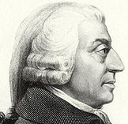
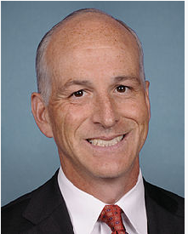
Agreement Decay
Intuition: the same value over a long time is not a strong indicator of referring to the same entities.
Adam Smith: (1723-1790)
Adam Smith: (1965-)
Definition (Agreement decay)
Agreement decay of attribute A over time ∆t is the probability that different entities share the same A-value within time ∆t.
Notes:
Similarly, we have the notion of agreement decay. The intuition is, …
e.g., obviously, these are two different people, even though they have the same names.
We give the formal definition of agreement decay:

Slide 18
Decay Curves
Decay curves of address learnt from European Patent data
Disagreement decay
Agreement decay

Slide 19
Learning Disagreement Decay
1. Full life span: [t, tnext)
A value exists from t to t’, for time (tnext-t)
2. Partial life span: [t, tend+1)*
A value exists since t, for at least time (tend-t+1)
Lp={1, 2, 3}, Lf={4, 5}
d(∆t=1)=0/(2+3)=0
d(∆t=4)=1/(2+0)=0.5
d(∆t=5)=2/(2+0)=1
R. P. Institute
E1
1991
∆t=1
UW
AT&T
AT&T
E2
2004
2009
2010
∆t=5
∆t=2
UIUC
MSR
MSR
E3
2004
2008
2010
∆t=4
∆t=3
Change & last time point
Change point
Last time point
Full life span
Partial life span
Notes:
We can learn decay from sampled data sets, where we know if two records refer to the same entity.
To compute decay, we first collect two types of statistics:
A full life span: e.g., the affi. of E2 had been UW since 2004 and changed in 2009; so we have a full life span of 5 years.
2. A partial life span: e.g., the affi. Of E3 had been MSR since 2008 and we haven’t seen any change by 2010, so we know it hasn’t change for 3 years, but we are not sure if it will change in the future. so we have a partial life span of 3 years
We compute disagreement decay by the following formula.
e.g., When \delta t=1, we haven’t seen any change of affiliation within one year. So the decay is 0.
When \delta t=4, among two affi. Changes, we see one entity changing aff. Within 4 years, for the three partial life spans, their life span is below 4. we are not sure if any of them will change in 4 years.
we are not sure if any entity keeps aff. For more than 4 years. So the decay is .5.

Slide 20
Applying Decay
E.g.
r1 <Xin Dong, Uni. of Washington, 2004>
r2 <Xin Dong, AT&T Labs-Research, 2009>
Decayed similarity
w(name, ∆t=5)=1-dagree(name , ∆t=5)=.95,
w(affi., ∆t=5)=1-ddisagree(affi. , ∆t=5)=.1
sim(r1, r2)=(.95*1+.1*0)/(.95+.1)=.9
No decayed similarity:
w(name)=w(affi.)=.5
sim(r1, r2)=.5*1+.5*0=.5
Match
Un-match
Notes:
R()=wa (\delta t).sim/ sum of weights
Wa=1-decay
If not 0, 1
We use this formula to compute decayed similarity, where the weight of attributes are the compensation of their decays.
Given two record r1, r2, since name of the two records are the same, we use agreement decay, and the weight for name is compensation of decay; Similarly, affiliations of the two records are different, we use disagreement decay, and the weight of affiliation is .1. The overall decay similarity of r1, r2 is .9, which will probably allow us to merge the two records.
However, the no decayed simi. Is .5. given such a low sim, we will consider r1 and r2 as unmatch.

Slide 21
Applying Decay
ID | Name | Affiliation | Co-authors | Year
r1 | Xin Dong | R. Polytechnic Institute | Wozny | 1991
r2 | Xin Dong | University of Washington | Halevy, Tatarinov | 2004
r7 | Dong Xin | University of Illinois | Han, Wah | 2004
r3 | Xin Dong | University of Washington | Halevy | 2005
r4 | Xin Luna Dong | University of Washington | Halevy, Yu | 2007
r8 | Dong Xin | University of Illinois | Wah | 2007
r9 | Dong Xin | Microsoft Research | Wu, Han | 2008
r10 | Dong Xin | University of Illinois | Ling, He | 2009
r11 | Dong Xin | Microsoft Research | Chaudhuri, Ganti | 2009
r5 | Xin Luna Dong | AT&T Labs-Research | Das Sarma, Halevy | 2009
r6 | Xin Luna Dong | AT&T Labs-Research | Naumann | 2010
r12 | Dong Xin | Microsoft Research | He | 2011
☹All records are merged into the same cluster!!
☺ Able to detect changes!
Notes:
Accordingly to decayed simiarity, we are able to detect changes, e.g., r4 and r5 are merged.
But due to the way of clustering, we merged all records into the same cluster.
Because of high sim with r1,
Anim order, ☺ disappear

Slide 22
Outline
Motivation & intuitions
Problem statement
Solution
Decay
Temporal clustering
Experimental evaluation
Conclusions
Notes:
To avoid such mistakes, we propose three temporal clustering approaches, all of which consider records in time order.

Slide 23
Early Binding
Compare a new record with existing clusters
Make eager merging decision for each record
Maintain the earliest/latest timestamp for its last value
Notes:
The first one is called early binding.
The eager decision is ?

Slide 24
Early Binding
C1
ID | Name | Affiliation | Co-authors | From | To
r1 | Xin Dong | R. P. Institute | Wozny | 1991 | 1991
r2 | Xin Dong | Univ. of Washington | Halevy, Tatarinov | 2004 | 2004
☹earlier mistakes prevent later merging!!
r3 | Xin Dong | Univ. of Washington | Halevy | 2004 | 2005
r4 | Xin Luna Dong | Univ. of Washington | Halevy, Yu | 2004 | 2007
r10 | Dong Xin | University of Illinois | Ling, He | 2009 | 2009
C2
ID | Name | Affiliation | Co-authors | From | To
r7 | Dong Xin | University of Illinois | Han, Wah | 2004 | 2004
r8 | Dong Xin | University of Illinois | Wah | 2004 | 2007
☺ Avoid a lot of false positives!
r9 | Dong Xin | Microsoft Research | Wu, Han | 2008 | 2008
r11 | Dong Xin | Microsoft Research | Chaudhuri, Ganti | 2008 | 2009
r12 | Dong Xin | Microsoft Research | He | 2008 | 2011
C3
ID | Name | Affiliation | Co-authors | From | To
r5 | Xin Luna Dong | AT&T Labs-Research | Das Sarma, Halevy | 2009 | 2009
r6 | Xin Luna Dong | AT&T Labs-Research | Naumann | 2009 | 2010
Notes:
R7 cannot be merged to c1, because r2 and 7 are in the same year
When we see r10, C2 has aff. Of MSR in 2008, changing aff. In 1 year seems unlikely. While C1 has aff. Of UW since 2004; changing affi. in 5 years is more possible. So we merge r10 with C1.
Give ☺ and ☹
We avoid a lot of fp
Because of a wrong decision for r10, we are unable to
Give red, ☺; black, ☹
We still merge r1 with …

Slide 25
Late Binding
Keep all evidence in record-cluster comparison
Make a global decision at the end
Facilitate with a bi-partite graph

Slide 26
Late Binding
r1
XinDong@R.P.I -1991
1
C1
r1 | X.D | R.P. I. | Wozny | 1991 | 1
r2 | X.D | UW | Halevy, Tatarinov | 2004 | .5
r7 | D.X | UI | Han, Wah | 2004 | .33
0.5
r2
XinDong@UW -2004
0.5
C2
r2 | D.X | UW | Halevy, Tatarinov | 2004 | .5
r7 | D.X | UI | Han, Wah | 2004 | .22
0.22
0.33
r7
DongXin@UI -2004
0.45
C3
r7 | D.X | UI | Han, Wah | 2004 | .45
Choose the possible world with highest probability
create C2
p(r2, C1)=.5, p(r2, C2)=.5
create C3
p(r7, C1)=.33, p(r7, C2)=.22, p(r7, C3)=.45
Notes:
Bi-partite graph, record on one side; cluster on the other side;
We assign pob. According to the similarity of record and cluster. New cluster prob. Derived from existing clusters,
Example weight on edges
Read probability for r2, r7

Slide 27
Late Binding
ID | Name | Affiliation | Co-authors | Year
r1 | Xin Dong | R. Polytechnic Institute | Wozny | 1991
r2 | Xin Dong | University of Washington | Halevy, Tatarinov | 2004
r3 | Xin Dong | University of Washington | Halevy | 2005
r4 | Xin Luna Dong | University of Washington | Halevy, Yu | 2007
r5 | Xin Luna Dong | AT&T Labs-Research | Das Sarma, Halevy | 2009
r6 | Xin Luna Dong | AT&T Labs-Research | Naumann | 2010
r7 | Dong Xin | University of Illinois | Han, Wah | 2004
r8 | Dong Xin | University of Illinois | Wah | 2007
r9 | Dong Xin | Microsoft Research | Wu, Han | 2008
r11 | Dong Xin | Microsoft Research | Chaudhuri, Ganti | 2009
r12 | Dong Xin | Microsoft Research | He | 2011
r10 | Dong Xin | University of Illinois | Ling, He | 2009
C1
C2
☺ Correctly split r1, r10 from C2
C3
C4
☹ Failed to merge C3, C4, C5
C5
Notes:
Global view, we didn’t merge
Late binding is conservative in assigning probability, so we fail to …
Red block, ☺: r10 not merged to r10; r1 is also split
Black: ☹

Slide 28
Adjusted Binding
Compare earlier records with clusters created later
Proceed in EM-style
Initialization: Start with the result of early / late binding
Estimation: Compute record-cluster similarity
Maximization: Choose the optimal clustering
Termination: Repeat until the results converge or oscillate
Notes:
Compare earlier records with cluster formed later

Slide 29
Adjusted Binding
Compute similarity by
Consistency: consistency in evolution of values
Continuity: continuity of records in time
sim(r, C)=cont(r, C)*cons(r, C)
Case 1:
r.t
C.early
C.late
Case 2:
r.t
C.early
C.late
Case 3:
C.early
r.t
C.late
Case 4:
C.early
C.late
r.t
record time stamp
cluster time stamp
Notes:
No intuition
What is continuity?
Recall intuition,
Case 2,3 record is close to cluster; in 1 and 4, is far away from cluster C1, C4.

Slide 30
Adjusted Binding
r7
DongXin@UI -2004
C3
Once r8 is merged to C4, r7 has higher continuity with C4
r8
DongXin@UI -2007
r8 has higher continuity with C4
r9
DongXin@MSR -2008
C4
r10
DongXin@UI -2009
C5
r11
DongXin@MSR -2009
r10 has higher continuity with C4
r12
DongXin@MSR -2011
Notes:
Recall the four cases in previous slide, r10 has the highst cont. with C4. similary, r8 has the highest contiuity with c4.
Why r10 has higher cont?
1:30 36; decay: 37; clustering 42; exp: 48; related 53

Slide 31
Adjusted Binding
ID | Name | Affiliation | Co-authors | Year
r1 | Xin Dong | R. Polytechnic Institute | Wozny | 1991
r2 | Xin Dong | University of Washington | Halevy, Tatarinov | 2004
r3 | Xin Dong | University of Washington | Halevy | 2005
r4 | Xin Luna Dong | University of Washington | Halevy, Yu | 2007
r5 | Xin Luna Dong | AT&T Labs-Research | Das Sarma, Halevy | 2009
r6 | Xin Luna Dong | AT&T Labs-Research | Naumann | 2010
r7 | Dong Xin | University of Illinois | Han, Wah | 2004
r8 | Dong Xin | University of Illinois | Wah | 2007
r9 | Dong Xin | Microsoft Research | Wu, Han | 2008
r10 | Dong Xin | University of Illinois | Ling, He | 2009
r11 | Dong Xin | Microsoft Research | Chaudhuri, Ganti | 2009
r12 | Dong Xin | Microsoft Research | He | 2011
C1
C2
☺ Correctly cluster all records
C3
Notes:
R1 r2 are not merged, because of low contnity

Slide 32
Outline
Motivation & intuitions
Problem statement
Solution
Decay
Temporal clustering
Experimental evaluation
Conclusions

Slide 33
Experiment Setting
Implementation
Baseline: PARTITION, CENTER, MERGE
Our approaches: EARLY, LATE, ADJUST
Comparison: Precision/Recall/F-measure
Precision = |TP|/(|TP|+|FP|)
Recall =|TP|/(|TP|+|FN|)
F-measure = 2PR/(P+R)
Notes:
Existing clustering algo. for record linkage as baseline
P/R/F:
Where precision measures, among all matched record pair, how many are correct?
Recall measures, among all correct matches, how many are returned?
And F-1 is a trade-off between them.

Slide 34
Accuracy on Patent Data
Data set: a benchmark of European patent data set
1871 records, 359 entities, in 1978-2003
Compare name & affiliation
Golden standard: http://www.esf-ape-inv.eu/
Adjust improves over baseline by 11-22%
Notes:
3 slides: percent
Adjust is better than baseline; informative title (accuracy on patent data)
both decay and temporal clustering contribute to …
Adjust performs better than early and late
Adjusted binding improved over baseline methods by 11-22%.
The second graph shows the contribution of applying decay and applying temporal clustering. Applying decay on baseline methods increases recall a lot, but it is at the price of a big drop in precision. Temporal clustering, on the other hand, consider the time info. in clustering and in continuity computation, so it increases recall quite a bit without reducing precision much.
The third graph compares early, late, and adjusted binding. Early has a lower precision as it makes local decisions, while late has a lower recall as it is conservative in merging records. Adjust significantly improves recall over both methods, without sacrificing precision much.

Slide 35
Contribution of Decay and Temporal Clustering
Applying decay in itself increases recall by sacrificing precision
Temporal clustering increases recall moderately without reducing precision much
Combining both obtains the best results
Notes:
The full algo. Contains
Moderately

Slide 36
Comparison of Temporal Clustering Algorithms
Adjust improves over both
Early has a lower precision
Late has a lower recall
Notes:
Early, late has its own benefits.
Adjust has higher recall because … ; without precison much, given the global view.

Slide 37
Accuracy on DBLP Data – Xin Dong
Data set: Xin Dong data set from DBLP
72 records, 8 entities, in 1991-2010
Compare name, affiliation, title & co-authors
Golden standard: by manually checking
Adjust improves over baseline by
37-43%
Notes:
We have tested on Xin Dong data set from DBLP that …
Our solution improved over baseline methods by 43%

Slide 38
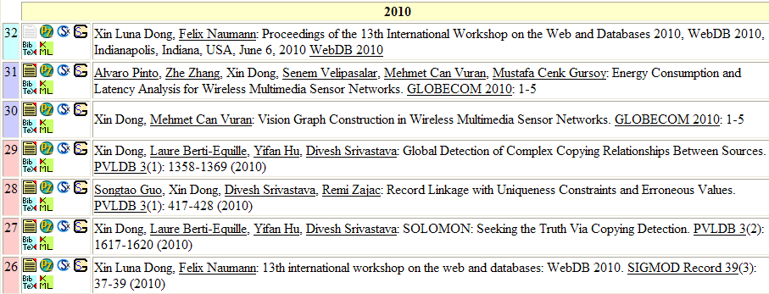
Error We Fixed
Records with affiliation University of Nebraska–Lincoln
Notes:
We fixed an error in DBLP: it correctly separates the records with affiliation UNL from Luna’s records

Slide 39
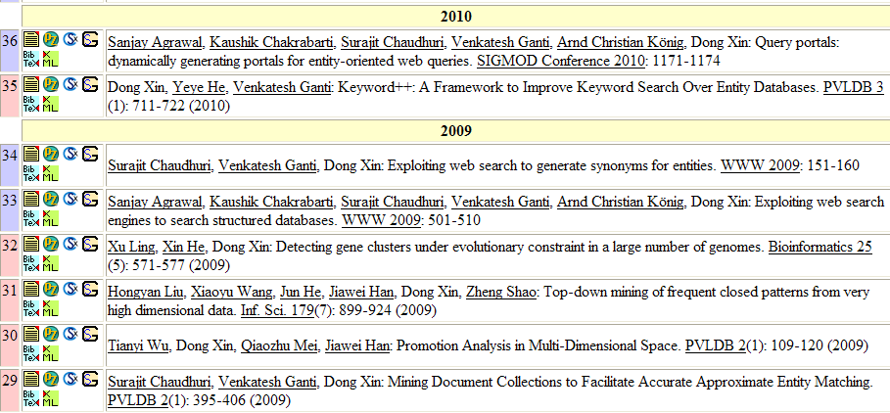
We Only Made One Mistake
Author’s affiliation on Journal papers are out of date
Notes:
It makes one mistake: it split two records from Dong Xin records. This is because the two records correspond to two journal papers and the author affiliation is out of date.

Slide 40
Accuracy on DBLP Data (Wei Wang)
Data set: Wei Wang data set from DBLP
738 records, 18 entities + potpourri, in 1992-2011
Compare name, affiliation & co-authors
Golden standard: from DBLP + manually checking
Adjust improves over baseline by
11-15%
High precision (.98) and high recall (.97)
Notes:
700 records for 18 identified authors.
Again adjust has the best results.
For 18 entities: extremly high recall & precision .98/.97
We experimented on Wei Wang data set on DBLP that…
Our approach improves over baseline methods by 15%. Notice that on this hardest data set, our approach obtains both high precision and high recall.

Slide 41
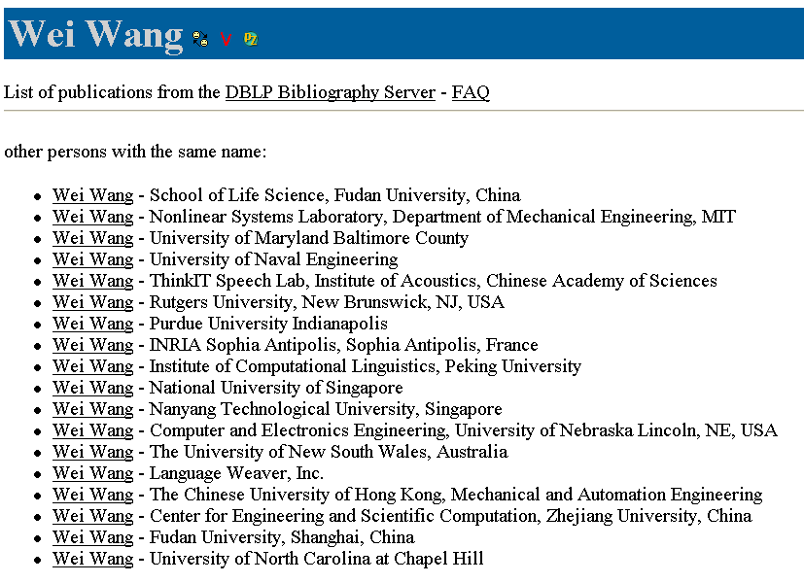
Mistakes We Made
1 record @ 2006
72 records @ 2000-2011
Notes:
We also make several mistakes on existing ww entries:
e.g., we merged this w w that contains only one record with the big w w cluster that contains 72 records, because they work in the same uni. and their time stamps are quite close.

Slide 42
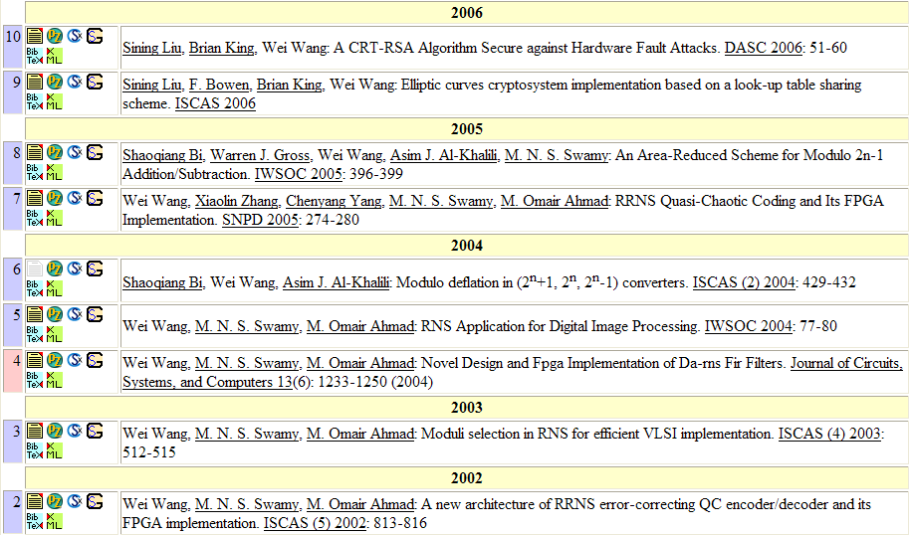
Mistakes We Made
Purdue University
Univ. of Western Ontario
Concordia University
Notes:
Another type of mistake is because of frequent changes. E.g., this researcher changed 3 affi. Within 4 years. And is considered as different researchers by our system.

Slide 43
Errors We Fixed … despite some mistakes
546 records in potpourri
Correctly merged 63 records to existing Wei Wang entries
Wrongly merged 61 records
26 records: due to missing department information
35 records: due to high similarity of affiliation
E.g., Northwest University of Science & Technology
Northeast University of Science & Technology
Precision and recall of .94 w. consideration of these records
Notes:
Identified other 130 authors
422 records : 2.7 records / author
Besides 18 entries in DBLP, there are also 546 records that do not have independent entries on DBLP and are merged together.
For 422 records, we have identified 130 authors. The average record per author is 2.7.
For the rest 124 records, we have correctly merged 63 records to the existing WW entries on DBLP.
We wrongly merged 26 records to WW entries, because several wei wang works in the same university. Without department info, we failed to separate them.
We also wrongly merged 35 records, because their affi. Is higher similar.

Slide 44
Related Work
Record linkage techniques
Record similarity computation
Classification [Fellegi,69], Distance [Dey,08], Rule [Hernandez,98]
Record clustering
Transitive rule [Hernandez,98], Optimization [Wijaya,09]
Behavior-based linkage
Periodical behavior patterns [Yakout,10]
Temporal information
Temporal data models:[Ozsoyoglu,95], [Roddick,02]
Decay models
Backward decay [Cohen,03], Forward decay [Cormode,09]
Notes:
Difference: we consider decay; time order in clustering
Difference: We differ in that 1) we
consider time difference between two records rather than from a
fixed point, and 2) we learn the decay curves purely from the data
rather than using a fixed function.

Slide 45
Conclusions & Future Work
Many data applications can benefit from leveraging temporal information for record linkage
Our solution
Apply decay in record-similarity computation
Consider records in time order for clustering
Future work
Combine with other dimension (e.g., spatial info)
Consider erroneous data, especially erroneous time stamps
Notes:
Many record linkage app. Can benefit from temporal info.
Short, in 3/4
The take-away message is:
Temporal info. is very important and many data app…
Our solution of linking temporal records …
Our future work includes …

Slide 46
Thanks!
Questions?

