Slide 1
Large-Scale Collective Entity Matching
Vibhor Rastogi (Yahoo! Research)
Nilesh Dalvi (Yahoo! Research)
Minos Garofalakis (Univ. of Crete )

Slide 2
Problem Description
Input: Database containing references to entities
Id | Author-1 | Author-2 | Paper
A₁ | John Smith | Richard Johnson | Indices and Views
A₂ | J Smith | R Johnson | SQL Queries
A₃ | Dr. Smyth | R Johnson | Indices and Views
Goal: Automatically match references to the same entity

Slide 3
Two kinds of Approaches
Pair-wise Entity Matching_{[FS69,BG04]}
Label pairs as match/non-match independently
Collective Entity Matching_{[BG06,SD06,ARS09]}
Label all pairs collectively
Id | Author-1 | Author-2 | Paper
A₁ | John Smith | Richard Johnson | Indices and Views
A₂ | J Smith | R Johnson | SQL Queries
A₃ | Dr. Smyth | R Johnson | Indices and Views
Notes:
Not required!

Slide 4
One Slide Summary
Current state-of-the-art: Collective Entity Matching
(+) High accuracy
(-) Often scale only to a few 1000 entities_{[SD06]}
How can we scale
Collective Entity Matching
to millions of entities?
Notes:
Add numbers to show remarkability
Not clear what entities are being deduped!

Slide 5
One Slide Summary
Current state-of-the-art: Collective Entity Matching
(+) High accuracy
(-) Often scale only to a few 1000 entities_{[SD06]}
Our Approach
Id | Author-1 | Author-2 | Paper
A₁ | John Smith | Richard Johnson | Indices and Views
A₂ | J Smith | R Johnson | SQL Queries
A₃ | Dr. Smyth | R Johnson | Indices and Views
Notes:
Add numbers to show remarkability
Not clear what entities are being deduped!

Slide 6
One Slide Summary
Current state-of-the-art: Collective Entity Matching
(+) High accuracy
(-) Often scale only to a few 1000 entities_{[SD06]}
Our Approach
P₁ | Indices and Views | John Smith | Richard Johnson
P₂ | Indices & Views | J. Smith | R. Johnson
Collective
Entity Matcher
P₂ | Indices & Views | J. Smith | R. Johnson
P₃ | Political Views | Jane Smith | R. Johnson

Slide 7
One Slide Summary
Current state-of-the-art: Collective Entity Matching
(+) High accuracy
(-) Often scale only to a few 1000 entities_{[SD06]}
Our Approach
Collective
Entity Matcher
P₁ | Indices and Views | John Smith | Richard Johnson
P₂ | Indices & Views | J. Smith | R. Johnson
Messages
Collective
Entity Matcher
P₂ | Indices & Views | J. Smith | R. Johnson
P₃ | Political Views | Jane Smith | R. Johnson

Slide 8
One Slide Summary
Current state-of-the-art: Collective Entity Matching
(+) High accuracy
(-) Often scale only to a few 1000 entities_{[SD06]}
Our Approach
Collective
Entity Matcher
P₁ | Indices and Views | John Smith | Richard Johnson
P₂ | Indices & Views | J. Smith | R. Johnson
Messages
Collective
Entity Matcher
P₂ | Indices & Views | J. Smith | R. Johnson
P₃ | Political Views | Jane Smith | R. Johnson

Slide 9
One Slide Summary
Current state-of-the-art: Collective Entity Matching
(+) High accuracy
(-) Scale only to roughly 1000 entities_{[SD06]}
Our Approach
Collective
Entity Matcher
P₁ | Indices and Views | John Smith | Richard Johnson
P₂ | Indices & Views | J. Smith | R. Johnson
Messages
Collective
Entity Matcher
P₂ | Indices & Views | J. Smith | R. Johnson
P₃ | Political Views | Jane Smith | R. Johnson
(+) Formal accuracy guarantees if entity matcher is well-behaved
(+) Scales to datasets with millions of entities

Slide 10
Overview
Model for Collective EM
Our Algorithms
Experimental Results
Conclusion

Slide 11
Example: Collective EM
Use rules to express correlation in matches
Paper(A_{1,}P₁) ∧ Paper(A_{2,}P₂) ∧ match(P₁,P₂) ➔ match(A₁,A₂)
[CM05]
CoAuthor(A_{1,}B₁) ∧ CoAuthor(A_{2,}B₂) ∧ match(B₁,B₂) ➔ match(A₁,A₂)
[BG06, SD06]
Match Paper₁ & Paper₃ (Same Title)
Match Richard Johnson & R Johnson (Since Papers matched)
Match John Smith & J Smith (Since CoAuthors matched)
Id | Author-1 | CoAuthor | Paper
A₁ | John Smith | Richard Johnson | Indices and Views
A₂ | J Smith | R Johnson | SQL Queries
A₃ | Dr. Smyth | R Johnson | Indices and Views
Notes:
Not required!

Slide 12
Model: Collective EM
We assume a black-box entity matcher
Deterministic Matcher M_{[BG06]}
Input: Set of references R & Set of evidence matches E
Output: Set of matches M(R,E) ⊆ C
Probabilistic Matcher M_{[SD06,ARS09]}
Input: Set of references R
Output: forall S ⊆ R x R, probability that set of matches = S
Theorem: A probabilistic matcher is also a deterministic matcher

Slide 13
Super-Modularity Requirement
Collective matching with only positive correlations
Super-modularity for deterministic matcher
If E ⊆ E’, then M(R,E) ⊆ M(R,E’)
Super-modularity for probabilistic matcher
M has a super-modular probability
Theorem: A super-modular probabilistic matcher is also a
super-modular deterministic matcher

Slide 14
Some Examples
Examples of super-modular correlations
Paper(A_{1,}P₁) ∧ Paper(A_{2,}P₂) ∧ match(P₁,P₂) ➔ match(A₁,A₂)
[CM05]
CoAuthor(A_{1,}B₁) ∧ CoAuthor(A_{2,}B₂) ∧ match(B₁,B₂) ➔ match(A₁,A₂)
[BG06, SD06]
Counter example: Transitivity Constraint
match(A₁,A₂) ^ match(A₂,A₃) ➔ match(A₁,A₃)
[SD06]

Slide 15
Related Work: Bird’s Eye View
Naïve approach ()
Use string similarity
Relational approach ([BG04])
Use string similarity in related attributes
Collective approach ([BG06],[SD06])
Use related entities
Paper-id | Paper Title | Author-1 | Author-2
P₁ | Indices and Views | John Smith | Richard Johnson
P₂ | Indices & Views | J. Smith | R. Johnson
P₃ | Political Views | Jane Smith | R. Johnson
Notes:
Not required!

Slide 16
Collective Entity Matching
Other Examples
cites(A₁,B₂) ∧ cites(A₂,B₂) ∧ match(B₁,B₂) ➔ match(A₁,A₂)
or
actor(M₁,A₁) ∧ actor(M₂,A₂) ∧ match(M₁,M₂) ➔ match(A₁,A₂)
State-of-the-art:
Machine-learning approaches (Culotta et. al., Singla et. al.)
Use graphical models
Scalability a huge issue
No efficient solution known

Slide 17
Overview
Model for Collective EM
Our Algorithms
Experimental Results
Conclusion

Slide 18
Efficiency: Use Canopies_{[McCallum et. al.]}
Ω(|References|²) complexity for entity matching
All pairs need to be compared
Divide references into overlapping canopies
Compare pairs only within canopies
J. Smith
John S.
John Jacob
Richard Johnson
John
Smith
Richard
Smith
Richard M.
Johnson
R. Smith
Canopy for John
Canopy for Richard
Canopy for Smith
Notes:
Start from here perhaps..

Slide 19
Efficiency: Use Canopies_{[McCallum et. al.]}
Reduces # of candidate pairs from:
O(|References|² ) to |Candidates|
J. Smith
John S.
John Jacob
Richard Johnson
John
Smith
Richard
Smith
Richard M.
Johnson
R. Smith
Canopy for John
Canopy for Richard
Canopy for Smith
Pair-wise approach becomes efficient: O(|Candidates|)

Slide 20
Efficiency of Collective approach
Collective methods still not efficient: Ω(|Candidates|²)
Example for Collective methods_{[SD06]}
|References|= 1000,|Candidates| = 15,000,
Time ~ 5 minutes
|References| = 50,000, |Candidates| = 10 million
Time required = 2,500 hours ~ 3 months

Slide 21
Main Idea
Run collective entity-matching over canopies separately
Example for Collective methods_{[SD06]}
|References|= 1000,|Candidates| = 15,000,
Time = 5 minutes
One canopy: |References| = 100, |Candidates| ~ 1000,
Time ~ 10 Seconds
|References| = 50,000, # of canopies ~ 13k
Time ~ 20 hours << 3 months!
Partitioning into smaller chunks helps!

Slide 22
One Problem
Correlations across canopies will be lost!
Example: CoAuthor rule grounds to the correlation
match(Richard Johnson, R Johnson) => match(J. Smith, John Smith)
J. Smith
John S.
John Jacob
Richard Johnson
John
Smith
Steve
Johnson
R
Johnson
R. Smith
Canopy for John
Canopy for Johnson
Canopy for Smith

Slide 23
Our Algorithm
Simple Message Passing (SMP)
Run entity matcher M locally in each canopy
If M finds a match(r₁,r₂) in some canopy, pass it as evidence to all canopies
Rerun M within each canopy using new evidence
Repeat until no new matches found in each canopy
Notes:
Add example and figure

Slide 24
Formal Properties
Convergence: No. of steps ≤ no. of matches
Consistency: Output independent of the canopy order
Soundness: Each output match is actually a global match
Completeness: Each global match is also a output match
J. Smith
John S.
John Jacob
Richard Johnson
John
Smith
Richard
Smith
Richard M.
Johnson
R. Smith
Notes:
Add example to show which matches are missed

Slide 25
Maximal Message Passing (MMP)
A set of matches S is maximal if
One globally correct match in S => all matches in S correct
We give a message passing algorithm using maximal messages
It is provably sound
It gives better completeness than sound messages

Slide 26
Overview
Model for Collective EM
Our Algorithms
Experimental Results
Conclusion

Slide 27
Experimental Evaluation
Data Sets
Name | # of Entities | # of Canopies | # of Pairs
HEPTH | 57K | 13K | 1.3M
DBLP-Sample | 51K | 30K | 0.5M
DBLP | 4.6M | 1.7M | 41M
Methodology
Use Canopies_{[Mccallum et. al.]} algorithm to partition data
Run MLN_{[Singla et. al.]} as black-box collective entity matcher
Our message-passing algorithms
Notes:
Add MLN can be replaced by rules

Slide 28
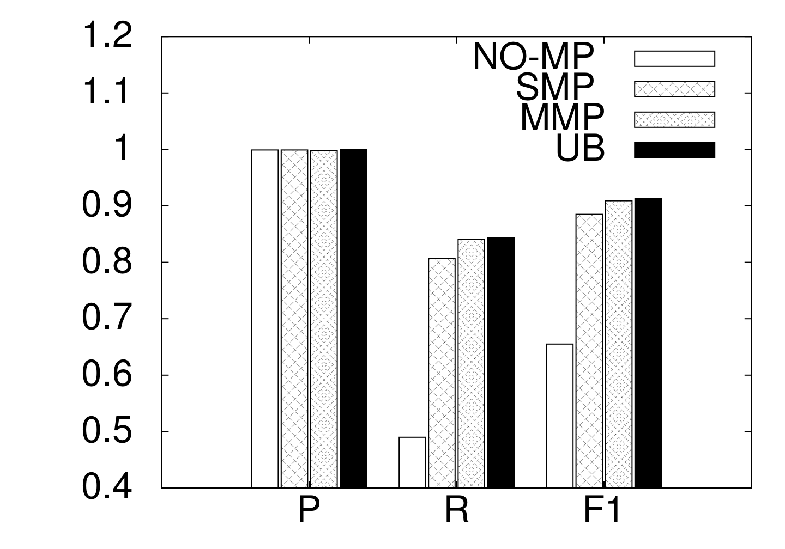
Accuracy Results
Goal: Compare precision, recall, F1 of message-passing algorithms
HEPTH Dataset
Compare against what?
Global run of MLN
UB:
precision = 1,
recall = MLN + perfect evidence
Precision
Recall
F1

Slide 29
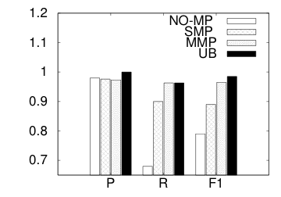
Accuracy Results (Contd.)
Goal: Compare precision, recall, F1 of message-passing algorithms
HEPTH Dataset
DBLP Dataset
Compare against what?
Global run of MLN
UB:
precision = 1,
recall = MLN + perfect-messages
Run Dedupalog_{[Arasu et. al.]} instead of MLN_{[Singla et. al.]}
as black-box collective entity matcher
Precision
Recall
F1
Precision
Recall
F1

Slide 30
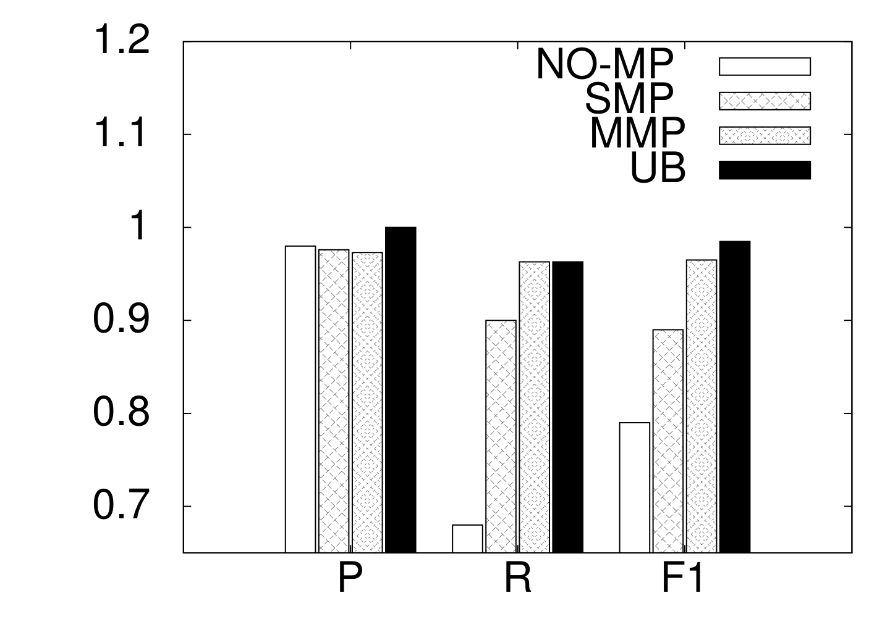
Accuracy Results: DBLP
Goal: Compare precision, recall, F1 of message-passing algorithms
DBLP Dataset
Compare against what?
Global run of MLN
UB:
precision = 1,
recall = MLN + perfect evidence
Precision
Recall
F1

Slide 31
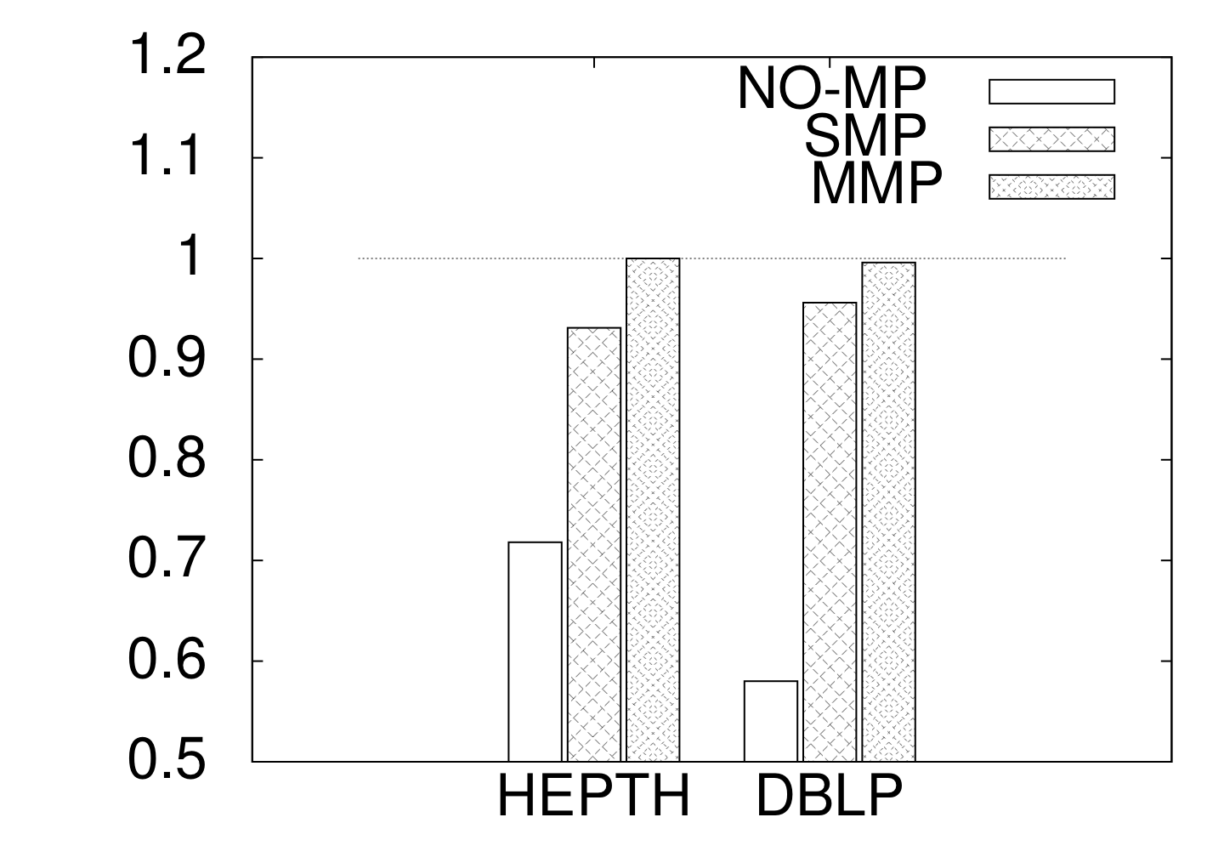
Accuracy Results (Contd.)
Completeness = ratio of recall w.r.t UB
Notes:
Not required

Slide 32
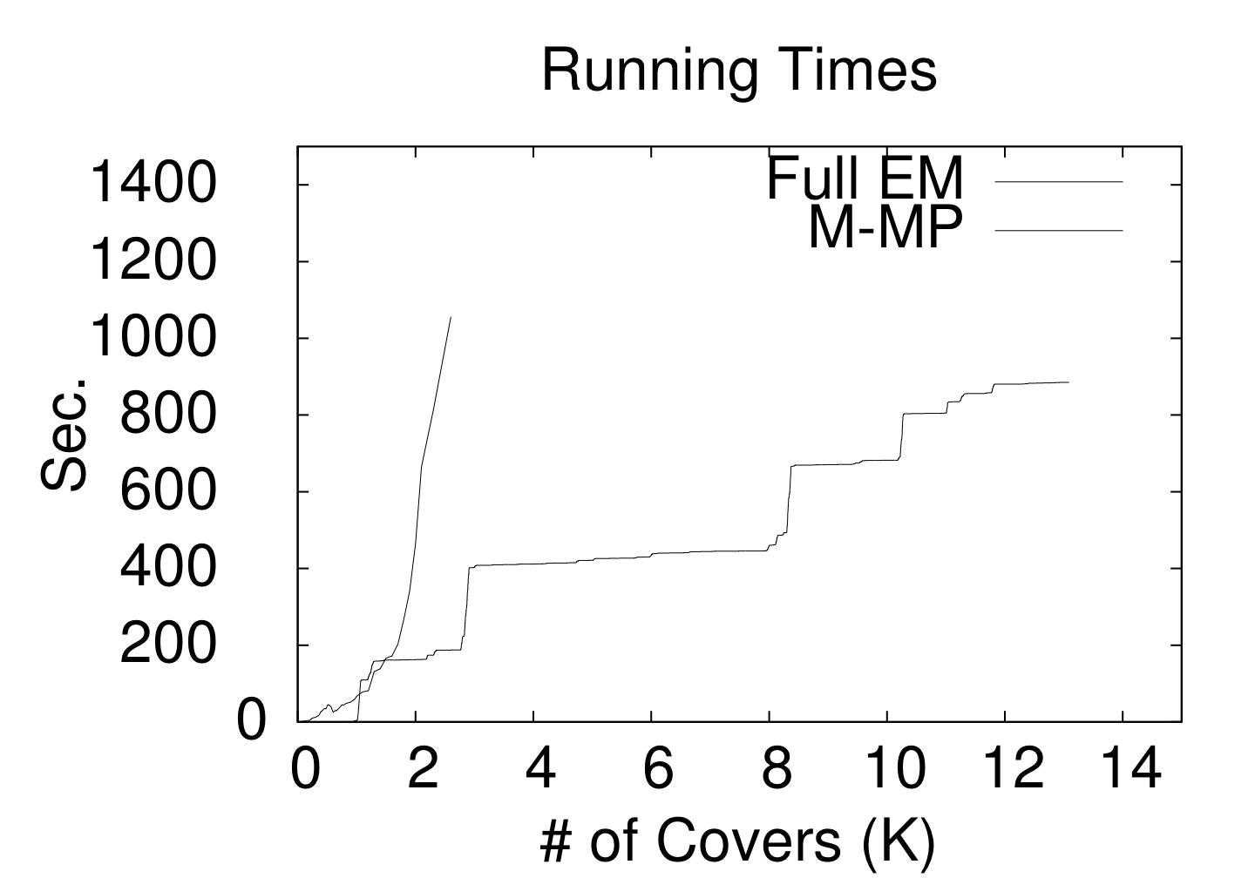
Scalability Results: HEPTH
Notes:
Add color?

Slide 33
Scalability Results: DBLP
The Ultimate Challenge
4.6M entities and 41M candidate pairs
Use map-reduce for distributed processing
Observed linear speed-up
 | NOMP | SMP | MMP
Single machine | 208 | 329 | 285
Map-reduce | 18 | 30 | 27
Running Times (minutes)

Slide 34
Current Implementation Status
Choose a domain for Entity Matching
Using ARXIV author database (57, 000 references)
Has ground truth data
Generate canopies
Using Lucene’s inverted index
Around 10,000 canopies
Perform local EM within canopies
Use Alchemy on each canopy (Domingos et. al.)
Takes less than 2 minutes for largest canopies
Implement simple message passing protocol
Implement maximal message passing protocol
Evaluate performance

Slide 35
Some interesting problems
Construct canopies for minimum overhead
Number of messages is small
Number of iterations to converge
We have a heuristic of adding extra related ref.
Design a scheduling algorithm
Which canopy to schedule next for local EM?
Theoretically analyze completeness
Empirically analyze completeness

Slide 36
Future Work
Use Hadoop for a distributed implementation
Apply it to other domains (s.a. restaurants & reviews, actors & movies)
Develop message passing scheme for rules with negative correlations
Horn clauses
Contain only one negative predicate
Almost supermodular

Slide 37
Conclusion
Collective approaches often do not scale
Naïve canopy-based approaches lose evidence across canopies
We give a distributed message-passing framework for collective entity matching
convergence, soundness guaranteed for rules with positive correlations

