Slide 1


Entity Matching : How Similar Is Similar?
Jiannan Wang (Tsinghua, China) Guoliang Li (Tsinghua, China)
Jeffrey Xu Yu (CUHK, HK, China)
Jianhua Feng (Tsinghua, China)

Slide 2
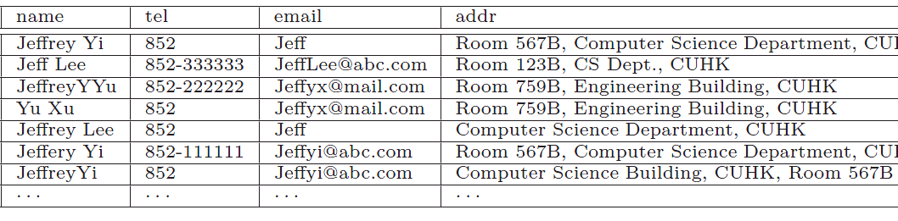
Entity Matching
Find records referring to the same entity
Matching

Slide 3
Rule-based Method
An example of a rule
similar name and the same tel ==> the same entity
Matching
Similar
Same

Slide 4



Rule-based Method
Advantages
Explainable
Programmable
Efficient

Slide 5
Rule-based Method
Problems
Generate record-matching rules
Expert’s experience
Reasoning about record-matching rules (PVLDB’09)
Support approximate-matching conditions
Similarity joins
E.g. SS-Join (ICDE’06)
How similar is similar?
similar name ???
① similar name and the same tel ==> the same entity
② the same address ==> the same tel
③ similar name and the same address ==> the same entity

Slide 6
How Similar Is Similar?
similar name
iff. sim(name₁ , name₂) ≥ θ
Example：S1 = “Jeffrey Yi” , S2 = “Jeffery Yi”
sim=Jaccard , θ=0.7
Jaccard(S1, S2) = |S1∩ S2|/ |S1∩ S2| = 1/3 < 0.7 ×
sim=ES , θ=0.7
ES(S1, S2) = 1- ED(S1, S2)/max(|S1|, |S2|) = 0.8 ≥ 0.7 √
Similarity Function
Threshold
Edit distance

Slide 7
How Similar Is Similar? (Cont’d)
Challenges
Record-matching rules
.
.
.
similar address and the same email
similar name and the same tel
.
.
.
Threshold
.
.
.
0.64
0.72
. . .
. . .
Edit Similarity
Jaccard Similarity
.
.
.
Similarity Functions

Slide 8
Outline
SiFi Problem Formulation
From Infinite Threshold to Finite Threshold
Eliminating Redundancy
Algorithms for SiFi Problem
Experiment
Conclusion

Slide 9
Attribute-matching Rule (AR)
explicit Attribute-matching Rule (eAR)
λ^{e}: (a, f , θ)
a: An attribute
f: A similarity function
θ : A threshold
r , r’ satisfy λ^{e} iff. f (r[a], r’[a])≥ θ
λ^{e}: (name, Jacc , 0.8)
RID | name | …
r₁ | Jeffery Yi
r₂ | Jeffrey Yi
r₃ | Jeffrey Yi
dissatisfy λ^{e}
satisfy λ^{e}

Slide 10
Attribute-matching Rule (AR)
explicit Attribute-matching Rule (eAR)
λ^{e}: (a, f , θ)
a: An attribute
f: A similarity function
θ : A threshold
r[a] , r’[a] satisfy λ^{e} iff. f (r[a], r’[a])≥ θ
implicit Attribute-matching Rule (iAR)
λ^{i}: (a, F , Θ)
a: An attribute
F: A set of similarity functions
Θ: A range of thresholds
λ^{e} is an instance of λ^{i} iff. f∈ F and θ ∈ Θ
λ^{i}: (name, {Jacc, ES} , [0,1])
λ^{e} : (name, Jacc ,0.8) (Instance)

Slide 11
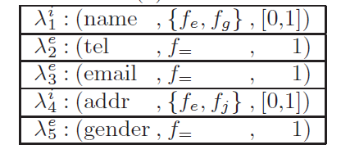
Record-matching Rule (RR)
A conjunction of ARs
φ: λ₁ Λ λ₂ Λ … Λ λ_{k}
λ₁e: (name, f_{e} , 0.7)
_{φ1}
 | λ₁^{i} Λ λ₂e
 | λ₃e Λ λ₄^{i}
 | λ₁^{i} Λ λ₄^{i} Λ λ₅e
Φ
_{φ2}
_{φ3}
λ₄e: (addr, f_{j} , 0.8)
_{ψ1}
 | λ₁e Λ λ₂e
 | λ₃e Λ λ₄e
 | λ₁e Λ λ₄e Λ λ₅e
Ψ
_{ψ2}
_{ψ3}

Slide 12
Evaluate the quality of Ψ
General Function: F (Ψ, M, D)
Ψ : An instance of Φ
M : A set of positive examples
D : A set of negative examples
Property: M_{Ψ} denotes record pairs that satisfy Ψ
The larger M_{Ψ}∩M, the larger F (Ψ, M, D)
The smaller M_{Ψ}∩D, the larger F (Ψ, M, D)
Subsume many well-know functions
Accuracy Rate:
F-Measure:
,where

Slide 13
SiFi Problem Formulation
similarity function identification in implicit record-matching rules for effective entity matching
SiFi Problem
Input
Φ: A set of RRs
M : A set of positive examples
D : A set of negative examples
Output
Ψ: An instance of Φ to maximize F (Ψ, M, D)

Slide 14
Outline
SiFi Problem Formulation
From Infinite Threshold to Finite Threshold
Eliminating Redundancy
Algorithms for SiFi Problem
Experiment
Conclusion

Slide 15
From Infinite Threshold to Finite Threshold
A range contains an infinite number of thresholds
λ^{i}: (a, f , [0,1])
A finite number of thresholds
θ is the upper-bound of Θ
θ = f(r[a], r’[a]) where (r, r’)∈ M
Only using this finite number of thresholds can also maximize the objective function F (Ψ, M, D)

Slide 16
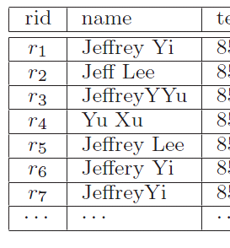
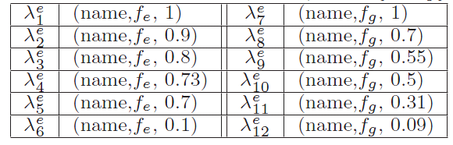
Example
λ^{i} : (name, { f_{e}, f_{g} }, [0, 1 ])
A collection of records
Record pairs | fe | fg
RP1,6 | 0.8 | 0.5
RP1,7 | 0.9 | 0.7
RP2,5 | 0.73 | 0.55
RP3,4 | 0.1 | 0.09
RP6,7 | 0.7 | 0.31
f_{e}(“Jeffrey Yi” , “Jeffery Yi”) = 0.8
Positive examples:
RPi,j denotes (ri, rj)

Slide 17
Outline
SiFi Problem Formulation
From Infinite Threshold to Finite Threshold
Eliminating Redundancy
Algorithms for SiFi Problem
Experiment
Conclusion

Slide 18
Two Types of Redundancy
Grouping
based on f
Threshold Redundancy
Threshold Redundancy
Similarity-function
Redundancy
Gf_{e}
Gf_{g}

Slide 19
Threshold Redundancy
Definition
An instance λ^{e}_{i} : (a, f, θ_{i} ) is threshold redundant
if ∃ λ^{e}_{j} : (a, f, θ_{j} )∈ Gf (θ_{i} > θ_{j} ) s.t. there is no negative example in
Record pairs that satisfy λ^{e}_{j}
Record pairs that satisfy λ^{e}_{i}
Intuitively, if λ^{e}_{j} can return more positive examples than λ^{e}_{i} and the same negative examples as λ^{e}_{i} , then λ^{e}_{i} is redundant w.r.t λ^{e}_{j}

Slide 20
Naive Solution
Time complexity
Example
No negative example in:

Slide 21
Our Solution
Time complexity
Example
No negative example in:
An instance with a smaller threshold can return more record pairs than that with a larger one.

Slide 22
Similarity-function Redundancy
Definition
An instance λ^{e}_{i} : (a, f_{i}, θ_{i} ) ∈ Gf_{i} is similarity-function redundant if ∃ λ^{e}_{j} ∈ Gf_{j} s.t.
More positive examples
Fewer negative examples

Slide 23
Naive Solution
Time complexity：
12

Slide 24
Our Solution
Time complexity
Equivalent redundancy condition
Gf_{i}
YES
NO
Gf_{j}

Slide 25
Outline
SiFi Problem Formulation
From Infinite Threshold to Finite Threshold
Eliminating Redundancy
Algorithms for SiFi Problem
Experiment
Conclusion

Slide 26
NP-Hard Problem
Record-matching rules
NP-hard ☹
Proof: Using a reduction from
Maximum-Coverage Problem
.
.
.
similar address and the same email
similar name and the same tel
.
.
.
Threshold
One iAR
(name, {f1, f2} , [0,1]) → { (name, f1 , 0.85), (name, f1 , 0.7) , (name, f1 , 0.66),…
,(name, f2 , 0.95), (name, f2 , 0.78), … }
Two iARs
(address, {f2, f3} , [0,1]) → { (address, f2 , 0.85), (address, f2 , 0.7),…
,(address, f3 , 0.95), (address, f3 , 0.78), … }
Similarity Functions

Slide 27
Heuristic Algorithms
SiFi-Greedy
Idea: The greedy algorithm for maximum-coverage problem
Algorithm: Identify the instance of the best iAR each time
SiFi-Gradient
Idea: Gradient descent
Algorithm: Iteratively adjust instances to their neighbors to reach a higher objective value
SiFi-Hill
Idea: Hill climbing
Algorithm: Iteratively adjust the instance of a single iAR to any possible instance to reach a higher objective value
Neglect the interaction among different iARs
Only consider Neighbor instances

Slide 28
Outline
SiFi Problem Formulation
From Infinite Threshold to Finite Threshold
Eliminating Redundancy
Algorithms for SiFi Problem
Experiment
Conclusion

Slide 29
Experiment Setup
Data sets
Cora is a collection of citation entries
Example size: |M| = 14,358, |D| = 170,380
Attributes (9): author, title, venue, address, publisher, editor, date, volume, pages
Restaurant is a collection of restaurant records
Example size: |M| = 87,492, |D| = 106
Attributes (5): name, address, phone, city, type
DBGen is a random mailing-list generator
Example size: |M|= 3071, |D| = 2426
Attributes (10): ssn, fname, minit, lname, stnum, stadd, apmt, city, state, zip

Slide 30
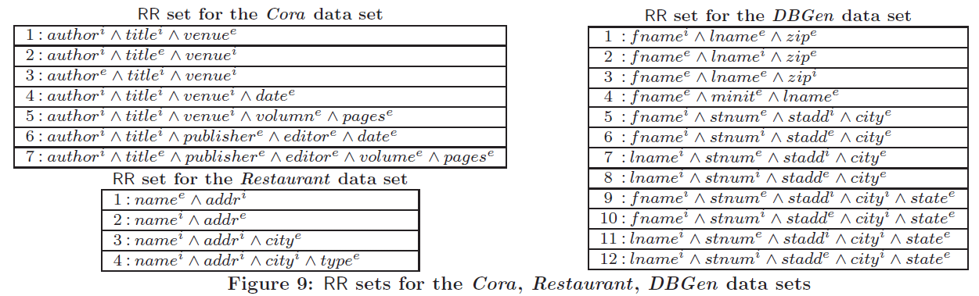
Experiment Setup
Record-matching rule set
Cora
Restaurant
DBGen

Slide 31
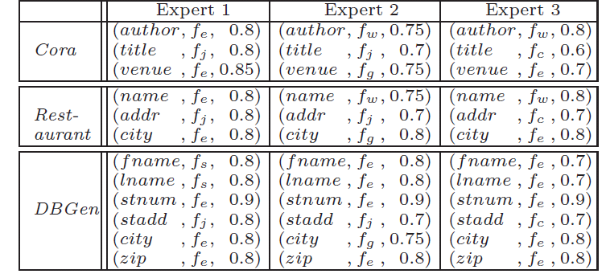
Comparison with Baseline Methods
Our algorithm
SiFi-Greedy, SiFi-Gradient, SiFi-Hill
Baseline
SiFi-Expert-1, SiFi-Expert-2, SiFi-Expert-3
SiFi-Equal
Change “similar name and the same tel”
to “the same name and the same tel”

Slide 32
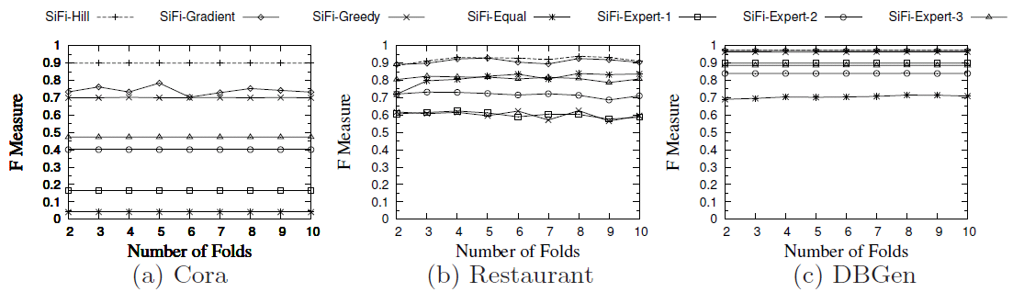
Comparison with Baseline Methods
1. Our methods perform better
2. SiFi-Hill performs the best
3. It is necessary to study “How similar is Similar?”
4. It is important to match some attribute values approximately

Slide 33
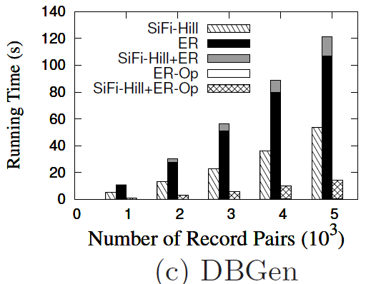
Evaluation of Eliminating Redundancy
2. Optimizing the eliminating-redundancy algorithm is quite necessary
1. Eliminating redundancy can improve the performance of SiFi-Hill

Slide 34
Comparison with Existing methods
Existing methods
OPTrees (VLDB’07)
An executable operator tree with data cleaning operators
SVM (KDD’03)
A record pair → n|F|-dimensional vector
SVM classifier
Join
Jacc(addr)>0.8 &&ES(Name)>0.9
R
R
Maximum
margins

Slide 35
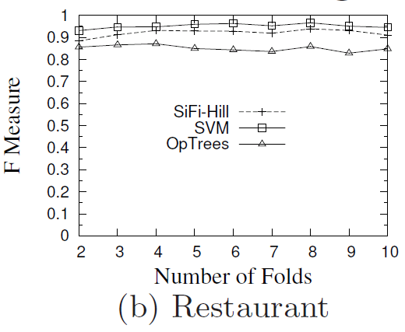
Comparison with Existing methods
2. SVM gets the highest value, but SiFi-Hill and OpTrees are more explainable
Effectiveness
1. SiFi-Hill gets higher values than OpTrees

Slide 36
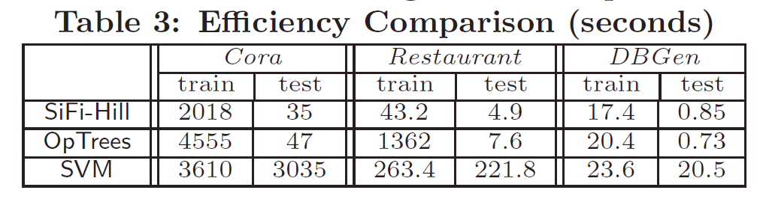
Comparison with Existing methods
Efficiency

Slide 37
Outline
SiFi Problem Formulation
From Infinite Threshold to Finite Threshold
Eliminating Redundancy
Algorithms for SiFi Problem
Experiment
Conclusion

Slide 38
Conclusion
We formulate the problem of “How similar is similar” for entity matching (SiFi)
We propose efficient methods to detect and eliminate redundancy among similarity functions and thresholds
We device three heuristic methods to address SiFi problem
Our method performs better than the state-of-the-art method, and is more explainable and efficient than machine learning based techniques

Slide 39

Thanks!
Q&A

