Slide 1
PathSim: Meta Path-Based Top-K
Similarity Search in Heterogeneous Information Networks
Yizhou Sun† Jiawei Han† Xifeng Yan‡ Philip S. Yu§ Tianyi Wu⋄
† University of Illinois at Urbana-Champaign, Urbana, IL
‡ University of California at Santa Barbara, Santa Barbara, CA
§ University of Illinois at Chicago, Chicago, IL
⋄ Microsoft Corporation, Redmond, WA

Slide 2
Content
Background and Motivation
Meta Path-based Similarity Framework
PathSim: A Novel Meta Path-Based Similarity Measure
Online Query Processing for Top-K Similarity Search
Experiments
Conclusions

Slide 3
Background
Heterogeneous information networks (HIN)
  Networks containing multi-typed objects, interconnected via multi-typed relationships
  Examples
    DBLP network: papers, authors, venues, terms
    Flickr network: pictures, tags, users, groups
  Sources
    From online web services: online shopping websites, social media websites, bibliographic websites, …
    From database systems: medical databases, university databases, police department databases, …

Slide 4
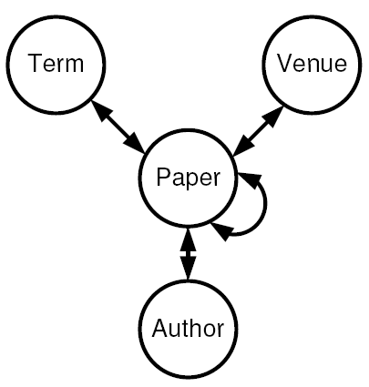
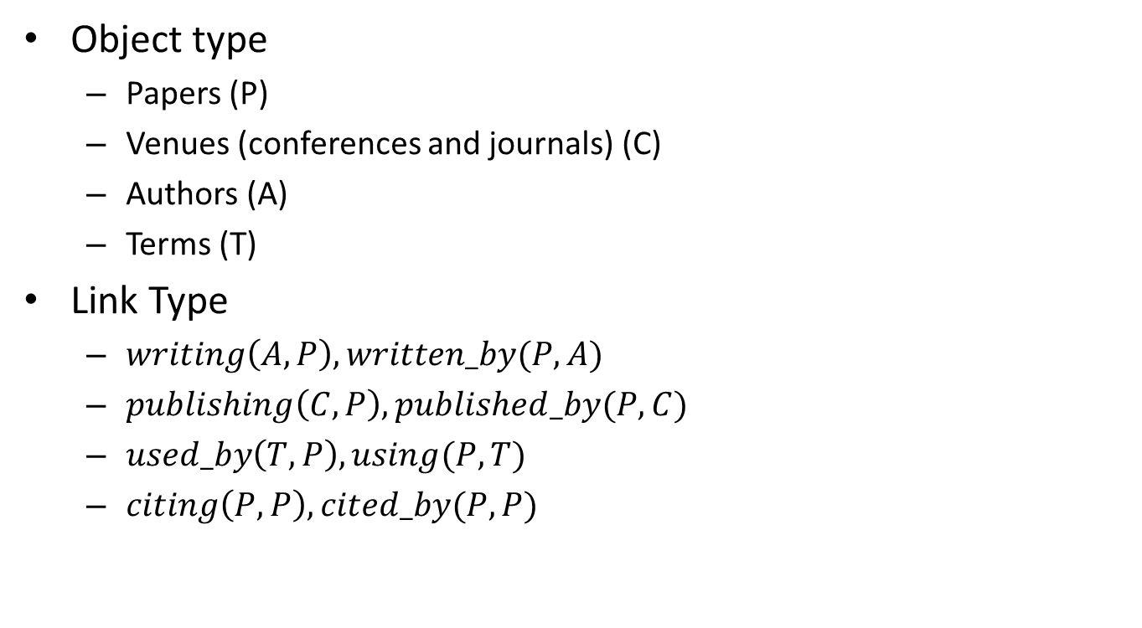
Example: the DBLP network
Object type
  Papers (P)
  Venues (conferences and journals) (C)
  Authors (A)
  Terms (T)
Link Type
  $writing\left(A,P\right), written_by(P,A)$
  $publishing\left(C,P\right), published_by(P,C)$
  $used_by\left(T,P\right), using(P,T)$
  $citing\left(P,P\right), cited_by(P,P)$
DBLP Network schema
Ann
P2
“data”
Jim
P1
VLDB
“network”
A Network Instance

Slide 5
Similarity Search in HIN
For DBLP network (or other bibliographic networks)
  Find the most “similar” authors for a given author
  Find the most “similar” venue for a given venue
For Flickr network
  Find the most “similar” picture for a given picture
  Find the most “similar” user for a given user
Similarity search should be a primitive operator in HIN
  Define similarity measures between objects in HIN, using structural information
  Answer top-k similarity search queries efficiently

Slide 6
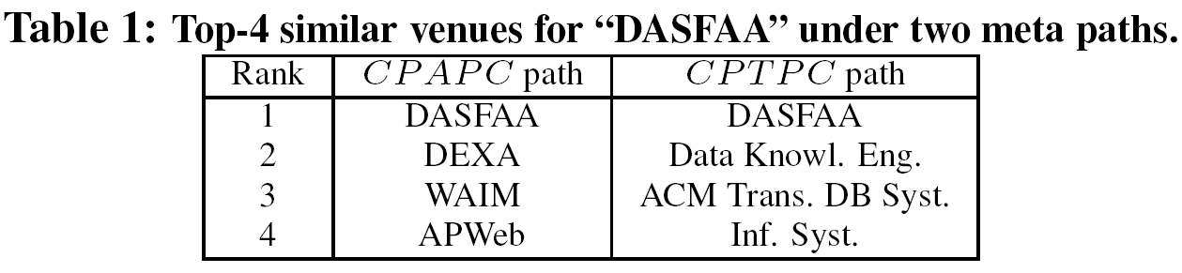
How to Define “Similarity” in HIN?
Different semantic meanings of “similarity” under different topological connectivity following different types of links
Limitation of current similarity/proximity measures defined in networks
  Do NOT distinguish different types of objects and different types of links in the network
    Different types of objects and links have different semantic meanings
  E.g., personalized PageRank (P-PageRank), SimRank
Notes:
Show example here?

Slide 7
Contributions
Investigate the problem of similarity search in heterogeneous information networks (HIN)
  Focus on the similarity search between objects from the same type
Propose a novel meta path-based framework for similarity definition in HIN
Propose a novel meta path-based similarity measure, PathSim, for finding “peers” in HIN
Propose efficient online query processing algorithms for top-k similarity search in HIN under PathSim definition

Slide 8
Content
Background and Motivation
Meta Path-based Similarity Framework
PathSim: A Novel Meta Path-Based Similarity Measure
Online Query Processing for Top-K Similarity Search
Experiments
Conclusions

Slide 9
Meta Path
Intuition
  Two objects can be connected via different connectivity paths
    E.g., two authors can be connected by
      “author-paper-author” (APA)
      “author-paper-author-paper-author” (APAPA)
      “author-paper-venue-paper-author” (APCPA)
      …
  Each connectivity path represents a different semantic meaning and implies different similarity semantics

Slide 10
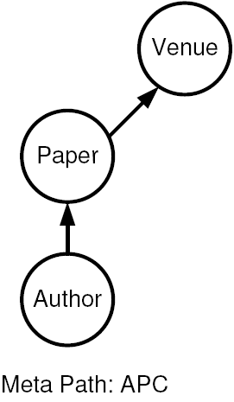
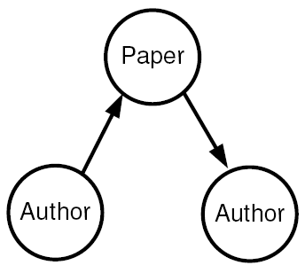

Examples: Meta Paths in the DBLP Network
Example of path instances:
“Jim-P1-VLDB”
Example of path instances:
“Jim-P1-Ann”

Slide 11
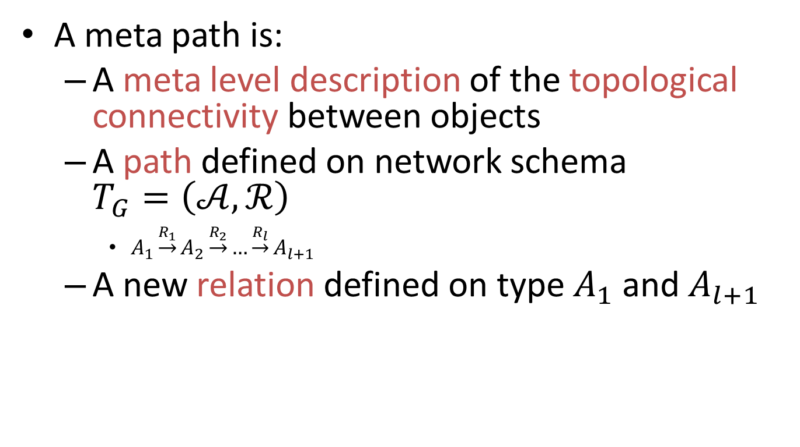
Different Views of Meta Paths
A meta path is:
  A meta level description of the topological connectivity between objects
  A path defined on network schema $T_{G}=\left(𝒜,ℛ\right)$
    $A_{1}\underset{→}{R_{1}}A_{2}\underset{→}{R_{2}}…\underset{→}{R_{l}}A_{l+1}$
  A new relation defined on type $A_{1}$ and $A_{l+1}$

Slide 12
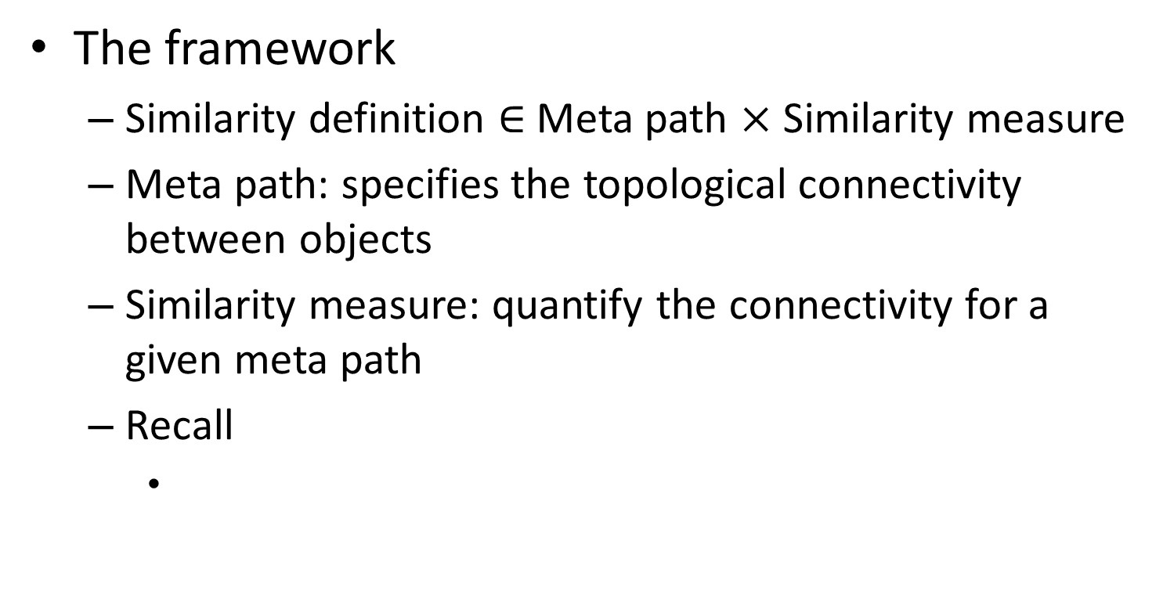
The Framework of Similarity Definition in HIN
The framework
  Similarity definition $∈$Meta path $×$ Similarity measure
  Meta path: specifies the topological connectivity between objects
  Similarity measure: quantify the connectivity for a given meta path
  Recall

Slide 13

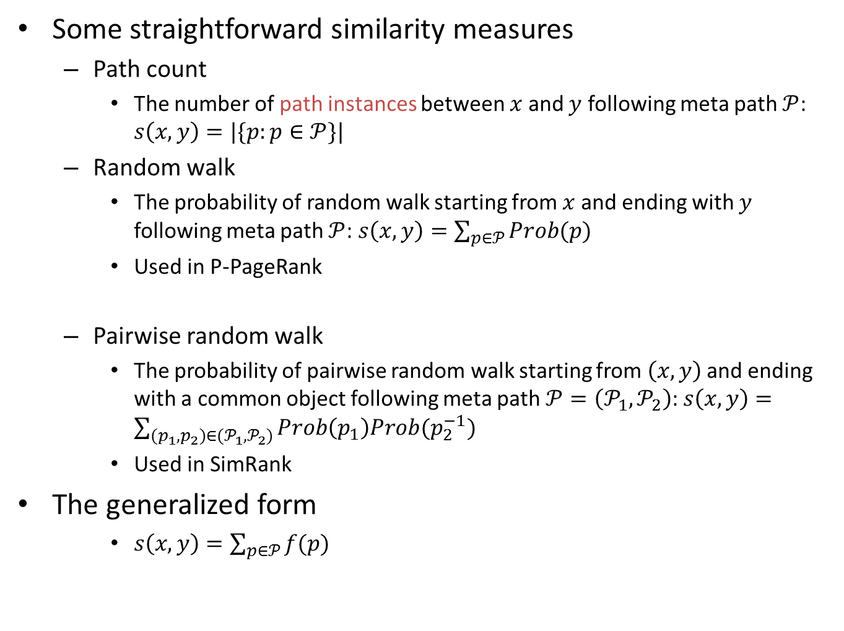

Examples of Meta Path-based Similarity Measures
Some straightforward similarity measures
  Path count
    The number of path instances between $x$ and $y$ following meta path $𝒫$: $s\left(x,y\right)=|\{p:p∈𝒫\}|$
  Random walk
    The probability of random walk starting from $x$ and ending with $y$ following meta path $𝒫$: $s\left(x,y\right)=\sum_{p∈𝒫}{Prob(p)}$
    Used in P-PageRank
  Pairwise random walk
    The probability of pairwise random walk starting from $\left(x,y\right)$ and ending with a common object following meta path $𝒫=\left(𝒫_{1},𝒫_{2}\right)$: $s\left(x,y\right)=\sum_{{(p}_{1},p_{2})∈(𝒫_{1},𝒫_{2})}{Prob\left(p_{1}\right)Prob(p_{2}^{−1})}$
    Used in SimRank
The generalized form
    $s\left(x,y\right)=\sum_{p∈𝒫}{f(p)}$
x
p
y
x
$$p_{1}$$
$$p_{2}$$
y
z

Slide 14

Content
Background and Motivation
Meta Path-based Similarity Framework
PathSim: A Novel Meta Path-Based Similarity Measure
Online Query Processing for Top-K Similarity Search
Experiments
Conclusions

Slide 15
PathSim: Similarity in Terms of “Peers”
Path count and Random walk (RW)
  Favor highly visible objects (objects with large degrees)
Pairwise random walk (PRW)
  Favor pure objects (objects with highly skewed scatterness in their in-links or out-links)
PathSim
  Favor “peers” (objects with similar visibility and strong connectivity under the given meta path)

Slide 16
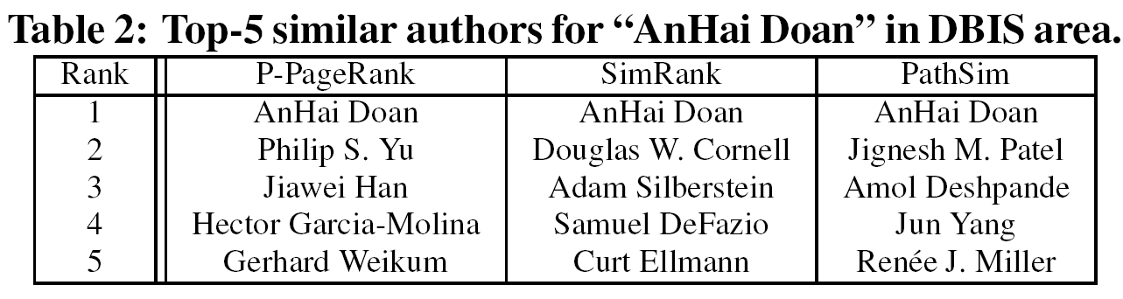
Motivating Examples
For DBLP network
  Find similar authors based on their reputation and field
For IMDB network
  Find similar actors based on their movie style and productivity
For Amazon network
  Find similar products based on their functionality and popularity
Under Meta Path APCPA

Slide 17
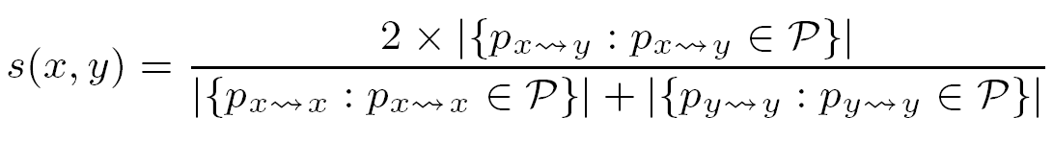

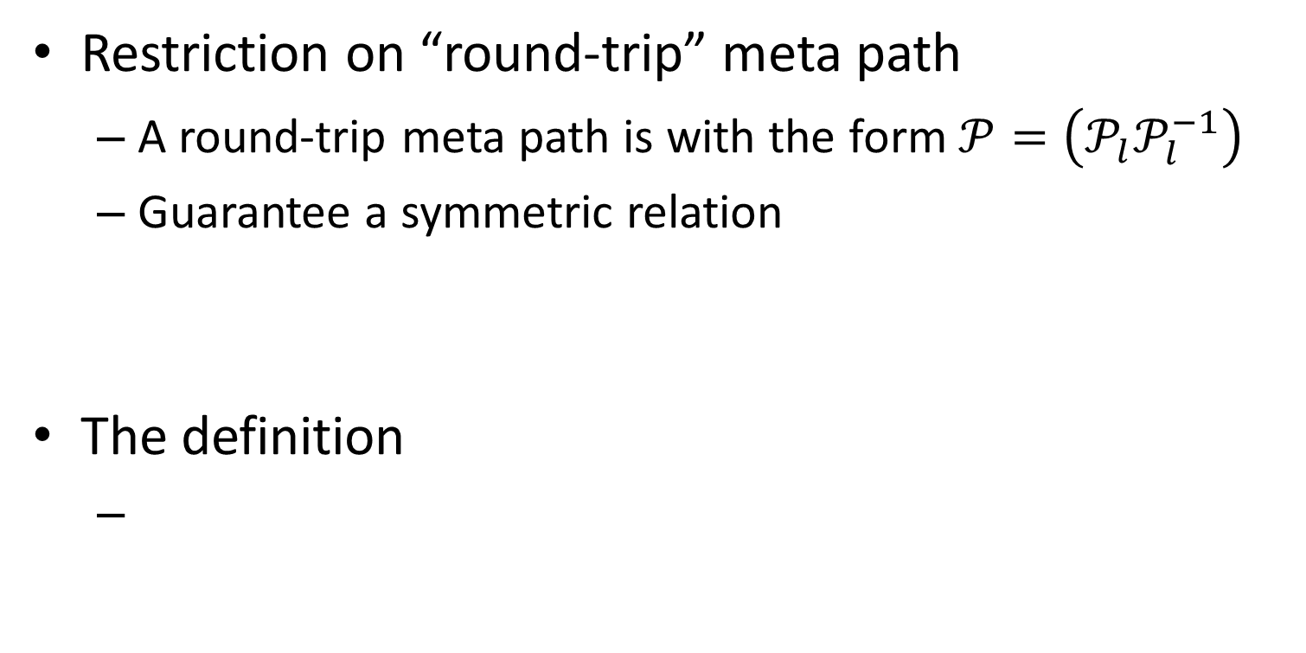

The Formal Definition of PathSim
Restriction on “round-trip” meta path
  A round-trip meta path is with the form $𝒫=\left(𝒫_{l}𝒫_{l}^{−1}\right)$
  Guarantee a symmetric relation
The definition
$$𝒫_{l}$$
$$𝒫_{l}^{−1}$$

Slide 18
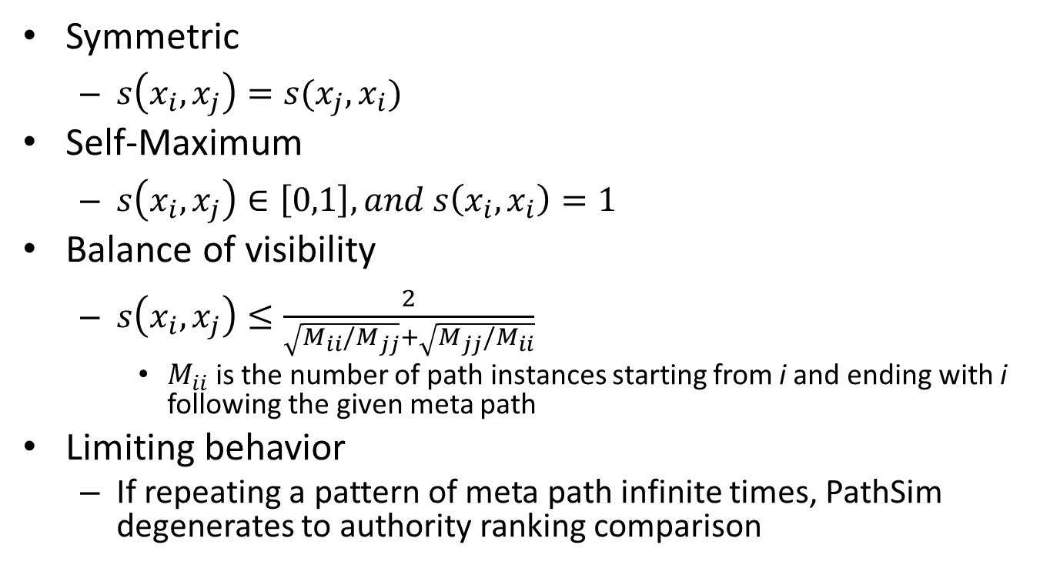
Properties of PathSim
Symmetric
  $s\left(x_{i},x_{j}\right)=s(x_{j},x_{i})$
Self-Maximum
  $s\left(x_{i},x_{j}\right)∈\left[0,1\right], and s\left(x_{i},x_{i}\right)=1$
Balance of visibility
  $s\left(x_{i},x_{j}\right)≤\frac{2}{\sqrt{M_{ii}/M_{jj}}+\sqrt{M_{jj}/M_{ii}}}$
    $M_{ii}$ is the number of path instances starting from i and ending with i following the given meta path
Limiting behavior
  If repeating a pattern of meta path infinite times, PathSim degenerates to authority ranking comparison
Long meta path without introducing new relationships is not that helpful!

Slide 19
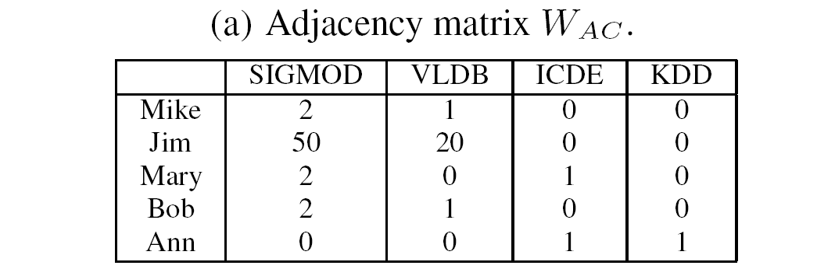
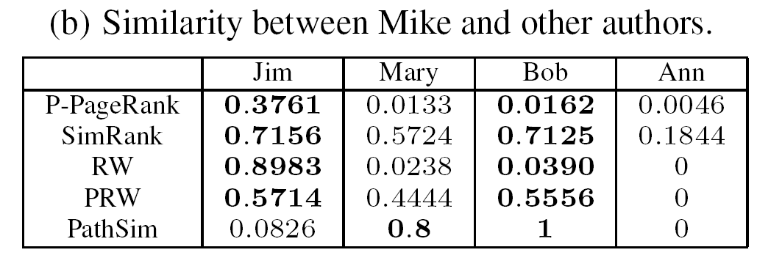
Comparison with Other Measures: A Toy Example
Who is the most similar to Mike?

Slide 20
Content
Background and Motivation
Meta Path-based Similarity Framework
PathSim: A Novel Meta Path-Based Similarity Measure
Online Query Processing for Top-K Similarity Search
Experiments
Conclusions

Slide 21
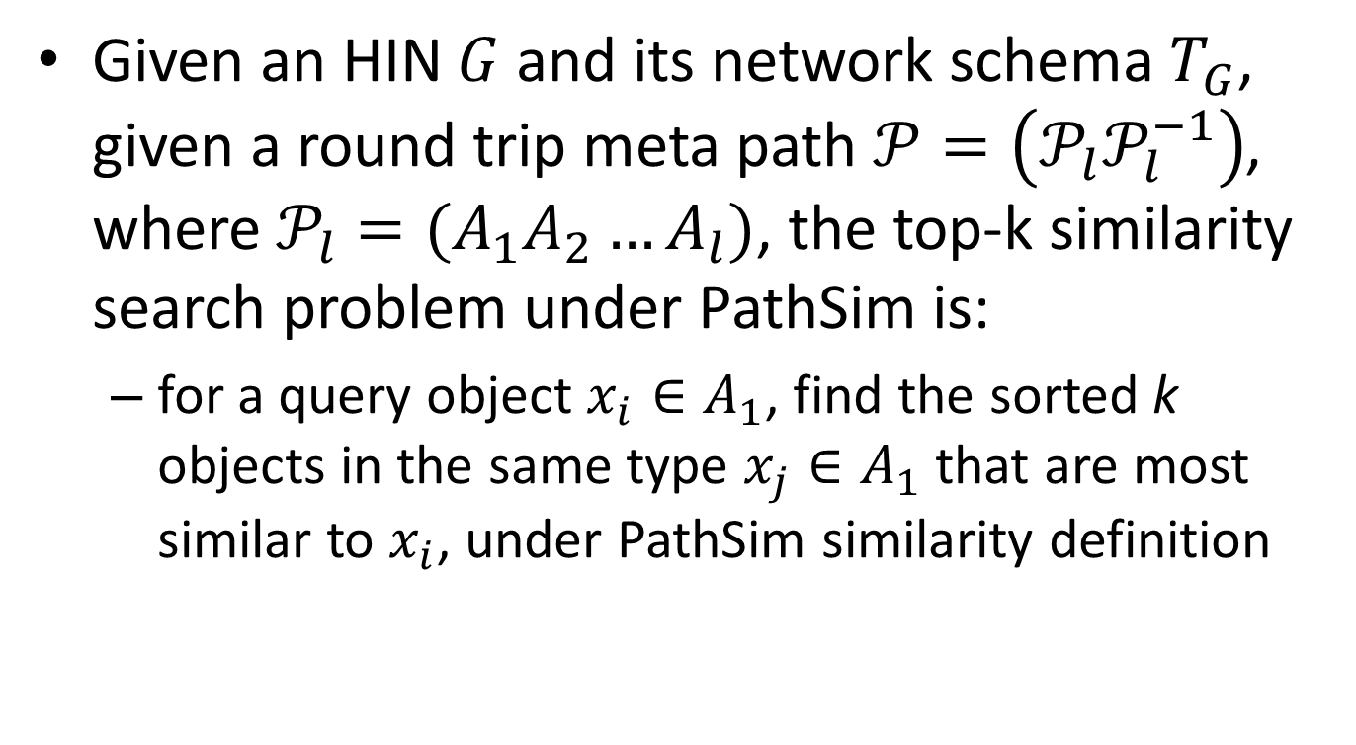
The Top-K Similarity Search Problem under PathSim
Given an HIN $G$ and its network schema $T_{G}$, given a round trip meta path $𝒫=\left(𝒫_{l}𝒫_{l}^{−1}\right)$, where $𝒫_{l}=(A_{1}A_{2}…A_{l})$, the top-k similarity search problem under PathSim is:
  for a query object $x_{i}∈A_{1}$, find the sorted k objects in the same type $x_{j}∈A_{1}$that are most similar to $x_{i}$, under PathSim similarity definition

Slide 22
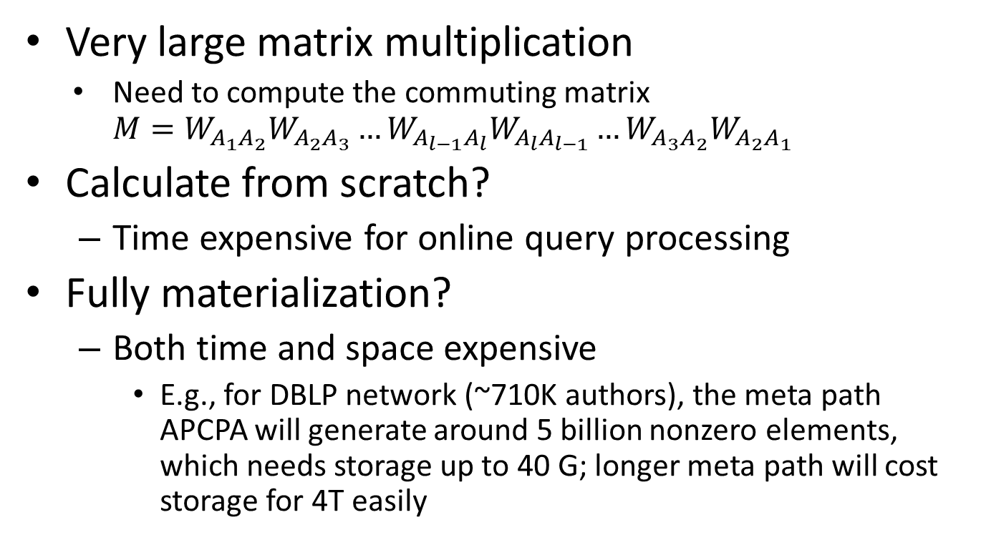
Major Issues for Online Computation
  Very large matrix multiplication
    Need to compute the commuting matrix $M=W_{A_{1}A_{2}}W_{A_{2}A_{3}}…W_{A_{l−1}A_{l}}W_{A_{l}A_{l−1}}…W_{A_{3}A_{2}}W_{A_{2}A_{1}}$
Calculate from scratch?
  Time expensive for online query processing
Fully materialization?
  Both time and space expensive
    E.g., for DBLP network (~710K authors), the meta path APCPA will generate around 5 billion nonzero elements, which needs storage up to 40 G; longer meta path will cost storage for 4T easily

Slide 23
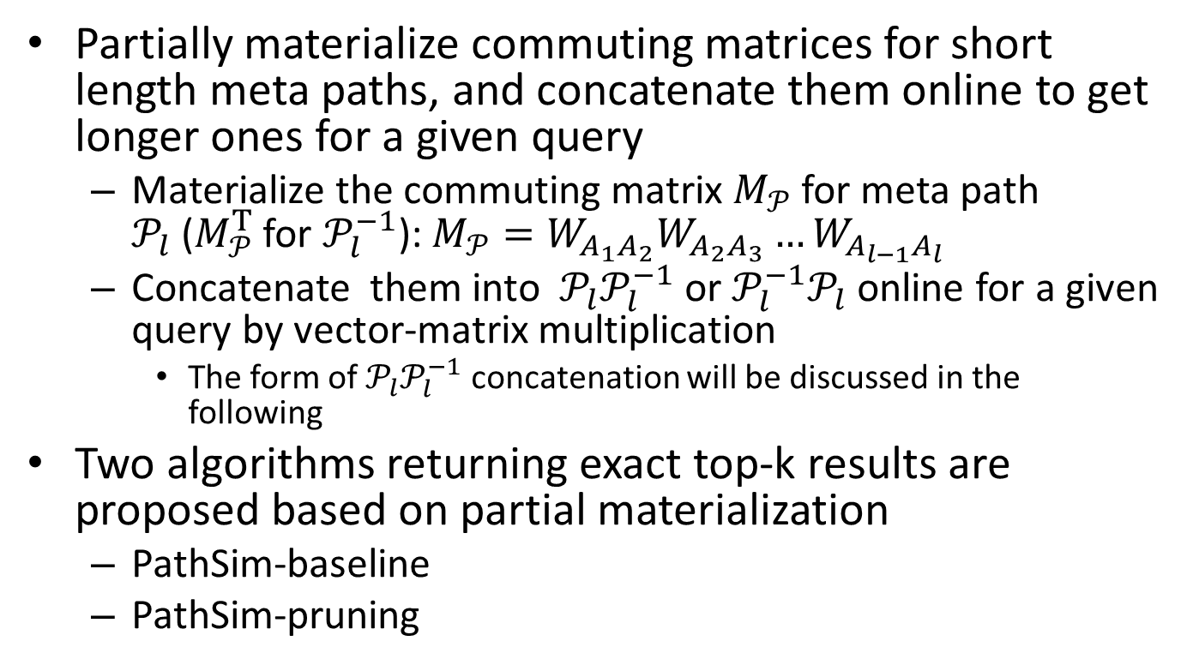
The Solution: Partial Materialization
Partially materialize commuting matrices for short length meta paths, and concatenate them online to get longer ones for a given query
  Materialize the commuting matrix $M_{𝒫}$ for meta path $𝒫_{l}$($M_{𝒫}^{T}$ for $𝒫_{l}^{−1}$): $M_{𝒫}=W_{A_{1}A_{2}}W_{A_{2}A_{3}}…W_{A_{l−1}A_{l}}$
  Concatenate them into $𝒫_{l}𝒫_{l}^{−1}$ or $𝒫_{l}^{−1}𝒫_{l}$ online for a given query by vector-matrix multiplication
    The form of $𝒫_{l}𝒫_{l}^{−1}$ concatenation will be discussed in the following
Two algorithms returning exact top-k results are proposed based on partial materialization
  PathSim-baseline
  PathSim-pruning

Slide 24
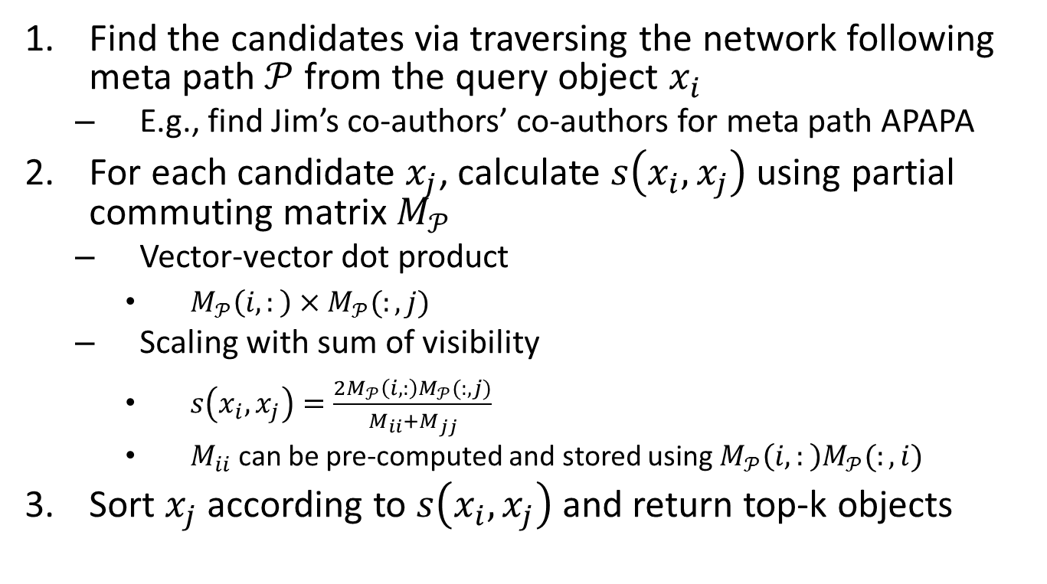
The Baseline Algorithm
Find the candidates via traversing the network following meta path $𝒫$ from the query object $x_{i}$
  E.g., find Jim’s co-authors’ co-authors for meta path APAPA
For each candidate $x_{j}$, calculate $s\left(x_{i},x_{j}\right)$ using partial commuting matrix $M_{𝒫}$
  Vector-vector dot product
    $M_{𝒫}\left(i,:\right)×M_{𝒫}(:,j)$
  Scaling with sum of visibility
    $s\left(x_{i},x_{j}\right)=\frac{2M_{𝒫}\left(i,:\right)M_{𝒫}(:,j)}{M_{ii}+M_{jj}}$
    $M_{ii}$ can be pre-computed and stored using $M_{𝒫}\left(i,:\right)M_{𝒫}(:,i)$
Sort $x_{j}$ according to $s\left(x_{i},x_{j}\right)$ and return top-k objects

Slide 25
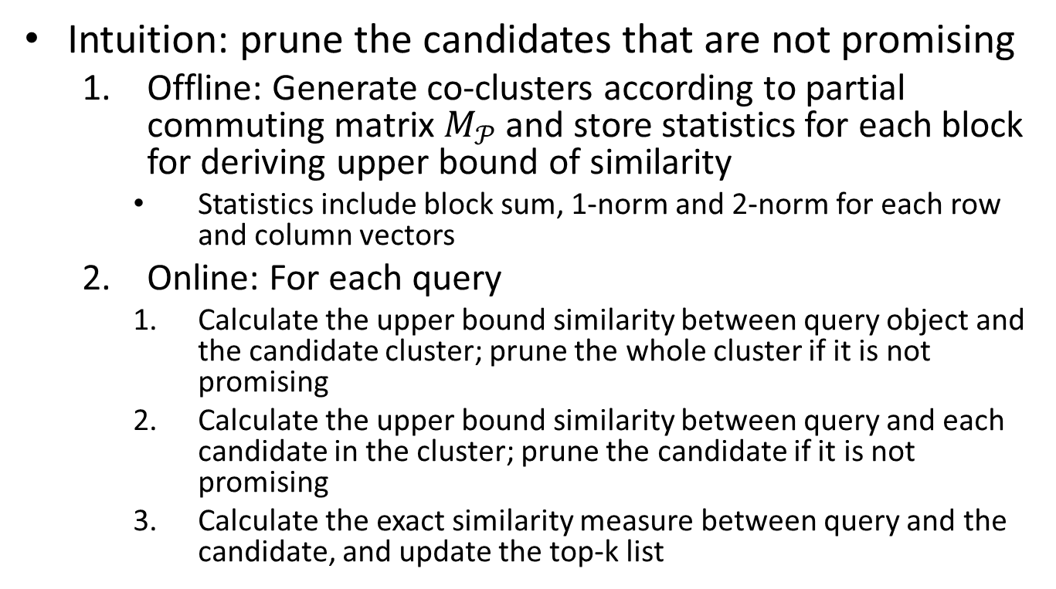
Co-clustering-based Pruning Algorithm
Intuition: prune the candidates that are not promising
  Offline: Generate co-clusters according to partial commuting matrix $M_{𝒫}$and store statistics for each block for deriving upper bound of similarity
    Statistics include block sum, 1-norm and 2-norm for each row and column vectors
  Online: For each query
    Calculate the upper bound similarity between query object and the candidate cluster; prune the whole cluster if it is not promising
    Calculate the upper bound similarity between query and each candidate in the cluster; prune the candidate if it is not promising
    Calculate the exact similarity measure between query and the candidate, and update the top-k list

Slide 26
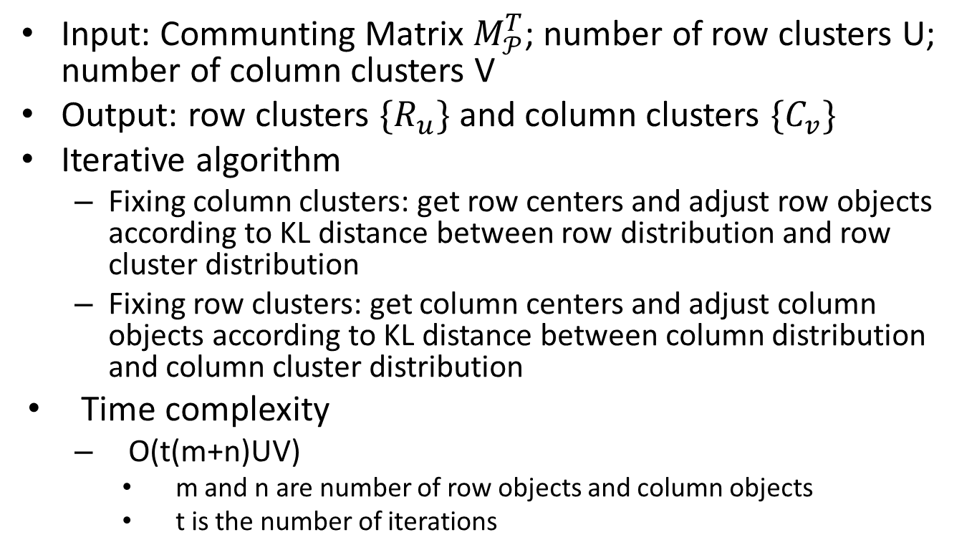

The Co-Clustering Algorithm on Parital Communting Matrix $M_{𝒫}^{T}$
Input: Communting Matrix $M_{𝒫}^{T}$; number of row clusters U; number of column clusters V
Output: row clusters $\{R_{u}\}$ and column clusters $\{C_{v}\}$
Iterative algorithm
  Fixing column clusters: get row centers and adjust row objects according to KL distance between row distribution and row cluster distribution
  Fixing row clusters: get column centers and adjust column objects according to KL distance between column distribution and column cluster distribution
Time complexity
  O(t(m+n)UV)
    m and n are number of row objects and column objects
    t is the number of iterations

Slide 27
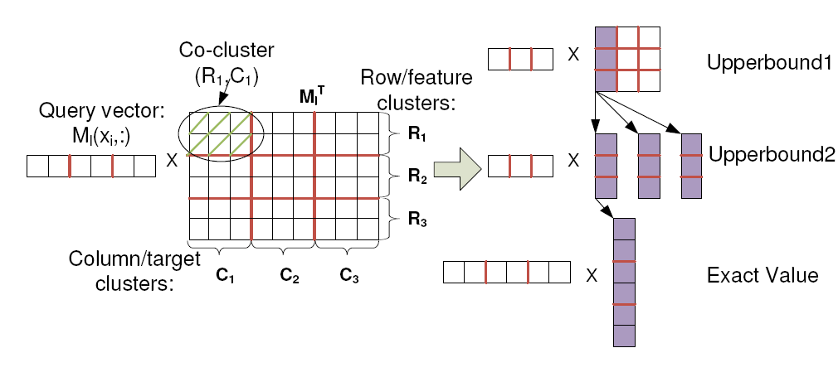
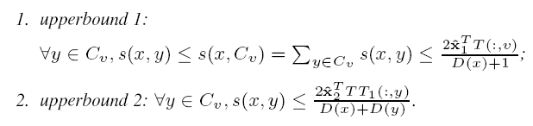
An Illustration for PathSim-Pruning

Slide 28
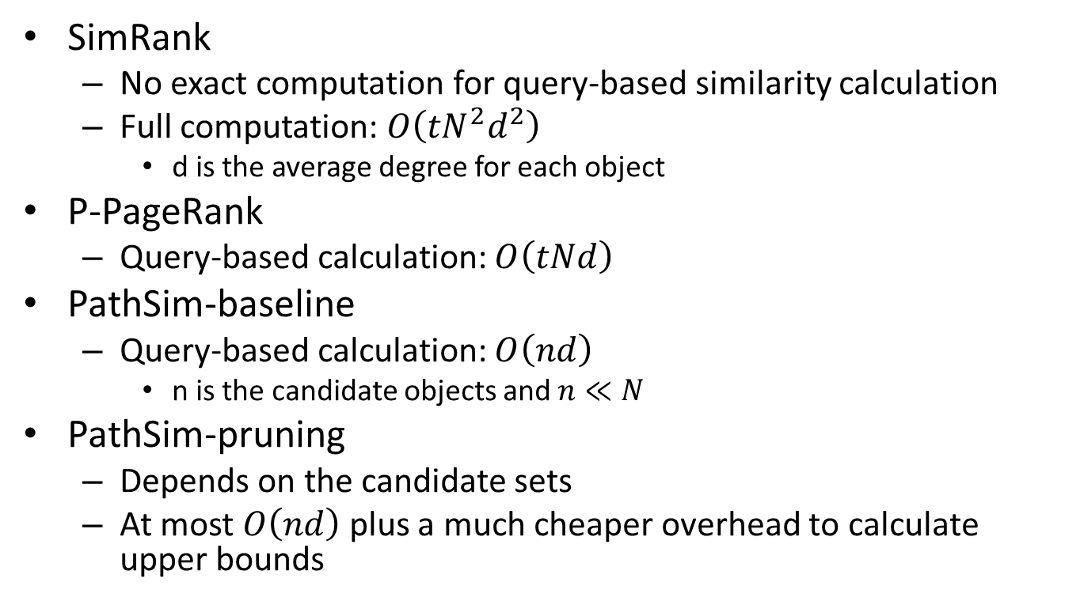
Time Complexity Analysis for Online Query Processing
SimRank
  No exact computation for query-based similarity calculation
  Full computation: $O\left({tN}^{2}d^{2}\right)$
    d is the average degree for each object
P-PageRank
  Query-based calculation: $O\left(tNd\right)$
PathSim-baseline
  Query-based calculation: $O\left(nd\right)$
    n is the candidate objects and $n≪N$
PathSim-pruning
  Depends on the candidate sets
  At most $O\left(nd\right)$ plus a much cheaper overhead to calculate upper bounds

Slide 29
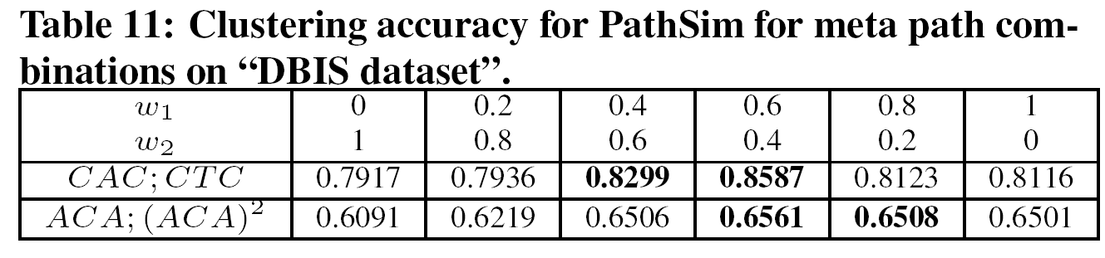
Similarity under Meta Path Combination
The combined similarity is defined as a linear combination of PathSim under different meta paths
  Experiment show that combined similarity can produce better clustering quality
  The search algorithm is easily extended from the single meta path search algorithm

Slide 30
Content
Background and Motivation
Meta Path-based Similarity Framework
PathSim: A Novel Meta Path-Based Similarity Measure
Online Query Processing for Top-K Similarity Search
Experiments
Conclusions

Slide 31
Datasets
The DBLP network
  By Nov. 2009
  Contains over 710K authors, 1.2M papers, 5K venues (conferences/journals), and around 70K terms appearing more than once (stopwords have been removed).
The Flickr network
  Contains 10,000 images from 20 groups as well as their related 664 users and 10284 tags appearing more than once.

Slide 32
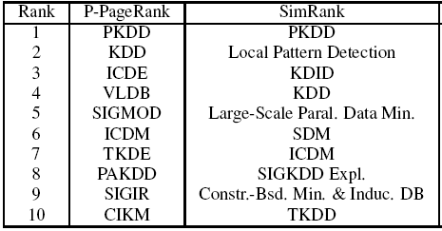
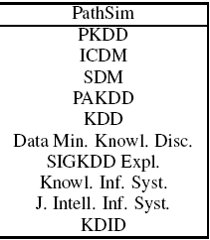

Effectiveness - the PathSim Measure
Case Study on the query “PKDD” on “DBIS dataset” under meta path CPAPC

Slide 33
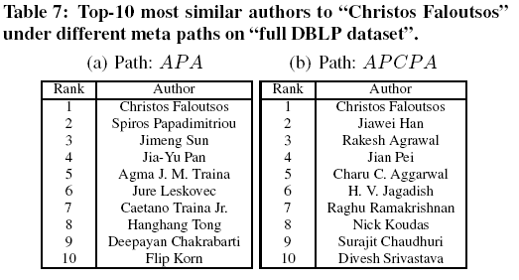
Effectiveness – semantic meanings under different meta paths

Slide 34
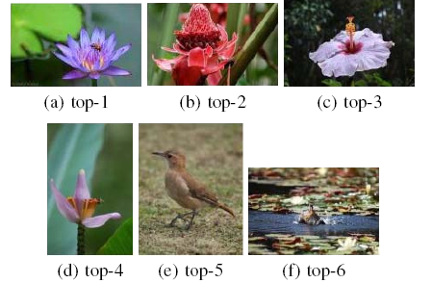
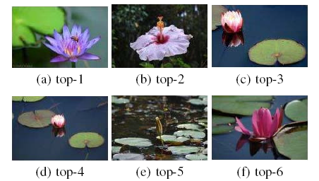
Effectiveness – Flickr

Slide 35
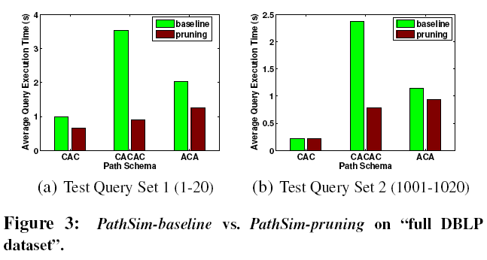
Efficiency: PathSim-baseline vs. PathSim-pruning

Slide 36
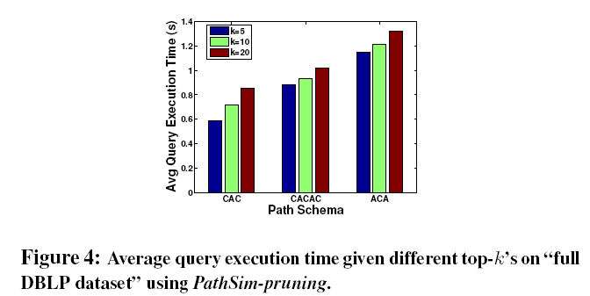
Efficiency: the Impact of Top-k

Slide 37
Content
Background and Motivation
Meta Path-based Similarity Framework
PathSim: A Novel Meta Path-Based Similarity Measure
Online Query Processing for Top-K Similarity Search
Experiments
Conclusions

Slide 38
Summary
Define a meta path-based similarity framework in HIN
Propose a new measure called PathSim, which is able to detect peer objects for the given meta path
Propose a co-clustering-based efficient online search algorithm to support top-k search

Slide 39
Ongoing Works on the Line
Meta path selection for similarity search in HIN
  Feature selection in attribute-based feature space
Relationship prediction in HIN
  Link prediction in homogeneous information network

Slide 40
Q&A

