Slide 1
Profiling, What-if Analysis, and Cost-based Optimization of MapReduce Programs
Herodotos Herodotou
Shivnath Babu
Duke University

Slide 2
Analysis in the Big Data Era
Popular option
Hadoop software stack
Java / C++ /
R / Python
Hive
Jaql
Elastic
MapReduce
Pig
Oozie
Hadoop
MapReduce Execution Engine
HBase
Distributed File System
Notes:
Analytics in Hadoop involves loading data as files and
running parallel MR computations to interpret and process the data.
Several systems have been built on top of Hadoop to satisfy user needs and preferences.

Slide 3
Analysis in the Big Data Era
Popular option
Hadoop software stack
Who are the users?
Data analysts, statisticians, computational scientists…
Researchers, developers, testers…
You!
Who performs setup and tuning?
The users!
Usually lack expertise to tune the system
Notes:
Users: computational analysts, system researchers, and business analysts

Slide 4
Problem Overview
Goal
Enable Hadoop users and applications to get good performance automatically
Part of the Starfish system
This talk: tuning individual MapReduce jobs
Challenges
Heavy use of programming languages for MapReduce programs and UDFs (e.g., Java/Python)
Data loaded/accessed as opaque files
Large space of tuning choices

Slide 5
MapReduce Job Execution
job j = < program p, data d, resources r, configuration c >
split 0
map
split 2
map
reduce
out 0
split 1
map
split 3
map
reduce
out 1
Two Map Waves
One Reduce Wave
Notes:
Parameters: number of map and reduce tasks, memory buffers, or use of compression
Job: cpu vs io computation, how selective the map is
Data: num unique values, key-value distributions
Cluster: num task slots, available task memory

Slide 6
Optimizing MapReduce Job Execution
job j = < program p, data d, resources r, configuration c >
Space of configuration choices:
Number of map tasks
Number of reduce tasks
Partitioning of map outputs to reduce tasks
Memory allocation to task-level buffers
Multiphase external sorting in the tasks
Whether output data from tasks should be compressed
Whether combine function should be used

Slide 7
Optimizing MapReduce Job Execution
Rules-of-thumb settings
2-dim projection of 13-dim surface
Use defaults or set manually (rules-of-thumb)
Rules-of-thumb may not suffice

Slide 8
Applying Cost-based Optimization
Goal:
Just-in-Time Optimizer
Searches through the space S of parameter settings
What-if Engine
Estimates perf using properties of p, d, r, and c
Challenge: How to capture the properties of an arbitrary MapReduce program p?
Notes:
Responsibility is given a job to execute on a particular data set on a particular cluster, to search through the high-dimensional space of parameter settings, in order to find the one with the best estimated performance.
Dynamic instrumentation: collect run-time monitoring information to build a job profile: a concise representation of the job execution.
Use existing methods (e.g., simulated annealing, stochastic gradient descent)

Slide 9
Job Profile
Concise representation of program execution as a job
Records information at the level of “task phases”
Generated by Profiler through measurement or by the What-if Engine through estimation
map
Serialize,
Partition
Memory Buffer
Sort,
[Combine],
[Compress]
split
Merge
DFS
Read
Map
Collect
Spill
Merge

Slide 10
Job Profile Fields
Dataflow: amount of data flowing through task phases
Map output bytes
Number of map-side spills
Number of records in buffer per spill
Costs: execution times at the level of task phases
Read phase time in the map task
Map phase time in the map task
Spill phase time in the map task
Dataflow Statistics: statistical information about the dataflow
Map func’s selectivity (output / input)
Map output compression ratio
Size of records (keys and values)
Cost Statistics: statistical information about the costs
I/O cost for reading from local disk per byte
CPU cost for executing Map func per record
CPU cost for uncompressing the input per byte

Slide 11
Generating Profiles by Measurement
Goals
Have zero overhead when profiling is turned off
Require no modifications to Hadoop
Support unmodified MapReduce programs written in Java or Hadoop Streaming/Pipes (Python/Ruby/C++)
Dynamic instrumentation
Monitors task phases of MapReduce job execution
Event-condition-action rules are specified, leading to run-time instrumentation of Hadoop internals
We currently use BTrace (Hadoop internals are in Java)

Slide 12
Generating Profiles by Measurement
split 0
map
reduce
out 0
enable
profiling
enable
profiling
raw data
raw data
map profile
reduce profile
split 1
map
enable
profiling
raw data
job profile
Use of Sampling
Profiling
Task execution

Slide 13
What-if Engine
Job
Profile
<p, d₁, r₁, c₁>
Input Data
Properties
<d₂>
Cluster
Resources
<r₂>
Configuration
Settings
<c₂>
What-if Engine
Job Oracle
Virtual Job Profile for <p, d₂, r₂, c₂>
Task Scheduler Simulator
Properties of Hypothetical job

Slide 14
Virtual Profile Estimation
Given profile for job j = <p, d₁, r₁, c₁>
estimate profile for job j' = <p, d₂, r₂, c₂>
Profile for j
(Virtual) Profile for j'
Dataflow
Statistics
Input
Data d₂
Confi-guration c₂
Cardinality
Models
Dataflow
Statistics
Cost
Statistics
Resources
r₂
White-box Models
Cost
Statistics
Dataflow
Relative
Black-box
Models
Dataflow
White-box Models
Costs
Costs

Slide 15
White-box Models
Detailed set of equations for Hadoop
Example:
Input data properties
Dataflow statistics
Configuration parameters
Calculate dataflow in each task phase in a map task
map
Serialize,
Partition
Memory Buffer
Sort,
[Combine],
[Compress]
split
Merge
DFS
Read
Map
Collect
Spill
Merge

Slide 16
Just-in-Time Optimizer
Job
Profile
<p, d₁, r₁, c₁>
Input Data
Properties
<d₂>
Cluster
Resources
<r₂>
Just-in-Time Optimizer
(Sub) Space Enumeration
Recursive Random Search
What-if Calls
Best Configuration
Settings <c_{opt}> for <p, d₂, r₂>

Slide 17
Recursive Random Search
Space Point
(configuration
settings)
Use What-if Engine to cost
Parameter Space

Slide 18
Experimental Methodology
15-30 Amazon EC2 nodes, various instance types
Cluster-level configurations based on rules of thumb
Data sizes: 10-180 GB
Rule-based Optimizer Vs. Cost-based Optimizer
Abbr. | MapReduce Program | Domain | Dataset
CO | Word Co-occurrence | NLP | Wikipedia
WC | WordCount | Text Analytics | Wikipedia
TS | TeraSort | Business Analytics | TeraGen
LG | LinkGraph | Graph Processing | Wikipedia (compressed)
JO | Join | Business Analytics | TPC-H
TF | TF-IDF | Information Retrieval | Wikipedia

Slide 19
Job Optimizer Evaluation
Hadoop cluster: 30 nodes, m1.xlarge
Data sizes: 60-180 GB

Slide 20
Job Optimizer Evaluation
Hadoop cluster: 30 nodes, m1.xlarge
Data sizes: 60-180 GB

Slide 21
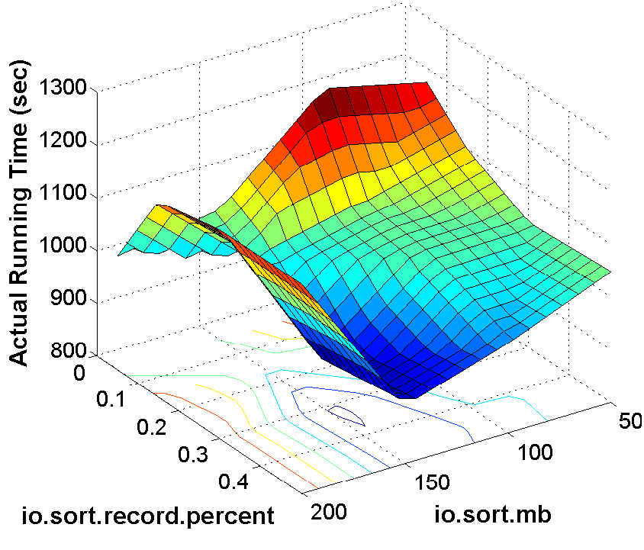
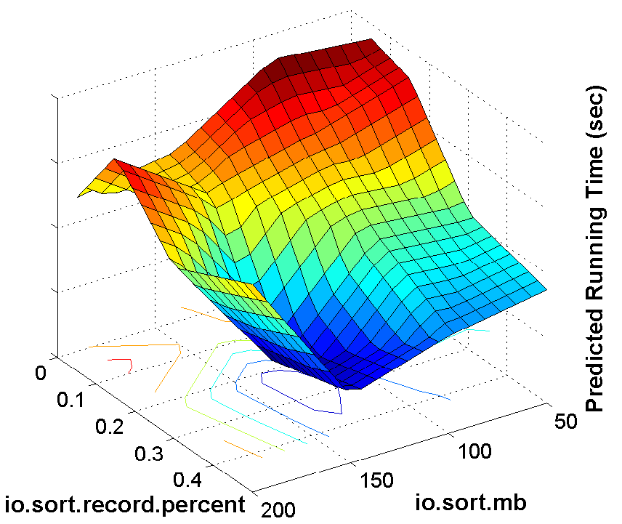
Estimates from the What-if Engine
Hadoop cluster: 16 nodes, c1.medium
MapReduce Program: Word Co-occurrence
Data set: 10 GB Wikipedia
True surface
Estimated surface

Slide 22
Estimates from the What-if Engine
Profiling on Test cluster, prediction on Production cluster
Test cluster: 10 nodes, m1.large, 60 GB
Production cluster: 30 nodes, m1.xlarge, 180 GB

Slide 23
Profiling Overhead Vs. Benefit
Hadoop cluster: 16 nodes, c1.medium
MapReduce Program: Word Co-occurrence
Data set: 10 GB Wikipedia

Slide 24
Conclusion
What have we achieved?
Perform in-depth job analysis with profiles
Predict the behavior of hypothetical job executions
Optimize arbitrary MapReduce programs
What’s next?
Optimize job workflows/workloads
Address the cluster sizing (provisioning) problem
Perform data layout tuning

Slide 25
Starfish: Self-tuning Analytics System
Software Release:
Starfish v0.2.0
Demo Session C:
Thursday, 10:30-12:00
Grand Crescent
www.cs.duke.edu/starfish

Slide 26
Hadoop Configuration Parameters
Parameter | Default Value
io.sort.mb | 100
io.sort.record.percent | 0.05
io.sort.spill.percent | 0.8
io.sort.factor | 10
mapreduce.combine.class | null
min.num.spills.for.combine | 3
mapred.compress.map.output | false
mapred.reduce.tasks | 1
mapred.job.shuffle.input.buffer.percent | 0.7
mapred.job.shuffle.merge.percent | 0.66
mapred.inmem.merge.threshold | 1000
mapred.job.reduce.input.buffer.percent | 0
mapred.output.compress | false

Slide 27
Amazon EC2 Node Types
Node Type | CPU (EC2 Units) | Mem (GB) | Storage (GB) | Cost ($/hour) | Map Slots per Node | Reduce Slots per Node | Max Mem per Slot
m1.small | 1 | 1.7 | 160 | 0.085 | 2 | 1 | 300
m1.large | 4 | 7.5 | 850 | 0.34 | 3 | 2 | 1024
m1.xlarge | 8 | 15 | 1690 | 0.68 | 4 | 4 | 1536
c1.medium | 5 | 1.7 | 350 | 0.17 | 2 | 2 | 300
c1.xlarge | 20 | 7 | 1690 | 0.68 | 8 | 6 | 400

Slide 28
Input Data & Cluster Properties
Input Data Properties
Data size
Block size
Compression
Cluster Properties
Number of nodes
Number of map slots per node
Number of reduce slots per node
Maximum memory per task slot

