Slide 1


Personalized Privacy Protection in Social Networks
Mingxuan Yuan, Lei Chen and Philip S. Yu

Slide 2
Outline
Background
Problem Description
Solution
Experiments and Conclusion

Slide 3







Social Network Benefits
data
(…)
(…)
(…)
Facebook
(…)
(…)
Government
Advertiser
Analyze and reveal some privacy information
Web agents
Marketing
Customers
Users
Notes:
[1] Social networks are getting more and more popular usage in recent years. As a result, studying and mining on the social networks become more and more important. For example, government can make proper policy to prevent the spreading of a certain disease by studying the spreading its rules. A company can issue advertisement more efficiently by studying how people influence each other. A social network website needs to publish its data to some customers.
[2] However, the social network data cannot be directly released due to the privacy request of the users who involve in the social network.
[3] The graph data must be sanitized before publishing to void the customers to analyze or reveal some privacy information.
[4] The customers here refer to the people who use the published data. And the users refer to the social network users who join those networks.

Slide 4
Privacy Protection Objective
Avoid Node re-identification
  Prob(u is p) <= 1/k
  Models
    K-degree anonymous (Sigmod 08 Liu et al.)
    K-neighborhood anonymous(ICDE 08 Zhou et al.)
    K-anonymous through clustering (VLDB 08 Hay et al., Pinkdd 08, Campan et al.)
    K-automorphism (VLDB 09 Zou et al.)
Avoid Edge discovery
  Prob(E(p₁, p₂)) <= 1/k or Prob(e, p) <= 1/k
  Models
    VLDB 09 Cormode et al.
    Sigmod 10 James et al.
(…)
(…)
(…)
Bob
USA
Phd.
37
(…)
(…)
Friend?
Bob
France
Phd.
37
Ting
China
Master
32
Notes:
[1] The privacy issue has already got lots of attention. Some works have been proposed to publish privacy preserving social networks. The users in a social network may have two privacy requirements.
[2] The first is to avoid node re-identification. Node re-identification is to correctly re-identify a user in the published graph with high probability based on certain knowledge. This is the same as the node re-identification on the anonymized tabular data except the knowledge used by an attacker may contain some connection information. For example, an attacker knows Bob is a 37 years old white guy with a phd. degree, he also knows Bob has two friends in the social network, this attacker can use this information to find out which node is Bob in the published graph. Then the information about Bob in the published graph is released. Several models have been proposed to prevent node re-identification based on different assumptions of the knowledge can be used by an attacker.
[3] Since the social connection information of a user is often sensitive, the other privacy requirement is to prevent the edge discovery in the published graph. Edge discovery is to either find two users have a connection or find a user is involved in a connection based on certain knowledge.

Slide 5
Privacy Protection Method
k=2
An attack can only correctly re-identify a node
with probability at most 50%
Bob
Tom
Clustering
2
2
1
1
2
3
Lily
Tim
Super node’s size >=2
Jack
Aron
Editing
Original Graph
Lily
An attacker’s knowledge
Notes:
[1] There are two basic methods to implement the protection, editing and clustering.
[2] For example, the privacy requirement is to make sure that an attacker can only correctly re-identify a node with probability at most 50%.
[3] One method is to publish a clustered graph.
[4] A clustered graph is a graph that each node represents at least k nodes in the original graph and each edge represents several edges in the original graph. A node is called as the super node and an edge is called as super edge in the clustered graph. If an attacker knows the neighborhood graph of Lily, he always finds that Lily belongs to at least 1 super node in the published graph. Since each super node’s size is at least k, an attacker can only correctly re-identify a node with probability at most 1/k=50%
[5] Another method is editing the original graph by adding or deleting edges and nodes to make the graph satisfy certain property. For example, by adding one edge, every node in the graph has the same neighborhood graph with at least one other node in the graph. Then an attacker who knows the neighborhood graph of Lily will always get at least two candidates in the published graph.
[6] Current protection models use either of these two methods to provide the same protection for all the users in the graph, this cannot satisfy the requirement of a publisher.

Slide 6
Outline
Background and Related Work
Problem Description
Solution
Experiments and Conclusion

Slide 7
The dilemma of a publisher
(…)
User: I need to protect my privacy
Miner: I want useful information
Soft Request
(…)
(…)
Hard Request
Utility
Privacy
Utility
Privacy
(…)
(…)
data
☹
miner
☺
user
user
user
☺
miner
☹
user
Miner
miner
I don’t want to buy the data
I don’t want to provide my data
Case 1
Case 2
Notes:
[1] A data publisher should make the published data satisfy the requirements of both the customers who require the graph data and the users who involve in the graph.
[2] The customers prefer the published data close to the original graph.
[3] For the users who join in the social network, they need to make sure their privacy information is protected. This is a hard request since if a user’s privacy cannot be guaranteed, he will refuse to join the social network.
[4] If using the current techniques, all the users can only be protected at the same level. If all the users' privacy is protected well, we must choose the strongest protection for all of them. In this case, the published graph is often faraway from the original graph. As a result, the data obtained by the customers is not useful. The customers will refuse to use this data.
[5] If the publisher satisfies the customer who requires the graph data by providing a weak protection to all users, some users may worry about their privacy and quit this social network.

Slide 8
Utility
Privacy
☺
miner
miner
☺
user
user
?
Notes:
Is it possible to find a solution to satisfy the requirements of both the customers who require the graph data and the users who involve in the graph?

Slide 9
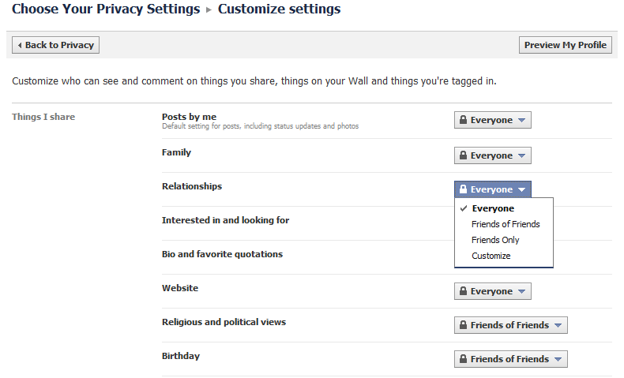
Social Network Websites Support ..
Notes:
[1] Let’s see what is supported by the current social network websites. This is the customize privacy setting panel provided by Facebook.
[2] We can see, each user is freely to set how part of information can be seen by others
[3] He can set who can see his profile information and who can see his connection information as well.

Slide 10

As a Result …
People can only read my posts
Alice
People can only read my posts and my favorite questions
Bob
People can only read my posts , my favorite questions and may relationships
Chilly
… …
Notes:
[1] As a result, the knowledge that an attacker can use to attack a user is only the information that this user released out
[2] For example, Alice …, Bob published more information than Alice, …, Chilly published even more than Bob …
[3] Each user has a clear definition about the knowledge that can be used by an attacker
[3] Although the privacy requirement is a hard request that must be satisfied, it is not necessary to provide the same protection to all the users.
[3] We can take the advantage of the customized setting to increase the utility of the published graph

Slide 11
Protection strategies …
Published Information
{u₁}
1
2₁, 2₂
3
…
m
{u₂}
stronger
{u₃}
{u₄}
{u₅}
Notes:
[1] depends on the different settings of users, the published information can be organized as a Pyramidal

Slide 12
Protection strategies …
Published Information
Corresponding Attacks
Request
{u₁}
1
2₁, 2₂
3
…
m
Based on 1
Prevented for {u₁}
{u₂}
Based on 2
Prevented for {u₂}
stronger
{u₃}
Based on 3
Prevented for {u₃}
{u₄}
… …
… …
{u₅}
Based on m
Prevented for {u_{m}}
Notes:
[1] If for each user, we can prevent the attacks based on the corresponding information, then all the users’ privacy requirements are satisfied

Slide 13
Current Protection strategies …
Published Information
Corresponding Attacks
Request
{u₁}
1
2₁, 2₂
3
…
m
Based on 1
☺
{u₂}
☺
Based on 2
stronger
{u₃}
☺
Based on 3
{u₄}
☺
… …
{u₅}
☺
Based on m
Prevented for all
Data buyer:
☹
Notes:
[1] As we mentioned before, if using the current techniques, one choice is to provide the strongest protection to all the users. Then users are satisfied but the customers might not like it

Slide 14
Protection strategies …
Published Information
Corresponding Attacks
Request
{u₁}
1
2₁, 2₂
3
…
m
Based on 1
☺
{u₂}
☺
Based on 2
stronger
{u₃}
☺
Based on 3
Prevented for all
{u₄}
☹
… …
{u₅}
☹
Based on m
Data buyer:
☺
Notes:
[1] The other choice is to provide a middle level protection to all the users. The customers may be satisfied but some users may in trouble

Slide 15
Ideal Protection Strategies
Published Information
Corresponding Attacks
Request
{u₁}
1
2₁, 2₂
3
…
m
Based on 1
☺
Prevented for {u₁}
{u₂}
☺
Based on 2
Prevented for {u₂}
stronger
{u₃}
☺
Based on 3
Prevented for {u₃}
{u₄}
☺
… …
… …
{u₅}
☺
Based on m
Prevented for {u_{m}}
Data buyer:
☺
Notes:
[1] The function of social network websites that allows users to do customized setting provides us a good opportunity to solve this problem
[2] If we can build a protection framework that provides different user protections based on their customized setting, we can satisfy both the requirements of the customers and users. That is we maximize the utility of the published graph without violating users’ privacy.

Slide 16
In this paper …
Published Information
Corresponding Attacks
1
2
3
Request
Knowledge 1
Level 1 attack
Level 1 protection
Node attributes
{u₁}
Based on 1
Prevented for {u₁}
Node attributes
Degree
stronger
{u₂}
Based on 2
Prevented for {u₂}
Node attributes
Degree
Edge attributes
{u₃}
Based on 3
Prevented for {u₃}
Notes:
[1] In this paper, suppose there are three levels of information. The weakest one is …. The second one is …. The strongest one is …. Of course there may exist stronger information such as the 1-hop, 2-hop neighborhood graphs etc. We focus on demonstrating a framework which can publish a social network and satisfy different levels of privacy protection requirements. We will not enumerate all of them.
[2] We call the level X knowledge as Knowledge X and the protection to it as Level X protection.

Slide 17
Our Protection Goal
For nodes
  An attacker can re-identify a node with probability at most 1/k
For edges
  An attacker can re-identify two nodes u and v has a connection with probability at most 1/k
  An attacker can re-identify a node u is involved in an edge e in the published graph with probability at most 1/k
Notes:
[1] We provide protections for both nodes and edges in our framework
[2] For nodes …
[3] For edges …

Slide 18
Outline
Background and Related Work
Problem Description
Solution
Experiments and Conclusion

Slide 19
Bottom up protection
Published Information
1
2
3
{u₁}
Node attributes
Node attributes
Degree
stronger
{u₂}
Node attributes
Degree
Edge attributes
{u₃}
Notes:
[1] Here is our solution. The published information is from the weakest to the strongest.
[2] Level 1 is node attribute protection. Level 2 is node attribute protection and degree protection. Level 3 is node attribute protection , degree protection and edge attribute protection. It is obviously that level 3 contains level 2, level 2 contains level 1.

Slide 20
Bottom up protection
Published Information
1
2
3
Pyramid
Bottom Up
Protect
{u₁ , u₂ , u₃}
Node attributes
{u₁ , u₂ , u₃}
Node attributes
Degree
stronger
{u₂, u₃}
Enhance
{u₂, u₃}
Node attributes
Degree
Edge attributes
Enhance
{u₃}
{u₃}
Notes:
[1] So the nodes which need level 3 protection by default need level 2 and level 1 protection. The nodes can be organized as a pyramidal and we can implement the personalized protection from the bottom to top
[2] Firstly, we provide protections based one level 1 knowledge for all the nodes
[3] Then we enhance the nodes that need level 2 and level 3 protections to reach level 2 protection
[4] Finally we enhance the nodes that need level 3 protection to reach level 3 protection

Slide 21
Avoid Attacks Using Knowledge 1
Method: Node protection
  Grouping + Node attributes permutation (Anatomy)
Node attributes
Group ID | Node attributes
… | …
3 | [1] Asian, 33, Phd [2] American, 26, master [3] African, 27, master
… | …
7 | [1] European, 29, Phd [2] American, 40, bachelor [3] Australian, 35, bachelor
… | …
M | …
k=3
0: friend
1: family
Group 3
0
… …
0
1
1
0
1
Group 7
Notes:
[1] For level 1 protection, since the attacker knows the node attributes, we use the grouping plus node attributes permutation method. We divide the nodes into groups such that each group has size at least k. Then the node attributed are published based on groups.
[2] Since each group has size at least k, we can guarantee the success probability of node re-identification is at most 1/k

Slide 22
Avoid Attacks Using Knowledge 1
Method: Node protection
Grouping + Node attributes permutation (Anatomy)
Edge protection (Two safety conditions)
[1] Make sure No edge within a group
[2] Control the number of edges between groups
k=3
0: friend
1: family
0
[1] attribute list 1
[2] attribute list 2
[3] attribute list 3
Bob
Alice
→ Chilly
… …
0
0
1
1
0
Each user has 2/k probability to have this edge
1
Notes:
[1] To protect edges, we let the dividing of nodes satisfy two safety conditions
[2] The first condition is to make sure there is no edge within a group. This is to guarantee the probability that an attacker finds a user is involved in an edge is at most 1/k
[3] For example, if there is an edge within a group, based on the node attributes related with this group, an attacker knows Bob, Alice and Chilly are in this group. Then any of them has probability 2/k to be involved in this edge. This violates one of the edge protection requirements

Slide 23
Avoid Attacks Using Knowledge 1
Method: Node protection
Grouping + Node attributes permutation
Edge protection (Two safety conditions)
[1] Make sure No edge within a group
[2] Control the number of edges between groups
k=3
0: friend
1: family
0
X
{p₁, p₂, p₃}
… …
0
1
d edges
1
0
1
{p₄, p₅, p₆}
Y
Notes:
[1] The second condition controls the number of edges between any two groups must be less than a threshold
[2] For example, if there are d edges between two groups, an attacker may find users {p1,p2,p3} are in group X and users {p4, p5, p6} are in group Y based on their attributes. If the d/(|X||Y|) is less than 1/k, we can make sure the probability an attacker finds two users have a connection is less than 1/k

Slide 24
Avoid Attacks Using Knowledge 2
Objective: For any group that contains one node which needs Level 2 protection, make all the nodes in it have the same degree
Method: Add noise edges/nodes under the two safety conditions
k=3
Node attributes
Degree
0: friend
1: family
0
… …
0
1
1
0
1
Notes:
[1] After all nodes reach level 1 protection, we need to enhance protection of the nodes who need level 2 protection or above to level 2 protection
[2] Since the level 2’s information is node attributes and node degree, we can make all the groups which have nodes that need level 2 protection or above only contain nodes with the same degree. We implement this by increasing the node degrees

Slide 25
Avoid Attacks Using Knowledge 2
Objective: For any group that contains one node which needs level 2 protection, make all the nodes in it have the same degree
Method: Add noise edges/nodes under the two safety conditions
k=3
0: friend
1: family
0
0
… …
0
1
1
0
1
1
Notes:
[1] We first create edges between nodes whose degree needs to be increased under the two safety conditions
[2] If there are still some nodes cannot reach their target degrees, we use some noise nodes to achieve the goal

Slide 26
Avoid Attacks Using Knowledge 2
Objective: For any group that contains one node which needs level 2 protection, make all the nodes in it have the same degree
Method: Add noise edges/nodes under the two safety conditions
k=3
1
0: friend
1: family
0
0
1
… …
0
1
0
0
1
0
1
1
1
Notes:
[1] We create noise node groups and connect the noise nodes with the nodes whose degrees need to be increased
[2] We make sure this process does not violate the two safety conditions and the noise nodes do not stand out.

Slide 27
Avoid Attacks Using Knowledge 3
Objective :For any group that contains one node which needs level 3 protection, make all the nodes in it have the same degree label sequence
Method: Generalize the edge labels
Node attributes
Degree
Edge attributes
k=3
1
0: friend
1: family
0
1
0
… …
0
1
0
0
1
0
1
1
1
Notes:
[1] In the last step, we enhance the protections to those nodes who need level three protection
[2] Since the level 3’s knowledge is the node attributes, degree and edge labels, we generalize the edge labels to those groups that contain at least one node needing level 3 protection
[3] Suppose this group contains one node who needs level 3 protection

Slide 28
Avoid Attacks Using Knowledge 3
Objective :For any group that contains one node which needs level 3 protection, make all the nodes in it have the same degree label sequence
Method: Generalize the edge labels
k=3
1
0: friend
1: family
0
1
{0,1}
… …
0
1
{0,1}
0
{0,1}
0
1
1
1
Notes:
[1] If the edge labels on these three edges are generalized, level 3 protection is achieved

Slide 29
Outline
Background
Motivation
Solution
Experiments and Conclusion

Slide 30
The Utilities Gained by Personalized Protection
Data sets
  Two real social networks and one synthetic network
Utilities
  Query errors
    Average error of all one hop queries
    Average error of all two hop queries
  Change of degree distribution
    Earth Mover Distance
Two methods
  Personalized
  Naïve Protection (Protect all nodes to the highest level)
Phd.
friend
Master
Phd.
friend
Master
coworker
Master
Notes:
[1] We tested effects of the personalized protection on two real social networks and one synthetic network
[2] Since we focus on the labeled graph, we first tested two queries
The first one ….
The second one …
[3] To show the change of graph structure, we also tested the change of degree distribution, we use the earth mover distance to show the difference between the degree distributions of the original graph and the published graph
[4] We compared the personalized protection and the naïve protection

Slide 31
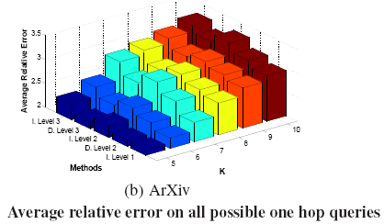
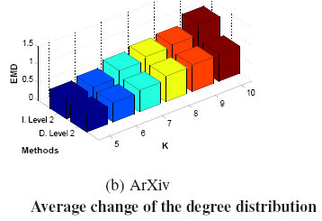
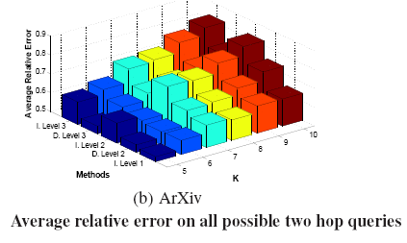
Notes:
From the result, we can see allowing personalized protection helps to increase the utility of the published graph

Slide 32
Conclusion
The facts
  Personalized privacy requirement is a special requirement of social networks
  It is helpful to solve the utility-privacy confliction by allowing personalized protection
Future works
  Develop clever protection models/algorithms to gain more benefits from the personalized protection
  Extend the idea to more complex attack models

Slide 33
Thanks
Q&A

