Slide 1
Data Coordination:
Supporting Contingent Updates
Michael Lawrence, Rachel Pottinger, Sheryl Staub-French
The University of British Columbia

Slide 2
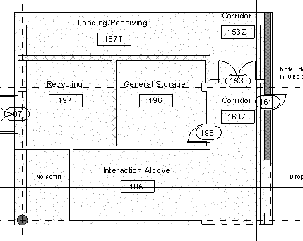
Scenario:
Architecture, Engineering and Construction
code | description | qty | unit
3310 | Install column formwork | 20 | ea
9250 | metal stud partition wall | 120 | sqft
… | … | … | …
Building Design
Cost Estimate

Slide 3
Data Coordination:
General Problem
Related, independent data sources B, C
Keep C up to date with B
Base Source B
(building design)
B
B'
Contingent Source C
(cost estimate)
C
?

Slide 4
Example:
Coordination Operations
ProjectItems
Component
code | qty
CH | 27
D1 | 27
CS | 12
CH | 12
code | qty
9.12 | 27
8.1 | 27
9.06 | 12
9.12 | 12
? | 27
id | type | area
0 | Column | 1
1 | Wall | 27
2 | Wall | 12
Material
ItemRates
code | category | type | rate
CH | Concrete | heavy | 25.00
CS | Concrete | sealing | 6.45
D1 | Drywall | 12mm | 3.50
cid | name | thickness
1 | Concrete | 300
1 | Drywall | 15
2 | Concrete | 200
code | category | type | rate
9.12 | Concrete | heavy | 25.00
9.06 | Concrete | sealing | 6.45
8.1 | Drywall | 12mm | 3.50
? | Paint | ? | ?
cid | name | thickness
1 | Light concrete | 300
1 | Drywall | 15
2 | Heavy concrete | 200
1 | Paint | 1
Building Design B
Cost Estimate C

Slide 5
Data Coordination Defining Characteristics
Base-Contingent relationship
  B dictates changes to C
  E.g. Weather Data (B) → Road Network (C)
Autonomous sources
  Domain heterogeneous
  Lack of system-wide collaboration
  Batch updates
Goal: Final, unambiguous instance of C

Slide 6
Data Coordination Related Work
Hyperion [Rodríguez-Gianolli et al. VLDB 05]
  P2P coordination with active rules (triggers)
ORCHESTRA [Green, Karvounarakis, Ives, Tannen VLDB 07]
  P2P with local querying
  Update sharing, fine-grained trust management
Youtopia [Koch, Kot VLDB 09]
  Collaborative Data Integration system

Slide 7
Outline
Overall Approach
Data Coordination Problem
View Differencing
Update Translation
  Insertions
  Deletions
  Combining Insertions + Deletions
Experimental Results

Slide 8
Approach
Use mapping constraints q_{B} = q_{C}
V_{B}(name, area) :− Component(id, type, area), Material(id, name, thickness), type = “Wall”
=
V_{C}(category, qty) :− ItemRates(code, category, type, rate), ProjectItems(code, qty)
Class of queries for q_{C}:
  Conjunctive
Class of queries for q_{B}:
  Union, negation, aggregation
C stores materialized view V
“Pull” coordination
The set of wall areas and materials should equal the
join of project item quantities and categories
Building Design (B)
Changes?
V
Cost Estimate (C)

Slide 9
Data Coordination Problem
Formalization
Problem
  Given C_{t} , V_{t} , B_{t+1}
  Find C_{t+1}
Time
B_{t+1}
Base Source
(Building Design)
V_{t}
View (stored by C)
q_{C}
C_{t}
C_{t+1}
Contingent Source
(Cost Estimate)

Slide 10
Data Coordination Problem
Formalization
Approach
    Find (V⁺,V⁻) (view differencing)
    (V⁺,V⁻) to all possible (C⁺,C⁻) (update translation)
    User selects final (C⁺,C⁻)
B_{t+1}
Base Source
(Building Design)
q_{B}
V_{t}
V_{t+1}
View (stored by C)
(V⁺,V⁻)
(Paint, 12)
q_{C}
q_{C}
(PB, Paint, Beige, 2.25)
(PB, 12)
(C⁺,C⁻)
Contingent Source
(Cost Estimate)
C_{t}
(?, Paint, ?, ?), (?, 12)
C_{t+1}

Slide 11
Outline
Overall Approach
Data Coordination Problem
View Differencing
Update Translation
  Insertions
  Deletions
  Combining Insertions + Deletions
Experimental Results

Slide 12
View Differencing
Find (V⁺, V⁻)
  Materialize V_{t+1} and compare with V_{t}
  Incremental view maintenance [Gupta + Mumick 99]
B_{t}
B_{t+1}
Old Base Source
B_{t+1}
Updated Base Source
Updated Base Source
Inputs
(B⁺, B⁻)
q_{B}
q_{B}
V_{t}
V_{t}
V_{t+1}
View (stored by C)
V_{t+1}
View (stored by C)
(V⁺, V⁻)
Inputs
Output
Outputs

Slide 13
Incremental View Maintenance
Counting Algorithm [Gupta + Mumick 99]
Tuple counts
Rewrite q_{B} as 2k queries (delta rules)
  k = number of relations queried
Evaluates V_{t+1} as additive union (U⁺)
New Extensions:
  Rewrite q_{B} to extract tuple counts
  Method for performing U⁺
  Extract (V⁺, V⁻) in U⁺

Slide 14
Outline
Overall Approach
Data Coordination Problem
View Differencing
Update Translation
  Insertions
  Deletions
  Combining Insertions + Deletions
Experimental Results

Slide 15
Update Translation
Inputs
Existing Stored View
V_{t}
(V⁺, V⁻)
q_{C}
(C⁺, C⁻)
C_{t}
Existing Contingent Source
Output

Slide 16
Update Translation Example
ProjectItems
code | qty
CH | 27
D1 | 27
CS | 12
CH | 12
code | qty
9.12 | 27
8.1 | 27
9.06 | 12
9.12 | 12
a | 12
V_{C}(category, qty) :− ProjectItems(code, qty),
ItemRates(code, category, type, rate)
category | qty
Concrete | 27
Drywall | 27
Concrete | 12
category | qty
Concrete | 27
Drywall | 27
Paint
Paint | 12
ProjectItems⁺
ItemRates
V⁺
code | category | type | rate
CH | Concrete | heavy | 25.00
CS | Concrete | sealing | 6.45
D1 | Drywall | 12mm | 3.50
code | category | type | rate
9.12 | Concrete | heavy | 25.00
9.06 | Concrete | sealing | 6.45
8.1 | Drywall | 12mm | 3.50
a | Paint | b | c
What are a, b, and c?
a = CH → V(Paint, 27)
ItemRates⁺

Slide 17
Update Translation Example
ProjectItems
code | qty
CH | 27
D1 | 27
CS | 12
CH | 12
V_{C}(category, qty) :− ProjectItems(code, qty),
ItemRates(code, category, type, rate)
category | qty
Concrete | 27
Drywall | 27
Concrete | 12
V⁻
ItemRates
code | category | type | rate
CH | Concrete | heavy | 25.00
CS | Concrete | sealing | 6.45
D1 | Drywall | 12mm | 3.50
Not Minimal
Deletes V(Concrete, 27)

Slide 18
Update Translation Challenges
Ambiguities (many feasible solutions)
Exact solution
  No side-effects (spurious V insertions/deletions)
Only update C
  additional constraint
Sets of insertions/deletions (batch process)

Slide 19
Update Translation Related Work
Translation by constant complement
  [Bancilhon & Spyratos TODS 1981]
Data exchange [Fagin et al. 2003, Barceló 2009]
  Generate instance of target schema given source schema/instance and mappings
Updates through views [Kotidis et al. 2006]
  Relax constraint
  Add abstraction level

Slide 20
Outline
Overall Approach
Data Coordination Problem
View Differencing
Update Translation
  Insertions
  Deletions
  Combining Insertions + Deletions
Experimental Results

Slide 21
Insertions
Chase [Fagin et al. ICDE 2003]
  Generates incomplete instance containing free variables
Constrain
  Conditional tables [Grahne 1991]
  Find spurious insertions
ProjectItems
code | qty
9.12 | 27
8.1 | 27
9.06 | 12
9.12 | 12
a | 12
code | qty
CH | 27
D1 | 27
CS | 12
CH | 12
ItemRates
category | qty
Concrete | 27
Drywall | 27
Concrete | 12
category | qty
Concrete | 27
Drywall | 27
Paint
Paint | 12
code | category | type | rate
CH | Concrete | heavy | 25.00
CS | Concrete | sealing | 6.45
D1 | Drywall | 12mm | 3.50
code | category | type | rate
9.12 | Concrete | heavy | 25.00
9.06 | Concrete | sealing | 6.45
8.1 | Drywall | 12mm | 3.50
a | Paint | b | c
V

Slide 22
Conditional Tables
Relation with free variables [Grahne 1991]
Tuple constraints φ
Our approach
Calculate spurious insertions
  S = q_{C}(C U C⁺) – (V U V⁺)
Force S = Ø
  Condition is complement of the φs
student | course | φ
Sally | Math | z = 0
Sally | CS | z ≠ 0
Sally | x | x ≠ physics
Tuples generated by chase
Sally takes Math or CS (but not both),
and possibly some other course which is not physics

Slide 23
Constrain Example
C U C⁺
q_{C}(C U C⁺)
V U V⁺
ProjectItems
V U V⁺
category | qty | φ
Concrete | 27
Drywall | 27
Concrete | 12
Paint | 12
Paint | 12 | a = CS
Paint | 12 | a = CS
Paint | 27 | a = D1
Paint | 27 | a = CH
Concrete | 12 | a = CH
Concrete | 12 | a = CS
Drywall | 12 | a = D1
S (spurious insertions)
category | qty
Concrete | 27
Drywall | 27
Concrete | 12
Paint | 12
code | qty
CH | 27
D1 | 27
CS | 12
CH | 12
a | 12
category | qty
Concrete | 27
Drywall | 27
Concrete | 12
Paint | 12
category | qty | φ
Paint | 27 | a = D1
Paint | 27 | a = CH
Drywall | 12 | a = D1
−
=
ItemRates
code | category | type | rate
CH | Concrete | heavy | 25.00
CS | Concrete | sealing | 6.45
D1 | Drywall | 12mm | 3.50
a | Paint | b | c
a cannot be CH or D1

Slide 24
Outline
Overall Approach
Data Coordination Problem
View Differencing
Update Translation
  Insertions
  Deletions
  Combining Insertions + Deletions
Experimental Results

Slide 25
Experiments
TPC-H Instance
Vary Database Size, Update Size, Query Size
View Differencing: C++/MySQL
Update Translation: C++/BerkeleyDB

Slide 26
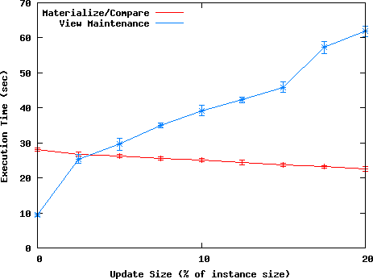
View Differencing Results
View Maintenance linear in update size
Materialize/Compare decreases due to decreasing view size
Additional experiments show view size and sort time dominate Materialize/Compare performance.
Execution Time (sec)
Update Size (% of instance size)

Slide 27
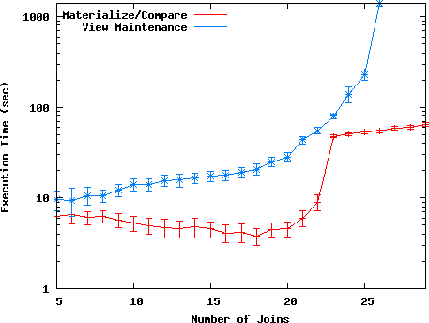
View Differencing Results
Instance: large hierarchy
View Maintenance exponential in number of joins
Only if all relations are updated
Materialize/Compare decreases due to decreasing view size
Evaluating q_{B} (MySQL) takes sharp rise at 23 joins
Execution Time (sec) – log scale
Number of Joins

Slide 28
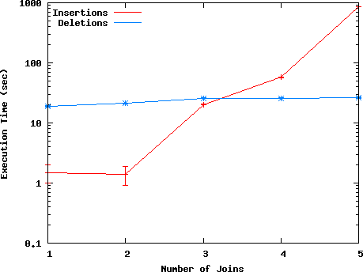
Update Translation Results
Instance: TPC-H
Insertions exponential due to exponential number of potentially spurious insertions
Deletions perform well due to hierarchy of many to one relationships and large pruning benefit
Execution Time (sec) – log scale
Number of Joins

Slide 29
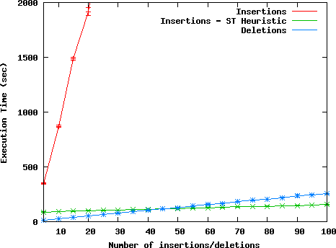
Update Translation Results
Instance: TPC-H
Insertions: high degree polynomial
Wasteful to consider translations of little interest
Static Tables Heuristic: Only generate tuples/free variables for a subset of relations
Deletions perform well due to optimizations available due to relational normalization
Execution Time (sec)
Number of Insertions/Deletions

Slide 30
Conclusions
System for coordinating Base – Contingent data sources with declarative mappings
Three stage approach to the data coordination problem
  View Differencing
  Update Translation
  User disambiguation
Adaptation of view maintenance for view differencing
Find all feasible update translations using incomplete information
  Insertions, deletions, and the combination
Implementation demonstrating feasibility and useful optimizations/heuristics

Slide 31
View Differencing Summary
MAC – sort time dominates
IVM-VD – query size dominates
MAC | IVM-VD
Arbitrary queries (subqueries, recursion, etc) | Conjunctive queries with union, negation, aggregation
Requires V_{t}, B_{t+1} | Requires (B⁺, B⁻), B_{t}, V_{t}, B_{t+1}
Better for large updates (> 2.5%) | Better for small updates
Better for large queries | Better for small queries

Slide 32
Tuple Generating Dependency Formulation
V = q_{C}(C) corresponds to 2 TGDs
Insertion TGD
(violated by V⁺(x))
V(x) ➔ Q_{C}(x, y)
Deletion TGD
(violated by V⁻(x))
Q_{C}(x, y) ➔ V(x)
(Q_{C} – Conjunction of relational predicates)

Slide 33
Deletions
Q_{C}(x, y) ➔ V(x)
V⁻(x) ➔ !Q_{C}(x, y)
e.g. V⁻(x₁, x₂) ➔ !C(x₁, y) v !C(y, x₂)

Slide 34
Deletions
V⁻(0, 2) → C⁻(0, y) or C⁻(y, 2) (for all y)
a | b
0 | 1
1 | 2
0 | 8
8 | 2
1 | 3
C
x₁ | x₂
0 | 2
0 | 3
V⁻
OR
y = 1
y = 8
AND
OR

Slide 35
Deletion Translation (Overview)
Use contrapositive of deletion TGD
  V⁻(x) ➔ !Q_{C}(x, y)
Formulate expression for minimal deletions
Recursive search w/pruning for feasible solutions

Slide 36
Deletions
Build expression in conjunctive normal form
  e.g. (C(0, 1) or C(1, 2)) and (C(0, 8) or C(8, 2) …)
Recursively try every combination
Prune infeasible combinations
  i.e. causing spurious deletions

Slide 37
Optimizations
Redundancy in constrain step
  z ≠ 2 AND (z ≠ 2 OR z ≠ 3)
Redundancy in deletions
  {C(0, 8), C(1, 2)} OR {C(0, 8), C(8, 2)}
  Worse with multiple deleted tuples

Slide 38
Generalizing
Arithmetic comparisons
  V(x₁, x₂) :- C(x₁, y), C(y, x₂), y > 4
  Afrati, Li, Pavlaki EDBT 2008
  Makes constrain step more difficult
Sets of constraints
  Conflicting updates
Approximate solutions

Slide 39
Extending
Ranking
Heuristics
Semantics
Issues Arising over Time

