Slide 1
RemusDB: Transparent High Availability for Database Systems
Umar Farooq Minhas¹, Shriram Rajagopalan², Brendan Cully²,
Ashraf Aboulnaga¹, Kenneth Salem¹, Andrew Warfield²

Slide 2
The Need for High Availability
A database system is highly available (HA) if it remains accessible to its users in the face of hardware failures
Users expect 24x7 availability even for simple database applications
HA requirement is no longer limited to mission critical applications
Key challenges in providing HA
maintaining database consistency in the face of failures
minimizing the impact of HA on performance
Existing HA solutions are complex and expensive
Goal: Provide simple and cheap HA for database systems

Slide 3

DBMS HA: Active/Standby Replication
DBMS
DBMS
Primary Server
Backup Server
Primary Server
DB
Database Changes
DB
A copy of the database is stored at two servers, a primary and a backup
Primary server accepts user requests and performs database updates
Changes to database propagated to backup server by propagating the transaction log
Backup server takes over as primary upon failure
Notes:
Clients typically lose connections on failure
and in some cases even transactions might be lost

Slide 4
High Availability As a Service
Active/standby replication is complex to implement in the DBMS, and complex to administer
propagating the transaction log
atomic handover from primary to backup on failure
redirecting client requests to backup after failure
minimizing effect on performance
Our approach: provide HA as a service from the underlying virtualization infrastructure
implement active/standby replication at the virtual machine layer
push the complexity out of the DBMS
any DBMS can be made HA with little or no modification
low performance overhead

Slide 5
RemusDB: Transparent HA for DBMS
VM
VM
Changes to VM State
DB
DBMS
DBMS
DB
Primary Server
Backup Server
Primary Server
RemusDB is a reliable, cost-effective, active/standby HA solution implemented at the virtualization layer
propagates all changes in VM state from primary to backup
HA with no code changes to the DBMS
completely transparent failover from primary to backup
failover to a warmed up backup server
Notes:
No connections are lost
No transactions are lost
Both DBMS state and the database are replicated, not just the database

Slide 6
Outline
Introduction
VM Based HA (Remus)
RemusDB
Experimental Evaluation
Conclusion

Slide 7
HA Through Virtual Machine Checkpointing
RemusDB is based on Remus, which is part of the Xen hypervisor
maintains replica of a running VM on a separate physical machine
extends live migration to do efficient VM replication
provides transparent failover with only seconds of downtime
Remus uses an epoch based checkpointing system
divides time into epochs (~50ms)
performs a checkpoint at the end of each epoch
the primary VM is suspended
all state changes are copied to a buffer
the primary VM is resumed
an asynchronous message is sent to the backup containing all state changes

Slide 8
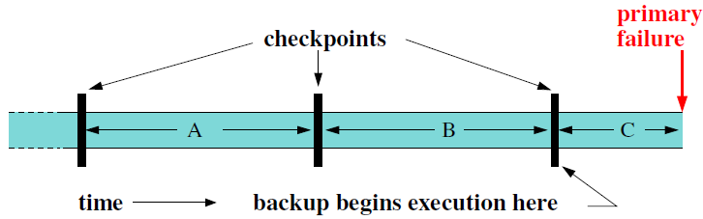
Remus Checkpoints
After a failure, backup resumes execution from the latest checkpoint
any work done by the primary during epoch C will be lost (unsafe)
Remus provides a consistent view of execution to clients
any network packets sent during an epoch are buffered until the next checkpoint
guarantees that a client will see results only if they are based on safe execution
same principle is also applied to disk writes

Slide 9

VM Checkpointing with Database Workloads
Remus protection
network
buffering
no protection
processing
Primary
Server
response
(unprotected)
response
(protected)
query
DBMS
Client
up to 32 %
response time
(unprotected)
response time
(protected)
overhead of
protection
RemusDB implements optimizations to reduce the overhead of protection for database workloads
recovers from failures in $≤$ 3 seconds while incurring 3% overhead

Slide 10
RemusDB
Remus, optimized for protecting DBMS
Memory Optimizations
database workloads tend to modify more memory in each epoch as compared to other workloads
reduce checkpointing overhead by
Network Optimization
exploit DBMS transaction semantics to avoid message buffering latency
commit protection (CP)
sending less data
asynchronous checkpoint compression (ASC)
protecting less memory
disk read tracking (RT)
memory deprotection

Slide 11
Asynchronous Checkpoint Compression
Goal: Reduce overhead by sending less checkpoint data
Key observations
Database workloads typically involve a large set of frequently changing pages of memory e.g., buffer pool pages
results in a large amount of replication traffic
Memory writes often change only a small part of the pages
data to be replicated contains redundancy
Replication traffic can be significantly reduced by only sending the actual changes to the memory pages

Slide 12
Asynchronous Checkpoint Compression
Protected VM
Domain 0
Dirty Pages
(epoch i)
Compute delta
and compress
to backup
LRU Cache
Dirty pages from
epochs [1 … i-1]
Xen
Notes:
Key ideas:
Compression on delta of the page
Compression is done asynch. in Dom0 while database processing can continue in parallel in the protected VM
Cache size 10% of VM size

Slide 13
Disk Read Tracking
Active VM
Standby VM
DBMS
DBMS
DB
BP
BP
DB
P
Changes to VM State
P
P
P
DBMS loads page from disk into buffer pool (BP)
clean to DBMS, dirty to Remus
Remus synchronizes dirty BP pages in every checkpoint
Synchronization of clean BP pages is unnecessary
can be read from the disk at the backup on failover

Slide 14
Disk Read Tracking
Goal: Reduce overhead by avoiding unnecessary page synchronizations
Disk read tracking in RemusDB
tracks the set of memory pages into which disk reads are placed
does not mark these pages dirty unless they are actually modified
adds an annotation to the replication stream indicating the disk sectors to read to reconstruct these pages

Slide 15
Network Optimization
Remus requires buffering of outgoing network packets
ensures clients can never see results of unsafe computation
adds 2 to 3 orders of magnitude in latency per round trip
single largest source of overhead for many database workloads
Key idea: Exploit consistency and durability semantics provided by database transactions
allow DBMS to decide which packets to protect
Commit Protection (CP)
protect only transaction control packets i.e., COMMIT and ABORT
any committed transaction is safe
Reduces latency but not fully transparent
Notes:
TPC-C Xact → 32 packet exchanges (average), 77 (max)

Slide 16
Implementing Commit Protection
Added a new setsockopt() option to Linux
an interface for the DBMS to selectively protect packets
DBMS changes
use setsockopt() to switch client connection to protected mode before sending COMMIT or ABORT
after failover, a recovery handler runs in the DBMS at the backup
aborts all in-flight transactions where the client connection was in unprotected mode
CP is not transparent to the DBMS
103 LoC for PostgreSQL, 85 LoC for MySQL
Notes:
Only read tracking required mods to hypervisor - about 5 lines (or perhaps 50 but the effective change to hypervisor was 5 lines) - some code in disk backend device driver - rest in Remus toolstack in Dom0 -1903 LoC TOTAL
CP - only the network backend device driver (netback) and output buffer code (396 + 13 LoC) (Guest kernel + hypervisor) ASC - Remus code that lives in Xen's management toolstack - not part of kernel. (593 LoC)

Slide 17
Outline
Introduction
VM Based HA (Remus)
RemusDB
Experimental Evaluation
Conclusion

Slide 18
Experimental Setup
TPC-C / TPC-H
PostgreSQL
/ MySQL
(Active VM)
PostgreSQL
/ MySQL
(Standby VM)
DB
DB
Xen 4.0
Xen 4.0
Primary Server
Backup Server
Gigabit Ethernet

Slide 19
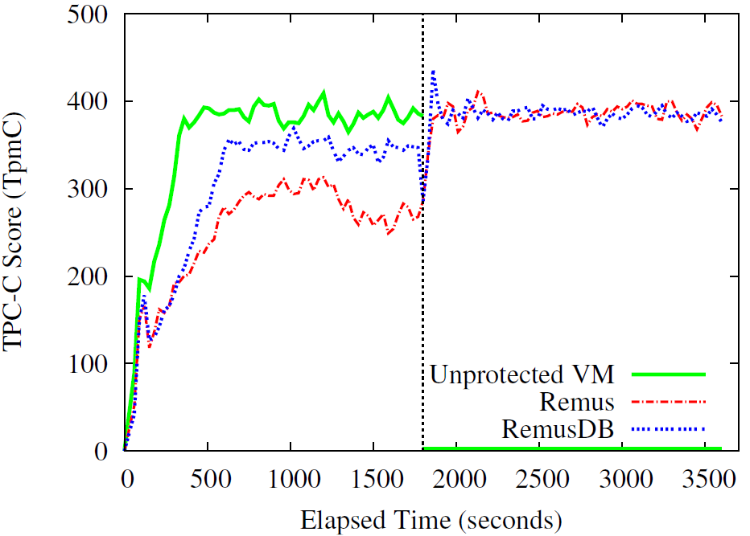
Behavior of RemusDB During Failover (MySQL)
Primary server fails

Slide 20
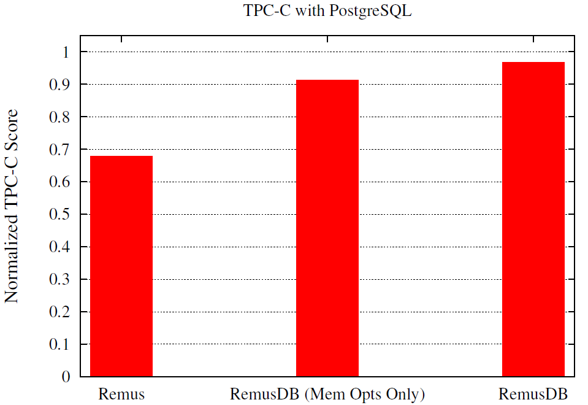
Overhead During Normal Operation (TPC-C)
Notes:
PostgreSQL
20W/200C
30 mins
DB →1.9 GB
BP → 190 MB
RAM → 2 GB
vCPUs → 2
CPI → 50 ms

Slide 21
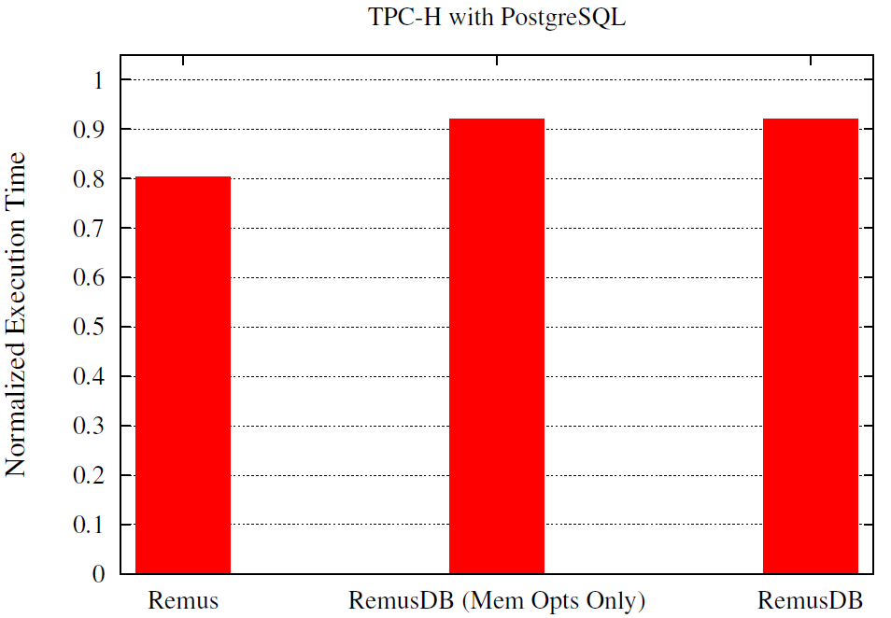
Overhead During Normal Operation (TPC-H)
Notes:
TPC-H has long-running compute and I/O intensive queries and each query typically involves a single round of communication between the server and the client
PostgreSQL
SF → 1
DB → 2.3 GB
BP → 750 MB
RAM → 1.5 GB
vCPUs → 2
CPI → 250 ms

Slide 22
Conclusion
Maintaining availability in the face of hardware failures is an important goal for any DBMS
Traditional HA solutions are expensive and complex by nature
RemusDB is an efficient HA solution implemented at the virtualization layer
offers HA as a service
relies on whole VM checkpointing
runs on commodity hardware
RemusDB can make any DBMS highly available with little or no modification while imposing very little performance overhead

Slide 23
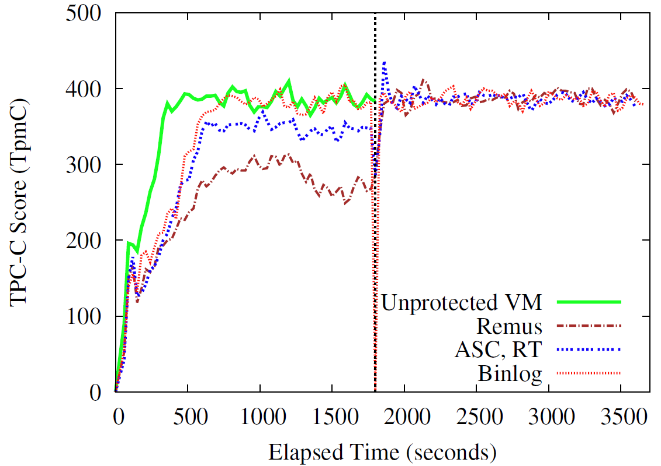
Behavior of RemusDB During Failover (MySQL)
Primary server fails

Slide 24
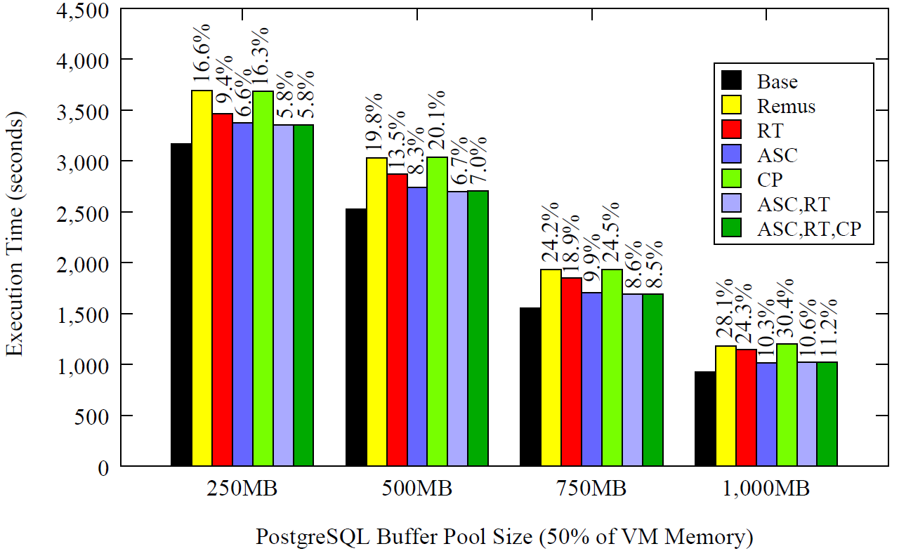
Effects of DB Buffer Pool Size (TPC-H)

Slide 25
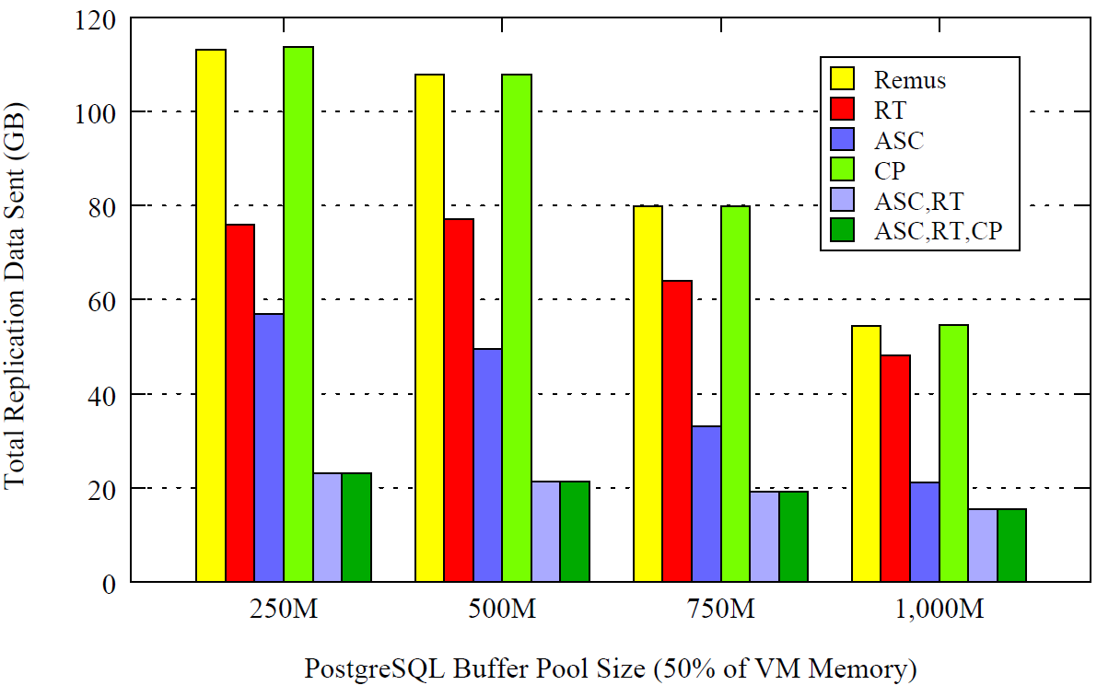
Effects of DB Buffer Pool Size (TPC-H)

Slide 26
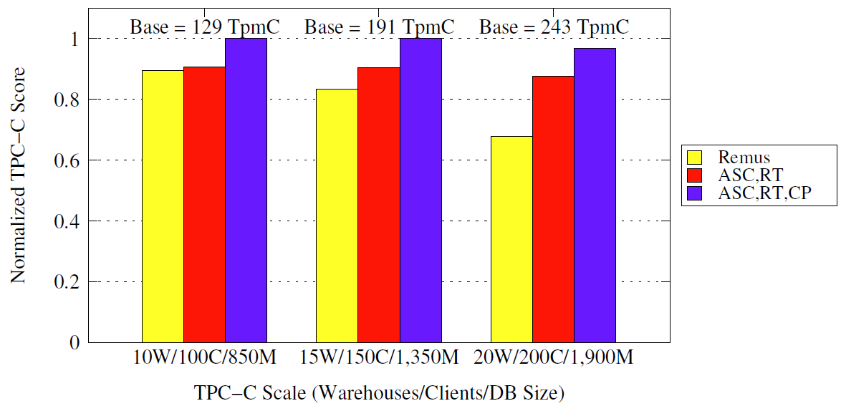
Effect of Database Size on RemusDB (TPC-C)

