Slide 1
iCBS: Incremental Cost-based Scheduling under Piecewise Linear SLAs
Yun Chi, Hyun Jin Moon, Hakan Hacigumus
NEC Laboratories America
Cupertino, USA

Slide 2
Outline of the Talk
Motivation and background
iCBS with O(log N) time complexity
iCBS with O(log^{^2} N) time complexity
Experimental results
Conclusion and future work

Slide 3
Outline of the Talk
Motivation and background
iCBS with O(log N) time complexity
iCBS with O(log^{^2} N) time complexity
Experimental results
Conclusion and future work

Slide 4
Motivation
Cost-aware scheduling
  each query has its cost
  scheduling considers costs
Important for a cloud service provider
  query deadline (Web queries)
  service level (gold vs. silver customer)
  explicit SLAs (often piecewise linear)

Slide 5
Motivation—CBS [Peh91]
The good
  cost/deadline aware
  very good cost performance

Slide 6

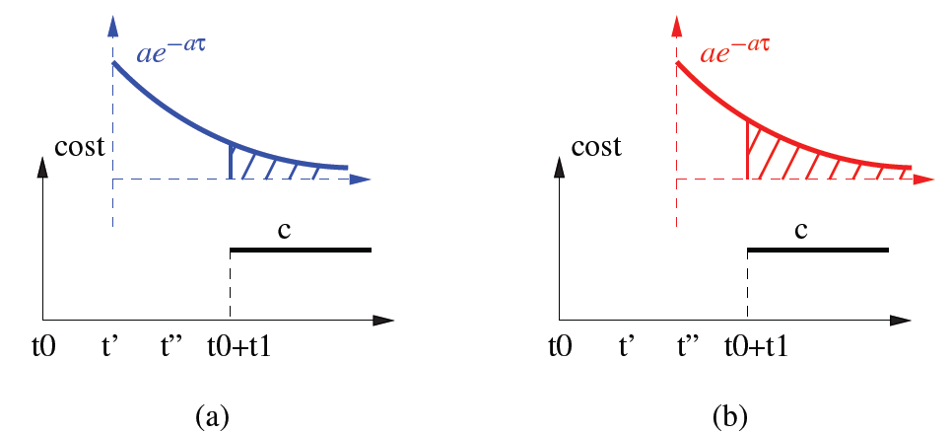
Motivation—CBS
The bad, at each time t,
  O(N) scores are computed
  each score involves an integration:

Slide 7
Our Contributions
Investigate CBS
  under piecewise linear SLAs
  how things change over time
Develop efficient iCBS
  uses above observations
  maintains scores incrementally
  no integration used
  achieves O(log^{^2} N) time complexity

Slide 8
Piecewise Linear SLAs
Agreement on query response time
  cost function f(t) is finite segments over time
  each segment is a linear function

Slide 9
Outline of the Talk
Motivation and background
iCBS with O(log N) time complexity
iCBS with O(log^{^2} N) time complexity
Experimental results
Conclusion and future work

Slide 10
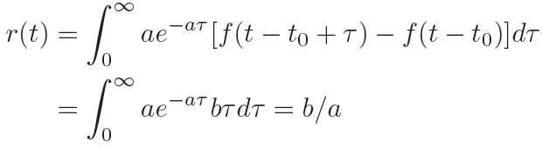
iCBS—Easy Cases, SLA (a)
CBS score is constant for this SLA
Refer to as in α stage

Slide 11

iCBS—Easy Cases, SLA (b)
CBS score is time-variant
However, only relative order is needed
Refer to as β stage

Slide 12
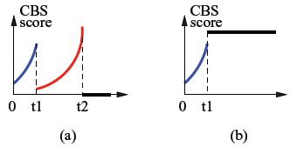
iCBS—Easy Cases, SLAs (c),(d)
CBS scores are time-variant in special ways
β stage, and then α stage

Slide 13
Outline of the Talk
Motivation and background
iCBS with O(log N) time complexity
iCBS with O(log^{^2} N) time complexity
Experimental results
Conclusion and future work

Slide 14

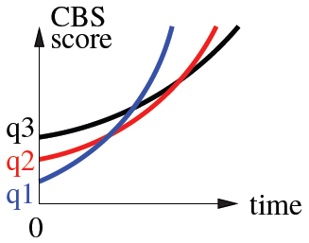
iCBS—Hard Cases, SLAs (e),(f)
CBS scores are time-variant

Slide 15
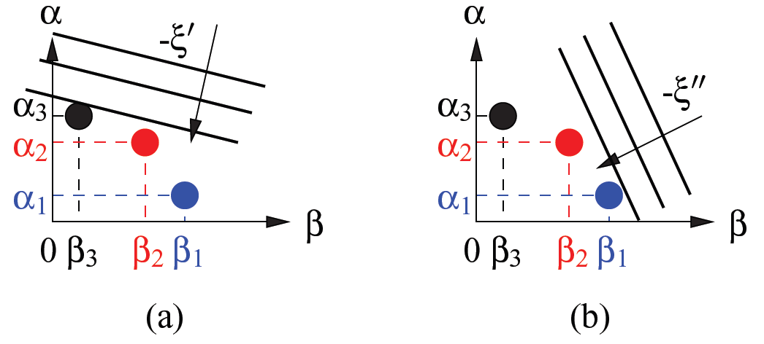
iCBS—Hard Cases, Solution
Put the scores in the dual space
  time-invariant in the dual space
At time t’, find , search in dual space

Slide 16
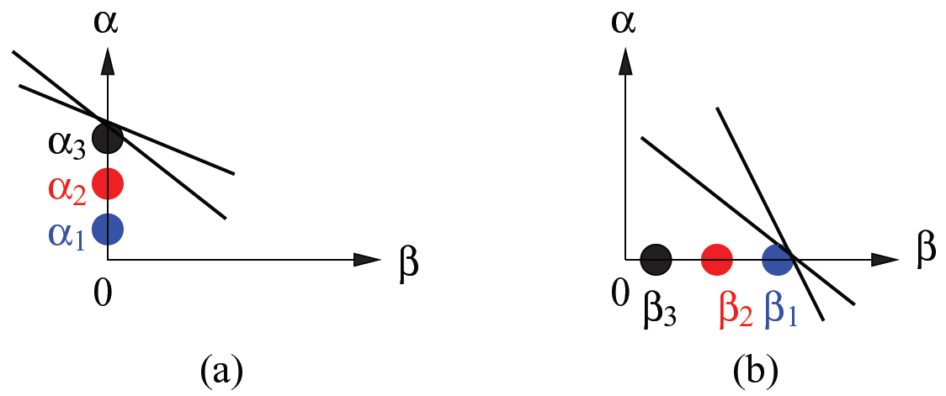
iCBS—Revisit Easy Cases
Why the easy ones are easy
Either in α stage, or β stage

Slide 17
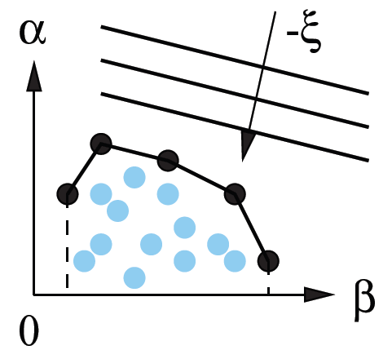
iCBS—Incremental Maintenance
In the dual space
  time-variant CBS ➔ a point
  position changes K times
Highest score on the convex hull
O(log^{^2} N) dynamic convex hull algorithm [PS85]

Slide 18
Outline of the Talk
Motivation and background
iCBS with O(log N) time complexity
iCBS with O(log^{^2} N) time complexity
Experimental results
Conclusion and future work

Slide 19
Experiment—Effectiveness
Compare iCBS’s cost per query with
  cost-unaware FCFS and SJF
  ASETS* by Guirguis et al. [GSC+09]
  FirstReward by Irwin et al. [IGC04]
Using different SLAs
  weighted tardiness (ASETS* [GSC+09])
  tardiness with upper bound (FirstReward [IGC04])
Over a variety of SLA parameters
  decay skew factor
  value skew factor

Slide 20
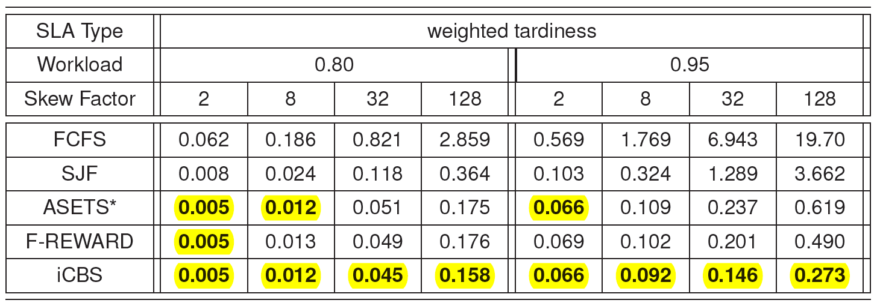
Experiment—Effectiveness, SLA-1
ASETS* designed for this SLA
CBS (iCBS) has best performance, especially
  with skewed SLAs, and high system load

Slide 21
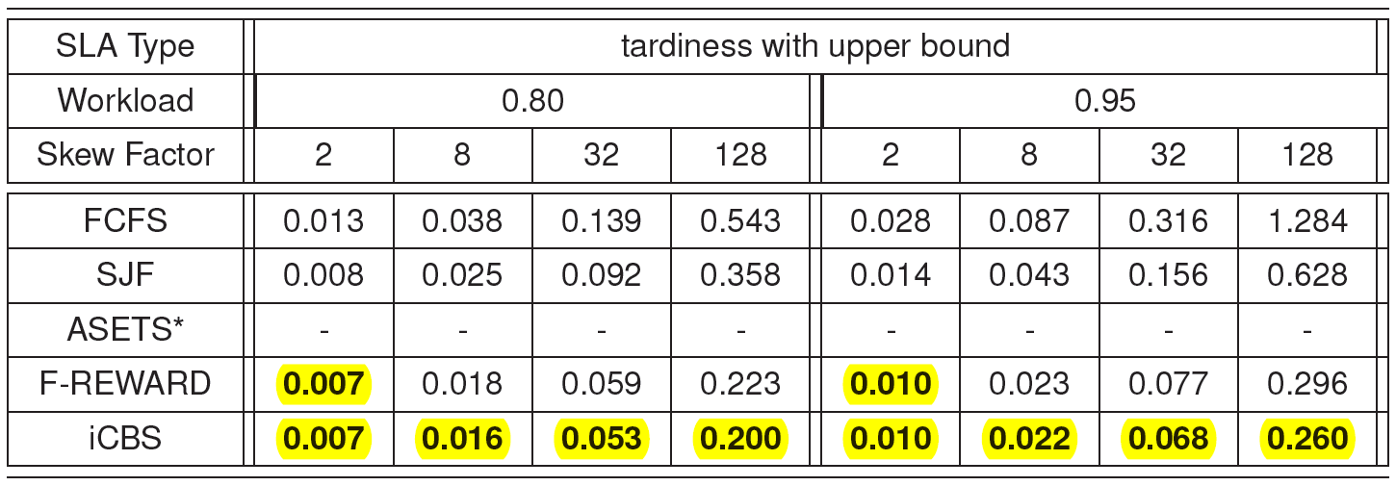
Experiment—Effectiveness, SLA-2
FirstReward designed for this SLA
CBS (iCBS) has best performance
ASETS* cannot be finished (days)

Slide 22
Experiment—Efficiency
iCBS with CBS: time vs. queue length
Query execution time
  exponential distribution (OLTP)
  Pareto (long-tail) distribution (OLAP)
Detailed setting
  Xeon PC, 3GHz CPU, 4GB memory
  Fedora 11 Linux
  implemented in Java

Slide 23
Experiment—Efficiency, Exponential
CBS: obviously O(N)
iCBS: relatively constant

Slide 24
Experiment—Efficiency, Pareto
With long queue, CBS takes >10ms
iCBS still 10-20 us

Slide 25
Related Work
Haritsa et al. [HCL93], value-based scheduling
Guirguis et al. [GSC+09], tardiness minimization
Irwin et al. [IGC04], balance risk and reward
Chi et al. [CMHT11], step-wise cost functions
Peha [Peh91], cost-based scheduling (CBS)

Slide 26
Outline of the Talk
Motivation and background
iCBS with O(log N) time complexity
iCBS with O(log^{^2} N) time complexity
Experimental results
Conclusion and future work

Slide 27
Conclusion and Future Work
Conclusion
  incremental cost-based scheduling
  under piecewise linear SLAs
Future directions
  query execution time: certain → uncertain
  MPL: 1 → M
  what to schedule: queries → transactions

Slide 28
Reference
[CMHT11] Y. Chi, H. J. Moon, H. Hacigumus, and J. Tatemura. SLA-tree: A framework for efficiently supporting SLA-based decisions in cloud computing. In EDBT, pages 129–140, 2011.
[GSC+09] Shenoda Guirguis, Mohamed A. Sharaf, Panos K. Chrysanthis, Alexandros Labrinidis, and Kirk Pruhs. Adaptive scheduling of web transactions. In ICDE, pages 357–368, 2009.
[HCL93] Jayant R. Haritsa, Michael J. Carey, and Miron Livny. Value-based scheduling in real-time database systems. The VLDB Journal, 2:117–152, 1993.
[IGC04] David E. Irwin, Laura E. Grit, and Jeffrey S. Chase. Balancing risk and reward in a market-based task service. In HPDC, pages 160–169, 2004.
[Peh91] Jon Michael Peha. Scheduling and dropping algorithms to support integrated services in packet-switched networks. PhD thesis, Stanford University, 1991.
[PS85] Franco P. Preparata and Michael I. Shamos. Computational geometry: an introduction. Springer-Verlag, Inc., New York, NY, USA, 1985.

Slide 29
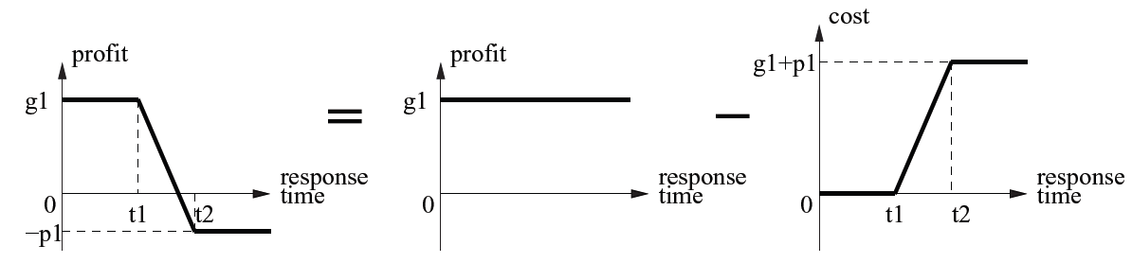
Backup Slide
Cost SLAs and profit SLAs are equivalent

Slide 30
Backup Slide
Performance for the most general SLAs

