Slide 1



Albatross: Lightweight Elasticity in Shared Storage Databases for the Cloud using Live Data Migration
Sudipto Das¹, Shoji Nishimura²,
Divyakant Agrawal¹, and Amr El Abbadi¹
¹Computer Science, UC Santa Barbara
²NEC Laboratories, Japan
Sponsors:

Slide 2










Web replacing Desktop
Notes:
In the last few years, we have witnessed a trend where web applications have been replacing desktop applications and large numbers of applications are now accessed via the browsers.

Slide 3











Paradigm shift in Infrastructure
Notes:
This shift from desktop to the web has also resulted in a paradigm shift in the application deployment infrastructure resulting in a paradigm popularly known as Cloud Computing.

Slide 4
Cloud application platforms
Serve thousands of applications (tenants)
  AppEngine, Azure, Force.com
Tenants are (typically)
  Small
  SLA sensitive
  Erratic load patterns
  Subject to flash crowds
Support for multitenancy is critical
Our focus: DBMSs serving these platforms

Slide 5
Optimize operating cost
“Put $ in the y-axis”
  Traditional systems only optimize performance
Incentive to aggressively consolidate tenant databases
How to deal with surge in load?
Aggressive consolidation

Slide 6
Elasticity in the Database tier
Load Balancer
Application/Web/Caching tier
Database tier
Notes:
So what does elasticity in the database tier mean?
Mention the cost performance trade-off and repeat the fact that it is the cloud infrastructure that allows us to optimize operating cost, something that was not thought important in classical infrastructures.

Slide 7
Live database migration
Migrate a tenant (or database partition) in a live system
  A critical operation to support elasticity
    Optimize operating cost
    Resource orchestration in multitenant systems
Different from
  Migration between software versions
  Migration in case of schema evolution
This paper: Decoupled storage architectures
  Shared nothing: see our SIGMOD 2011 paper

Slide 8
Decoupled storage abstraction
Tenant Applications
Controller
Query Router
DBMS Node
Tenant Cell (TM + DM)
Tenant Cell
DBMS Nodes
Tenant Cell (TM + DM)
Cached DB State
Tenant Cell (TM + DM)
Transaction State
Log Manager
Network Attached Storage (NAS)

Slide 9
VM migration for DB elasticity
One tenant-per-VM
  Pros: allows fine-grained load balancing
  Cons
    Performance overhead
    Poor consolidation ratio [Curino et al., CIDR 2011]
Multiple tenants in a VM
  Pros: good performance
  Cons: Migrate all tenants➔ Coarse-grained load balancing
VM
VM
VM
Hypervisor
VM
Hypervisor

Slide 10
Live database migration
Multiple tenants share the same database process
  Shared process multitenancy
Migrate individual tenants on-demand in a live system
  Virtualization in the database tier
Straightforward solution
  Stop serving tenant at the source
  Migrate to destination
  Start serving at the destination
  Expensive!

Slide 11
Migration cost measures
Service un-availability
  Time the tenant is unavailable
Number of failed requests
  Number of operations failing/transactions aborting
Performance overhead
  Impact on response times
Additional data transferred

Slide 12
Why is live DB migration hard?
Migrating a live tenant database
  How to ensure no transaction aborts?
  How to minimize performance impact?
Nodes can fail during migration
  How to guarantee correctness during failures?
    Transaction atomicity and durability
    Recover migration after failure
Transactions execute during migration
  How to guarantee serializability?
    Transaction correctness equivalent to normal operation

Slide 13
Our approach: Albatross
Migrate DB cache and transaction state
Make a snapshot of the cache and migrate
  Source continues serving transactions ➔ destination lags source
  Iteratively copy the database cache
Copy transaction state in final step
  Transactions resume at destination
Destination start “warm”
  Low performance impact and no aborted transactions
Migrate transactions on-the-fly
  Transactions start at source and complete at destination

Slide 14
Normal operation
Transactions
T₁₁, T₁₂, T₁₃, …
172
183
124
231
Cache
123
142
182
192
197
130
149
84
Tenant/DB Partition
Source
Destination

Slide 15

Phase I: Begin migration
172,
124,
231,
123,
142,
182,
192,
130,
84
Transactions
T₁₁, T₁₂, T₁₃, …
172
183
124
231
Cache
123
142
182
192
Snapshot of the cache
197
130
149
84
Tenant/DB Partition
Tenant/DB Partition
Source
Destination

Slide 16
Phase I: Begin migration
Transactions
T₁₁, T₁₂, T₁₃, …
123, 142, 182, 192, 130, 84
172
183
124
231
172
124
231
123
142
182
192
197
130
149
84
Track changes
Tenant/DB Partition
Tenant/DB Partition
231
Source
124
Destination
172

Slide 17
Phase I: Begin migration
Transactions
T₁₁, T₁₂, T₁₃, …
172
183
124
231
172
124
231
123
123
142
182
192
84
142
182
192
197
130
130
105
149
287
84
Track changes
Tenant/DB Partition
Tenant/DB Partition
Source
Destination

Slide 18
Phase II: Iterative phase
-84
-130,
105,
287,
183,
142,
192,
197,
149
Transactions
T₂₁, T₂₂, T₂₃, …
172
183
124
231
172
124
231
123
123
142
182
192
84
142
182
192
197
105
149
287
130
Track changes
Tenant/DB Partition
Tenant/DB Partition
Source
Destination

Slide 19
Phase II: Iterative phase
Transactions
T₂₁, T₂₂, T₂₃, …
172
172
124
231
123
3
183
124
231
287
142
123
142
182
192
84
182
192
105
183
197
149
197
130
212
105
149
287
Track changes
Tenant/DB Partition
Tenant/DB Partition
Source
Destination

Slide 20
Phase III: Atomic handover
Transactions
-172,
-197,
3,
212,
123
142,
231
T₃₁, T₃₂, T₃₃, …
T₃₁, T₃₂, T₃₃, …
172
124
3
183
124
231
3
231
123
123
142
182
192
287
142
182
192
212
212
105
149
287
105
183
197
149
Tenant/DB Partition
Tenant/DB Partition
Source
Destination

Slide 21
Normal operation
Transactions
T₃₁, T₃₂, T₃₃, …
T₃₁, T₃₂, T₃₃, …
172
124
3
183
124
231
3
231
123
123
142
182
192
287
142
182
192
212
212
105
149
287
105
183
197
149
Tenant/DB Partition
Tenant/DB Partition
Source
Destination

Slide 22
Correctness
Safety: Exactly one owner for a tenant
  Atomic handover protocol: guarantees safety of ownership handover
Serializability: Transaction state copied during migration ➔ guarantees serializability
Durability:
  Changes from aborted transactions are not persisted
  Changes from committed transactions are never lost
  Transaction logs synchronized to guarantee durability
Independent recovery in most cases

Slide 23
Implementation
Implemented in ElasTraS, a scalable multitenant database system
  Append-only storage layout
    Separate read and write caches
  Optimistic concurrency control
  Storage layout consists of SSTables
    An SSTable is a collection of blocks with in an internal index
  Read cache is a set of the blocks
Snapshot: Read the block ids cached
Changes maintained incrementally
Termination ➔ copy read and write sets of transactions and flush write cache

Slide 24
Evaluation
Evaluated against two baseline techniques
  Stop and Migrate (S&M)
    Stop serving tenant at source
    Flush changes
    Migrate control to destination and restart
  Flush and Migrate (F&M)
    Flush changes while continuing to serve tenant
    Final stop and migrate
Evaluated using two benchmarks
  TPC-C and YCSB

Slide 25

Experimental methodology
    Default transaction parameters:
    10 operations per transaction 80% Read, 15% Update, 5% Inserts
    Workload: 12K Txns
System Controller
Metadata
Migrate
    Hardware: 2.4 Ghz Intel Core 2 Quads, 8GB RAM, 7200 RPM SATA HDs with 32 MB Cache,
    Gigabit ethernet
    Default DB Size: 1 GB
    Default Cache size: 250 MB

Slide 26
Results overview
Unavailability window
  Albatross: 300-800ms
  S&M: 2-4 second unavailability, F&M: 200-500ms
Failed requests
  Albatross: Zero
  S&M and F&M: hundreds
Increase in transaction latency
  Albatross: 15-30%
    Negligible performance impact during migration
  S&M and F&M: 200-400% increase in latency
Data transferred:
  Albatross:1.3-1.6 times database cache
  S&M and F&M: approximately the size of the cache

Slide 27
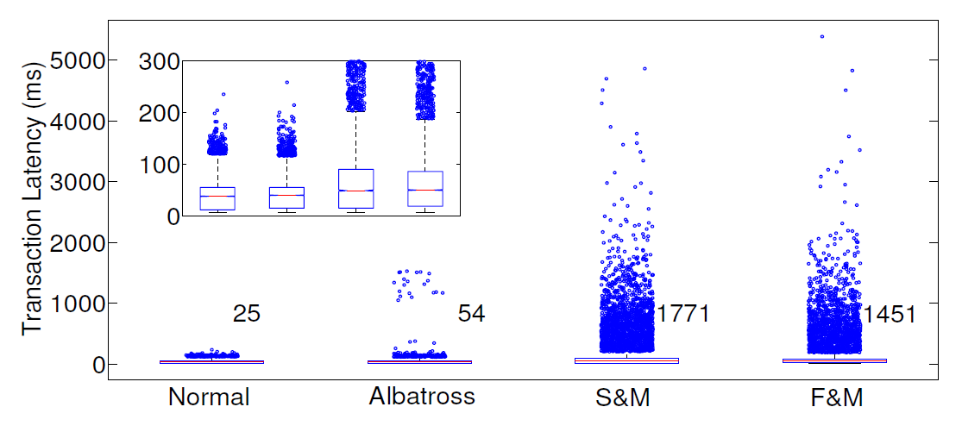
Impact on latency
Minimal impact on latency as a result of migration

Slide 28
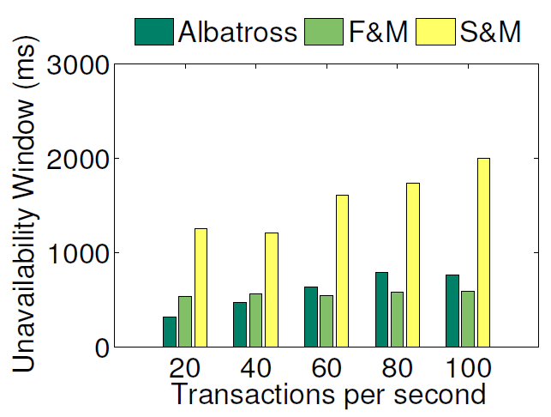
Unavailability window

Slide 29
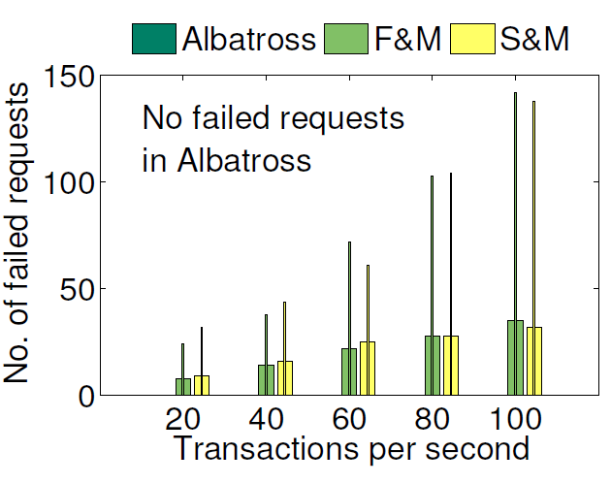
Failed requests

Slide 30
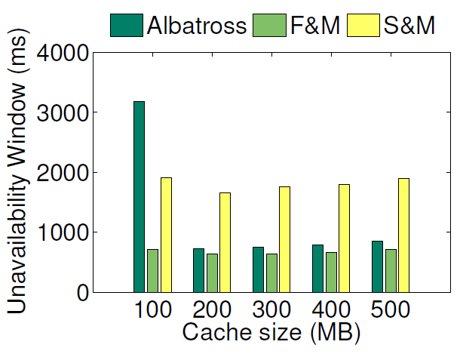
Adversarial scenario
Working set does not fit in cache

Slide 31
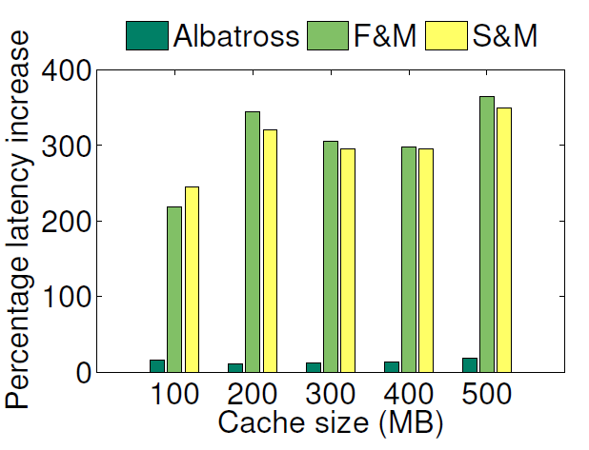
Adversarial scenario
Continues to have minimal performance impact

Slide 32
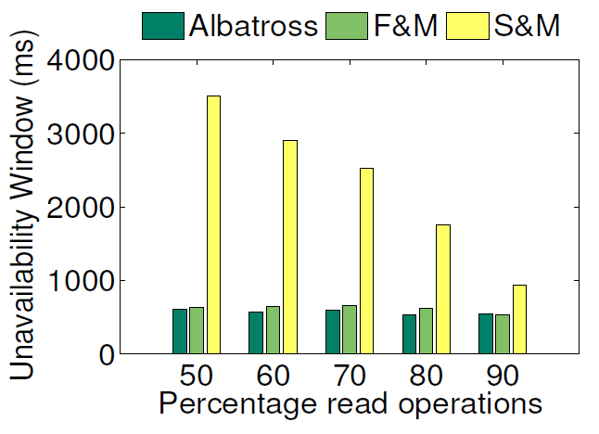
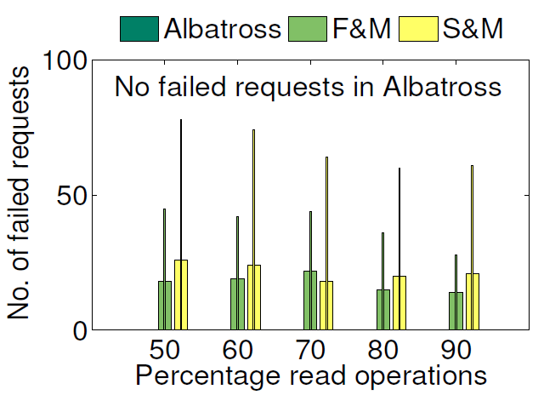
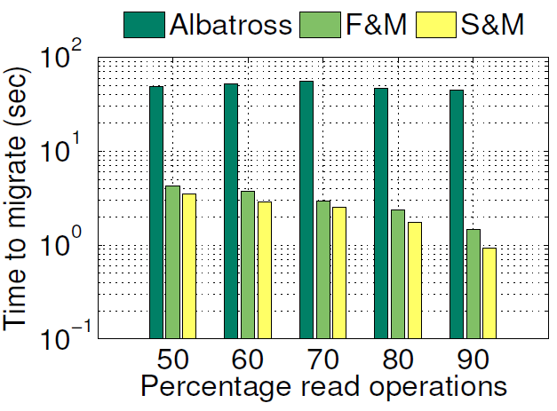
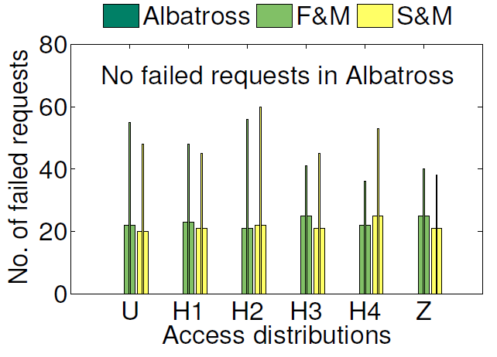
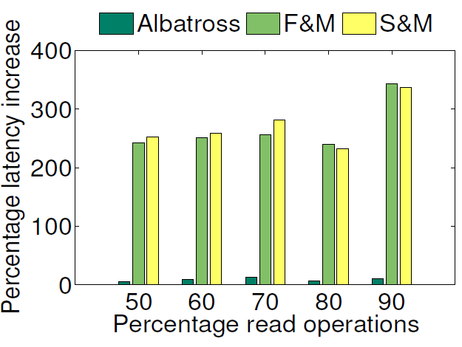
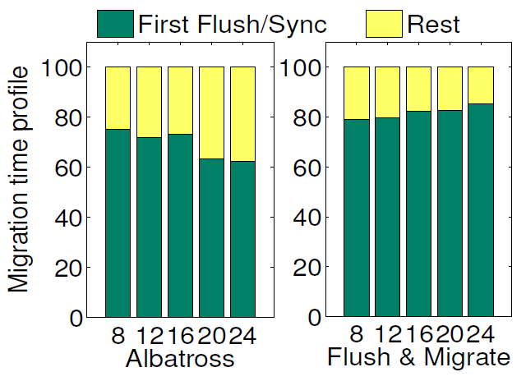
More experiments

Slide 33
Highlights
Live database migration critical for lightweight elasticity as a first class notion
Albatross – low cost live migration for shared storage architectures
No transactions aborted ➔ No service interruption
<15% increase in transaction latency immediately after migration
Guaranteed safety in the presence of failures

Slide 34

Thank you!
sudipto@cs.ucsb.edu
http://www.cs.ucsb.edu/~sudipto
http://www.cs.ucsb.edu/~dsl

Slide 35
Back-up

Slide 36
Challenge: Lightweight Elasticity
Provisioning on-demand and not for peak
Optimize operating cost!
Resources
Capacity
Resources
Demand
Capacity
Demand
Time
Time
Traditional Infrastructures
Deployment in the Cloud
Unused resources
Slide Credits: Berkeley RAD Lab
Notes:
In addition, when such a database is deployed on an elastic pay-per-use cloud infrastructure that allows for on-demand provisioning compared to static provisioning for the peak load, the challenge is to make the database layer elastic as the underlying cloud infrastructure without introducing a lot of overhead to make it elastic.
Scale vs Elasticity

Slide 37
Albatross
Transaction State
Transaction State
DBMS Node
Cached DB State
Cached DB State
Tenant/DB Partition
Tenant/DB Partition
Source
Destination
Persistent Image

Slide 38
Albatross
Ownership
Source (N_{src})
Destination (N_{dst})
Steady State
1. Begin Migration
2. Iterative Copying
3. Atomic Handover
Steady State
Time
Initiate Migration
Snapshot cache at N_{src}
Initialize tenant at N_{dst}
N_{src} continues executing transactions
Synchronize and Catch-up
Track changes to DB State at N_{src}
Iteratively synchronize state changes
Finalize Migration
Stop serving Tenant at N_{src}
Synchronize cache
Migrate transaction state
Transfer ownership to N_{dst}

Slide 39
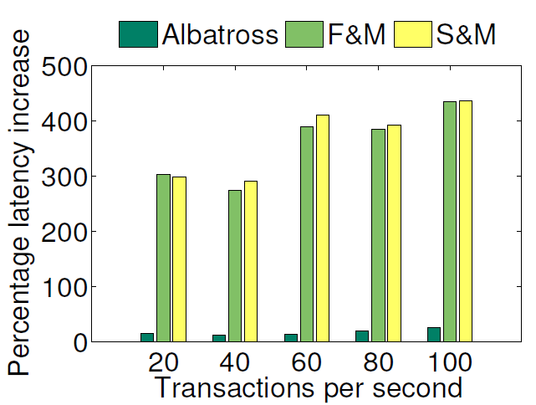
Impact on latency

Slide 40
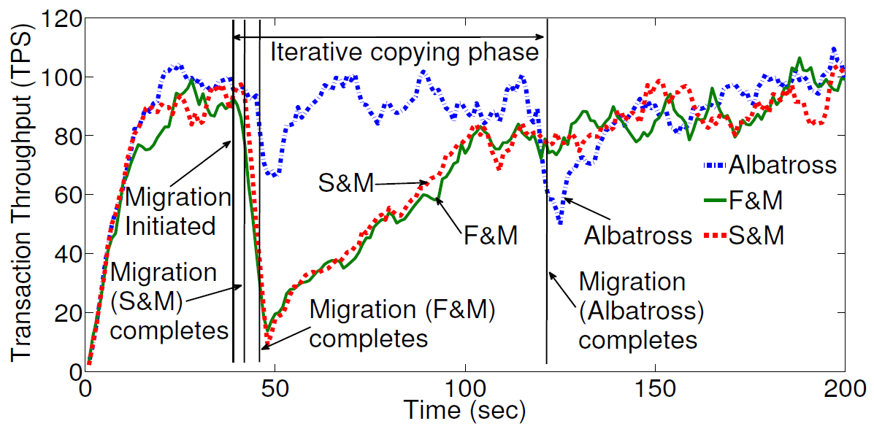
Impact on throughput
Minimal impact on throughput both during and after migration

