Slide 1
Completeness of Queries over Incomplete Databases
Simon Razniewski
Joint work with Werner Nutt
Free University of Bozen-Bolzano

Slide 2
Introduction
Data completeness: important aspect of data quality
Query answering over incomplete data: extensively studied
Query Completeness: little work

Slide 3
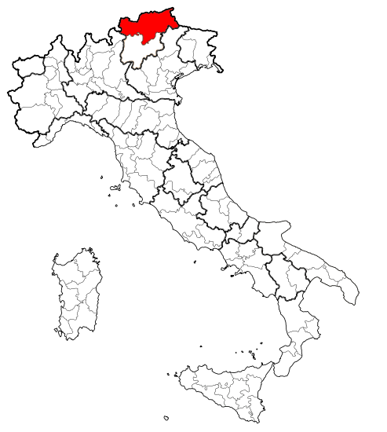
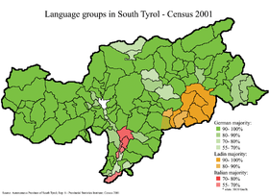
Bolzano is in the Province of South Tyrol
Autonomous, trilingual province in the north of Italy
Bolzano

Slide 4

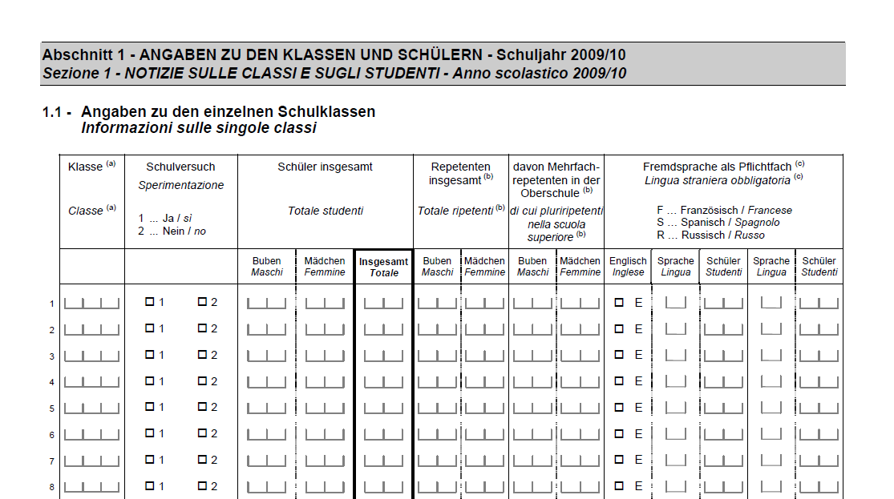

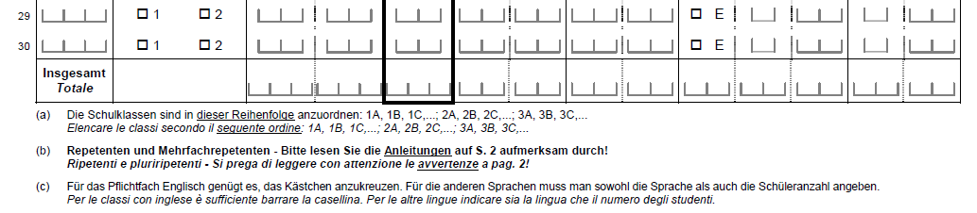
School Data in South Tyrol
Decentrally maintained database Statistical reports
??
notoriously incomplete correctness important

Slide 5
Example Database Schema
Pupil(pname, age, sname)
School(sname, type, language)

Slide 6
Completeness Reasoning Example
Suppose we have data about pupils from all
  German schools
  Italian schools, except the high school “Da Vinci“
  Ladin schools, except the middle school “Gherdëna“
Will the following query get a correct answer?
  “How many pupils are at German primary schools?“
  Yes
  (if we also have all German primary schools)

Slide 7
Completeness Reasoning Example (Cntd)
Suppose we have data about pupils from all
  German schools
  Italian schools, except the high school “Da Vinci“
  Ladin schools, except the middle school “Gherdëna“
Will the following query get a correct answer?
  “How many Ladin pupils are there?
  Maybe not, pupils from “Gherdëna“ could be missing

Slide 8
Overview
Formalization
  Incomplete Database
  Query Completeness
  Table Completeness
Reasoning for Conjunctive Queries
  Bag Semantics
  Set Semantics
  Aggregate Queries

Slide 9
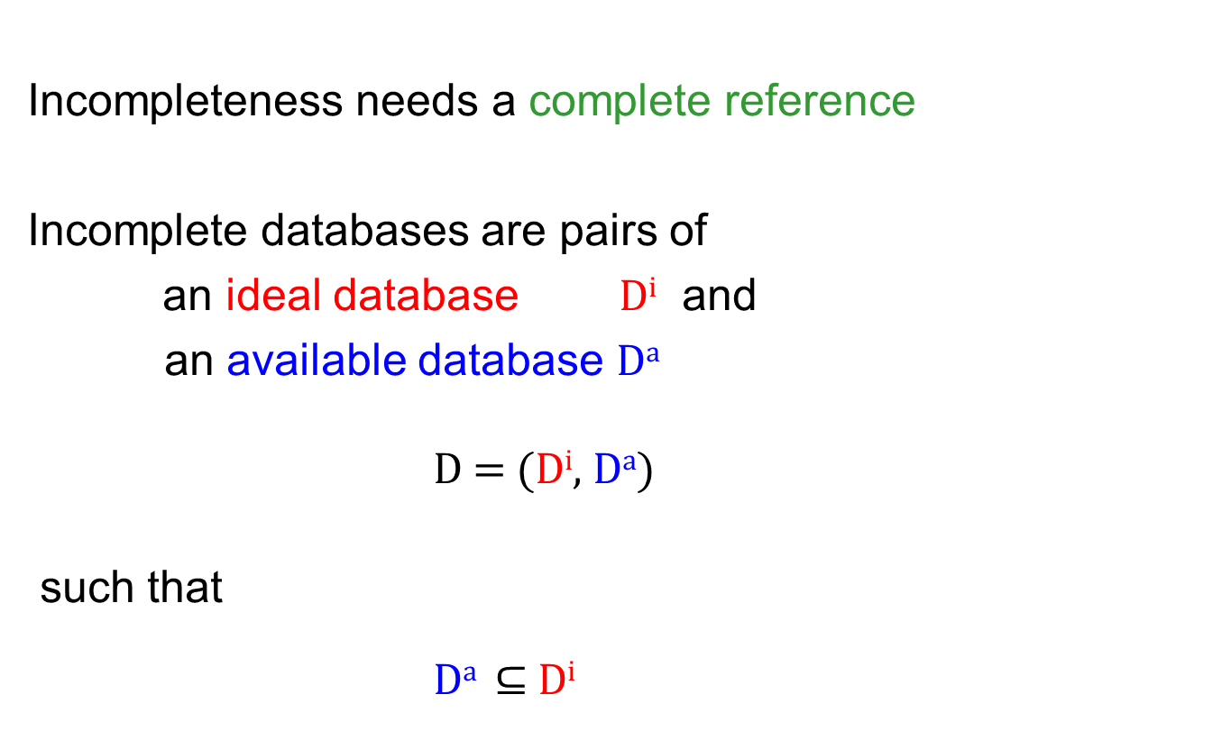
Incomplete Database (Motro 1989)
Incompleteness needs a complete reference
Incomplete databases are pairs of
an ideal database D^{i} and
an available database Dª
D = (D^{i}, Dª)
such that
Dª $⊆$ D^{i}

Slide 10
Incomplete Database - Example
    D = (D^{i}, Dª)
    “Paul and Andrea are pupils in the ideal database”
    D^{i} = { pupil(‘Paul‘, 11, ‘Da Vinci‘),
    pupil(‘Andrea‘, 14, ‘Gherdëna‘) }
    “Our available database misses the fact that Andrea is a pupil“
    Dª = { pupil(‘Paul‘, 11, ‘Da Vinci‘) }

Slide 11

Query Completeness (Motro 1989)
Query Q
“The set of answers to Q is complete“
Notation: Compl(Q)
Semantics:
  (D^{i}, Dª) $⊨$Compl(Q) iff Q(D^{i}) = Q(Dª)

Slide 12
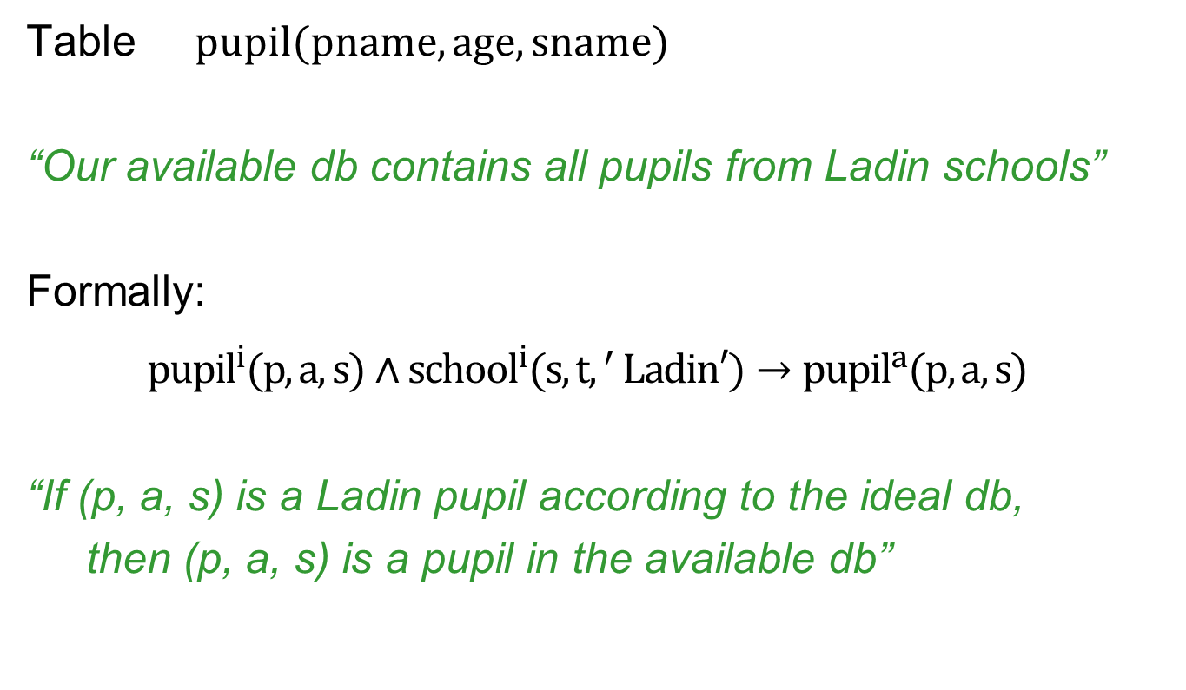
Table Completeness (Levy 1996)
Table pupil(pname, age, sname)
“Our available db contains all pupils from Ladin schools”
Formally:
${pupil}^{i}(p,a,s)∧{school}^{i}(s,t{, }^{′}Ladin′)→{pupil}^{a}(p,a,s)$
“If (p, a, s) is a Ladin pupil according to the ideal db,
then (p, a, s) is a pupil in the available db”
This is a full TGD
(= tuple generating dependency)

Slide 13
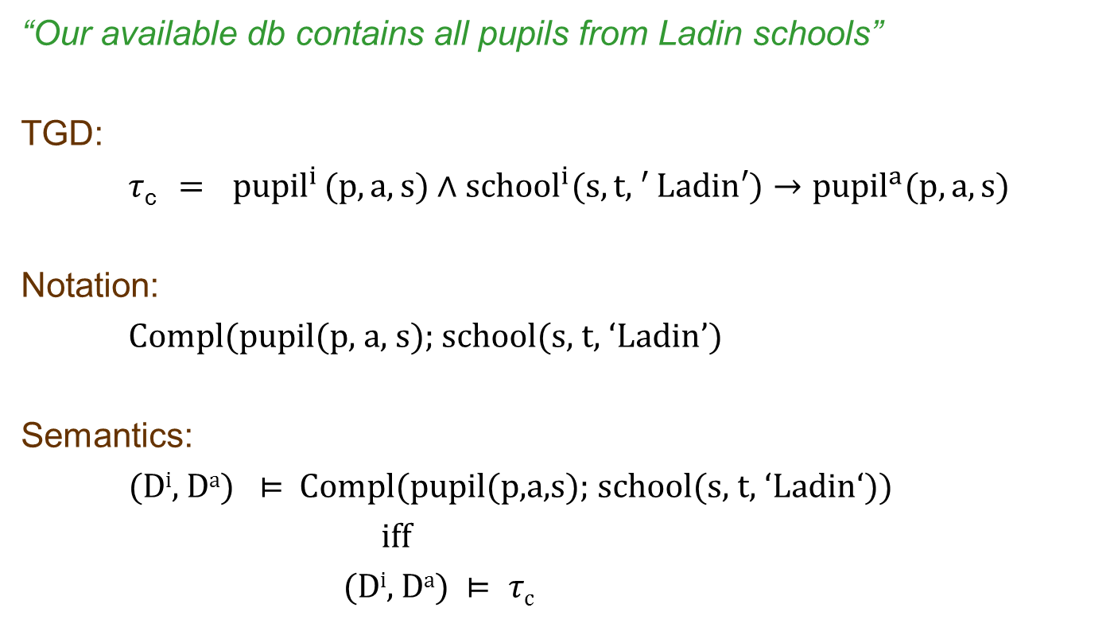
Table Completeness (Cntd)
“Our available db contains all pupils from Ladin schools”
TGD:
$τ$_{c} $= { pupil}^{i}(p,a,s)∧{school}^{i}(s,t{, }^{′}Ladin′)→{pupil}^{a}(p,a,s)$
Notation:
Compl(pupil(p, a, s); school(s, t, ‘Ladin’)
Semantics:
(D^{i}, Dª) $⊨$ Compl(pupil(p,a,s); school(s, t, ‘Ladin‘))
iff
(D^{i}, Dª) $⊨ τ$_{c}

Slide 14
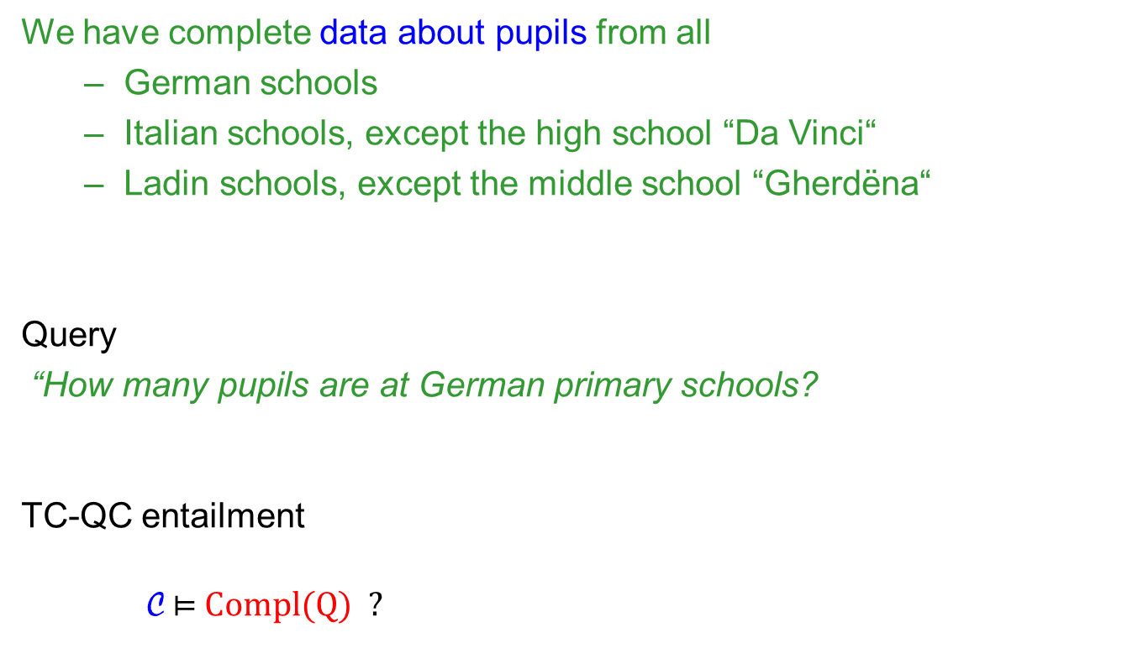
Completeness Reasoning
We have complete data about pupils from all
  German schools
  Italian schools, except the high school “Da Vinci“
  Ladin schools, except the middle school “Gherdëna“
Query
“How many pupils are at German primary schools?
TC-QC entailment
C $⊨$ Compl(Q) ?
TC
Statements
C
QC
Statement
Compl(Q)

Slide 15
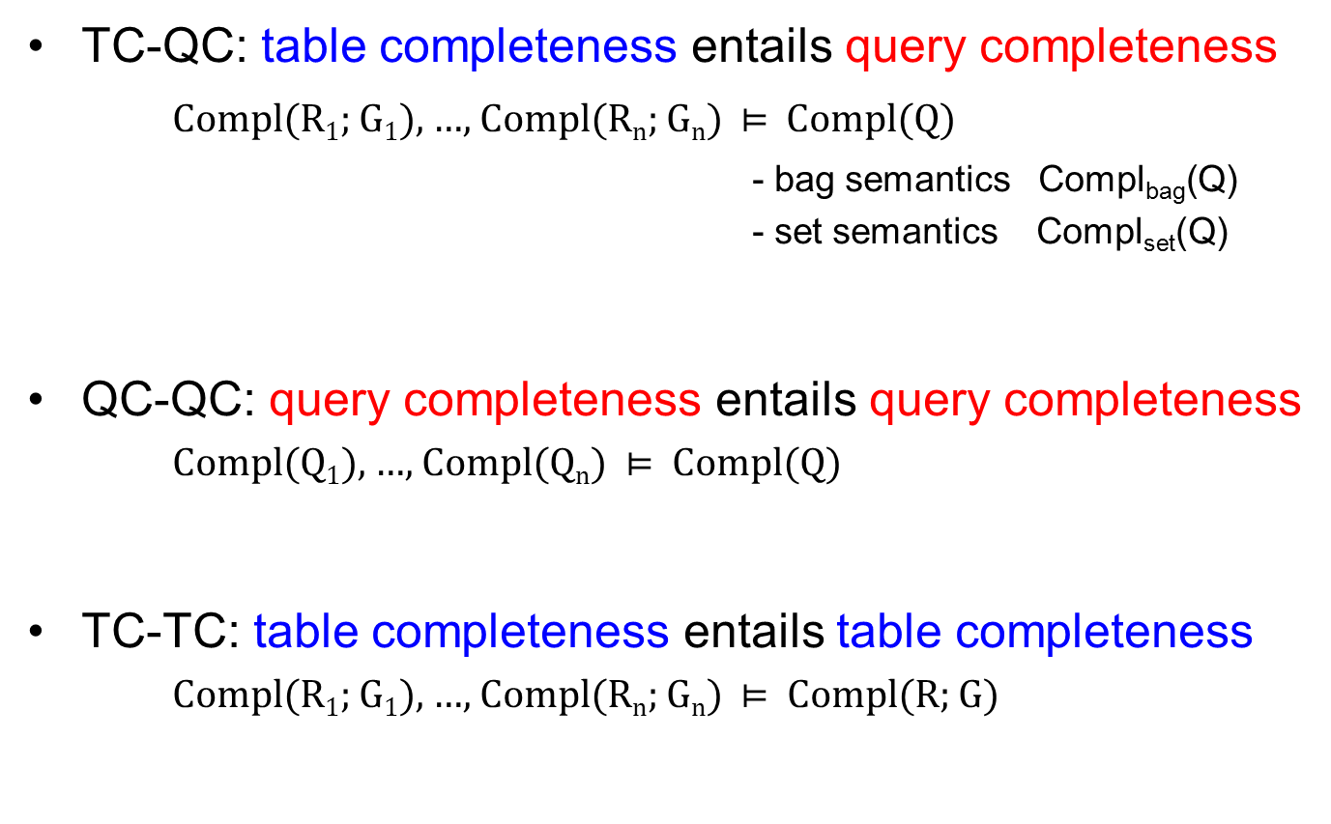
Completeness Reasoning (Cntd)
TC-QC: table completeness entails query completeness
Compl(R₁; G₁), …, Compl(R_{n}; G_{n}) $⊨$Compl(Q)
                - bag semantics Compl_{bag}(Q)
                - set semantics Compl_{set}(Q)
QC-QC: query completeness entails query completeness
Compl(Q₁), …, Compl(Q_{n}) $⊨$ Compl(Q)
TC-TC: table completeness entails table completeness
Compl(R₁; G₁), …, Compl(R_{n}; G_{n}) $⊨$ Compl(R; G)

Slide 16
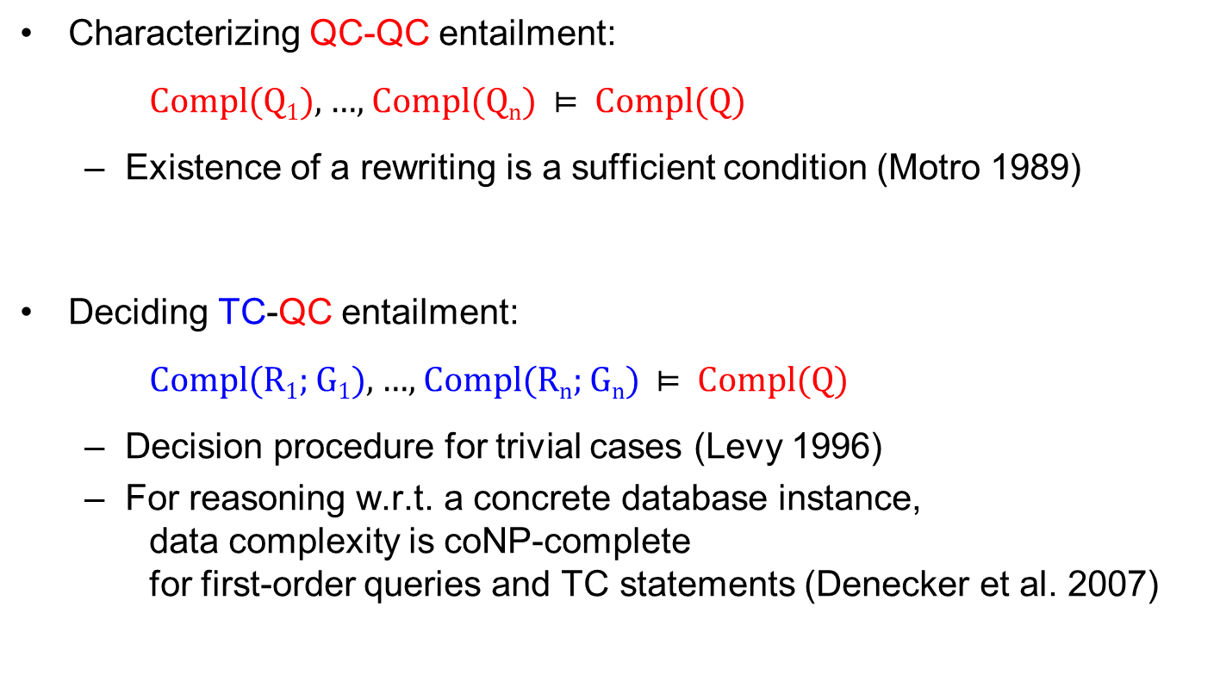
What is Known?
Characterizing QC-QC entailment:
Compl(Q₁), …, Compl(Q_{n}) $⊨$ Compl(Q)
  Existence of a rewriting is a sufficient condition (Motro 1989)
Deciding TC-QC entailment:
Compl(R₁; G₁), …, Compl(R_{n}; G_{n}) $⊨$ Compl(Q)
  Decision procedure for trivial cases (Levy 1996)
  For reasoning w.r.t. a concrete database instance, data complexity is coNP-complete for first-order queries and TC statements (Denecker et al. 2007)

Slide 17

TC-QC_{bag} – Canonical TC Statements
“How many 12-year old pupils are at the Italian schools?''
Q(COUNT(p)) :− pupil(p, 12, s), school(s, t, ‘Italian')‏
Q can be answered correctly if
- every 12-year old pupil from an Italian school is there
- every Italian school with a 12-year old pupil is there
That is, if the database satisfies
- Compl(pupil(p, a, s); school(s, t, ‘Italian'), a = 12)‏
- Compl(school(s, t, l); pupil(p, 12, s), l = ‘Italian')‏
canonical
completeness
statements for Q

Slide 18
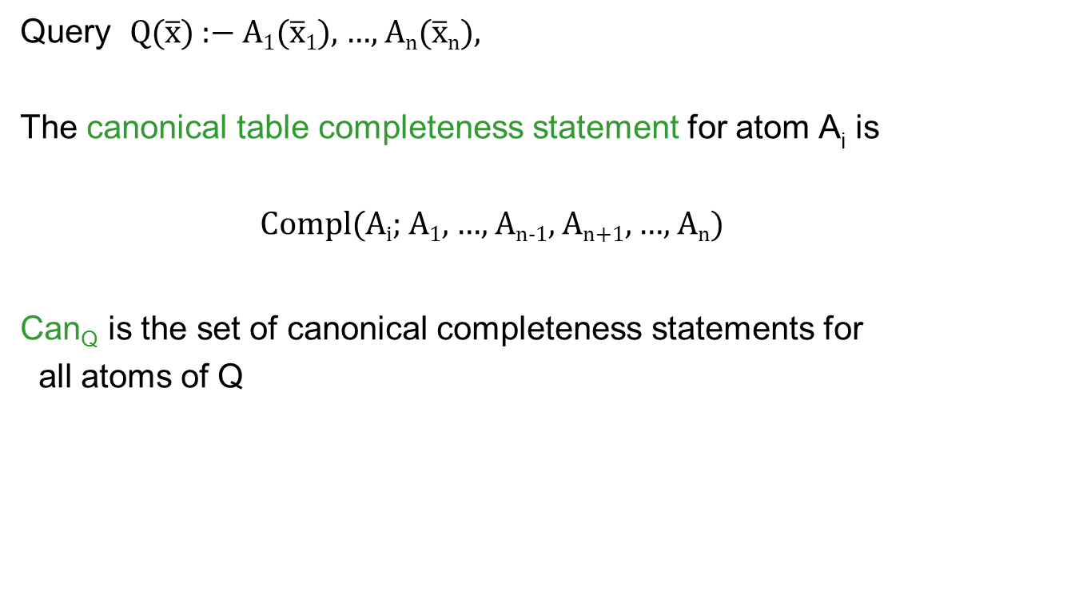
TC-QC_{bag} – Canonical TC Statements (Cntd)
Query Q($\overline{\text{x}}$) :− A₁($\overline{\text{x}}\text{1}$), …, A_{n}($\overline{\text{x}}$_{n}),
The canonical table completeness statement for atom A_{i} is
Compl(A_{i}; A₁, …, A_{n-1}, A_{n+1}, …, A_{n})
Can_{Q} is the set of canonical completeness statements for
all atoms of Q
Proposition: (D^{i}, Dª) $⊨$ Can_{Q} implies (D^{i}, Dª) $⊨$ Compl_{bag} (Q)

Slide 19
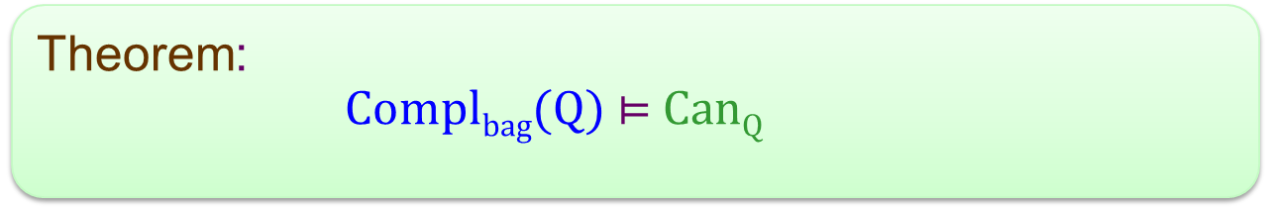

TC-QC_{bag} Reduces to TC-TC
We saw:
Can_{Q} $⊨$Compl_{bag} (Q) ($⊨$Compl_{set} (Q))
For any set C of TC-statements:
C $⊨$Compl_{bag}(Q) iff C $⊨$ Can_{Q}
Theorem:
Compl_{bag}(Q) $⊨$ Can_{Q}
TC-QC TC-TC

Slide 20
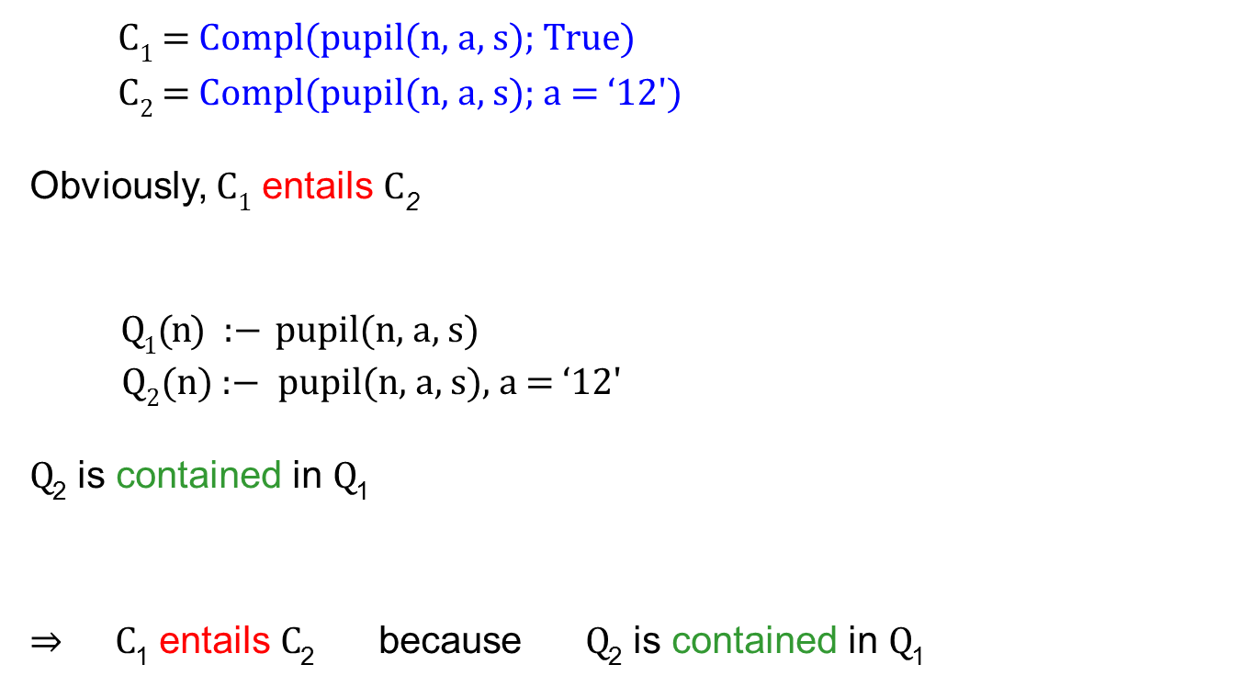
TC-TC Entailment = Query Containment
    C₁ = Compl(pupil(n, a, s); True)
    C₂ = Compl(pupil(n, a, s); a = ‘12')
Obviously, C₁ entails C₂
Q₁(n) :− pupil(n, a, s)
Q₂(n) :− pupil(n, a, s), a = ‘12'
Q₂ is contained in Q₁
$⇒$ C₁ entails C₂ because Q₂ is contained in Q₁

Slide 21
TC-TC Entailment = Query Containment (Cntd)
TC statements describe parts of tables that are complete
TC statements entail each other if the parts described are contained
Entailment of TC from TC can naturally be reduced to query containment
Theorem:
Let L be a class of conjunctive queries that
(i) contains for every relation the identity query
(ii) is closed under intersection
Then TC-TC entailment and containment of unions of queries
can be reduced to each other in linear time.

Slide 22
Complexity
Classes of conjunctive queries:
CQ: Conjunctive queries with comparisons over dense orders
RQ: Relational conjunctive queries (i.e., without comparisons)
LCQ: Linear conjunctive queries (i.e., without self-joins)
LRQ: Linear relational conjunctive queries

Slide 23
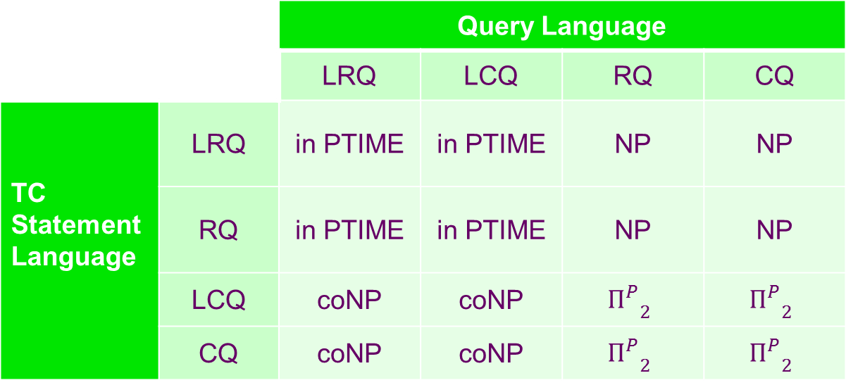
TC-QC_{bag} - Complexity
 |  | Query Language
 |  | LRQ | LCQ | RQ | CQ
TC Statement Language | LRQ | in PTIME | in PTIME | NP | NP
 | RQ | in PTIME | in PTIME | NP | NP
 | LCQ | coNP | coNP | $${П_{}^{P}}_{2}$$ | $${П_{}^{P}}_{2}$$
 | CQ | coNP | coNP | $${П_{}^{P}}_{2}$$ | $${П_{}^{P}}_{2}$$
Notes:
coNP scheint neu zu sein, Pi^P_2-Resultate sind alle neu bis auf CQ-CQ (überprüft bei v. d. Meyden)

Slide 24
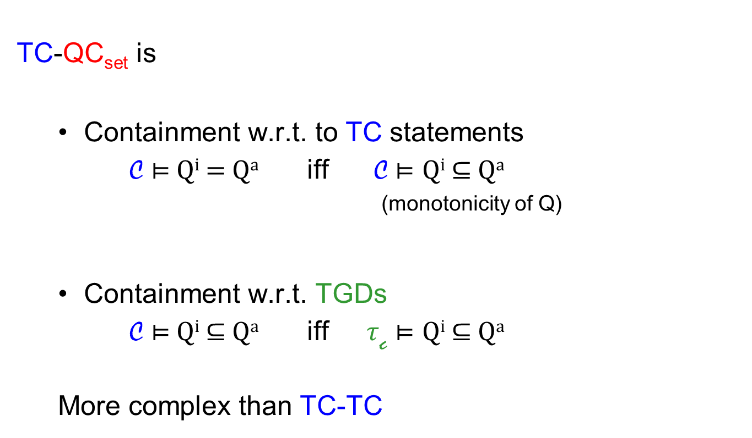
TC-QC_{set}
TC-QC_{set} is
  Containment w.r.t. to TC statements
C $⊨$Q^{i} $=$ Qª iff C $⊨$ Q^{i} $⊆$ Qª
^{(monotonicity of Q)}
  Containment w.r.t. TGDs
  C $⊨$Q^{i}$⊆$ Qª iff $τ$_{c} $⊨$ Q^{i} $⊆$ Qª
  More complex than TC-TC

Slide 25


TC-QC_{set}
TC-QC_{bag} - Complexity
 |  | Query Language
 |  | LRQ | LCQ | RQ | CQ
TC Statement Language | LRQ | in PTIME | in PTIME | NP | NP
 | RQ | in PTIME | in PTIME | NP | NP
 | LCQ | coNP | coNP | $${П_{}^{P}}_{2}$$ | $${П_{}^{P}}_{2}$$
 | CQ | coNP | coNP | $${П_{}^{P}}_{2}$$ | $${П_{}^{P}}_{2}$$
$${П_{}^{P}}_{2}$$
$${П_{}^{P}}_{2}$$
Notes:
Sagen: dreimal Härte gezeigt über Härte des korrespondierenden Containmentproblemes, einmal gilt das nicht => hier ein anderes Containmentproblem auf TC-QC reduziert

Slide 26
Completeness Reasoning for Aggregate Queries
SUM and COUNT: similar to bag semantics
MIN and MAX: similar to set semantics

Slide 27
QC-QC and Query Determinacy
Motro’s idea: Look for rewritings
Given
Q₁(x) :− R(x), S(x)
Q₂(x) :− T(x)
Suppose we know Compl(Q₁) and Compl(Q₂)
Consider
Q(x) :− R(x), S(x), T(x)
We see: Q can be rewritten as
Q(x) :− Q₁(x), Q₂(x)
Therefore, we conclude Compl(Q)

Slide 28
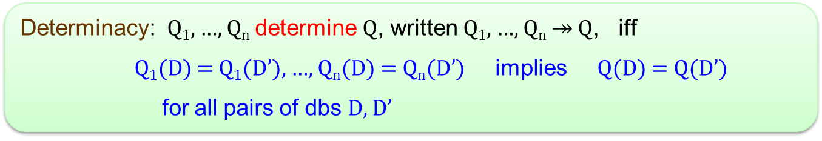
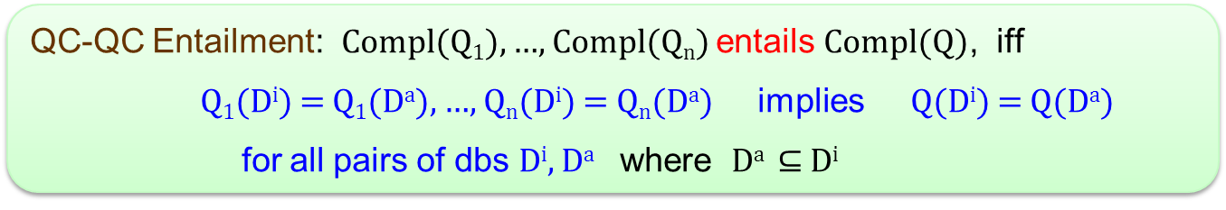
QC-QC and Query Determinacy (Cntd)
Queries Q₁, …, Q_{n}, Q
Determinacy: Q₁, …, Q_{n} determine Q, written Q₁, …, Q_{n} $↠$ Q, iff
Q₁(D) = Q₁(D’), …, Q_{n}(D) = Q_{n}(D’) implies Q(D) = Q(D’)
for all pairs of dbs D, D’
QC-QC Entailment: Compl(Q₁), …, Compl(Q_{n}) entails Compl(Q), iff
Q₁(D^{i}) = Q₁(Dª), …, Q_{n}(D^{i}) = Q_{n}(Dª) implies Q(D^{i}) = Q(Dª)
for all pairs of dbs D^{i}, Dª where Dª $⊆$ D^{i}
Proposition: Q₁, …, Q_{n} $↠$ Q implies Compl(Q₁), …, Compl(Q_{n}) $⊨$ Compl(Q)

Slide 29
QC-QC and Query Determinacy (Cntd)
However:
  Decidability of determinacy for conj. queries is open (Segoufin/Vianu ‘05)
  Necessity of determinacy for QC-QC entailment is open
Theorem: For boolean queries, existence of rewritings, determinacy and
QC-QC entailment coincide

Slide 30
Where Can Completeness Statements Come From?
Any conclusion only as correct as the statements it is derived from
~> On which basis can someone give a completeness statement?
  Someone knows some part of the real world
  E.g., a class teacher knows all his students
  The method of data collection is known to be complete
  E.g., at the deadline for enrolment all forms must be present
  Cardinalities of parts of the real world are known and the method of data collection is correct
  E.g., no nonexisting schools are registered and the number of
  schools in South Tyrol is known

Slide 31
Conclusion
Framework for modelling completeness
  query answers (Motro: QC statements)
  parts of databases (Levy: TC statements)
Reasoning
  Complexity analysis of TC-TC and TC-QC
  Connection between determinacy and QC-QC
  Reasoning in the presence of instances
Current work
  Schema constraints (keys, foreign keys, finite domains)
  Null values
  Prototypical implementation

