Slide 1
The Complexity of Causality and Responsibility
for Query Answers and non-Answers
Alexandra Meliou, Wolfgang Gatterbauer, Katherine Moore,
and Dan Suciu

Slide 2
Motivating Example: Explanations
IMDB Database Schema
Query
“What genres does Tim Burton direct?”
?
Relevant lineage:
137 tuples !!

Slide 3
Example cont. (Musicals)
unimportant tuple
important tuples
Ranking Provenance
Goal:
Rank tuples in order of importance

Slide 4
Solution: Causality
The fundamental question of causality:
  “What is the cause of an effect?”
Causality theory has long been studied in AI and philosophy.
  [Lewis73, EiterLucasiewicz02, HalpernPearl05, Menzies08]
Offers a metric (responsibility) for measuring the contribution of a variable to an outcome
[ChocklerHalpern04]
ranking

Slide 5
Contributions
We suggest responsibility as an effective measure for ranking provenance.
  Explanations
  Error tracing
We define causality and responsibility in a database context.
Complete complexity analysis for computing causality and responsibility for the case of conjunctive queries without self-joins
  Interesting dichotomy result.
  Non-trivial algorithm for computing responsibility in the PTIME cases.

Slide 6
Endogenous/exogenous tuples
Partition the data into 2 groups:
Exogenous tuples (denoted by )
  tuples that we consider correct/verified/trusted. They are not candidate causes
  E.g. the Genre, and Movie_Director tables
Endogenous tuples (denoted by )
  Untrusted tuples, or simply of interest to the user. They are potential causes
  E.g. the Director and Movie tables

Slide 7
Counterfactuals
A variable is a counterfactual cause if a change in its value, changes the value of the result
  E.g.
Limitations: disjunctive causes
  E.g.
A and B are both counterfactual causes of C

Slide 8
Contingencies
Generalize counterfactual causes
A contingency is a hypothetical setting of the endogenous variables that makes a tuple counterfactual
  A is a cause under the contingency B=0

Slide 9
Responsibility (intuition)
Measures the degree of causality, the contribution of a tuple
A larger contingency, means a tuple has smaller degree of causality
Counterfactual causes have the most contribution (empty contingency set)

Slide 10
Causality for Conjunctive Queries
(database)
(endogenous tuple)
(an answer to q)
Definition: Causality
(contingency)
(endogenous tuples)
Intuition: If the removal of t removes the answer, then t is counterfactual
If there is a set of tuples whose removal makes t counterfactual, t is a cause
Definition: Responsibility
Intuition: The more tuples that need to be removed, the less important t is

Slide 11
Example
Query:
(Datalog notation)
Lineage expression:
Database:
Responsibility:
Assume all endogenous
NOTE: If is exogenous, is not a cause.

Slide 12
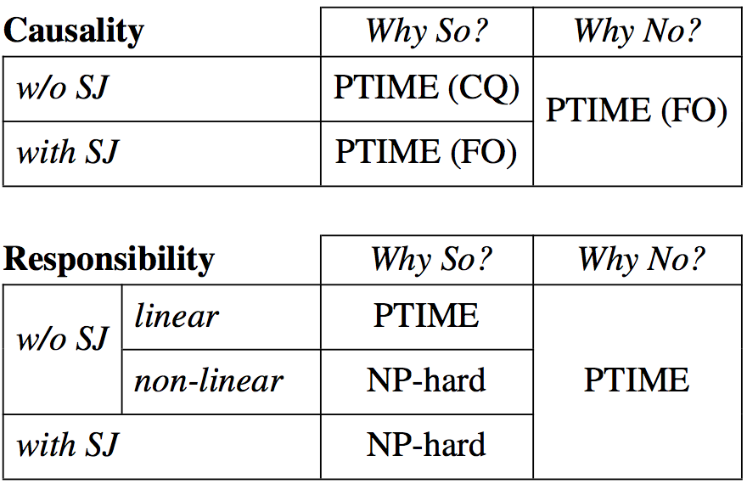
Complexity Results (Data Complexity)
answers
non-answers
dichotomy

Slide 13
Responsibility: PTIME Queries
Assume conjunctive queries with no self joins
A simple case:
The lineage of q will be of the form:
What is the responsibility of
PTIME

Slide 14
Responsibility: PTIME Queries
More interesting:
*
(R tuples)
(S tuples)
Intuition: a cut in the graph interrupts the s-t flow. The addition of t re-instantiates it.
t becomes counterfactual
*
easy
✔

Slide 15
Responsibility: Hard Queries
Theorem: The following queries are NP-hard:
endogenous
If unspecified, it could be either

Slide 16
Query Dual Hypergraph
Definition: Linear Queries
There exists an ordering of the nodes of the dual hypergraph, such that every hyperedge is a consecutive subsequence.
Query hypergraph
Query dual hypergraph
Theorem:
Computing responsibility for all linear queries is in PTIME.
None of these are linear

Slide 17
Weakenings
NP-hard
PTIME
R is exogenous, and therefore its tuples cannot be part of the contingency set
Expand R with the domain of z. Responsibility of T tuples is not affected!
Dissociation

Slide 18
Responsibility Dichotomy
Definition: Weakly Linear Queries
A query is weakly linear, if there exists a set of weakenings that leads to a linear query
Dichotomy Theorem:
(data complexity)
If q is weakly linear, then computing responsibility for q is in PTIME
If q is not weakly linear, then it is NP-hard

Slide 19
Conclusions
Defined causality and responsibility for conjunctive queries
Complete complexity analysis for CQ without self-joins
  Interesting dichotomy result
  Non-trivial algorithm for PTIME cases
Open problem:
  Self-joins

