Slide 1
Where in the world is my data?
Sudarshan Kadambi
Yahoo! Research
VLDB 2011
Joint work with Jianjun Chen, Brian Cooper, Adam Silberstein, David Lomax, Erwin Tam, Raghu Ramakrishnan and Hector Garcia-Molina

Slide 2
Problem Description
Consider a distributed database, with replicas kept in-sync via. an asynchronous replication mechanism.
Consider a social networking application that uses this distributed database.
Consider a user who is based in Europe.
If user’s record is never accessed in Asia, we shouldn't need to pay the network/disk bandwidth to update the record in the Asian replica.

Slide 3
Criteria used to replicate a given record
Dynamic Factors
  How often is the record read vs. updated?
  Latency of forwarded reads.
Static Factors
  Legal Constraints
  Critical data items such as billing records might have additional replication requirements.
  In this presentation, we’ll look at selective replication at a record level that respects policy constraints and minimize replication costs and is tuned to support latency guarantees.

Slide 4
Architecture
PNUTS.
Asynchronous Replication.
Timeline Consistency.
Replicate everywhere.
With selective replication, some replicas have a full copy of record, others only have stubs.
Each stub has the primary key and additional metadata such as list of replicas that have a full copy of the record.
Read for a record at a replica that contains a stub will result in a forwarded read.

Slide 5
Optimization Problem
Given the following constraints:
Policy constraints that define the allowable and mandatory locations for full replicas of each record, and the minimum number of full replicas for each record, and
A latency SLA which specifies that a specified fraction of read requests must be served by a local, full replica
Choose a replication strategy to minimize the sum of replication bandwidth and forwarding bandwidth for a given work- load.
Note: Total Bandwidth = Update Bandwidth + Forwarding Bandwidth

Slide 6
Policy Constraints
Based on legal dictates, availability needs and other application requirements.
[CONSTRAINT I]
IF
TABLE_NAME = "Users”
THEN
SET 'MIN_COPIES' = 2
SET 'INCL_LIST' = ’USWest'
CONSTRAINT_PRI = 0

Slide 7
Policy Constraints (contd.)
[CONSTRAINT II]
IF
TABLE_NAME = "Users" AND
FIELD_STR('home_location') = 'france'
THEN
SET 'MIN_COPIES' = 3 AND
SET 'EXCL_LIST' = ’Asia'
CONSTRAINT_PRI = 1

Slide 8
Constraint Enforcement
Master makes an initial placement decision when the record is inserted.
R and stub (R) are published to the messaging layer in a single transaction.
If record contents change, full copies can migrate (promotions/demotions).
Constraints are validated when they're supplied.
Our system don't allow constraints to be changed after data is inserted.
Notes:
If the record is updated such that it matches different constraints, master might change the placement of the record.
Successfully published messages are guaranteed to be delivered, insert either succeeds and places a record/stub in every region or fails and writes nothing.
Old full replica location that are no longer listed in the full replica list of the stubs will demote their copy to a stub (discarding the data values).
The properties should be able to be mutual satisfied.

Slide 9
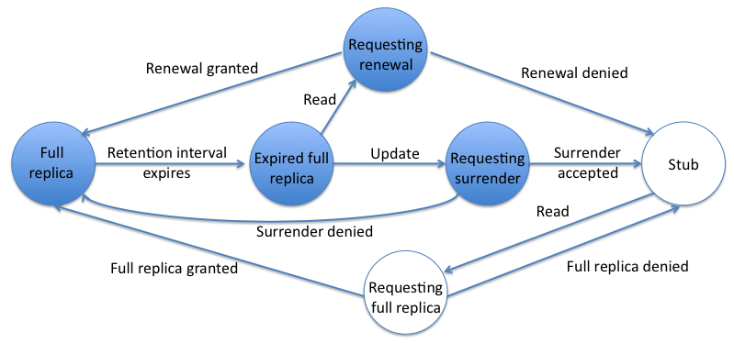
Dynamic Placement
Notes:
1. Make a full replica when we see a read at a stub location, and demote it back to a stub when we see a write at a different location.
2. Premise that if a record is read from a location, it is likely to be read again. For e.g a user session might consist of multiple reads in a row.
3. At the same time, if we see an update for a record that has not seen a local read recently, it is possible that the user sessions is over and we should demote that full replica to avoid the cost of further propagate updates.
4. The local replica location requests promotion or demotion, but the master decides whether to grant the request in order to ensure policy constraints are enforced.
5. After a location makes a new full replica, it retains that full replica for atleast some interval I.
6. During I, updates are applied to the replica, and it is served to local readers.
7. Once the interval expires, we do not take immediate action.
8. We wait for the next operation: if the next operation is a read, we still have an up-to-date replica stored locally. We serve it, and then retain the full replica for another interval I.
9. If the next operation is a write, we demote the full replica to a stub.
10. If no reads or writes occur for a while after the interval expires, the full replica lingers, but this does no harm since there are no updates to consume bandwidth.

Slide 10
Retention Interval
Too short: locations will be quick to surrender full replicas.
Too long: single read can cause a full replica to be retained for a long time.

Slide 11
Latency constraints
Dynamic placement places full copies where reads exceeds writes and stubs elsewhere.
Might be necessary to make extra full copies so that latency SLA is met.
One way to accomplish is by increasing the number of copies.
Another is to increase the retention interval I.
Notes:
Since extra copies would be made irrespective of whether the record is accessed at those new locations.
Full replicas will be less likely to be demoted to stubs, meaning that more often reads will find a full replica at a location instead of a stub.

Slide 12
Experimental Setup
Social networking application.
Users have a home location from where their reads and writes originate.
Varied the remote probability, the read/write ratio, the size of reads/writes and user mobility.
For constraint schemes, we use min copies of 2. Each record must have a full copy at the user's home location.
Notes:
System retrieves latest profiles for a user's friends when a user logs in.
When a user logs in, the application reads the user's friends' records and with some probability, updates the user's own record.
Synthetic social graph and read/write traces.
Favors replicate-everywhere and to a lesser extent static schemes. Use a retention interval of 300 seconds.

Slide 13
Configuration
Clusters in data centers in US, India, Singapore.
100,000 1 /KB records.
5M read/write operations for each data point.
For dynamic schemes, generated a trace of 6M operations and used the first 1M for warmup.

Slide 14
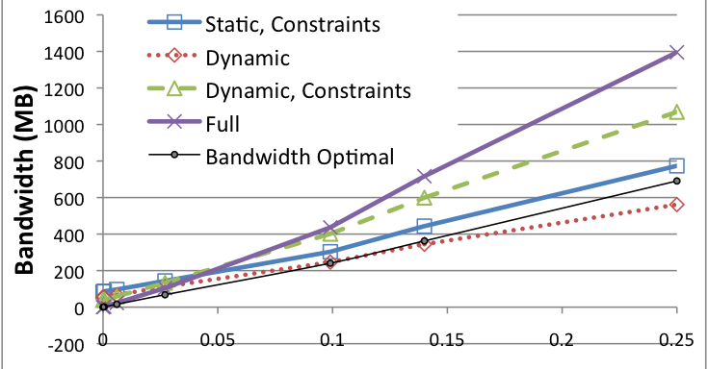
Varying read/write proportion
Insight: Dynamic scheme performs well with increasing number of writes, as it can keep as few as one copy. Due to the adaptation overhead, Dynamic with Constraints performs worse than Static Constraints.

Slide 15
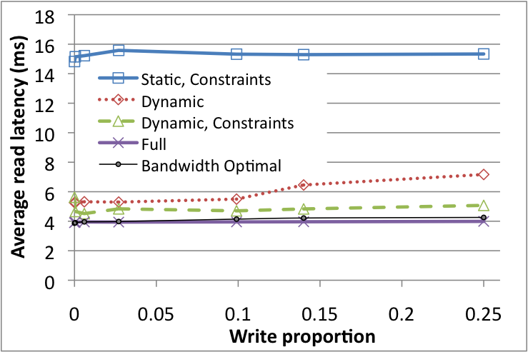
Varying read/write proportion
Insight: Latency of the dynamic scheme increases as write proportion increases, as the likelihood increases that an update reaches an expired full replica and causes the demotion of that replica to a stub. Hence there is fewer full replicas, increasing overall latency.

Slide 16
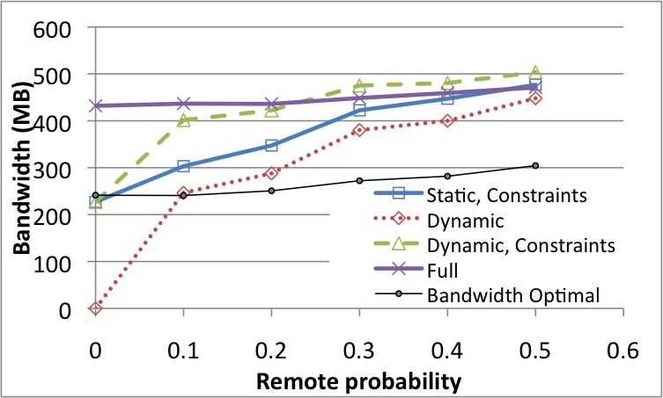
Impact of Locality
Insight: As remote probability increases, even though the proportion of writes remains the same at 10%, the effect of those writes get amplified as a higher proportion of records at a replica are obtained adaptively.
Notes:
As remote probability increases, there is less geographic locality of access and all schemes (except Full) must do an increasing number of forwarded reads, costing bandwidth.

Slide 17
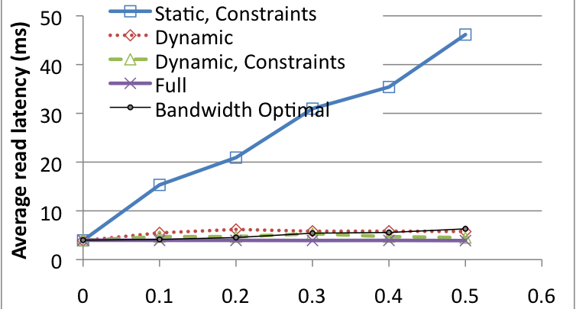
Impact of Locality
Insight: Static Constraints pays the penalty of having to repeatedly do forwarded reads for friend’s records, without being able to store those records locally.

Slide 18
Real Data Trace
10 days of logs,170,000 unique users, 32 million operations.
The trace is read-heavy; About 40% operations are remote.
Dynamic with Constraints get similar average read latencies (about 4ms) as Full.
Total bandwidth for Full is 8 Mb and 6.8 Mb for Dynamic with Constraints.

Slide 19
Comparison with other techniques
Caching.
Replication.
Our Technique: Caching + Replication
  Minimum bookkeeping.
  Local + Global decision making.
Also applicable to other web databases such as BigTable and Cassandra.
Notes:
1. Caching is storing transient copies in memory and invalidating them on an update.
2. Replication operates on a table level and stores long lived data on disk.
3. Hybrid approach: granularity is at the record level and copies are transiently stored (like in caching) but the storage is on disk and we propagate updates (like in replication).
4. Considered scheme that gathered read and write statistics per record.
5. Challenge with read counters - don't want to perform write just to update the read counter, also don't want to keep these stats in memory as there might be billions of records per node and we've that much less memory for caching user data.
6. Mention ADR during discussion on collecting read/write stats.

Slide 20
Related Work
Adaptive Dynamic Replication (Wolfson et al.)
Data Replication in Mariposa (economic model)
Minimal cost replication for availability (Yu and Vahdat)
Cache placement based on analyzing distributed query plan (Kossmann et al.)
Replication strategies in peer to peer networks (Cohen and Shenker)

Slide 21
Conclusion
Proposed mechanism for selectively replicating data at a record granularity while respecting policy constraints.
Currently being rolled out to production at Yahoo.
Examined a dynamic placement scheme with small bookkeeping overhead.
Experimental results show significant improvement in bandwidth usage.
Tunable in order to meet latency constraints.

Slide 22
Thank You

Slide 23
Eventual Consistency
Application can apply concurrent updates to different replicas of the same record in parallel.
PNUTS publishes changes asynchronously to other replicas and resolves conflicts using the local timestamp of each write.
With selective replication: updates are not published to stubs, this may cause a replica to not eventually receive all changes to a record.
To address this, require a full replica to republish its write after detecting overlapping promotions for other replicas of the same record.
Notes:
All replicas eventually receive all changes to the same record and resolve conflicts identically.

