Slide 1
Threshold Queries over Distributed Data Using a Difference of Monotonic Representation
VLDB ‘11, Seattle
Guy Sagy, Technion, Israel
Daniel Keren, Haifa University, Israel
Assaf Schuster, Technion, Israel
Izchak (Tsachi) Sharfman, Technion, Israel

Slide 2
In a Nutshell
A horizontally distributed database: many objects, each of them distributed between many nodes.
Given a function f() which assigns a value to every object – alas, the value depends on the object’s attributes at all nodes.
Need to find all objects for which f() > τ.
First solve for monotonic f(), using a geometric bounding theorem. Allows to quickly – and locally – prune many objects.
Extend to general functions by expressing them as a difference of monotonic functions.

Slide 3
Example : Distributed Search Engine
Each server maintains its local statistics
We’d like to know the top-k most globally correlated word pairs (e.g. : Olympic & China)
Word1 | Word2 | Count
Olympic | China | 640
Soccer | 100M | 500
Insurance | 100M | 450
Word1 | Word2 | Count
Olympic | China | 2900
Swimming | Phelps | 1000
100M | Swimming | 100

Slide 4
Threshold Queries over Distributed Data
Data is partitioned over nodes.
Each node stores a tuple of attributes for each object (e.g. object = word pair, attribute tuple = contingency table).
An object’s score –
  First aggregating the attributes
  Then applying an arbitrary scoring function
Threshold query – given a threshold τ, our goal is to report all objects whose global score exceeds it.

Slide 5
Previous work
Simple aggregate scoring functions:
  David Wai-Lok Cheung and Yongqiao Xiao. Effect of data skewness in parallel mining of association rules. In PAKDD ’98
  Assaf Schuster and Ran Wolff. Communication-efficient distributed mining of association rules. In SIGMOD ’01
  Qi Zhao, Mitsunori Ogihara, Haixun Wang, and Jun Xu. Finding global icebergs over distributed data sets. In PODS ’06
Monotonic aggregate scoring functions:
  Pei Cao and Zhe Wang. Efficient top-k query calculation in distributed networks. In PODC ’04
  Sebastian Michel, Peter Triantafillou, and Gerhard Weikum. Klee: a framework for distributed top-k query algorithms. In VLDB ’05
  Hailing Yu, Hua-Gang Li, Ping Wu, Divyakant Agrawal, and Amr El Abbadi. Efficient processing of distributed top- queries. In DEXA, 2005.
Non monotonic scoring functions in Centralized Setup
  Dong Xin, Jiawei Han, and Kevin Chen-Chuan Chang. Progressive and selective merge: computing top-k with ad-hoc ranking functions. In SIGMOD ’07..
  Zhen Zhang, Seung won Hwang, Kevin Chen-Chuan Chang, Min Wang, Christian A. Lang, and Yuan-Chi Chang. Boolean + ranking: querying a database by k-constrained optimization. In SIGMOD ’06.

Slide 6
Non-linear example:
Correlation Coefficient
- Frequency of occurrences of word A (word B), divided by the number of queries at node i
- The global frequency of occurrences of word A (word B)
- Frequency of occurrences of word A with word B at node i
- The global frequency of a pair of words A and B.
The global correlation coefficient:

Slide 7
Non-linear functions: Correlation Coefficient – cont.
Each server maintains a tuple for each pair of words
Need to determine the pairs whose global correlation is above τ.
The global score can be higher than all the local ones (cannot happen for e.g. convex functions).
 | Queries Number | WordA | WordB | WordA & WordB
Node1 | 1000 | 100 | 100 | 19 | 0.1 | 0.1 | 0.019 | 0.1
Node2 | 1000 | 400 | 400 | 184 | 0.4 | 0.4 | 0.184 | 0.1
Global | 2000 | 500 | 500 | 203 | 0.25 | 0.25 | 0.1015 | 0.208

Slide 8
Non-linear functions:
Chi-Square
Given two words A,B and distributed contingency tables
The chi-square value is defined by
Not B | B | Node 1
0 | 100 | A
100 | 0 | not A
Not B | B | Node 2
100 | 0 | A
0 | 100 | not A
Not B | B | Total
50 | 50 | A
50 | 50 | not A
χ²=1
χ²=1
χ²=0

Slide 9
TB (Tentative Bound) Algorithm
Step 1:
  Check a local constraint for each object in each node, and report to the coordinator objects which violate it; they form the candidate set.
Step 2:
  Collect the data for the candidate set objects, and report only those whose global score exceed the threshold
The main challenge is in decomposing the distributed query into a set of local conditions

Slide 10
The Bounding Theorem
In Sigmod06’¹ a geometric method was proposed for defining local constrains for general functions over distributed streams:
Reference point known to all nodes
Each node constructs a sphere
Theorem: convex hull is contained
in the union of spheres
The score of the global vector is
bounded by the maximal score
over all spheres
¹ I. Sharfman, A. Schuster, and D. Keren. “A geometric approach to monitoring threshold functions over distributed data streams.” In SIGMOD, 2006

Slide 11
TB (Tentative Bound) Algorithm
Step 1:
  Locally construct a sphere for each object
  Compute the maximum value for each object over the sphere (local constraint)
  Report to coordinator objects whose maximum value exceeds τ (candidate set)
Step 2:
  Collect the data for all objects in the candidate set, and report only those whose global score exceeds τ

Slide 12
The previous geometric method cannot be applied to the static distributed databases treated here:
  The maximum score was calculated for each object in each node
  This computation is CPU intensive (finding the maximum score over all the vectors in each sphere)

Slide 13
TB Monotonic Algorithm -
Reference Point & TUB
Setting a global reference point
  Each node reports a single d-dimensional vector which contains the minimum local value in each dimension
  The global reference point V_{lower} (V_{upper} ) contains the minimum (maximum) global value in each dimension
TUB - Tentative Upper Bound (u_{j,i}):
  The local vector for each object (o_{j}) in node (p_{i}) is used to construct a sphere
  u_{j,i} is the maximum score in the sphere

Slide 14
TB Monotonic Algorithm –
Minimizing Access Cost
Domination Relationship:
dominates if every component of is not smaller than the corresponding component of . Denote
Monotonic f :
b
a
d
j
g
f
i
e
k
c
h
l
b dominates a , g dominates c,e,f,h

Slide 15
TB algorithm –
Minimizing Access Cost (cont.)
Theorem: if dominates , then u_{a,i}u_{b,i} .
Therefore, if an object is dominated by an object whose TUB is below the threshold, we can discard the first object from consideration.
j
b
i
a
e
d
g
c
k
h
f
l
v_{lower}

Slide 16
TB algorithm –
Minimizing Access Cost (cont.)
Compute skyline
Compute TUB for skyline objects
If TUB value of an object is greater than τ, report it and remove from skyline
Return until all TUB values of skyline objects are below τ

Slide 17
TB algorithm –
Efficiently computing TUB values
Finding the TUB value is an optimization problem
Generally, can have many local minima
In case of a monotonic function, a branch-and-bound algorithm can be used
  Bound the sphere within a box
  Calculate the maximum value (trivial)
  In case it’s above the threshold,
  partition the box
The algorithm efficiently finds
objects whose global score is
below the threshold

Slide 18
TB algorithm–
Non-Monotonic Scoring Functions
The algorithm presented so far assumes monotonicity
Many functions (e.g. chi-square) are non-monotonic
We represent any non-monotonic function as a difference of monotonic functions (D.O.M.F):

Slide 19
Example

Slide 20
Choose a “dividing threshold” t_{div}
Request from all nodes to report:
  All objects whose TUB (using m₁) is > t_{div}
  All objects whose TLB (using m₂) is < t_{div-} τ
  The reported objects are the coordinator’s candidate set
Step 2 - collect all data for objects in candidate set, proceed as before

Slide 21
D.O.M.F and Total Variation
Definition 1. Let p = {a=x₀<x₁<...<x_{n}=b} be a partition of the interval [a, b]. Let the variation V (f, p) of the function f(x) over p be defined as:
Definition 2. Let P(a, b) be the set of all partitions of the interval [a,b]. The total variation over the interval is defined as:

Slide 22
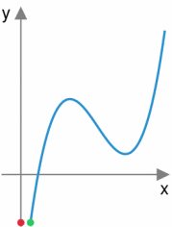

Slide 23
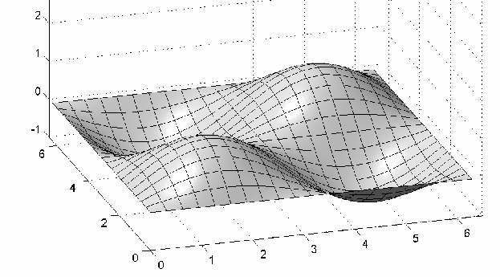
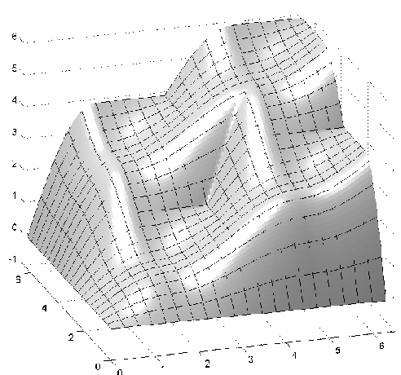
D.O.M.F - Total variation

Slide 24
Computing Total Variation
Univariate function (well-known):
Given a differentiable function f(x,y):
  Dynamic Programming

Slide 25
D.O.M.F - Representation
The definition of
over the interval [a,b] is as follows:
m₁ and m₂ are monotonically increasing (for any dimension)

Slide 26
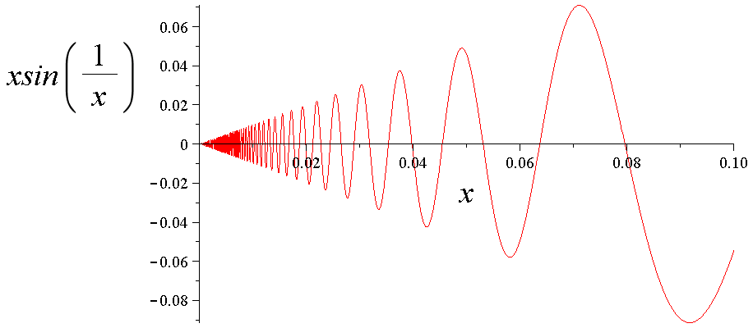
Can’t do it for some nasty functions…

Slide 27
Results
Algorithms -
  Naïve – collects all the distributed data and computes the threshold aggregation query in a central location
  TB – Tentative Bound algorithm
  OPC - An offline Optimal Constraint Algorithm (knows the convex hull of the local vectors)
Data Sets
  Reuters Corpus (RC, RT)
  AOL Query Log (QL)
  Netix Prize dataset (NX)

Slide 28
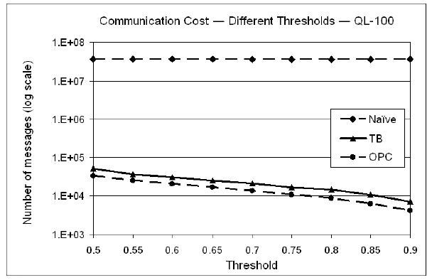
Communication cost for different threshold values

Slide 29
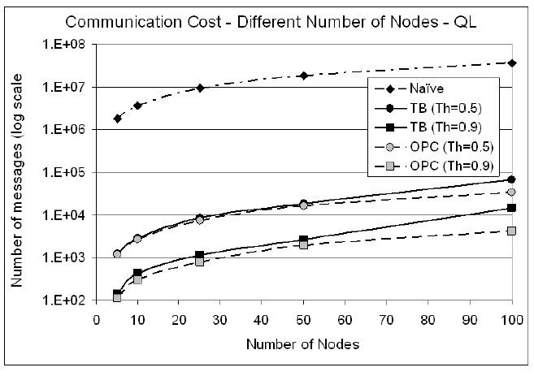
Communication cost for different numbers of nodes

Slide 30
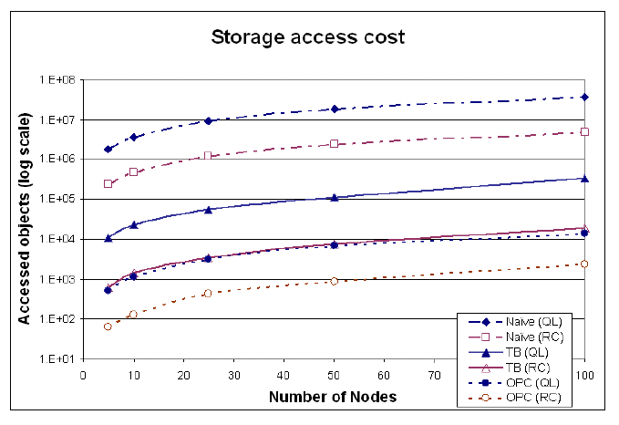
Access costs for the TB algorithm

Slide 31
Summary
An efficient algorithm for performing distributed threshold aggregation queries for monotonic scoring functions
  Minimize communication cost
  Access only fraction of the data in each node
  Minimize computational cost
A novel approach for representing any non-monotonic scoring function as a difference of monotonic functions, and applying this representation to querying general functions.

Slide 32
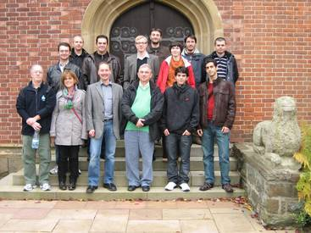


Research supported by FP7-ICT Programme, Project “LIFT”,
Local Inference in Massively Distributed Systems http://www.lift-eu.org/

