Slide 1
Is it Still Big Data if it Fits in my Pocket?
Dave Campbell
Microsoft

Slide 2
The Journey: Objective
Try to separate hype from reality
Identify unique new value
Is map-reduce a giant steps backwards?
What are the dominant dimensions of “Big Data”

Slide 3
The Journey: Process
Engaged and connected with many people
Many interesting debates
Created, tested, and refined a frame to explain Big Data phenomenon
Major driving forces
Encountered independently evolved common patterns
Wrote code & prototyped

Slide 4
The Journey: Results
An (one) explanation for the phenomenon
A set of design & architecture patterns
Material to inform an R&D agenda

Slide 5
The Story

Slide 6
The Knowledge Hierarchy
Knowledge
Application
Knowledge
Structure / Value
Information
Data
Signal
Effort / Latency

Slide 7
The Current Paradigm
Build conceptual model
Build a physical model
Answer the questions
Questions to answer
Build a logical model
Collect the data
Load the data
(Tune)
t →
Time to Insight: Weeks to Months
Notes:
For decades, we have been building information systems, particularly for decision support and business intelligence, in mostly the same fashion. We typically start with the questions we want answers to. Then we create an information model and produce the data to populate that model. We’ve also had to build a physical or implementation model of the system.

Slide 8
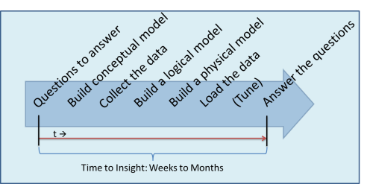
Lifecycle of a Question
Validation
Question
Different Question
Worth asking again?
Not interesting
Make it repeatable
Bring it to production

Slide 9
A Tightly Coupled System
Available data prepared on basis of scope of analysis
Available
Data
Model
Scope of
Analysis
Conceptual
Logical
Physical
Notes:
We have gone from scope of analysis to available data for decades.
Gathering available data was expensive - we started by having to keypunch it in.
Modeling the data is expensive
The logical model has served as a scaffolding for the physical model and the physical model held the key to performance optimizations to get adequate query response – e.g. indexes & aggregations, etc.
Each of these components has been tightly coupled and interdependent
- Intelligence analysis has gone the other way – a wealth of data and reduction to insight.

Slide 10
Models have traditionally been coupled
Conceptual
Logical
Physical
Logical model has been scaffolding for physical:
Relational: Indexes
MOLAP: Aggregations
In-memory technologies breaking logical/physical knot!
Knowledge domain coupled to conceptual model

Slide 11
Today’s Challenge
Available
Data
Scope of
Analysis
Model
Data are freely available
Ability to model it is much more of a gating factor than raw size
Particularly when considering new forms of data
Notes:
An abundance of available data.
Shift from scarcity to abundance.
Challenge is in making sense of the available data.
It’s less about the size of the available data and more about the free availability and different forms of data to reason about.
Different forms of data - Example: GPS telemetry from Ambulances for national health service

Slide 12
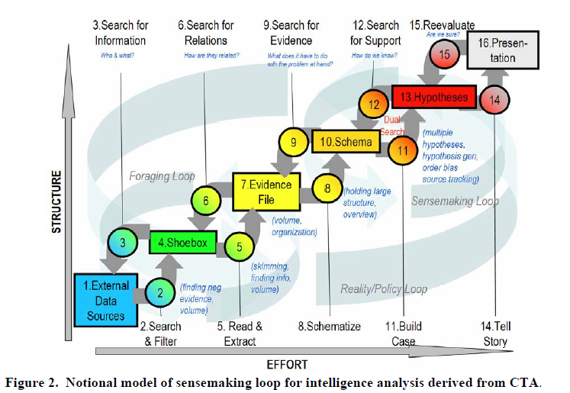
Sensemaking: Intelligence Analysis
Reference: “The Sensemaking Process and Leverage Points for Analyst Technology as Identified Through Cognitive Task Analysis”, Peter Pirolli and Stuart Card, 2005
Notes:
From intelligence analysis – makes complete sense. Their challenge has been to make sense of a ton of subtle signals

Slide 13
Sensemaking
Explanation
Explanatory
Frame
Data
Support
Interdependent relationship
Supports abductive logic
Current systems support sensemaking within a modeled domain. Big Data expands this.
Reference: “A Data-Frame Theory of Sensemaking”, G.A. Klein, et. al.

Slide 14
Key Value Proposition
Available
Data
Model
Traditional
System
Model
Traditional
System
Model
Model
New
System
Model
Key elements of “Big Data” value:
Reducing friction to produce valuable information
Enabling sensemaking over a broader space
Enabling model / algorithm generation

Slide 15
Reworking The Knowledge Hierarchy
Knowledge
Application
Knowledge
Application
Knowledge
Knowledge
Structure / Value
Information
Information
Data
Data
Signal
t →
Time to insight improvement
Effort / Latency

Slide 16
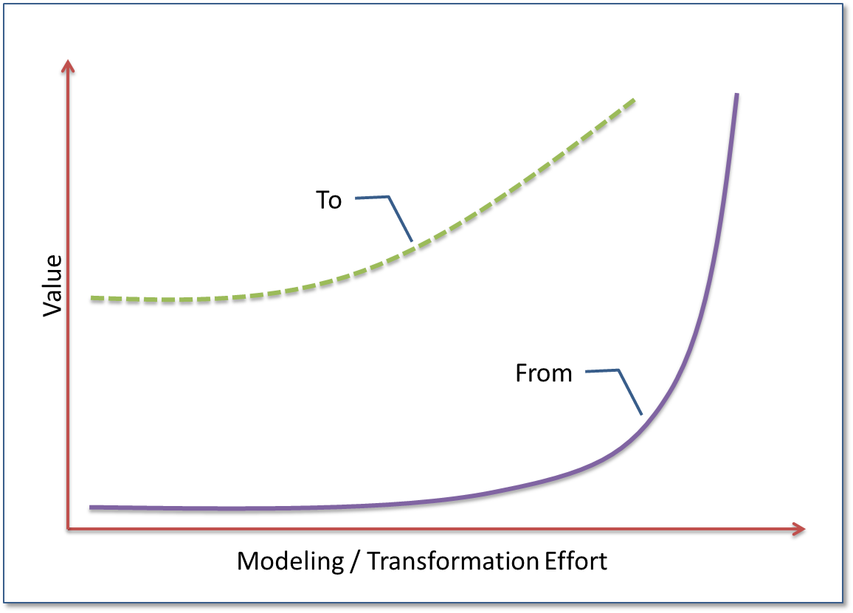
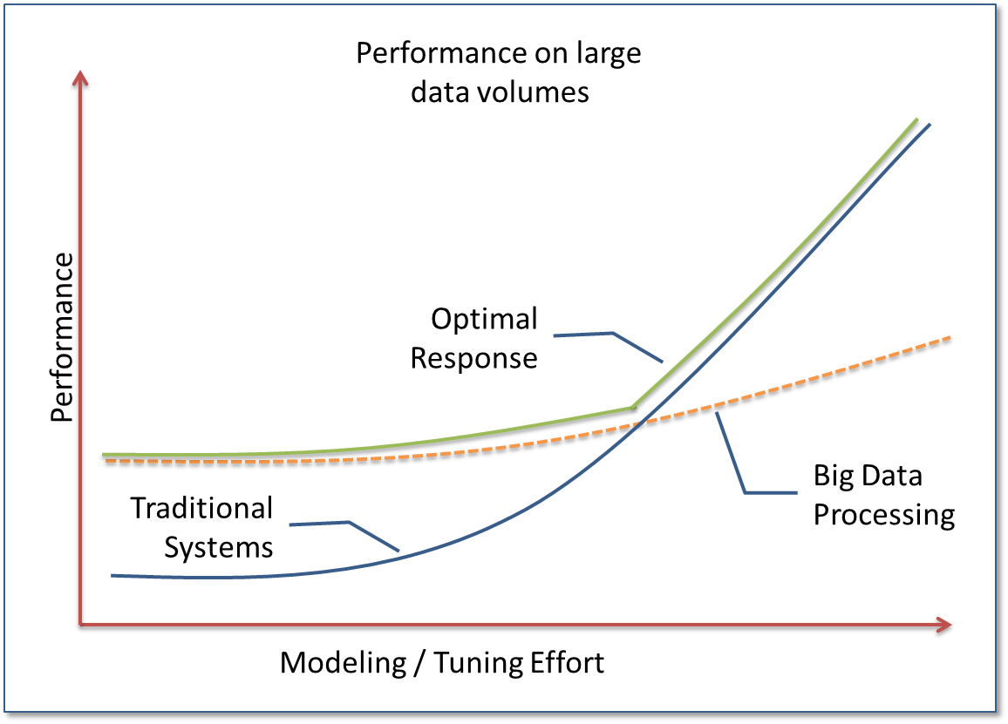
Objective: Change Shape of Two Curves

Slide 17
Emergent Architectural Patterns

Slide 18
Big Data Patterns
Have observed some common patterns
Many appear to occur via independent evolution
Prototyped over personal sources
Patterns:
“Digital Shoebox”
“Information Production”
“Transform & Load”
“Model Development”
“Monitor, Mine, Manage”

Slide 19
Pattern: Digital Shoebox
Intent: Retain ‘all’ ambient data to enable sensemaking over all available signals
Applicability: Use to create a source data pool to bootstrap subsequent information generation
Description:
Enabling Trends:
Cost of data acquisition → $0
Cost of data storage → $0
Tipping point occurs if:
Must keep modeling and storage costs low to achieve this…
Implementation:
Augment raw data with sourceID, and instanceID and retain on inexpensive but reliable storage
$$\left(\frac{perceivedLatentValue}{time}\right)>\left(\frac{cost\left(dataAquisition\right)+cost\left(dataStorage\right)}{time}\right)$$

Slide 20
Pattern: Digital Shoebox
Source Model: The natural model in which the data are produced
Acquisition Model: An augmented source model which contains source identifier and instance (typically timestamp)
AcquisitionModel = {sourceID, instanceID, sourceData}
SourceID
InstanceID
Source
Source
Source
Source
A
1
Source
Source
Source
Source
A
2
Source
A
3
Source
B
1
Source
B
2
Source
B
3
C
1
Source
Source
C
2
Source
Source
C
3
Source
Source

Slide 21
Personal Example
GPS
GPS
GPS
Source
A
1
Source
Outlook
Source
Outlook
A
2
Outlook
A
3
Source
B
1
Source
B
2
Source
B
3
C
1
Source
HA
C
2
Source
HA
C
3
Source
HA
GPS – Have been carrying a GPS data logger for 5 months
HA – Log file from home automation system
Outlook – Have script that produces when I send mail, to whom, and, if a reply, my response latency

Slide 22
Pattern: Information Production
Intent: Turn acquired data from digital shoebox into other events and states
Applicability: Used to transform raw data into information for subsequent processing
Description:
Often requires temporal processing & correlation of acquired data
Key point: Cleansing often much easier in transformed domain
Implementation:
Requires environment for parsing, grouping, aggregation, and often joining of acquired data

Slide 23
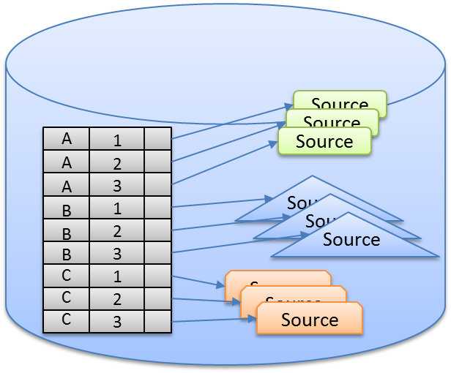
Information Production
Transforms source data into events & states
Data cleanup, cleansing & imputation
Quite often cleansing happens in transformed domain
E.g. Nights on the road vs. @ Home
Wind up with a set of composable transforms
Produced information stored in Digital Shoebox or downstream system
Transform
Transform

Slide 24
Personal Example - GPS
T₃
Tree of transforms and filters
Cleansing often happens in transformed domain
E.g. Where I slept each night…
Can produce higher level information
[DwellAtHome],[RouteToWork], [DwellAtWork] = ‘Commute to work’
Using higher level information:
Commute duration ← f(leavingTime)
T₂
Source
T₁
T₄
T₅

Slide 25
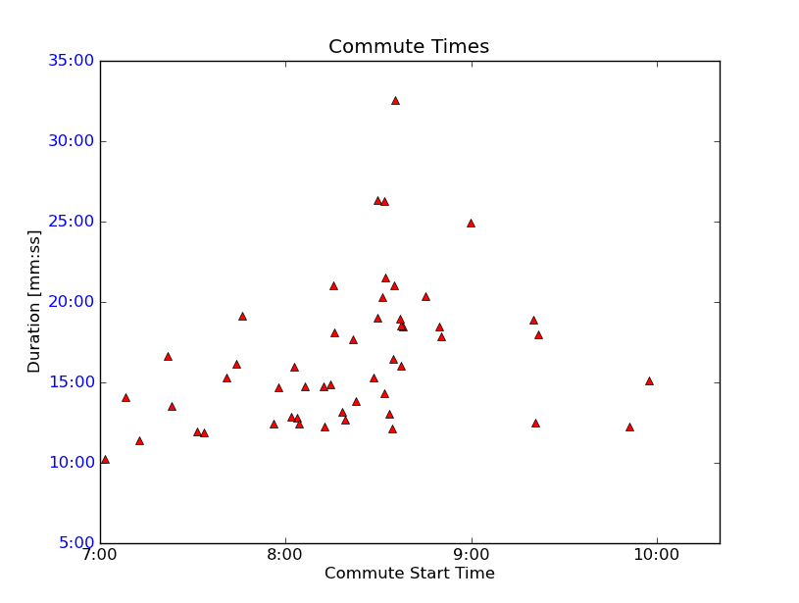
Commute Time as f(leaveTime)

Slide 26
Event & State Correlation
Dwell geolocation
+
2011-06-10 06:18:26, 2011-06-10 06:16:18, 0.04
2011-06-10 06:21:18, 2011-06-09 08:27:50, 21.89
2011-06-10 06:24:37, 2011-06-09 07:43:58, 22.68
2011-06-10 06:26:48, None, 0.00
2011-06-10 06:29:37, 2011-06-09 06:53:34, 23.60
2011-06-10 06:34:41, 2011-06-09 12:00:25, 18.57
2011-06-10 06:39:52, 2011-06-09 17:44:54, 12.92
2011-06-10 06:43:18, 2011-06-09 14:28:49, 16.24
Outlook statistics
=
How much email do I send from home vs. at work?

Slide 27
Pattern: Transform & Load
Intent: Transform acquired data and produced information to load into traditional systems – e.g. Data Warehouse, OLAP cube, etc.
Applicability: Used to load other systems for production use or other analysis
Description:
Transformations and queries over the Digital Shoebox are used to load downstream systems
Jobs can be scheduled or invoked by other systems
Implementation:
Requires repeatable transform mechanism
Adapters to downstream systems
Scheduling mechanism

Slide 28
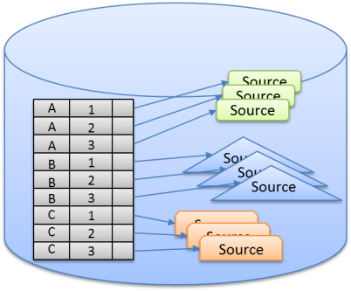
Transform & Load
Information Model
Information Model
Acquisition Model
Information Model
Information Model
Information Model
Data Mart
Data Warehouse
…
CEP System
Notes:
Key points:
How do you store a copy of the web? <ts, url, body>
The digital shoebox lets us restate history. E.g. Detect and filter out noise.
Traditional systems often threw out data as early as possible, making it impossible to go back and reconstruct history

Slide 29
Pattern: Model Development
Intent: Enable “sensemaking” directly over the Digital Shoebox without extensive up front modeling
Applicability: Used to create knowledge from Digital Shoebox contents
Description:
Provide a suite of tools which operate efficiently to enable model discovery, refinement and validation
Implementation:
Requires exploration, visualization, and statistical tools

Slide 30
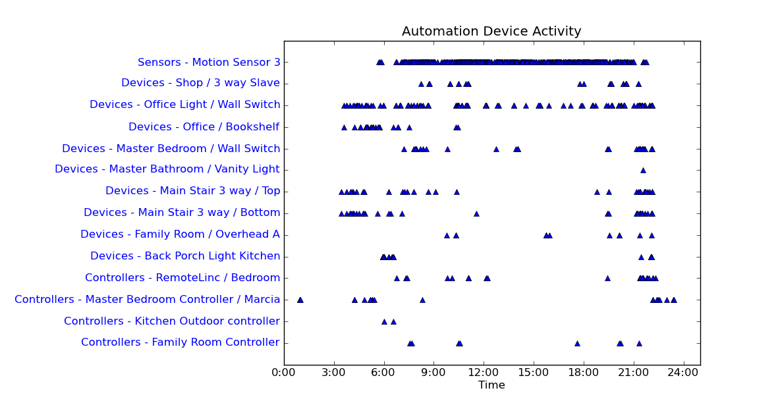
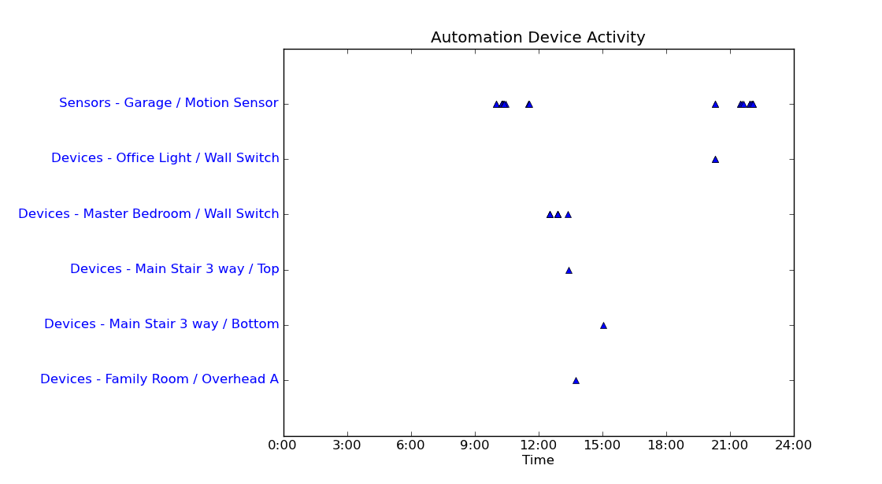
Model Development Example
It’s clear that I’m an “early to be, early to rise”, guy
When not home, only activity is from the pet-sitter & cleaners
Marcia gets up after me and likes to read in bed…

Slide 31
Pattern: Monitor, Mine, Manage
Intent: Develop and use generated models to perform active management or intervention
Applicability: Use for fraud detection, system alerting, intrusion detection, user classification, …
Description:
Historical data is used to develop a model (algorythm) which is installed in active system
Implementation:
Requires model generation pattern, active monitoring system [e.g. Complex Event Processing (CEP)]

Slide 32
Pattern: Monitor, Mine, Manage
2
Monitor & collect data
Mine and create online model
Deploy online model to actively manage
1
This is about reducing “Time to Action”!
3
Examples:
Financial fraud detection and prevention
Audience intelligence
Personal: “Home & Away” settings for home automation

Slide 33
Pattern Map
Digital Shoebox
Model Development
Information Production
Monitor, Mine & Manage
Transform & Load

Slide 34
Tying it Together
Monitor, Mine, Manage
Knowledge
Application
Knowledge
Application
Knowledge
Knowledge
Model Generation
Structure / Value
Information
Information
Data
Data
Transform & Load
Information Production
Signal
Digital Shoebox
t →
Time to Insight
Effort / Latency

Slide 35
R&D Agenda
Improved sensemaking tools:
Visualization
Temporal and spatial correlation
Machine learning
Large “Ambient Data” can eclipse existing methods
E.g. language translation
Robust big-data query processing
Leverage various degrees of structure and modeling
General locality awareness
Checkpoint vs. restart tradeoff
Emergent intermediate structure – infer and reify dimensions
Re-stating history
Re-feed downstream systems sourcing from big-data environment
Re-think slowly changing dimensions

Slide 36
Wrap up
Big Data is multi-faceted
Interesting architecture/design patterns emerging
Realizing new value requires re-thinking existing system assumptions
“Time to insight/action” should be a driving metric
Complements existing data platform
Intersection with HPC/TC world
This is reshaping information management

