Slide 1
Generic Schema Matching, Ten Years Later
Philip A. Bernstein Microsoft Corp.
Jayant Madhavan Google
Erhard Rahm Univ. of Leipzig

Slide 2
The Schema Matching Problem
The problem of generating correspondences between elements of two schemas
BookInfo
Books
ID char(15) key
AuthorID integer references AuthorInfo
BookTitle varchar(150)
ListPrice float
DiscountPrice float
ISBN char(15) key
Title varchar(100)
Author varchar(50)
MarkedPrice float
AuthorInfo
AuthorID integer key
LastName varchar(25)
FirstName varchar(25)

Slide 3
Basic Inputs to Matching Techniques
Element names
Schema structure
Constraints: data type, keys, nullability
BookInfo
ID char(15) key
AuthorID integer references AuthorInfo
BookTitle varchar(150)
ListPrice float
DiscountPrice float
Books
ISBN char(15) key
Title varchar(100)
Author varchar(50)
MarkedPrice float
AuthorInfo
AuthorID integer key
LastName varchar(25)
FirstName varchar(25)

Slide 4
Other Inputs to Basic Matching
Synonyms
Code = Id = Num = No
Zip = Postal [code]
Node = Server
Data instances
Elements match if they have similar instances or value distributions
Acronyms
PO = Purchase Order
UOM = Unit of Measure
SS# = Social Security Number

Slide 5
Many Apps Need Correspondences
Data translation
Data integration
ER design tools
Schema evolution
Object-to-relational mapping
XML message translation
Data warehouse loading (ETL)

Slide 6
Semantics of Correspondences
A correspondence is just a relationship, with no semantics
Correspondences can be directly useful
Schema merging, impact analysis, …
Or they can be semantically enriched
Clio project [Miller et al., VLDB 2000]
Translate correspondences into constraints on instances
Then translate constraints into an executable mapping

Slide 7
Example
π_{ISBN,Title,MarkedPrice}(Books) = π_{ID,BookTitle,ListPrice}(BookInfo)
π_{Author}(Books) = π_{FirstName+LastName}(AuthorInfo)
BookInfo
ID char(15) key
AuthorID integer references AuthorInfo
BookTitle varchar(150)
ListPrice float
DiscountPrice float
Books
ISBN char(15) key
Title varchar(100)
Author varchar(50)
MarkedPrice float
AuthorInfo
AuthorID integer key
LastName varchar(25)
FirstName varchar(25)

Slide 8
Example (continued)
Books
= πID, BookTitle, FirstName+LastName, ListPrice(BookInfo ⋈ AuthorInfo)
BookInfo
ID char(15) key
AuthorID integer references AuthorInfo
BookTitle varchar(150)
ListPrice float
DiscountPrice float
Books
ISBN char(15) key
Title varchar(100)
Author varchar(50)
MarkedPrice float
AuthorInfo
AuthorID integer key
LastName varchar(25)
FirstName varchar(25)

Slide 9
History
1994-98, I worked on Microsoft Repository
[Bernstein et al, “The Microsoft Repository,” VLDB 1997]
I talked to many tool developers
They were all working with models of software artifacts and mappings between them
This led me to propose Model Management
Bulk operators to manipulate models & mappings
Match, Merge, Diff, Compose, Invert, ModelGen, …

Slide 10
Model Management Scenarios
They’re all multi-step
The first step usually generates a mapping: S-map-T
Then merge(S,T), diff(S,T), compose(S′-map-S, S-map-T)
So the Match operator was the place to start.
Survey the literature
Develop new match algorithms
We found existing work on schema matching was embedded in other multi-step solutions

Slide 11
Schema Matching is an Independent Problem
It was one of our contributions
There are now hundreds of papers on the topic
The problem can’t be solved perfectly because
It depends on the available information
It depends on the required accuracy
It depends on the application and usage scenario
So it’s no wonder our paper is highly cited!

Slide 12
Outline
Problem definition
History – what led us to the problem
Summary of our 2001 paper (Jayant Madhavan)
Approaches since 2001 & Future trends (Erhard Rahm)

Slide 13
Generic Schema Matching, Ten Years Later
Jayant Madhavan
Google

Slide 14






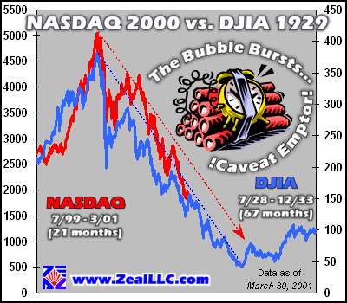


Notes:
We started work on this paper in the summer of 2010. Let

Slide 15
Goals and Contributions
Our original goals
Introduce schema matching as an independent problem and independent component
Provide a credible candidate algorithm and implementation as a basis for future work
Generic: independent of data model and target application
Our contributions
Taxonomy of schema matching algorithms
Schema-based hybrid matching algorithm
Evaluation that compared multiple approaches
Notes:
We we working on schema matching against such a backdrop. When we started, our original goals were to introduce schema matching as an independent problem and as an independent component that could be fitted into a model management system. We wanted to provide a credible candidate implementation that we could reuse in the future. Given the model management angle, the algorithm had to be generic, i.e., as independent of data model and target application as possible.
Besides these technical goals, I was first year graduate student right here in Seattle at the University of Washington. This was my first research project. So, needless to say, I was hoping to do a good job… and well, if things worked out, I’d get a trip to Rome out of it. Nothing like international travel to motivate a new grad student.
In the paper we claimed the contributions to be a taxonomy of schema matching algorithms, our specific schema matching algorithm, and what at that was one of the first side-by-side evaluations of schema matching approaches.
In retrospect too, these did turn out to be contributions.
Erhard is going to come back to the taxonomy. Let me start with an overview of our approach – one that we called Cupid.

Slide 16

Cupid overview
Schema-based hybrid matching algorithm
Combines multiple approaches that use only schema (no instances)
Input: Two schema graphs
Output: Similarity matrix and candidate mapping
Linguistic matching: compare elements based on names
Structure matching: compare elements based on relationships
Wsim = w * Lsim + (1 – w) * Ssim
Not the first to propose either linguistic or structure matching
Notes:
In case you haven’t already figured it out, this is the Match operator we are talking about and Cupid was the match maker.
Using the taxonomy we proposed, Cupid was a schema-based hybrid algorithm, i.e., it combined multiple approaches that in turn based only on schema information (no instances).
Given two schema graphs as input, our goal was to compute a similarity matrix with a similarity value between each pair of elements in the two schemas. An input mapping can be provided as a hint and an output mapping can be generated by selecting high similarity value pairs from the matrix.
The matching proceeded in two phases. First, was a linguistic matching phase, where the elements were compared based on their names. Then, we did a structure matching were the elements were compared based on their context or their relationships to other element. A weighted similarity value was computed a linear combination of the linguistic and structure similarity values.
I should note that the idea of doing linguistic and structure matching was not new and we essentially improved upon some of the related that had been proposed in the literature at that time.

Slide 17
Example from VLDB’01
PO
PurchaseOrder
POLines
Items
POShipTo
DeliverTo
Item
Item
Name
Address
Name
City
Street
Line
ItemNumber
City
Street
UoM
UnitOfMeasure
Qty
Quantity
Notes:
This is a example that I picked out of my VLDB’01 presentation. What we have are two XML schemas for purchase orders: while to human the schemas might appear instantly to be similar, there are differences in naming as well as differences in structure, e.g., Address, that make automatic matching challenging.

Slide 18
Linguistic Matching
Tokenization of names
PurchaseOrder → purchase + order
Expansion of acronyms
UOM → unit + of + measure
Clustering based on keywords and data-types
Street, City, POAddress → Address
Linguistic similarity
Pair-wise comparison of elements that belong to the same cluster
Token similarity = f(string matching, synonymy score)
Token set similarity = average (best matching token similarity)
Thesaurus: acronymns, synonyms, stop words and categories
Notes:
Lets start with linguistic matching: we consider the name of each element in insolation. The names were tokenized based changes in casing and/or punctuations. We expanded out acronyms, and we eliminated stop words. Each of this was done by looking up a thesaurus. Each element name was now a set of tokens. The tokens (and hence the elements) were assigned category labels based on the presence of specific keywords, data types or hierarchical structure. Only elements within the same category were compared. Computing linguistic similarity was now a matter of comparing two sets of tokens, and was achieved by a combination of string similarity measures and thesaurus lookups. The details are in the paper. We used a thesaurus at that time that was hand crafted, and needless to say results were sensitive to some extent on the contents of the thesaurus. There have been a few interesting works since then that focus on effectively using an off-the-shelf thesaurus like WordNet. I would like to bring attention particularly to recent work by Mike Cafarella and others that shows that schemas synonyms can be learned within a domain by analyzing the headers of tables extracted on the web.

Slide 19
Structure Matching
PO
PurchaseOrder
POLines
Items
POShipTo
DeliverTo
Item
Item
Name
Address
Name
City
Street
Line
ItemNumber
City
Street
UoM
UnitOfMeasure
Qty
Quantity
Notes:
Lets now look at structure matching. Assuming the three elements linguistically match, this clearly makes it very likely that Line matches ItemNumber. Similarly, that fact that Name, City and Street match and that Ship is somewhat related linguistically to Deliver, greatly increases the changes that POShipTo matches DeliverTo, albeit the fact that there exists an unmatched internal element Address. These intuitions form the basic for our TreeMatch algorithm.

Slide 20
Tree Match Algorithm
Atomic elements (leaves) are similar
Linguistically and data-type similar
Their contexts, i.e., ancestors, are similar
Compound elements (non-leaves) are similar if
Linguistically similar
Elements in their context, i.e., subtrees rooted at the elements, are similar
Mutually dependent formulation
Leaves determine internal node similarity
Similarity of internal nodes leads to increase in leaf similarity
Bottom-up traversal of trees
Notes:
First, atomic elements are similar if they are linguistically similar and they have compatible data types and that they have contexts, I.e., ancestors that are similar.
Conversely, component elements are similar if they are linguistically similar and they have other elements in their context that are similar, i.e., their subtrees are similar.
This leads to a mutually dependent formulation. Leaves determine internal node similarity, and similarity of internal nodes leads to the increase in leaf similarity.
The tree match algorithm exploits these ideas as it traversals both schemas trees in bottom-up order.

Slide 21
Tree Match: Mutually Reinforcing Similarity
PO
PurchaseOrder
Wsim > th_{high}
POLines
Items
Wsim > th_{high}
Item
Item
Ssim ++
Line
ItemNum
Ssim ++
UoM
UnitofMeasure
Ssim ++
Qty
Quantity
Extensions for shared types, referential integrity, views, etc.
Notes:
When comparing the two item elements, we find that in additional to the name match, there is good matching of leaves in its sub-tree and hence the weighted similarity is higher than a threshold. Subsequently, we bump up inter-leaf similarity by a small amount. The result is that Line is now more likely to match ItemNum. Traversing up the trees, POLines is now even more likely to match Items given the near perfect alignment of its leaves. This information is used to further reinforce the inter-leaf similarity in their subtrees.

Slide 22
Evaluation
Cupid compared with MOMIS/ARTEMIS @ Modena/Milano, DIKE @Calabria
Canonical tasks and real world examples
Technical conclusions
Linguistic matching with attention to detail does help
Structure matching can identify non-linguistic matches
Structure matching can disambiguate between seemingly identical structures in different contexts
Ability to match across relational schemas, XML variants, possibly others
Notes:
We compared the results of our matching with two other systems: the MOMIS/ARTEMIS system from the Universities of Modena and Milano and the Dike system from the University of Calabria. We compared the results produced by each of these systems on canonical and real world examples. Each of the three systems had a notions of linguistic and structure matching, but did so differently. We found that linguistic matching with additional attention to tokenization did help. The structure matching helped to identify non-linguistic matches and to also disambiguate be seemingly identical structured in different contexts, and we found that Cupid was able to certain extent meet our genericity requirement by being able to compare across relational and XML schemas.

Slide 23
What we learned?
Schema Matching Taxonomy
Provided a framework to describe future solutions and place them in comparison to other work
Quantitative evaluation
Set a precedent for future papers
Very thankful to MOMIS/ARTEMIS and DIKE teams
Making software available helps a lot
Possible even when developed in industry
We get requests for software even to this day

Slide 24
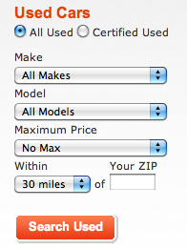
Follow up Techniques
Using schema matching results as is: possible when matches only contribute implicitly end-user task
For example, building a deep-web crawler [Madhavan+, VLDB’08]
Design mediated schema
Extract schemas of web forms
Match web forms to mediated schemas
Generate URLs for interesting subset of form submissions
Add generated pages to the corpus of indexed pages
www.cars.com
Domain Models
Books
Used Cars
Author
Make
ISBN
Model
Price
Price
Year
Location
Notes:
As Phil has mentioned earlier, schema matching results are at best approximate. They need to be manually verifies and cannot to used as is in most traditional data integration applications. However, there are applications where they can be used as is. These tend to be the only those where the matching results contribute only implicitly to an end-user task. Take for example, a deep-web crawler, a crawler that can be used by a search engine to index content behind HTML forms. Such a crawler can be constructed as follows: we design a mediated schema that covers a few domains of interest. We collect webforms in that domain, extract the schemas underlying the webforms and match those schemas against the mediated schema. We can generate URLs corresponding the form submissions using the knowledge in the mediated schema and finally, add the generated pages to the index of a search engine. Now, a search engine user does not know what the matching – since they see only web pages. This is one of the approaches highlights in a VLDB’2008 paper I co-authored.

Slide 25





Collective Schema Matching
Schema matching is almost never an isolated task
It ought to get easier over time!
allcars.com
craigslist auto
[Doan+, SIGMOD’01]: Learn to match sources to a mediated schema
[Do+, ICDE’02]: Compose known matches to discover new ones
Notes:
In 2001, schema matching tended to be a one off operation. But this is rarely so. It is often the case the multiple matching tasks have to be performed over a period of time by a single organization. If this were the case then it ought to get easier over time. This idea was first explored by AnHai Doan and others in SIGMOD’01. Given mappings from multiple source schemas to a single mediated schema, they learned models for elements in the mediated schema and then used it to predict mappings to any other schema that was to be mapped to the mediated schema. In ICDE’02, Hong Hai Do and others showed that mappings can be predicted by composing other known mappings.

Slide 26
Collective Schema Matching
allcars.com
craigslist auto
[He+, SIGMOD’03]: Build mediated schema for a domain by clustering elements in multiple schemas
craigslist auto
[Madhavan+, ICDE’05]: Learn to map between new schemas based on other schemas and mappings in the same domain
Notes:
In SIGMOD’03, Bin He and others showed that given sufficiently large numbers of schemas in a well-defined domain, a mediated schema can be constructed by clustering elements in multiple schemas. Further, in ICDE’05 I and my co-authors were able to schemas that you can predict mappings between new schemas in a domain by leveraging information from other schemas and mappings in that domain. Each of these approaches has pushed the envelope further about how the ability to predict mappings can improve as more schemas and mappings are analyzed within a single domain.

Slide 27
Generic Schema Matching, Ten Years Later
Erhard Rahm
University of Leipzig

Slide 28
Progress in many areas
Match workflows
New match techniques
User interaction for Match
Semantic matching
Match techniques for large schemas
Self-tuning match workflows
Reuse-oriented matching
Holistic (collective) schema matching
Numerous match prototypes
Evaluation of match tools
Commercial tools

Slide 29
Schema matching is a multi-step process
General workflow (COMA, …)
Input
schemas
S1
Combination of matcher results
Pre-processing
Matcher
Execution (sub-workflow)
Selection of correspondences
Result Mapping
S2
Matcher sub-workflows
Matcher1
Matcher
Matcher1
Matcher2
…
Matcher2
Matcher1
Matcher
Matcher3
Matcher
Sequential matchers
Parallel (independent) matchers
Mixed strategy

Slide 30
New match techniques
Graph matching
e.g., similarity flooding [Melnik et al, ICDE 2002]
Instance-based ontology matching
concepts with similar instances should match
consider all instances of a concept as a document and utilize document similarity (e.g., TF/IDF) to find matching concepts
Usage-based matching
utilize query logs for hints about related schema elements (e.g., in join clauses) [Elmeleegy et al., ICDE 2008]
Hamster approach for taxonomy matching [Nandi et al, VLDB 2009]

Slide 31
Instance-based ontology matching
Concepts with most similar instances should match
requires shared/similar instances for most concepts
Mutual treatment of entity resolution (instance matching) and ontology matching
Promising for link discovery in the Linked Open Web of Data
O1
?
O2
?
O1 instances
O2 instances

Slide 32
User interaction for Match
GUI support to inspect and correct computed correspondences [Falconer et al., ISWC 2007]
Incremental schema matching [Bernstein et al., VLDB 2006]
focused matching on user-selected element / subtree
Provision of top-k matches per element for selection
[Gal, J Data Semantics 2006]
Collaborative schema matching using a wiki-like infrastructure to provide and improve mappings
[McCann et al., ICDE 2008]

Slide 33

Semantic matching
Correspondences with semantic relationships equality, more general, less general, disjointness
e.g. PortableComputers Tablets
S-Match [Giunchiglia et al, ESWC 2004]
Discovery of mapping expressions
e.g., room-price = room-rate * (1 + tax-rate)
iMAP [Dhamankar et al., SIGMOD 2004]
Conditional correspondences [Bohannon et al., VLDB 2006]
e.g., if productType = “book” then S1.Invoice.Code =S2.ISBN

Slide 34
Match techniques for large schemas
Low-level optimizations
Optimized string matching
Space-efficient similarity matrices
Database-based matching
Parallel matching
Inter-matcher and intra-matcher parallelism
Partition-based matching (COMA++, Falcon-AO)
Reduced search space by matching only similar schema partitions/fragments
Light-weight search for similar schema fragments

Slide 35
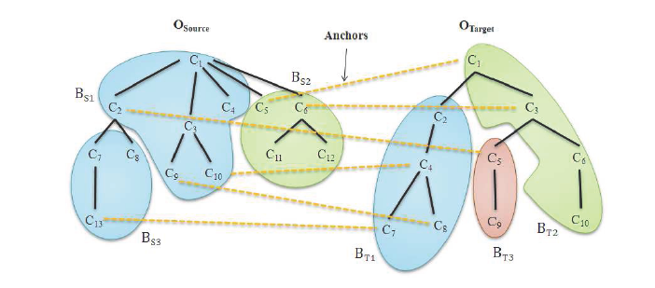
Partition-based matching in FALCON-AO
[Hamdi et al, 2009]
Initially determine highly similar element pairs called “anchors”
Only partitions that share at least one anchor are matched

Slide 36
Self-tuning match workflows
Semi-automatic configuration
Selection of promising matchers
Ordering of different matchers
Combination of match results
Selection of correspondences (top-k, threshold, …)
Initial tuning frameworks: Apfel, eTuner, YAM
Use of supervised machine learning
need previously solved match problems for training
difficult to support large schemas
Heuristic approaches
Use linguistic and structural similarity of input schemas to select matchers and their weights (RiMOM)
Favor matchers giving higher similarity values in the combination of matcher results (QOM, PRIOR+, OpenII)

Slide 37
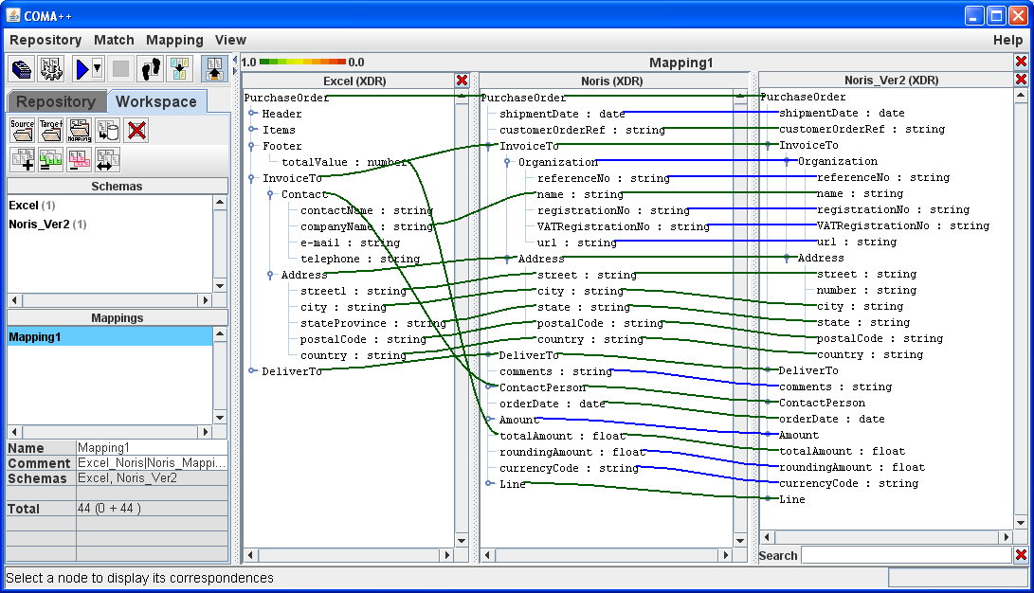
Reuse-oriented Matching
Many similar match tasks → reuse previous matches
Schema and mapping repository needed
Example: reuse match results after schema evolution
compose previous match result S—T with mapping T-T’ to solve new match task S—T’
Schema S
Schema T
Schema T’
POrder Article Payee BillAddress Recipient ShipAddress
Purchase-order Product BillTo Name Address ShipTo Name Address
Contact Name
Address
Purchase-order2 Product BillTo Name Address ShipTo Name Address
ContactPhone
source schema
target schema
Mapping
Excel ↔ Noris
old target
Mapping
Noris ↔ Noris_Ver2

Slide 38
Reuse-oriented Matching (2)
First proposals for reuse at 3 mapping granularities
Reuse complete schema mappings, e.g. after schema evolution
Reuse individual element correspondences, e.g. synonyms
Reuse mappings between schema fragments
Fragment-level reuse most sophisticated
Populate repository by most relevant fragments and their mappings
Analyze schemas to be matched for fragment pairs in the repository
Assemble and complement fragment mappings

Slide 39
Holistic (collective) schema matching
Matching between N schemas, e.g. web forms
mostly simple schemas
Typical use case: creation of a mediated schema
Holistic matching based on clustering of similar attributes (Wise-Integrator, DCM, HSM, …)
utilize high name similarity between schemas
similar names within a schema are mismatches
Probabilistic mediated schemas [Das Sarma et al., SIGMOD 2008]
Ranking of several clustering alternatives based on probabilistic mappings
Fully automatic approach

Slide 40
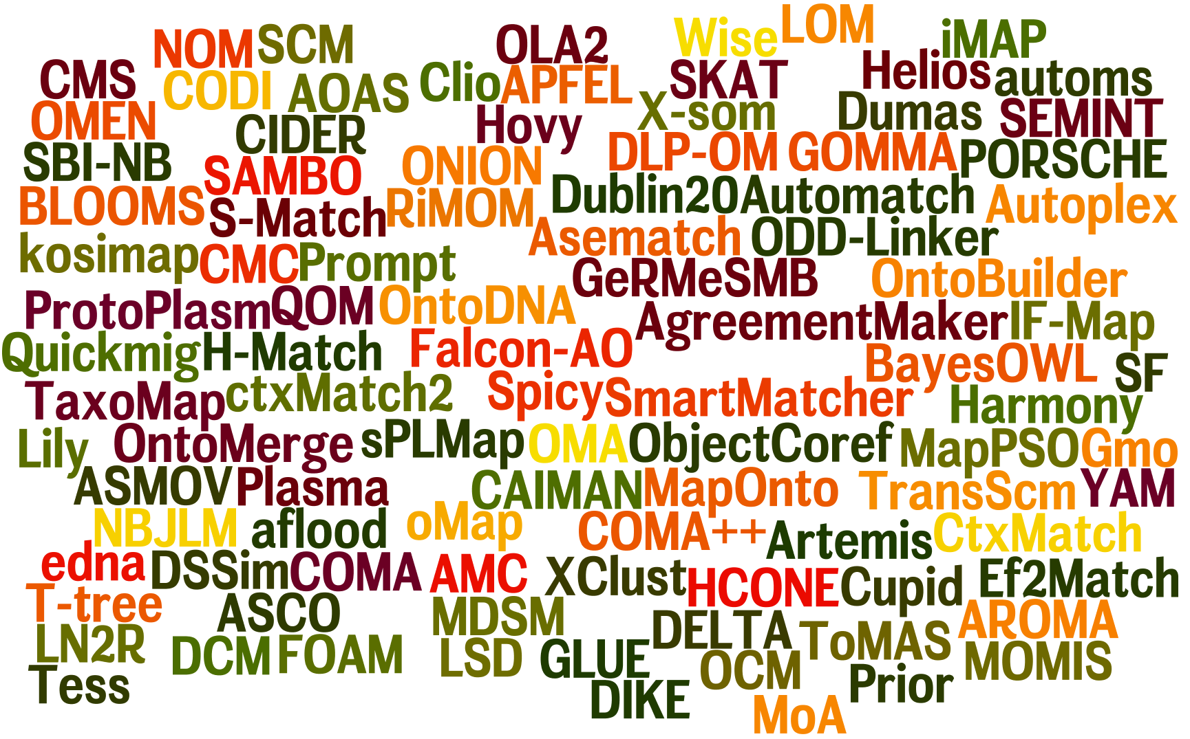
Research match prototypes

Slide 41
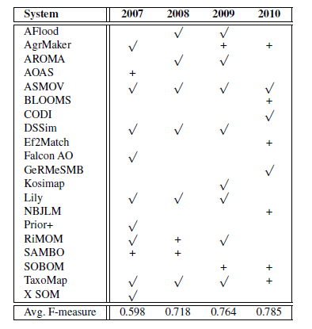
Benchmarking Initiative OAEI*
Yearly ontology matching contests since 2005
Up to 17 participating systems per year
Simple tests (Benchmark) a and larger test cases (Anatomy, Directory)
Improvements for Benchmark and Anatomy, but not for Directory
[Euzenat et al, OM 2010]
Anatomy test case
Ontology Alignment Evaluation Initiative, http://oaei.ontologymatching.org

Slide 42
Match Prototype Comparison*
*Rahm, E.: Towards large-scale schema and ontology matching. In: Schema Matching and Mapping, Springer-Verlag, 2011

Slide 43
Commercial schema matching tools
Many GUI-based mapping editors to manually specify correspondences and mappings
Initial support for automatic matching, in partiular linguistic matching
Altova MapForce
MS BizTalk Server 2010
SAP Netweaver
IBM Infosphere
Many further improvements possible
Structural / instance-based matching
Advanced techniques for large schemas

Slide 44
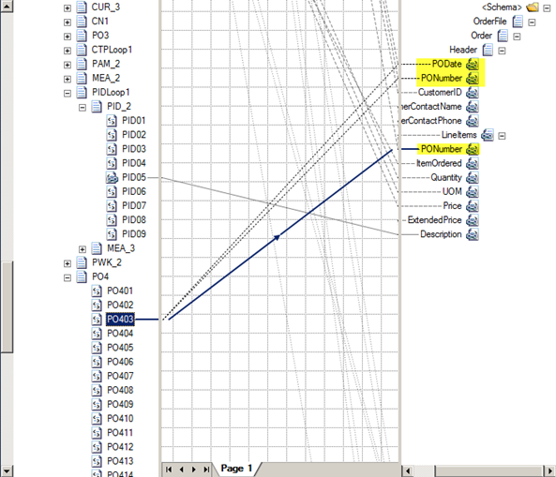
BizTalk 2010 Screenshot
Indicative match result for selected node PO403

Slide 45
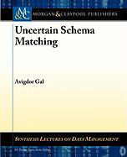
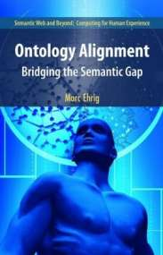

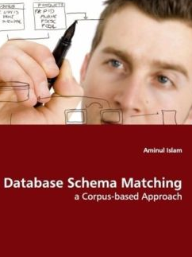
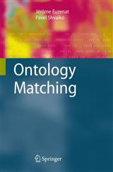
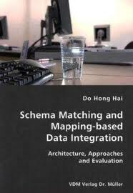
Books

Slide 46
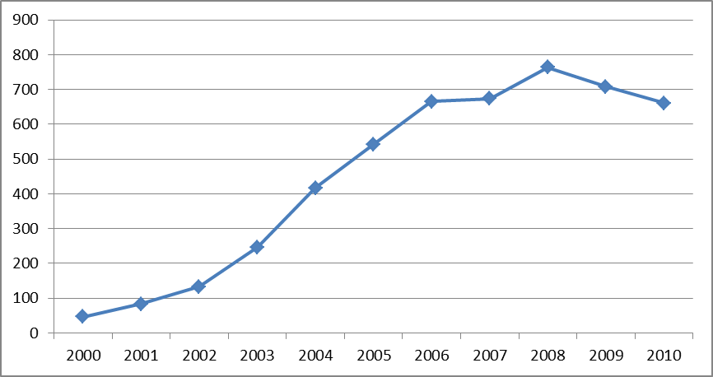
Google Scholar: Paper counts
more than 5000 publications for keyword “schema matching” since year 2000
Pubs per year

Slide 47
Remaining research challenges (1)
Joint treatment of entity resolution and schema matching, e.g. for Linked Data
More comprehensive mapping reuse
Self-Tuning
Improvements for
user interaction
Large-scale schema matching
Semantic matching
Holistic/collective schema matching …

Slide 48
Remaining research challenges (2)
Fully automatic schema matching for web applications
More match-based approaches for
Ontology/schema merging
Ontology/schema evolution
…

