Slide 1
Web Scale Taxonomy Cleansing
Taesung Lee, Zhongyuan Wang, Haixun Wang, Seung-won Hwang
VLDB 2011

Slide 2
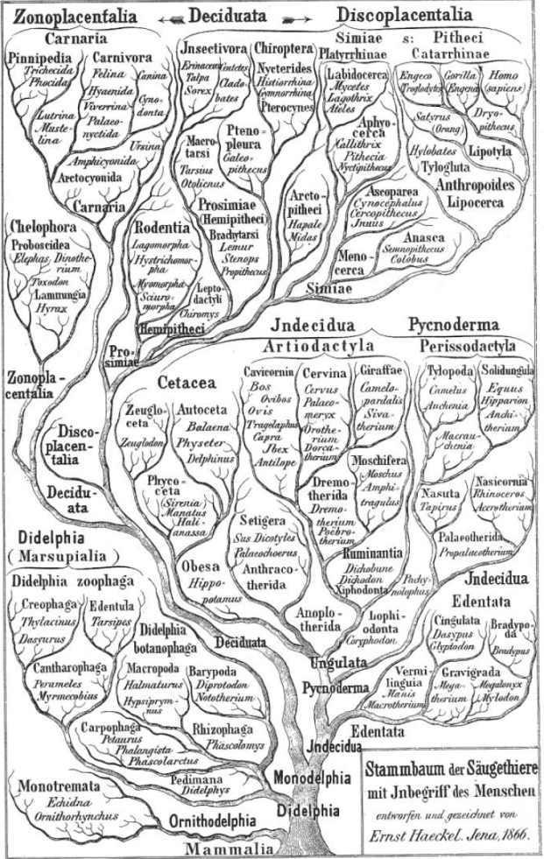
Knowledge
Taxonomy
  Manually built
    e.g. Freebase
  Automatically generated
    e.g. Yago, Probase
  Probase: a project at MSR
  http://research.microsoft.com/probase/

Slide 3
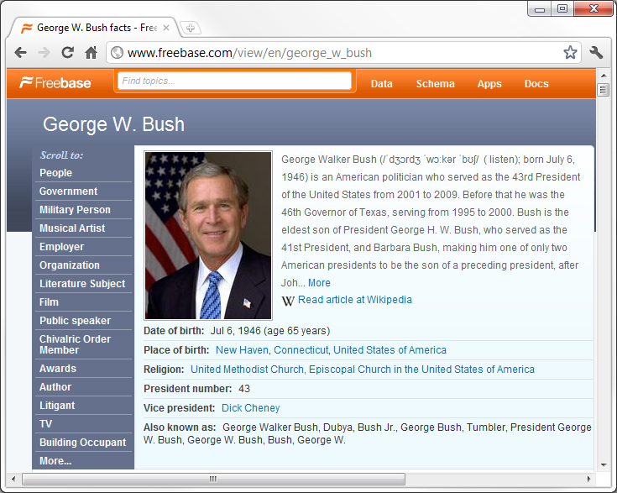
Freebase
A knowledge base built by community contributions
Unique ID for each real world entity
Rich entity level information

Slide 4
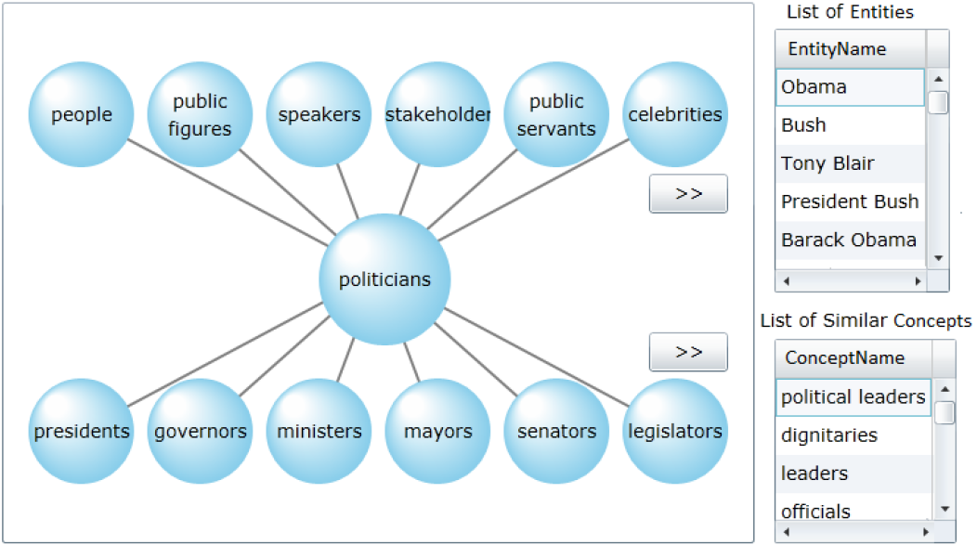
Probase, the Web Scale Taxonomy
Automatically generated from Web data
Rich hierarchy of millions of concepts (categories)
Probabilistic knowledge base
people
politicians
George W. Bush, 0.0117
Bill Clinton, 0.0106
George H. W. Bush, 0.0063
Hillary Clinton, 0.0054
presidents
Bill Clinton, 0.057
George H. W. Bush, 0.021
George W. Bush, 0.019

Slide 5
Characteristics of Automatically Harvested Taxonomies
Web scale
  Probase has 2.7 millions categories
  Probase has 16 million entities and Freebase has 13 million entities.
Noises and inconsistencies
  US Presidents: {…George H. W. Bush, George W. Bush, Dubya, President Bush, G. W. Bush Jr.,…}
Little context
  Probase didn’t have attribute values for entities
  E.g. we have no information such as birthday, political party, religious belief for “George H. W. Bush”

Slide 6
Leverage Freebase to
Clean and Enrich Probase
 | Freebase | Probase
How is it built? | manual | automatic
Data model | deterministic | Probabilistic
Taxonomy topology | Mostly tree | DAG
# of concepts | 12.7 thousand | 2 million
# of entities (instances) | 13 million | 16 million
Information about entity | rich | Sparse
adoption | Widely used | New

Slide 7
Why we do not bootstrap from freebase
Probase try to capture concepts in our mental world
  Freebase only has 12.7 thousand concepts/categories
  For those concepts in Freebase we can also easily acquire
  The key challenge is how can we capture tail concepts automatically with high precision
Probase try to quantify uncertainty
  Freebase treats facts as black or white
  A large part of Freebase instances(over two million instances) are distributed in a few very popular concepts like “track” and “book”
How can we get better one?
  Cleansing and enriching Probase by mapping its instances to Freebase!

Slide 8
How Can We Attack the Problem?
Entity resolution on the union of Probase & Freebase
Simple String Similarity?
George W. Bush
George H. W. Bush
  Jaccard Similarity = ¾
George W. Bush
Dubya
  Jaccard Similarity = 0
Many other learnable string similarity measures are also not free from these kind of problems

Slide 9
How Can We Attack the Problem?
Attribute-based Entity Resolution
Naïve Relational Entity Resolution
Collective Entity Resolution
Unfortunately, Probase did not have rich entity level information
OK. Let’s use external knowledge

Slide 10
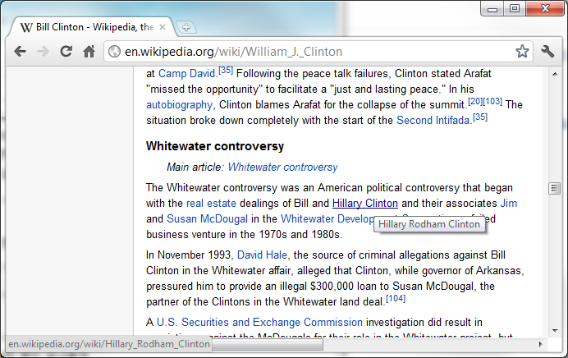
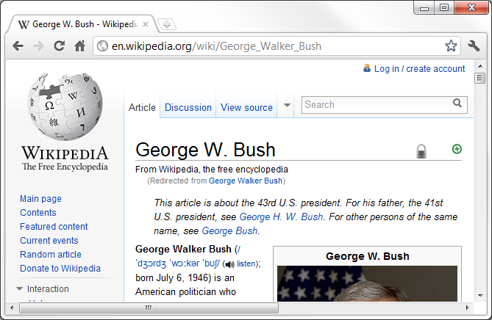
Positive Evidence
To handle nickname case
  Ex) George W. Bush – Dubya
  Synonym pairs from known sources – [Silviu Cucerzan, EMNLP-CoNLL 2007, …]
    Wikipedia Redirects
    Wikipedia Internal Links – [[ George W. Bush | Dubya ]]
    Wikipedia Disambiguation Page
    Patterns such as ‘whose nickname is’, ‘also known as’

Slide 11
What If Just Positive Evidence?
Wikipedia does not have everything.
  typo/misspelling
    Hillery Clinton
  Too many possible variations
    Former President George W. Bush

Slide 12
What If Just Positive Evidence?
(George W. Bush = President Bush)
+ (President Bush = George H. W. Bush)
= ?
Entity Similarity Graph
Dubya
George W. Bush
President Bush
Bush
Bush Sr.
George H. W. Bush

Slide 13
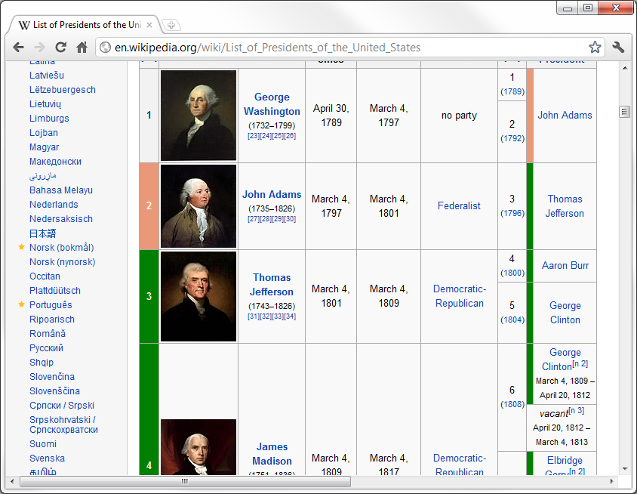
Negative Evidence
Dubya
What if we know they are different?
It is possible to…
  stop transitivity at the right place
  safely utilize string similarity
  remove false positive evidence
‘Clean data has no duplicates’ Principle
  The same entity would not be mentioned in a list of instances several times in different forms
  We assume these are clean:
    ‘List of ***’, ‘Table of ***’
    such as …
    Freebase
George W. Bush
Different!
President Bush
Bush
Bush Sr.
George H. W. Bush

Slide 14
Two Types of Evidence in Action
Instance Pair Space
[Evidence]
Wikipedia Disambiguation Page
Correct Matching Pairs
[Evidence]
Wikipedia Redirect Page
[Evidence]
String Similarity
Negative Evidence
[Evidence]
Wikilinks
Negative Evidence

Slide 15
Scalability Issue
Large number of entities
Simple string similarity (Jaro-Winkler) implemented in C# can process 100K pairs in one second
More than 60 years for all pairs!
 | Freebase | Probase | Freebase * Probase
# of concepts | 12.7 thousand | 2 million | 25.4 * 10⁹
# of entities (instances) | 13 million | 16 million | 208 * 10¹²

Slide 16
Scalability Issue
‘Birds of a Feather’ Principle
  Michael Jordan the professor - Michael Jordan the basketball player
    may have only few friends in common
  We only need to compare instances in a pair of related concepts;
    High # of overlapping instances
    High # of shared attributes
Computer Scientists
Basketball players
Athletes

Slide 17

With a Pair of Concepts
Building a graph of entities
  Quantifying positive evidence for edge weight
  Noisy-or model
    Using All kinds of positive evidence including string similarity
0.9
Dubya
George W. Bush
0.6
0.9
President Bill Clinton
0.6
0.8
0.6
President Bush
Bill Clinton
Bush
0.4
0.3
Hillary Clinton
George H. W. Bush

Slide 18
Multi-Multiway Cut Problem
Multi-Multiway Cut problem on a graph of entities
  A variant of s-t cut
  No vertices with the same label may belong to one connected component (cluster)
    {George W. Bush, President Bill Clinton, George H. W. Bush},
    {George W. Bush, Bill Clinton, Hillary Clinton}, …
  The cost function: the sum of removed edge weights
Multiway cut
Our case
0.9
Dubya
0.9
Dubya
George W. Bush
George W. Bush
0.6
0.9
President Bill Clinton
0.6
0.9
President Bill Clinton
0.6
0.8
0.6
0.8
0.6
President Bush
Bill Clinton
0.6
President Bush
Bill Clinton
Bush
0.4
Bush
0.4
0.3
Hillary Clinton
0.3
Hillary Clinton
George H. W. Bush
George H. W. Bush

Slide 19
Our method
Monte Carlo heuristics algorithm:
  Step 1: Randomly insert one edge at a time with probability proportional to the weight of edge
  Step 2: Skip an edge if it violates any piece of negative evidence
We repeat the random process several times, and then choose the best one that minimize the cost

Slide 20
0.9
Dubya
George W. Bush
0.9
President Bill Clinton
0.6
0.6
0.6
President Bush
Bush
0.4
0.3
0.5
George H. W. Bush
Bush Sr.
1.0

Slide 21
0.9
Dubya
George W. Bush
0.9
President Bill Clinton
0.6
0.6
0.6
President Bush
Bush
0.4
0.3
0.5
George H. W. Bush
Bush Sr.
1.0

Slide 22
0.9
Dubya
George W. Bush
0.9
President Bill Clinton
0.6
0.6
0.6
President Bush
Bush
0.4
0.3
0.5
George H. W. Bush
Bush Sr.
1.0

Slide 23
0.9
Dubya
George W. Bush
0.9
President Bill Clinton
0.6
0.6
0.6
President Bush
Bush
0.4
0.3
0.5
George H. W. Bush
Bush Sr.
1.0

Slide 24
0.9
Dubya
George W. Bush
0.9
President Bill Clinton
0.6
0.6
President Bush
Bush
0.4
0.3
0.5
George H. W. Bush
Bush Sr.
1.0

Slide 25
0.9
Dubya
George W. Bush
0.9
President Bill Clinton
0.6
0.6
President Bush
Bush
0.4
0.3
0.5
George H. W. Bush
Bush Sr.
1.0

Slide 26
0.9
Dubya
George W. Bush
0.9
President Bill Clinton
0.6
0.6
President Bush
Bush
George H. W. Bush
Bush Sr.
1.0

Slide 27
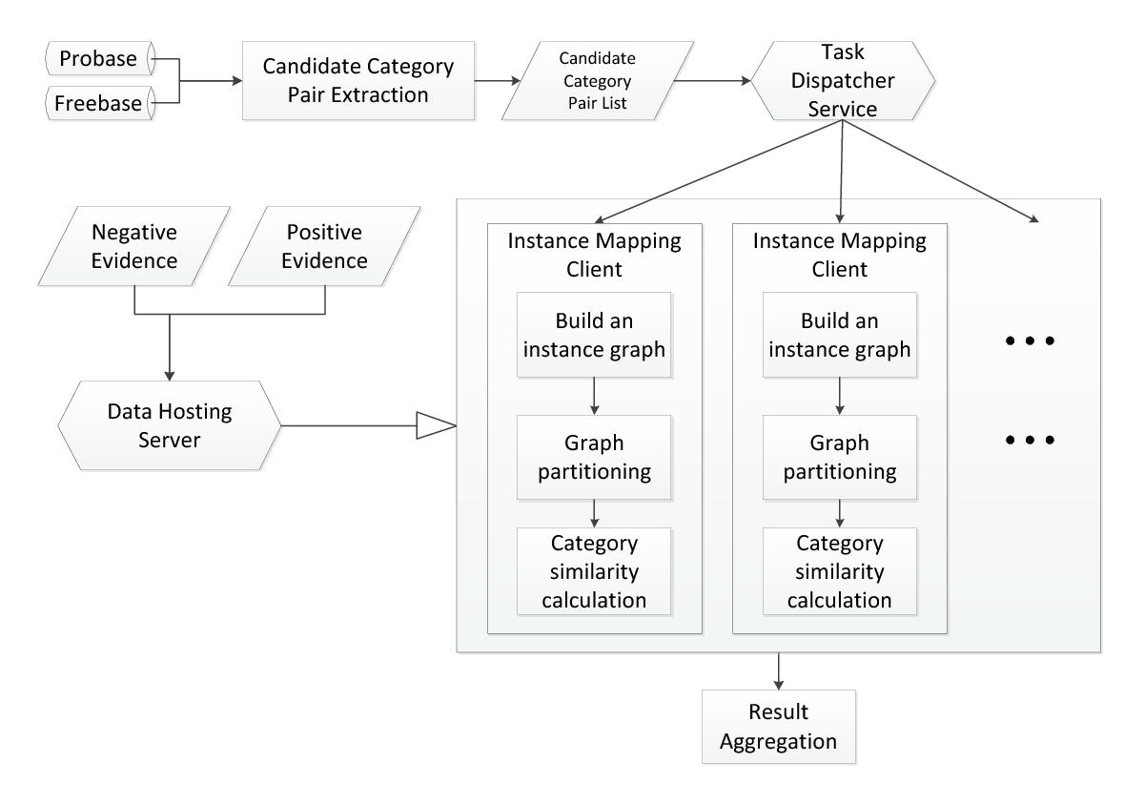
Experimental Setting
Probase: 16M instances / 2M concepts
Freebase (2010-10-14 dump): 13M instances / 12.7K concepts
Positive Evidence
  String similarity: Weighted Jaccard Similarity
  Wikipedia Links: 12,662,226
  Wikipedia Redirect: 4,260,412
  Disambiguation Pages: 223,171
Negative Evidence (# name bags)
  Wikipedia List: 122,615
  Wikipedia Table: 102,731
  Freebase

Slide 28
Experimental Setting
Baseline #1
  Positive evidence (without string similarity) based method.
  Maps two instances with the strongest positive evidence.
  If there is no evidence, not mapped.
Baseline #2
  String similarity based method.
  Maps two instances if the string similarity, here Jaro-Winkler distance, is above a threshold (0.9 to get comparable precision).
Baseline #3
  Markov Clustering with our similarity graphs
  The best method among the scalable clustering methods for entity resolution introduced in [Hassanzadeh, VLDB2009]

Slide 29
Some Examples of Mapped Probase Instances
Freebase Instance | Baseline #1 | Baseline #2 | Baseline #3 | Our Method
George W. Bush | George W. Bush, President George W. Bush, Dubya | George W. Bush | George W. Bush, President George W. Bush, George H. W. Bush, George Bush Sr., Dubya | George W. Bush, President George W. Bush, Dubya, Former President George W. Bush
American Airlines | American Airlines, American Airline, AA, Hawaiian Airlines | American Airlines, American Airline | American Airlines, American Airline, AA, North American Airlines | American Airlines, American Airline, AA
John Kerry | John Kerry, Sen. John Kerry, Senator Kerry | John Kerry | John Kerry, Senator Kerry | John Kerry, Sen. John Kerry, Senator Kerry, Massachusetts Sen. John Kerry, Sen. John Kerry of Massachusetts

Slide 30
More Examples
* Baseline #3 (Markov Clustering) clustered and mapped all related Barack Obama instances to Ricardo Mangue Obama Nfubea by wrong transitivity of clustering
Freebase Instance | Baseline #1 | Baseline #2 | Baseline #3 | Our Method
Barack Obama | Barack Obama, Barrack Obama, Senator Barack Obama | Barack Obama, Barrack Obama | None * | Barack Obama, Barrack Obama, Senator Barack Obama, US President Barack Obama, Mr Obama
mp3 | mp3, mp3s, mp3 files, mp3 format | mp3, mp3s | mp3, mp3 files, mp3 format | mp3, mp3s, mp3 files, mp3 format, high-quality mp3

Slide 31
Precision / Recall
Probase Class | Politicians |  | Foramts |  | Systems |  | Airline
Freebase Type | /government /politician |  | /computer /file_format |  | /computer /operating_system |  | /aviation /airline
 | Precision | Recall | Precision | Recall | Precision | Recall | Precision | Recall
Baseline #1 | 0.99 | 0.66 | 0.90 | 0.25 | 0.90 | 0.37 | 0.92 | 0.63
Baseline #2 | 0.97 | 0.31 | 0.79 | 0.27 | 0.59 | 0.26 | 0.96 | 0.47
Baseline #3 | 0.88 | 0.63 | 0.82 | 0.48 | 0.88 | 0.52 | 0.96 | 0.54
Our method | 0.98 | 0.84 | 0.93 | 0.86 | 0.91 | 0.59 | 1.00 | 0.70

Slide 32
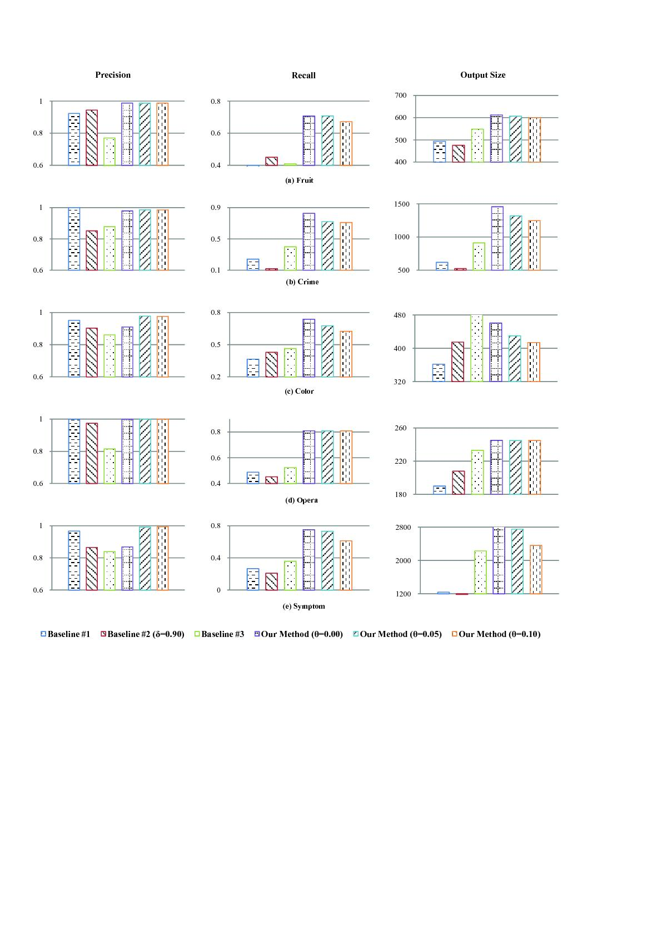
More Results

Slide 33
More Results

Slide 34
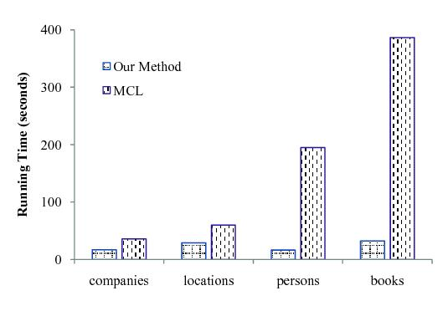
Scalability
Our method (in C#) is compared with
Baseline #3 (Markov Clustering, in C)
Category | |V| | |E|
Companies | 662,029 | 110,313
Locations | 964,665 | 118,405
Persons | 1,847,907 | 81,464
Books | 2,443,573 | 205,513

Slide 35
Summary & Conclusion
A novel way to extract and use negative evidence is introduced
Highly effective and efficient entity resolution method for large automatically generated taxonomy is introduced
The method is applied and tested on two large knowledge bases for entity resolution and merger

Slide 36
References
[Hassanzadeh, VLDB2009]
O. Hassanzadeh, F. Chiang, H. C. Lee, and R. J. Miller. Framework for evaluating clustering algorithms in duplicate detection. PVLDB, pages 1282–1293, 2009.
[Silviu Cucerzan, EMNLP-CoNLL 2007, …]
Large Scale Named Entity Disambiguation Based on Wikipedia Data, EMNLP-CoNLL Joint Conference, Prague, 2007
R. Bunescu. Using encyclopedic knowledge for named entity disambiguation, In EACL, pages 9-16, 2006
X. Han and J. Zhao. Named entity disambiguation by leveraging wikipedia semantic knowledge. In CIKM, pages 215-224, 2009
[Sugato Basu, KDD04]
S. Basu, M. Bilenko, and R. J. Mooney. A probabilistic framework for semi-supervised clustering. In SIGKDD, pages 59–68, 2004.
[Dahlhaus, E., SIAM J. Comput’94]
E. Dahlhaus, D. S. Johnson, C. H. Papadimitriou, P. D. Seymour, and M. Yannakakis. The complexity of multiterminal cuts. SIAM J. Comput., 23:864–894, 1994.
For more references, please refer to the paper. Thanks.

Slide 37
~Thank You~
Get more information from:

