Slide 1


VLDB'11
Databases will visualize queries too
Wolfgang Gatterbauer
University of Washington
Database Group
http://queryviz.com
Notes:
* This talk argues that (developing approaches and building systems) that transform exsting Q into appropriate graphical repr can help user in composing new queries
* Why that?

Slide 2
Two Interactions between Users and Queries
Intent: Find...
essential for Query Browse and Re-use
hard
SQL
Query Interpretation
SELECT A FROM R
WHERE B not in
(SELECT D
FROM S)
Query Composition
Recent work on Query Management: Idea: Re-use and adapt existing queries
Problem: Query Interpretation is hard too!
CQMS
Khoussainova et al. [CIDR’09]
even used for testing purposes, e.g., on www.gradiance.com
SQL QuerIE
Chatzopoulou et al. [SSDBM’09]
SQLshare
Howe, Cole [MS eSc WS’10]
DBease
Li et al. [CIDR’11]
Notes:
* QC is the process by which users transform their intent into an appropriate SQL query
* called query specificationby by Nandi (guided interaction), and also argued that hard / hard can also mean just takes time, more than one would wish for (Nandi & Jagadish)
* To speed-up, facilitate, several systems proposed, that fall into QM / basic idea: leverage an existing log of queries / reason is that starting from existing templates makes live easier
* requires that users understand what queries do / hard; code understanding, to extend that reverse used for testing

Slide 3
Browsing and Understanding existing Queries
select distinct a3.fname, a3.lname
from Actor a0, Casts c0, Casts c1, Casts c2, Casts c3,
Actor a3
where a0.fname = 'Kevin' and a0.lname = 'Bacon'
and c0.pid = a0.id and c0.mid = c1.mid
and c1.pid = c2.pid and c2.mid = c3.mid
and c3.pid = a3.id
and not exists (select xc1.pid
from Actor xa0, Casts xc0, Casts xc1
where xa0.fname = 'Kevin' and xa0.lname = 'Bacon'
and xa0.id = xc0.pid and xc0.mid = xc1.mid
and xc1.pid = a3.id)
and not exists (select ya0.id
from Actor ya0
where ya0.fname = 'Kevin' and ya0.lname = 'Bacon’)
select W1.wid
from Worlds W1
where not exists
(select *
from Worlds W2
where W2.wid < W1.wid
and not exists
(select *
from Worlds W3
where W3.wid = W1.wid
and not exists
(select *
from Worlds W4
where W4.wid = W2.wid
and W4.tid = W3.tid)))
select F1.person
from Frequents F1
where not exists
(select F2.bar
from Frequents F2
where F2.person = F1.person
and not exists
(select S3.drink
from Serves S3, Likes L4
where L4.person = F1.person
and L4.drink = S3.drink
and S3.bar = F2.bar))
select S.sname
from Sailors S
where not exists
(select B.bid
from Boats B
where not exists
(select R.bid
from Reserves R
where R.bid = B.bid
and R.sid = S.sid))
select Team, Day
from Scores S1
where not exists
(select *
from Scores S2
where S1.Runs = S2.Runs
and (S1.Team <> S2.Team
or S1.Day <> S2.Day))
Notes:
* Bacon #2 / * What if we supplement/accompany with an appropriate visual representation (succinct summary)

Slide 4
Query Visualization can help
select distinct a3.fname, a3.lname
from Actor a0, Casts c0, Casts c1, Casts c2, Casts c3,
Actor a3
where a0.fname = 'Kevin' and a0.lname = 'Bacon'
and c0.pid = a0.id and c0.mid = c1.mid
and c1.pid = c2.pid and c2.mid = c3.mid
and c3.pid = a3.id
and not exists (select xc1.pid
from Actor xa0, Casts xc0, Casts xc1
where xa0.fname = 'Kevin' and xa0.lname = 'Bacon'
and xa0.id = xc0.pid and xc0.mid = xc1.mid
and xc1.pid = a3.id)
and not exists (select ya0.id
from Actor ya0
where ya0.fname = 'Kevin' and ya0.lname = 'Bacon’)
select W1.wid
from Worlds W1
where not exists
(select *
from Worlds W2
where W2.wid < W1.wid
and not exists
(select *
from Worlds W3
where W3.wid = W1.wid
and not exists
(select *
from Worlds W4
where W4.wid = W2.wid
and W4.tid = W3.tid)))
select F1.person
from Frequents F1
where not exists
(select F2.bar
from Frequents F2
where F2.person = F1.person
and not exists
(select S3.drink
from Serves S3, Likes L4
where L4.person = F1.person
and L4.drink = S3.drink
and S3.bar = F2.bar))
select S.sname
from Sailors S
where not exists
(select B.bid
from Boats B
where not exists
(select R.bid
from Reserves R
where R.bid = B.bid
and R.sid = S.sid))
Casts
Casts
Casts
Casts
Actor
select Team, Day
from Scores S1
where not exists
(select *
from Scores S2
where S1.Runs = S2.Runs
and (S1.Team <> S2.Team
or S1.Day <> S2.Day))
pid
pid
pid
pid
id
mid
mid
mid
mid
fname='Kevin'
W
lname='Bacon'
select
select
Frequents
Scores
Scores
Frequents
Serves
Actor
Casts
Casts
Actor
wid
SELECT
id
pid
pid
id
person
person
person
bar
select
Team
W
Team
Reserves
Team
W
select
fname
Sailors
fname='Kevin'
Boats
fname
mid
mid
>
bar
drink
lname
lname
lname='Bacon'
wid
wid
Day
wid
Day
bid
Day
name
name
bid
tid
Runs
Likes
W
Runs
sid
sid
person
Actor
wid
id
drink
fname='Kevin'
tid
lname='Bacon'
Notes:
* Note that visualization includes the schema / * Bacon #2
* Vis not only possible approach

Slide 5
Four principal ways for Query Interpretation
with SQL
1
Manipulate SQL text
e.g., syntactic highlighting
e.g., aligning query blocks
How to facilitate
SQL query interpretation?
represent other than query
2
Show query results
e.g., example data results, related to
as combination of input / output / query?
Olston et al. [Sigmod’09]
w/o SQL
in NL
Ioannidis et al. [NLDB’08] [CIDR'00, ICDE'10]
3
Translate into NL text
represent query
as visual
4
Visualize Query
http://queryviz.com
in a different query language ?
into music ?
as ???
Notes:
* make SQL as readable as possible / * Olston: study the problem of generating example intermediate data that quickly illustrates the semantics of the operators in data flow programs to users.
* What sets QV apart from other 3: there is a diff and this difference has to do with the speed by which we humans can make sense of the information presented / and remember previously seen information

Slide 6
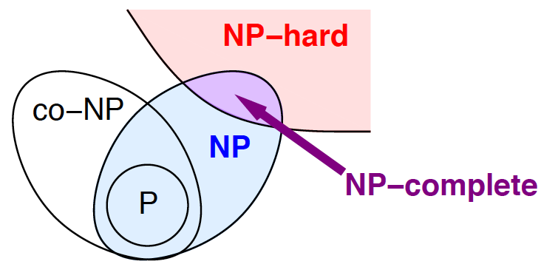
"One picture > 1000 words"
Text
Visual
"... P is the set of problems that can be solved quickly... NP is the set of decision problems where we can verify a YES answer quickly if we have the solution in front of us... A problem is NP-hard if a polynomial-time algorithm for would imply a polynomial-time algorithm for every problem in NP... a problem is NP-complete if it is both NP-hard and an element of NP."
"...what we think the world looks like" according to
Erickson [lecture notes’09]
Notes:
* memorizability / recognition of previously seen patterns / especially true for logical constructs, relations between objects (think Venn diagrams)
* nothing new

Slide 7
Query Visualization vs. Visual Query Languages
easy
hard
Target to Visualize
Data
Queries
User Action
Interpret
(Read)
Information Visualization
Query
Visualization
Compose
(Write)
Visual Query Languages
_______________
Recent focus in DB
Lot of past work, see e.g. survey
Catarci et al. [J. Vis. Lang. Comput.’97]
Notes:
* gotten some recent track by the DB community * fundemental asymmetry in the bandwidth, chanel capacity / Many Eyes by IBM / Hans Rosling visualization of statistics at TED conferences
* user interaction is quite cumbersome: interactively construct visual constructs / * connect graphical elements
* What is the reason of me showing you visuals instead of bullet points on PPT / Well, because visuals help get the message through more easily / That doesn't mean that it took me less time to prepare / And that's why visual composition is hard
* one thesis of this talk is why VQL have not found widespread adoption: VQL require a sequential composition of a query.
* 1 picture says more than 1000 words, but creating a picture, needs 1000 hand strokes

Slide 8
The Challenge
Find the appropriate visual alphabet which
(i) allows users to quickly understand a query's intent,
(ii) can be easily learned by users, and
(iii) can express a large fraction of SQL.
goal
Additionally, find
(iv) automatic translations from SQL to the visualization.
Notes:
*. goal & challenge is that of language development / user interface design
* including a visually-appealing automatic arrangement of nodes of the visualization.
* Next: our solution / Jonathan / upfront: do not try to parse everything

Slide 9
... logical correspondence
... digrammatic reasoning, reading order, inside/outside
... start from existing known stuff
... ambiguity example
... online test & grammar
... grouping example / disjunctions

Slide 10
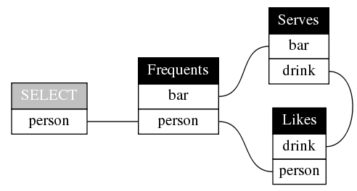
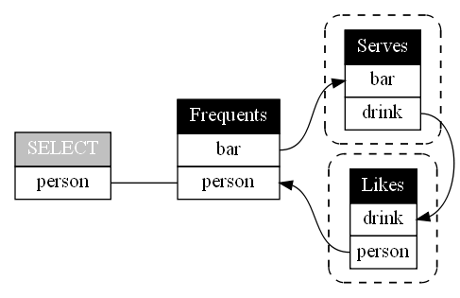
Incremental Complexity
Design decision: start from known visual metaphors for CQs; gradually generalize
Likes(person, drink)
Frequents(person, bar)
Serves(bar, drink, price)
Unlike SQL: no aliases needed; schema implicit
select F.person
from Frequents F, Likes L, Serves S
where F.person = L.person
and F.bar = S.bar
and L.drink = S.drink
Unlike Datalog: no anony-mous variables shown
Q(x) :- Frequents(x,y), Serves (y,z,_), Likes (x,z)
Q: Find persons that frequent some bar that serves some drink they like.
+167% more SQL text
+13% more visual elements
¬∃: dashed line around relation
select F.person
from Frequents F
where not exists
(select S.drink
from Serves S
where S.bar = F.bar
and not exists
(select L.drink
from Likes L
where L.person = F.person
and S.drink = L.drink))
Design decision: allow an implicit reading order to the arrow
Q: Find persons that frequent some bar that serves only drinks they like.
Notes:
* will show you some queries, it is not necessary for you to parse them

Slide 11
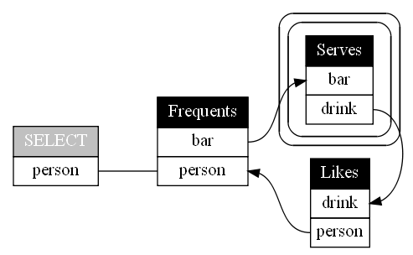
Logical transformations
Likes(person, drink)
Frequents(person, bar)
Serves(bar, drink, price)
∀: double line around relation
Design decision: limited logical transforma-tion can further simplify representation
Q: Find persons that frequent a bar so that they like all drinks served.
Q: Find persons that frequent some bar so that there is no drink served that the person does not like.
¬∃: dashed line around relation
select F.person
from Frequents F
where not exists
(select S.drink
from Serves S
where S.bar = F.bar
and not exists
(select L.drink
from Likes L
where L.person = F.person
and S.drink = L.drink))
Q: Find persons that frequent some bar that serves only drinks they like.
Notes:
* will show you some queries, it is not necessary for you to parse them

Slide 12
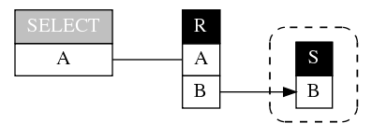
QueryViz for Query Intent, not Debugging
Discontinuity with NULL values
select R.A
from R
where not exists
(select *
from S where S.B = R.B)
select R.A
from R
where R.B not IN
(select S.B
from S)
Empty result if S.B contains NULL
Discontinuity with empty tables
select R.a
from R, S
where R.a=S.a
or exists
(select *
from T
where R.a=T.a)
select R.a
from R, S, T
where R.a=S.a
or R.a=T.a
S
SELECT
R
A
A
A
T
A
Empty result if T is empty
Design decision: minimum visual complexity  possible overloading and ambiguity like in NL

Slide 13
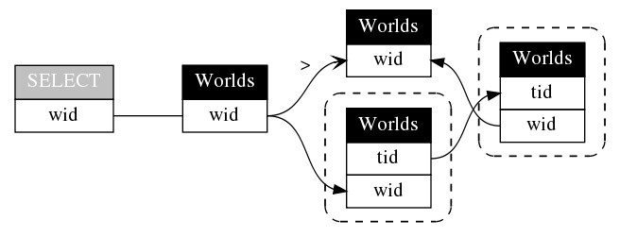
Arrangement of Tables and Arrows in the Graph
Hollow arrow for comparison within the same component (CQ block)
SELECT W1.wid
FROM Worlds W1, Worlds W2
WHERE W1.wid > W2.wid
AND not exists
(SELECT *
FROM Worlds W3
WHERE W3.wid = W1.wid
AND not exists
(SELECT *
FROM Worlds W4
WHERE W4.wid = W2.wid
AND W4.tid = W3.tid))
Arrangement currently via Graphviz; place for improvement
Design decision: overloading of meaning to the arrow symbol
Q: Find worlds for which there exists another earlier world that contains all its tuples.

Slide 14
http://queryviz.com
Input: Schema
Iinput Query
Output: visualization
Danaparamita & G [EDBT'11]
Notes:
also have constructs for grouping, not yet implemented

Slide 15
Wide Open Questions
1. How to visualize outer joins, sorting, arithmetic expressions, etc.?
2. What is the appropriate level of abstraction? (intent vs. debugging)
3. What are the appropriate basic visual metaphors?
4. Can we visualize at different granularities? ("zooming in")
5. How can we visualize query fragments?
6. How to adapt visualizations to audiences? ("one size fit all")
7. How to optimally place the visual elements?
8. How to standardize evaluation of alternative approaches? ("TPC-H for speed of Query Interpretation" via user studies)

Slide 16
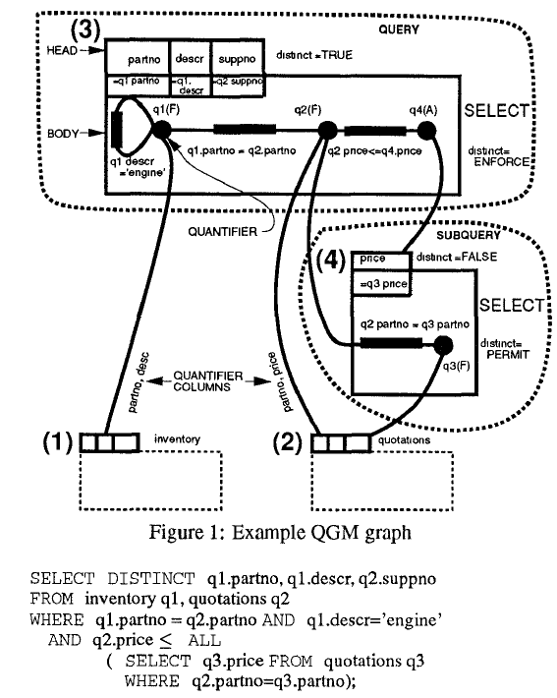
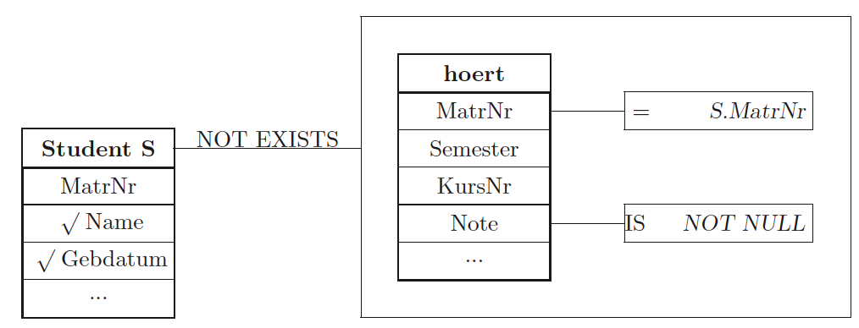
Wide Open Questions
1. How to visualize outer joins, sorting, arithmetic expressions, etc.?
2. What is the appropriate level of abstraction? (intent vs. debugging)
3. What are the appropriate logical symbols?
Correlated nesting is preserved
4. Can we visualize at different granularities? ("zooming in")
select
Scores
Scores
5. How to adapt visualizations to audiences? ("one size fit all")
Team
Team
Team
Day
Day
Day
6. How can we visualize query fragments?
Runs
Runs
7. How to optimally place the visual elements?
Starbust
Most VQL* such as Visual SQL
Pirahesh et al. [Sigmod’92]
Jaakkola & Thalheim. [ER WS’03]
http://queryviz.com
8. How to standardize evaluation of alternative approaches? ("TPC-H for speed of Query Interpretation" via user studies)
Query Plan
SQL Query
Query Intent
more abstract
* Note that VQL (Visual Query Languages) do not provide the reverse functionality of query visualization
Notes:
1:1 correspondence / set vs. bag semantics / Minimal visual complexity versus overloading (at the expense of ambiguity) / simplification of logical equivalences

Slide 17
Wide Open Questions
1. How to visualize outer joins, sorting, arithmetic expressions, etc.?
2. What is the appropriate level of abstraction? (intent vs. debugging)
3. What are the appropriate basic visual metaphors?
select
Frequents
Frequents
Likes
select
Frequents
Frequents
Likes
person
person
person
person
person
person
person
person
bar
drink
bar
drink
QueryViz: default reading order and logical equivalences
Serves
retain original nesting
Serves
bar
bar
drink
drink
select
Frequents
Frequents
Likes
select(person)
person
person
person
person
bar
drink
Frequents(,)
Serves
Arrows encoding logical relations instead of boxes
bar
Something completely different
Frequents(,)
drink
Likes(,)
Serves(,)

Slide 18
Wide Open Questions
1. How to visualize outer joins, sorting, arithmetic expressions, etc.?
2. What is the appropriate level of abstraction? (intent vs. debugging)
3. What are the appropriate basic visual metaphors?
4. Can we visualize at different granularities? ("zooming in")
5. How can we visualize query fragments?
6. How to adapt visualizations to audiences? ("one size fit all")
7. How to optimally place the visual elements?
8. How to standardize evaluation of alternative approaches? ("TPC-H for speed of Query Interpretation" via user studies)
Notes:
8. crowdsourcing

Slide 19
The Vision in a Nutshell
Q Visualization can facilitate Q Composition through (i) faster Q Interpretation and thus Q Re-use, and (ii) a visual understanding of SQL design patterns.
Thus "Databases will visualize queries too"
easy
hard
sel
R
Query Interpretation
A
A
S
B
D
Query Re- finement
Query Vi- sualization
SELECT A FROM R
WHERE B not in
(SELECT D
FROM S)
Query Composition

Slide 20
BACKUP

Slide 21
Query: Aggregates / Group by
Course (course-no, title )
Transcript (student-id, course-no, grade)
select
Transcript
student-id
student-id
Course
COUNT(course-no)
COUNT(course-no)
select t.student-id
from Transcript t
group BY t.student-id
having COUNT(t.course-no) =
(select COUNT(course-no)
from Course).
Q: "Find the students who have taken as many (different) courses as there are courses offered by the university (tuples in the courses relation).”
(“…assuming that there are no duplicates in either relation, that all Transcript tuples refer to valid courseno’s,
and that there are no “NULL” values…”)
Query from: G. Graefe, R. Cole. Fast Algorithms for Universal Quantification in Large Databases (TODS 1995)

Slide 22
Simple disjunctions
R(A)
S(A)
T(A)
select R.A
from R, S, T
where R.A = S.A
or R.A = T.A
S
Note: graph does not explain why with empty S relation, the result is empty (unintuitive conceptual SQL evaluation strategy …)
select
R
A
A
A
T
A
SQL1 a₁: ∃a₂.∃a₃. R(a₁) ∧ S(a₂) ∧ T(a₂) ∧ [ a₂=a₁ ∨ a₃=a₁ ]
Graph a₁: R(a₁) ∧ (∃a₂. [ S(a₂) ∧ a₂=a₁ ∨ T(a₂) ∧ a₂=a₁ ]
Graph a₁: R(a₁) ∧ (∃a₂. [ S(a₂) ∧ a₂=a₁ ] ∨ ∃a₃. [ T(a₃) ∧ a₃=a₁ ] )
Query from: H. Garcia-Molina et al. Database systems: the complete book. 2002. p.260

Slide 23
Human-Computer Interaction
easy
hard
Communication Medium
Text
Visual (graphics)
User Action
Interpret
(Read)
Sequential
Parallel
Compose
(Write)
Sequential
Sequential

Slide 24
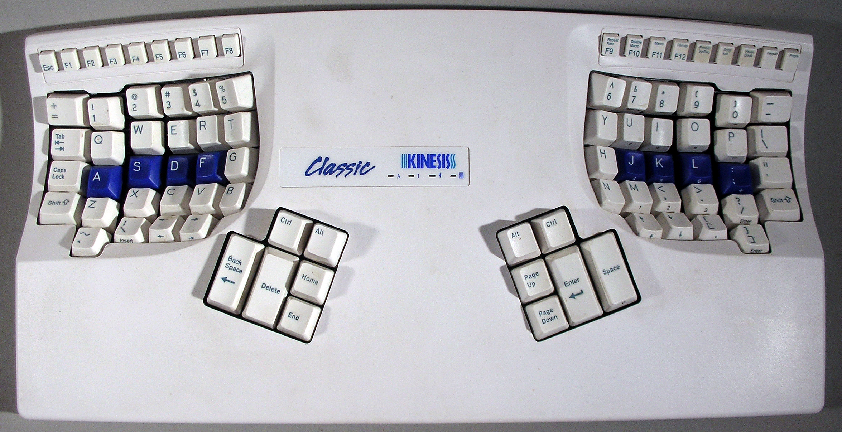
Barriers to Adoption
(1) Transition with lower productivity
(2) Price
Typing speed*
Kinesis
+12%
Kinesis: ~ 250 $
Standard: ~ 50 $
100%
-58%
???
Time
* Self-test and test with first-time user: 3 repetitions, 2-minute typing test from http://hi-games.net/typing-test/

Slide 25
No Barriers to Adoption
select W1.wid
from Worlds W1
where not exists
(select *
from Worlds W2
where W2.wid < W1.wid
and not exists
(select *
from Worlds W3
where W3.wid = W1.wid
and not exists
(select *
from Worlds W4
where W4.wid = W2.wid
and W4.tid = W3.tid)))
select S.sname
from Sailors S
where not exists
(select B.bid
from Boats B
where not exists
(select R.bid
from Reserves R
where R.bid = B.bid
and R.sid = S.sid))
select distinct a3.fname, a3.lname
from Actor a0, Casts c0, Casts c1, Casts c2, Casts c3,
Actor a3
where a0.fname = 'Kevin' and a0.lname = 'Bacon'
and c0.pid = a0.id and c0.mid = c1.mid
and c1.pid = c2.pid and c2.mid = c3.mid
and c3.pid = a3.id
and not exists (select xc1.pid
from Actor xa0, Casts xc0, Casts xc1
where xa0.fname = 'Kevin' and xa0.lname = 'Bacon'
and xa0.id = xc0.pid and xc0.mid = xc1.mid
and xc1.pid = a3.id)
and not exists (select ya0.id
from Actor ya0
where ya0.fname = 'Kevin' and ya0.lname = 'Bacon’)
select F1.person
from Frequents F1
where not exists
(select F2.bar
from Frequents F2
where F2.person = F1.person
and not exists
(select S3.drink
from Serves S3, Likes L4
where L4.person = F1.person
and L4.drink = S3.drink
and S3.bar = F2.bar))
select Team, Day
from Scores S1
where not exists
(select *
from Scores S2
where S1.Runs = S2.Runs
and (S1.Team <> S2.Team
or S1.Day <> S2.Day))
Casts
Casts
Casts
Casts
Actor
pid
pid
pid
pid
id
mid
mid
mid
mid
fname='Kevin'
select
select
Frequents
Scores
W
Scores
lname='Bacon'
Frequents
Serves
wid
select
Sailors
Reserves
Boats
person
person
Actor
bar
Actor
Casts
Casts
person
select
Team
W
Team
Team
W
SELECT
id
pid
>
id
pid
bar
drink
name
name
bid
bid
wid
wid
fname='Kevin'
wid
fname
fname
Day
mid
mid
lname
lname
Day
lname='Bacon'
Day
sid
sid
tid
Runs
Likes
W
Runs
person
Actor
wid
drink
id
tid
fname='Kevin'
lname='Bacon'
(1) Q Visualization does not replace the existing
model of interaction for Q Composition
(2) free: only enhances the existing way

Slide 26
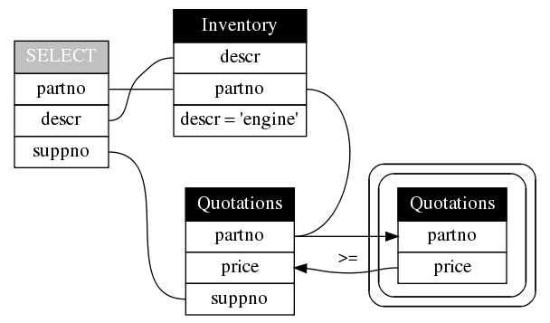
Comparison: QGM (Query Graph Model)
QGM
Pirahesh et al. [Sigmod’92]
Schema
Inventory(partno, descr)
Quotations(partno, suppno, price)
Query: Find suppliers and parts for which the supplier price is less than that of all other suppliers.
QueryViz
Note that automatic attribute node placement can be improved

Slide 27
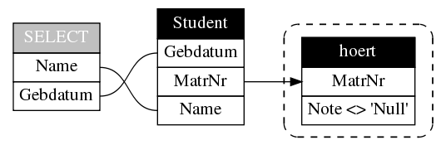
Comparison: Visual SQL
Visual SQL
Schema
Student (MatrNr, Name, Gebdatum)
hoert (MatrNr, Semester, KursNr, Note)
Thalheim. [Visual SQL: eine ER-basierte Einfuehrung in die Datenbankprogrammierung Teil I, p. 44, 2003]
Query: Which students have not yet successfully taken any lecture?
Correlated nesting is preserved and needs to be detected by user
QueryViz
select S.Name, S.Gebdatum
from Student S
where not exists
(select *
from hoert H
where S.MatrNr = H.MatrNr
and H.Note is not null)
Note that automatic node placement can be improved

Slide 28
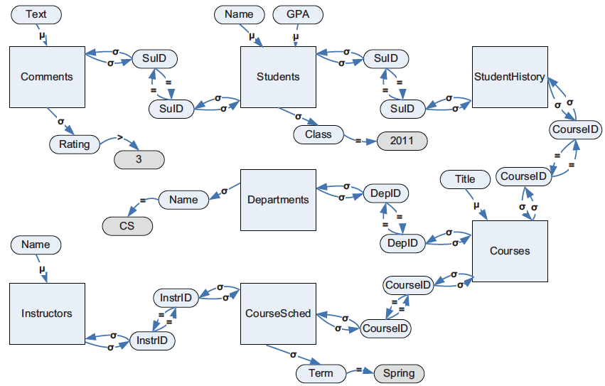
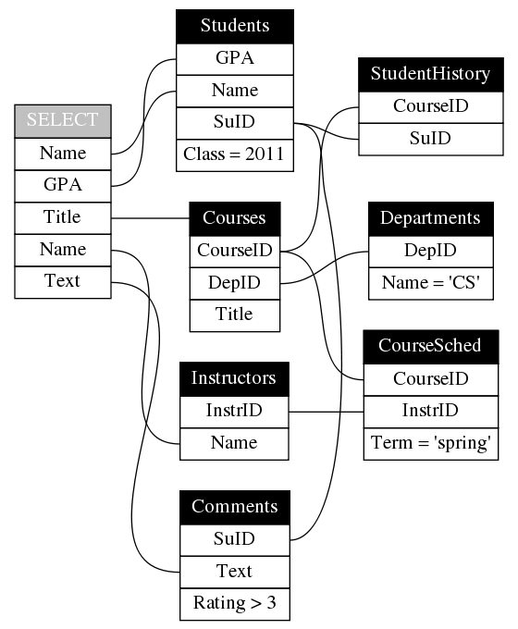
Comparison: DB Graph
Departments(DepID, DepCode, Name)
Courses(CourseID, DepID, Title)
Instructors(InstrID, Name)
Students(SuID, Name, Class, GPA)
CourseSched(CourseID, Year, Term, InstrID, TimeSlot)
StudentHistory(SuID, CourseID, Year, Term, Grade)
Comments(SuID, CourseID, Year, Term, Text, Rating, Date)
Intermediate Database graph for transforming into NL
Koutrika et al. [ICDE'10]
Query:
Find the title of courses, the name of instructors, the gpa and name of students, and the description of comments for courses that are taught by instructors, are taken by students that gave comments, and are offered by departments. Return results only for courses whose term is spring, students whose class is 2011, comments whose rating is greater than 3, and departments whose name is CS.
QueryViz
select s.Name, s.GPA, c.Title, i.Name, co.Text
from Students s, Comments co,
StudentHistory h, Courses c, Departments d,
CourseSched cs, Instructors i
where s.SuID = co.SuID and
s.SuID = h.SuID and h.CourseID = c.CourseID and
c.DepID = d.DepID and
c.CourseID = cs.CourseID and cs.InstrID = i.InstrID and
s.Class = 2011 and co.Rating > 3 and
cs.Term = 'spring' and d.Name = 'CS'

Slide 29
OUT

Slide 30
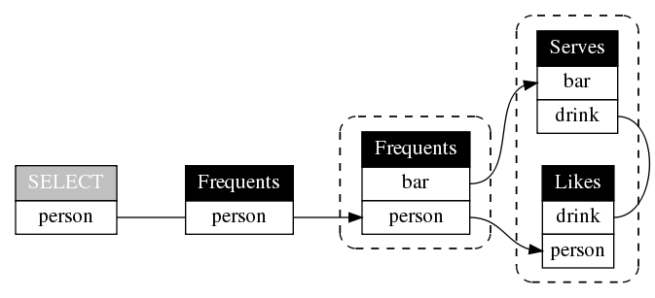
Combining succinctness ideas from DRC and TRC
Likes(person, drink)
Frequents(person, bar)
Serves(bar, drink, price)
Natural reading order that corres-ponds to the intended meaning
select distinct F1.person
from Frequents F1
where not exists (select *
from Frequents F2
where F2.person = F1.person
and not exists (select *
from Serves S3, Likes L4
where S3.drink = L4.drink
and S3.bar = F2.bar
and L4.person = F2.person))
Connected components can represent a nested subquery
Like Datalog (DRC): no aliases needed: Frequents appears twice
Like SQL (TRC): only relevant variables are shown: Price is missing
Q: Find persons that frequent only bars that serve some drink they like.

Slide 31
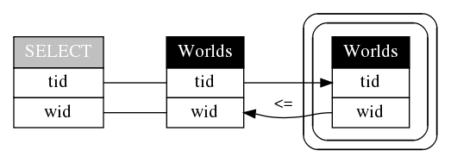
Two bounding box types: for all ∀ and not exists ¬∃
Worlds(wid, tid)
Note the comparison operator is read: The wid at the beginning of the arrow (on the right) <= wid at the end (on the left)
wid: world ID
tid: tuple ID
For all: ∀ : double line around relation
Not exists: ¬∃: dashed line around relation
select W1. tid, W1.wid
from Worlds W1
where W1.wid >= all
(select W2.wid
from Worlds W2
where W2.tid = W1.tid)
Find worlds and tuples, so that for all worlds that contain the same tid, their wid is smaller or equal to this world.
Q: Worlds and tuples, where tuples do not appear in a later world.

Slide 32
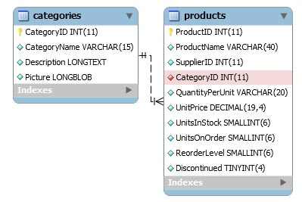
Alternatives
5-22-2009
1. One category can have many products
2. One product has only one category.
Source: ?

Slide 33
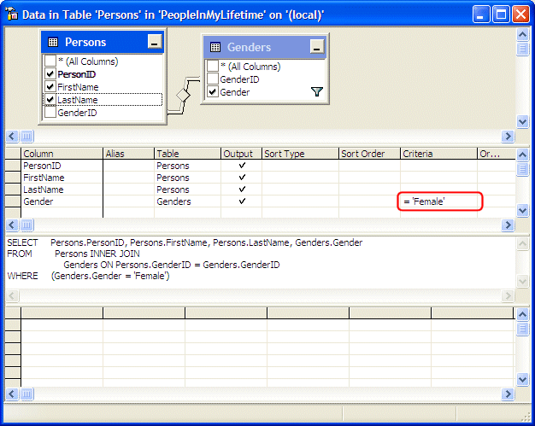
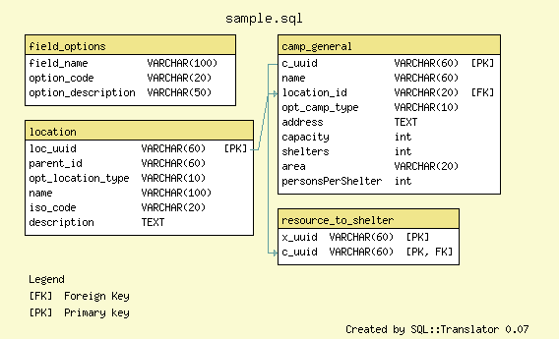
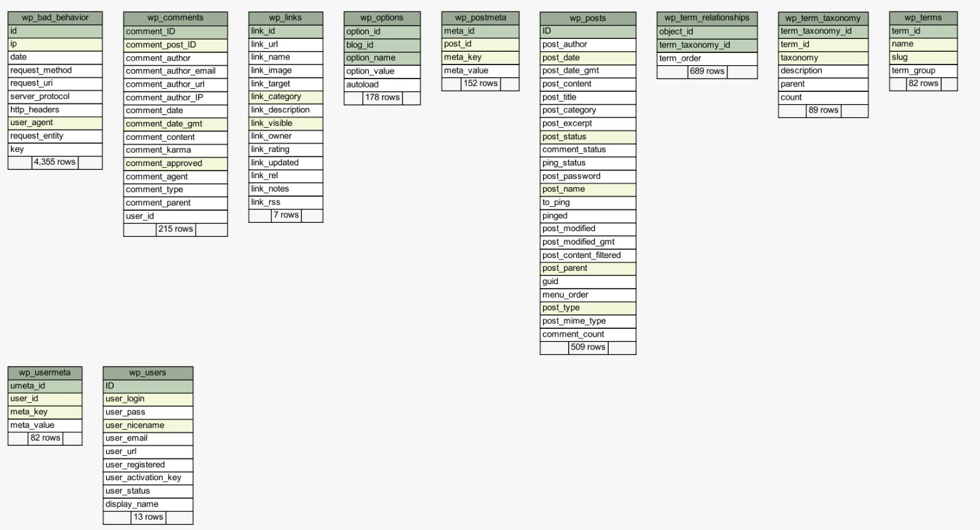
Familiar visual constructsatives
5-22-2009
Source: ?

Slide 34
Familiar visual constructs

Slide 35
Alternatives
5-22-2009
Source: http://techmania.wordpress.com/2008/06/09/creating-er-diagrams-from-sql/

Slide 36
Alternatives
5-22-2009
Source: http://schemaspy.sourceforge.net/

Slide 37
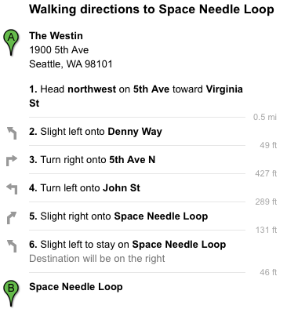
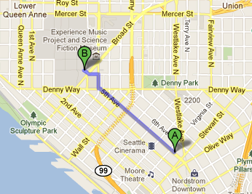
Why Query Visualization is different
Compare to Browsing through a log of walking directions to various sights in Seattle

Slide 38
Query Visualization vs. Visual Query Languages
easy
hard
Target to Visualize
Data
Queries
User Action
Interpret
(Read)
Information Visualization
Query
Visualization
Compose
(Write)
Visual Query Languages
_______________
Recent focus in DB
Lot of past work, see survey
Catarci et al. [J. Vis. Lang. Comput.’97]
Notes:
* What is the reason of me showing you visuals instead of bullet points on PPT / Well, because visuals help get the message through more easily / That doesn't mean that it took me less time to prepare / And that's why visual composition is hard
* fundemental asymmetry in the bandwidth, chanel capacity
* user interaction is quite cumbersome: interactively construct visual constructs / * connect graphical elements

Slide 39
Two Interactions between Users and Queries
Intent: Find...
essential for Query Browse and Re-use
hard
SQL
Query Interpretation
SELECT A FROM R
WHERE B not in
(SELECT D
FROM S)
Query Composition
Recent work on Query Management: Idea: Re-use and adapt existing queries
Problem: Query Interpretation is hard too!
even used for testing purposes, e.g., on www.gradiance.com
CQMS
Khoussainova et al. [CIDR’09]
SQL QuerIE
Chatzopoulou et al. [SSDBM’09]
SQLshare
Howe, Cole [MS eSc WS’10]
Motivation: How can we best facilitate Query Interpretation and thus Query-Reuse?
DBease
Li et al. [CIDR’11]

Slide 40
Question: right level of abstraction?
Correlated nesting is preserved
select
Scores
Scores
Team
Team
Team
Day
Day
Day
Runs
Runs
Starbust
Most VQL such as Visual SQL
QueryViz
Pirahesh et al. [Sigmod’92]
Jaakkola and B. Thalheim. [ER WS’03]
Danaparamita, G [EDBT’11]
Note that these approaches don't provde the reverse functionality of query visualization.
Query Plan
SQL Query
Query Intent
more abstract

Slide 41
Summary: The Argument for Query Visualization
(1) Existing work on Q Management suggests Q-Browse and Q-Reuse to facilitate Q Composition.
(2) Q-Browse requires fast Q Interpretation by users.
Text
Visual
(3) Thesis: Q Visualization can help.
Interpret
Sequential
Parallel
(4) Suggestion: QueryViz as one system
Compose
Sequential
Sequential
(5) Different systems can easily be evaluated and compared.
(6) Important: Like InfoVis and unlike Visual Q Languages, Q Visualization enhances the user experience without replacing the current mode for Q Composition.
Data
Queries
Interpret
InfoVis
Query
Visualization
Compose
__________
Visual Query Languages
Notes:
Main argument is that Query Visualization can make query composition easier:
(1) Recent work on Query Management suggests Query-Browse and Query-Reuse for facilitating Query Composition.
(2) Query-Browse requires fast Query Interpretation by users.
(3) Among the main 4 options, Query Visualization is
Unlike Visual Query Languages, Query Visualization enhances the user experience without changing the current interaction for query composition.

Slide 42

Databases will visualize queries too
Wolfgang Gatterbauer
VLDB'11
Database group
University of Washington
http://queryviz.com

Slide 43
Query Visualization vs. Visual Query Languages
easy
hard
Target to Visualize
Data
Queries
Information Visualization
Query
Visualization
Visual Query Languages
_______________
Recent focus in DB
Lot of past work
Notes:
Interpreting 2-dimensional graphics is the only modus in which a user can act on information in parallel and thus fast. This is also the difference to Visual Query Languages which require a sequential composition of a query.

Slide 44
Query Visualization vs. Visual Query Languages
easy
hard
Communication Medium
Text
Visual (graphics)
User Action
Interpret
(Read)
Sequential
Parallel
Compose
(Write)
Sequential
Sequential
Notes:
Interpreting 2-dimensional graphics is the only modus in which a user can act on information in parallel and thus fast. This is also the difference to Visual Query Languages which require a sequential composition of a query.
there is some good argument why visualization is different from other approaches
with all other approaches users have to process sequentially
an important observation / why it is different

Slide 45
Why users need to interpret queries?
How can we facilitate Query Interpretation?
Find...
Query Interpretation
SQL
Data
SELECT A FROM R
WHERE B not in
(SELECT D
FROM S)
A
a
Query Composition
Query Evaluation
b
c
Query Composition is hard
Problem:
Query Interpretation is hard too
Hence recent work on Query Management
Idea: Re-use and adapt existing queries
e.g., used for testing purposes on www.gradiance.com
CQMS: Khoussainova et al. [CIDR’09]
SQL QuerIE: Chatzopoulou et al. [SSDBM’09]
SQLshare: Howe, Cole [MS eScience WS’10]
DBease: Li et al. [CIDR’11]
Notes:
facilitating query interpretation can help query composition. how can we do that best?
assumes that users know what past queries do, i.e. they can easily interpret queries

Slide 46
Query Visualization vs. Visual Query Languages
easy
hard
Communication Medium
Target to Visualize
Text
Visual (graphics)
Data
Queries
User Action
Interpret
(Read)
Sequential
Parallel
Information Visualization
Query
Visualization
Compose
(Write)
Sequential
Sequential
Visual Query Languages
_______________
Notes:
Interpreting 2-dimensional graphics is the only modus in which a user can act on information in parallel and thus fast. This is also the difference to Visual Query Languages which require a sequential composition of a query.

Slide 47
Summary: The Argument for Query Visualization
(1) Existing work on Q. Management suggests Q.-Browse and Q.-Reuse to facilitate Q. Composition.
(2) Q.-Browse requires fast Q. Interpretation by users.
Text
Visual
(3) Thesis: Q. Visualization can help.
Interpret
Sequential
Parallel
(4) Suggestion: QueryViz as one system
Compose
Sequential
Sequential
(5) Different systems can easily be evaluated and compared.
(6) Important: Like InfoVis and unlike Visual Q. Languages, Q. Visualization enhances the user experience without replacing the current mode for Q. Composition.
Data
Queries
Interpret
InfoVis
Query
Visualization
Compose
__________
Visual Query Languages
Notes:
Main argument is that Query Visualization can make query composition easier:
(1) Recent work on Query Management suggests Query-Browse and Query-Reuse for facilitating Query Composition.
(2) Query-Browse requires fast Query Interpretation by users.
(3) Among the main 4 options, Query Visualization is
Unlike Visual Query Languages, Query Visualization enhances the user experience without changing the current interaction for query composition.

Slide 48
Colors
LightGreen RGB: 144 238 144
LightCoral RGB: 240 128 128
Communication Medium
Target to Visualize
Text
Visual (graphics)
Data
Queries
User Action
Interpret
(Read)
Sequential
Parallel
Information Visualization
Query
Visualization
Compose
(Write)
Sequential
Sequential
Visual Query Languages
_______________
Notes:
LightGreen RGB: 144 238 144
LightCoral RGB: 240 128 128

Slide 49
Query Visualization vs. Visual Query Languages
Communication Medium
Target to Visualize
Text
Visual (graphics)
Data
Queries
User Action
Interpret
(Read)
Sequential
Parallel
Information Visualization
Query
Visualization
Compose
(Write)
Sequential
Sequential
Visual Query Languages
_______________

Slide 50
Query Browse with Query Visualization
Query Browse without Query Visualization
select W1.wid
from Worlds W1
where not exists
(select *
from Worlds W2
where W2.wid < W1.wid
and not exists
(select *
from Worlds W3
where W3.wid = W1.wid
and not exists
(select *
from Worlds W4
where W4.wid = W2.wid
and W4.tid = W3.tid)))
select S.sname
from Sailors S
where not exists
(select B.bid
from Boats B
where not exists
(select R.bid
from Reserves R
where R.bid = B.bid
and R.sid = S.sid))
select distinct a3.fname, a3.lname
from Actor a0, Casts c0, Casts c1, Casts c2, Casts c3,
Actor a3
where a0.fname = 'Kevin' and a0.lname = 'Bacon'
and c0.pid = a0.id and c0.mid = c1.mid
and c1.pid = c2.pid and c2.mid = c3.mid
and c3.pid = a3.id
and not exists (select xc1.pid
from Actor xa0, Casts xc0, Casts xc1
where xa0.fname = 'Kevin' and xa0.lname = 'Bacon'
and xa0.id = xc0.pid and xc0.mid = xc1.mid
and xc1.pid = a3.id)
and not exists (select ya0.id
from Actor ya0
where ya0.fname = 'Kevin' and ya0.lname = 'Bacon’)
select F1.person
from Frequents F1
where not exists
(select F2.bar
from Frequents F2
where F2.person = F1.person
and not exists
(select S3.drink
from Serves S3, Likes L4
where L4.person = F1.person
and L4.drink = S3.drink
and S3.bar = F2.bar))
select Team, Day
from Scores S1
where not exists
(select *
from Scores S2
where S1.Runs = S2.Runs
and (S1.Team <> S2.Team
or S1.Day <> S2.Day))
Notes:
the ability for users to search for and browse through past queries

Slide 51
Queries and Users
Motivation of this talk:
How can we facilitate Query Interpretation?
Find...
Query Interpretation
SQL
Data
SELECT A FROM R
WHERE B not in
(SELECT D
FROM S)
A
a
Query Composition
Query Evaluation
b
c
Default-all propagation (α_{p}^{d})
Minimal propagation (α_{p}^{m})
Argument for default-all: If annotations are on domain values, then retrieving all annotations are relevant.
Counter-Argument: But then these anno-tations can be modeled in a separate table as normalized tables.
Note minimal propagation is not equivalent to just evaluating the where-provenance for the query: Q₇(x,y):-Rª(x,y),Rª(y,_). E.g. α_{p}(t₅,B,Q₇) = {e,f,g}
Notes:
size 20
then big letters scaled 110%

Slide 52
Queries and Users
Find...
Query Interpretation
SELECT A FROM R
WHERE B not in
(SELECT D
FROM S)
Query Composition
Default-all propagation (α_{p}^{d})
Minimal propagation (α_{p}^{m})
Argument for default-all: If annotations are on domain values, then retrieving all annotations are relevant.
Counter-Argument: But then these anno-tations can be modeled in a separate table as normalized tables.
Note minimal propagation is not equivalent to just evaluating the where-provenance for the query: Q₇(x,y):-Rª(x,y),Rª(y,_). E.g. α_{p}(t₅,B,Q₇) = {e,f,g}
Notes:
size 20
then big letters scaled 110%

Slide 53
Query Browse with Query Visualization
Query Browse with Query Visualization
select S.sname
from Sailors S
where not exists
(select B.bid
from Boats B
where not exists
(select R.bid
from Reserves R
where R.bid = B.bid
and R.sid = S.sid))
select
Sailors
Reserves
Boats
name
name
bid
bid
sid
sid
Notes:
the ability for users to search for and browse through past queries

Slide 54
Query Browse with Query Visualization
Query Browse with Query Visualization
select S.sname
from Sailors S
where not exists
(select B.bid
from Boats B
where not exists
(select R.bid
from Reserves R
where R.bid = B.bid
and R.sid = S.sid))
select Team, Day
from Scores S1
where not exists
(select *
from Scores S2
where S1.Runs = S2.Runs
and (S1.Team <> S2.Team
or S1.Day <> S2.Day))
select
Scores
Scores
select
Sailors
Team
Reserves
Team
Boats
Team
name
name
bid
bid
Day
Day
Day
sid
Runs
sid
Runs
Notes:
the ability for users to search for and browse through past queries

Slide 55
Query Browse with Query Visualization
Query Browse with Query Visualization
select S.sname
from Sailors S
where not exists
(select B.bid
from Boats B
where not exists
(select R.bid
from Reserves R
where R.bid = B.bid
and R.sid = S.sid))
select F1.person
from Frequents F1
where not exists
(select F2.bar
from Frequents F2
where F2.person = F1.person
and not exists
(select S3.drink
from Serves S3, Likes L4
where L4.person = F1.person
and L4.drink = S3.drink
and S3.bar = F2.bar))
select Team, Day
from Scores S1
where not exists
(select *
from Scores S2
where S1.Runs = S2.Runs
and (S1.Team <> S2.Team
or S1.Day <> S2.Day))
select
select
Frequents
Scores
Scores
Frequents
Serves
select
Sailors
Reserves
Boats
person
person
person
bar
Team
Team
Team
bar
drink
name
name
bid
bid
Day
Day
Day
sid
Runs
sid
Likes
Runs
person
drink
Notes:
the ability for users to search for and browse through past queries

Slide 56
Query Browse with Query Visualization
Query Browse with Query Visualization
select W1.wid
from Worlds W1
where not exists
(select *
from Worlds W2
where W2.wid < W1.wid
and not exists
(select *
from Worlds W3
where W3.wid = W1.wid
and not exists
(select *
from Worlds W4
where W4.wid = W2.wid
and W4.tid = W3.tid)))
select S.sname
from Sailors S
where not exists
(select B.bid
from Boats B
where not exists
(select R.bid
from Reserves R
where R.bid = B.bid
and R.sid = S.sid))
select F1.person
from Frequents F1
where not exists
(select F2.bar
from Frequents F2
where F2.person = F1.person
and not exists
(select S3.drink
from Serves S3, Likes L4
where L4.person = F1.person
and L4.drink = S3.drink
and S3.bar = F2.bar))
select Team, Day
from Scores S1
where not exists
(select *
from Scores S2
where S1.Runs = S2.Runs
and (S1.Team <> S2.Team
or S1.Day <> S2.Day))
select
select
Frequents
Scores
W
Scores
Frequents
Serves
wid
select
Sailors
Reserves
Boats
person
person
person
bar
select
Team
W
Team
Team
W
>
bar
drink
name
name
bid
bid
wid
Day
wid
Day
Day
wid
sid
sid
tid
Runs
Likes
W
Runs
person
wid
drink
tid
Notes:
the ability for users to search for and browse through past queries

Slide 57
Query Browse with Query Visualization
Query Browse with Query Visualization
select W1.wid
from Worlds W1
where not exists
(select *
from Worlds W2
where W2.wid < W1.wid
and not exists
(select *
from Worlds W3
where W3.wid = W1.wid
and not exists
(select *
from Worlds W4
where W4.wid = W2.wid
and W4.tid = W3.tid)))
select S.sname
from Sailors S
where not exists
(select B.bid
from Boats B
where not exists
(select R.bid
from Reserves R
where R.bid = B.bid
and R.sid = S.sid))
select distinct a3.fname, a3.lname
from Actor a0, Casts c0, Casts c1, Casts c2, Casts c3,
Actor a3
where a0.fname = 'Kevin' and a0.lname = 'Bacon'
and c0.pid = a0.id and c0.mid = c1.mid
and c1.pid = c2.pid and c2.mid = c3.mid
and c3.pid = a3.id
and not exists (select xc1.pid
from Actor xa0, Casts xc0, Casts xc1
where xa0.fname = 'Kevin' and xa0.lname = 'Bacon'
and xa0.id = xc0.pid and xc0.mid = xc1.mid
and xc1.pid = a3.id)
and not exists (select ya0.id
from Actor ya0
where ya0.fname = 'Kevin' and ya0.lname = 'Bacon’)
select F1.person
from Frequents F1
where not exists
(select F2.bar
from Frequents F2
where F2.person = F1.person
and not exists
(select S3.drink
from Serves S3, Likes L4
where L4.person = F1.person
and L4.drink = S3.drink
and S3.bar = F2.bar))
select Team, Day
from Scores S1
where not exists
(select *
from Scores S2
where S1.Runs = S2.Runs
and (S1.Team <> S2.Team
or S1.Day <> S2.Day))
Casts
Casts
Casts
Casts
Actor
pid
pid
pid
pid
id
mid
mid
mid
mid
fname='Kevin'
select
select
Frequents
Scores
W
Scores
lname='Bacon'
Frequents
Serves
wid
select
Sailors
Reserves
Boats
person
person
Actor
bar
Actor
Casts
Casts
person
select
Team
W
Team
Team
W
SELECT
id
pid
>
id
pid
bar
drink
name
name
bid
bid
wid
wid
fname='Kevin'
wid
fname
fname
Day
mid
mid
lname
lname
Day
lname='Bacon'
Day
sid
sid
tid
Runs
Likes
W
Runs
person
Actor
wid
drink
id
tid
fname='Kevin'
lname='Bacon'
Notes:
the ability for users to search for and browse through past queries

Slide 58
Databases will visualize queries too
Version Aug 27, 2011
Wolfgang Gatterbauer
(VLDB'11)
Database group
University of Washington
http://queryviz.com

Slide 59
CONTROLLING NUMBER OF STUDENTS IN CLASS*
Choice Proseminar WIE WS 2005/06
Who decides about
people taking the class?
Actual options
Examples
Previous achievements
Numerus clausus
1
Active selection by lecturer
Qualification exam or interview
Bucerius Law School in Hamburg
US universities (SAT tests)
2
Increased workload**
Increased workload
Proseminar Web Information Extraction WS 2005/06
3
3
Control
Self-selection by students
Enforced grading
WU-Wien; Same lecture, 2 Professors
4
First come, first serve
Medizin Wien WS 05/06
Some courses at TU-Wien, WU-Wien
? USI Graz (Hanggliding course) ?
5
Other processes (non-deterministic)
Small visibility of announcement
6
Kärntner Approch in Alpbach
Auctions or similar processes
7
“3er Vorschlag” WU-Wien
* Assuming capacity constraints that cannot be removed
** Mainly content related workload, but also increased administrative efforts, such as inconvenient lecture times
Source: Wolfgang
Notes:
...

Slide 60
Query Browse with Query Visualization
select W1.wid
from Worlds W1
where not exists
(select *
from Worlds W2
where W2.wid < W1.wid
and not exists
(select *
from Worlds W3
where W3.wid = W1.wid
and not exists
(select *
from Worlds W4
where W4.wid = W2.wid
and W4.tid = W3.tid)))
select S.sname
from Sailors S
where not exists
(select B.bid
from Boats B
where not exists
(select R.bid
from Reserves R
where R.bid = B.bid
and R.sid = S.sid))
select distinct a3.fname, a3.lname
from Actor a0, Casts c0, Casts c1, Casts c2, Casts c3,
Actor a3
where a0.fname = 'Kevin' and a0.lname = 'Bacon'
and c0.pid = a0.id and c0.mid = c1.mid
and c1.pid = c2.pid and c2.mid = c3.mid
and c3.pid = a3.id
and not exists (select xc1.pid
from Actor xa0, Casts xc0, Casts xc1
where xa0.fname = 'Kevin' and xa0.lname = 'Bacon'
and xa0.id = xc0.pid and xc0.mid = xc1.mid
and xc1.pid = a3.id)
and not exists (select ya0.id
from Actor ya0
where ya0.fname = 'Kevin' and ya0.lname = 'Bacon’)
select F1.person
from Frequents F1
where not exists
(select F2.bar
from Frequents F2
where F2.person = F1.person
and not exists
(select S3.drink
from Serves S3, Likes L4
where L4.person = F1.person
and L4.drink = S3.drink
and S3.bar = F2.bar))
select Team, Day
from Scores S1
where not exists
(select *
from Scores S2
where S1.Runs = S2.Runs
and (S1.Team <> S2.Team
or S1.Day <> S2.Day))
Notes:
the ability for users to search for and browse through past queries

Slide 61
Query Browse with Query Visualization
select W1.wid
from Worlds W1
where not exists
(select *
from Worlds W2
where W2.wid < W1.wid
and not exists
(select *
from Worlds W3
where W3.wid = W1.wid
and not exists
(select *
from Worlds W4
where W4.wid = W2.wid
and W4.tid = W3.tid)))
select S.sname
from Sailors S
where not exists
(select B.bid
from Boats B
where not exists
(select R.bid
from Reserves R
where R.bid = B.bid
and R.sid = S.sid))
select distinct a3.fname, a3.lname
from Actor a0, Casts c0, Casts c1, Casts c2, Casts c3,
Actor a3
where a0.fname = 'Kevin' and a0.lname = 'Bacon'
and c0.pid = a0.id and c0.mid = c1.mid
and c1.pid = c2.pid and c2.mid = c3.mid
and c3.pid = a3.id
and not exists (select xc1.pid
from Actor xa0, Casts xc0, Casts xc1
where xa0.fname = 'Kevin' and xa0.lname = 'Bacon'
and xa0.id = xc0.pid and xc0.mid = xc1.mid
and xc1.pid = a3.id)
and not exists (select ya0.id
from Actor ya0
where ya0.fname = 'Kevin' and ya0.lname = 'Bacon’)
select F1.person
from Frequents F1
where not exists
(select F2.bar
from Frequents F2
where F2.person = F1.person
and not exists
(select S3.drink
from Serves S3, Likes L4
where L4.person = F1.person
and L4.drink = S3.drink
and S3.bar = F2.bar))
select Team, Day
from Scores S1
where not exists
(select *
from Scores S2
where S1.Runs = S2.Runs
and (S1.Team <> S2.Team
or S1.Day <> S2.Day))
Casts
Casts
Casts
Casts
Actor
pid
pid
pid
pid
id
mid
mid
mid
mid
fname='Kevin'
select
select
Frequents
Scores
W
Scores
lname='Bacon'
Frequents
Serves
wid
select
Sailors
Reserves
Boats
person
person
Actor
bar
Actor
Casts
Casts
person
select
Team
W
Team
Team
W
SELECT
id
pid
>
id
pid
bar
drink
name
name
bid
bid
wid
wid
fname='Kevin'
wid
fname
fname
Day
mid
mid
lname
lname
Day
lname='Bacon'
Day
sid
sid
tid
Runs
Likes
W
Runs
person
Actor
wid
drink
id
tid
fname='Kevin'
lname='Bacon'
Notes:
the ability for users to search for and browse through past queries

Slide 62
QueryViz: helping users understand SQL queries
Focus: Usability of Databases
How to help users re-using existing queries
Jagadish et al. [Sigmod’07]
Proposed a Collaborative Query Management System
select W1.wid
from Worlds W1
where not exists
(select *
from Worlds W2
where W2.wid < W1.wid
and not exists
(select *
from Worlds W3
where W3.wid = W1.wid
and not exists
(select *
from Worlds W4
where W4.wid = W2.wid
and W4.tid = W3.tid)))
select distinct a3.fname, a3.lname
from Actor a0, Casts c0, Casts c1, Casts c2, Casts c3, Actor a3
where a0.fname = 'Kevin'
and a0.lname = 'Bacon'
and c0.pid = a0.id
and c0.mid = c1.mid
and c1.pid = c2.pid
and c2.mid = c3.mid
and c3.pid = a3.id
and not exists
(select xc1.pid
from Actor xa0, Casts xc0, Casts xc1
where xa0.fname = 'Kevin'
and xa0.lname = 'Bacon'
and xa0.id = xc0.pid
and xc0.mid = xc1.mid
and xc1.pid = a3.id)
and not exists
(select ya0.id
from Actor ya0
where ya0.fname = 'Kevin'
and ya0.lname = 'Bacon’)
select F1.person
from Frequents F1
where not exists
(select F2.bar
from Frequents F2
where F2.person = F1.person
and not exists
(select S3.drink
from Serves S3, Likes L4
where L4.person = F1.person
and L4.drink = S3.drink
and S3.bar = F2.bar))
Casts
Casts
Casts
Casts
Actor
select S.sname
from Sailors S
where not exists
(select B.bid
from Boats B
where not exists
(select R.bid
from Reserves R
where R.bid = B.bid
and R.sid = S.sid))
pid
pid
pid
pid
id
select Team, Day
from Scores S1
where not exists
(select *
from Scores S2
where S1.Runs = S2.Runs
and (S1.Team <> S2.Team
or S1.Day <> S2.Day))
mid
mid
mid
mid
fname='Kevin'
W
lname='Bacon'
select
select
Frequents
Scores
wid
Scores
Frequents
Serves
Actor
Casts
Casts
Actor
W
select
W
person
person
person
bar
SELECT
id
pid
pid
id
select
Sailors
>
Reserves
Boats
Team
Team
fname='Kevin'
Team
fname
fname
mid
mid
bar
drink
wid
wid
bid
wid
name
name
lname='Bacon'
bid
lname
lname
Day
Day
Day
tid
W
Likes
sid
Runs
sid
person
Actor
wid
Runs
id
tid
drink
fname='Kevin'
lname='Bacon'
Khoussainova et al. [CIDR’09]
DG [EDBT’11 (demo)]
Query Visualization: QueryViz
minimal yet expressive visual vocabulary
combines succinctness ideas from SQL and Datalog
Online interface at http://QueryViz.com
Notes:
the ability for users to search for and browse through past queries

Slide 63
Query Visualization vs. Visual Query Languages
Communication Medium
Target to Visualize
Text
Visual (graphics)
Data
Queries
User Action
User Action
Interpret
(Read)
Sequential
Parallel
Interpret
(Read)
Information Visualization
Query
Visualization
Compose
(Write)
Sequential
Sequential
Compose
(Write)
_______________
Visual Query Languages

Slide 64
Fig_MatrixDataQuery
4-1-2011
Target to Visualize
Data
Queries
User Action
Interpret
(Read)
Information Visualization
Query
Visualization
Compose
(Write)
Visual Query Languages
_______________

Slide 65
Query Visualization vs. Visual Query Languages
Communication Medium
Text
Visual (graphics)
User Action
Interpret
(Read)
Sequential
Parallel
Compose
(Write)
Sequential
Sequential

