Slide 1

Resiliency-Aware Data Management
Matthias Boehm¹ Wolfgang Lehner¹ Christof Fetzer²
TU Dresden
¹ Database Technology Group
² Systems Engineering Group
August 30, 2011

Slide 2


Motivation: Increasing Error Rates
Increasing Component Error Rates
  Decreasing feature sizes (new tech generations)
  Reduced voltage supply
  Static (hard) vs. dynamic (soft) errors
  8% increase error rate
  per tech generation [Borkar05]
  25,000 – 70,000 FIT / Mbit [Schroeder09]
Increasing System Error Rates
  Increasing scale
    # of components (core, transistor)
    Memory capacities
  Example:
    Fixed error rate / component
Cosmic Radiation
(95% neutrons)
Mem
CPU
1
1
1
P( )=0.01
P( )=0.01
1
P( )=0.01
1
1
P( )=0.01
P( )=0.01
(at least one component fails)
P( )=0.039
➔ Errors and error-prone behavior will become the normal case

Slide 3
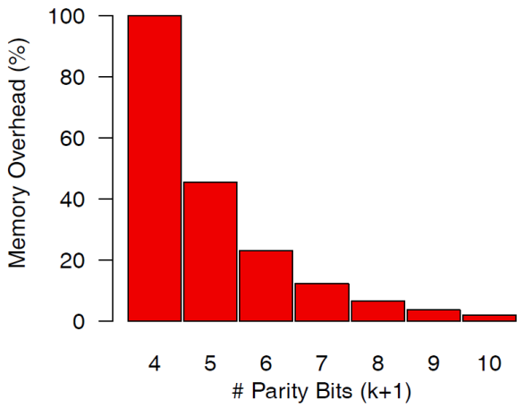
Motivation: Resiliency Costs
Implicit (silent) vs. Explicit (detected/corrected) Errors
  State-of-the-art: error detection and correction at HW/OS level
State-of-the-Art: Resilient Memory
  ECC / parity bits / memory scrubbing / full data redundancy
State-of-the-Art: Resilient Computing
  Computation redundancy
(8,4)
(16,11)
  ECC Extended Hamming(7+1,4)
(32,26)
d1 | d2 | d3 | d4
p1 | p2
d1
p3
d2 | d3 | d4
(64,57)
P
0 | 0 | 1 | 1
1 | 0
0
0
0 | 1 | 1
1
Task A
Triple Modular Redundancy
(TMR):
Double Modular Redundancy
(DMR):
Task A
Task A‘
voting
=?
Task A‘
Task A‘‘
➔ Such resiliency mechanisms cause „resiliency costs“

Slide 4

Motivation: Resiliency Costs (2)
Resiliency Costs Categories
  Performance overhead (throughput, latency)
  Memory overhead
  Energy consumption
  Monetary HW costs
Resiliency Costs @ OS-Level
  Memory overhead (capacity, bandwidth)
  Computation overhead
  Energy consumption (increased time)
Resiliency Costs @ HW-Level
  Monetary HW costs (Chipset, ECC RAM)
  Energy consumption (time, chip space)
  Computation overhead
Data Management
OS / Middleware
OS / Middleware
HW Infrastructure
HW Infrastructure
0
1
2
3
CPU
L3
ECC mem control
Memory
ECC RAM
ECC RAM
➔ Increasing error rates ~ increasing resiliency costs!

Slide 5

Vision of
Resiliency-Aware Data Management

Slide 6
Vision Overview
nice-to-have
analytics
Problem of State-of-the-Art
  Resiliency-awareness on HW / OS level
  (general-purpose)
  Increasing error rates
  Increasing resiliency costs
Key Observation
  Different resiliency requirements
  Data management context knowledge
Resiliency-Aware Data Management
  Exploit context knowledge
  of query processing and data storage
  Efficiency (reduced resiliency costs)
  Effectiveness (detection/correction)
Q_{i}
U_{i}
input
streams
mission- critical queries
Data
Management
Data
Management
Data System
Access System
Storage System
HW/OS
primitives
configuration
OS / Middleware
HW Infrastructure

Slide 7


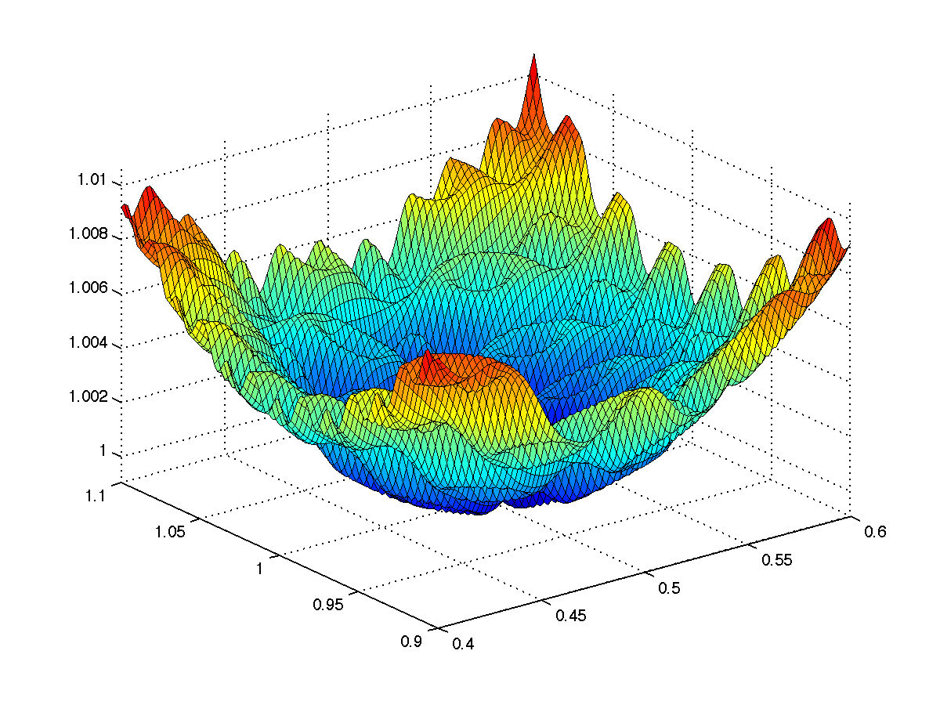

Resilient Database Challenges
C1: Resilient
Query Processing
C3: Resiliency-Aware Optimization
C2: Resilient
Data Storage

Slide 8

C1: Resilient Query Processing
C1: QP
C3: Opt
Challenge
  Problem: missing/invalid tuples (explicit/implicit)
  Goal: reliable query results by error correction / error-tolerant algorithms
Example (Advanced Analytics)
  Q: Ψ_{k=365}(γ( σ_{a<107}R⋈S⋈T⋈U ))
  Computation redundancy
C2: DS
Plan Scheduling
Operator Semantics
Intermediate Results
Guard Plan
Ψ_{k=365}
Check
γ
γ
⋈
⋈
⋈
⋈
⋈
⋈
σ_{a<107}
S
T
U
σ_{a<107}
S
T
U
R
R

Slide 9
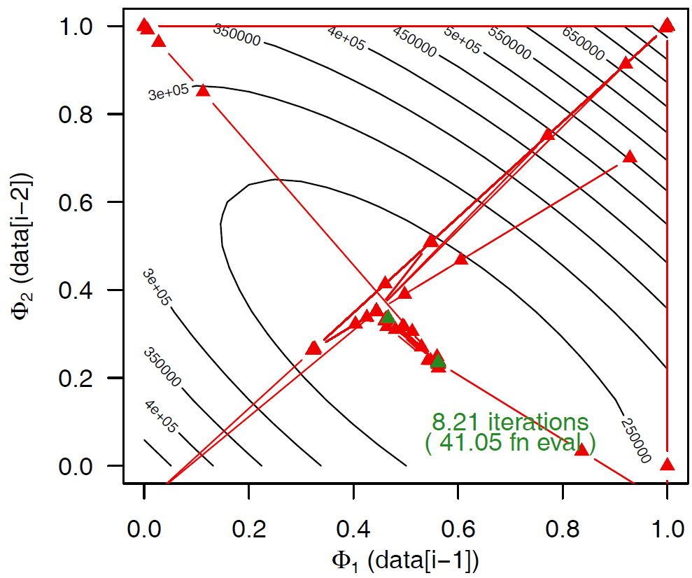
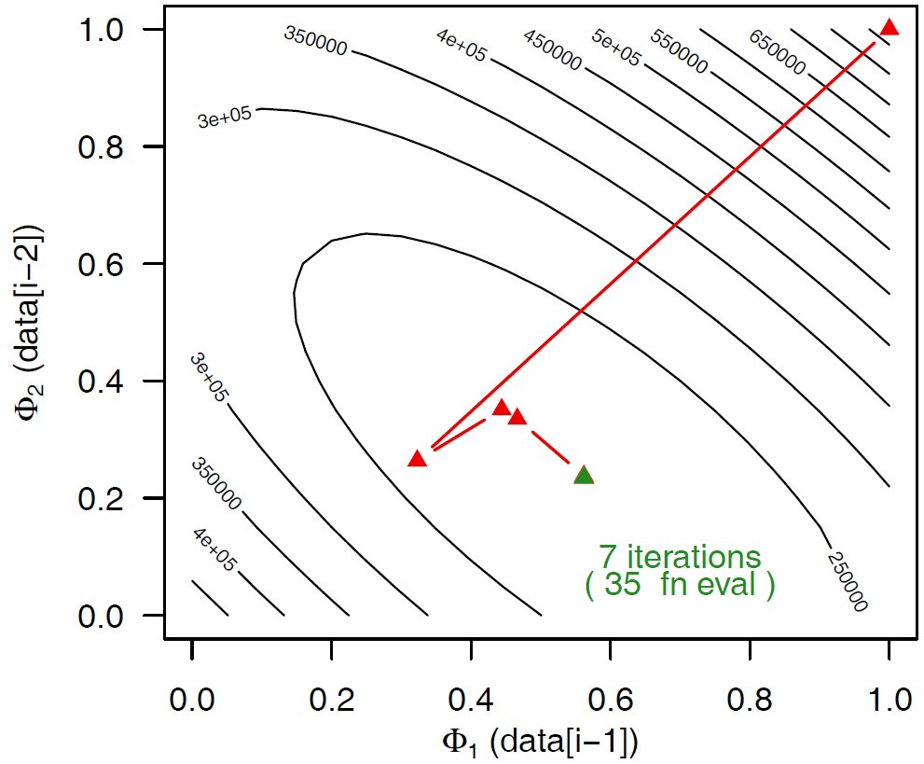
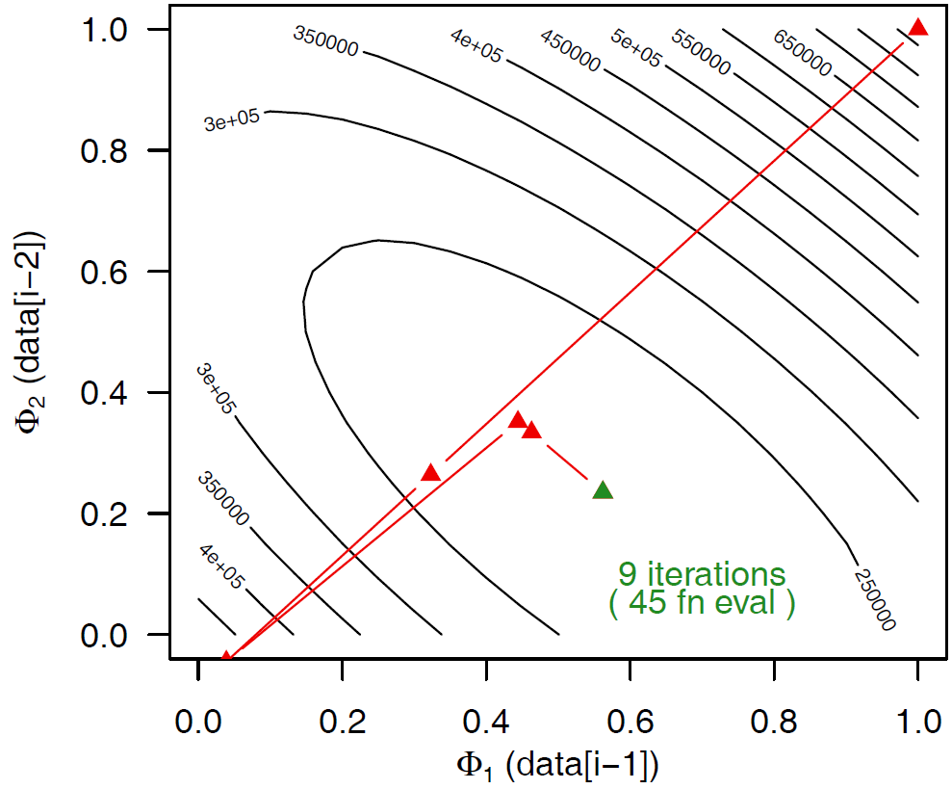
C1: Resilient Query Processing (2)
C1: QP
C3: Opt
Example (Advanced Analytics cont.)
  AR(2), MSE, L-BFGS-B, C40 Energy Demand
  P( )=0.01
  val ∈ [0,max]
  N=100
C2: DS
Approximate Query Results
Error-Tolerant Algorithms
Error-Proportional Overhead

Slide 10
C2: Resilient Data Storage
C1: QP
C3: Opt
Challenge
  Problem: data loss/corruption (explicit/implicit)
  Goal: data stability by data redundancy and error correction
Example (Data Partitioning)
  Table R (a,b,c)
  Data redundancy
  (synopsis and replicas)
Optimization
  Exploit the multiple replicas ➔ (complementary) layouts
  E.g., different sorting orders, partitioning schemes, compression schemes, etc
C2: DS
Synopsis S_{R}
Synopsis S_{R‘}
a | b | c
a | b | c
Table R
Table R‘
a | b | c
a
a | b | c
b
c
Test Scheduling
Multiple Replicas
Workload Characteristics
Time-based /on-the-fly
error detection and correction

Slide 11


C3: Resiliency-Aware Optimization
C1: QP
C3: Opt
Challenge
  Problem: search space of QP/DS, HW heterogeneity
  Goal: Multi-objective optimization (performance, accuracy, energy, resiliency)
Example (Frequency/Voltage Scaling (DFS,DVS))
  1) Choose frequency level
  2) Select voltage scheme
  3) Optimize voltage
  E.g., decreased frequency/voltage
C2: DS
Q:
Ψ_{k=365}
γ
⋈
⋈
⋈
DFS/DVS
–
–
(+)
–
+
+
σ_{a<107}
S
T
U
(–)
Performance
–
R
convex
Errors
Energy
+
Multi-Objective, Global,
Architecture-Aware Optimization
Accuracy

Slide 12
Conclusion
Problem of State-of-the-Art
  General-purpose resiliency mechanisms at HW/OS level
  Increasing error rates ➔ increasing resiliency costs
Summary
  Vision of „Resiliency-Aware Data Management“
  Challenge Resilient Query Processing
  Challenge Resilient Data Storage
  Challenge Resiliency-Aware Optimization
  Research directions and more in the paper!
Conclusion / New Opportunities
  Resiliency-aware data management can reduce resiliency costs
  Research Opportunity:
    Reconsideration of many DB aspects w.r.t. resiliency
  Colloboration Opportunity:
    Inter-disciplinary research field (HW, OS, Systems, DB)

Slide 13
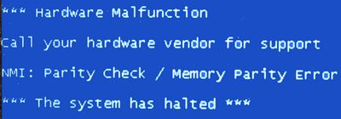
Choose your Resiliency Level!

Slide 14
Resiliency-Aware Data Management
Matthias Boehm¹ Wolfgang Lehner¹ Christof Fetzer²
TU Dresden
¹ Database Technology Group
² Systems Engineering Group
August 30, 2011

Slide 15

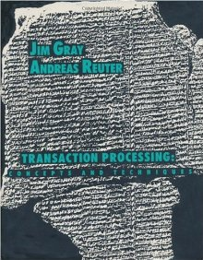
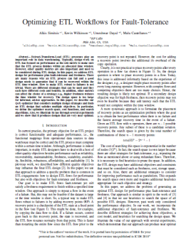
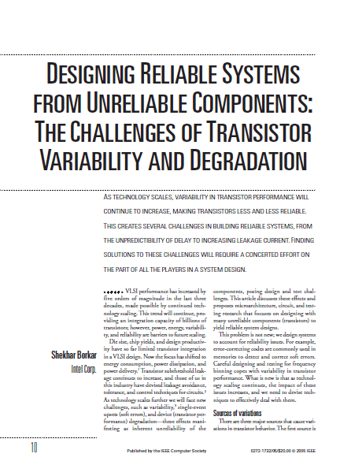
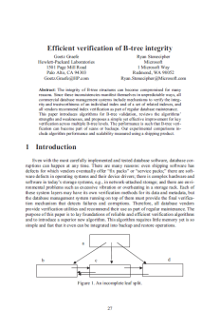
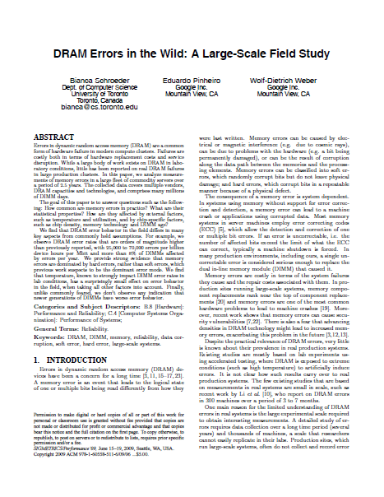
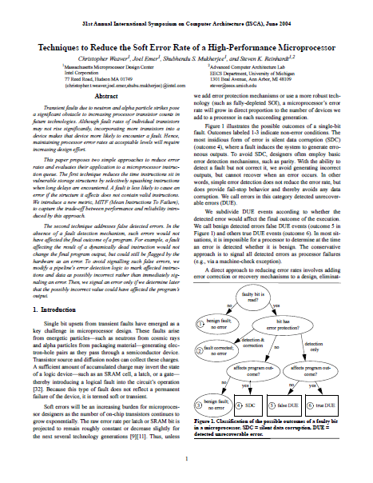
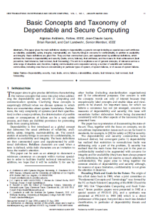
Background and Related Work

Slide 16
Background and Related Work
Taxonomy
  Faults (tech defects), Errors (system-internal), Failures (system-external)
Static vs Dynamic Errors (memory / computation)
  Static (hard / permanent): cosmic radiation, dynamic variability, aging
  Dynamic (soft / transient): static variability, aging
Implicit vs. Explicit Errors
  Implicit: silent errors ➔ general-purpose techniques (ECC, etc)
  Explicit: detected or corrected errors
Related Work @ DB-Level
  Error-aware frameworks (e.g., MapReduce/Hadoop) ➔ general-purpose techniques
  Recovery processing / replication [Upadhyaya11] ➔ reacting on explicit errors
  Implicit: [Graefe09], [Borisov11], [Simitsis10] ➔ specific DM aspects
➔ Holistic resilient data management

Slide 17
Choose your Resiliency Level!

Slide 18
TX Level vs. Resiliency Level
Similarities
  Different application requirements on integrity
    TX: physical and operational integrity
    Resiliency: physical integrity
  Ensuring integrity incurrs cost overheads
  Context knowledge can be exploited for reducing costs
    TX: TX scheduling (logical serialization)
    Resiliency: challenges and use cases
Differences
  Configuration granularity
    TX: we could handle different TX level concurrently
    Resiliency: configuring HW parameters can have global influence on multiple queries on that HW component
  Scope
    TX: integrity for running query or TX (assumption: DB is transformed from one consistent state to another by TX only)
    Resiliency: computation and data integrity

