Slide 1
Data Markets in the Cloud: An Opportunity for the Database Community
Magdalena Balazinska, Bill Howe, and Dan Suciu
University of Washington
Project supported in part by NSF and Microsoft

Slide 2
The Value ($$$) of Data
Buying and selling data are common operations
Real-time stock prices + trade data: $35,000/year
(https://www.xignite.com)
Land parcel information: $60,000/year
(https://datamarket.azure.com)
Database

Slide 3
Organized Data Market
Logically centralized point for buying and selling data
Facilitates data discovery
Facilitates logistics of buying and selling data
Public clouds are well-suited to support data markets
Cloud data markets are indeed emerging!
We argue that organized data markets raise important challenges for our community
Notes:
Facilitates logistics of buying and selling data across many buyers and many sellers.

Slide 4
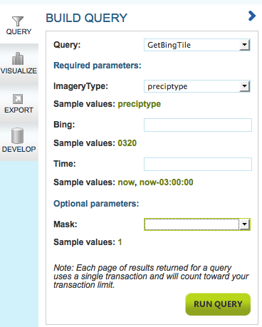
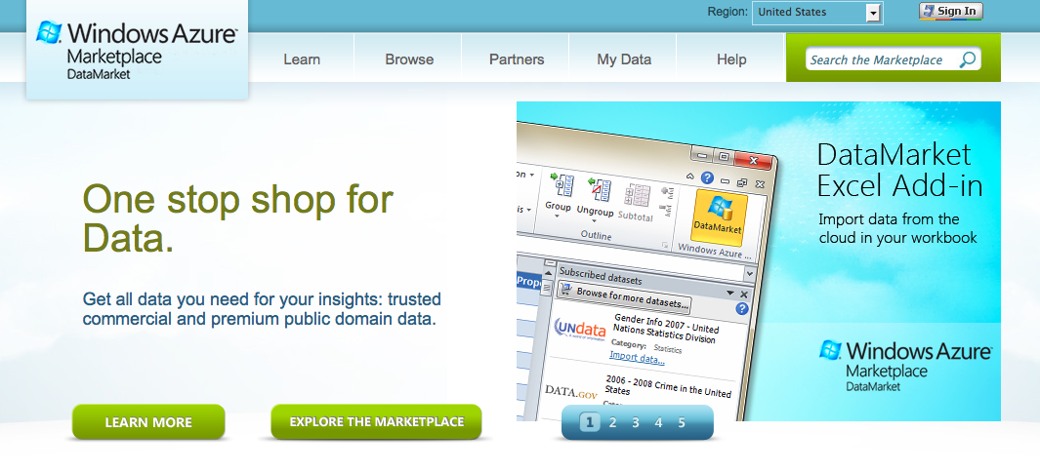
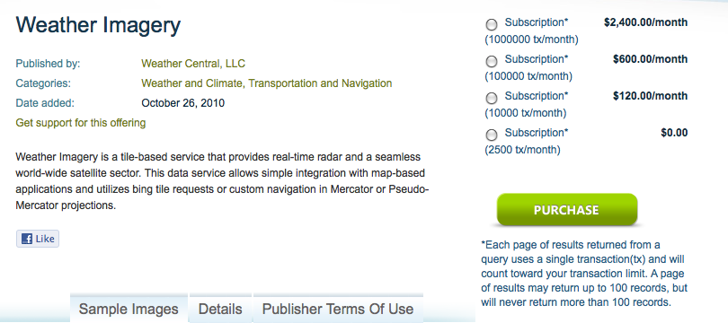
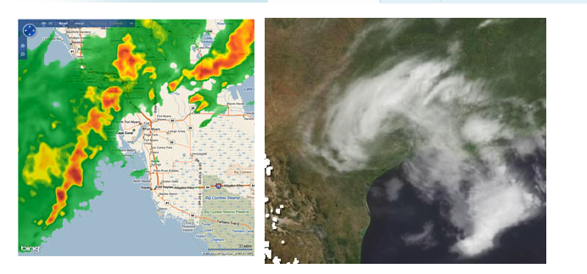
Example 1: Azure DataMarket

Slide 5
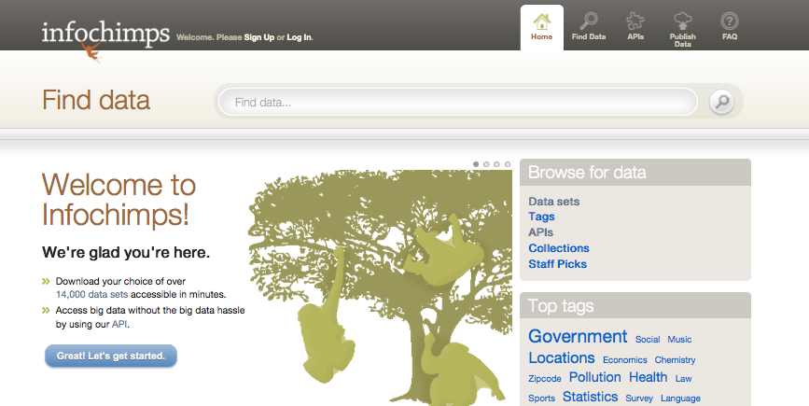
Example 2: Infochimps

Slide 6
Technical Challenges (1)
Study the behavior of agents in a data market
Study how data should be priced
E.g., Pointless to price data based on production costs
E.g., Useful to create versions for different market segments
Inform public policy regulating the data market
Challenges for economists
Notes:
Economists will derive and express declarative pricing constraints, the DB community will develop the system to enforce these constraints and study their consequences on query processing.

Slide 7
Technical Challenges (2)
Develop and study pricing models for data
How should sellers specify pricing parameters?
How should system compute prices based on seller input?
What are the properties of various pricing models
Develop supporting tools and services
Tools for expressing and computing prices
Tools for processing priced data
Challenges for database community
Notes:
Can we help sellers figure out prices?

Slide 8
Novel Problem
Prior work at the intersection of DB and economics focused on resource management
[Dash, Kantere, Ailamaki 2009]
[Kantere et al. 2011]
[Stonebraker et. al. 1996]
We are talking about putting a price on data

Slide 9
Technical Challenges (2)
Develop and study pricing models for data
How should sellers specify pricing parameters?
How should system compute prices based on seller input?
What are the properties of various pricing models
Develop supporting tools and services
Tools for expressing and computing prices
Tools for processing priced data

Slide 10
Example Scenario
Seller has a database of business contact information
Economist: “Supply and demand dictate that
businesses in entire country: $600
businesses in one province or state: $300
one type of business: $50”
Buyer:
Q1: “Businesses with more than 200 employees” (selection)
Q2: “Businesses in same city as Home Depot” (self-join)
Q3: “Businesses in cities with high yearly precipitation” (join)
How to satisfy buyer?

Slide 11
Current Pricing: Fixed Prices
Fixed price for entire dataset (CustomLists, Infochimps)
Must create and price views specific to queries Q1, Q2, Q3
OR user must buy entire dataset if view not available
AND user must perform joins by herself
Certainly the case if datasets have different owners
Notes:
Emphasize that this is what is going on right now without the DB community.

Slide 12
Current Pricing: Subscriptions
Subscriptions (Azure DataMarket, Infochimps API)
Fixed number of transactions per month
Must create and price appropriate parameterized queries
Currently these queries are dataset specific (i.e., no joins!)
Can satisfy Q1: “Businesses with more than 200 employees”
Harder Q2: “Businesses in same city as Home Depot”
Cannot Q3: “Businesses in cities with high yearly precipitation”

Slide 13
Other Data Pricing Issues
Today’s data pricing can also have bad properties
Example: Weather Imagery on Azure DataMarket
1,000,000 transactions -> $2,400
100,000 -> $600
10,000 -> $120
2,500 -> $0
Arbitrage opportunity:
Emulate many users
Get as much data as you want for free!
Challenge 1: Develop pricing models that are flexible yet have provable, good properties (e.g., no arbitrage)

Slide 14
Potential Approach: View-Based Pricing
Seller specifies a set of queries Q₁, … Q_{n}
And their prices: price(Q₁), …, price(Q_{n})
D = all businesses in North America
V₁ (businesses in Canada) = $600
V₂ (businesses in Alberta) = $300
V₃ (all Shell businesses) = $50
Etc.
Notes:
Economist puts constraints on prices and we build systems that fill-in the gaps.

Slide 15
Potential Approach: View-Based Pricing
System computes other query prices
Q2: “Businesses in same city as Home Depot”, etc.
Price computation is automated
Solved as a constrained optimization problem
System guarantees price properties
For example, ensures that no arbitrage is possible

Slide 16
Data Pricing Challenges
Understand properties of pricing schemes
When can we guarantee that no arbitrage is possible?
How to handle data updates?
Will updates require changes to prices?
How to handle price updates?
Will one price-change affect all others?
How to price value-added of data transformations?
Should a self-join query be more expensive than a selection?
Should queries with empty results be free?
How to price data properties (e.g., cleanliness)?
Notes:
Easy to use?

Slide 17
Technical Challenges (2)
Develop and study pricing models for data
How should sellers specify pricing parameters?
How should system compute prices based on seller input?
What are the properties of various pricing models
Develop supporting tools and services
Tools for expressing and computing prices
Tools for processing priced data

Slide 18
Data Market Tools
Efficient query-price computer
Data pricing should not add much overhead to query proc.
But some techniques (e.g. provenance-pricing) are expensive
Pricing updates
Given an earlier user-query with a price
Compute price of incremental query output after updates
Challenge 2: Build systems that compute query prices with minimum overhead

Slide 19
Data Market Tools (continued)
Price-aware query optimizer
Answer query over multiple datasets as cheaply as possible
Predict the price of a query result (quantify uncertainty)
Study potential benefits of incremental query processing
…
Challenge 3: Build price-aware
query optimizers

Slide 20
Data Market Tools (continued)
Pricing Advisor
Checks properties of a pricing scheme
Helps set and tune prices based on data provider goals
Computes prices of new views
Explains income or bill
Compares data providers with different pricing schemes
Challenge 4: Build support tools for
buyers and sellers

Slide 21
Conclusion
Data helps drive businesses and applications
Organized data markets emerging, facilitated by clouds
But need the right tools to maximize success
Theory of data pricing
Systems for computing prices, checking properties, etc.
http://data-pricing.cs.washington.edu

Slide 23
Fixed Price

Slide 24
Fixed Price
Cheaper by province

Slide 25
Strawman 3: View-Based Pricing
This is a constrained optimization problem
Each query price is a constraint
Can add other constraints: e.g., total price of DB
Two methods to derive prices of new queries
Reverse-eng. price of base tuples s.t. constraints
Assume a function that converts base tuple prices into query prices
Compute base tuple prices in a way that maximizes entropy, user utility, or other function s.t. constraints
Compute new query prices directly

Slide 26
Strawman 1: PRICE-Semiring
Approach
Assign a price to individual base tuples
Automatically compute price of query result:
(R⁺,min,+,∞,0)
R
S
SELECT DISTINCT A,D FROM R,S
WHERE R.B = S.B AND S.D=x
Q =
A B C
B D
a b e
d b g
a c e
p
b x
c x
b y
q
A D
r
t
a x
d x
min(p + q, s + t)
s
u
r + q
a pricing function on tuples:
a pricing calculation:
p = $0.1
r = $0.01
s = $0.5
q = $0.02
t = $0.03
u = $0.04
min(p + q, s + t)= $0.12
r + q = $0.03
price(Q) = $0.15

Slide 27
Strawman 1: PRICE-Semiring
Benefits
Support datasets where different tuples have different values
Allow users to ask arbitrary queries
Can compute prices across datasets and even data owners
Avoids some bad properties such as arbitrage
But
Limited flexibility: e.g., submodular pricing impossible
Odd prices? Self-join can be more expensive than dataset

Slide 28
Strawman 2: Provenance Expressions
Approach: Same as above BUT
Derive provenance information for each result tuple
Price is a function of provenance expressions
R
S
SELECT DISTINCT A,D FROM R,S
WHERE R.B = S.B AND S.D=x
Q =
A B C
B D
a b e
d b g
a c e
p
b x
c x
b y
q
A D
r
t
a x
d x
Provenance: p, q, s, and t
s
u
Provenance: r and q
a pricing function on tuples:
a pricing calculation (applying a 25% discount):
p = $0.1
r = $0.01
s = $0.5
q = $0.02
t = $0.03
u = $0.04
price(Q) = f( price(p), price(q), price(r), price(s), price(t))
= 0.75 (0.1 + 0.02 + 0.01 + 0.5 +0.03 )
= $0.50

Slide 29
Strawman 2: Provenance Expressions
Benefits
More powerful pricing functions become possible
E.g., submodular pricing
But
Properties with complex pricing need studying
Naïve implementation could be highly inefficient

Slide 30
Data Pricing Issues (continued)
Lump sum or subscription pricing is also inflexible
For lump sum, can only buy pre-defined views
For subscription, can only ask pre-defined queries
Would like arbitrary queries over multiple datasets

